Slide 1

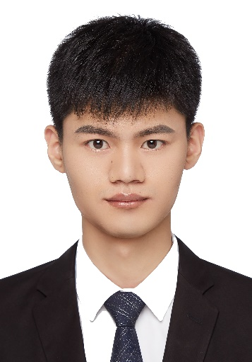
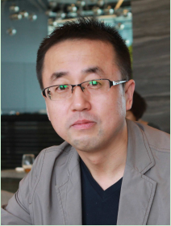
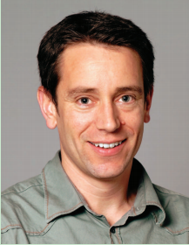
View Inter-Prediction GAN: Unsupervised Representation Learning for 3D Shapes by Learning Global Shape Memories to Support Local View Predictions
Zhizhong Han
1,2
1
1
2
Mingyang Shang
Yu-Shen Liu
Matthias Zwicker
1
School of Software, Tsinghua University, Beijing, China
2
Department of Computer Science, University of Maryland, College Park, USA

Slide 2
Content
Background
Motivation
Current solutions
The key idea of VIP-GAN
Problem statement
Technical details
Results
Contributions

Slide 3
Background
Feature learning for 3D shapes is crucial for 3D shape analysis:
Classification
Retrieval
Segmentation
Supervised 3D feature learning has produced remarkable results:
Under large scale 3D benchmarks
Train deep neural networks
With supervised information, such as class labels and point correspondences

Slide 4
Motivation
However, obtaining supervised information requires intense manual labeling effort.
Therefore, unsupervised 3D feature learning with deep neural networks is an important research challenge.

Slide 5
Current solutions
Several studies have addressed this challenge.
Train deep learning models using “supervised” information mined from the unsupervised scenario.
Different strategies for the prediction of a shape :
From itself by minimizing reconstruction error or embedded energy.
From its context given by views or local shape features.
From views and itself together.
Use all views to provide a holistic context of 3D shapes.

Slide 6
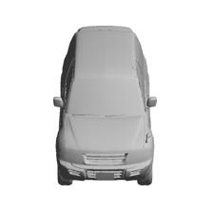
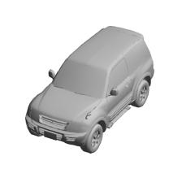
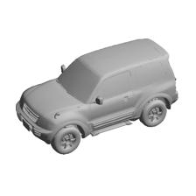
The key idea of VIP-GAN
In contrast, our approach called View Inter-Prediction GAN (VIP-GAN) learns to
make multiple local view inter-predictions among neighboring views.
The view inter-prediction task mimics human perception of view-dependent patterns:
Based on changes between neighbor views, easily imagine the center view.
Reversely, based on the center, easily imagine the neighbor views.
?
?
?

Slide 7
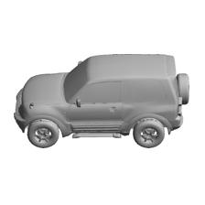
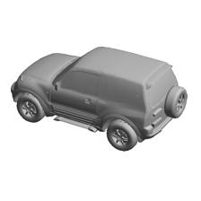
The key idea of VIP-GAN
As a key idea, VIP-GAN implements the 3D shape representation as a shape-specific global memory.
Its contents are learned to support all local view inter-prediction tasks for each shape.
The global feature of a 3D shape:
……
A vector
Update
Update
Update
View inter-prediction
View inter-prediction
View inter-prediction
The sequential views of the 3D shape:

Slide 8
Problem statement
Learn a global feature F of a 3D shape m from its V views without any supervised information.
……
V views of a 3D shape
VIPGAN
F

Slide 9
Technical details
First, we split the set of V views into V sections of equal length.
Section 1
Section 2
Section 3
Section 4
Each one of the V views is the center in each section.

Slide 10
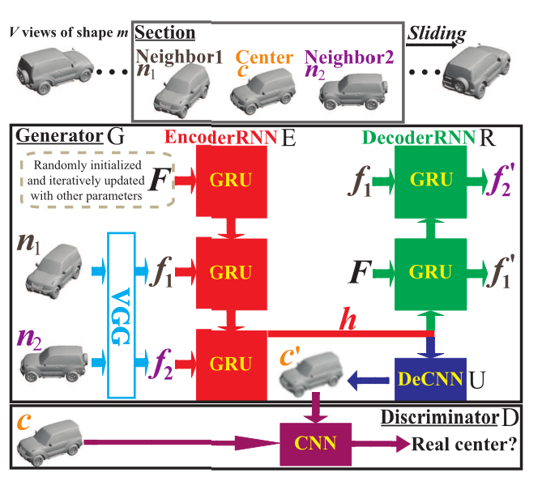
Technical details
VIP-GAN learns F for the 3D shape by inter-view prediction in each section.
EncoderRNN E
DecoderRNN R
Generator G
DeCNN
Discriminator D

Slide 11
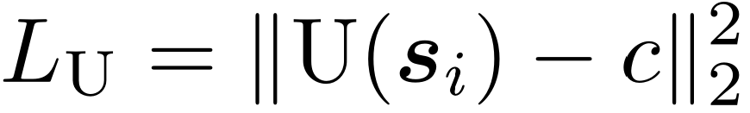
Technical details
For each section si ,
the prediction of the center c from its neighbors
si
Center view prediction loss:
This center view prediction is conducted in the image space.

Slide 12
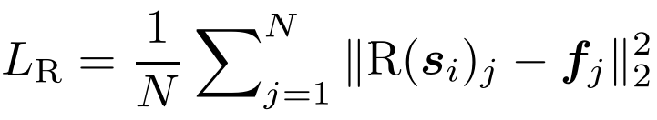
Technical details
For each section si ,
the prediction of the neighbors from its center.
si
Neighbor views prediction loss:
To enable VIP-GAN to more fully understand the 3D shape, the neighbor view prediction is conducted in the feature space, which is different from the center view prediction.

Slide 13

Technical details
For each section si ,
making the predicted center view more real.
si
Adversarial loss on predicted center view:

Slide 14

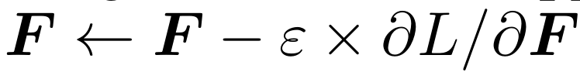
Technical details
For each section si ,
si
The loss of VIP-GAN:
α and β control the balance among the aforementioned losses.
F is learned by being iteratively updating:
ε is the learning rate.

Slide 15
Results
Experimental evaluation in
3D shape classification
3D shape retrieval
Dataset
ModelNet10
ModelNet40
ShapeNet

Slide 16
Results
Parameter setup and ablation studies
 | Only U | Only U-C | Only R | Only D | U+3*R | U+3*R+0.05*D | CGAN
Instance | 84.80 | 75.77 | 90.53 | 47.80 | 92.51 | 94.05 | 89.10
Class | 83.96 | 74.78 | 89.88 | 44.49 | 92.08 | 93.71 | 88.34

Slide 17
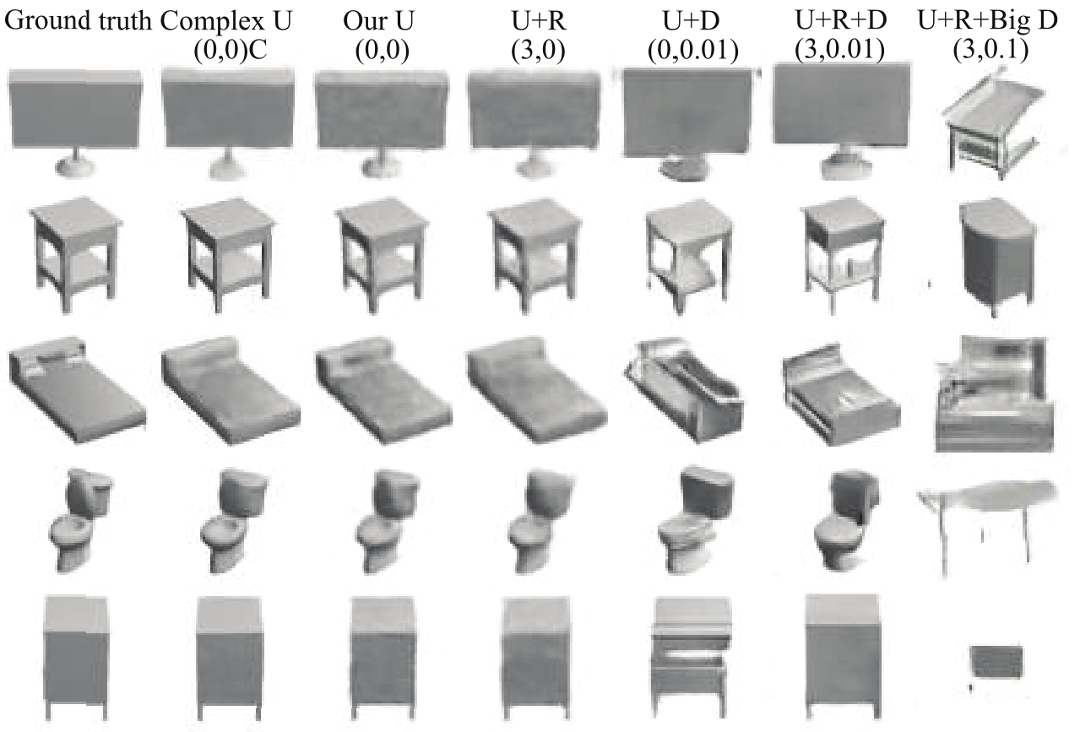
Results
Generated center views

Slide 18
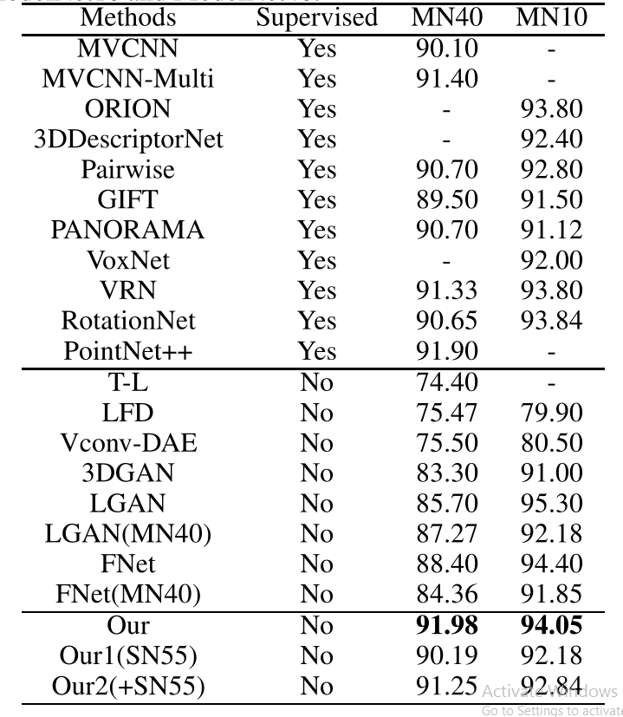
Results
Classification

Slide 19
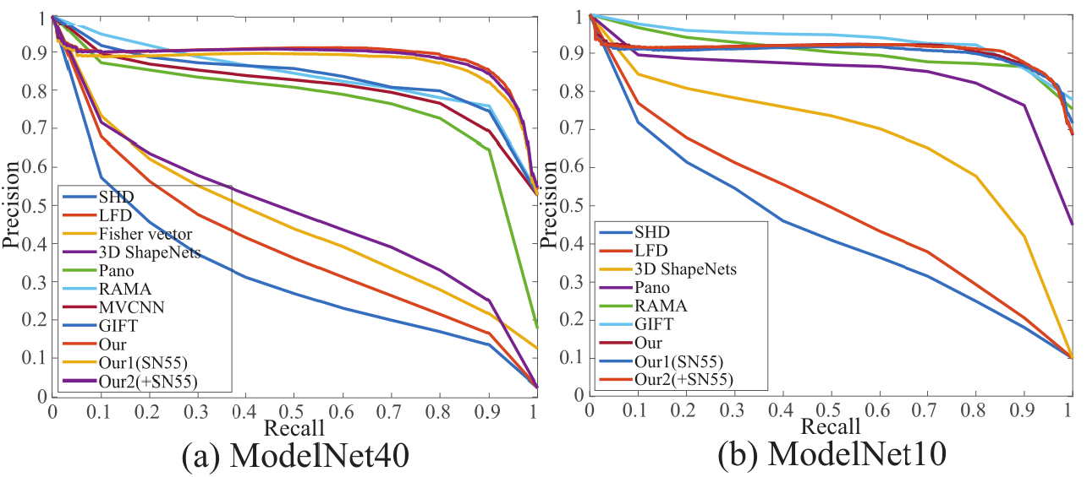
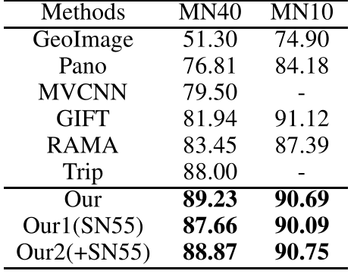
Results
Retrieval

Slide 20
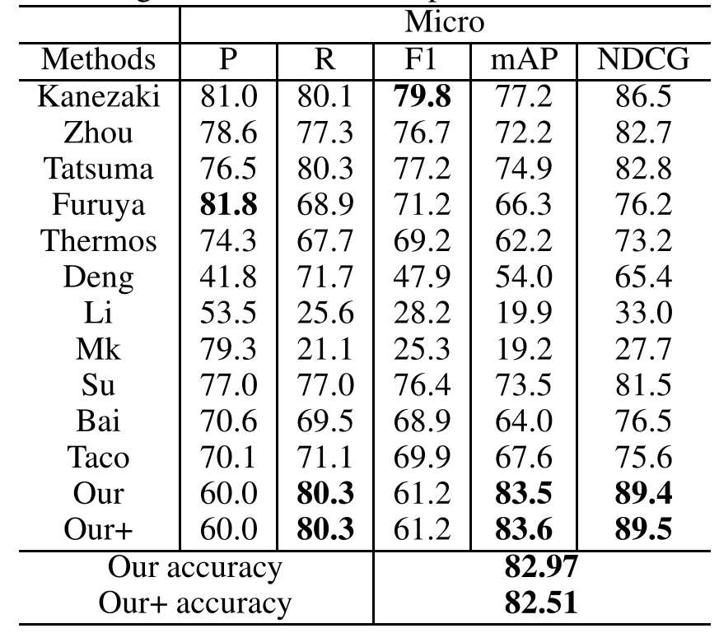
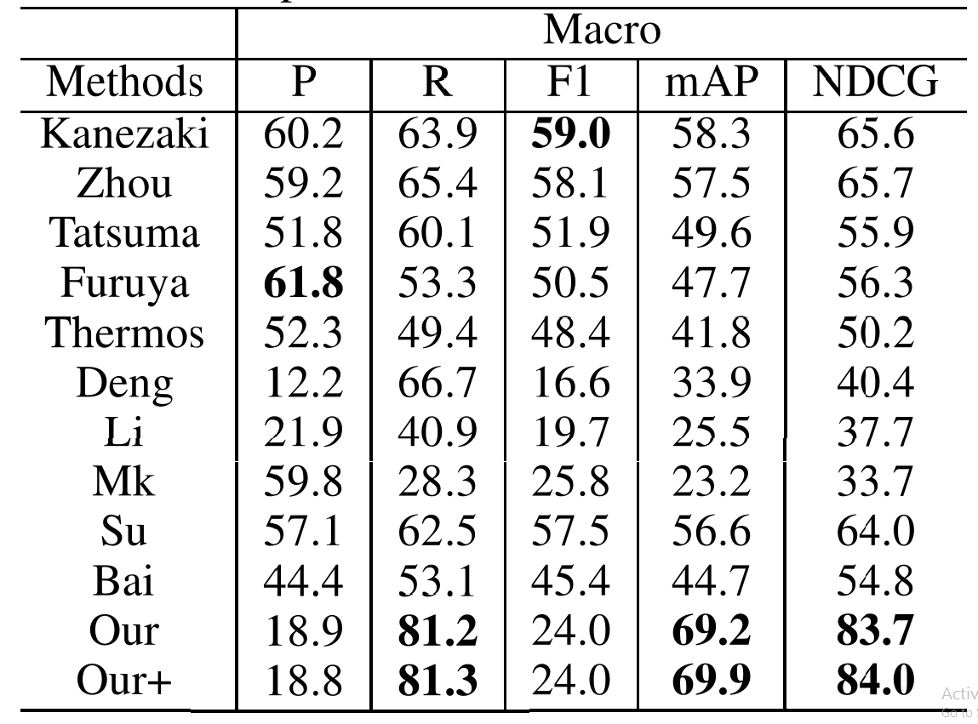
Results
Retrieval under ShapeNet55

Slide 21
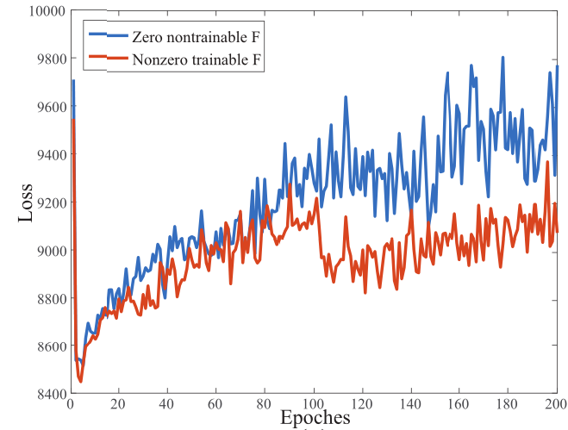
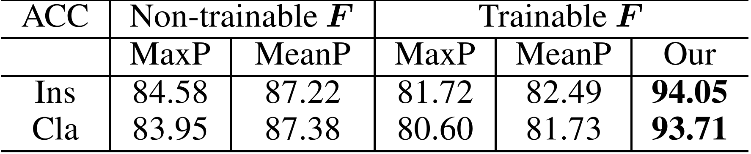
Results
Effectiveness of our implicit view aggregation

Slide 22
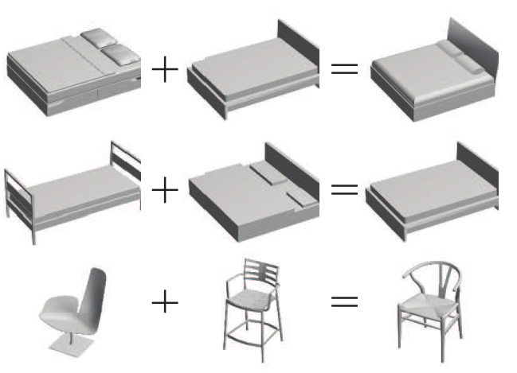
Results
Effectiveness of our implicit view aggregation

Slide 23
Contributions
We propose VIP-GAN as a novel deep learning model to perform unsupervised 3D global feature learning through view inter-prediction with adversarial training, which leads to state-of-the-art performance in shape classification and retrieval.
VIP-GAN makes it possible to mine fine-grained “supervised” information within the multi-view context of 3D shapes by imitating human perception of view-dependent patterns, which facilitates effective unsupervised 3D global feature learning.
We introduce a novel implicit aggregation technique for 3D global feature learning based on RNN, which enables VIP-GAN to aggregate knowledge learned from each view prediction across a view sequence effectively.

Slide 24
Thank you!

