Slide 1
Return-to-libc Attacks
Introduction on Information security

Slide 2
Outline
Non-executable Stack countermeasure
How to defeat the countermeasure
Tasks involved in the attack
Function Prologue and Epilogue
Launching attack

Slide 3
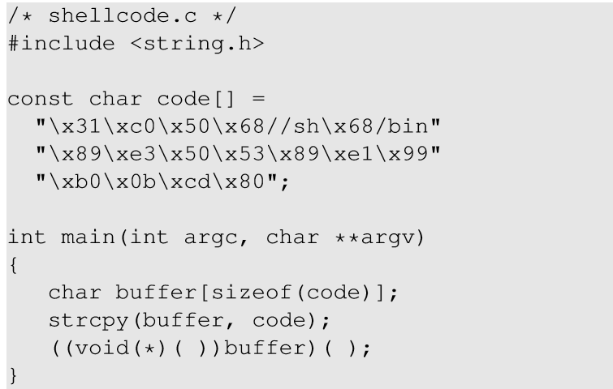
Non-executable Stack
Running shellcode in C program
Calls shellcode
Notes:
Consider the above code that places a shellcode in a buffer on the stack, casts the buffer as a function and calls the function.

Slide 4
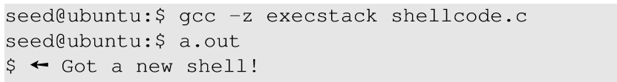
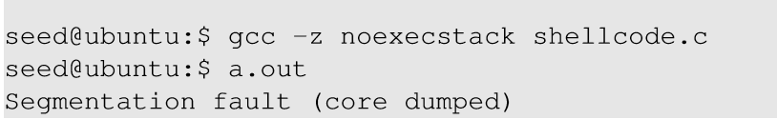
Non-executable Stack
With executable stack
With non-executable stack
Notes:
title

Slide 5
Outline
Non-executable Stack countermeasure
How to defeat the countermeasure
Tasks involved in the attack
Function Prologue and Epilogue
Launching attack

Slide 6
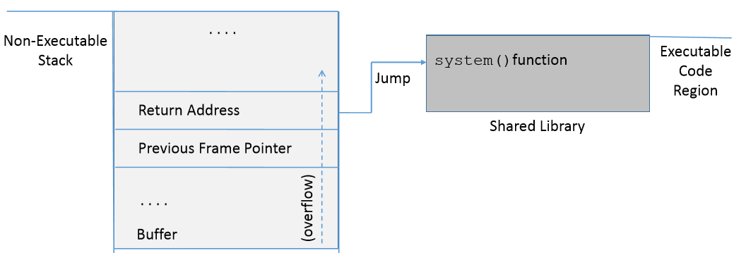
How to Defeat This Countermeasure
Jump to existing code: e.g. libc library.
Function: system(cmd): cmd argument is a command which gets executed.

Slide 7
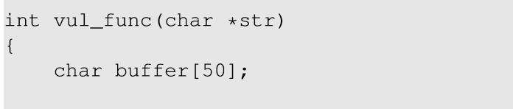
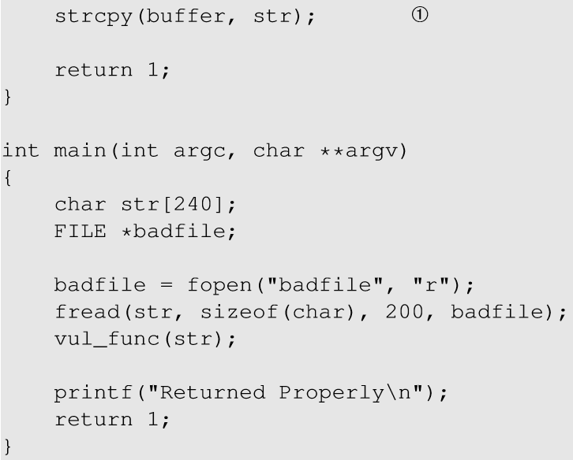
Environment Setup
This code has potential buffer overflow problem in vul_func()
Buffer overflow problem

Slide 8
Environment Setup
“Non executable stack” countermeasure is switched on, StackGuard protection is switched off and address randomization is turned off.
Root owned Set-UID program.

Slide 9
Outline
Non-executable Stack countermeasure
How to defeat the countermeasure
Tasks involved in the attack
Function Prologue and Epilogue
Launching attack

Slide 10
Overview of the Attack
Task A : Find address of system().
To overwrite return address with system()’s address.
Task B : Find address of the “/bin/sh” string.
To run command “/bin/sh” from system()
Task C : Construct arguments for system()
To find location in the stack to place “/bin/sh” address (argument for system())

Slide 11
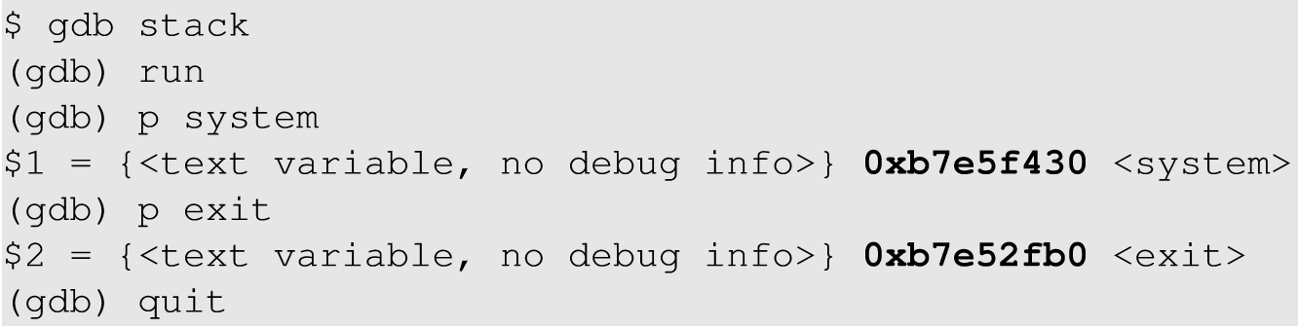
Task A : To Find system()’s Address.
Debug the vulnerable program using gdb
Using p (print) command, print address of system() and exit().
Notes:
Libc library is loaded in the memory when a program runs. For the same program, the library is loaded in the same location. Hence, we can use gdb to find the location of the library functions.

Slide 12
Task B : To Find “/bin/sh” String Address
Export an environment variable called “MYSHELL” with value “/bin/sh”.
MYSHELL is passed to the vulnerable program as an environment variable, which is stored on the stack.
We can find its address.
Notes:
The exported environment variables in the shell process is always passed to the child process.Hence, when a new environment variable is exported and vulnerable program is run, the environment variable is passed to the vulenarbale code and hence, in it’s memory.

Slide 13
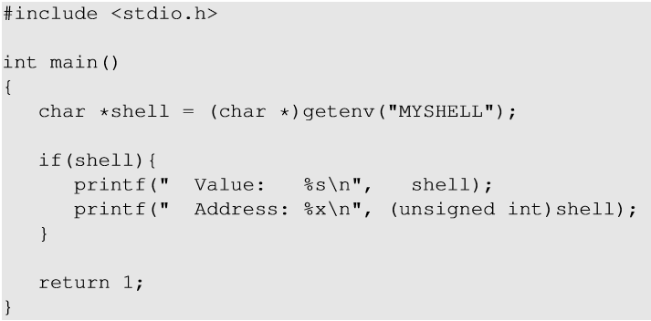
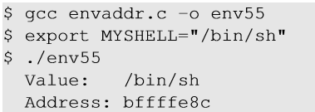
Task B : To Find “/bin/sh” String Address
Export “MYSHELL” environment variable and execute the code.
Code to display address of environment variable

Slide 14
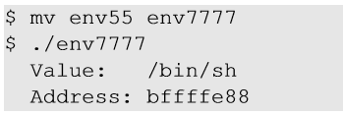
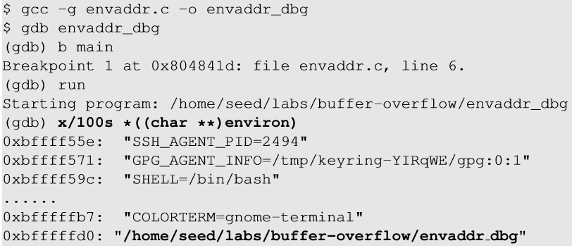
Task B : Some Considerations
Address of “MYSHELL” environment variable is sensitive to the length of the program name.
If the program name is changed from env55 to env77, we get a different address.
Notes:
Environment variables are stored in the stack region of the process, but before the environment variables are pushed, the name of the program is pushed first which affects the memory locations of the environment variables. It took us quite a while to figure out why simply changing the file name can make the attack fail.

Slide 15
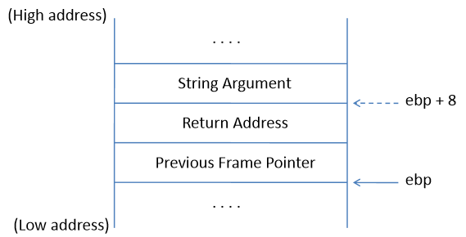
Task C : Argument for system()
Arguments are accessed with respect to ebp.
Argument for system() needs to be on the stack.
Need to know where exactly ebp is after we have “returned” to system(), so we can put the argument at ebp + 8.
Frame for the system() function

Slide 16
Outline
Non-executable Stack countermeasure
How to defeat the countermeasure
Tasks involved in the attack
Function Prologue and Epilogue
Launching attack

Slide 17

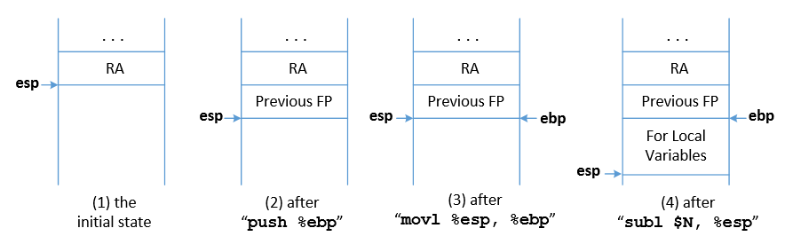
Task C : Argument for system()
Function Prologue
esp : Stack pointer
ebp : Frame Pointer
Notes:
The start of the function call contains 3 instructions as mentioned.
When a function is called, return address (RA) is pushed into the stack. This is the beginning of the function before function prologue gets executed. The stack pointer (esp register) points at RA location.
The previous frame pointer is pushed in the stack, so when the function returns, the caller’s frame pointer is recovered.
The stack pointer now points to the previous frame pointer. The frame pointer (ebp) is pointed to the current stack pointer now so that the frame pointer always points to the old frame pointer.
The stack pointer now moves by N bytes to leave space for the local variables of the function.

Slide 18

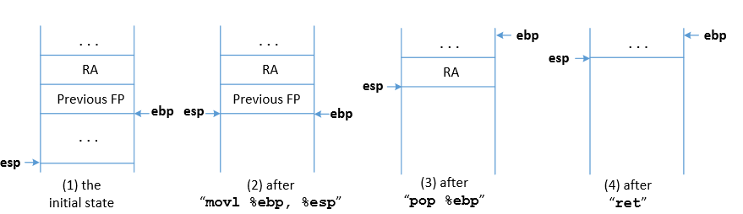
Task C : Argument for system()
Function Epilogue
esp : Stack pointer
ebp : Frame Pointer
Notes:
The stack pointer now points where the frame pointer points to in order to release the stack space allocated for the local variables.
The previous frame pointer is assigned to %ebp to recover the frame pointer of the caller’s function.
The return address is popped from the stack and the program jumps to that address. This instruction moves the stack pointer.

Slide 19
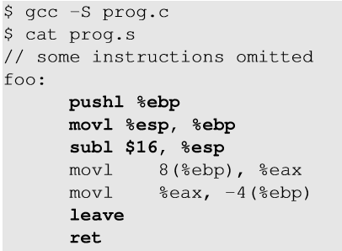
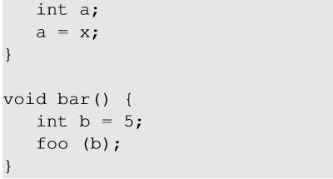
Function Prologue and Epilogue example
1
Function prologue
Function epilogue
2
1
2
8(%ebp) ⇒ %ebp + 8
Notes:
The code can be compiled into assembly code using gcc -s.

Slide 20
Outline
Non-executable Stack countermeasure
How to defeat the countermeasure
Tasks involved in the attack
Function Prologue and Epilogue
Launching attack

Slide 21
How to Find system()’s Argument Address?
Change ebp and esp
Modified Return Address
bof() epilogue
system() prologue
Use of system()’s argument
In order to find the system() argument, we need to understand how the ebp and esp registers change with the function calls.
Between the time when return address is modified and system argument is used, vul_func() returns and system() prologue begins.

Slide 22
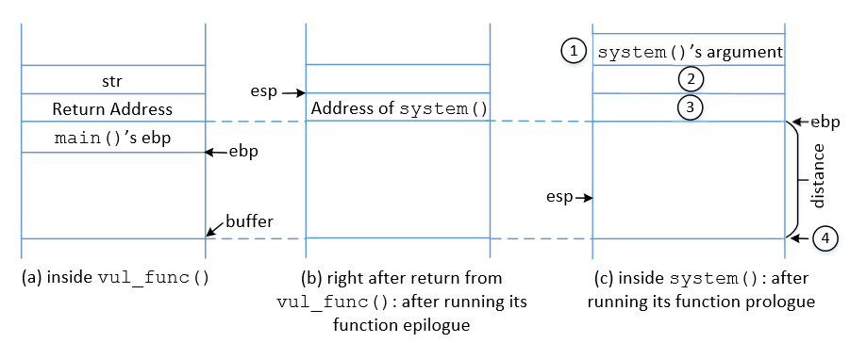
Memory Map to Understand system() Argument

Slide 23
Flow Chart to understand system() argument
Return address is changed to system() address.
ebp is replaced by esp after vul_func() epilogue
Jump to system()
“/bin/sh” is stored in ebp+8
ebp is set to current value of esp
system() prologue is executed
Check the memory map
ebp + 4 is treated as return address of system(). We can put exit() address so that on system() return exit() is called and the program doesn’t crash.

Slide 24
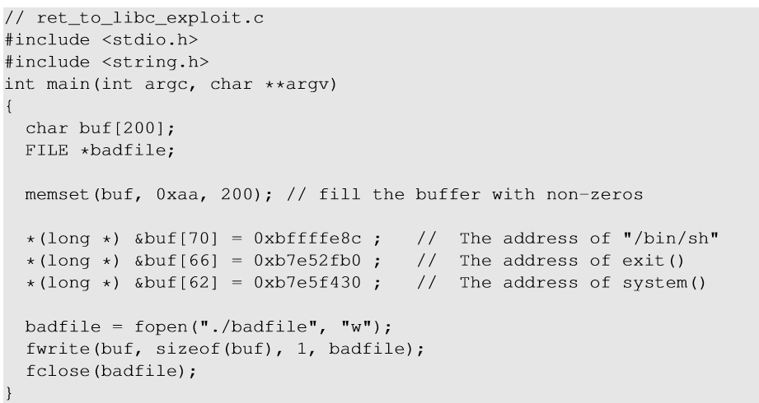
Malicious Code
ebp + 12
ebp + 8
ebp + 4
Notes:
We are inside the vulnerable function (before return occurs), so ebp currently points to the stack frame of the vulnerable function.

Slide 25
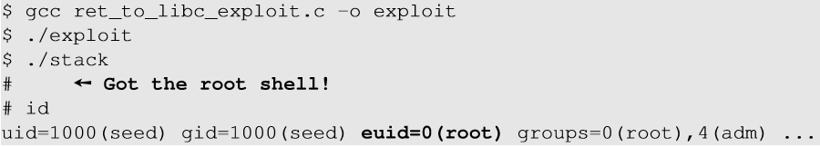
Launch the attack
Execute the exploit code and then the vulnerable code

Slide 26
Return-Oriented Programming
In the return-to-libc attack, we can only chain two functions together
The technique can be generalized:
Chain many functions together
Chain blocks of code together
The generalized technique is called Return-Oriented Programming (ROP)

Slide 27
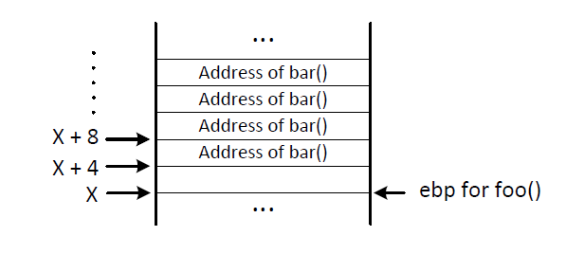
Chaining Function Calls (without Arguments)

Slide 28
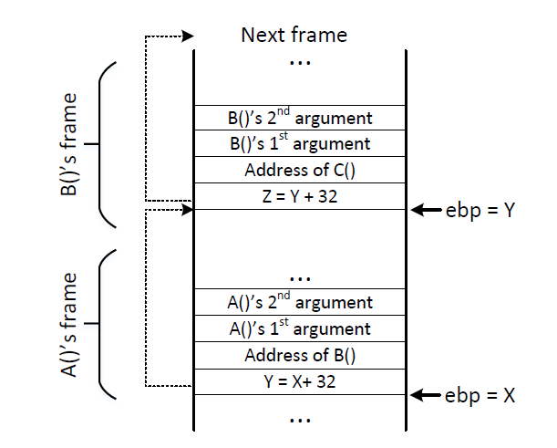
Chaining Function Calls with Arguments
Idea:
skipping function prologue

Slide 29
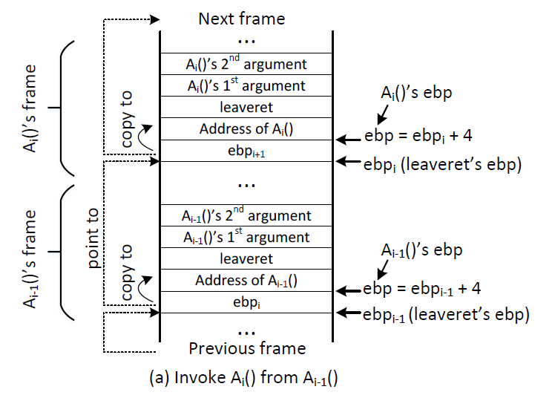
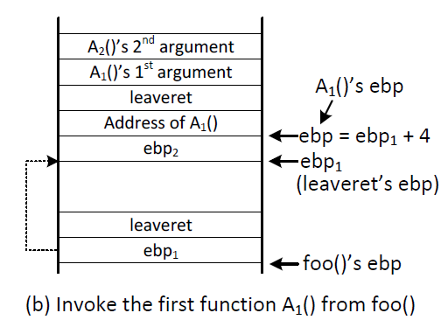
Chaining Function Calls with Arguments
Idea: using leave and ret

Slide 30
Chaining Function Calls with Zero in the Argument
Idea: using a function call to dynamically change argument to zero on the stack
Sequence of function calls (T is the address of the zero): use 4 sprint() to change setuid()’s argument to zero, before the setuid function is invoked.
Invoke setuid(0) before invoking system(“/bin/sh”) can defeat the privilege-dropping countermeasure implemented by shell programs.

Slide 31
Summary
The Non-executable-stack mechanism can be bypassed
To conduct the attack, we need to understand low-level details about function invocation
The technique can be further generalized to Return Oriented Programming (ROP)

