Slide 1
Lecture 17 Dijkstra’s Algorithm
Dijkstra’s Algorithm
Problem solved
Instance
Correctness
2. Systems of difference constraints
Problem solved
Instance
Algorithm
Correctness

Slide 2
Single-source shortest path problem
Input: A weighted directed graph G=(V, E; W) and a source vertex s.
Output: Shortest-path weight from s to each vertex v in V, and a shortest path from s to each vertex v in V if v is reachable from s.

Slide 3
Problem Solved by Dijkstra’s
Single-source shortest-paths problem
Edge weight >=0
Input: A graph G=(V, E) and a source s, and a nonnegative function w: E→R⁺
Output: For each vertex v, shortest path weight δ(s,v), and a shortest path if exists.

Slide 4
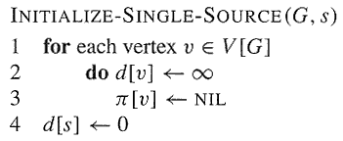
Relaxation--Initialization
The initial estimate of δ(s, v) can be given by:

Slide 5
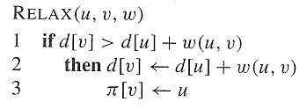
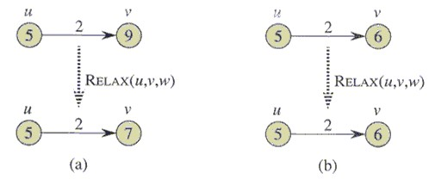
A Relaxation Step

Slide 6
The Dijkstra Algorithm
DIJKSTRA(G,w,s)
Initialize-Single-Source(G,s)
S←∅
Q←V[G]
while Q≠∅
do u←EXTRACT-MIN(Q)
S←S∪{u}
for each v ∈Adj[u]
do RElAX(u,v,w)
INITIALIZE-SINGLE-SOURCE(G,s)
1 for each vertex v∈V[G]
2 do d[v] ← ∞
3 π[v] ← NIL
4 d[s] ← 0
RELAX(u,v,w)
1 if d[v] > d[u] + w(u,v)
2 then d[v] ← d[u]+w(u,v)
3 π[v] ←u

Slide 7
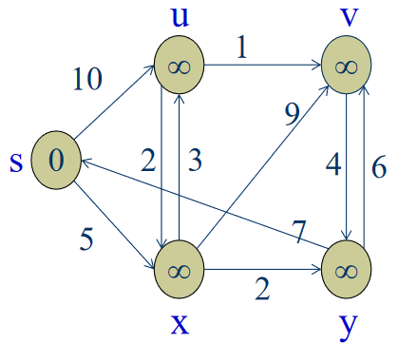
Dijkstra’s Algorithm - example
Initial Graph
Source
Mark 0
Distance to all nodes marked ∞

Slide 8
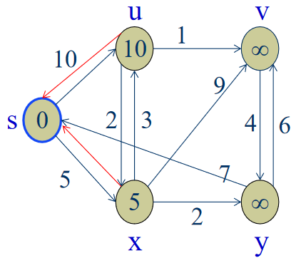
Dijkstra’s Algorithm - Operation
S={s}
Initial Graph
Source
S= ∅
Relax edges leaving source

Slide 9

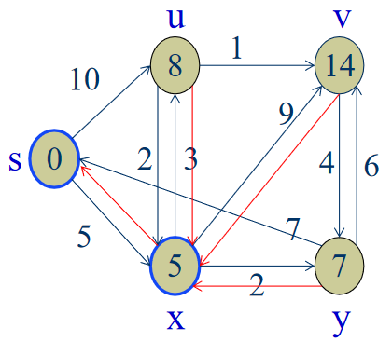
Dijkstra’s Algorithm - Operation
Relax u and a shorter path via x
exists
Relax y
Red arrows show
predecessors
Sort vertices and choose closest

Slide 10
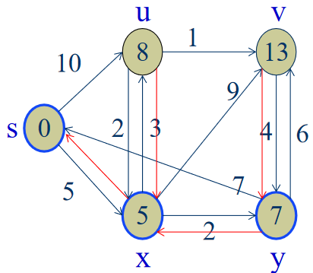
Dijkstra’s Algorithm - Operation
Relax v and a shorter path via y
exists
Sort vertices and choose closest
S is now { s, x }

Slide 11
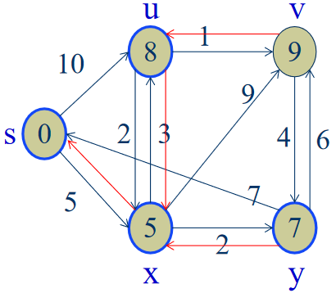
Dijkstra’s Algorithm - Operation
Update d[v]
Sort vertices and choose closest, u
S is now { s, x, y }

Slide 12
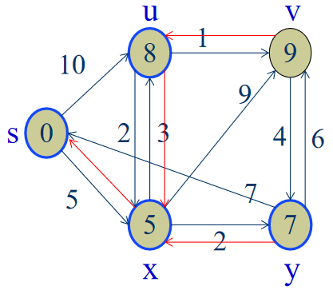
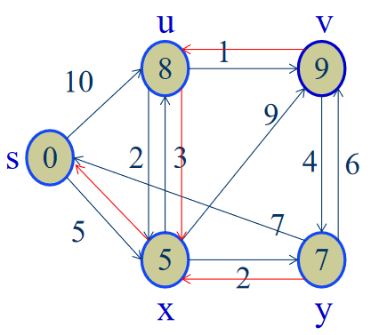
Dijkstra’s Algorithm - Operation
S is now { s, x, y, u }
Finally add v

Slide 13
Dijkstra’s Algorithm - Operation
Pre-decessors show shortest paths sub-graph
S is now { s, x, y, u }

Slide 14
Correctness of Dijkstra’s
Theorem 24.6
Dijkstra’s algorithm, run on a weighted,directed graph G=(V, E), with non-negative weight function w and source s, terminates with d[u]= δ(s,u) for all vertices u∈V.

Slide 15
Convergence property
If s ~→ u→ v is a shortest path from s to v in G, and if d[u] = δ(s, u) at any time prior to relaxing edge (u, v), then d[v] = δ(s, v) at all times afterward.

Slide 16
Correctness of Dijkstra’s
Theorem 24.6
Dijkstra’s algorithm, run on a weighted,directed graph G=(V, E), with non-negative weight function w and source s, terminates with d[u]= δ(s,u) for all vertices u∈V.
Proof (by contradiction)
Since S=V in the end, we only need to prove that for each vertex v added to S, there holds d[v]= δ(s, v) when v is added to S.
Suppose that u is the first vertex for which d[u] ] ≠ (s, u) when it was added to S
Note
u is not s because d[s] = 0= δ(s, s)
There must be a path s~→u, since otherwise d[u]= δ(s, u) = ∞.
Since there’s a path, there must be a shortest path (note there is no negative cycle).

Slide 17
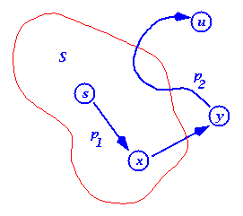
Dijkstra’s Algorithm - Proof
Let s~→x→y ~→u be a shortest path from s to u, where at the moment u is chosen to S,
x is in S and y is the first outside S
When x was added to S, d[x] = δ(s, x)
Edge x→y was relaxed at that time, so at time u is chosen, d[y] = δ(s, y)

Slide 18
Dijkstra’s Algorithm - Proof
So, d[y]= δ(s, y) ≤ δ(s, u) ≤ d[u]
But, when we chose u, both u and y are in Q, so d[u] ≤ d[y] (otherwise we would have chosen y)
Thus the inequalities must be equalities
d[y] = δ(s, y) = δ(s, u) = d[u]
And our hypothesis (d[u] ≠ δ(s, u)) is contradicted!
1.Why the red inequality holds? How about negative edges exist?
2.When u is added to S, a shortest path s→u in S is found.

Slide 19
Dijkstra’s Algorithm - Time Complexity
Like that of PRIM’s
If using arrays
O( V² )
Using special data structure
O(ElogV) or O(VlogV+E)

Slide 20
Compared to BFS
DIJKSTRA(G,w,s)
INITIALIZE-SINGLE-SOURCE(G,s)
S←∅
Q←V[G]
while Q≠∅
do u←EXTRACT-MIN(Q)
S←S∪{u}
for each v ∈Adj[u]
do RELAX(u,v,w)
BFS(G,s)
For each vertex u ∈V,
color[u]=W; d[u]=∞; π[u]=NIL; color[s]=G; d[s]=0;
2. Q={s}.
3. while Q is nonempty
u=dequeue(Q)
for each v ∈ adj[u],
if(color[v]==W), do
color[v]=G;
d[v]=d[u]+1;
π[v]=u;
enqueue(Q,v);
color[u]=B
Note: vertices in Q are in non-decreasing
order of d, and there are only two values
d, and d+1 in Q.

Slide 21
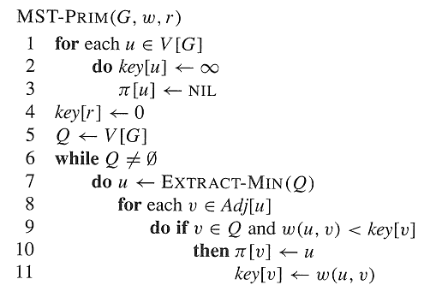
Compared to PRIM
DIJKSTRA(G,w,s)
for each u ∈V[G]
do d[u]←∞
π[u]←NIL
d[s]←0
S←∅
Q←V[G]
while Q≠∅
do u←EXTRACT-MIN(Q)
S←S∪{u}
for each v ∈Adj[u]
do if v ∈ Q and d[u]+w(u,v)<d[v]
then π[v]←u
d[v]←d[u]+w(u,v)

Slide 22
Linear Programming
Linear programming problem:
Input: matrix A_{mn}, vector b_{m}, and vector c_{n}.
Output: vector x_{n}, such that
maximize cx
subject to Ax<=b.
Notes
This problem has polynomial time solution.
Many problems can be converted into LP.

Slide 23
An Instance
单位产品所需原料数量（公斤） | 产品 Q1 | 产品 Q2 | 产品 Q3 | 原料供用量 （公斤/日）
原料P1 | 2 | 3 | 0 | 1500
原料P2 | 0 | 2 | 4 | 800
原料P3 | 3 | 2 | 5 | 2000
单位产品的利润 （千元） | 3 | 5 | 4

Slide 24
LP

Slide 25
Feasibility problem of LP
Feasible solution: x_{n}, subject to Ax<=b.
Feasibility problem of LP:
Given Matrix A m×n, b m-vector
Output: either a feasible solution x if one exists, or a judgment that no feasible solution exists.

Slide 26
Systems of difference constraints
Each row of A contains exactly one “1” and one “-1”. All other elements are “0”.
Each row is a difference constraint:
x_{j}-x_{i}<=b_{k}, 1<=k<=m.
An example
x₁-x₂<=0
x₁-x₅<=-1
x₂-x₅<=1
x₃-x₁<=5
x₄-x₁<=4
x₄-x₃<=-1
x₅-x₃<=-3
x₅-x₄<=-3
Solution x=(-5,-3,0,-1,-4); x’=(-5+d,-3+d,0+d,-1+d,-4+d)
(0,2,5,4,1)

Slide 27
Relations between solutions to DC
Lemma 24.8: Let x=(x₁,x₂,…,x_{n}) be a solution to a system Ax<=b of difference constraints, and let d be any constant. Then x+d=(x₁+d, …, x_{n}+d) is a solution to Ax<=b as well.
Proof.

Slide 28
Constraints graph
Given a system Ax<=b of difference constraints
The constraint graph is a weighted, directed graph G=(V, E;w), where:
V={v₀,v₁,…,v_{n}} //v₀ is an extra vertex
E={(v_{i},v_{j}):x_{j}-x_{i}<=b_{k} is a constraint}
∪{(v₀,v₁),(v₀,v₂),…,(v₀,v_{n})}. //each vertex is reachable from v₀
w(v_{i},v_{j})=b_{k}, if x_{j}-x_{i}<=b_{k} is a constraint;
w(v₀,v_{i})=0.

Slide 29
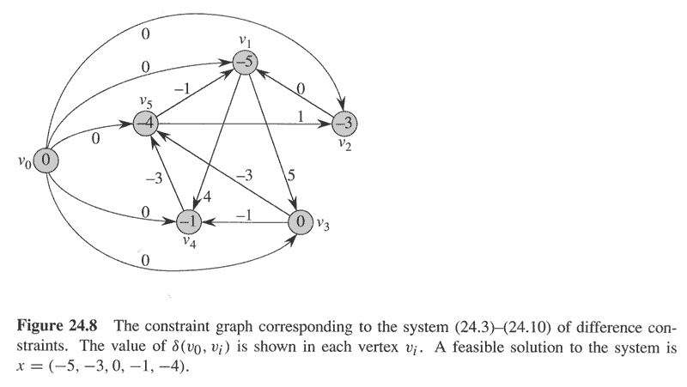
Constraint graph of example

Slide 30
Solve Difference Constraints by SSSP in constraint graph
Thoerem24.9: Given a system Ax<=b of difference constraints, let G=(V, E) be the corresponding constraint graph.
If G contains no negative-weight cycles, then
x=(δ(v₀,v₁), δ(v₀,v₂), …, δ(v₀,v_{n}))
is a feasible solution for the system.
If G contains a negative-weight cycle, then there is no feasible solution for the system.

Slide 32
Correctness of Theorem 24.9
Proof. (⇒)If G does not contain negative-weight cycles. Then shortest path is well defined. And since there is an edge from v₀ to each vertex, all shortest paths from v₀ is finite. Consider any edge (v_{i},v_{j})(any constraint). By the triangle inequality, δ(v₀,v_{j}) ≤ δ(v₀,v_{i})+w(v_{i},v_{j}) or, equivalently, δ(v₀,v_{j})- δ(v₀,v_{i}) ≤ w(v_{i},v_{j}). Thus, letting x_{i}= δ(v₀,v_{i}) and x_{j}= δ(v₀,v_{j}) satisfies the difference constraint x_{j}-x_{i} ≤ b_{k} =w(v_{i},v_{j}) that corresponds to edge (v_{i},v_{j}).

Slide 33
Proof continued
If G contains a negative-weight cycle C=<v₁,v₂,…,v_{k}>, where v₁=v_{k}. We will show that there is no feasible solution. Cycle C corresponds to the following difference constraints: x₂-x₁<=w(v₁,v₂); x₃-x₂<=w(v₂,v₃); …, x_{k}-x_{k-1}<=
w(v_{k-1},v_{k}), x₁-x_{k}<=w(v_{k},v₁). If there is a feasible solution x, it will satisfy all these k inequalities. It also satisfies the summation of the inequalities, i.e., 0<=w(C) , a contradiction to C is negative-weighted.

Slide 34
Property of DC
Observation(According to Theorem24.9):
A difference constraints system has a solution
⇔ constraint graph contains no negative cycle, and x=(δ(v₀,v₁), δ(v₀,v₂), …, δ(v₀,v_{n})) is a solution.
A difference constraints system has no solution ⇔ constraint graph contains negative cycles.

Slide 35
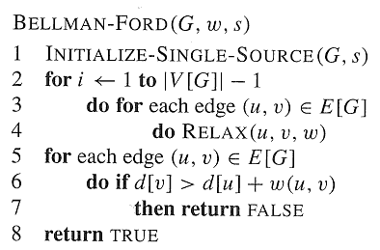
Bellman-Ford solution to DC
Algorithm:
Compute constraint graph G;
Run Bellman-Ford on constraint graph G;
If Bellman-Ford returns True, then x=(δ(v₀,v₁), …, δ(v₀,v_{n})) is a solution to DC; if Bellman-Ford returns false, DC has no solution.

Slide 36
Conclusion
Dijkstra’s algorithm
理解正确性证明中为什么三个不等号成立？
Difference constraints
会求解差约束系统。

Slide 37
Homework
24.3-2
24.3-3

