Slide 1
Dirty COW Race Condition Attack
Introduction on Information security
Ning Feng
2978539712@qq.com

Slide 2
Outline
Dirty COW vulnerability
Memory Mapping using mmap()
Map_shared, Map_Private
Mapping Read-Only Files
How to exploit?

Slide 3
Dirty COW vulnerability
Interesting case of the race condition vulnerability.
Existed in the Linux Kernel since September 2007 , was discovered and attacked on October 2016.
Affects all Linux-based operating system, including Android.
Consequences :
Modify protected files like /etc/passwd.
Gain root privileges by exploiting the vulnerability.

Slide 4
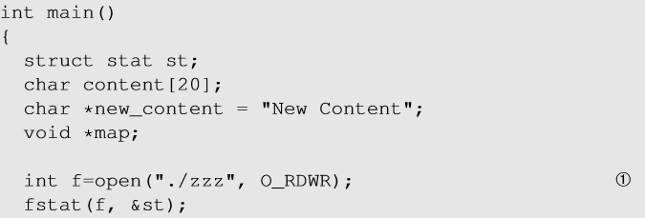
Memory Mapping using mmap()
mmap() - system call to map files or devices into memory. Default mapping type is file-backed mapping, which maps an area of a process’s virtual memory to files;reading from the mapped area causes the file to be read
Line ① opens a file in read-write mode.

Slide 5

Memory Mapping using mmap()
Line ② calls mmap() to create a mapped memory
1st arg: Starting address for the mapped memory
2nd arg: Size of the mapped memory
3rd arg: If the memory is readable or writable. Should match the access type from Line ①
4th arg: If an update to the mapping is visible to other processes mapping the same region and if the update is carried through to the underlying file
5th arg: File that needs to be mapped
6th arg: Offset indicating from where inside the file the mapping should start.

Slide 6
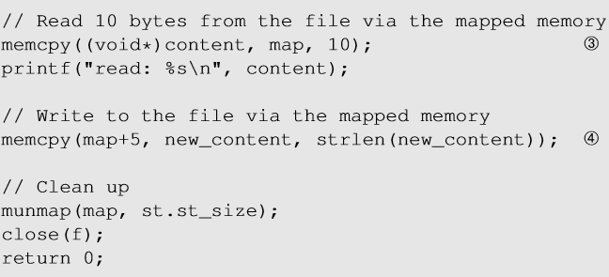
Memory Mapping using mmap()
Access the file for simple reading and writing using memcpy().

Slide 7
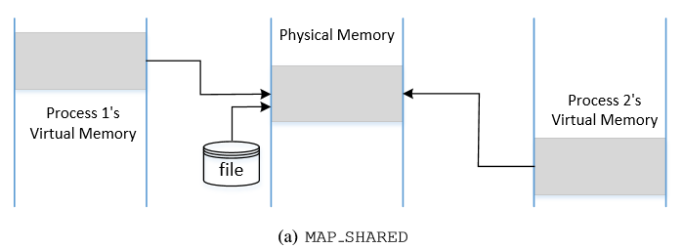
MAP_SHARED and MAP_PRIVATE
MAP_SHARED: The mapped memory behaves like a shared memory between the two processes.
When multiple processes map the same file to memory, they can map the file to different virtual memory addresses, but the physical address where the file content is held is same.

Slide 8
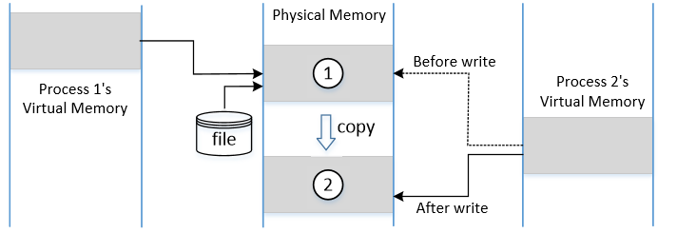
MAP_SHARED and MAP_PRIVATE
MAP_PRIVATE: The file is mapped to the memory private to the calling process.
Changes made to memory will not be visible to other processes
The contents in the original memory need to be copied to the private memory.
If the process tries to write to the memory, OS allocates a new block of physical memory and copy the contents from the master copy to the new memory.
Mapped virtual memory will now point to the new physical memory.

Slide 9
Copy On Write
Technique that allows virtual memory in different processes to map to the same physical memory pages, if they have identical contents.
When a child process is created using fork() system call :
OS lets the child process share the parent process’s memory by making page entries point to the same physical memory.
If the memory is only read, memory copy is not required.
If any one tries to write to the memory, an exception will be raised and OS will allocate new physical memory for the child process (dirty page), copy contents from the parent process, change each process’s (parent and child) page table so that it points to it’s own private copy.

Slide 10
Discard Copied Memory
madvise(): Give advices or directions to the kernel about the memory from addr to addr + length
advice (3rd argument): MADV_DONOTNEED
We tell the kernel that we do not need the claimed part of the address any more. The kernel will free the resource of the claimed address and the process’s page table will point back to the original physical memory.

Slide 11
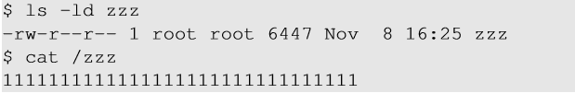
Mapping Read-Only Files: Create a File First
Experiment :
Create a file zzz in the root directory. Set owner/group to root and make it readable to other users.
If we have a seed account :
We can only open this file using read_only flag (O_RDONLY).
If we map this file to the memory, we need to use PROT_READ option, so the memory is read-only.

Slide 12
Mapping Read-Only Files
Normally, we cannot write to the read-only memory.
However, if the file is mapped using MAP_PRIVATE, OS makes an exception and allow us write to the mapped memory, but we have to use a different route, instead of directly using memory operations, such as memcpy().
The write() system call is such a route.

Slide 13
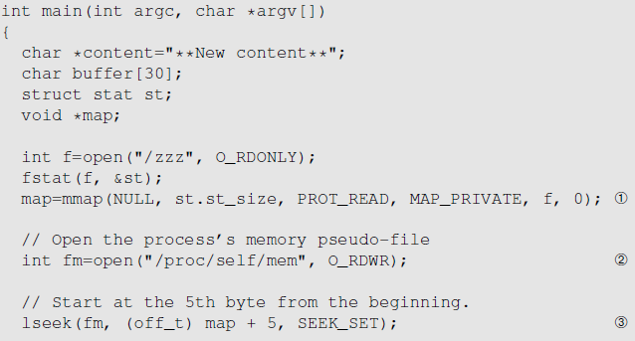
Mapping Read-Only Files: the Code
Line ①: Map /zzz into read-only memory. We cannot directly write this to memory, but it can be done using the /proc file system.
Line ②: Using the /proc file system, a process can use read(),write() and lseek() to access data from its memory.
Line ③: The lseek() system call moves the file pointer to the 5th byte from the beginning of the mapped memory.
Notes:
Proc file system : File system in Unix-like operating system that presents information about the processes and other system information in a hierarchical file-like structure. It provides a convenient and standardized method for dynamically accessing process data.

Slide 14
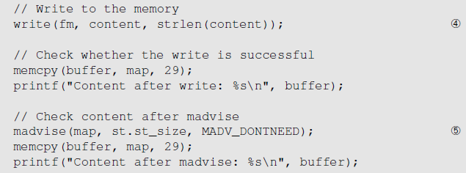
Mapping Read-Only Files: the Code
Line ④: The write() system call writes a string to the memory. It triggers copy on write (MAP_PRIVATE), i.e., writing is only possible on a private copy of the mapped memory.
Line ⑤: Tell the kernel that private copy is no longer needed. The kernel will point our page table back to the original mapped memory. Hence, the changes made to the private file is discarded.

Slide 15
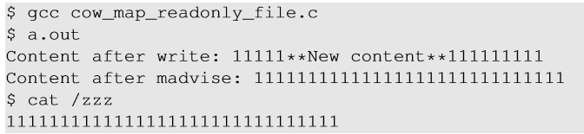
Mapping Read-Only Files: The Result
Memory is modified as we can see the changed content. But the change is only in the copy of the mapped memory; it does not change the underlying file.

Slide 16
The Dirty-COW Vulnerability
For Copy-On-Write, three important steps are performed:
Make a copy of the mapped memory
Update the page table, so the virtual memory points to newly created physical memory
Write to the memory.
The above steps are not atomic in nature: they can be interrupted by other threads which creates a potential race condition leading to Dirty Cow vulnerability.

Slide 17
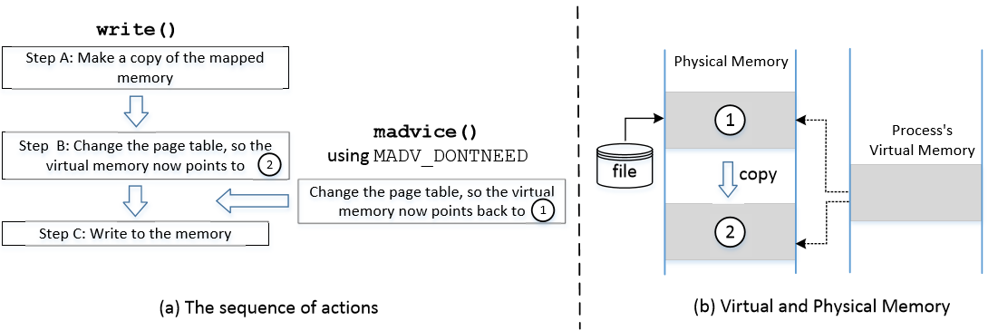
Dirty-COW vulnerability
Notes:
In (B), page table of the process is changed, so the virtual memory now points to the physical memory marked by 2. Then Step (C) successfully writes to the memory. What if we run some other commands between these two steps like :
i) Change page entries for the virtual memory.
ii) Discard the private copy of the mapped memory using madvise() so that the page table points to the original mapped memory. (marked by 1)

Slide 18
Dirty-COW vulnerability
If madvise() is executed between Steps B and C :
Step B makes the virtual memory point to 2.
madvise() will change it back to 1 (negating Step B)
Step C will modify the physical memory marked by 1, instead of the private copy.
Changes in the memory marked by 1 will be carried through to the underlying file, causing a read-only file to be modified.
When write() system call starts, it checks for the protection of the mapped memory. When it sees that is a COW memory, it triggers A,B,C without a double check.

Slide 19
Exploiting Dirty COW vulnerability
Basic Idea : Need to run two threads
Thread 1: write to the mapped memory using write()
Thread 2: discard the private copy of the mapped memory
We need to race these threads against each other so that they can influence the output.

Slide 20
Exploiting Dirty COW vulnerability
Selecting /etc/passwd as Target File: The file is a read-only file, so non-root users cannot modify it.
Change it to 0000 using the Dirty COW vulnerability
The third field denotes the User-ID of the user (for Root, it is 0). If we can change the third field of our own record (user testcow) into 0, we can turn ourselves into root.

Slide 21
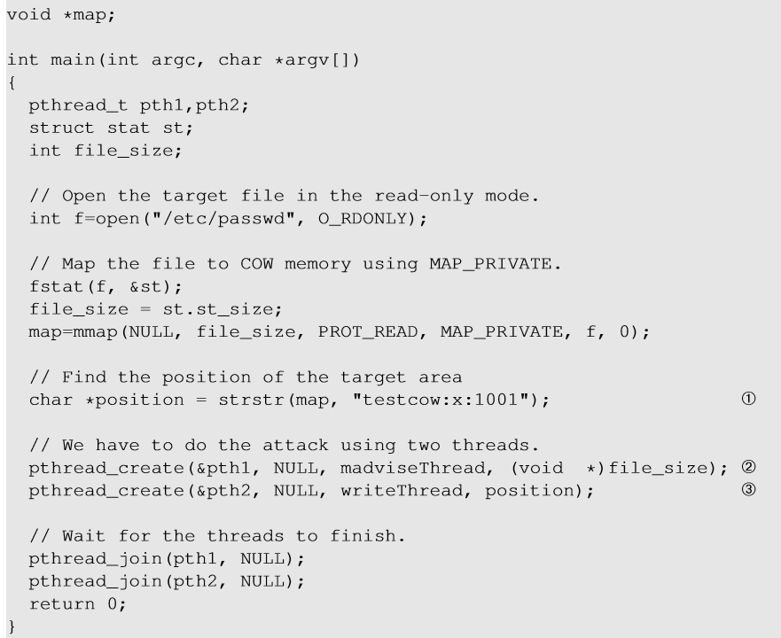
Attack: the Main Thread
Set Up Memory Mapping and Threads
Open the /etc/passwd file in read-only mode
Map the memory using MAP_PRIVATE
Find the position in the target file.
Create a thread for madvise()
Create a thread for write()

Slide 22
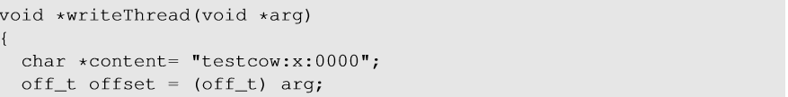
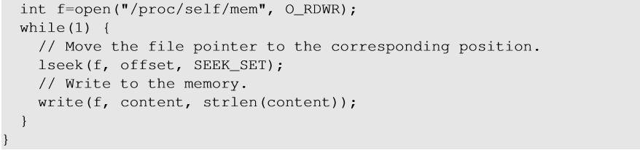
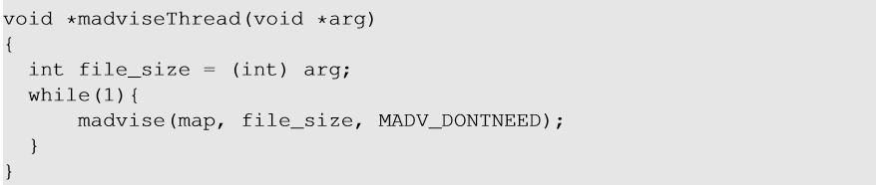
Attack: the Two Threads
The write Thread: Replaces the string “testcow:x:1001” in the memory with “testcow:x:0000”
The madvise Thread: Discards the private copy of the mapped memory so the page table points back to the original mapped memory.

Slide 23
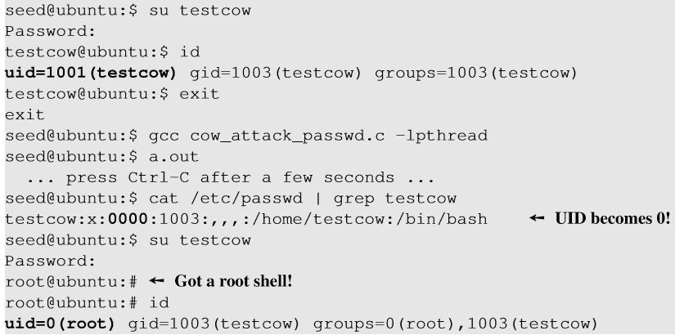
Attack result
Notes:
On running the described system calls infinitely in an infinite loop for sometime, we can see that the /etc/passwd is modified.
We stop the attack code after running it for sometime.On switching user to testcow, we get the root shell

Slide 24
Summary
DirtyCOW is a special type of race condition problem
It is related to memory mapping
We learned how the vulnerability can be exploited
The problem has already been fixed in Linux

