Slide 1
Chapter 3: Processes

Slide 2
Chapter 3: Processes
Process Concept
Process Scheduling
Operations on Processes
Cooperating Processes
Interprocess Communication
Communication in Client-Server Systems

Slide 3
3.1 Process Concept
How to describe the execution of a program?
What to call all the CPU activities?

Slide 4
讨论：一个程序在系统中的运行过程
程序 vs. 运行中的程序
要执行一个程序，需要涉及到众多的问题
需要申请、使用系统资源，例如
Memory：text（Code），data，heap，stack
CPU
Files
I/O devices
…
如果程序运行时所需的资源目前不可用，程序就无法继续执行，执行过程需要暂停，等资源可用后继续恢复执行；（描述程序的执行过程中的状态，状态之间的转换）
CPU调度：操作系统按一定的策略从众多正在运行的程序中选择合适的为其分配CPU，从而执行之；（需要知道哪些可以被调度，上下文如何保存、保存到何地？）
系统需要知道程序是否已经执行结束？（结束后需要回收已分配的资源）
可能与其它运行中的程序进行交互、通信
对于同一个程序，可能需要同时多次运行（描述同一个程序的多个运行中的实例）
…
需要有一个实体描述一个运行中的程序

Slide 5
3.1.1 The Process
Process – a program in execution; process execution must progress in sequential fashion.
进程本质上是一个运行中的程序
是一个正在执行程序的实例
Program becomes process when an executable file loaded into memory
当一个程序被操作系统装入到内存中时，就成为一个进程
自学：可执行文件的格式，特别是文件头，如Windows的EXE文件格式，或Linux的ELF等
An operating system executes a variety of programs:
Batch system – jobs
Time-shared systems – user programs or tasks, or process
Textbook uses the terms job and process almost interchangeably.

Slide 6
The Process
What does a program look like when it is executed?

Slide 7
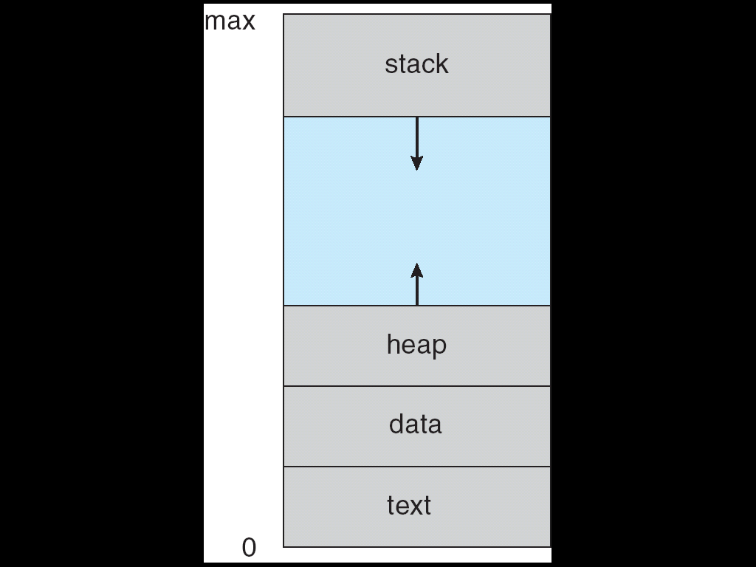
Process in Memory
地址
进程的地址空间（虚拟地址空间）

Slide 8
Components of a program in execution

Slide 9
Components of Process
A process includes Multiple parts
Text section containing program code
Data section containing global variables and static variables
Stack containing temporary data
local variables, function parameters, function return addresses
It grows and shrinks as functions are called and returned
Heap containing memory dynamically allocated during run time
Such as memory space allocated by malloc() in C or new() in C++
Current activity including Program Pounter(PC), Stack Pointer (SP) ,processor registers, etc.

Slide 10
Components of Process
思考：OS如何获取关于进程的如下信息：
进程的代码、数据、堆、栈等在内存的哪些位置？
进程如何知道打开了哪些文件，申请使用了哪些资源
进程的标识pid，进程的状态等存放在什么地方？
当进程切换时，需要保存与恢复其上下文，上下文暂存到何处？
许多等待调度的进程构成一个队列。队列中的元素是什么？
如果多个进程同时申请使用同一个资源，需要为等待使用该资源的进程建立一个队列。队列中的元素是什么？
…….
OS如何感知一个进程的存在？

Slide 11
Components of Process
A process includes Multiple parts
Text section containing program code
Data section containing global variables and static variables
Stack containing temporary data
local variables, function parameters, function return addresses
It grows and shrinks as functions are called and returned
Heap containing memory dynamically allocated during run time
such as malloc() in C or new() in C++ 所使用的内存
Current activity including Program Pounter(PC), Stack Pointer (SP) ,processor registers
PCB--Process Control Block
相当于进程的档案
OS→PCB→进程的任何信息

Slide 12
Components of Process(Unix)
A process includes: (UNIX)
text section – contains the program code
data section – contains global variables
PCB
current activities
stack – contains temporary data
Heap – containing memory dynamically allocated during run time
program counter （PC）
general registers

Slide 13
Process Concept
process
60年代初期在MIT的MULTICS系统以及IBM的CTSS/360中引入
Some definitions of the process
A program in execution; 进程是一个运行中的程序
进程是程序的一次执行；
进程是可以和别的计算并发执行的计算；
进程可定义为一个数据结构及能在其上进行操作的一个程序；
进程是一个程序及其数据在处理机上顺序执行时所发生的活动；
进程是可并发执行的程序在一个数据集合上的运行过程；
进程是程序在一个数据集合上的运行活动，是系统进行资源分配和调度的一个独立单位；（ 汤子赢版） （思考：进程是调度的基本单位？）
进程是进程实体的运行过程，其中进程实体包括：
程序段
数据段
PCB
Stack, program counter , general registers
3

Slide 14
Same program, Separate process
赫拉克利特：人不能两次踏进同一条河流
一个程序不能两次属于同一个进程
如何理解？
一个程序可被多次执行；
每次运行都是一个可执行程序不同的运行活动—OS为其创建的进程也不会相同；
即使每次运行的程序（代码段）相同，但处理的数据（数据段）可能不同；
即使每次运行的程序（代码段）相同，处理的数据（数据段）也相同，但OS为其分配PCB、进程号、堆、栈等系统分配资源肯定不同；
运动员←→多次竞赛过程
飞机←→飞行过程

Slide 15
Same program, Separate process
Although two processes may be associated with the same program, they are nevertheless considered two separate execution sequences.
For instance,
Several users may be running different copies of the mail program
The same user may invoke many copies of the web browser program.
Each of these is a separate process; and although the text sections are equivalent, the data, heap, and stack sections vary.

Slide 16
Some features of the process
OS引入进程的概念是为了方便描述程序的运行活动（运行过程）
进程与程序是截然不同的两个概念；
一个程序可以对应多个进程；(One program can be several processes)
同一个程序可以被执行多次
一个进程也可以由多个程序段共同完成一项任务；
这些程序段可能是独立的程序模块，但运行时这些程序段在同一个进程中
多个程序（段）可能运行在同一个进程的上下文中
进程具有五个特征，而程序则不具备；
进程的五个基本特征：
动态性
独立性
并发性
异步性
结构特征

Slide 17
Some features of the process
动态性 (active )
A program is a passive entity, such as a file containing a list of instructions stored on disk (often called an executable file).
A process is an active entity, with a program counter specifying the next instruction to execute and a set of associated resources.
Program becomes process when executable file loaded into memory
动态性是进程的最基本的特征，表现在进程由创建而产生，由调度而执行，因得不到资源而暂停执行，由撤销而消亡；
进程具有一定的生命期；

Slide 18
Some features of the process
独立性
进程实体是一个能独立运行的基本单位，同时也是系统中独立获得资源和独立调度的基本单位；
在不支持多线程的系统中，进程是CPU独立调度的基本单位；
进程需要一定的资源，以完成其所负担的任务
如 CPU time，memory，files, I/O devices
OS会在创建进程，或进程的过程中给进程分配其所需的资源
进程拥有资源，因此在上下文切换时，耗时比较大，导致运行效率不高；（辎重部队与作战部队）
如果将进程能够独立获得资源和独立调度这两个属性分开
支持线程的系统中，进程是独立获得资源的基本单位，线程是独立调度的基本单位

Slide 19
Some features of the process
并发性(Concurrency)
静态的程序没有并发概念
运行中的程序，即进程，才可以在系统内并发执行
多个进程能在一段时间内同时（并发）执行；

Slide 20
Some features of the process
异步性
指进程按各自独立的、不可预知的速度向前推进；
进程执行过程中可能走走停停，开始执行时间，持续时间均无法预知；
或者说，进程按异步方式运行；
OS中必须采取措施保证各程序之间能协调运行；

Slide 21
Some features of the process
结构特征
从结构上看，进程实体由程序段、数据段、堆、栈、PCB等元素组成；
有的资料中将程序段、数据段、PCB称为进程影像；

Slide 22
回顾：进程在系统中的建模
操作系统引入进程的概念后，需要解决的一些问题
如：
一个进程从创建到撤销，可能在CPU上执行，也可能由于某些原因暂时不能执行，条件允许时再继续执行，如何表达进程的这些情景？
类比
一个单位，如何获知某职工目前的工作情况？
设定了一些工作状态：如在职、停薪留职、退休、离职、….
进程的状态，及状态转换

Slide 23
3.1.2 Process State
As a process executes, it changes state
The state of a process is defined in part by the current activity of that process
new: The process is being created
ready: The process is waiting to be assigned to a processor
running: Instructions are being executed
waiting: The process is waiting for some event to occur (such as an I/O completion or reception of a signal)
terminated: The process has finished execution
仅保留进程的进程表项与pid，其它资源被操作系统收回
不参与进程调度

Slide 24
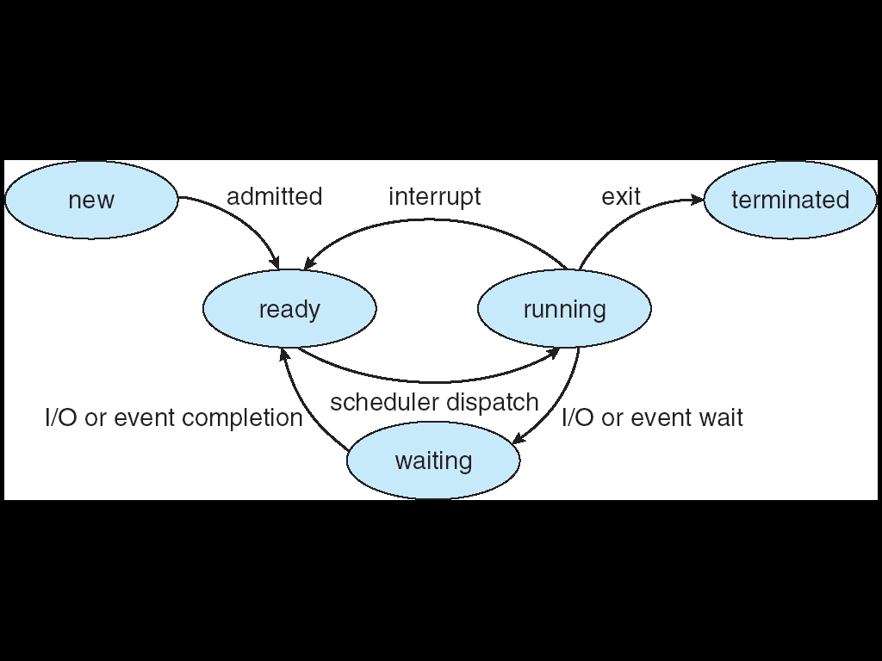
Diagram of Process State
yield()
time-slice (quantum) expired (Timer preemptive)
higher priority process (preemptive)
UNIX：
zombie，僵死
如去银行办理业务，接受业务员服务、填写相关表格、被抢先等事件导致状态转换

Slide 25
Process State—New--in Nachos
new: The process is being created
This process is not ready to run yet, because
Its stack has not been allocated.
Its control block has not been initialized yet either.
In particular, it does not have the initial value for PC (program counter)
it does not know where to start if it is scheduled to run.
….
进程运行所需的信息还不完整，尚无法执行

Slide 26
Process State—New--in Nachos
In Nachos, class Thread defines a thread
Its constructor only declares some private members, such as
stack, registers and state
But not initialize them
Therefor its state is “NEW” or “JUST CREATED.”
当调用fork()后，进程状态便由“JUST CREATED”变为ready
请参阅 Nachos中code/threads中的相关代码

Slide 27
Process State--New
Thread::Thread(char* threadName) //Nachos
{
name = threadName;
stackTop = NULL;
stack = NULL;
status = JUST_CREATED;
#ifdef USER_PROGRAM
space = NULL;
#endif
}

Slide 28
Nachos: Functions in class Thread
void Fork(VoidFunctionPtr func, _int arg); (NEW→READY)
Make thread run (*func)(arg)
void Yield(); (RUNNING→READY)
Relinquish the CPU if any other thread is runnable
Make the transition from state RUNNING to READY if the ready queue is not empty
void Sleep(); (RUNNING →WAITING )
Put the thread to sleep and relinquish the processor
Make the transition from RUNNING to WAITING or BLOCKED and make a context switch to a thread from the ready queue
void Finish(); (RUNNING→TERMINATED)
The thread is done executing
Make the transition from RUNNING to TERMINATED

Slide 29
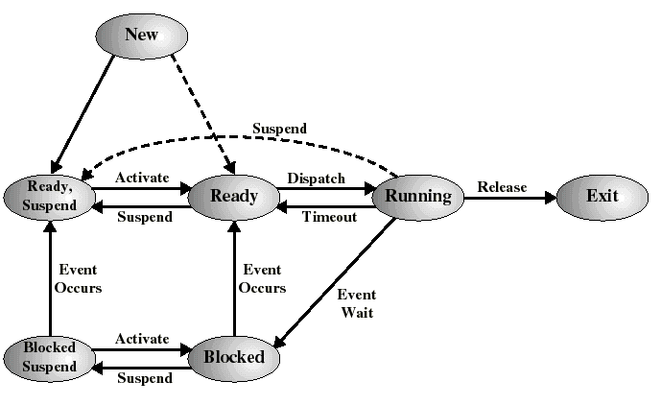
进程七状态转换图
挂起
活动
调度
释放
挂起
超时
事件
发生
事件
发生
等待
事件
活动
挂起
如景区游人调控,休学

Slide 30
suspend vs. block activity vs. wakeup
suspend (挂起)
active→static
activate (激活)
static → active
blocked(waiting,sleeping) (阻塞、等待、睡眠)
running→waiting
wakeup (唤醒)
waiting →ready

Slide 31
Process State in Linux
TAKS_RUNNING
The process is either executing on a cpu or waiting to be executed.
TASK_INTERRUPTIBLE
The process is suspended until some condition becomes true.
TASK_UNINTERRUPTIBLE
When it is in this state, a process must wait until a given event occurs without being interrupted. (保证代码执行的原子性)
TASK_STOPPED
Process execution has been stopped;
TASK_TRACED
Process execution has been stopped by a debugger.
EXIT_ZOMBIE
Process execution is terminated, but the parent process has not yet issued a wait() or waitpid system call to return information about the dead process.
EXIT_DEAD
The final state: the process is removed by the system because the parent process has just issued wait() or waitpid() system call for it.

Slide 32

单选题
答案解析
1分
答案解析
下列选项中，导致创建新进程的操作是（）。
I. 用户成功登录系统 II. 设备分配 III. 启动程序执行
此题未设置答案，请点击右侧设置按钮
C
A
仅 I 和 II
B
仅 II 和 III
C
仅 I 和 III
D
I 、II、 III
提交
可为此题添加文本、图片、公式等解析，且需将内容全部放在本区域内。正常使用需3.0以上版本

Slide 33
单选题
答案解析
1分
答案解析
下列选项中，会导致进程从执行态变为就绪态的事件是（）。（2015）
此题未设答案
D
A
执行P（或wait）操作
B
申请内存失败
C
启动I/O设备
D
被高优先级进程抢占
提交
可为此题添加文本、图片、公式等解析，且需将内容全部放在本区域内。正常使用需3.0以上版本

Slide 34
单选题
答案解析
1分
答案解析
此题未设置答案，请点击右侧设置按钮
若一个用户进程通过read系统调用读取一个磁盘文件中的数据，则下列关于此过程的叙述中，正确的是（）。
I、若该文件的数据不在内存，则该进程进入睡眠等待状态
II、请求read系统调用会导致CPU从用户态切换到核心态
III、read系统调用的参数应该包含文件的名称
A
A
仅 I、II
B
仅 II
C
仅 III
D
I、II、III
提交
可为此题添加文本、图片、公式等解析，且需将内容全部放在本区域内。正常使用需3.0以上版本

Slide 35
回顾：进程在系统中的建模
操作系统引入进程的概念后，需要解决的一些问题
如：
系统中如何表达（表示）一个进程？如何感知一个进程的存在？
类比
一个单位如何知道一个员工的有关信息？
为每个职工建立档案
为进程创建一个结构体，保存进程的有关信息，称为PCB

Slide 36
3.1.3 Process Control Block (PCB)
PCB
系统为了管理进程设置的一个专门的数据结构，用它来记录进程的外部特征，描述进程的运动变化过程
系统利用PCB来控制和管理进程，所以PCB是系统感知进程存在的唯一标志
进程与PCB是一一对应的
通常，进程队列，实际上是进程所对应的PCB队列
类比：银行取号、面试简历

Slide 37
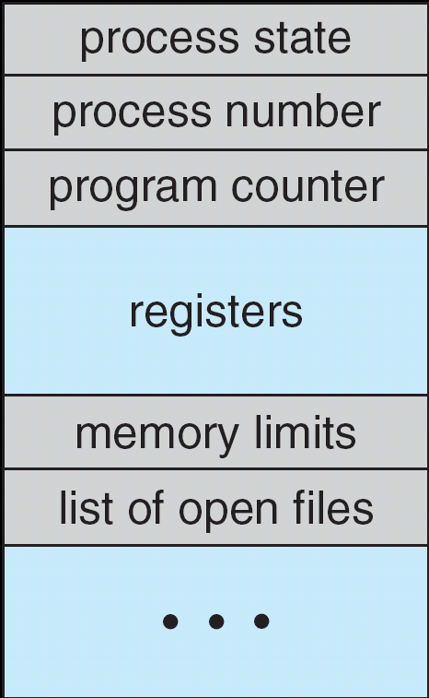
Process Control Block (PCB)
机器猫

Slide 38
Process Control Block (PCB)
Information associated with each process (PCB)
Process state – new, ready, running, waiting, halted, etc.
Program counter – location of instruction to next execute
CPU registers – contents of all process-centric registers, this state information must be saved when an interrupt occurs, to allow the process to be continued correctly afterward (fig. 3.4)
CPU scheduling information - priorities, scheduling queue pointers
Memory-management information – memory allocated to the process
Accounting information – CPU used, clock time elapsed since start, time limits
I/O status information – I/O devices allocated to process, list of open files

Slide 39
Process Control Block (PCB)
Information associated with each process.
Process number
Process state
Program counter (PC)
CPU registers (fig. 3.4)
CPU scheduling information
Memory-management information
Accounting information
File status information
I/O status information
Pointer to next PCB
机器猫

Slide 40
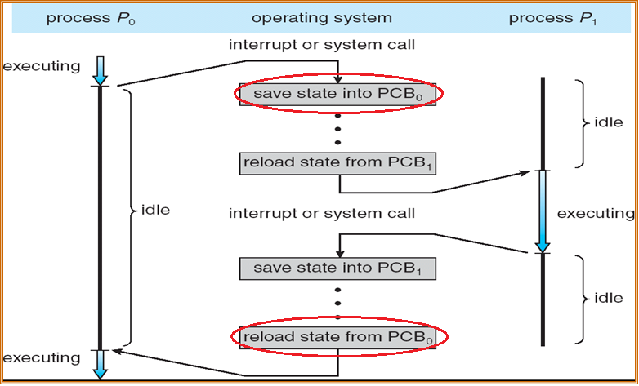
PCB– CPU registers (context)
Figure 3.4 CPU Switch From Process to Process

Slide 41
Process Control Block (PCB)
PCB是进程存在的唯一标志；
操作系统通过PCB而感知进程的存在；

Slide 42
Process Control Block (PCB)
PCB表：
系统把所有PCB组织在一起，并把它们放在内存的固定区域，就构成了一个系统全局的PCB表
PCB表的大小决定了系统中最多可同时存在的进程个数，称为系统的并发度
一个进程与一个PCB是一一映射
一个进程从创建到撤销，其对应的PCB可能要在多个PCB队列中来回穿梭

Slide 43
Process Control Block (PCB)
链接结构：同一状态进程的PCB组成一个链表，不同状态的进程对应多个不同的链表
就绪链表、阻塞链表, ...
索引结构：对具有相同状态的进程，分别设置各自的PCB索引表，表明PCB在PCB表中的地址

Slide 44
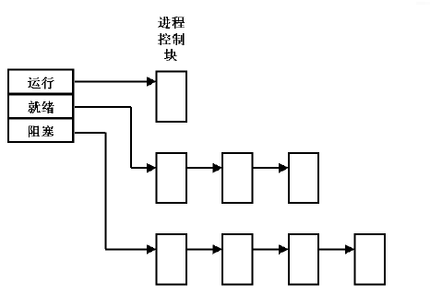
链接结构

Slide 45
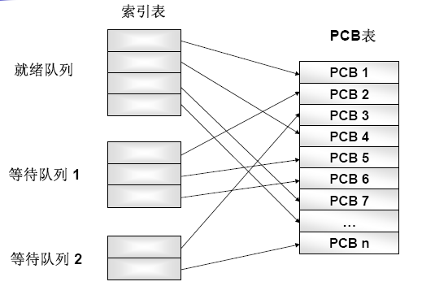
索引结构

Slide 46
单选题
答案解析
1分
答案解析
此题未设置答案，请点击右侧设置按钮
单处理机系统中，可并行的是（）。
进程与进程 II. 处理机与设备
III. 处理机与通道 IV. 设备与设备
(2009)
D
A
I、II、III
B
I、II、IV
C
I、III、IV
D
II、III、IV
提交
可为此题添加文本、图片、公式等解析，且需将内容全部放在本区域内。正常使用需3.0以上版本

Slide 47
Process Scheduling Queues
3.2 Process Scheduling
Job queue – set of all processes in the system
As processes enter the system, they are put into a job queue
Usually not in main memory yet
Ready queue – set of all processes residing in main memory, ready and waiting to execute (waiting for CPU)
Device queues – set of processes waiting for an I/O device
Processes migrate among the various queues
景区

Slide 48
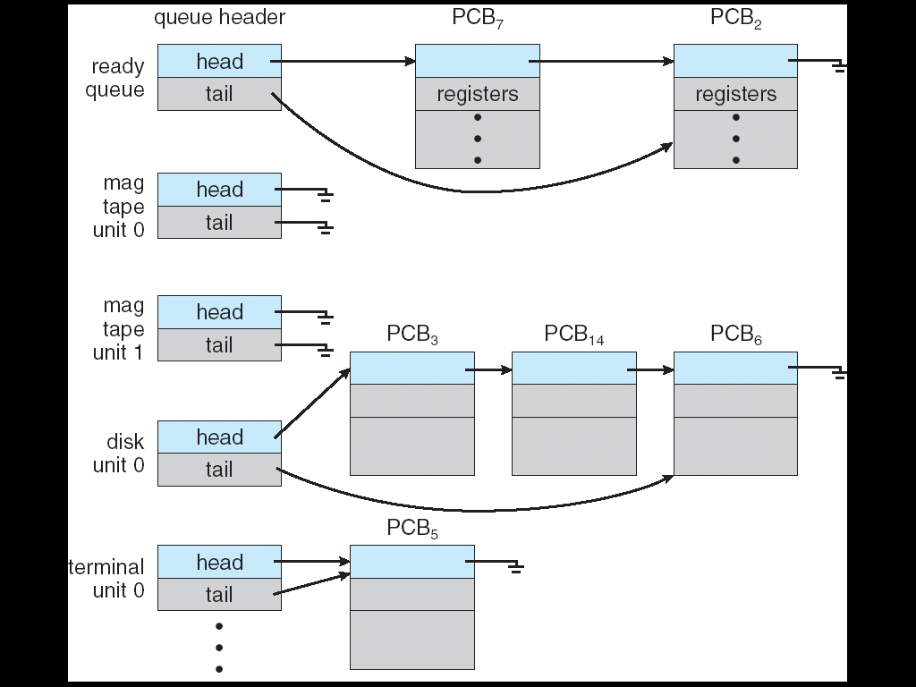
Ready Queue And Various I/O Device Queues

Slide 49
Schedulers
Short-term scheduler (or CPU scheduler)
Long-term scheduler (or job scheduler)
Medium-term Scheduler (Swapping)

Slide 50
Short-term Schedulers
Short-term scheduler (or CPU scheduler) – selects which process should be executed next and allocates CPU
Short-term scheduler is invoked frequently (milliseconds) ⇒ (must be fast)
Controls the utilization of CPU, and system throughput (调度算法)

Slide 51
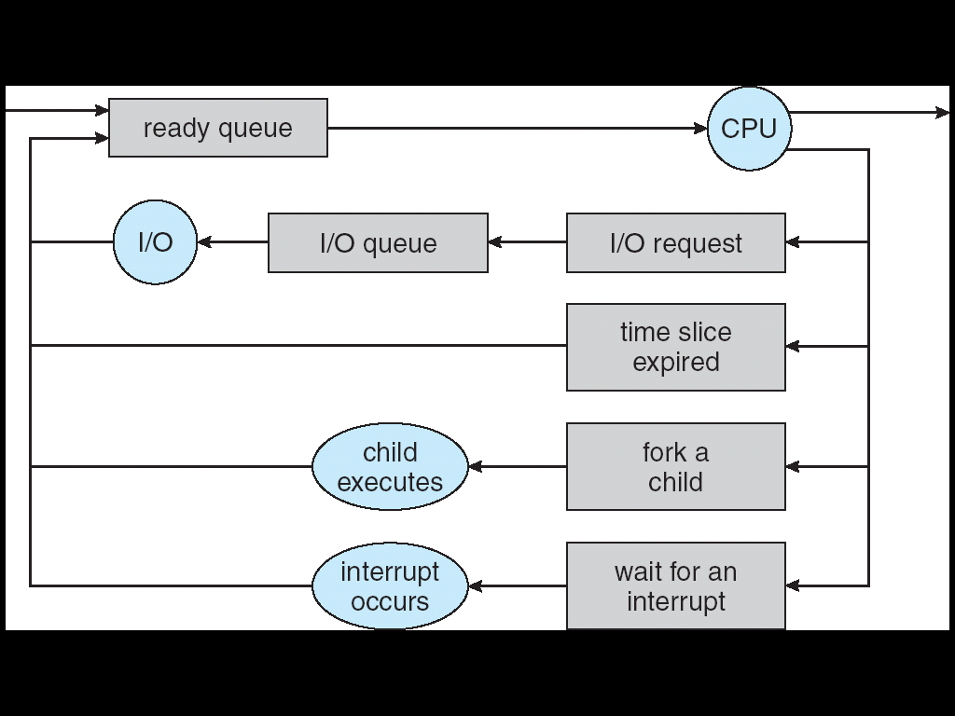
Representation of Process Scheduling
Queueing diagram represents queues, resources, flows
执行结束
new
I/O完成
yield()
父子进程可以并发执行；
一般父进程等待子进程结束；
因中断而释放CPU

Slide 52
Long-term Scheduler
Usually used in batch system
In a batch system, more processes are submitted than can be executed immediately.
These processes are spooled to a mass-storage device (typically a disk), where they are kept for later execution.
Long-term scheduler (or job scheduler) – selects which processes should be loaded into memory and be brought into the ready queue from the pool.
Long-term scheduler is invoked infrequently (seconds, minutes) ⇒ (may be slow)
The long-term scheduler controls the degree of multiprogramming （ the number of processes in memory）

Slide 53
Long-term Scheduler
Processes can be described as either:
I/O-bound process – spends more time doing I/O than computations, many short CPU bursts
CPU-bound process – spends more time doing computations; few very long CPU bursts
Long-term scheduler strives for good process mix
长程调用，或作业调用，可以根据作业的特点（计算型，I/O型）平衡系统中CPU与设备、设备与设备之间的平衡

Slide 54
Long-term Scheduler--features
Long-term scheduler is invoked infrequently (seconds, minutes) ⇒ (may be slow)
The long-term scheduler controls the degree of multiprogramming （ the number of processes in memory）
Long-term scheduler strives for good process mix

Slide 55
类比
长程调度（作业调度） vs. 短程调度（进程调度）
XXX包子铺
xxx包子铺

Slide 56
UNIX，Windows--No Long-term Scheduler
On some systems, such as time-sharing systems, the long-term scheduler may be absent or minimal.
UNIX and Microsoft Windows systems often have no long-term scheduler
Simply put every new process in memory for the short-term scheduler.
思考：
How to controls the degree of multiprogramming on time-sharing systems?

Slide 57
UNIX，Windows--No Long-term Scheduler
How to controls the degree of multiprogramming on time-sharing systems?
If the performance declines to unacceptable levels on a multiuser system
Solution: Simply quit some users
If the memory is insufficient
Solution: Leaves some ready processes on the disk
UNIX: “ready in memory” or “ready not in memory”
(参见：UNIX操作系统设计，P114，进程状态之间的转换)
Addition of Medium Term Scheduling

Slide 58
Short-term vs. Long-term scheduler
Long-term scheduler
invoked infrequently
controls the degree of multiprogramming
strives for good process mix of I/O-bound and CPU-bound processes, in order to balance the utilization of CPU and I/O devices.
Short-term scheduler
invoked frequently
Controls the utilization of CPU, and system throughput
游园人数调控
**包子铺

Slide 59
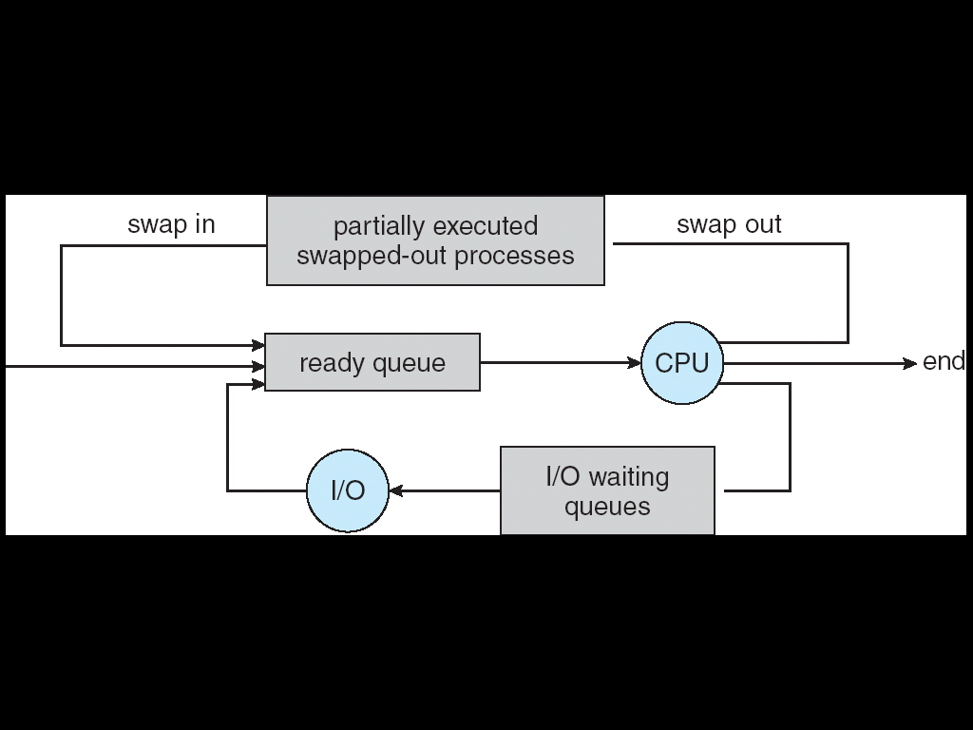
Addition of Medium Term Scheduling
Medium Term Scheduler – can be added if degree of multiple programming needs to decrease
Remove process from memory, store on disk, bring back in from disk to continue execution: swapping
Selects which process should be swapped in or swapped out.
走出去，请进来

Slide 60
3.2.3 Context Switch
Switching the CPU to another process requires performing a state save of the current process and a state restore of a different process. This task is known as a context switch.
当发生上下文切换时，内核将旧进程的状态保存到其PCB中，然后从新进程的PCB中恢复先前保存的上下文
Context of a process represented in the PCB

Slide 61
Context Switch
Context-switch time is overhead; the system does no useful work while switching
The more complex the OS and the PCB ➔ the longer the context switch
Time dependent on hardware support
Memory speed, the number of registers that must be copied, and the existence of special instructions
E.g. 如果CPU能够提供一条指令，用来保存或恢复所有寄存器的内容，将会缩短上下文切换的时间
With multiple sets of registers, a context switch simply includes changing the pointer to the current register set.
如 Sun UltraSPACK提供了多组寄存器集合，进程上下文切换仅仅改变当前寄存器组的指针即可
With one set of registers, …

Slide 62
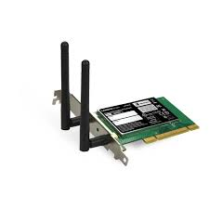
Switching Processes
Compiled
Program 1
Compiled
Program 2
System Libs
System Libs
Compiler
Process 1
Process 2
Threads
Address Spaces
Files
Sockets
Threads
Address Spaces
Files
Sockets
Operating System
ISA
Processor
PgTbl
& TLB
Memory
Storage
Networks
Hardware
OS
Mem
I/O Ctrlr

Slide 63
Switching Processes
Compiled
Program 1
Compiled
Program 2
System Libs
System Libs
Compiler
Process 1
Process 2
Threads
Address Spaces
Files
Sockets
Threads
Address Spaces
Files
Sockets
Operating System
ISA
Processor
PgTbl
& TLB
Memory
Storage
Networks
Hardware
OS
Mem
I/O Ctrlr

Slide 64
Switching Processes
Compiled
Program 1
Compiled
Program 2
System Libs
System Libs
Compiler
Process 1
Process 2
Threads
Address Spaces
Files
Sockets
Threads
Address Spaces
Files
Sockets
Operating System
ISA
Processor
PgTbl
& TLB
Memory
Storage
Networks
Hardware
OS
Mem
I/O Ctrlr

Slide 65
Switching Processes
Compiled
Program 1
Compiled
Program 2
System Libs
System Libs
Compiler
Process 1
Process 2
Threads
Address Spaces
Files
Sockets
Threads
Address Spaces
Files
Sockets
Operating System
ISA
Processor
PgTbl
& TLB
Memory
Storage
Networks
Hardware
OS
Mem
I/O Ctrlr

Slide 66
Switching Processes
Compiled
Program 1
Compiled
Program 2
System Libs
System Libs
Compiler
Process 1
Process 2
Threads
Address Spaces
Files
Sockets
Threads
Address Spaces
Files
Sockets
Operating System
ISA
Processor
PgTbl
& TLB
Memory
Storage
Networks
Hardware
OS
Mem
I/O Ctrlr

Slide 67
Switching Processes
Compiled
Program 1
Compiled
Program 2
System Libs
System Libs
Compiler
Process 1
Process 2
Threads
Address Spaces
Files
Sockets
Threads
Address Spaces
Files
Sockets
Operating System
ISA
Processor
PgTbl
& TLB
Memory
Storage
Networks
Hardware
OS
Mem
I/O Ctrlr

Slide 68
Context Switch
关于上下文切换的更多细节请参阅
《Unix操作系统设计》第122页6.3节--“进程的上下文”
Nachos：
code/threads/scheduler.cc中的Scheduler::Run()，以及调用该方法的代码
code//threads/ switch-linux.s中的SWITCH()

Slide 69
回顾
操作系统为什么引入进程的概念？

Slide 70
回顾
操作系统为什么引入进程的概念？
描述可执行程序的一次运行活动
进程申请资源，系统为进程分配资源
代码、数据的内存空间
堆、栈
PC等寄存器
分配的I/O、打开的文件等信息
PCB
…
通过PCB感知进程的存在
参与CPU调度 (时间片、优先级、状态的改变、上下文切换)
进程之间的协作、同步、通信等
可以同时运行一个程序的多个实例（i.e. word, ppt,ie等）
…
4

Slide 71
单选题
答案解析
1分
答案解析
下列选项中，不可能在用户态发生的事件是（）。
此题未设置答案，请点击右侧设置按钮
C
A
系统调用请求
B
外部中断
C
进程切换
D
缺页
提交
可为此题添加文本、图片、公式等解析，且需将内容全部放在本区域内。正常使用需3.0以上版本

Slide 72
3.3 Operations on Process
Process Creation
Process Termination

Slide 73
3.3.1 Process Creation
A process may create several new processes, via a create-process system call, during the course of execution.
Parent process create children processes, which, in turn create other processes, forming a tree of processes
Generally, process identified and managed via a process identifier (pid)
成吉思汗

Slide 74
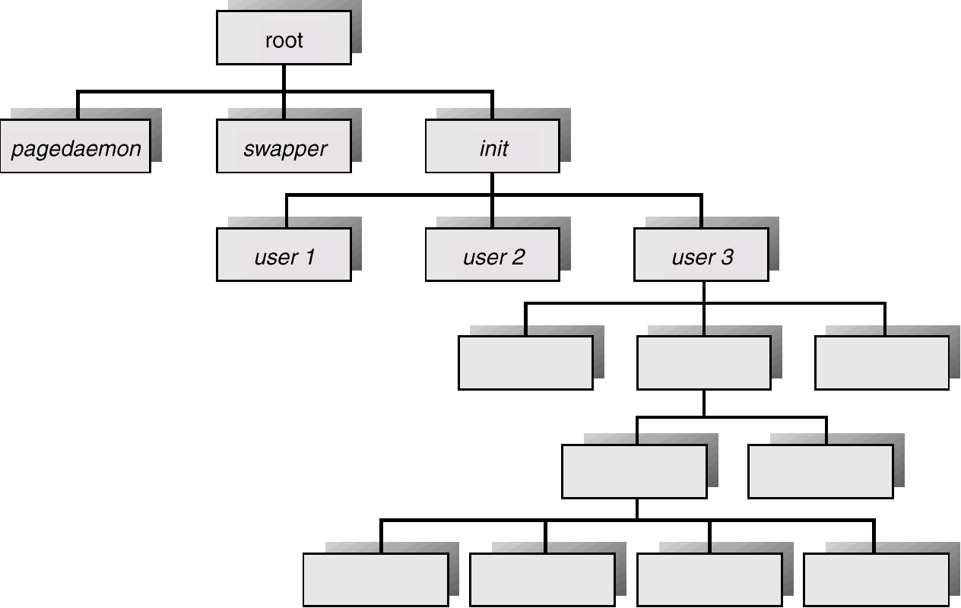
Processes Tree on a UNIX System
1号进程是系统中除0号进程以外其它进程的祖先进程(init)
用户登录系统后，该进程为用户创建相应的用户进程
该用户进程依次创建该用户的其它进程
1号进程
0号进程
系统引导时创建0号进程（系统中唯一一个不需要通过fork()创建的进程）
然后0号进程利用系统调用fork()进程创建1号进程
0进程就变成对换进程(swaper)；

Slide 75
UNIX中的进程0与进程1
0进程-是一个特殊进程，它是在系统引导时被创建的；
1进程--当0进程创建了一个子进程1后，0进程就变成对换进程(swaper)；
1进程被称为init进程，是系统中其他每个进程的祖先；
进程0 是系统中唯一不通过fork()创建的进程；

Slide 76
A Tree of Processes in Linux

Slide 77
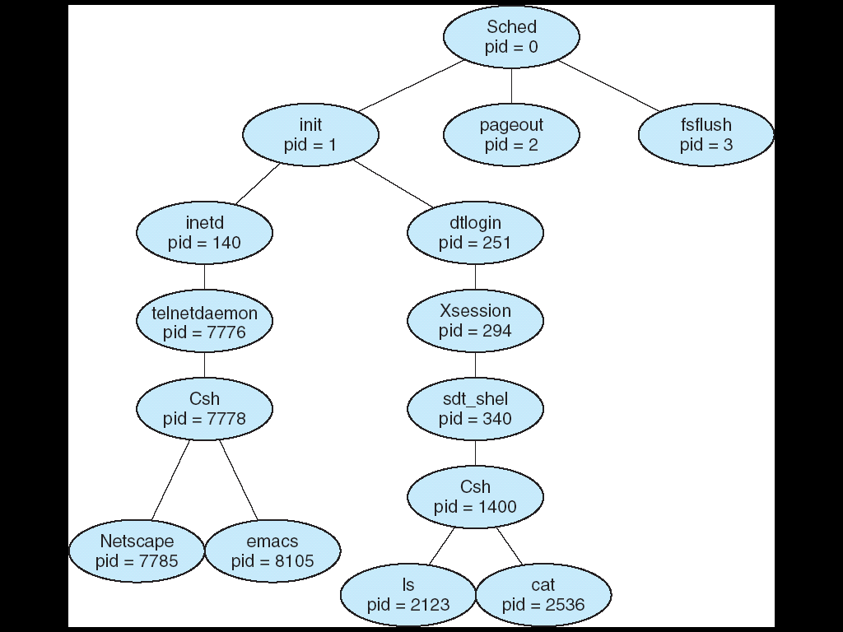
A tree of processes on a typical Solaris

Slide 78
Process Creation
父进程可以创建众多的子进程
父子进程之间应该如何协调它们之间的资源、地址空间（执行代码）、执行过程等相关问题
Resource sharing options
Parent and children share all resources
Children share subset of parent’s resources
Parent and child share no resources
Address space options
Child duplicate of parent
Child has a program loaded into it
Execution optons
Parent and children execute concurrently
Parent waits until children terminate
成吉思汗

Slide 79
Process Creation (UNIX)
UNIX中，fork() system call creates a new process
Resource sharing
子进程继承父进程在子进程创建之前父进程所拥有的所有资源
子进程创建之后，父子进程开始资源分离 （先继承，后分离）
Address space
内核为子进程做一个父进程的上下文的拷贝；
PCB中的有关信息，代码，数据，栈
PCB中的信息：打开的文件,当前工作目录, PC,SP,…..
父进程和子进程在不同的地址空间上运行；
子进程可以装入并执行自己的程序
Execution
父子进程可以并发执行
通常父进程在结束之前，需要等待子进程结束

Slide 80
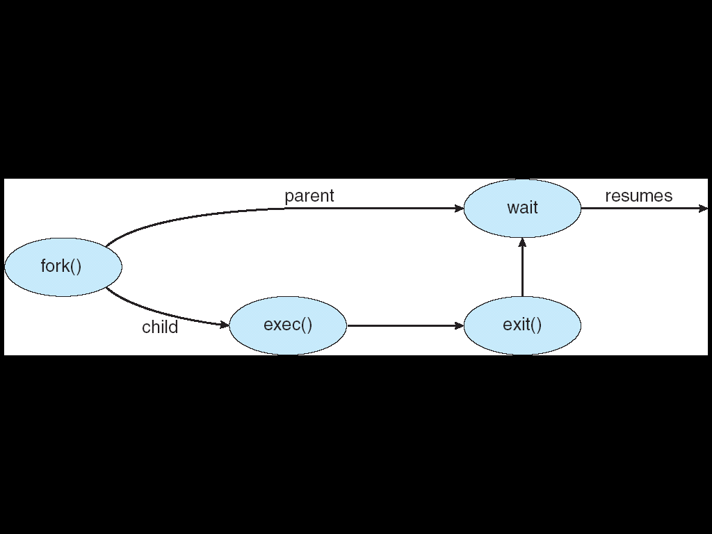
Process Creation (UNIX examples)
UNIX examples
fork() system call creates new process
exec() system call used after a fork() to replace the process’ memory space with a new program
parent
父子外出：父等子

Slide 81
Threads in Java
Java中当利用继承Thread类或实现Runnable接口创建一个线程，然后调用线程的start()方法，系统中涉及到几个线程
例如：
public class testThread {
public static void main(String[] args) {
Task task=new Task();
Thread thread_1=new Thread(task);
thread_1.start();
// thread_1.run() //与上条语句的执行过程有何区别?
System.out.println(“Hello ”);
}
}
class Task implements Runnable {
public void run() {
System.out.println(“World ”);
}
}
问：
1、语句thread_1.start()执行后，JVM中有几个与该程序有关的线程在运行
2、程序的运行结果是什么？
3、 thread_1.start()与 thread_1.run()有何区别？

Slide 82
Thread.start() in Java (Cont.)
官方注释：
public void start()
Causes this thread to begin execution; the Java Virtual Machine calls the run method of this thread.
The result is that two threads are running concurrently: the current thread (which returns from the call to the start method) and the other thread (which executes its run method).
It is never legal to start a thread more than once. In particular, a thread may not be restarted once it has completed execution.

Slide 83
Thread.start() in Java (Cont.)
Java中调用thread.start()
例如：
public class testThread {
public static void main(String[] args) {
Task task=new Task();
Thread thread_1=new Thread(task);
thread_1.start(); // thread_1.run() //…
System.out.println(“Hello ”);
}
}
class Task implements Runnable {
public void run() {
System.out.println(“World ”);
}
}
Answer：
1、有两个线程在并发执行，一个是调用startt()的线程，这里就是JVM为main()创建的主线程，另一个是主线程创建的子线程，执行Task 中的run()方法
2、理论上讲，程序的执行结果可能是 Hello World, 也可能是World Hello
3、 thread_1.start()：父子线程并发执行；
thread_1.run()：父线程调用执行子线程的run()，顺序执行（在父线程的上下文中执行子线程）

Slide 84
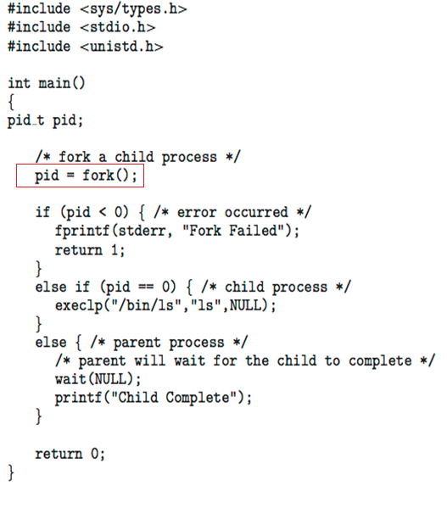
C Program Forking Separate Process

Slide 85
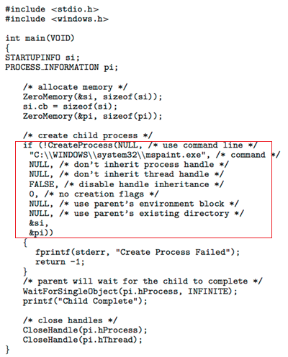
Creating a Separate Process via Windows API

Slide 86
UNIX：系统调用fork--创建一个新的进程上下文
代码
数据
用户栈
代码
数据
用户栈
更多细节请参阅“UNIX操作系统设计”—P147, 7.1节

Slide 87
System call fork()
语法：int pid=fork(); 或 pid_t pid=fork(); （ 头文件：sys/types.h ）
内核为系统调用fork完成下列操作：
为子进程在进程表中分配一个空项（empty slot）(PCB)
为子进程赋予一个唯一的进程标识号(PID)
为子进程分配独立的（内存）地址空间
复制父进程的上下文到子进程的地址空间
将父进程的PCB、数据、栈、PC等内容到子进程的相应地址空间中
对于代码：子进程可能调用exec()装入一个新的程序而覆盖父进程的代码，因此有的系统不真正将父进程的代码复制到一个新的内存物理区，只是增加该取的引用数即可。
注：子进程的PCB中有父进程访问的文件、设备、运行环境等，如打开的文件，PC等；
栈中有局部变量；
对父进程返回子进程的进程号，对子进程返回零。
课后阅读：了解 vfork() 的功能与设计理念

Slide 88
思考： fork()后，子进程从何处开始执行
fork()系统调用为子进程复制了父进程的上下文
包括复制了PC、SP等内容
思考：父子进程处于不同的地址空间中
按照一般理解
父子进程在不同的地址空间中运行
PC、SP中的内容不应该相同，应该不同
父子进程才可以分别执行自己的代码
复制PC、SP等内容有何用处？

Slide 89
思考： fork()后，子进程从何处开始执行
os
PC的内容：
现在的操作系统中，PC给出的指令地址不是物理内存地址，只是一个相对地址。
是相对于进程起始位置的一个偏移量
CPU中的MMU负责将PC中的内容转换为真实的物理地址，然后送到地址总线上去对物理内存进行寻址
….
父进程
pid=fork()
PC的值
PC
….
测试
在父进程中声明一个变量a
输出a的地址
fork一个子进程后，在子进程中输出a的地址
两个地址是相同的
变量a的地址对于父子进程来说，其偏移量是相同的
子进程
pid=fork()
PC的值
PC
….

Slide 90
思考： fork()后，子进程从何处开始执行
子进程继承了父进程的PC、SP
尽管父子进程PC、SP的值相同，父子进程访问的是不同地址空间中的内存区域
因此，父子进程在各自的地址空间中，均从fork()之后的语句开始执行

Slide 91
算法：fork
输入：无
输出：对父进程是子进程的 PID
对子进程是0
{ 检查可用的核心资源
取一个空闲的进程表项和唯一的 PID 号
检查用户没有过多的运行进程
将子进程的状态设置为“创建”状态（new）
将父进程的进程表中的数据拷贝到子进程表中
当前目录的索引节点和改变的根目录(如果可以)的引用数加1
文件表中的打开文件的引用数加1
在内存中作父进程上下文的拷贝(U area, text,data,stack)
在子进程的系统级上下文中压入虚设系统级上下文层
/* 虚设上下文层中含有使子进程能识别自己的数据，并使子进程被调度时
从这里开始运行 */
if (正在执行的进程是父进程)
{ 将子进程的状态设置为“就绪”状态
return (子进程的 PID) // 给父进程返回子进程的进程号 }
else
{ 初始化u area的计时区
return 0; } // 给子进程返回0
} //参见《UNXI操作系统设计》 P148

Slide 92
System call fork()
fork()的返回值
如果正确执行
给父进程，返回非0的正整数（子进程的进程号）
给子进程，返回0
如果出现错误（未成功创建）
返回 -1
fork()的功能
内核为子进程做一个父进程上下文的拷贝；
复制父进程的PCB作为子进程的PCB
在新的地址空间中复制父进程的一个拷贝（有不同的实现）
关于资源
创建子进程之前父进程的的资源：子进程继承
创建子进程之后进程的资源：各自独立
父进程和子进程在不同的地址空间上运行；

Slide 93
Pid=fork()的返回值
os
父进程中执行pid=fork()
父子进程的地址空间中各有一个变量pid
操作系统内核给父进程中的pid返回子进程的进程号（pid>0）
操作系统内核给子进程中的pid返回0）
….
父进程
pid=fork()
pid:子进程号
….
子进程
pid=fork()
pid:0
….

Slide 94
fork的几个要点
父子进程具有独立的地址空间
父子进程资源的共享与分离
父进程中在fork之前创建的变量—继承
PCB：除进程号以外的所有内容
变量：父进程所拥有的全局、局部变量等
文件描述符：父进程打开的文件、设备描述符
缓冲区：如c中printf()语句所使用的输出缓存
…
fork之后各自创建的变量—分离
PCB、栈、堆：各自新增或修改的内容，独立
变量：各自新定义或修改，独立
文件描述符：存储文件描述符的变量各自独立，对文件的操作也完全独立
注意：尽管各进程对文件的访问是独立的，但可能互相影响文件中的内容
缓冲区，如输出缓存
….

Slide 95
fork()--进一步讨论
父子进程各自的执行代码及父子进程的执行
子进程继承父进程的缓存
父与子---系统调用exec()、wait()
子进程继承父进程的变量
父进程如何创建多个子进程
子进程继承父进程的I/O
与实验有关的几个系统调用

Slide 96
fork()例—父子进程的执行代码
#include <stdio.h>
#include <unistd.h> //fork()
#include <sys/types.h> //pid_t
main()
{
pid_t pid; //int pid;声明一个整型变量pid，用于保存fork()的返回值
printf("hello\n");
pid=fork();
if (pid = = 0)
printf ("world\n");
}
// 程序的执行结果什么？
//注意父子进程的地址空间，资源继承与分离的问题

Slide 97
fork()例 (续)
//父进程
#include <stdio.h>
#include <unistd.h> //fork()
#include <sys/types.h> //pid_t
main()
{
pid_t pid;
printf(“hello\n”);
pid=fork();
if (pid = = 0) //false
printf (“world\n”);
}
//子进程
#include <stdio.h>
#include <unistd.h> //fork()
#include <sys/types.h> //pid_t
main()
{
pid_t pid;
printf(“hello\n”);
pid=fork();
if (pid = = 0) //true
printf (“world\n”);
}
hello
world

Slide 98
fork()例 (续)
进程的执行结果
父进程输出 “hello”
子进程输出 “world”
屏幕输出：（顺序固定）
hello
world

Slide 99
fork()—比较1
#include <stdio.h>
#include <unistd.h> //fork()
#include <sys/types.h> //pid_t
main()
{
pid_t pid;
pid=fork();
if (pid = = 0)
printf (“hello\n”);
else
printf(“world\n”);
}
// 程序的执行结果什么？

Slide 100
fork()—比较1
//父进程
#include <stdio.h>
#include <unistd.h> //fork()
#include <sys/types.h> //pid_t
int main()
{
pid_t pid;
pid=fork();
if (pid = = 0) //false
printf (“hello\n”);
else
printf(“world\n”);
}
//子进程
#include <stdio.h>
#include <unistd.h> //fork()
#include <sys/types.h> //pid_t
main()
{
pid_t pid;
pid=fork();
if (pid = = 0) //true
printf (“hello\n”);
else
printf(“world\n”);
}
hello
world

Slide 101
fork()—比较1
程序执行结果：
父进程输出：world
子进程输出：hello
屏幕显示：
理论上，顺序不确定

Slide 102
fork()—比较2
#include <stdio.h>
#include <unistd.h> //fork()
#include <sys/types.h> //pid_t
main()
{
pid_t pid;
pid=fork();
if (pid = = 0)
printf (“hello\n”);
printf(“world\n”);
}
// 程序的执行结果什么？

Slide 103
fork()—比较2
//父进程
#include <stdio.h>
#include <unistd.h> //fork()
#include <sys/types.h> //pid_t
int main()
{
pid_t pid;
pid=fork();
if (pid = = 0) //false
printf (“hello\n”);
printf(“world\n”);
}
//子进程
#include <stdio.h>
#include <unistd.h> //fork()
#include <sys/types.h> //pid_t
int main()
{
pid_t pid;
pid=fork();
if (pid = = 0) //true
printf (“hello\n”);
printf(“world\n”);
}
hello
world
world

Slide 104
Fork()—比较2
结果：
父进程输出：world
子进程输出：hello
world
屏幕显示：
一般情况下：world (父)
hello (子)
world (子)
输出顺序是否一定是如上所示？
子进程输出“hello”，“world”的顺序是固定的
理论上讲，父子进程输出顺序不确定

Slide 105
fork()--进一步讨论
父子进程各自的执行代码及父子进程的执行
子进程继承父进程的缓存
父与子---系统调用exec()、wait()
子进程继承父进程的变量
父进程如何创建多个子进程
子进程继承父进程的I/O
与实验有关的几个系统调用

Slide 106
关于输出缓存 例1
//sample 1
int main()
{
printf(“Hi, there!”);
return 0;
}
// 程序的执行结果？
//sample 2
int main()
{
printf(“Hi, there!\n”);
return 0;
}
// 程序的执行结果？
//sample 3
int main()
{
printf(“Hi, there!”);
fflush(stdout);
return 0;
}
// 程序的执行结果？
均输出Hi, there!”，因为进程退出时均自动清空缓存

Slide 107
关于输出缓存 例2
//sample 1
int main()
{
printf(“Hi, there!”);
pause();
// for (;;);
return 0;
}
// 程序的执行结果？
//sample 2
int main()
{
printf(“Hi, there!\n”);
pause();
// for (;;);
return 0;
}
// 程序的执行结果？
//sample 3
int main()
{
printf(“Hi, there!”);
fflush(stdout)
pause();
return 0;
}
// 程序的执行结果？
注：pause()—暂停进程的执行，进程进入等待状态，等待某个信号的发生；
这里的目的是防止进程运行结束退出，而自动将缓存的数据输出；
pause() 默认是等待ctrl-c信号，进程收到该信号后，默认的操作是终止进程；

Slide 108
关于输出缓存例2（续）
//sample 1
int main()
{
printf(“Hi, there!”);
pause();
// for (;;);
return 0;
}
// 屏幕无输出
//sample 2
int main()
{
printf(“Hi, there!\n”);
pause();
return 0;
}
// 屏幕输出Hi, there!
//sample 3
{
printf(“Hi, there!”);
fflush(stdout)
pause();
return 0;
}
// 屏幕输出Hi, there!
系统将Buffer中的内容输出到设备的几种情况：
1、缓冲区满
2、C语句 fflush(stdout)
3、printf()函数中”\n”，”\r”等转义符
4、C语句scanf()
5、程序终止退出
6、…
注：“\n”, fflush(stdout)都有清空输出缓存的功能

Slide 109
fork()—继承缓存
//sample 1
int main()
{
printf(“Hi, there!”);
pid=fork();
}
// 程序的执行结果什么？
//sample 2
int main()
{
printf(“Hi, there! \n”);
pid=fork();
}
// 程序的执行结果什么？
//sample 3
int main()
{
printf(“Hi, there!”);
fflush(stdout);
pid=fork();
}
// 程序的执行结果什么？

Slide 110
fork()—继承缓存（续）
//sample 1
main()
{
printf(“Hi, there!”);
pid=fork();
}
// 程序的执行结果什么？
//sample 2
main()
{
printf(“Hi, there! \n”);
pid=fork();
}
// 程序的执行结果什么？
//sample 3
main()
{
printf(“Hi, there!”);
fflush(stdout);
pid=fork();
}
// 程序的执行结果什么？
输出两次“Hi, there!”;
子进程继承了父进程的缓存及缓存中的数据。
仅父进程输出“Hi, there!”
子进程继承了父进程一个空的缓存。
仅父进程输出“Hi, there!”
子进程继承了父进程一个空的缓存。

Slide 111
fork()—继承缓存
对于sample 1，“Hi, there!”输出两次，父子进程各输出一次；
父进程的输出语句printf(“Hi, there!”)将字符串”Hi, there!”送入缓存
注：但尚未输出到屏幕，当缓存写满后，再往缓存写入数据，系统会将缓存的内容一次性写出，并将新数据写入已清空的缓存中；
子进程继承了父进程的缓存(内容为“Hi, there!”)；
一般情况下，进程退出后，系统会自动清空缓存
当父进程执行完退出，系统自动清空父进程的缓存，将Hi, there!输出到屏幕；
当子进程执行完退出，系统自动清空子进程的缓存，将Hi, there!输出到屏幕；
因此， “Hi, there!”输出两次，父子进程各输出一次；

Slide 112
fork()—继承缓存
对于sample 2，sample 3，仅父进程输出”Hi, there!”
“\n”，fflush(stdout); 都有清空缓冲器的功能(将缓存的内容输出到指定的设备或文件)
尽管子进程继承了父进程的缓冲器，但父进程已经将缓存清空，因此子进程没有内容输出。

Slide 113
关于缓存—启示
使用printf()输出内容到屏幕时，适时地使用printf(“\n”)，否则只有当显示缓存满后才将内容一次性地输出；
一般系统为I/O默认设置大小为1KB的buffer；
例如调试程序时利用printf()跟踪调试系统的执行，如果在某一位置加入语句printf(“Reach position 1”)，可能执行到该语句，屏幕无结果输出。
对于文件操作，当用fd=open(“文件名”)打开一个文，并对其进行读写操作后，特别是写操作后，一定使用close(fd)将其关闭，以便系统：
释放系统为打开文件所分配的资源，如文件描述符、文件控制块、文件表中所占用的表项
清空释放读写缓存，将最后写入到缓存的内容物理写入到磁盘的文件中，避免导致副作用

Slide 114
fork()--进一步讨论
父子进程各自的执行代码及父子进程的执行
子进程继承父进程的缓存
父与子---系统调用exec()、wait()
子进程继承父进程的变量
父进程如何创建多个子进程
子进程继承父进程的I/O
与实验有关的几个系统调用

Slide 115
Process Creation (UNIX examples)
UNIX examples
fork() system call creates new process
exec() system call used after a fork() to replace the process’ memory space with a new program
parent
父子外出：父等子

Slide 116
C Program Forking Separate Process
#include <sys/types.h> #include <stdio.h> #include <unistd.h> #include <stdlib.h>
#include <sys/wait.h>
int main()
{
pid_t pid;
/* fork another process */
pid = fork();
if (pid < 0) { /* error occurred */
fprintf(stderr, "Fork Failed"); //stdout，stdin
exit(-1);
}
//fork()成功执行
else if (pid == 0) { /* child process */
execlp(“/bin/ls”, “ls”, NULL); //执行一个外部程序“/bin/ls”
}
else { /* parent process */
/* parent will wait for the child to complete */
wait (NULL); //等待子进程结束
printf ("Child Complete");
exit(0);
}
}
fig. 3.10

Slide 117
System call--exec()族
execl, execle, execlp, execv, execve, execvp
execve()原型：
int execve(const char *path, char* const argv[], char* const envp[]);
其中，
path 要装入的新的执行文件的绝对路径名字符串.
argv[] 要传递给新执行程序的完整的命令参数列表(可以为空).
envp[] 要传递给新执行程序的完整的环境变量参数列表(可以为空).
系统调用execve()：
如果执行成功，用path所指定的可执行文件的副本覆盖调用execve() 的进程的地址空间，它绝不会再返回到调用进程。
如果exec调用失败，返回-1。
在exec调用之前存在的进程的用户级上下文的内容，除了exec的参数之外，在exec调用之后就不能再存取了；
在系统调用exec之后，子进程不再执行原来的代码，而是执行新装入的程序；
进程中在系统调用exec()之后的语句不会被执行

Slide 118
System call-exec()
UNIX核心实现系统调用exec()的算法参见“UNIX操作系统设计”P168。

Slide 119
C Program Forking Separate Process
#include <sys/types.h> #include <stdio.h> #include <unistd.h> #include <stdlib.h>
#include <sys/wait.h>
int main()
{
pid_t pid;
/* fork another process */
pid = fork();
if (pid < 0) { /* error occurred */
fprintf(stderr, "Fork Failed");
exit(-1);
}
//fork()成功执行
else if (pid == 0) { /* child process */
execlp(“/bin/ls”, “ls”, NULL); //执行一个外部程序ls
//………unreachable……………
}
else { /* parent process */
/* parent will wait for the child to complete */
wait (NULL); //等待子进程结束
printf ("Child Complete");
exit(0);
}
}
fig. 3.10

Slide 120
System call -wait
一个进程执行结束后，会进入“terminated”状态，并未被真正销毁
此时内核为进程保留了进程表项（含有进程的退出码），以及pid等资源
其它资源均被系统收回
UNIX中，将“terminated”状态称为“zombie”状态
当子进程先于其父进程执行结束进入僵死状态，此时的子进程被称为僵死进程
父进程负责回收僵死子进程进程的
收集子进程的有关信息，如占用的CPU时间等，归到父进程
然后系统则收回僵死进程的有关资源
父进程通过系统调用wait或waitpid回收其僵死子
早期的UNIX版本
如果父进程不回收其僵死子进程，这些子进程会一直僵死下去
如果系统中的僵死进程过多，可能会导致系统无进程号、无进程表项等资源而无法创建新的进程
现在的UNIX版本
如果子进程进入僵死状态，而父进程没有回收，当父进程执行结束退出后，系统会负责回收
父子外出：父等子

Slide 121
测试代码--僵死子进程
#include <sys/types.h>
#include <stdio.h>
#include <unistd.h>
#include <stdlib.h>
#include <sys/wait.h>
int main()
{
pid_t pid;
pid=fork();
if (pid == 0) {
printf("Child pid=%d\n",getpid());
printf(“My parent pid=%d\n",getppid());
}
else {
printf("parent pid=%d\n",getpid());
printf("parent:parent pid=%d\n",getppid());
pause(); //让子进程先于父进程结束
}
}
父子外出：父等子

Slide 122
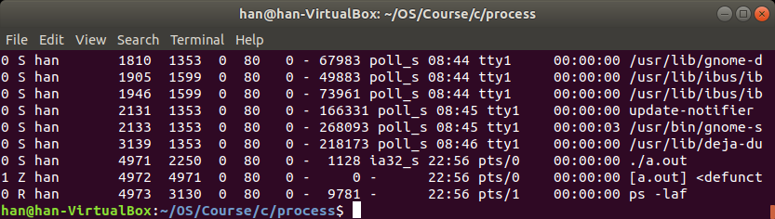
测试代码--僵死子进程
另开一个命令窗口
运行shell命令 ps –lef
结果如下：其中其进程状态标示’Z’表示Zombie
父子外出：父等子

Slide 123
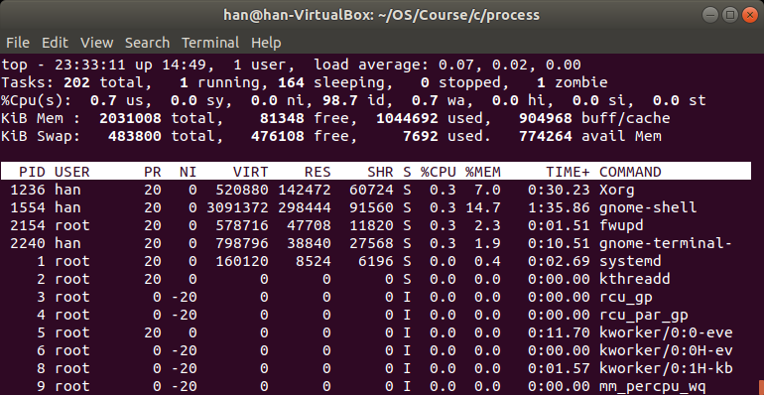
测试代码--僵死子进程
另开一个命令窗口
运行shell命令 top
结果如下：说明有一个进程是僵死进程
父子外出：父等子

Slide 124
Process Creation (UNIX examples)
orphan—孤儿进程
如果父进程没有等待子进程结束而先行退出
子进程则成为孤儿进程
导致子进程成为孤儿进程的原因
父进程由于没有执行wait()、waitpid()等待子进程结束先行退出
父进程执行错误等原因被强行终止
系统对孤儿进程的处理
将孤儿子进程归属到1号进程（Init）（如Cetos，32位Ubuntun）
现在的操作系统将其归到用户进程（如 64位Ubuntu）
通常
父进程执行完自己的任务后，在程序代码的最后，需调用wait()、waitpid()等待子进程结束，或回收已经僵死的子进程
父子外出：父等子

Slide 125
测试代码—孤儿子进程
#include <sys/types.h>
#include <stdio.h>
#include <unistd.h>
#include <stdlib.h>
#include <sys/wait.h>
int main()
{
pid_t pid;
pid=fork();
if (pid == 0)
{
printf("\nChild pid=%d\n",getpid());
printf("My parent pid=%d\n",getppid());
sleep(3);
}
else
{
printf("\nParent pid=%d\n",getpid());
printf("Parent:My parent pid=%d\n",getppid());
}
}
父子外出：父等子

Slide 126
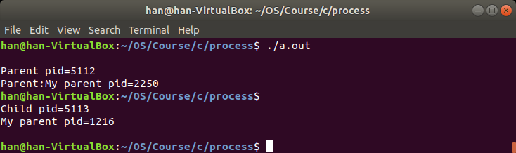
测试代码--孤儿进程
在命令窗口运行./a.out
结果如下：改变了子进程的父进程
子进程的父进程应该是pid=5112
由于父进程先于子进程结束退出，子进程的父进程变为pid=1216
父子外出：父等子

Slide 127
System call -wait
一个进程可以通过调用wai()t使它的执行与子进程的终止同步；
父进程执行wait()系统调用的效果
如果执行wait()的进程没有子进程，直接返回；
如果执行wait()的进程有子进程，但子进程尚未僵死，父进程进入睡眠，子进程结束变成僵死进程时将其唤醒；
如果找到一个僵死“zombie”子进程
内核将子进程在内核态及用户态执行的累计时间加到父进程的PCB相应字段中
释放被僵死子进程所占用的进程表项（pid也就被是否），该表项可以分配给其它进程
注：
进程终止进入zombie状态后，会给父进程发送一个“子进程死（SIGCHLD）“信号，该信号将父进程唤醒

Slide 128
System call -wait
系统调用wait()的两种调用格式
#include <sys/types.h>
#include <sys/wait.h>
pid_t wait(int *status); //等待第一个结束的子进程
pid_t waitpid(pid_t pid,int *status,int option); //等待一个特定的子进程结束

Slide 129
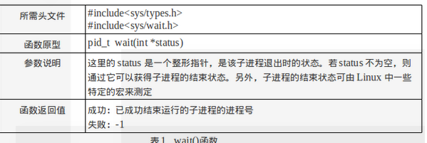
格式1：wait(int *status);
#include <sys/types.h>
#include <sys/wait.h>
pid_t wait(int *status); //格式1
格式1：pid=wait(stat_addr);
pid是返回的僵死子进程的进程号；
stat_addr是一个整数指针，是用户空间的一个地址，它含有子进程的退出状态；
该格式的wait，如果有多个子进程，一般是等到第一个终止的子进程后，就返回；
wait执行成功，返回等待到的终止子进程的进程号，不成功返回-1

Slide 130
格式二：waitpid(…);
#include <sys/types.h>
#include <sys/wait.h>
格式二：pid_t waitpid(pid_t pid,int *status,int option);
status 用于保留子进程的退出状态
pid 可以为以下可能值：
<-1： 等待所有PGID 等于PID 的绝对值的子进程
注： PGID(Process Group ID, 进程组 ID号)
-1 ：等待所有子进程，只要等待到一个，就返回（同wait）
0 ：等待所有PGID 等于调用进程PGID的任何一个子进程
>0 ：等待PID 等于pid的一个特定的子进程，若该子进程尚未结束，父进程阻塞
option 规定了调用waitpid进程的行为：
WNOHANG ：若等待的子进程没有结束，父进程不阻塞，立即返回
WUNTRACED ：若pid指定的子进程没有报告状态，返回其状态
waitpid执行成功，返回等待到的终止子进程的进程号，不成功返回-1

Slide 131
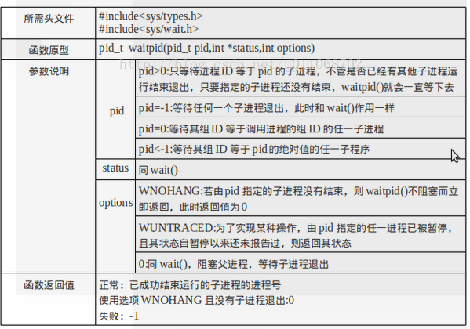
格式二：waitpid(…);

Slide 132
System call-wait()
UNIX核心实现系统调用wait()的算法参见“UNIX操作系统设计”P165。

Slide 133
C Program Forking Separate Process
#include <sys/types.h>
#include <stdio.h>
#include <unistd.h>
#include <stdlib.h>
#include <sys/wait.h>
int main()
{
pid_t pid;
/* fork another process */
pid = fork();
if (pid < 0) { /* error occurred */
fprintf(stderr, “Fork Failed”);
exit(-1);
}
else if (pid == 0) { /* child process */
execlp(“/bin/ls”, “ls”, NULL); //执行一个外部程序
}
else { /* parent process */
/* parent will wait for the child to complete */
wait (NULL); //父进程等待子进程结束
printf ("Child Complete");
exit(0);
}
}
fig. 3.10

Slide 134
fork()--进一步讨论
父子进程各自的执行代码及父子进程的并发执行
子进程继承父进程的缓存
父与子---系统调用exec()、wait()
子进程继承父进程的变量（全局与局部变量）
父进程如何创建多个子进程
子进程继承父进程的I/O
与实验有关的几个系统调用

Slide 135
Page 117, exercise 3.4, fig 3.24
//子进程继承父进程的全部变量（数据区）
#include <sys/types.h>
#include <stdio.h>
#include <unistd.h>
#include <stdlib.h>
#include <sys/wait.h>
int value=5;
int main()
{
pid_t pid;
pid=fork();
if (pid<0) { //没有成功创建子进程，错误处理，exit(-1);};
if (pid==0) //子进程
value +=15;
else if (pid>0) //父进程
{
wait(NULL);
printf(“PARENT:value=%d\n”,value); //输出结果是什么？
exit(0);
}
}

Slide 136
Page 117, exercise 3.4, fig 3.24
//子进程继承父进程的局部变量（栈）
#include <sys/types.h>
#include <stdio.h>
#include <unistd.h>
#include <stdlib.h>
#include <sys/wait.h>
// int value=5;
int main()
{
int value=5;
pid_t pid;
pid=fork();
if (pid==0) //子进程
value +=15;
else if (pid>0) //父进程
{
wait(NULL);
printf(“PARENT:value=%d\n”,value); //输出结果是什么？
exit(0);
}
}

Slide 137
Page 117, exercise 3.4
执行结果：PARENT:value=5
此时，子进程中，value=5+15=20
子进程继承了父进程的全局与局部变量value=5，作为自己的变量
因此，fork()之后，父子进程分离，分别拥有自己的变量value
分离之后对变量的修改，互不影响

Slide 138
思考：父、子进程变量value的地址
#include <sys/types.h>
#include <stdio.h>
#include <unistd.h>
#include <stdlib.h>
#include <sys/wait.h>
int value=5;
int main()
{
pid_t pid;
pid=fork();
if (pid==0) //子进程
{
value +=15;
printf("Child:value=%d\n",value);
printf("CHILD: &value=%p\n",&value); //与父进程的输出结果相同还是不同？
exit(0);
}
else if (pid>0) //父进程
{
wait(NULL);
printf("PARENT:value=%d\n",value); //输出结果是什么？
printf("PARENT:&value=%p\n",&value); //与子进程的输出结果相同还是不同？
exit(0);
}
}

Slide 139
续上页
执行结果：
父子进程输出的各自的变量value的地址是相同的
注：
尽管根据地址符&取出的两个变量的地址相应，但它们指向的内存物理单元地址是不同的
因为父子进程在不同的地址空间上运行
该例也说明了，进程执行时，CPU给出的变量地址，包括PC中的内容
仅仅是一个相对于各自地址空间起始位置的偏移量，是一个相对地址
不是用于对内存单元进行寻址时地址总线上的地址
访存时，CPU中的MMU模块将该相对地址变换成具体的内存地址，送到地址总线上

Slide 140
关于指针变量
#include <sys/types.h>
#include <stdio.h>
#include <unistd.h>
#include <stdlib.h>
#include <sys/wait.h>
int value=5;
int *p=&value; //父进程定义的全局整型指针变量
int main()
{
pid_t pid=fork();
if (pid==0) { //子进程
*p +=15;
printf("CHILD: p=%p\n",p); //与父进程的输出结果相同还是不同？
printf("CHILD: *p=%d\n",*p); //输出什么？
exit(0);
}
else if (pid>0) { //父进程
printf("PARENT: p=%p\n",p); //与子进程的输出结果相同还是不同？
printf("PARENT: *p=%d\n",*p); //输出结果是什么？
wait(NULL);
exit(0);
}
}

Slide 141
续上页
执行结果：
CHILD: *p=20
PARENT: *p=5
子进程继承了父进程的全局与局部变量value=5，作为自己的变量
子进程继承了父进程的全局与局部变量指针*p，指向各自指向自己的变量value
因此，fork()之后，父子进程分离，分别拥有自己的变量value，以及指向value的指针变量p
分离之后对变量、指针的修改，互不影响
该例也说明了相对地址的概念

Slide 142
fork()--进一步讨论
父子进程各自的执行代码及父子进程的并发执行
子进程继承父进程的缓存
父与子---系统调用exec()、wait()
子进程继承父进程的变量
父进程如何创建多个子进程
子进程继承父进程的I/O
与实验有关的几个系统调用

Slide 143
例：创建多个子进程1
main()
{
pid_t pid1,pid2=0xFF;
pid1=fork();
pid2=fork();
if (pid1 = = 0) //子进程1
printf ("how\n");
if (pid2==0) //子进程2
printf("are\n");
printf("you\n"); //父进程
}
一用户欲创建两个子进程，让父进程与这两个子进程分别承担不同的任务(例如输出 how are you),
左边的代码是否达到其目的？
请问：
1、系统为该程序创建了几个进程？
2、每个进程的输出结果是什么？说明原因？
(考察进程树)

Slide 144
考察简化后的程序结构
main()
{
pid_t pid1,pid2;
pid1=fork();
pid2=fork();
printf("Hello World\n");
}
请问：
1、系统为该程序创建了几个进程？
2、"Hello World"输出了几次？

Slide 145
考察简化后的程序结构
main()
{
pid_t pid1,pid2;
pid1=fork();
pid2=fork();
printf("Hello World\n");
}
父进程
父进程输出1次
pid1=fork()
pid2=fork()
子进程1
子进程2
子进程1输出1次
子进程2输出1次
pid2=fork()
子进程1.1
包括父进程在内，系统该该程序创建了4个进程，“Hello World”输出4次。
子进程1.1输出1次

Slide 146
例：创建多个子进程1
main()
{
pid_t pid1,pid2;
pid1=fork();
pid2=fork();
if (pid1 = = 0)
printf (“how\n”);
if (pid2==0)
printf(“are\n”);
printf("you\n");
}
一用户欲创建两个子进程，让父进程与这两个子进程分别承担不同的任务(输出 how are you),
左边的代码是否达到其目的？
请问：
1、系统为该程序创建了几个进程？
2、每个进程的输出结果是什么？说明原因？
(考察进程树)

Slide 147
例：创建多个子进程1(Cont.)
fork()返回值：pid1>0,pid2>0
执行pid1=fork()之后,
pid2=fork()之前，
fork()返回：pid1=0
pid2=未知
父进程：you
main()
{
pid_t pid1,pid2;
pid1=fork();
pid2=fork();
if (pid1 = = 0)
printf (“how\n”);
if (pid2==0)
printf(“are\n”);
printf("you\n");
}
pid2=fork()
执行pid2=fork()之后，
保持原值： pid1=0
fork()返回：pid2>0
(该进程是pid2=fork()创建的子进程的父进程)
pid1=fork()
输出：how,you
输出：are,you
pid2=fork()
fork()返回： pid2=0
继承父进程的返回值:：pid1>0
输出：how,are, you
fork()返回： pid2=0
继承其父进程pid1的返回值:：pid1=0

Slide 148
例：创建多个子进程1（cont.)
//父进程
#include <stdio.h>
main()
{
pid_t pid1,pid2;
pid1=fork(); //>0
pid2=fork(); //>0
if (pid1 = = 0)
printf (“how\n”);
if (pid2==0)
printf(“are\n”);
printf("you\n");
}
在父进程的地址空间中，变量pid1与pid2均为正整数
输出：you

Slide 149
例：创建多个子进程1（cont.)
//子进程(pid1)
#include <stdio.h>
main()
{
pid_t pid1,pid2;
pid1=fork(); //0
pid2=fork(); //>0
if (pid1 = = 0)
printf (“how\n”);
if (pid2==0)
printf(“are\n”);
printf("you\n");
}
1、父进程执行pid1=fork()创建了一个子进程(pid1);
2、子进程pid1再调用语句pid2=fork()创建了一个pid1的子进程(pid2)，
3、对于子进程进程pid1来说，变量pid1=0，而pid2>0，因此pid1输出信息：
输出：how
you
在该地址空间中，pid1=0，pid2>0 (进程pid1是pid2的父进程)

Slide 150
例：创建多个子进程1（cont.)
//子进程(pid1.2)
(由子进程pid1创建的子进程pid2)
#include <stdio.h>
main()
{
pid_t pid1,pid2=0xFF;
pid1=fork();
pid2=fork();
if (pid1 = = 0) //继承0
printf (“how\n”);
if (pid2==0) //返回0
printf(“are\n”);
printf("you\n");
}
输出：how
are
you
在子进程pid1中，pid1=0，pid1.2作为pid1的子进程，继承了pid1中的变量pid1(=0)，系统为子进程pid1.2中的变量pid2返回0

Slide 151
例：创建多个子进程1（cont.)
//子进程(pid2)
#include <stdio.h>
main()
{
pid_t pid1,pid2=0xFF;
pid1=fork();
pid2=fork(); //返回0
if (pid1 = = 0) //继承>0
printf (“how\n”);
if (pid2==0)
printf(“are\n”);
printf("you\n");
}
在子进程(pid2)的地址空间中，变量pid2为0，而pid1>0
输出：are
you

Slide 152
例：创建多个子进程1（Cont.）
包括父进程在内，系统共创建了4个进程
父进程
子进程(pid1)
子进程(pid2)
子进程(pid2)
屏幕显示结果：很乱（课后可以一试）

Slide 153
创建多个子进程，例2
Including the initial parent process, how many processes are created by the fowlling program？
#include <stdio.h>
#include <unistd.h>
int main()
{
fork(); /* fork a child process */
fork(); /* fork another child process */
fork(); /* and fork another */
return 0;
}

Slide 154
例：创建多个子进程2
父进程
pid1=fork()
pid2=fork()
pid3=fork()
子进程1
子进程2
子进程3
pid2=fork()
pid3=fork()
pid3=fork()
子进程1.1
子进程1.2
子进程2.1
包括父进程在内，系统为该程序创建了8个进程。
父进程直接创建了3个子进程；
子进程1直接创建了2个
子进程1-1直接创建了1个
子进程2直接创建了1个
pid3=fork()
子进程1.1.1

Slide 155
fork()使用规则
鉴于上例中的问题，一般情况下，fork()按如下规则编程：
main()
{ pid_t pid;
pid=fork();
if(pid<0) { // 建立子进程失败
//perror(“fork”); //perror(“系统调用名”)，给出具体的错误信息
printf("Create Process fail!\n");
exit(-1);
}
else if (pid = = 0) { //子进程代码；
//如果还需要创建子进程，可以按该方法嵌套
}
else if (pid>0){ //父进程代码
//sleep(2); //给系统一定的时间创建子进程
//如果还需要创建子进程，可以按该方法嵌套
//父进程等待子进程结束
}
}

Slide 156
fork的几个要点（Review）
父子进程独立的内存空间
父子进程资源的共享与分离
fork之前的创建的变量—先继承，后分离
子进程继承了父进程的变量，作为自己的私有变量；
创建子进程之前父进程所拥有的变量
文件描述符（文件描述符变量分离，但对文件的操作与文件表项有关，因此他们并不完全独立）
fork之后创建的变量—完全分离
一般的私有变量
文件描述符（文件描述符变量分离，对文件的操作也完全独立）
5

Slide 157
fork()
父子进程各自的执行代码及父子进程的并发执行
子进程继承父进程的缓存
父与子---系统调用exec()、wait()
子进程继承父进程的变量
父进程如何创建多个子进程
子进程继承父进程的I/O（打开的文件）
与实验有关的几个系统调用

Slide 158
fork()--进一步讨论—继承I/O
fork()系统调中，内核为子进程做一个父进程上下文的拷贝
其中包括PCB，复制父进程的PCB作为子进程的PCB
PCB中包含进程打开的文件
理解先继承后分离的思想
比较如下两个进程的执行结果

Slide 159
fork()－子进程继承父进程的I/O问题--1
#include <fcntl.h>
#include <unistd.h>
int fdrd,fdwt;
char c;
main()
{
fork()；
// 两个进程执行同样的代码
if ((fdrd=open(“source”,O_RDONLY))= = -1)
exit(1);
if ((fdwt=creat(“dest”,0666))= = -1) exit(1);
rdwrt();
close(fdrd);
close(fdwt);
exit(0);
}
//依次从源文件中读出一个字节，写到目标文件中，直到源文件的文件尾
rdwrt()
{
for (;;)
{
if (read(fdrd,&c,1) !=1) return;
write(fdwt,&c,1);
}
}

Slide 160
fork()－子进程继承父进程的I/O问题--2
#include <fcntl.h>
#include <unistd.h>
int fdrd,fdwt;
char c;
main()
{
if ((fdrd=open(“source”,O_RDONLY))= = -1)
exit(1);
if ((fdwt=creat(“dest”,0666))= = -1) exit(1);
fork()；
// 两个进程执行同样的代码
rdwrt();
close(fdrd);
close(fdwt);
exit(0);
}
//依次从源文件中读出一个字节，写到目标文件中，直到源文件的文件尾
rdwrt()
{
for (;;)
{
if (read(fdrd,&c,1) !=1) return;
write(fdwt,&c,1);
}
}

Slide 161
讨论：UNIX打开文件后系统数据结构
假定一个进程A执行下列代码：
fd1=open(“/etc/passwd”,O_RDONLY);
fd2=open(“local”,O_RDWR);
fd3=open(“/etc/passwd”,O_WRONLY);
打开文件“/etc/passwd”两次，一次读，一次写；
以读写方式打开文件“local”文件一次；
基于索引节点表（FCB）、文件表、PCB之间的关系，说明文件的打开并返回fd的过程；
基于该表，说明后续对文件读、写、关闭等操作的工作过程；
参见《UNIX操作系统设计》，P72

Slide 162
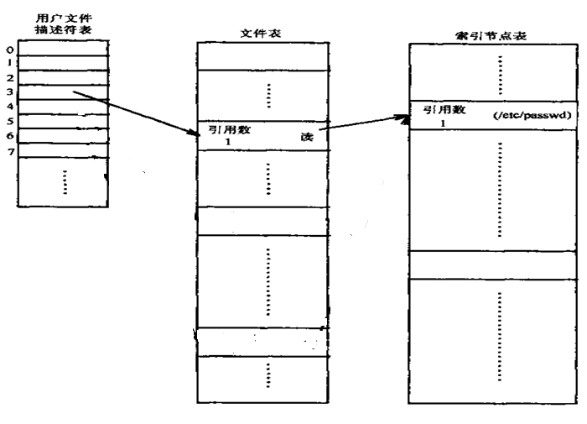
打开文件后的系统核心数据结构
执行语句：fd1=open(“/etc/passwd”,O_RDONLY); //fd1=3
本进程
全局表
全局表
？
i-node：index node，FCB其中包含文件的所有信息
索引结点表主要包括：
（1）从磁盘读入的打开文件的索引结点
（2）文件表中指向该i-node的表项的个数（打开文件的次数）
主要包含的内容：
文件打开方式：只读，读/写等
读写偏移量（读写指针）
用户文件描述符表中，指向该表项的文件描述符个数
指向索引节点的指针
……

Slide 163
讨论：文件描述符与打开文件之间的关系
每一个文件描述符与一个打开文件相对应；（文件句柄）
多个不同的文件描述符也会指向同一个文件（文件表的表项）；
同一个文件可以被不同的进程打开，也可以在同一个进程中被打开多次；
系统为每一个进程维护了一个进程私有的文件描述符表；
该表的索引值都是从0开始；（系统预留：0,1,2）
在不同的进程中会看到相同的文件描述符
内核为打开的文件维护的3个数据结构
1. 进程级的文件描述符表
2. 系统级的（打开）文件表
3.系统级的（文件系统）i-node表（FCB，UNIX中称为i-node）

Slide 164
讨论：进程级的文件描述符表
进程级的描述符表的每一条目记录了单个文件描述符的相关信息
1. 对打开文件描述符的引用
2. 控制文件描述符操作的一组标志
目前，此类标志仅定义了一个，即close-on-exec标志

Slide 165
讨论：系统级的文件表
内核对所有打开的文件维护一个系统级的表格（open file description table），也称之为打开文件表（open file table）；
表格中各条目有时称为打开文件的句柄（open file handle）；
一个打开文件句柄中给出了一个打开文件相关的全部信息，主要包括：
1. 当前文件读写偏移量（调用read()和write()时更新，或使用lseek()直接修改）
2. 打开文件时所使用的状态标识（即open()的flags参数）
3. 文件访问模式（如调用open()时所设置的只读模式、只写模式或读写模式等）
4. 与信号驱动相关的设置
5. 对该文件i-node对象的引用
6. 文件类型（例如：常规文件、套接字或FIFO）和访问权限
7. 一个指针，指向该文件所持有的锁列表
8. 文件的各种属性，包括文件大小以及与不同类型操作相关的时间戳

Slide 166
讨论：系统级的i-node表
系统级的打开文件索引节点表，又称为活动的索引节点表;
打开一个文件时，将在磁盘上的文件的索引节点装入到内核维护的索引节点表中；
同时设置上一些访问文件时的一些控制信息，如引用数，表示一个文件目前被打开的次数；
参见https://blog.csdn.net/ai2000ai/article/details/79738422

Slide 167
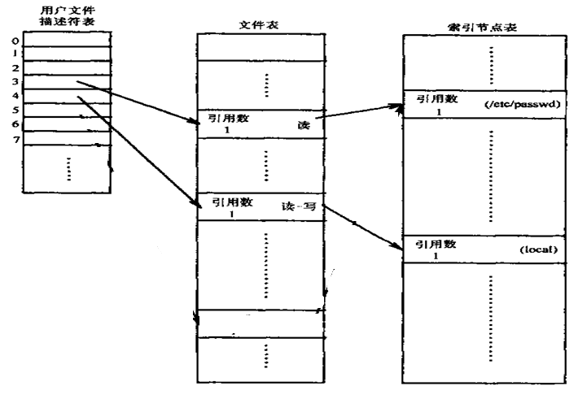
打开文件后的系统核心数据结构
fd1=open(“/etc/passwd”,O_RDONLY); //fd1=3
fd2=open(“local”,O_RDWR); //fd2=4

Slide 168
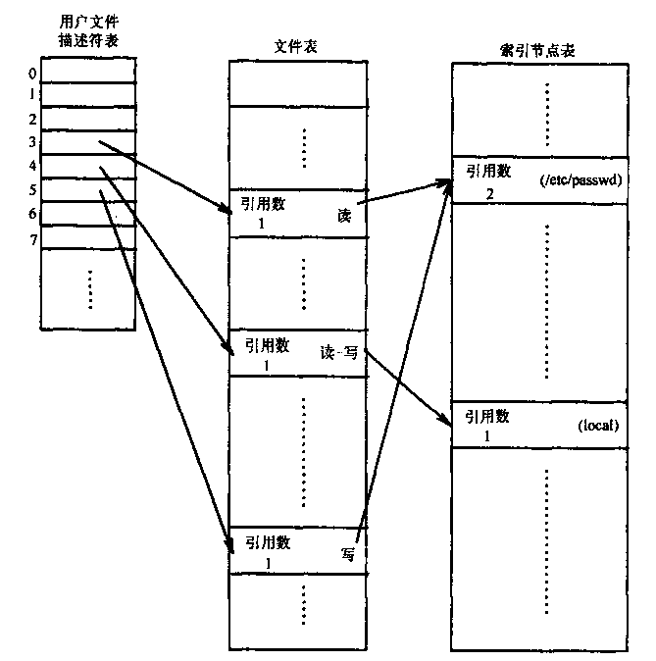
打开文件后的系统核心数据结构
fd1=open(“/etc/passwd”,O_RDONLY); //fd1=3
fd2=open(“local”,O_RDWR); //fd1=4
fd3=open(“/etc/passwd”,O_WRONLY); //fd3=5
请参见“UNIX操作系统设计”，第72页

Slide 169
进程打开文件后的数据结构
注1：三个标准设备的描述符
操作系统中将设备当作文件看待；
0，1，2也就是三个标准设备对应的文件描述符；
0：stdin
1：stdout
2：stderr
内核创建进程时，自动打开了上述三个标准设备
注2：打开文件的过程及文件描述符
fd1=open(“/etc/passwd”,O_RDONLY)中fd1的含义
在文件表中中存有文件的读写指针（或读写偏移量）等信息
注3：文件描述符的含义以及基于其的文件操作，如：
read(fd1,&c)中基于fd的读取过程
write(fd1,&c,1)中基于fd的写入过程
注4：关闭文件(设备)的过程
close(fd1)的过程

Slide 170
三个标准设备-例1
//屏幕输出键盘输入 (Linux环境)
#include <unistd.h> //read()、write()
#include <stdlib.h> //exit()
main()
{
char c;
for (; ;)
{
//从标准输入设备（键盘）读取键入的内容
read(0,&c,1); //stdin
if (c==‘Z’) //当键入’Z’，进程结束
exit(1);
//将键盘键入的内容输出到屏幕上
write(1,&c,1); }
}
注：read(0,%c,1)，不能写成 read(stdin,&c,1)，因为stdin是一个结构体
同样，write(1,%c,1)，不能写成 write(stdout, &c,1)

Slide 171
三个标准设备-例2
下述程序的功能是什么？（Linux环境下运行）
#include <stdio.h> //scanf(), printf()
#include <fcntl.h> // O_RDONLY, O_RDWR
#include <unistd.h> //close()
int main(int argc, char** argv)
{
close(0); //关闭标准输入设备stdin
int fin=open(“tin.txt”,O_RDONLY); //返回fin=0
int a,b;
printf("Enter a,b:\n");
scanf(“%d %d”,&a,&b);
printf("a=%d, b=%d\n",a,b);
close(1); //关闭标准输出设备stdout
int fout=open(“tout.txt”,O_RDWR); //返回fout=1
printf("%d+%d=%d\n",a,b,a+b);
close(fin);
close(fout);
}
输入重定向到文件tin.txt
输出重定向到文件tout.txt

Slide 172
三个标准设备-例2
下述程序的功能是什么？
//注：在windows环境下运行，不能在Linux下运行
// 两个系统下的编译器对语句scanf()的处理方法不同
#include <stdio.h>
int main(int argc, char** argv)
{
fclose(stdin);
FILE *fin=fopen(“tin.txt”,“r”);
//printf(“fin->_file=%d\n”,fin->_file); //结构体fin对应的文件描述符是0
//如果没有语句fclose(stdin)，该值为3;
int a,b;
printf(“Enter a,b:\n");
scanf(“%d%d”,&a,&b);
fclose(stdout);
FILE *fout=fopen(“tout.txt”,“w”);
//printf(“fout->_file=%d\n”,fout->_file); //结构体fin对应的文件描述符是1
printf(“%d+%d=%d\n”,a,b,a+b);
return 0;
}

Slide 173
三个标准设备-例2
下述程序的功能是什么？
//在windows环境下运行，不能在Linux下运行
int main(int argc, char** argv)
{
fclose(stdin); //关闭标准输入设备
FILE *fin=fopen(“tin.txt”,“r”); //将标准输入定向到文件tin.txt中；
int a,b;
printf(“Enter a,b:\n");
scanf(“%d%d”,&a,&b); //从文件tin.txt中输入数据
fclose(stdout); //关闭标准输出设备
FILE *fout=fopen(“tout.txt”,“w”); //将标准输出定向到文件tout.txt中；
printf(“%d+%d=%d\n”,a,b,a+b); //输出到文件tout.txt中；
return 0;
}
//从文件tin.txt中读取两个整数，写入到文件tout.txt中；
I/O re-direction

Slide 174
三个标准设备-例2
标准C程序
Windows与Linux均可执行
int main(int argc, char** argv)
{
fclose(stdin); //关闭标准输入设备
FILE *fin=fopen(“tin.txt”,“r”); //将标准输入定向到文件tin.txt中；
int a,b;
printf(“Enter a,b:\n");
fscanf(fin, “%d%d”,&a,&b); //从文件tin.txt中输入数据
fclose(stdout); //关闭标准输出设备
FILE *fout=fopen(“tout.txt”,“w”); //将标准输出定向到文件tout.txt中；
fprintf(fout, “%d+%d=%d\n”,a,b,a+b); //输出到文件tout.txt中；
return 0;
}
//从文件tin.txt中读取两个整数，写入到文件tout.txt中；

Slide 175
两个独立进程打开文件后的数据结构
假定一个进程A执行下列代码：
fd1=open(“/etc/passwd”,O_RDONLY);
fd2=open(“local”,O_RDWR);
fd3=open(“/etc/passwd”,O_WRONLY);
假定另一个进程B执行下列代码：
fd1=open(“/etc/passwd”,O_RDONLY);
fd2=open(“private”,O_RDONLY);
文件“/etc/passwd”被两个进程打开3次，其余2个文件被两个进程分别打开一次

Slide 176
两个独立进程打开文件后的数据结构
/etc/passwd
local
private
请参见“UNIX操作系统设计”，第73页

Slide 177
一个进程关闭文件后的数据结构
假定一个进程A执行下列代码：
fd1=open(“/etc/passwd”,O_RDONLY);
fd2=open(“local”,O_RDWR);
fd3=open(“/etc/passwd”,O_WRONLY);
假定另一个进程B执行下列代码：
fd1=open(“/etc/passwd”,O_RDONLY);
fd2=open(“private”,O_RDONLY);
//执行文件读写等操作
close(fd1);
close(fd2);

Slide 178
进程B关闭文件后的数据结构
请参见“UNIX操作系统设计”，第80页

Slide 179
fork()－子进程继承父进程的I/O问题--1
#include <fcntl.h>
#include <unistd.h>
int fdrd,fdwt;
char c;
main()
{
fork()；
// 两个进程执行同样的代码
if ((fdrd=open(“source”,O_RDONLY))= = -1)
exit(1);
if ((fdwt=creat(“dest”,0666))= = -1) exit(1);
rdwrt();
close(fdrd);
close(fdwt);
exit(0);
}
rdwrt()
{
for (;;)
{
if (read(fdrd,&c,1) !=1) return;
write(fdwt,&c,1);
}
}

Slide 180
fork之前父进程PCB中打开的文件信息
fork()之前，父进程尚未打开任何文件，变量fdrd及fdwt无返回值

Slide 181
fork之后子进程继承父进程的I/O
子进程只是继承了父进程的PCB，以及尚未赋值的fdrd、fdwt及c

Slide 182
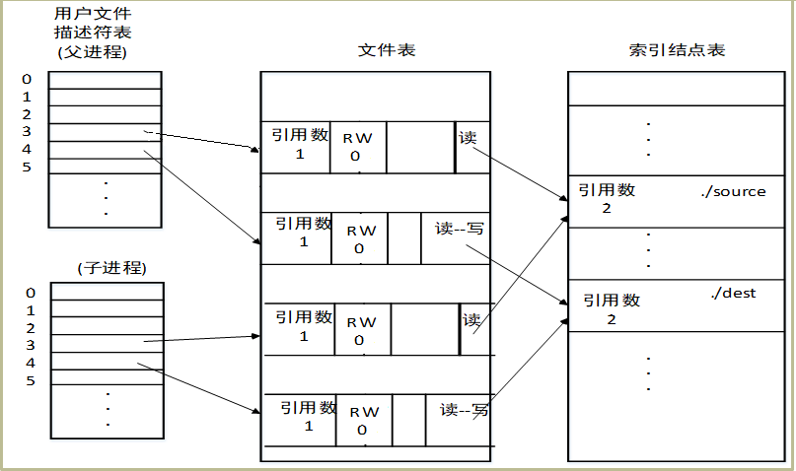
fork之后父子进程各自打开文件

Slide 183
fork()－子进程继承父进程的I/O问题--1
内核调用fork为子进程做一个父进程上下文的拷贝；
父进程和子进程在不同的地址空间上运行；
fork之后，子进程继承了父进程的变量fdrd、fdwt及c,，作为自己的变量
每个进程都能访问自己的私有的全局变量fdrd，fdwt和c，以及栈变量argc和argv；但不允许访问另一个进程的这些变量；
fork之后，父子进程分别打开源文件source ，分别创建目标文件dest
源文件source被独立打开了两次，在文件表中对应两个的文件表项
目标文件dest被独立创建了两次，在文件表中对应两个的文件表项
父子进程的fd1分别指向源文件不同的文件表项
父子进程的fd2分别指向目标文件不同的文件表项
对于同一个文件，在文件表中有自己独立的文件描述符，意味着
文件表中的读写偏移量是独立的；
多个进程中的read与write等操作是独立进行的，互不干涉；

Slide 184
fork()－子进程继承父进程的I/O问题--1
因此程序的运行结果是：
源文件分别被父、子进程读了一次（内容相互重叠）
目标文件分别被父、子进程写了一次（内容相互覆盖）
但目标文件内容与源文件内容是一致的

Slide 185
fork()－子进程继承父进程的I/O问题--2
#include <fcntl.h>
#include <unistd.h>
int fdrd,fdwt;
char c;
main()
{
if ((fdrd=open(“source”,O_RDONLY))= = -1)
exit(1);
if ((fdwt=creat(“dest”,0666))= = -1) exit(1);
fork()；
// 两个进程执行同样的代码
rdwrt();
close(fdrd);
close(fdwt);
exit(0);
}
rdwrt()
{
for (;;) {
if (read(fdrd,&c,1) !=1) return;
write(fdwt,&c,1); }
}

Slide 186
fork()之前父进程打开的文件
用户文件
描述符表
(
)
文件表
索引结点表
父进程
0
1
2
.
.
3
.
.
4
.
.
5
.
.
引用数
RW
读
引用数
./
source
.
1
0
1
.
.
.
.
.
.
引用数
RW
读
--
写
引用数
./
dest
1
0
1
.
.
.
.
.
.

Slide 187
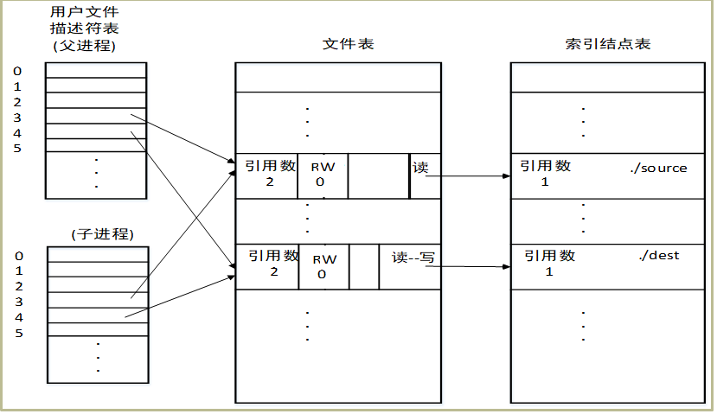
fork()之后，子进程继承父进程打开的文件(继承、共享)
注意文件读写指针的共享

Slide 188
子进程继承父进程的文件描述符
子进程继承了父进程的文件描述符fd1与fd2
父子进程可分别通过这两个文件描述符独立地访问源文件与目标文件
由于fork之前，父进程已经打开了源文件与目标文件，而子进程并没有再次打开源文件，也没有再次创建目标文件
在文件表中，源文件与目标文件各自只有一个表项
父子进程的fd1同时指向了源文件在文件表中的同一个表项
父子进程的fd2同时指向了目标文件在文件表中的同一个表项
多个进程使用相同的文件表项，访问同一个文件，意味着
各进程访问文件时，文件的读写偏移量是相互影响的
多个进程中的read与write等操作不是独立进行的，互相影响；
因为内核在每次调用read和write之后，都要自动增加文件的偏移量；

Slide 189
子进程继承父进程的文件描述符
父子进程不会读、写到相同的文件偏移量上
父子进程似乎将源文件拷贝了两次，但它们分担了工作，因此目标文件的内容依赖于核心调度两个进程的次序；
核心不能保证两个进程执行的相对速率。
如果源文件中的内容是”ab”，目标文件中的内容可能是无序的
例如 ：源文件“ab”→目标文件：”ba” or “ab”
源文件内容与目标文件内容可能是不同的。

Slide 190
课后阅读：关于系统调用creat()
至于是否允许一个文件被创建两次，取决于操作系统对系统调用creat()的实现。
UNIX中，如果要创建的文件已经存在，且有相应的访问许可，内核就释放所有已存在的文件的数据块，并置文件的大小为0；（清文件）
（允许多次创建）
类似于open()系统调用中，使用O_TRUNC（截零）方式打开一个文件。

Slide 191
fork()
父子进程各自的执行代码及父子进程的并发执行
子进程继承父进程的缓存
父与子---系统调用exec()、wait()
子进程继承父进程的变量
父进程如何创建多个子进程
子进程继承父进程的I/O
与实验有关的几个系统调用

Slide 192
其它几个常用的系统调用
signal()—注册自己的软中断信号处理程序
kill()—给其它进程发送软中断信号
电信编程

Slide 193
UNIX中的软中断信号（信号）
软中断信号（signal，简称信号）
通知进程发生了异步事件，内核在合适的时机处理这些收到的软中断信号
类似于JAVA中的listener()，或其它可视化编程语言的事件处理程序
类似于硬件中断的检测与处理
系统或其它进程可以通过给某一进程发送软中断信号，以控制进程的行为
软中断信号的发出
内核可以从内部给进程发送软中断信号（内核→进程）
可用通过键盘按键给进程发出软中断信号（属于内核发出）（键盘→进程）
进程也可以通过系统调用kill()相互发送软中断信号（进程←→ 进程 ）
进程的PCB中，有相应软中断信号的标识
每一位对应一个特定的信号
当进程收到一个软中断信号，内核按接收到的信号类型设置相应的位
软中断信号的处理时机
参见下页图示

Slide 194
课后阅读
关于signal()的使用，内核何时响应等问题请参考“UNIX操作系统设计”的153页。
当进程从核心态转到用户态时，系统检查并处理软中断信号。
当进程从执行态进入睡眠，或者调度进程执行时，系统检查软中断信号。
系统检查软终端信号，即若收到某个软中断信号后，置位PCB中相应的软中断标识。
但无法标识该信号收到多少次。

Slide 195
signal系统调用
作用
设置进程接收到某个信号后，应该如何处理该信号
可以通过signal()自定义类似于热键(hot key)的功能
方法
在进程中利用signal()系统调用注册自己定义的信号处理函数，当进程收到该信号后，就执行自己定义的信号处理函数
如果进程中不注册signal()的处理函数 ，则当进程收到该信号后，就执行系统默认的信号处理函数（SIG_DFL）

Slide 196
signal系统调用
signal系统调用语法:
#include <signal.h>
typedef void (*sighandler_t)(int); //参数时捕捉到的信号
sighandler_t signal(int signum, sighandler_t handler);
signum ：要捕捉的信号
handler： 进程中自定义的信号处理函数名
signal 调用成功会返回信号处理函数的返回值，不成功返回-1，并设置系统变量errno为SIG_ERR。
可以简化为：
void handler(int) { //自定义的信号处理函数 }
signal(int signum, (void)handler);
注册信号signum的自定义处理函数handler

Slide 197
System call –signal例
#include <stdio.h>
#include <unistd.h>
int main()
{
pause(); //等待信号SIGINT
return 0;
}
#include <stdio.h>
int main()
{
while(1) ;
return 0;
}
当键盘按下ctrl-c后，两个进程分别会出现什么现象？
注：ctrl-c 产生信号SIGINT
两进程各自执行SIGINT(ctrl-c)的默认操作，终止进程，退出到shell；
两者的区别：
左边进入等待（阻塞）状态，等待系统或其它进程给它发送SIGINT信号；
右边处于执行状态；

Slide 198
System call –signal例
#include <stdio.h>
#include <unistd.h>
#include <signal.h>
int count=0;
void SIGINTCatcher (int sig) { //自定信号SIGINT处理方法
count++;
printf(“en en! - I caught signal %d %d time(s)\n”, sig,count);
//exit(0); //思考：如果加上该语句，执行过程如何？
}
int main() {
(void) signal(SIGINT, SIGINTCatcher); //注册信号SIGINT的处理函数
pause(); //睡眠，等待信号SIGINT，可由按键Ctrl+c或系统调用kill产生
}
//程序执行到pause()后进入阻塞，当键盘按下ctrl-c后，出现什么现象？
// pause()：进程阻塞，等待信号SIGINT
// 按下ctrl-c，执行一次SIGINTCatcher()，然后进程退出。
// SIGINTCatcher()中输出按下ctrl+c的次数，以及内核为信号SIGINT的编号

Slide 199
System call –signal例（续）
#include <stdio.h>
#include <unistd.h>
#include <signal.h>
int count=0;
void SIGINTCatcher (int sig) {
count++;
printf(“en en! - I caught signal %d %d time(s)\n”, sig,count);
}
int main() {
(void) signal(SIGINT, SIGINTCatcher);
while(1) sleep(1) ;
}
//程序执行到while(1) sleep(1)睡眠一秒后继续循环，当键盘按下ctrl-c后，说明现象？
//每次按下ctrl-c，执行一次SIGINTCatcher()，输出按下ctrl+c的次数，以及信号SIGINT的编号，且一直重复上述过程，进程不终止。

Slide 200
System call –signal例
#include <stdio.h>
#include <unistd.h>
#include <signal.h>
int count=0;
void SIGINTCatcher (int sig) {
count++;
printf(“en en! - I caught signal %d %d time(s)\n”, sig,count);
(void) signal(SIGINT, SIG_DFL); //重设信号SIGINT为默认处理
}
int main() {
(void) signal(SIGINT, SIGINTCatcher);
while(1) sleep(1);
}
//程序执行到while(1) sleep(1)睡眠一秒后继续循环，当键盘按下ctrl-c后，说明现象
//第一按下ctrl-c，执行SIGINTCatcher，设置信号SIGINT为默认处理（终止进程）
//第二次按下ctrl-c键，不再执行SIGINTCatcher，执行默认操作，进程退出

Slide 201
进程屏蔽或忽略某信号
#include <stdio.h>
#include <unistd.h>
#include <signal.h>
int main() {
(void) signal(SIGINT, SIG_IGN); //忽略该信号
while(1)
sleep(1);
}
程序执行到while(1) sleep(1)睡眠一秒后继续循环，当键盘按下ctrl-c后，说明现象
//进程忽略信号SIGINT
//按下ctrl-c，进程不会收到该信号，也就不会处理，也不会终止

Slide 202
子进程继承父进程注册的信号处理
#include <stdio.h>
#include <unistd.h>
#include <signal.h>
void SIGINTCatcher (int sig) { //父进程定义的信号处理函数}
int main() {
(void) signal(SIGINT, SIGINTCatcher);
pid_t pid=fork();
if (pid<0) { /*子进程创建不成功，错误处理*/ }
else if (pid==0) //子进程代码
{ /*….. */}
else //父进程代码
{
sleep(2); //给内核一定的时间创建子进程
//……
}
}
子进程继承了父进程对信号SIGINT的处理方式
当按下ctrl-c，父子进程各执行了一次SIGINTCatcher()

Slide 203
父子进程可以对相同的信号有不同的处理
#include <stdio.h>
#include <unistd.h>
#include <signal.h>
void SIGINTCatcher _Parent (int sig) { //父进程定义的信号处理函数}
void SIGINTCatcher _Child(int sig) { //子进程定义的信号处理函数}
int main() {
(void) signal(SIGINT, SIGINTCatcher_Parent); //注册父进程的信号处理函数
pid_t pid=fork()
if (pid<0) {//子进程创建不成功，错误处理}
else if (pid==0) //子进程代码
{
(void) signal(SIGINT, SIGINTCatcher_Child); //注册子进程的信号处理函数
//signal(SIGINT, SIG_DFL);
// signal(SIGINT, SIG_IGN);
//子进程其它代码
}
else //父进程代码
{sleep(2); //…..}
}
子进程继承了父进程对信号SIGINT的处理方式，但又重新注册处理方式
当按下ctrl-c，父子进程各自执行它们相应的处理程序

Slide 204
常见的一些信号
SIGINT --键盘中断（ctrl+c) (break,delete）默认处理：终止进程
SIGTSTP --进程挂起 (ctrl+z)
SIGQUIT—进程结束 (ctrl+| ) 默认处理：终止进程，但core dumped
SIGHUP –hangup，挂起
SIGILL—非法指令
SIGKILL –要求进程终止
SIGBUS—总线错
SIGSYS—系统调用参数错
SIGPIPE –向无读者管道上写
SIGALRM—闹钟
SIGUSR1—用户定义信号
SIGUSR2-第二个用户定义的信号
SIGCLD-子进程死
SIGPWR-电源故障

Slide 205
System call -kill
一个进程向其它进程发送信号，控制其它进程的行为
kill系统调用语法：
#include <sys/types.h>
#include <signal.h>
int kill(pid_t pid, int sig);
pid 接收信号的进程号
signal 要发送的信号（如SIGINT等）
kill发送成功返回0，失败返回-1。
pid：可能选择有以下四种
pid>0 将信号发送给进程号为 pid 的进程
pid=0 将信号发送给与调用kill的进程同组的所有进程
pid=-1 将信号广播传送给系统内所有的进程 (1号进程INIT除外)
pid<-1 将信号传给进程组号为 pid 绝对值的所有进程

Slide 206
System call –kill例
#include <stdio.h>
#include <unistd.h>
#include <signal.h>
#include <sys/types.h>
int count=0;
void gotSignal(int sig)
{ count++;
printf(“en en! – process %d got signal %d %d time(s)\n”, getpid(),sig,count);
}
int main()
{
(void) signal(SIGINT, gotSignal);
pid_t pid=fork(); //子进程可继承父进程对信号SIGINT的处理方式
if (pid==0) {
pause();
printf(“Child Continue…\n”);
kill(getppid(),SIGINT); } //子进程给父进程发送信号SIGINT
else {
sleep(2); //等待子进程创建完毕
kill(pid,SIGINT); //父进程给进程pid（子进程）发送信号SIGINT
waitpid(pid,NULL,0); //等待进程pid（子进程）结束
}
return 0;
}

Slide 207
System call –kill例
执行结果：父子进程分别收到对方发来的SIGINT信号，并分别执行一次用户自定义的SIGINT的处理函数gotSignal()
注：父进程注册了信号SIGINT的处理函数
子进程也继承了这一行为
但两个函数分处于不同的地址空间，即两个函数是独立的
因此函数gotSignal()的输出信息中count的值，是父子分离的，相互独立的
getpid()的返回值也是相应进程的进程号
在父进程的地址空间中，返回父进程的进程号
在子进程的地址空间中，返回子进程的进程号
void gotSignal(int sig)
{ count++;
printf(“en en! – process %d got signal %d %d time(s)\n”, getpid(),sig,count);
}

Slide 208
一个进程控制另一个进程的行为
//自定义信号处理函数，父进程终止子进程
#include <stdio.h>
#include <unistd.h>
#include <signal.h>
#include <sys/types.h>
void SIGINT_handler(int sig)
{
printf(“Child exit!\n”);
exit(0); //终止子进程
}
int main()
{
pid_t pid=fork();
if (pid==0) {
signal(SIGINT, SIGINT_handler);
while(1);
else {
sleep(2); //等待子进程创建完毕
/* 父进程完成某些操作 */
kill(pid,SIGINT); //父进程给子进程发送信号SIGINT，终止子进程的执行
waitpid(pid,NULL,0); //等待进程pid（子进程）结束
}
return 0;
}

Slide 209
一个进程控制另一个进程的行为（默认操作）
//利用信号的默认操作，父进程终止子进程
#include <stdio.h>
#include <unistd.h>
#include <signal.h>
#include <sys/types.h>
int main()
{
pid_t pid=fork();
if (pid==0) {
// signal(SIGINT, SIG_DFL); //SIGINT的默认操作是终止进程
while(1);
else {
sleep(2); //等待子进程创建完毕
/* 父进程完成某些操作 */
kill(pid,SIGINT); //父进程给子进程发送信号SIGINT，终止子进程的执行
waitpid(pid,NULL,0); //等待进程pid（子进程）结束
}
return 0;
}

Slide 210
用户定义信号 SIGUSR1与SIGUSR2
//同SIGINT等其它信号的使用方法，只是没有键盘中断与其对应
#include <stdio.h>
#include <unistd.h>
#include <signal.h>
void SIGUSR1_Handler(int sig) { //父进程定义的信号处理函数}
void SIGUSR2_Handle (int sig) { //子进程定义的信号处理函数}
int main() {
(void) signal(SIGUSR1, SIGUSR1_Handler);
pid_t pid=fork()
if (pid<0) {//子进程创建不成功，错误处理}
else if (pid==0) //子进程代码
{
(void) signal(SIGUSR2, SIGUSR2_Handle);
kill(getppid(), SIGUSR2);
//子进程其它代码
}
else //父进程代码
{
sleep(2);
kill(pid, SIGUSR1);
//…..
wait(NULL);
}
}
父进程给子进程发送信号SIGUSR2，子进程给父进程发送信号SIGUSR1

Slide 211
函数alarm()与信号SIGALRM
alarm()函数
原型：unsigned int alarm(unsigned int seconds);
功能：间隔seconds秒给调用该函数的进程发送SIGALRM信号
其中：alarm(0)返回剩余的时间（秒数）
例
void SIGALRM_Handler()
{ //信号处理函数 } //调用函数alarm(seconds)后，间隔seconds秒后执行该函数
int main()
{
int seconds=5;
signal(SIGALRM,SIGALRM_Handler);
alarm(seconds); //seconds秒后给进程发送信号SIGALRM
//其它代码
return 0;
}
可以实现类似时钟中断的功能，定时执行一定的操作

Slide 212
3.3.2 Process Termination
进程可以显式地调用exit，或在程序的结尾隐含地调用exit，使进程终止执行
Process executes last statement and asks the operating system to delete it (exit)
Output data from child to parent (via wait)
Process’ resources are deallocated by operating system
进入“Terminated”状态
Parent may terminate execution of children processes (abort,TerminateProcess() in Windows)，if
Child has exceeded allocated resources
Task assigned to child is no longer required

Slide 213
Process Termination
If parent is exiting
Some operating system do not allow child to continue if its parent terminates
if a process terminates, then all its children must also be terminated.
All children terminated - cascading termination
例如：Windows中“结束进程树”
When a process terminates, its resources are deallocated by the operating system.
However, its entry in the process table must remain there until the parent calls wait()
because the process table contains the process’s exit status

Slide 214
算法：exit
进程可以显式地调用exit，或在程序的结尾隐含地调用exit

Slide 215
Process Termination（Cont.）
如果父进程没有等待子进程结束，子进程可能成为
僵死进程
早期的UNIX版本中，僵死进程会一直处于僵死状态
现在的版本，系统负责回收，或用户进程回收
孤儿进程
有的版本将1号进程作为其父进程（如Ubuntu32，Cetos等）
有的版本将该用户的用户进程作为其父进程（如Ubuntu64位）
良好的编程习惯是父进程利用wait等待子进程结束

Slide 216
3.4 Interprocess Communication (IPC)
IPC，mechanism for processes
to communicate and
to synchronize their actions

Slide 217
Cooperating Processes
Independent process cannot affect or be affected by the execution of another process
Cooperating process can affect or be affected by the execution of another process
Advantages of process cooperation (team-work)
Information sharing (e.g. producer-consumer problem (a shared memory, a shared file, etc. )
Computation speed-up (beaking a task into subtasks, and the several subtasks executing in parallel)
Modularity (constructing a system in a modular fashing, dividing the system functions into seperate processes or threads )
Convenience (one may work on many tasks at the same time, eg. editing, printing, and compiling in parallel.)

Slide 218
Cooperating Processes
Cooperative processes require an interprocess communication(IPC) mechanism that will allow them to exchange data and information.
Two fundament methods:
Shared memory
Message passing
In UNIX
Shared memory
Message passing
Shared file，i.e. Pipeline，similar to message passing
利用磁盘文件实现消息队列
Semaphore、Kill+Signal

Slide 219
Communications Models
(a) Message passing. (b) shared memory.
Both are common in operating systems

Slide 220
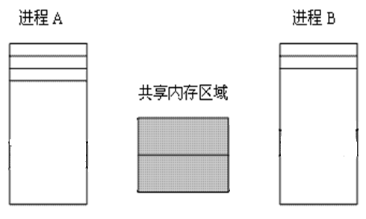
3.4.1 Shared memory
共享存储区不在该进程地址空间范围内，进程无法访问，否则地址越界
共享存储区不在该进程地址空间范围内，进程无法访问，否则地址越界
某进程创建了一个存储区
共享内存映射图
利用系统调用shmget()创建一个共享存储区
共享内存区域
应该同时属于要共享该存储区的所有进程的地址空间，这些进程才能访问，才能相互共享
否则，进程无法访问，导致无法共享。

Slide 221
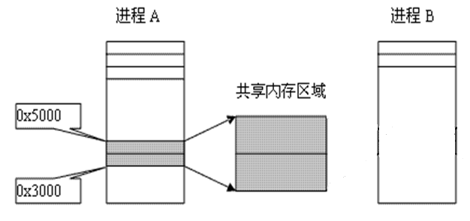
Shared memory
将共享存储区纳入该进程地址空间，进程才能访问
进程B无法访问将共享存储区
某进程创建了一个存储区
共享内存映射图
利用系统调用shmat()将共享存储区附接到进程A的地址空间上，成为进程A的地址空间的一部分； shmat→shmattach
进程A即可访问（如读、写）该存储区
进程B尚不能访问该存储区

Slide 222
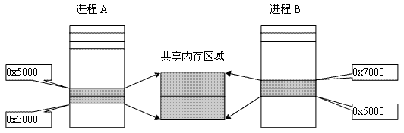
Shared memory
将共享存储区纳入该进程地址空间，进程才能访问
将共享存储区纳入该进程地址空间，进程才能访问
某进程创建了一个存储区
共享内存映射图
附接之后，进程A与进出B均可访问该共享存储区
附接之后，每个进程可得到共享存储区的地址，可以视为C语言中的指针类变量的存储区域
用C语言中的指针类变量的函数可访问该存储区
如：strcpy()，scanf()，sprint()等

Slide 223
Shared memory
共享内存映射图
共享完毕后，需要删除该共享存储区
删除之前，需要将共享存储区从进程的地址空间中剥离，才能删除
系统调用shmdt()将共享存储区从进程的地址空间中剥离；dt—detach
利用系统调用shmctl()删除共享存储区

Slide 224
Shared memory
假定进程A、B、C要通过共享内存进行通信
进程A创建一段存储区Seg，用于三个进程A、B、C共享
这时该存储区Seg不属于任何一个进程的地址空间
进程A、B与C均不能访问（why？）
将存储区分别Seg附接到进程A、B与C的地址空间中，则
存储区Seg属于进程A、B与C的地址空间
进程可以访对存储区Seg读写，进行通信
读写时需要进程之间同步
A、B、C通信结束后需要将存储区Seg与其地址空间剥离
进程A将存储区Seg删除

Slide 225
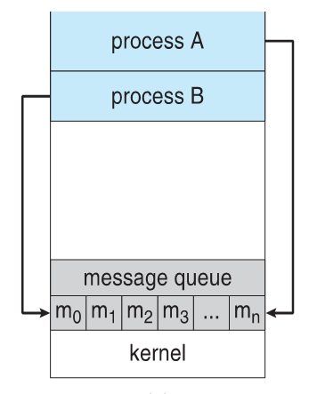
3.4.2 Message-Passing System
Message system – processes communicate with each other without resorting to shared variables
系统维护一个消息队列（FIFO）
进程A可发送消息到消息队列
进程B可从消息队列中接收消息
反之亦然
实现了进程之间的通信

Slide 226
Message-Passing System
Message system – processes communicate with each other without resorting to shared variables
IPC facility provides two operations:
send(message) – message size fixed or variable
receive(message)
If P and Q wish to communicate, they need to:
establish a communication link between them
exchange messages via send/receive
Implementation of communication link
physical (e.g., shared memory, hardware bus, or network)
logical (e.g., logical properties)

Slide 227
Implementation Questions
How are links established?
Can a link be associated with more than two processes?
How many links can there be between every pair of communicating processes?
What is the capacity of a link?
Is the size of a message that the link can accommodate fixed or variable?
Is a link unidirectional or bi-directional?

Slide 228
Message-Passing System
Two schemes
Direct Communication
如：信、纸条直接送到收信人手中
Indirect Communication
via Mailbox

Slide 229
Naming--Direct Communication
Processes must name each other explicitly:
send (P, message) – send a message to process P
receive(Q, message) – receive a message from process Q
Properties of communication link
Links are established automatically
A link is associated with exactly one pair of communicating processes
Between each pair there exists exactly one link
The link may be unidirectional, but is usually bi-directional
eg. system call -- kill(pid,SIGINT)
making a call

Slide 230
Naming--Indirect Communication
Messages are directed and received from mailboxes (also referred to as ports)
Each mailbox has a unique id
Processes can communicate only if they share a mailbox
Properties of communication link
Link established only if processes share a common mailbox
A link may be associated with many processes
Each pair of processes may share several communication links
Link may be unidirectional or bi-directional

Slide 231
Naming-Indirect Communication
Operations
create a new mailbox
send and receive messages through mailbox
destroy a mailbox
Primitives are defined as:
send(A, message) – send a message to mailbox A
receive(A, message) – receive a message from mailbox A
eg. Email
Short Messaging Service (SMS)
(QQ, webchat ?)

Slide 232
Naming-Indirect Communication
Mailbox sharing
P₁, P₂, and P₃ share mailbox A
P₁, sends; P₂ and P₃ receive
Who gets the message?
Solutions
Allow a link to be associated with at most two processes
Allow only one process at a time to execute a receive operation
Allow the system to select arbitrarily the receiver. Sender is notified who the receiver was.

Slide 233
Synchronization
Message passing may be either blocking or non-blocking
Blocking is considered synchronous
Blocking send has the sender block until the message is received （by receiver ）
Blocking receive has the receiver block until a message is available
Non-blocking is considered asynchronous
Non-blocking send has the sender send the message and continue
Non-blocking receive has the receiver receive a valid message or null
类似于socket中的阻塞/非阻塞机制

Slide 234
Buffering
Queue of messages attached to the link; implemented in one of three ways
1. Zero capacity – 0 messages Sender must wait for receiver (rendezvous)
2. Bounded capacity – finite length of n messages Sender must wait if link full
3. Unbounded capacity – infinite length Sender never waits

Slide 235
3.5 Example of IPC Systems
Windows xp
Message-passing
UNIX V提供的进程间通信机制
Shared memory
Message-passing
Pipeline
Semaphore
Signal

Slide 236
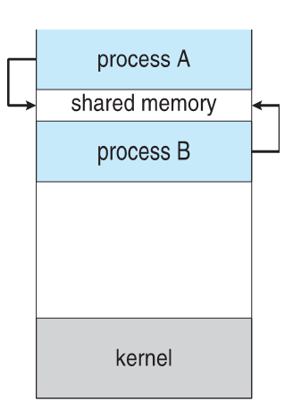
Shared memory
共享内存区映射图

Slide 237
共享内存（存储区）过程
shmget：依据键值key创建一个共享存储区，返回其描述符
1、利用系统调用int shmget (key_t key, int size, int shmflg)新建或获取一段键值为key，大小为size，标志为shmflg的共享内存，返回共享内存标识符，如：
int shmid = shmget(key, 1024, IPC_CREAT|0666) ;
如创建一个key=0x8888，大小为1024字节，访问权限为0666的共享内存区
IPC_CREAT：如果键值0x8888对应的共享存储区不存在，创建之，访问权限为0666，并返回其标识符；如果已经存在，返回其标识符；
int shmid = shmget(key,size, IPC_CREAT |IPC_EXCL|0666);
如果key对应的共享存储区已经存在，返回错误（-1）
如果key对应的共享存储区不存在，创建之，返回shmid
int shmid = shmget(IPC_PRIVATE, size,S_IRUSR|S_IWUSR);
IPC_PRIVATE=0，创建仅在该进程内使用的的共享存储区，访问权限为0600
思考：有何意义，或有何作用？
int shmid = shmget(key, size,IPC_EXCL);
如果key对应的共享存储区已经存在，返回shmid //key != IPC_PRIVATE
如果key对应的共享存储区不存在，返回错误（-1）

Slide 238
共享内存（存储区）过程
shmat: 将新建的存储区附接到进程
2、利用系统调用void *shmat(int shmid, const void *shmaddr, int shmflg)把标识符shmid所指的共享内存区对象映射（附接）到调用进程的地址空间上，返回附接地址。如
shmaddr = (char *)shmat( shmid, NULL, 0 ) ;
第1步中创建的共享内存不属于任何进程地址空间的一部分，由于存储保护的原因，所有进程无法访问该共享存储区的地址空间
将共享存储区附接到一个进程的地址空间上之后，该共享存储区就成为该进程虚地址空间的一部分，进程就能够以存取其它虚地址一样的方法访问它

Slide 239
共享内存（存储区）过程
读写共享存储区
3、读写共享内存（理论上，读写之间的同步需要借助于信号量实现）
写
strcpy( shmaddr, "Hi, I am child process!\n") ;
scanf(“%[^\n]”, shmaddr); //字符串的结束符为回车
sprintf(shmaddr,”Hi, there!”);
读
char *str=shmaddr; //读取的内容
printf(“%s\n”,str);

Slide 240
Shared memory
shmdt:共享存储区使用完毕后，与进程分离，然后释放
4、分离共享内存：当程序不再需要共享内时，需要将共享内存与进程地址空间分离以便对其进行释放，如
int ret=shmdt( shmaddr ) ;
5、shmctl:释放共享内存，如
shmctl(shmid, IPC_RMID, NULL) ;
参数IPC_RMID：删除由shmid标识的共享存储区

Slide 241
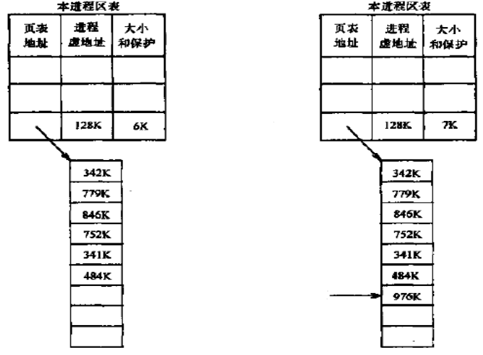
关于共享内存区与进程地址空间的附接与分离
数据表项
数据表项
附接之前可访问的数据空间大小
附接之后，进程可访问附接上的1K共享存储区
附接1KB的共享存储区
empty
附接之前
附接之后

Slide 242
Shared memory
ipcs命令---显示已经创建的消息队列、共享内存以及信号量
ipcs： ipcs –m：仅显示已创建共享存储区
ipcs –q：仅显示已创建的消息队列
ipcs –s：仅显示已创建信号量
ipcrm命令 –删除已创建的ipc
ipcrm [ -m SharedMemoryID ]
ipcrm [ -M SharedMemoryKey ]
ipcrm [ -q MessageID ]
ipcrm [ -Q MessageKey ]
ipcrm [ -s SemaphoreID ]
ipcrm [ -S SemaphoreKey ]

Slide 243
Shared memory—单进程（Fig. 3.6）
#include <stdio.h>
#include <sys/shm.h>
#include <sys/stat.h>
int main() {
int segment_id; //the identifier for the shared memory segment
char* shared_memory; //a pointer to the shared memory segment
const int size = 4096 //the size (in bytes) of the shared memory segment
//allocate a shared memory segment
// S_IRUSR: Permits the file's owner to read it. (c.f. S_IRGRP) // S_IWUSR: Permits the file's owner to write to it. (c.f. S_IWGRP) segment_id = shmget(IPC_PRIVATE,size,S_IRUSR|S_IWUSR);
//attatch the shared memory segment
shared_memory=(char*)shmat(segment_id,NULL,0);
//write a message to the shared memory segment
sprintf(shared_memory,”Hi, there!”);
//now print out the string from shared memory
printf(“*%s\n”, shared_memory);
//now detach the shared memory segment
shmdt(shared_memory);
//now remove the shared memory segment
shmctl(segment_id ,IPC_RMID,NULL);
return 0;
}

Slide 244
Shared memory例--进程之间通信
所有共享该段内存的进程在获取共享内存的标识符时，即执行系统调用shmid = shmget(0x8888, 1024, IPC_CREAT|0666)时，要使用相同的key值，以指明是共享同一个存储区，如0x8888

Slide 245
Shared memory例--进程之间通信-write.c
#include <unistd.h>
#include <stdlib.h>
#include <stdio.h>
#include <string.h>
#include <errno.h>
#include <string.h>
#include <sys/shm.h>
int main() {
ket_t shm_key=0x1234;
int shmid, ret；
char *sharedmemory;
const int size=getpagesize(); //1024
char str[size], c;
shmid=shmget(shm_key,size,IPC_CREAT|0666);
if (shmid==-1) {
perror("shmget”);
exit(EXIT_FAILURE); }
sharedmemory=shmat(shmid,NULL,0);
if (sharedmemory==(void*)-1) {
perror("shmat");
exit(EXIT_FAILURE); }

Slide 246
Shared memory例--进程之间通信-write.c
do {
printf("You are going to write to Shared Memory:\n");
scanf(“%s”,str);
strcpy(sharedmemory,str);
//写入tired后双方结束发送与接收过程
} while (strncmp(sharedmemory,“tired”,5)!=0);
ret=shmdt(sharedmemory);
if (ret==-1) perror("shmdt");
ret=shmctl(shmid,IPC_RMID,NULL);
if (ret==-1) perror("shmctl");
return EXIT_FAILURE;
}

Slide 247
Shared memory例--进程之间通信-read.c
#include <unistd.h>
#include <stdlib.h>
#include <stdio.h>
#include <errno.h>
#include <string.h>
#include <sys/shm.h>
int main() {
ket_t shm_key=0x1234;
int shmid, ret;
char *sharedmemory;
const int size=getpagesize();
char str[size];
shmid=shmget(shm_key,size,IPC_CREAT|0666);
if (shmid==-1) {
perror("shmget”);
exit(EXIT_FAILURE); }
sharedmemory=shmat(shmid,NULL,0);
if (sharedmemory==(void*)-1) {
perror("shmat");
exit(EXIT_FAILURE); }

Slide 248
Shared memory例--进程之间通信-read.c
while(1) {
//等待写进程写入数据；应该用信号量实现同步
while (strlen(sharedmemory)==0) ;
str=sharedmemory;
printf("read: %s\n",str);
if (strncmp(sharedmemory,“tired",5)==0) break;
//清除共享内存，为了接收时判断是否有写入数据
strcpy(sharedmemory,“\0”);
}
ret=shmdt(sharedmemory);
if (ret==-1) perror("shmdt");
ret=shmctl(shmid,IPC_RMID,NULL);
if (ret==-1) perror("shmctl");
return EXIT_FAILURE;
}

Slide 249
Message-passing
消息队列通信过程
1、利用系统调用int msgget(key_t key, int msgflg)新建或获取一个消息队列，返回消息队列标识符。如
msqid = msgget(0x1234,IPC_CREAT|0666); //通信的进程必须使用相同的key值
可以用msqid = msgget(0x1234, IPC_EXCL);检查该key值对应的消息队列是否已经存在
2、发送/接收消息
可以利用下列函数发送/接收消息
int msgsnd(int msqid, const void *msgp, size_t msgsz, int msgflg);
int msgrcv(int msqid, void *msgp, size_t msgsz, long msgtyp, int msgflg);
如：
msgsnd(msgid, (void*)&msgdata, MAX_TEXT, 0) ; // MAX_TEXT最大一般是8192 bytes （8KB）
msgrcv(msgid, (void*)&msgdata, BUFSIZ, msgtype, 0) ;
BUFSIZ在stdlib.h中定义，其值=8192 （8KB）
3、删除消息队列
通信结束后应删除消息队列
int msgctl(int msgid, int command, struct msgid_ds *buf);
如：msgctl(msgid, IPC_RMID, 0); // command还有其他选项

Slide 250
Message-passing
int msgsnd(int msqid, const void *msgp, size_t msgsz, int msgflg);
msgid：由msgget函数返回的消息队列标识符
msgp：一个指向准备发送的消息结构的指针，例如，一个消息结构如下：
struct msg { //头文件<sys/msg.h>或<linux/msg.h>中定义
long int message_type; //>0,接收函数根据该消息类型接收消息
char text[1]; //长度应与msgsz 声明的一致（纯数据，不包括消息类型）
};
msgsz：msg_ptr指向的消息数据的长度，即上例中的BUFSIZ
msgflg：0：当队列满，进程阻塞；IPC_NOWAIT：进程不阻塞，返回-1；
命令ipcs –l 可查看消息队列最大长度、每个消息最大字节数、消息队列最大占用的字节数
ret=msgsnd(….)：如果调用成功， 将msgp指定的消息放到消息队列中，并返回0，失败时返回-1.

Slide 251
Message-passing
int msgrcv(int msqid, void *msgp, size_t msgsz, long msgtyp, int msgflg);
msgid：由msgget函数返回的消息队列标识符
msgp：一个指向准备发送消息的指针，消息结构如下：
struct my_message {
long int message_type; //接收函数将根据该消息类型确定是否接收该消息
char text[1];
};
msgsz：msg_ptr指向的消息数据的长度（纯数据）
msgtyp：
=0：获取队列中的第一个消息；
>0：获取指定消息类型的第一个消息（在msgsnd()中指定发送的消息类型）；
<0：获取类型等于或小于msgtype的绝对值，且绝对值最小的第一个消息
msgflg：0：当队列空，进程阻塞；IPC_NOWAIT：进程不阻塞，返回-1；
命令ipcs –l 可查看消息队列最大长度、每个消息最大字节数、消息队列最大占用的字节数
ret=msgrcv (….) ：调用成功时，返回放到接收缓存区中的字节数，消息被复制到由msgp指向的用户分配的缓存区中，然后删除消息队列中的对应消息。失败时返回-1.

Slide 252
3.6 Communication in Client-Server Systems
不同系统中进程之间的通信
网络间通信
Sockets
Remote Procedure Calls
Remote Method Invocation (Java)

Slide 253
3.6.1 Sockets
A socket is defined as an endpoint for communication
Concatenation of IP address and port
The socket 161.25.19.8:1625 refers to port 1625 on host 161.25.19.8
Communication consists between a pair of sockets

Slide 254
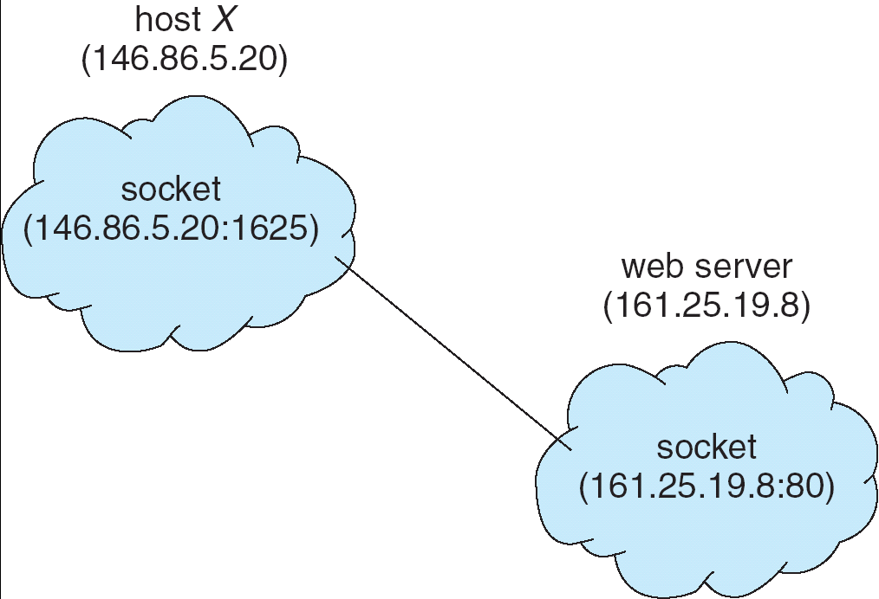
Socket Communication

Slide 255
3.6.2 Remote Procedure Calls
Remote procedure call (RPC) abstracts procedure calls between processes on networked systems.
Stubs – client-side proxy for the actual procedure on the server.
The client-side stub locates the server and marshalls the parameters.
The server-side stub receives this message, unpacks the marshalled parameters, and performs the procedure on the server.

Slide 256
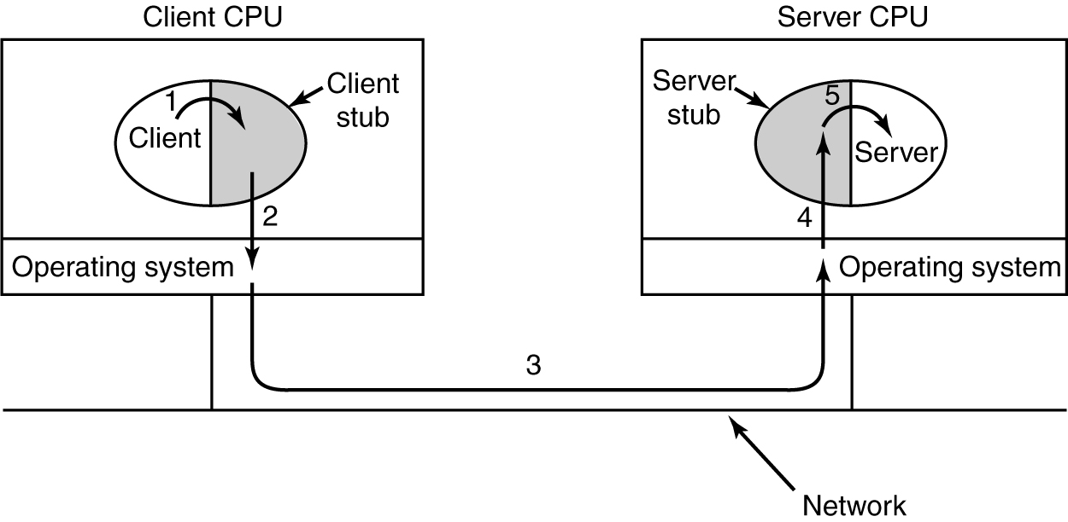
Remote Procedure Call

Slide 257
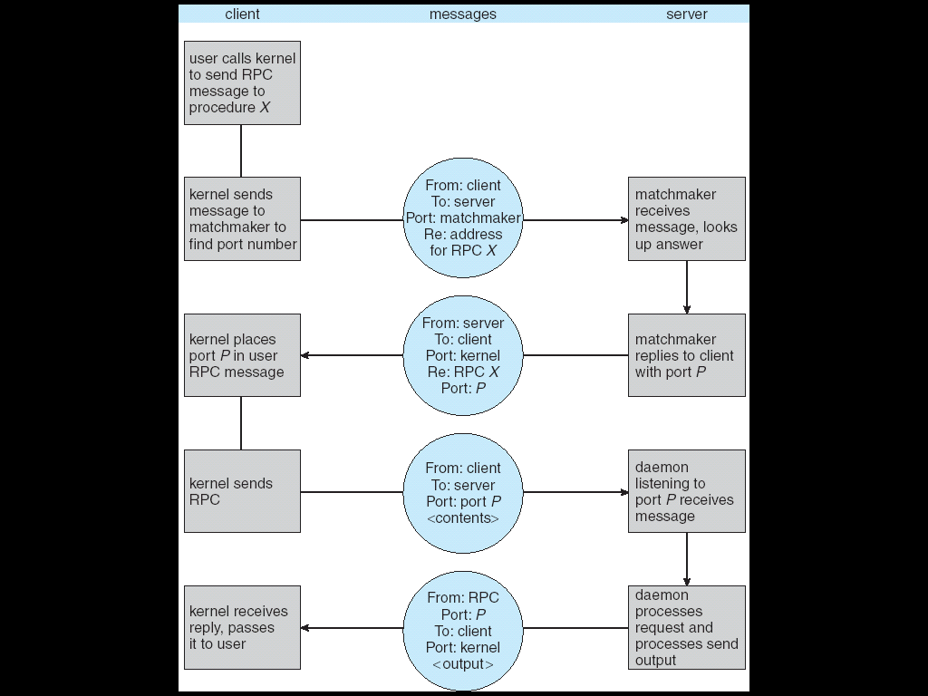
Execution of RPC

Slide 258
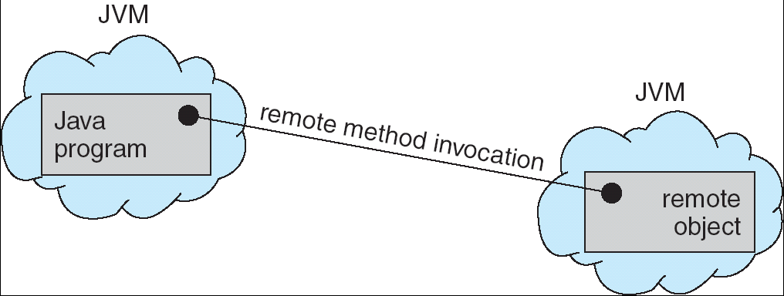
3.6.3 Remote Method Invocation
Remote Method Invocation (RMI) is a Java mechanism similar to RPCs.
RMI allows a Java program on one machine to invoke a method on a remote object.

Slide 259
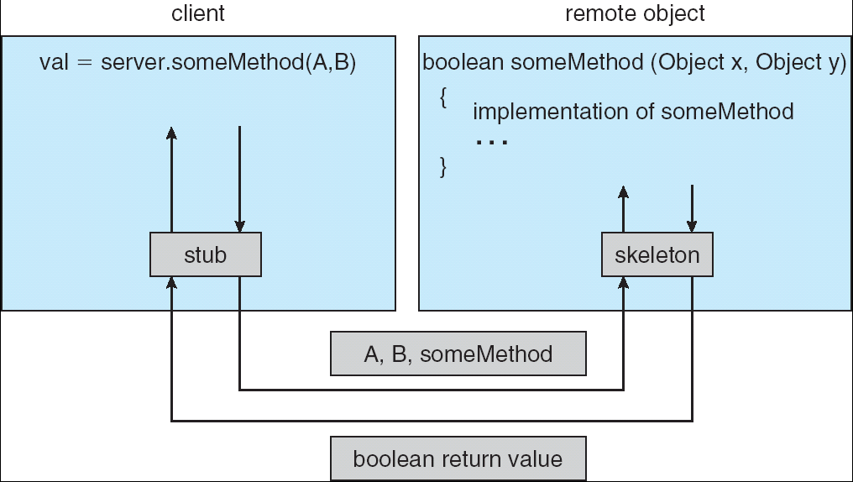
Marshalling Parameters

Slide 260
课后复习题
要点
进程的概念
进程的状态、转换及其转换条件（状态转换图）
PCB的概念及其作用
进程的创建与撤销的相关知识（包括例题）
几种进程间的通信方法
What are the two models of interprocess communication? What are the strengths and weaknesses of the two approaches?
Page 116
1,2,4

Slide 261
End of Chapter 3

