Slide 1


Algorithm Design and Analysis
姜海涛
School of Computer Science and Technology
Shandong University
htjiang@sdu.edu.cn

Slide 2
Text Book & Reference Books
Text Book:
  Introduction to Algorithms (Third Edition)
    Thomas H. Cormen, Charles E. Leiserson, Ronald L. Rivest and Clifford Stein
    The MIT Press (Higher Education Press)
    Chapter 22-26
Reference Books
  《图算法》：马绍汉编著，山东大学出版社。

Slide 3
Why Study this Course?
Closely related to our lives(打酒,货郎).
Help to learn how others analyze and solve problems.
Help to develop the ability of analyzing and solving problems via computers.
Very interesting if you can concentrate on this course.

Slide 5
Prerequisite
Data Structure(二维数组,链表,队列,堆栈)
C/C++, Java or other programming languages
A little mathematics(初等数学)
Ready? Let’s begin ……

Slide 6
Lecture 1
Time Complexity
Time Complexity
掌握算法的时间复杂度的概念？
能分析一个算法的时间复杂度
掌握时间复杂度的三个表示符号。

Slide 7
What is a Problem?
A general question to be answered, usually possessing several parameters or free variables, whose value are left to be specified.
Described by giving:
  Input(instance): A general description of all its parameters
  Output(question): A statement of what properties the answer is required to satisfy.

Slide 8
What is an Algorithm?
An algorithm is a detailed step-by-step method for solving a problem.
x¹⁰=x• x• x• x• x• x• x• x• x• x
x¹⁰=((x• x)²• x)²
An algorithm is a detailed step-by-step method for solving a problem.

Slide 10
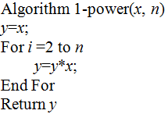
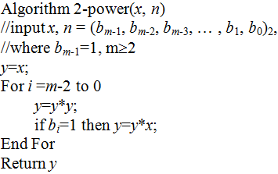
Two Algorithms
Exponentiation(求幂运算):
  Input: x ∈ R, n ∈ N⁺.
  Question: x^{n}

Slide 11
How to Evaluate an Algorithm?
The Time Complexity
  Polynomial Time Problem
  (all the problems in this course)
    How to search a graph?
    Minimum Spanning Tree Problem
    Shortest Path Problem
    Maximum Flow Problem
  NP-hard Problem
    Fixed Parameter Tractable
    W-hard Problem
The Approximation Factor

Slide 12
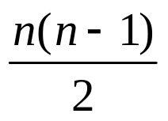
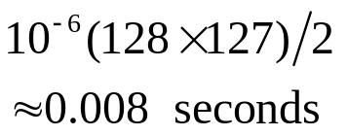
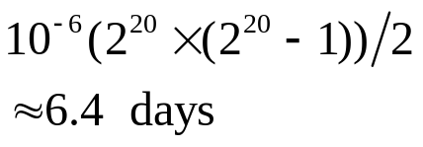
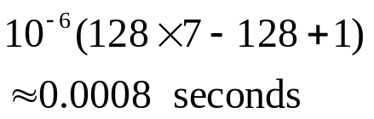
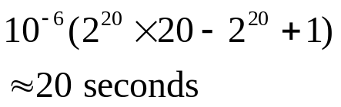

An example to illustrate the importance of analyzing the running time of an algorithm
The Sorting Problem:
Input(实例): An array of n elements A[1…n],
Output(询问): Sort the entries in A in non-decreasing order.
Assumption: each element comparison takes 10⁻⁶ seconds on some computing machine.
algorithm | # of element comparisons | n=128 =2⁷ | n=1,048,567 =2²⁰
Selection Sort (选择排序)
Merge Sort (归并排序)

Slide 13
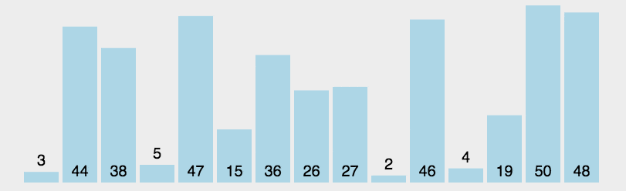

Slide 14
The Importance of Analyzing the Running Time of an Algorithm
Conclusion: Time is undoubtedly an extremely precious resource to be investigated in the analysis of algorithms.
Question: How to Analyze Running Time?

Slide 15
Asymptotic Running Time(渐近估计)
How to measure the efficiency of an algorithm from the point of view of time?
Is actual (exact) running time a good measure?
The answer is No. Why?
1. Actual time is determined by not only the algorithm, but also many other factors;
2. The measure should be machine or technology independent;
3. Our estimates of times are relative as opposed to absolute;
4. Our main concern is not in small input instances but the behavior of the algorithms under investigation on large input instances.
Then, is there a better measure? The answer is Yes. It is
asymptotic running time

Slide 16
Elementary Operation
Elementary Operation(基本操作): Any computational step whose cost is always upper-bounded by a constant amount of time regardless of the input data or the algorithm used.
Examples of elementary operations:
  Arithmetic operations: addition, subtraction, multiplication and division.
  Comparisons and logical operations.
  Assignments, including assignments of pointers.
Instance size or Input size(实例长度,输入长度):
  The number of elements in an array(n).
  For graph, the number of vertices (|V|)and the number of edges(|E|).

Slide 17
Time Complexity (continued)
What’s Time Complexity?
When analyzing the running time of an algorithm, we are only interest in the elementary operations, the total number of elementary operations is called the time complexity of the algorithm.
在算法分析中,总是只考虑算法中的基本操作, 并估计算法执行过程中所需要的基本操作总次数,这个总操作次数称为算法的时间复杂度.
Once again, we are interested in the running time for large input sizes, or more precisely, we want to discover how fast the running time of an algorithm increases as the size of the input increases (This is called order of growth of the algorithm，增长趋势).

Slide 18
Asymptotic Running Time (continued)
  The running time of an algorithm is a function of input size, e.g. f(n);
  In the expression of the function, the costs of elementary operations can be written as their upper-bounds,
  e.g. f(n) = c₁n² + c₂n + c₃, c₁, c₂, c₃ > 0;
  The lower-order terms can be abandoned (or neglected) safely, e.g. f(n) = c₁n² ;
  The leading constants can also be abandoned safely,
  e.g. f(n) = n² ;
Once we dispose of lower-order terms and leading constants from a function that expresses the running time of an algorithm, we say that we are measuring the asymptotic running time of the algorithm.

Slide 19
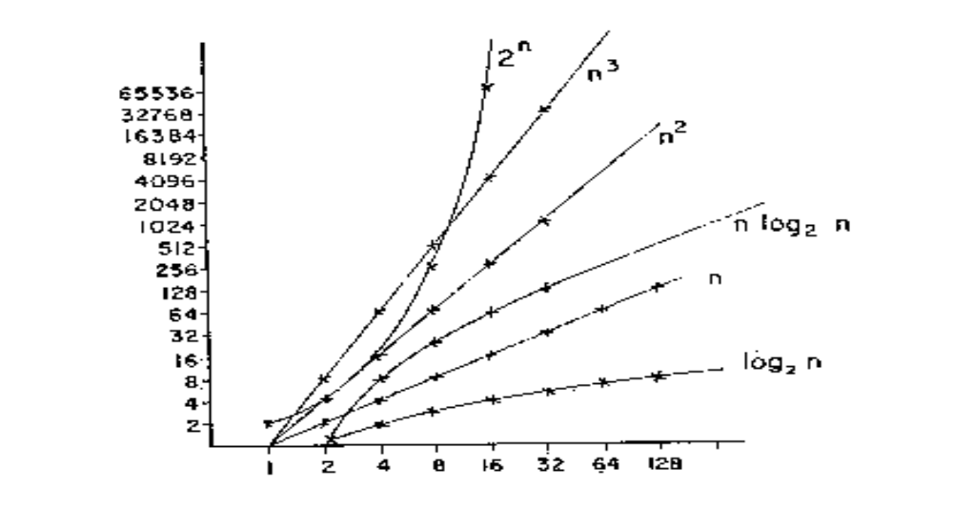
Illustration of some typical asymptotic running time functions
We can see:The linear algorithm is obviously slower than the quadratic one and faster than logarithmic one, etc..
We can say: The quadratic algorithm has a higher order of growth, higher order of asymptotic running time, or higher order of time complexity, than the linear one; etc..

Slide 20
Asymptotic Notations
To describe the asymptotic running time of an algorithm in a convenient way, notations are introduced. These notations are so-called Asymptotic Notations.
In this course, we use three notations:
    O(.) : “Big-Oh” – the most used
    Ω(.) : “Big omega”
    Θ(.) : “Big theta”

Slide 21
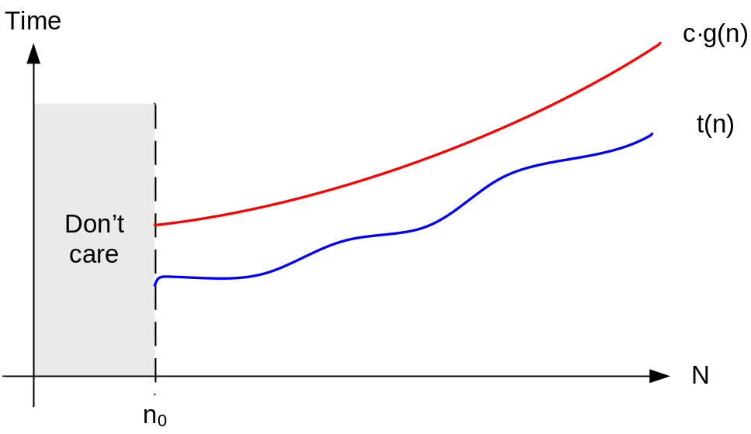
O-notation
Informal definition of O(.):
  If an algorithm’s running time t(n) is bounded above by a function g(n), to within a constant multiple c, for n > n₀, we say that the running time of the algorithm is O(g(n)).
Obviously, O-notation is used to bound the worst-case running time of an algorithm

Slide 22
O-notation
Formal definition of O(.):
  A founction t(n) is said to be in O(g(n)), if there exist some c > 0, n₀ > 0, such that t(n) ≤ cg(n), for all for n > n₀.

Slide 23
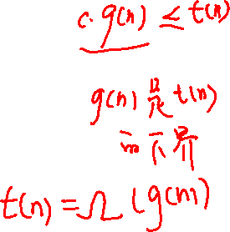
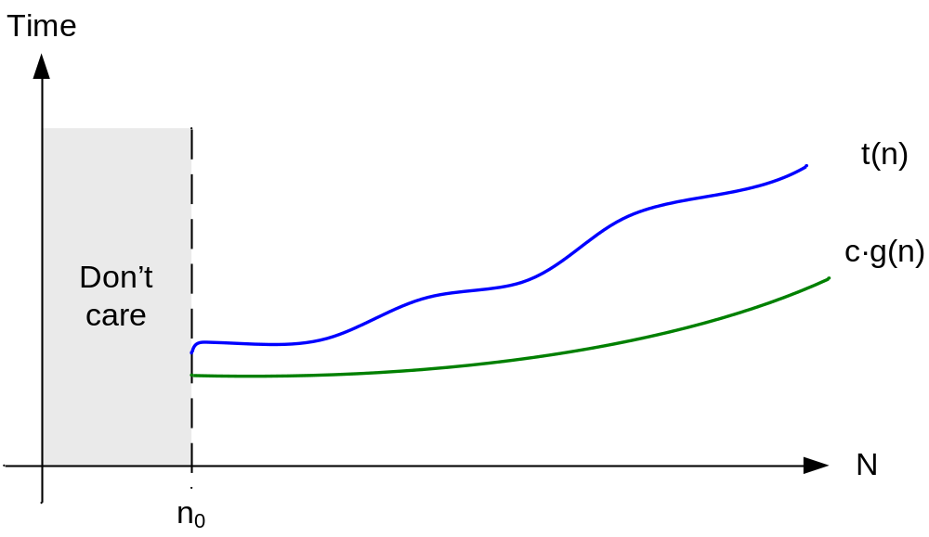
Ω-notation
Informal definition of Ω(.) :
  If an algorithm’s running time t(n) is bounded blow by a function g(n), to within a constant multiple c, for n > n₀, we say that the running time of the algorithm is Ω(g(n)).

Slide 24
Ω-notation
Formal definition of Ω(.) :
  A founction t(n) is said to be in Ω(g(n)), if there exist some c > 0, n₀ > 0, such that t(n) ≥ cg(n), for all n > n₀.
Obviously, Ω -notation is used to bound the best-case running time of an algorithm

Slide 25
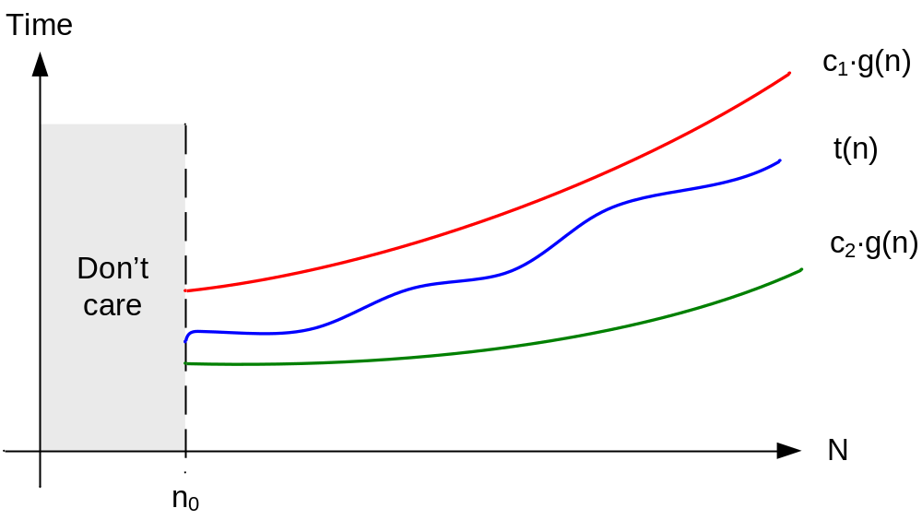
Θ-notation
Informal definition of Θ(.) :
  If an algorithm’s running time t(n) is bounded above and blow by a function g(n), to within a constant multiple c₁ and c₂, for n > n₀, we say that the running time of the algorithm is Θ(g(n)).

Slide 26
Θ-notation
Formal definition of Θ(.) :
  A function t(n) is said to be in Θ(g(n)) if there exist c₁ > 0, c₂ > 0, and n₀ > 0, such that c₂g(n) ≤ t(n) ≤ c₁g(n), for all n > n₀.

Slide 27
Three Types of Analysis
Best-Case Analysis: too optimistic
Average-Case Analysis: too difficult, e.g. the difficulty to define “average case”, the difficulty related with mathematic
Worst-Case Analysis: very useful and practical. We will adopt this approach.

Slide 28
Evaluate the two algorithms
Exponentiation(求幂运算):
Input: x ∈ R, n ∈ Z⁺.
Question: x^{n}
Time Complexity is O(n)
Time Complexity is O(logn)

Slide 29
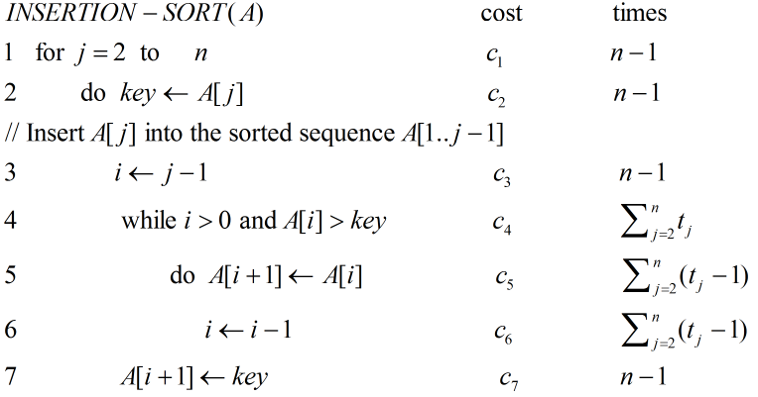
Example of Three Types of Analysis

Slide 30
Conclusion
问题、算法、算法的时间复杂度、三个渐进估计表示符号。
重点：掌握算法的时间复杂度的概念，能分析一个算法的时间复杂度。

Slide 31
Graph Preliminary Knowledge
In this class, try to answer three questions:
  What is a graph?
  How to represent a graph?
  Basic properties of a graph

Slide 32
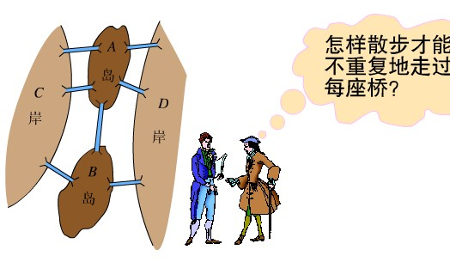

Graph Preliminary Knowledge
The origination of graph
(Maybe the first graph!) 哥尼斯堡七桥问题.

Slide 33
Graph Basics (Undirected)
A Graph G is a pair (V, E), where V is a finite set of objects and E is a set of pairs on V
  Denoted as G = (V, E)
  Element of V: vertex; V: vertex set
  Element of E: edge(arc); E: edge set
Undirected Graph : each pair in E is unordered, i.e., if (u, v) ∈E, then (u, v) = (v, u).
Undirected graph: G₁ = (V={1, 2, 3}, E={(1, 2), (2, 3), (3,1)})
or G₁ = (V={1, 2, 3}, E={(2, 1), (3, 2), (1,3)})
1
2
3

Slide 34
Graph Basics (Directed)
Directed Graph: each pair in E is ordered, i.e., for each pair of vertices, u, v, <u, v> ∈ E does not necessarily mean <v, u> ∈ E, and vice versa.
Directed graph: G₂ = (V={1, 2, 3}, E={<1, 2>, <2, 3>, <3,1>})
1
2
3

Slide 35
Schematic Representation
e₆
e₆
v₁
e₁
e₁
v₂
v₅
v₁
v₂
v₅
e₂
e₃
e₇
e₂
e₃
e₇
e₄
v₄
e₄
v₃
v₆
v₃
v₄
v₆
e₅
e₅
Can you give the representation in format G = (V, E) for above graphs?

Slide 36
Graph Basics (Adjacency)
Adjacency: In a graph G = (V, E), if (u, v) ∈ E, we say that vertex v is adjacent to vertex u.
  If G is an undirected graph, vertex u is adjacent to vertex v, too. The adjacency relation is symmetric.
  We also say (u , v) is incident with u and v, vice versa.
  If G is a directed graph and if <u, v> ∈ E, vertex v is adjacent to vertex u. Now, <u, v> is from (or leaves) vertex u to (or enters) vertex v.

Slide 37
Graph Basics(Multiple, Simple)
Repeated edges: edges e and f have the same endpoints.
Self-loop: an edge from a vertex to itself.
Simple graph: a graph without repeated edges and without self-loops.
Weighted graph: each edge e has a weight w(e), w(e)∈R.

Slide 38
Graph Basics (Degree)
Degree of a vertex v:
  For undirected graph:
    Number of edges incident with v.(Self-loop?)
    Denote as d_{G}(v) or simply, d(v).
  For directed graph:
    In-degree: number of edges entering (or incident to) v.
    Out-degree: number of edges leaving (or incident from) v.
    Denote as id_{G}(v), od_{G}(v) or simply, id(v), od(v) respectively.
Isolated vertex: a vertex whose degree is 0.

Slide 39
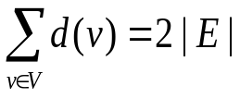
Graph Properties
Theorem 1.1 (Handshaking Lemma)
  Given an undirected graph G = (V, E), , where | E | is the number of edges in G.
  Proof: can you give?
  How about a directed graph? (sum of in-degrees equals to sum of out-degrees, i.e., the number or arcs)
Corollary 1.2
  Given an undirected graph G = (V, E), the number of vertices with odd degrees is even.
  Proof: can you give?

Slide 41
Graph Basics (Cycle)
A path is a sequence of vertices p = <v₀, v₁, v₂, …, v_{k}> such that (v_{i},v_{i+1}) ∈E, i=0,1,…,k-1.
  路径: v₀, v₁, …, v_{k} are distinct (except that v₀ = v_{k}).
  通路: otherwise
A cycle is a path c = <v₀, v₁, v₂, …, v_{k}> with v₀ = v_{k}.
  圈和回路.
  For undirected graph, a cycle contains at least 3 edges, that is, k ≥ 3 and v₁, v₂, …, v_{k} are distinct.
  For directed graph, a cycle contains at least 2 edge.
  A self-loop is a cycle of length 1.
Acyclic graph: a graph with no cycles.

Slide 42
Graph Basics (Sub-graph)
A graph G’ = (V’, E’) is a sub-graph of G = (V, E) if V’⊆ V and E’ ⊆ E.
  A graph G’ = (V’, E’) is a vertex induced sub-graph of G = (V, E) if V’⊆ V and E’ = {(u, v) ∈ E: u, v ∈V’}.

Slide 43
Graph Basics (Connected)
An undirected graph is connected if every pair of vertices is connected by a path.
  Connected component of a graph: a sub-graph that is connected and is not included in any other connected sub-graphs with more edges or vertices.
  Any connected, undirected graph G = (V, E) satisfies that | E | ≥ | V | -1.
A directed graph is strongly connected if every two vertices are reachable from each other.
  Strongly connected components of a directed graph

Slide 45
Special graphs
A complete graph is an undirected graph in which every pair of vertices is adjacent.
A bipartite graph is a graph G = (V, E) in which V can be partitioned into two sets V₁ and V₂ such that (u, v) ∈ E implies either u∈V₁ and v∈V₂ or u∈V₂ and v∈V₁.
A tree is a connected, acyclic, undirected
graph.(|E|=|V|-1; a unique path between any pair of vertices.)
A forest is an acyclic, undirected graph.

Slide 46
Representations of graphs
Two standard ways:
  A collection of adjacency lists
  An adjacency matrix
Sparse graph: | E | is much less than | V |²
  Adjacency-list representation is preferred
Dense graph: | E | is close to | V |²
  Adjacency-matrix representation is preferred

Slide 47
Adjacency-list representation
consist of an array Adj of | V | lists, one for each vertex in V.
adjacency list Adj[u] contains all the vertices v such that there is an edge (u, v) ∈ E, i.e., all vertices that are adjacent to u.
vertices in Adj[u] can be stored in arbitrary order.

Slide 48
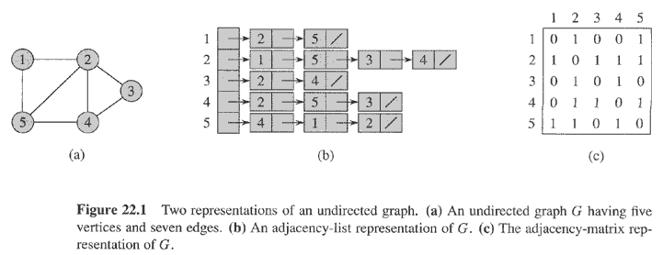
Representations of graphs (Examples)

Slide 49
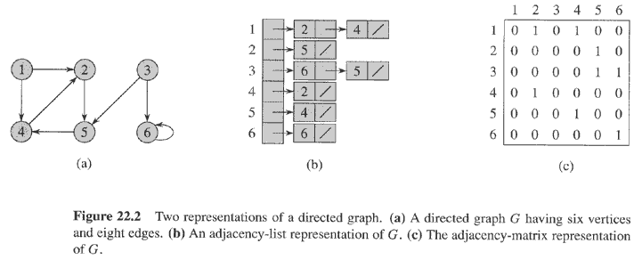
Representations of graphs (Examples)

Slide 50
Adjacency-list representation
Some questions.
  How to compute the degree of each vertex?
  What is the total length of all the adjacency-lists?
  How to determine whether a given edge is present in the graph or not?

Slide 51
Adjacency-list representation
sum of the lengths of all the adjacency lists is
  2| E | if G is an undirected graph
  | E | if G is a directed graph
Memory needed to store an adjacency-list representation of a graph is O(| V | + | E |)
Weighted graph can be represented by adjacency lists.

Slide 52
Adjacency-list representation (advantage vs disadvantage)
Advantage:
  when the graph is sparse, uses only O(| V | + | E |) memory.
Disadvantage:
  no quicker way to determine if a given edge (u, v) is present in the graph than searching v in the adjacency list Adj[u]. O(| V |)

Slide 53
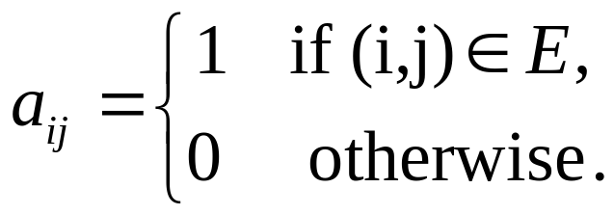
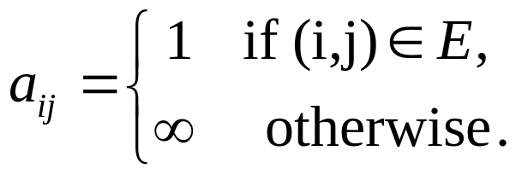
Adjacency-matrix representation
Consists of a | V | × | V | matrix A = (a_{ij}) such that
or
A is symmetric along the main diagonal for undirected graphs, that is, A^{T} = A.
For directed graph, generally, A^{T} ≠ A. Can you imagine what directed graph satisfies A^{T} = A?
Adjacency-matrix can be used to represent weighted graphs.

Slide 54
Representations of graphs (Examples)

Slide 55
Representations of graphs (Examples)

Slide 56
Properties of adjacency-matrix representation
Lemma1.3: Suppose that A is the adjacency-matrix representation of an undirected graph G, then the element A^{k}[i, j] of A^{k} = A⋅A⋅… ⋅A is the number of paths(通路) of length k that connect vertices i and j.
  Proof by induction on k.
    Basic step: k = 1, A¹ = A, A[i, j] is the number of paths of length 1 that connect vertices i and j.
    Hypothesis : A^{k}[i, j] is the number of paths of length k that connect vertices i and j.
    Inductive step: A^{k+1}=A ⋅ A^{k}, we have A^{k+1}[i, j] = Σ_{l∈V} A[i, l] ⋅ A^{k}[l, j]. For A[i, l] is the number of paths of length 1 that connect vertices i and l, A^{k}[l, k] is the number of paths of length k that connect vertices l and j. So, A[i, l] ⋅ A^{k}[l, j] is the number of paths of length k+1 that connect vertices i and j via l. Consider all vertices l, 1≤ l ≤ n, we get our conclusion.

Slide 57
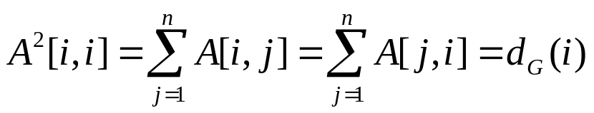
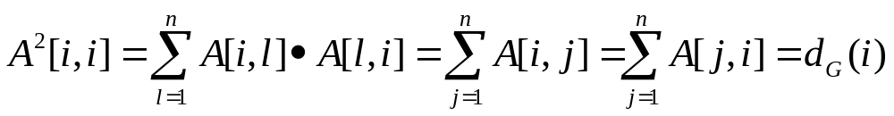
Properties of adjacency-matrix representation
Corollary 1.4
Proof: For symmetry of adjacency-matrix,
A[i, l]=A[l, i] = 0 or 1, so
1
2
A²[1, 1]: 2: (1, 2, 1), (1, 3, 1)
A²[2, 2]: 3: (2, 1, 2), (2, 3, 2), (2, 4, 2)
3
4

Slide 58
Adjacency-matrix representation (Advantage vs disadvantage)
Advantage:
  Easily or quickly to determine if an edge is in the graph or not. O(1)
Disadvantage:
  Uses more memory to store a graph. O(| V |²)

Slide 59
Conclusion
图的一些基本概念。
图的一些基本性质：握手定理及推论，连通性及点边数量关系。
重点：掌握图的两种表示方式及各自优缺点。

