Slide 1

Lecture 12
Maximum Flow Continued
Edmonds-Karp algorithm
Maximum bipartite matching

Slide 2
The Ford-Fulkerson Method
FORD-FULKERSON-METHOD(G,s,t)
  initialize flow f to 0
  while there exists an augmenting path p
  do augment flow f along p
  return f

Slide 4
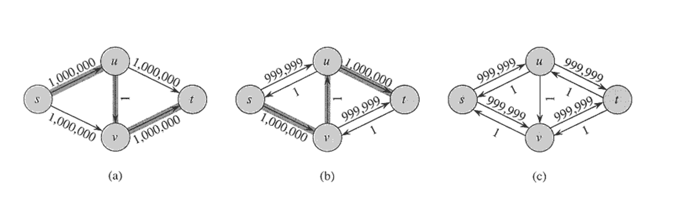
Analysis of Ford-Fulkerson Method
Time complexity: O(E|f*|)

Slide 5
Edmonds-Karp Algorithm
The augmenting path is a shortest path from s to t in the residual network, where each edge has unit weight.
Time complexity: O(VE²)

Slide 6
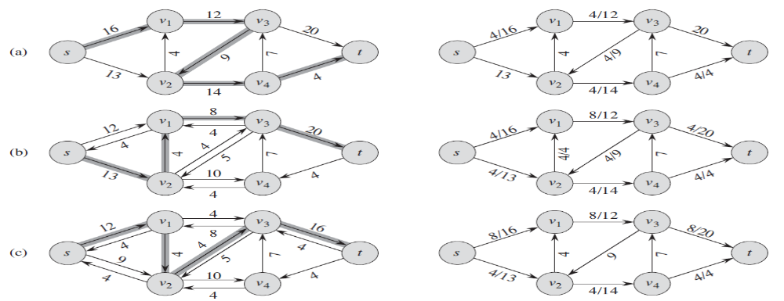
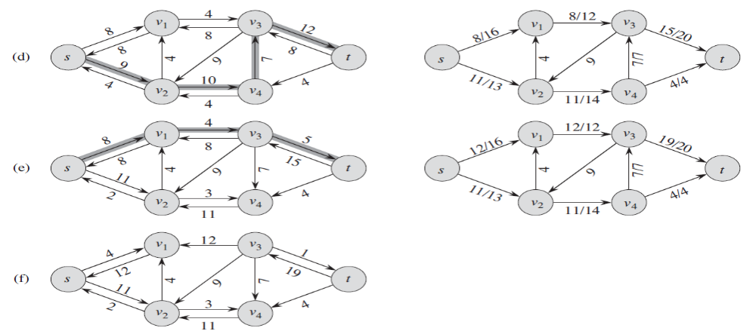

Slide 7
a
12
b
16
20
s
4
7
t
9
13
c
d
4
14

Slide 8
12
a
12
b
a
b
20
16
20
16
s
4
7
t
s
4
7
t
9
9
13
4
13
c
d
4
c
d
14
14
a
12/12
b
12/16
12/20
s
4
7
t
9
13
c
d
4
14

Slide 9
12
a
12
b
a
b
20
16
20
16
s
4
7
t
s
4
7
t
9
9
13
4
13
c
d
4
c
d
14
14
12/12
a
12
b
a
b
4
8
12/16
12/20
12
12
s
4
7
t
s
4
7
t
9
9
13
c
d
4
13
c
d
4
14
14

Slide 10
a
12
b
a
12
b
16
20
16
20
s
4
7
t
s
4
7
t
9
9
13
c
d
4
13
c
d
4
14
14
a
12/12
b
a
12
b
12/16
12/20
4
8
12
4
7
12
t
s
4
7
t
s
9
9
13
c
d
4
13
c
d
4
14
14
a
12/12
b
12/16
12/20
s
4
7
t
9
4/13
c
d
4/4
4/14

Slide 11
a
12
b
a
12
b
16
20
16
20
s
4
7
t
s
4
7
t
9
9
13
c
d
4
13
c
d
4
14
14
a
12/12
b
a
12
b
12/16
12/20
4
8
12
4
7
12
t
s
4
7
t
s
9
9
13
c
d
4
13
c
d
4
14
14
a
12/12
b
a
12
b
12/16
12/20
4
8
s
12
4
7
12
t
s
4
7
t
9
9
9
4
c
10
d
4
4/13
c
d
4/4
4/14
4

Slide 12
a
12
b
a
12
b
16
20
16
20
s
4
7
t
s
4
7
t
9
9
13
c
d
4
13
c
d
4
14
14
a
12/12
b
12/16
12/20
a
12
b
4
8
s
4
7
t
12
12
9
s
4
7
t
4
9
13
c
d
14
13
c
d
4
12/12
14
a
b
12
12/16
12/20
a
b
4
8
s
4
7
t
s
12
4
7
12
t
9
9
9
4/13
c
d
4/4
4
c
10
d
4
4/14
4
a
12/12
b
12/16
19/20
s
4
7/7
t
9
11/13
c
d
4/4
11/14

Slide 13
a
12
b
a
12
b
16
20
16
20
s
4
7
t
s
4
7
t
9
9
13
c
d
4
13
c
d
4
14
14
a
12/12
b
12/16
12/20
a
12
b
4
8
s
4
7
t
12
12
9
s
4
7
t
4
9
13
c
d
14
13
c
d
4
12/12
14
a
b
12
12/16
12/20
a
b
4
8
s
4
7
t
s
12
4
7
12
t
9
9
9
4/13
c
d
4/4
4
c
10
d
4
4/14
4
a
12/12
b
a
12
b
12/16
19/20
4
1
4
t
12
4
7
12
t
s
7/7
s
9
2
9
11/13
c
d
4/4
11
c
3
d
4
11/14
11

Slide 14
Critical Lemma
Lemma 26.8
If the Edmonds-Karp is run on a flow network G= (V, E) with source s and sink t, then for all vertices v∈V-{s,t}, the shortest-path distance δ_{f} (s,v) in the residual network G_{f} increases monotonically with each flow augmentation.

Slide 15
a
12
b
a
12
b
16
20
16
20
s
4
7
t
s
4
7
t
9
9
13
c
d
4
13
c
d
4
14
14
a
12/12
b
12/16
12/20
a
12
b
4
8
s
4
7
t
12
12
9
s
4
7
t
4
9
13
c
d
14
13
c
d
4
12/12
14
a
b
12
12/16
12/20
a
b
4
8
s
4
7
t
s
12
4
7
12
t
9
9
9
4/13
c
d
4/4
4
c
10
d
4
4/14
4
a
12/12
b
a
12
b
12/16
19/20
4
1
4
t
12
4
7
12
t
s
7/7
s
9
2
9
11/13
c
d
4/4
11
c
3
d
4
11/14
11

Slide 17
Proof
  f : the flow before the first augmentation that decreases some δ_{f}(s,v).
  f’: the flow after the augmentation.
  Let v∈V-{s,t} be the vertex with the minimum δ_{f’}(s,v) whose distance was decreased by the augmentation, so that δ_{f’}(s,v) < δ_{f}(s,v).
  p=s~→u→v be a shortest path from s to v in G_{f’}, so that (u,v)∈ E_{f’}and
  δ_{f’}(s,u) = δ_{f’}(s,v)-1.
  We have δ_{f’}(s,u) ≥δ_{f}(s,u)
  Now we prove that (u,v)∉ E_{f} since otherwise,
  δ_{f}(s,v) ≤ δ_{f}(s,u)+1 ≤ δ_{f’}(s,u)+1 = δ_{f’}(s,v), contradicts δ_{f’}(s,v) < δ_{f}(s,v).
  Since (u,v)∉ E_{f} and (u,v)∈ E_{f’}, the augmentation must have increased the flow from v to u. As only flows on the shortest path can be increased, then (v,u) is on the shortest path in G_{f}, thus we have
  δ_{f}(s,v) = δ_{f}(s,u)-1 ≤ δ_{f’}(s,u)-1 = δ_{f’}(s,v)-2, contradicts δ_{f’}(s,v) < δ_{f}(s,v).
  Such vertex v can not exist.

Slide 18
Analyze its time complexity
Theorem 26.9
The total number of flow augmentations performed by the Edmonds-Karp algorithm is O(VE).
critical edge: an edge (u,v) on an augmenting path p with
c_{f}(p)= c_{f}(u,v)
There must be at least one critical edge on an augmenting path. After augment the flow, the critical edge disappears from the residual network.
To prove the theorem, we will show that each edge can become critical at most (|V|-1)/2 times.

Slide 20
Proof of the Theorem
  (u,v)∈E, when (u,v) is critical on an augmenting path for the first time, we have, δ_{f}(s,v) =δ_{f}(s,u)+1.
  Then (u,v) disappears from the residual network. It can not reappear until the flow from u to v is decreased, which occurs only if (v,u) appears on an augmenting path. If f’is the flow in G when this event occurs, then we have δ_{f’}(s,u) = δ_{f’}(s,v)+1.
  Since δ_{f}(s,v) ≤ δ_{f’}(s,v), then δ_{f’}(s,u) = δ_{f’}(s,v)+1≥ δ_{f}(s,v)+1= δ_{f}(s,u)+2.
  Consequently, from the time (u,v) becomes critical to the time it next becomes critical, the distance of u increases by at least 2. the distance of u is at most |V|-21. Thus, (u,v) can become critical at most (|V|-1)/2≤ |V|/2 times.
  There are at most 2|E| edges and each augmenting path has at least one critical edge.

Slide 21
Maximum Matching in Bipartite Graphs
Bipartite graph G=(V,E): If V=L∪R, and L∩R=∅, and E=E(L, R), that is, each edge with one end in L and the other in R.
Matching: M⊆E, such that no elements in M share common end points.
Maximum matching M: for any other matching M’, there is |M|≥|M’|

Slide 22
Matching and Maximum Matching

Slide 23
Maximum matching in bipartite graph
Problem:
  Input: a bipartite undirected graph G=(L∪R,E)
  Output: a maximum matching M of G.

Slide 24
1
1
1
1
1
1
1
1
1
t
s
1
1
1
1
1
1
1
1

Slide 25
How?
Solution: By using maximum flow algorithm.
Directed graph G’=(V’,E’):
  V’={s,t} ∪V
  E’={(s,u)|u∈L} ∪{(v,t)|v ∈R} ∪{(u,v)| u∈L, v ∈R, (u,v) ∈E}
Network: G’, with source s and sink t, and capacity function f:
  c(s,u)=1
  c(v,t)=1
  c(u,v)=1

Slide 26
Why integer-valued flow
Theorem 26.11
If the capacity function c takes on integral values, then the maximum flow produced by Ford-Fulkerson method has the property that |f| is integer-valued. Moreover all f(u,v) is an integer.

Slide 27
Max. matching VS Max. flow
Lemma 26.10
Let G=(V=L∪R, E) be a bipartite graph and G’=(V’,E’) be its corresponding flow network.
If M is a matching in G, then there is an integer-valued flow f in G’ with value |f|=|M|.
Conversely, if f is an integer-valued flow in G’ , then there is a matching M in G with cardinality |M|=|f|.

Slide 28
1
1
1
1
1
1
1
1
1
t
s
1
1
1
1
1
1
1
1

Slide 29
1
1
1
1
1
1
1
1
1
t
s
1
1
1
1
1
1
1
1

Slide 30
Proof of the Lemma
  (→) Define f: if (u,v) ∈ M, then f(s,u)= f(u,v)=f(v,t)=1 and f(u,s)= f(v,u)=f(t,v)=-1, otherwise f(u,v)=0. f is a flow.
  Each edge (u,v) ∈ M corresponds to 1 unit of flow in G’ that traverses the path s→u→v→t, and the paths are disjoint, except for s and t.
  Then |f|=f(L∪{s},R∪{t})=|M|

Slide 31
Proof of the Lemma
  (←) Define M={(u,v):u∈L,v∈R, and f(u,v)>0}. M is a matching.
  Each vertex u has at most one entering edge (s,u), c(s,u)=1. If one unit positive flow does enter, then one unit positive flow must leave. Since f is integer-valued, the one unit flow can enter and leave on at most one edge. Thus if f(s,u)=1, there is exactly one vertex v such that f(u,v)=1, and at most one edge leaving u carries positive flow.
  For every matched vertex u∈L, f(s,u)=1, and for every edge (u,v)∈E-M, f(u,v)=0.
  |M|= f(L,R) =f(L,V’) - f(L,L) - f(L,s) - f(L,t) = f(s,L) = f(s,V’)=|f|

Slide 32
Correctness and Time Complexity
Corollary 26.12: |M|=|f|. From Lemma 26.10.
Time complexity: O(VE) why?

Slide 33
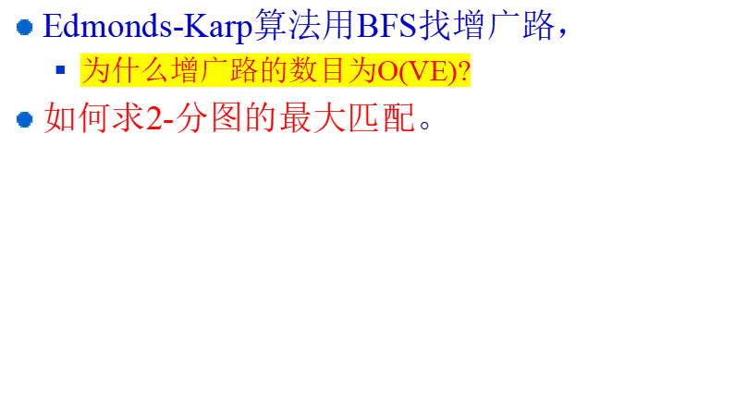
Conclusion

Slide 34
Homework
计算下图的最大匹配

