Slide 1

Lecture 13-2
An Overall Review
Some homework
The total Content

Slide 2
Just for fun
纸上得来终觉浅，恳请老师画重点；
天若有情天亦老，范围一定要画小；
天涯何处无芳草，别说整本书都考；
绝知此事要躬行，老师请念师生情；
春眠不觉晓，挂科得补考；
安能摧眉折腰事权贵，题出难了我不会；
南朝四百八十寺，大题少让写点字；
桃花潭水深千尺，卷子最好一张纸；
谁知盘中餐，代表整个班~

Slide 3
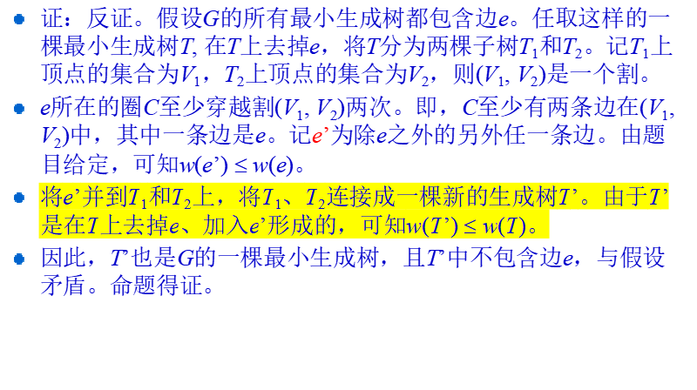
23.1-5

Slide 4
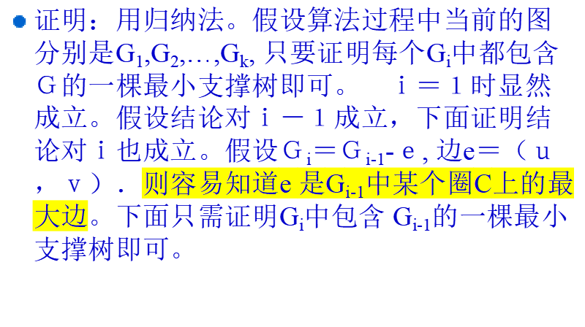
Proof 23-4(a)

Slide 5
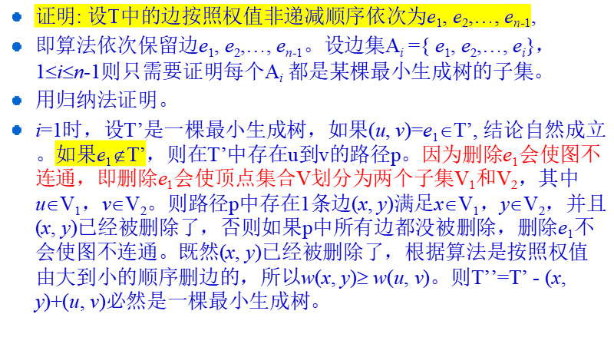
23-4(a)

Slide 6
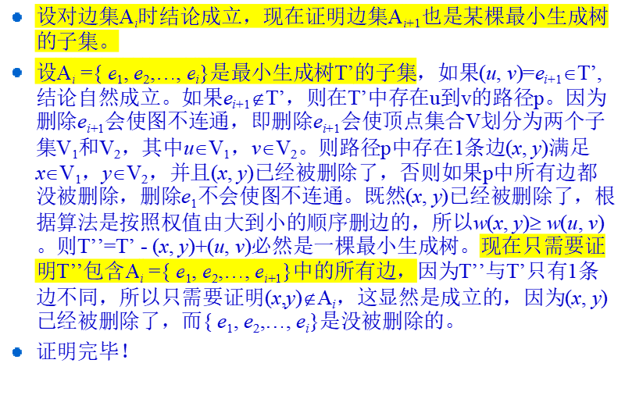
Continued

Slide 7
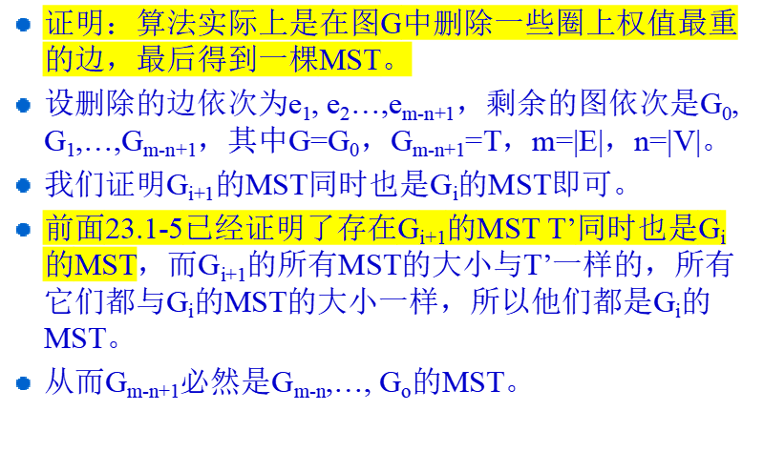
23-4(c)

Slide 8
Bottleneck Spanning Tree
A bottleneck spanning tree T of a connected, weighted and undirected graph G is a spanning tree of G whose largest edge weight is minimum over all spanning trees of G.
  Let T₁, T₂, …, T_{m} are all the spanning trees G, and the largest edge of each tree is e_{t1}, e_{t2}, …, e_{tm.} If w(e_{ti}) ≤ w(e_{tj}) for 1 ≤ j ≤ m and j ≠ i, then T_{i} is a bottleneck spanning tree.
  The value of a BST T is the weight of the maximum-weight edge in T.
  The bottleneck spanning tree may not be unique.

Slide 9
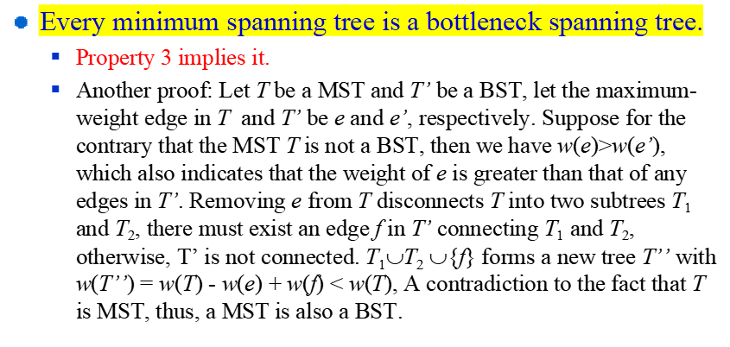
BST vs MST

Slide 10
The BST Problem
The Problem:
  Input: A weighted, connected and undirected graph G.
  Output: A BST T of G.
A solution:
  Kruskal’s and Prim’s Algorithm works for the BST problem.
More efficient algorithm exist for the problem?

Slide 11
A Verification Problem
A verification problem:
  Input: A graph G = (V, E; W) and an integer b
  Output: TRUE if the value of the bottleneck spanning tree of G is at most b and FALSE otherwise
How to solve this problem in linear time?

Slide 12
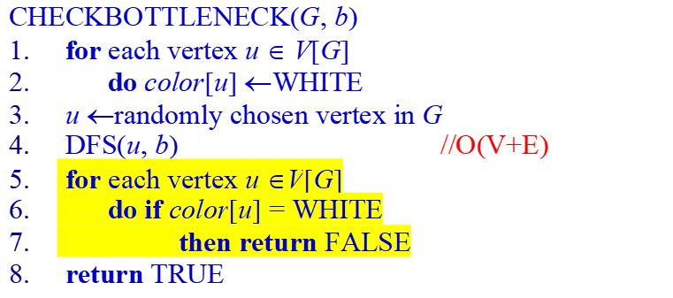
DFS(u, b)
color[u] ←GRAY
for each v ∈Adj[u]
do if color[v] = WHITE and w(u, v)≤b
then DFS(v, b)
color[u] ←BLACK

Slide 13
Solve the BST Problem
BOTTLENECK(G)
sort the weights of edges of G in non-decreasing order: e[1], e[2], …, e[| E |]
start ← 1
end ← | E |
while start < end
do middle ← ⎣(start + end)/2⎦
if CHECKBOTTLENECK(G, e[middle]) = FALSE
then start ←middle
else end ←middle //in the end there is a BST with value =e[end],
u ← randomly chosen a vertex of G
call DFS(u, e[start]) to build a spanning tree

Slide 14
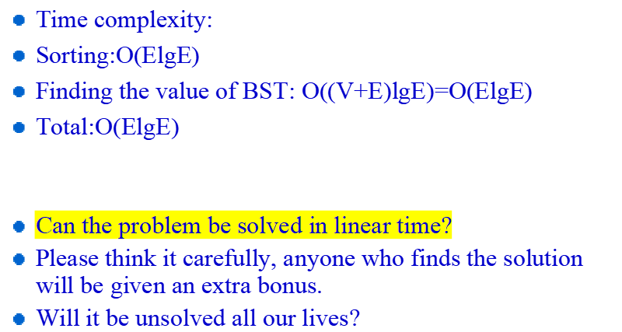
Solve the Problem in Linear Time

Slide 15
Single-Source Shortest Path
Variants of Shortest-Paths Problems
Properties of Shortest-Paths and Relaxation
  Triangle inequality
  Upper-bound
  No-path property
  Convergence property
  Path-relaxation property
  Predecessor-subgraph property

Slide 16
Bellman-Ford Algorithm
The Bellman-Ford Algorithm
  Correctness proof
  24.1-6
In DAG
  correctness

Slide 17
24.1-6
首先对G进行改造。增加一个新的顶点s，以及s到G中所有顶点的边，边上的权重均为0。记如此得到的图为G’ = (V’, E’)。
将E中的边任意定一个顺序。对E中每一条边e，进行如下测试。将e从G’上去掉。调用BF算法在当前图G’上测试是否有负费用圈。若有，则e永久删除。否则，表明e在剩下的唯一一个负权重圈中，将e重新放回到G’。这样测试完E中所有的边之后，最后留在G’中的（不包括从s出发的那些新加的边）即是一个负权重圈。
© 2004 SDU <number>

Slide 18
All-Pair Shortest Paths
Matrix multiplication
  Idea: l_{ij}^{(m)}
  The recursive formula:
  l_{ij}⁽¹⁾ =w_{ij}
  l_{ij}^{(m)} = min_{1≤k≤n} {l_{ik}^{(m-1)} + w_{kj}}
  Time complexity

Slide 19
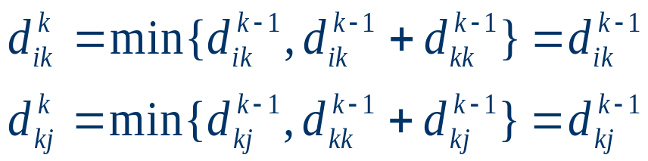
The Floyd-Warshall Algorithm
Idea: d_{ij}^{(m)}
The recursive formula:
  d_{ij}⁽⁰⁾ = w_{ij}
  d_{ij}^{(k)} = min(d_{ij}^{(k-1)}, d_{ik}^{(k-1)} + d_{kj}^{(k-1)})
Time complexity
Run some examples
25.2-5

Slide 20
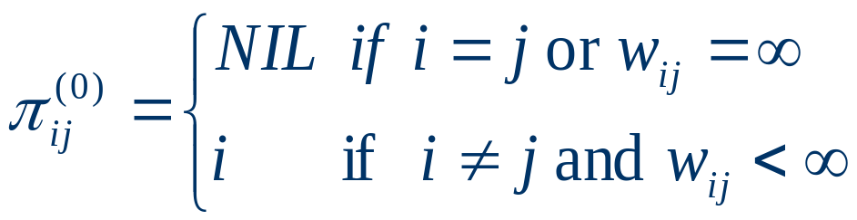
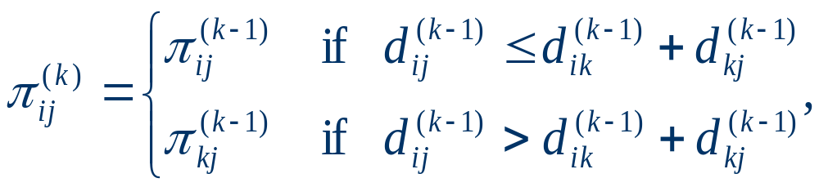
Constructing a shortest path
For k=0
For k>=1

Slide 21
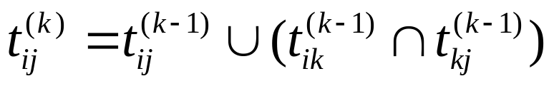
Transitive closure
How to revise the Floyd-Warshall Algorithm?
Time Complexity
25.2-8

Slide 22
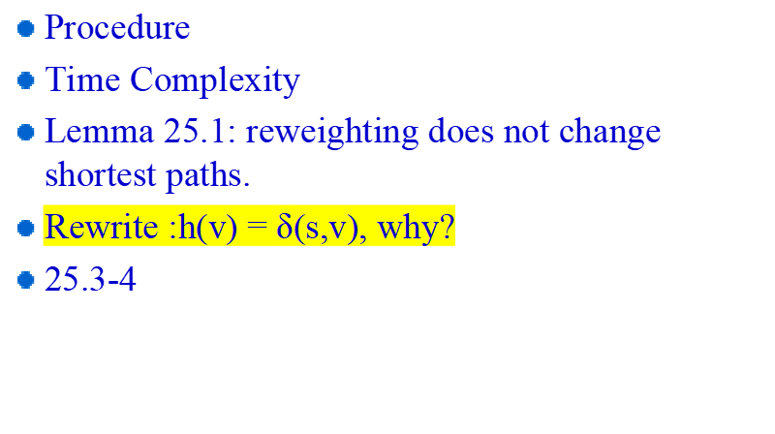
Johnson’s Algorithm

Slide 23
Maximum Flow
Definitions
There properties of the flow:
  Capacity constraint
  Skew symmetry
  Flow conservation

Slide 24
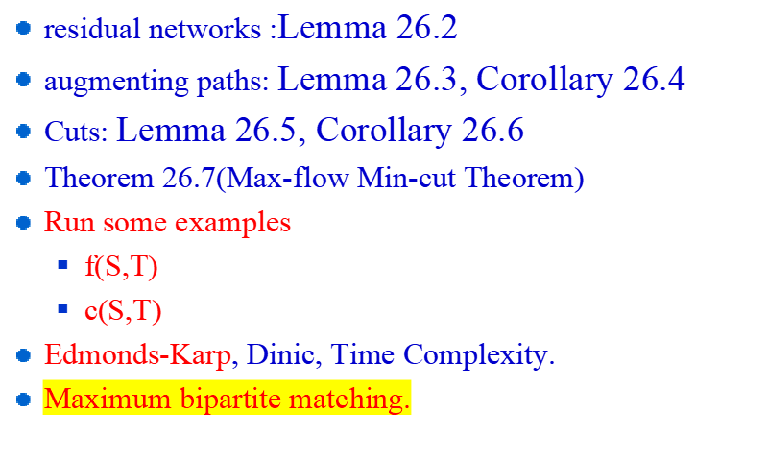
The Ford-Fulkerson Method

Slide 25
What should I say?
We have burdened our song with so much music that it is slowly sinking and our art has become so ornate that the makeup has corroded her face.

Slide 26
Thank you!

