Slide 1
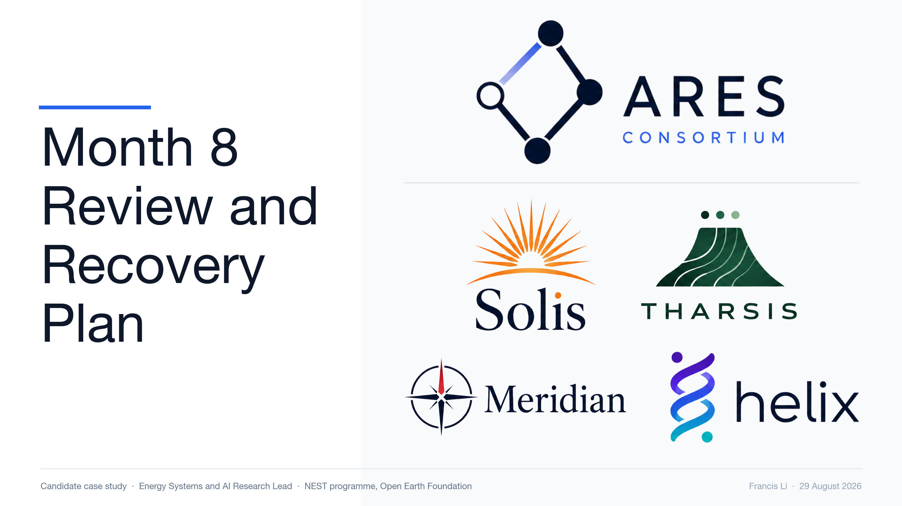

Slide 2
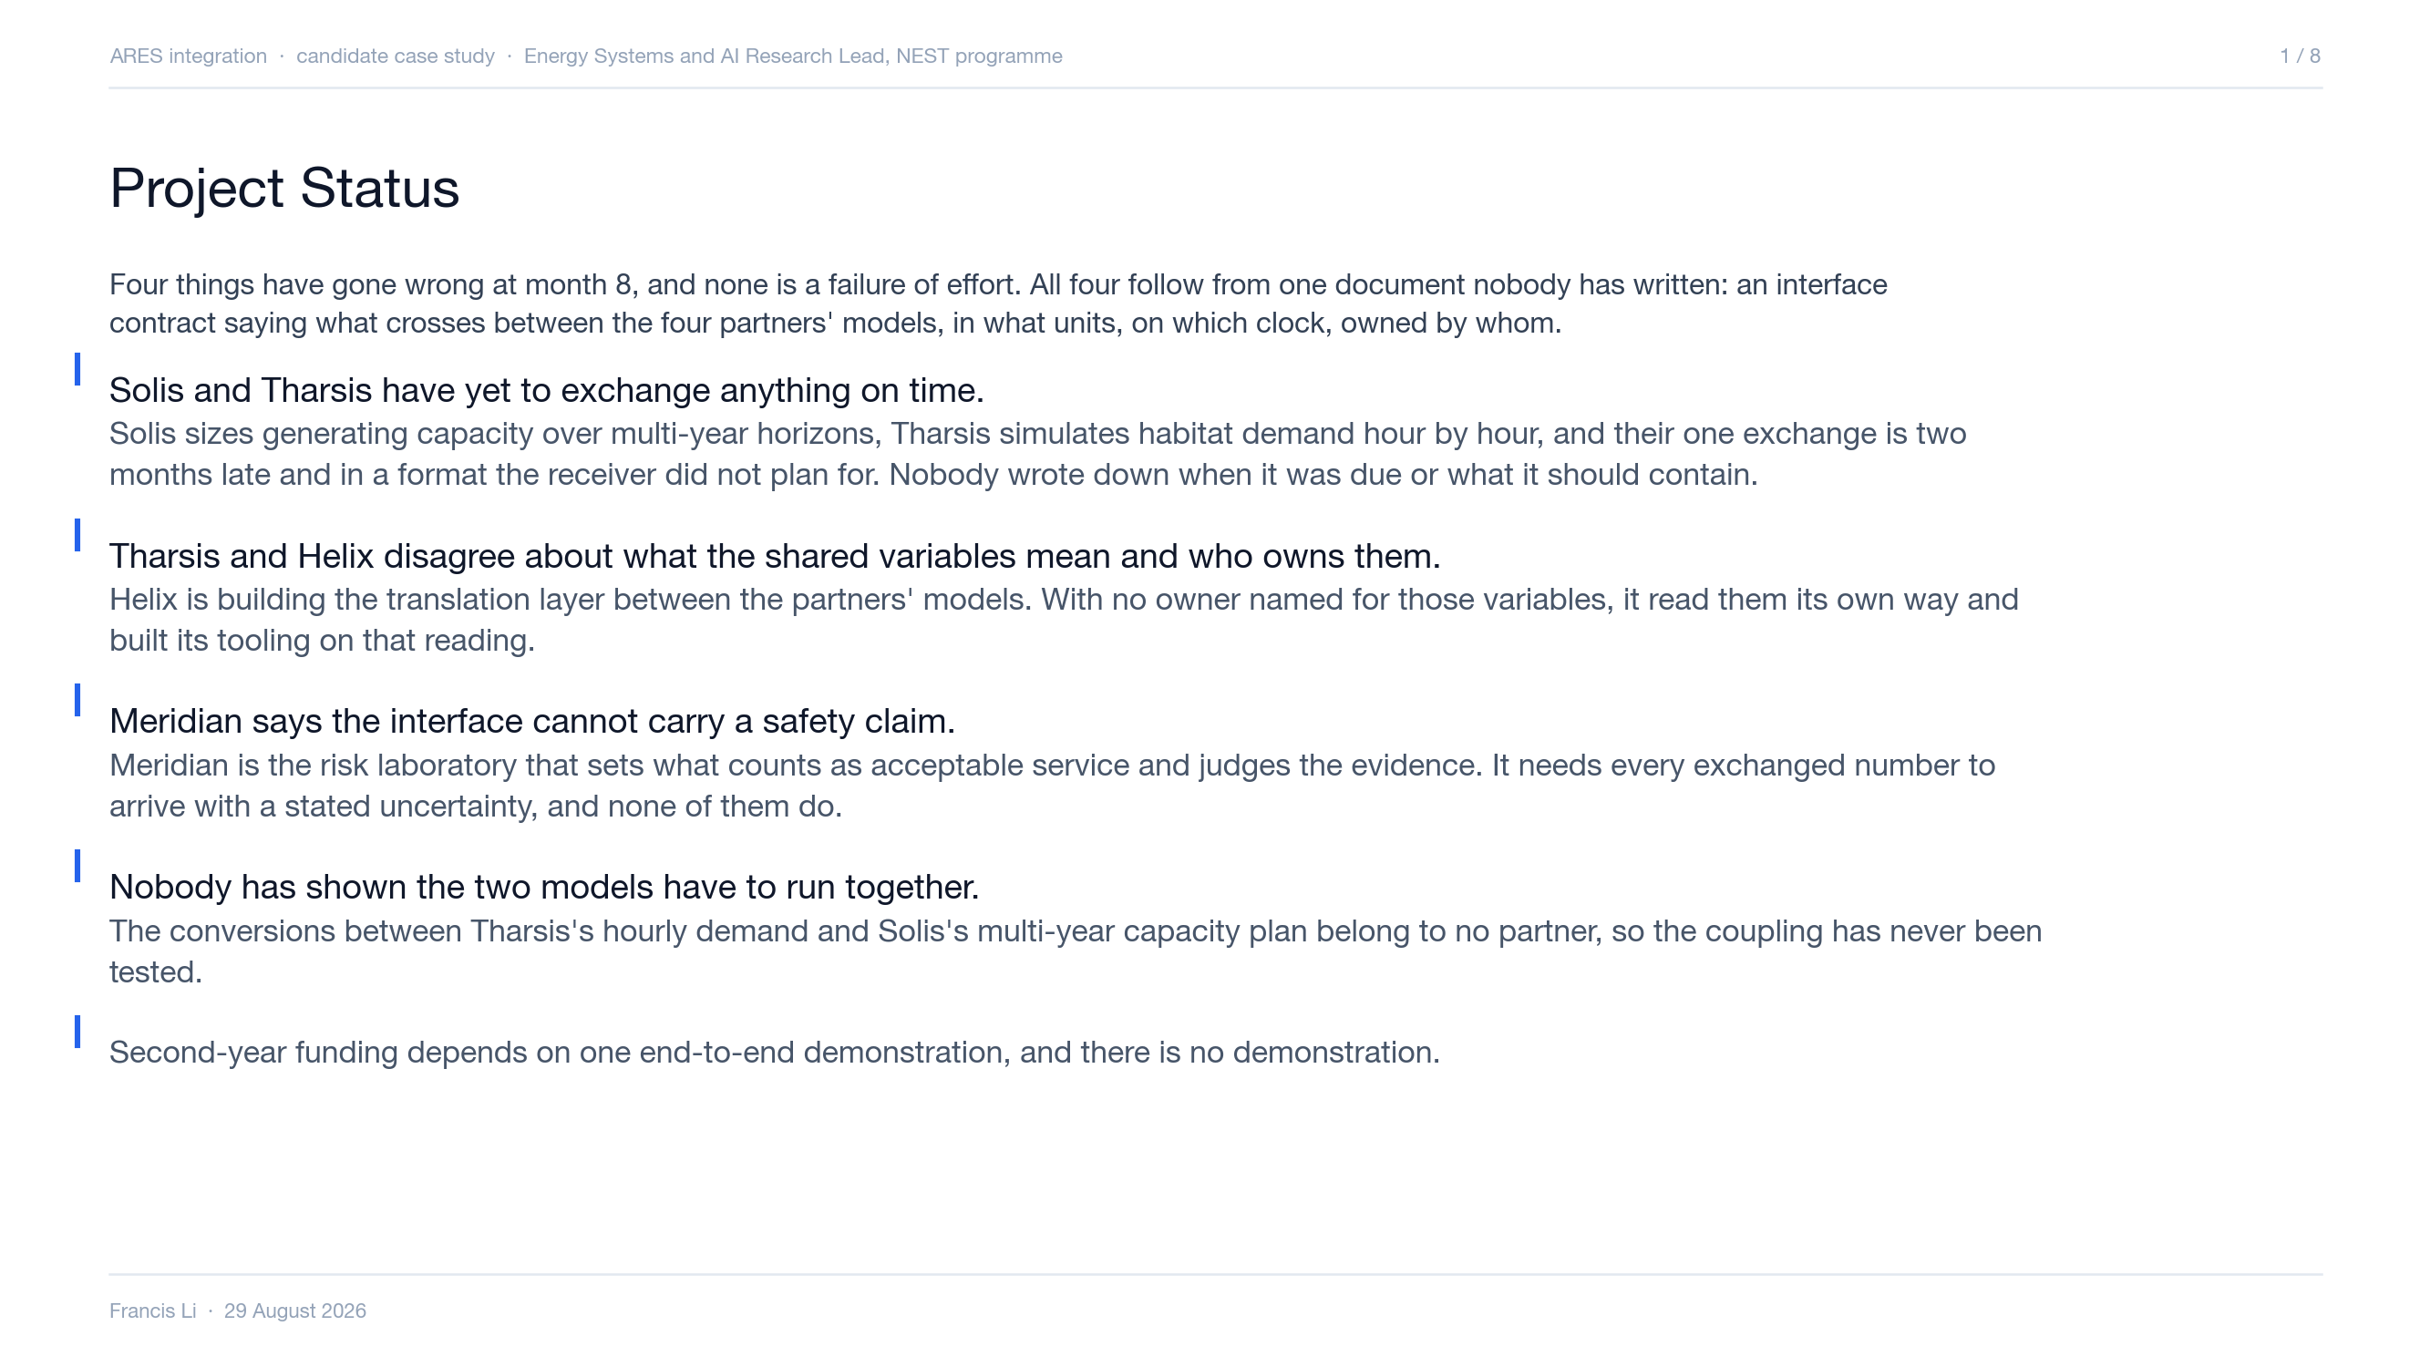
Notes:
Open here. This slide stops the room treating these as four problems with four owners. The four partners are Solis, capacity engineering, Tharsis, habitat demand simulation, Meridian, the risk laboratory, and Helix, the translation layer.

Slide 3
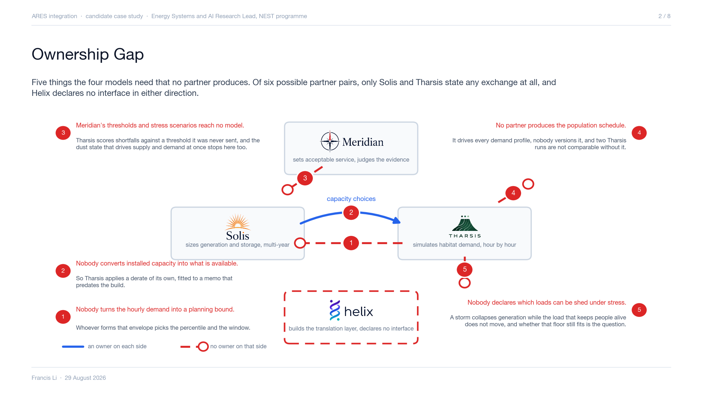
Notes:
How these were found, if asked: list what each partner consumes against what each produces, and read off what appears on neither side. Nothing here is invented, every gap is read off the partners' own declarations. Of the six possible pairs the brief states two, Solis to Tharsis, the exchange that is two months late and not in the planned format, and Tharsis with Helix, the shared interface variables they disagree about. The return path from Tharsis to Solis is implied by the two clauses and never stated. Meridian appears in no stated exchange with anybody, which is why its thresholds reach no model. GAP-1 and GAP-2 are conversions, an aggregation operator and a derate function. Each is real work, each requires a judgement, which percentile, which window, whose failure rates, and each is assigned to nobody. GAP-4 is not a modelling output at all, it is a programme assumption about who is on Mars doing what, which is exactly why it fell between four models. GAP-5 is the one that decides the fidelity argument on the next slide, because a storm collapses supply while the life-support floor does not move. If asked what would close these: name an owner for each, which is week 1 of the plan.

Slide 4
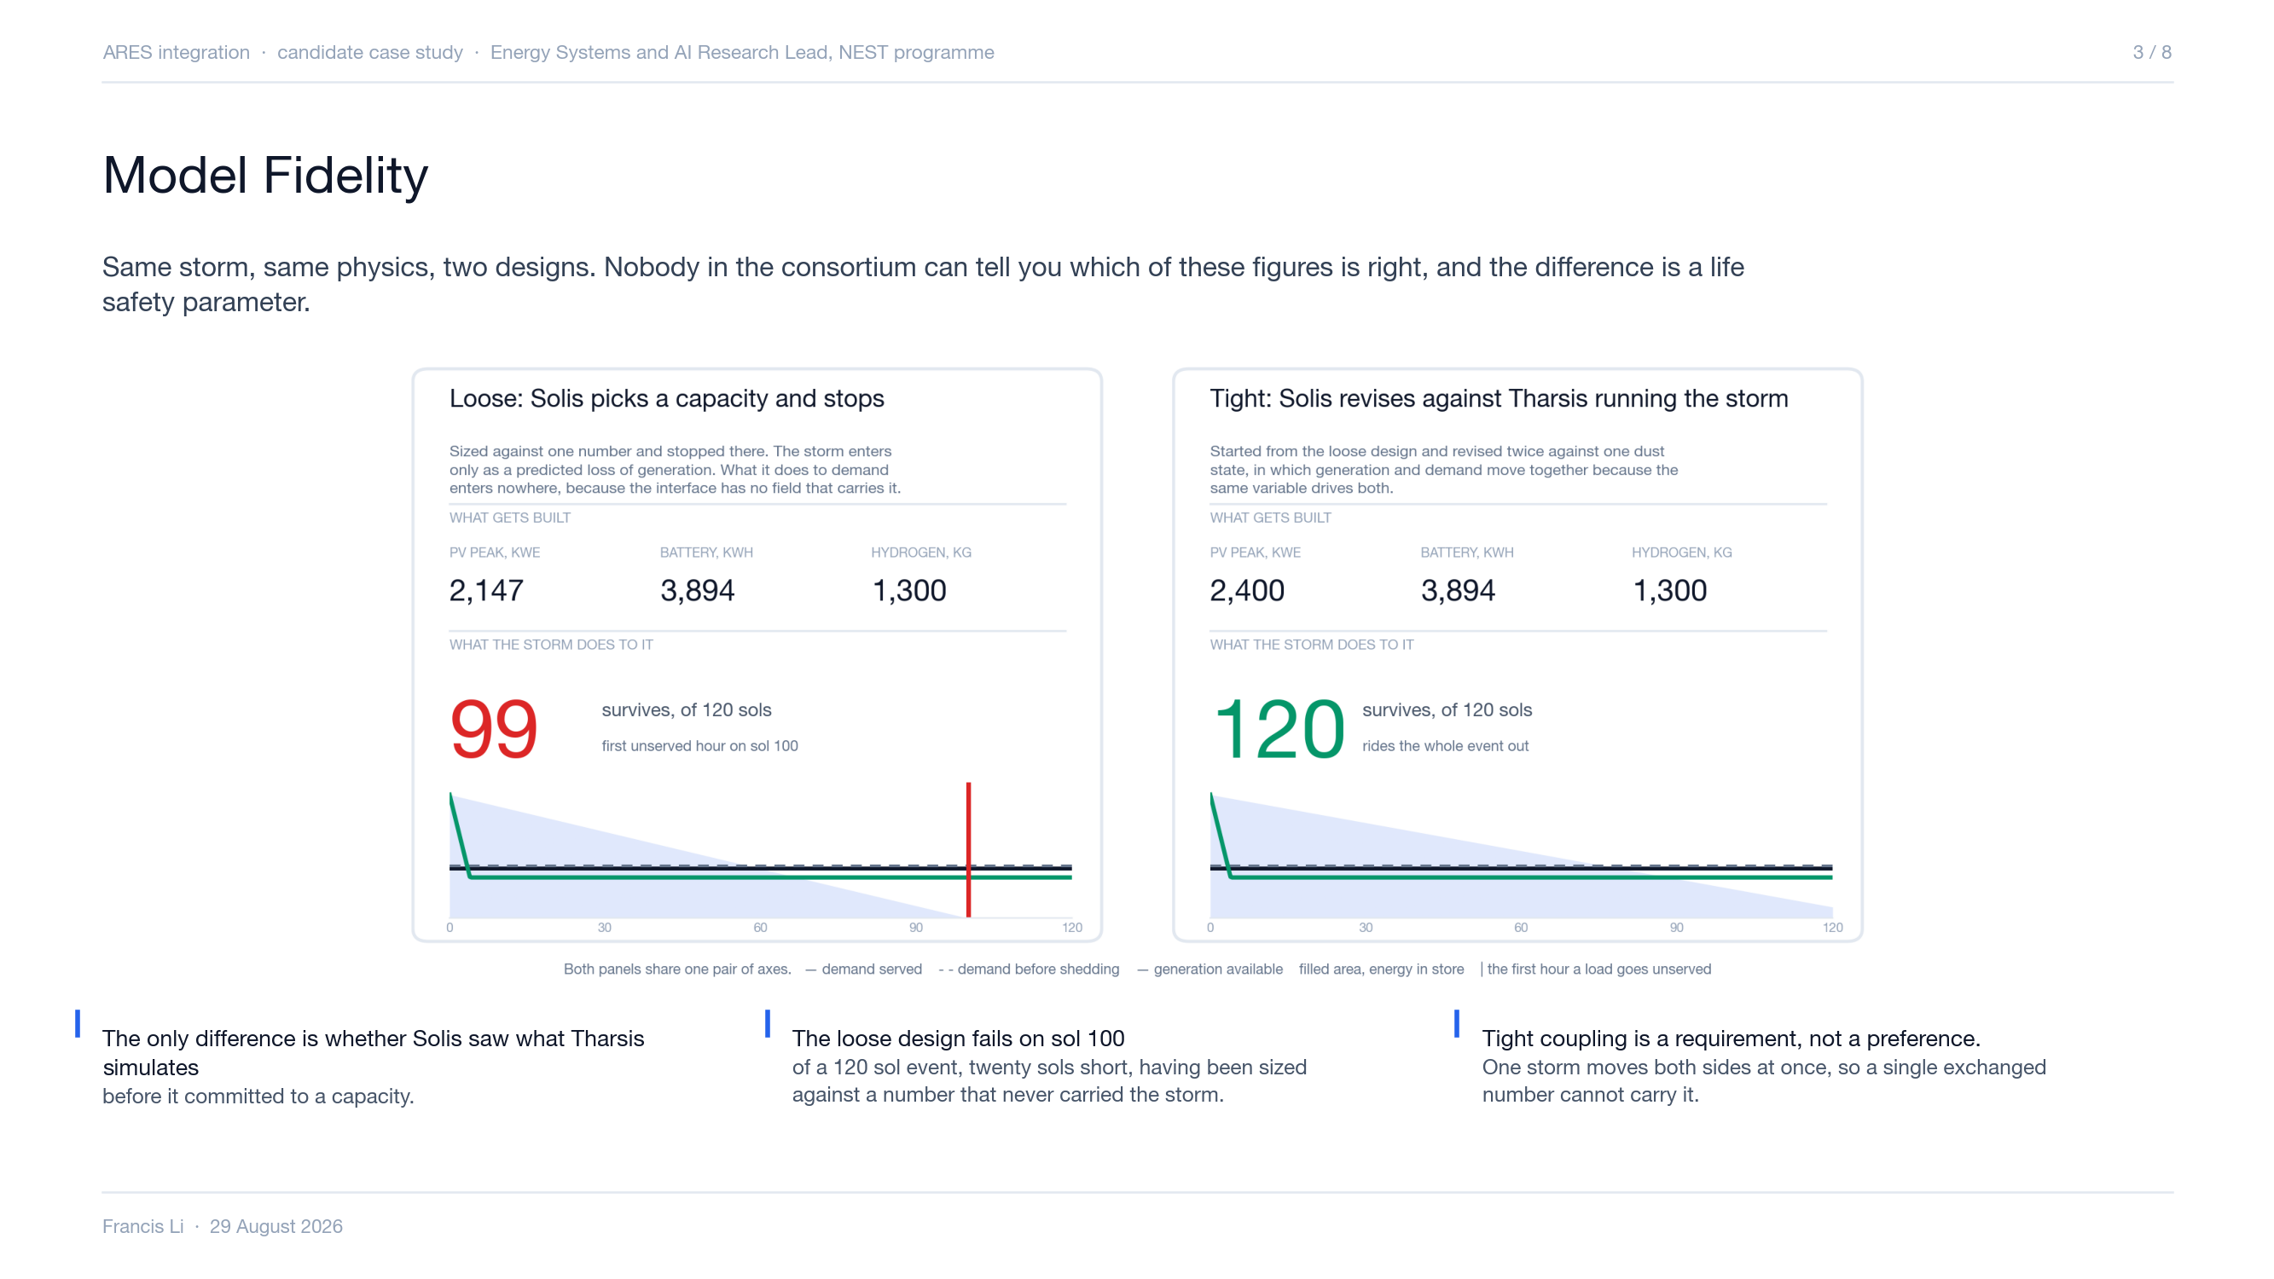
Notes:
Slow down here, the language is deliberate. Counter-case: loose coupling is defensible for a planning study and indefensible for a resilience claim, and the funder is buying a resilience claim. Where the floor sits is Meridian's to state, which is why track B elicits it in weeks 1 to 3. The credibility threshold is Li et al. 2019, Applied Energy 239. Source if asked: the 2018 dust figures are Opportunity's own telemetry as reported by JPL, 645 Wh on 30 May falling to 22 Wh by 10 June, against a clear-sky baseline near 600 to 900 Wh per sol. Real published data, external to the brief, unlike everything else here. Backup exhibit, on the page rather than a slide: if pressed on why coupling matters in practice, pull up the storage figure. 120 sols is 2,959 hours, so every kilowatt that cannot be shed needs 2,959 kWh stored, which is 13.5 to 17.9 tonnes of battery per kW or 1.3 to 1.6 tonnes of fuel cell reactant. You do not store your way out, you generate your way out. And the multiplier is fixed while the number of kilowatts it applies to is exactly what neither partner can compute alone. Be honest on the demand side if pressed. Crew are inside a pressurised habitat at all times, so a storm changes no sheltering behaviour, and there is no published uplift figure for a Mars habitat in a storm. The published direction is the other way: Cataldo 2009, NASA GRC E-18237, Table II holds habitat power flat through a storm and takes rover recharge and drilling to zero, and Rucker 2016, JSC-CN-35576, puts keep-alive near 22 kW against 35 kW normal. That does not weaken the coupling argument, it sharpens it. The storm forces a shed, and what decides survival is whether the floor that cannot be shed still fits under the derated supply. Neither partner can compute that floor alone, which is the load taxonomy, gap 5 on the ownership slide.

Slide 5
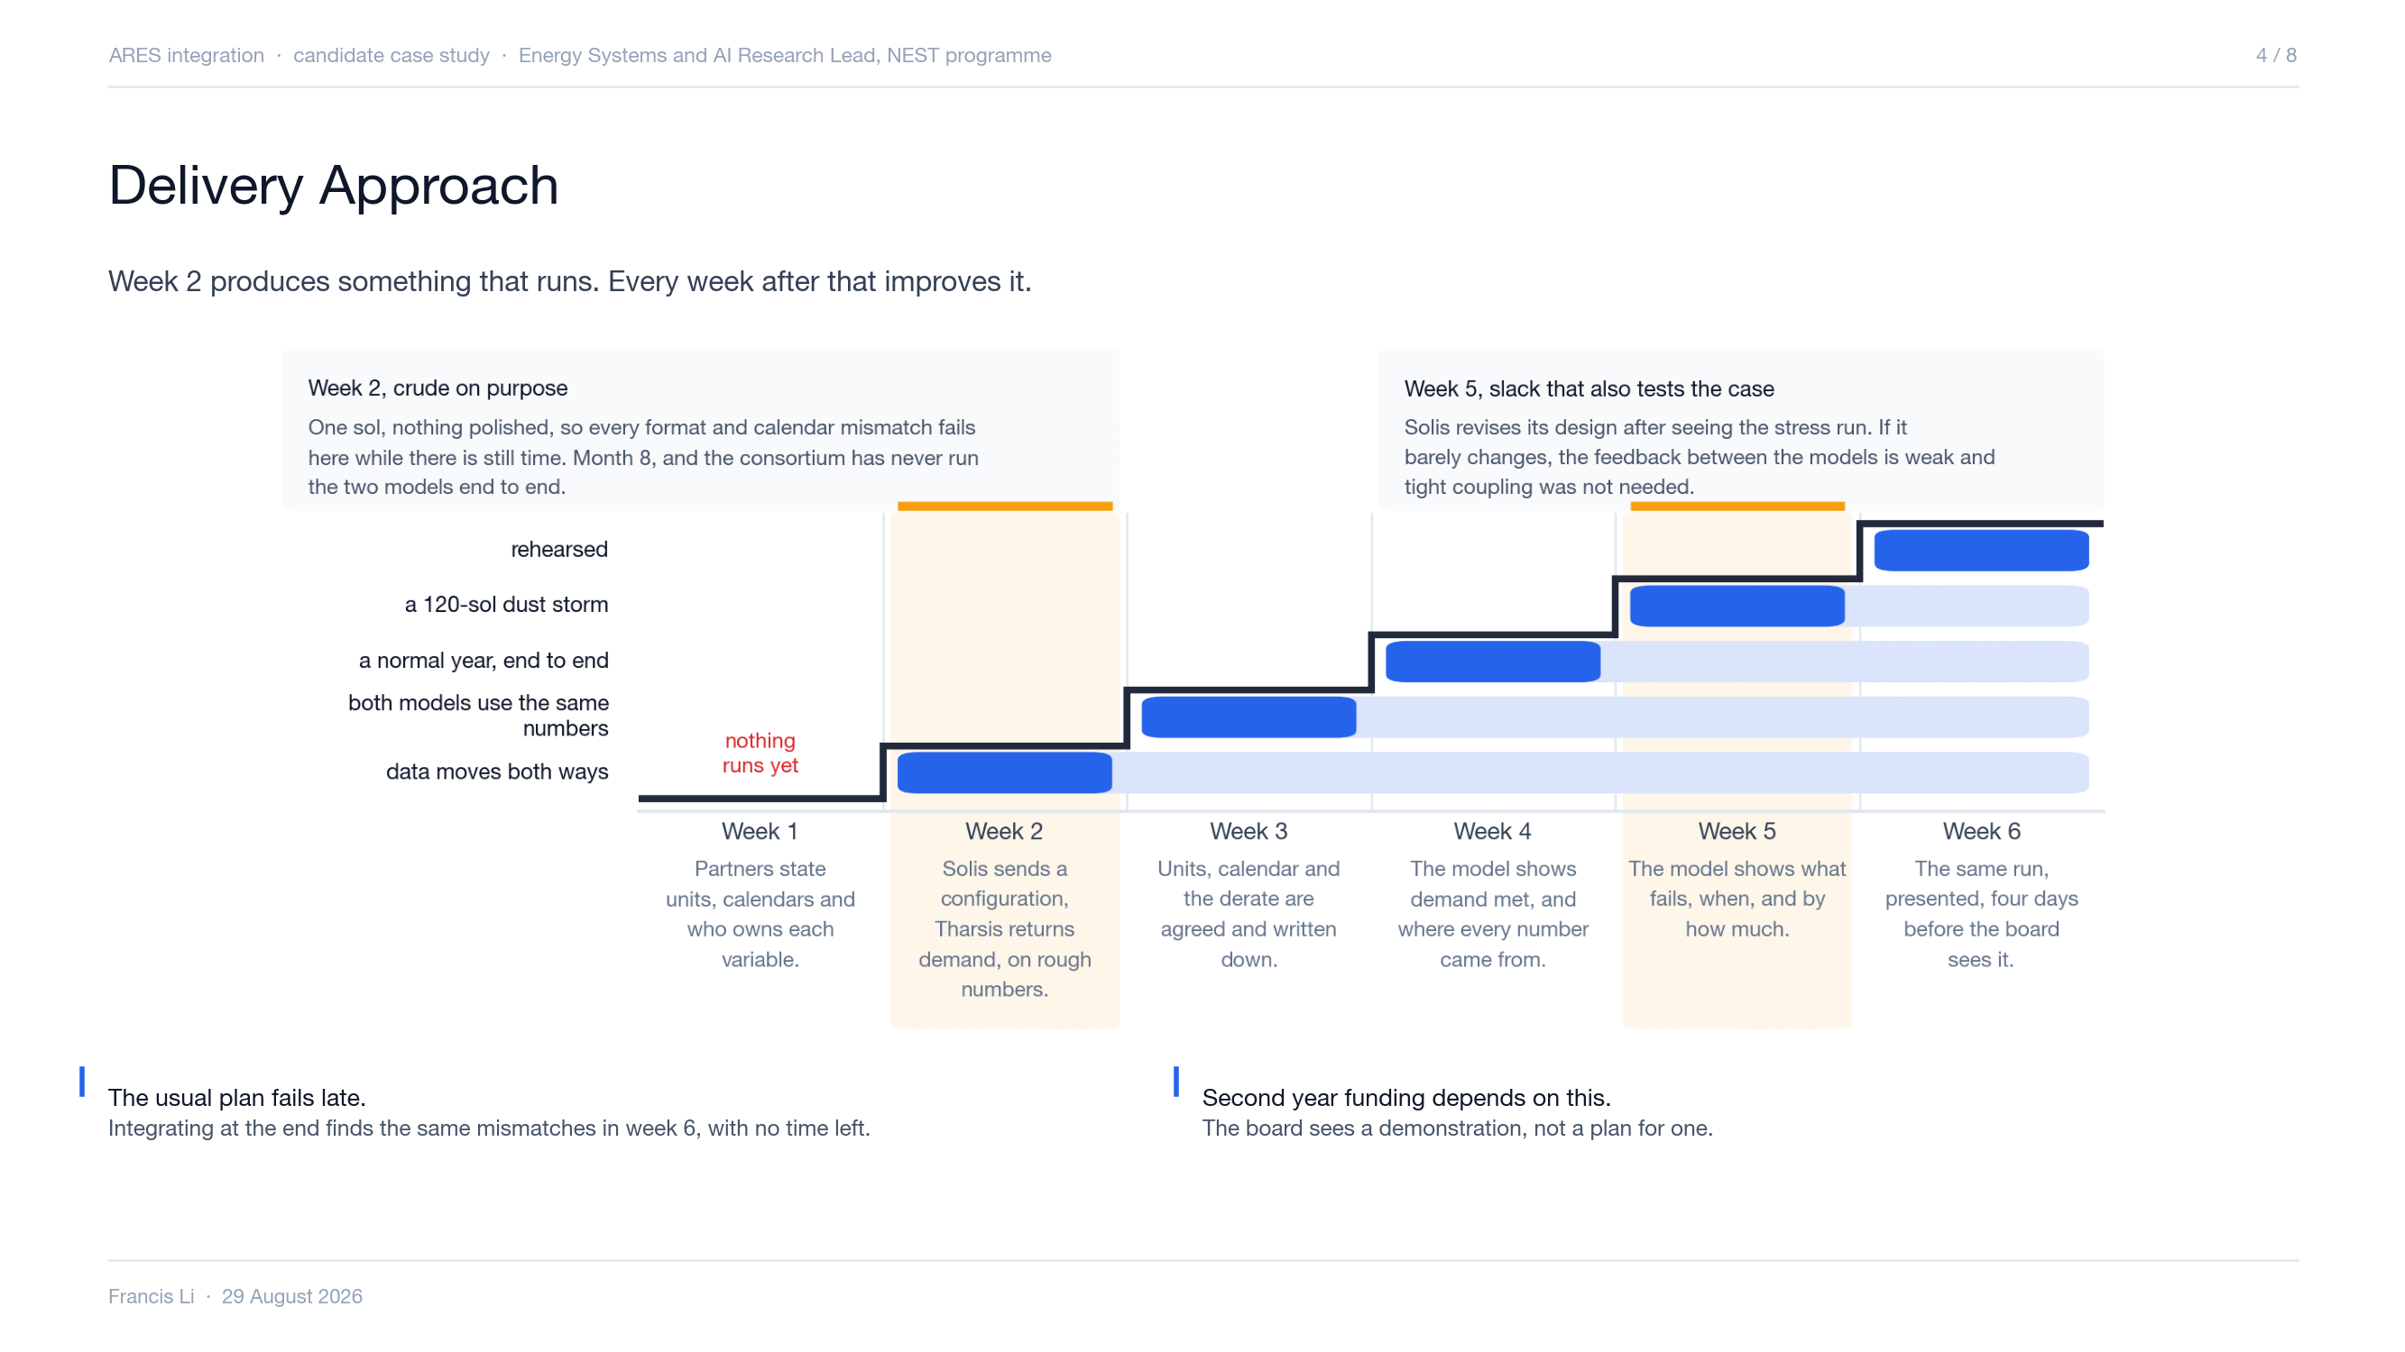
Notes:
The shape is the argument. From week 2 the demonstration exists and runs, and every week after that improves the same one rather than building toward a first, so each week is a superset of the week before and the worst case in week 6 is showing week 5's version. Week 2 runs end to end on deliberately crude inputs, one sol and nothing polished, because the job of that run is to make every format, encoding and calendar mismatch fail while there is still time. The consortium is at month 8 and has never run the two models end to end, so an exchange arriving late and in an unexpected format is exactly what to expect. Week 5 is buffer, with nothing scheduled into it that cannot move out, and it doubles as the test of the recommendation: Solis revises its design after seeing the stress run, and if the design barely changes then the feedback between the models is weak and tight coupling was not needed.

Slide 6
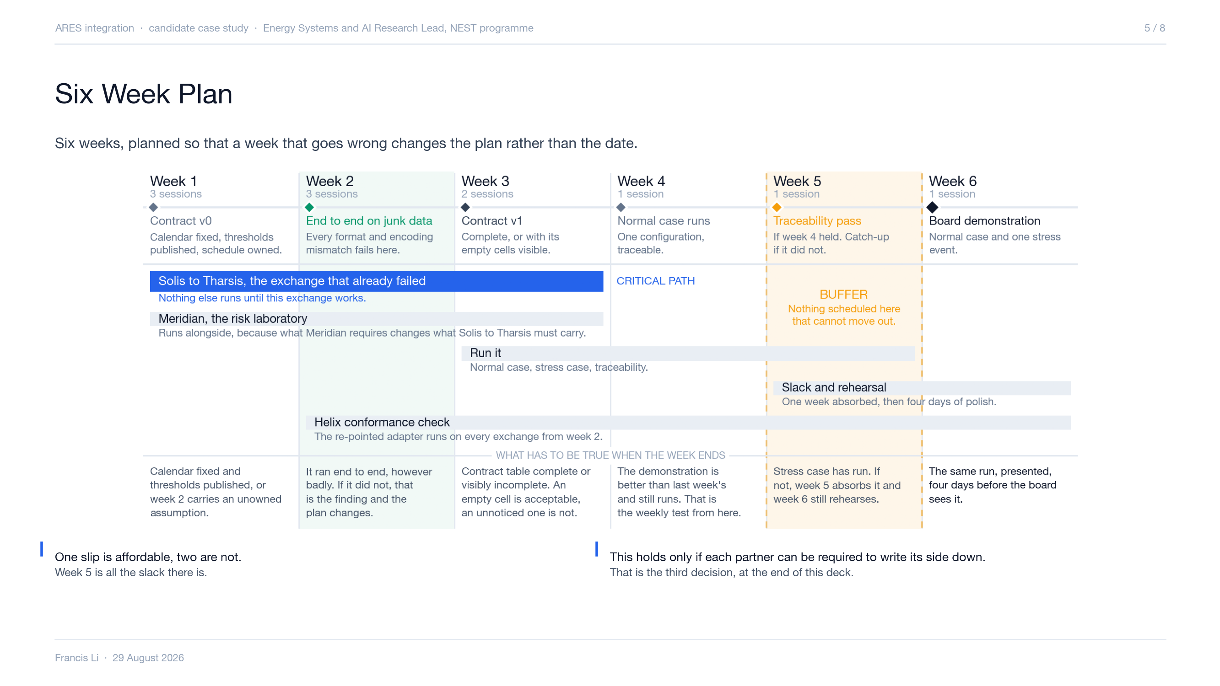
Notes:
The picture is the slide, so do not read it out. Take questions on it. The bottom row is the one that matters, because it is what you can hold us to at the end of each week, and week 6 is the demonstration itself. Three things worth saying if they come up. Week 5 is buffer, and nothing is scheduled into it that cannot move out, so a stress case that slips lands there and week 6 still rehearses. The traceability pass means every number in the demonstration traces back to the model, the contract, the schedule version and the threshold set that produced it, which is what lets anyone check the demonstration means what it says. And the conformance check is the only role the brief supports for Helix, since it names no input and no output for them. The riskiest hour in the plan is the derate session in week 2, because Solis cannot state how its capacity degrades without Meridian's failure definitions, and if that slips week 4 runs on an assumption nobody owns.

Slide 7
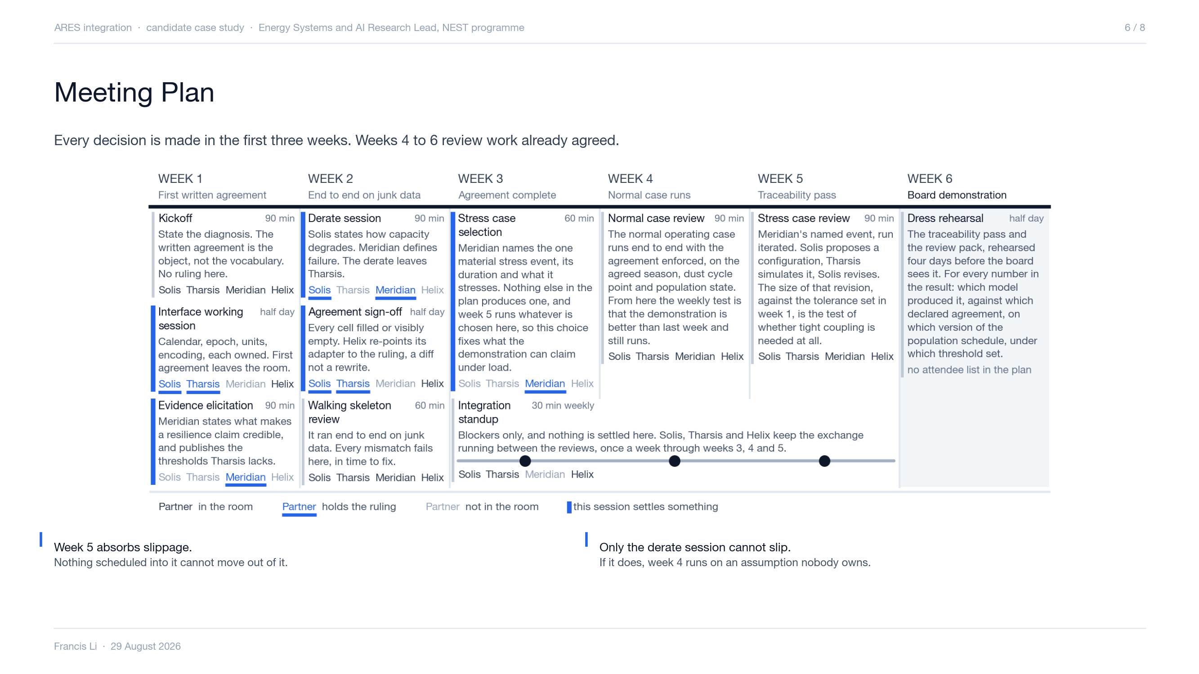
Notes:
Let them read it. The calendar is the slide and it answers what a board member wants: when each session is, what it is for, what leaves the room, who is in it and who rules. Six of the ten sessions fall in weeks 1 and 2, five sessions settle something and all five are done by week 3, and from week 4 the sessions review a thing that already runs. The expensive one is the derate session in week 2. Solis cannot state how its capacity degrades without Meridian's failure definitions, so the two rule on it together, and if it slips, week 4 carries an assumption nobody owns. On Helix, the point is not that they are junior. They convert between two vocabularies, so they must be present when meaning is settled or they build against something nobody consulted them on, and converting between two vocabularies gives them no standing to rule on what either one means. That is why they are in seven rooms and underlined in none. The standup is thirty minutes a week in weeks 3 to 5, not a fourth workshop.

Slide 8
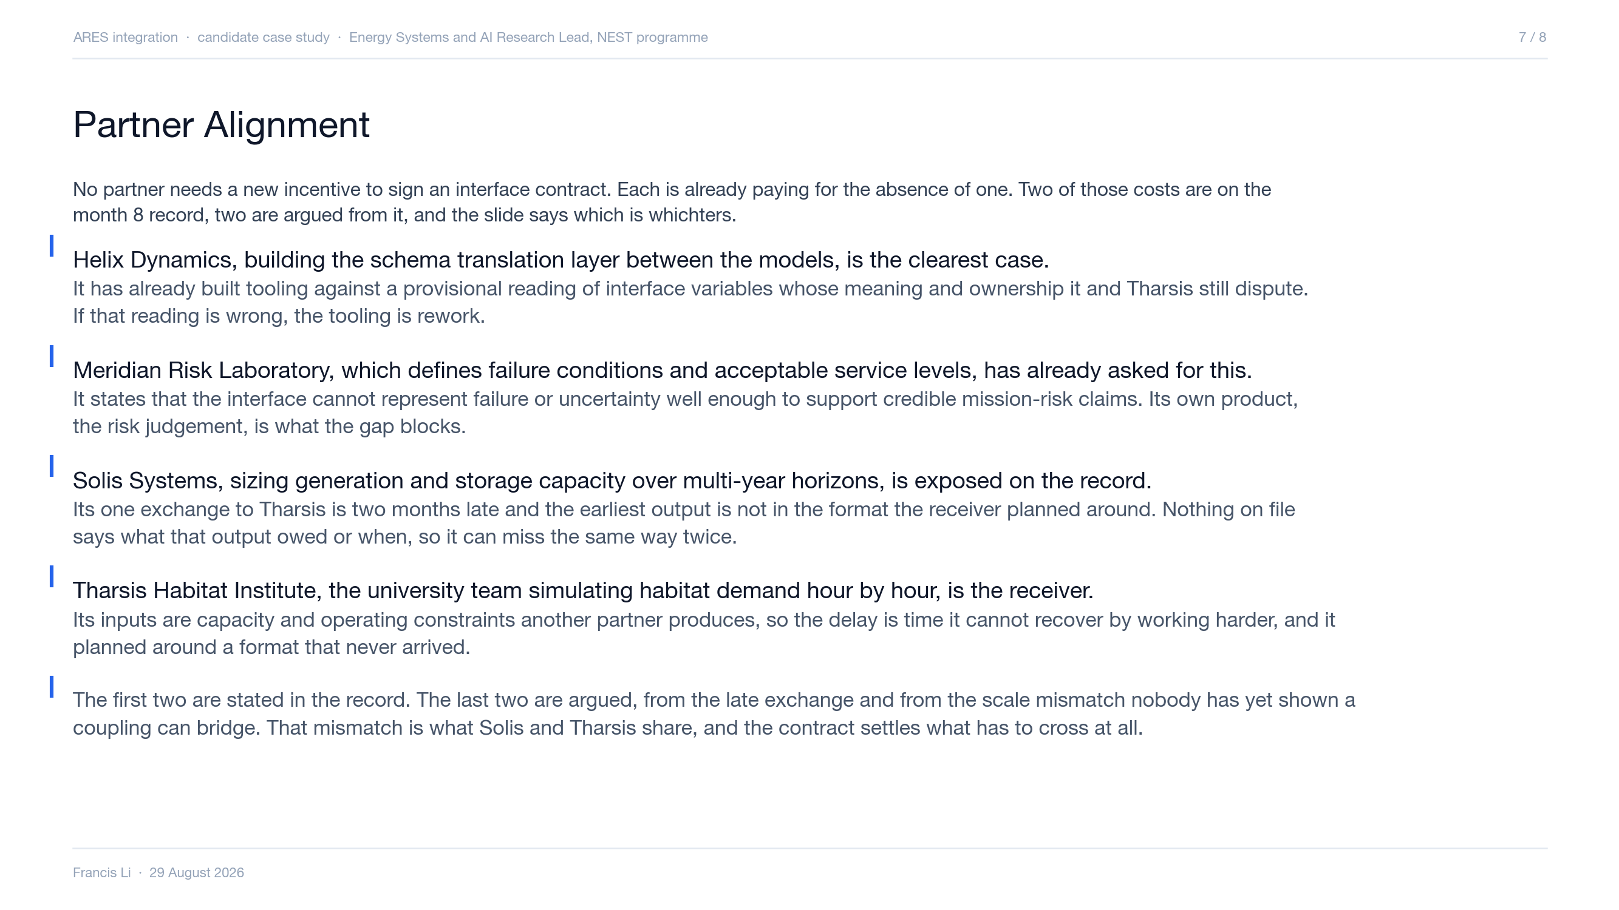
Notes:
The order is deliberate. Helix and Meridian are the two you can point at in the month 8 record, so they carry the slide and they are the two to approach first. Solis and Tharsis are argued, not quoted, and the honest framing is that the late exchange exposes both ends of it for different reasons. If challenged on Solis: the point is not that Solis is at fault. It is that no document states what that exchange should have contained or when it was due, so nobody in this room can say whether the delivery was met, and Solis has no way to show it. That is a cost to Solis whichever way the facts fall. If challenged on Tharsis: it consumes what the other models produce, which is what makes a two month slip unrecoverable rather than merely late. On the fourth symptom, the scale mismatch: settling what has to cross is also how the consortium finds out whether a tight bidirectional coupling is needed. Two partners are currently at risk of building one that nobody has justified. What this slide deliberately does not do is state any partner's preference, position or willingness. Nobody has told us those, and a board slide that invents them is the first thing a partner will correct in the room.

Slide 9
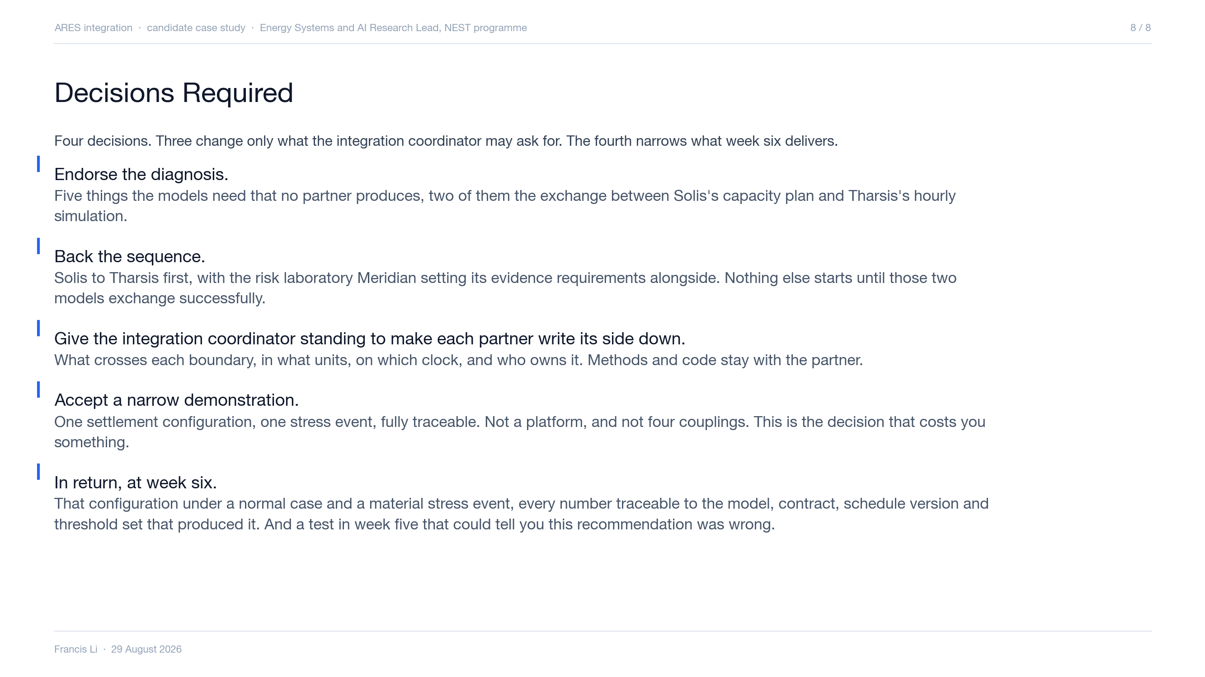
Notes:
Close on the last two bullets. The narrow demonstration is the real ask, because it means saying no to breadth that would look better in a status report. If asked what happens without the written contract: partners keep filling the same gaps privately, the models keep disagreeing for reasons that appear in neither specification, and month 14 looks like month 8 with less money. If asked whether this is enough for year two: the demonstration is what the funder said it wanted to see, and the traceability pass is what lets anyone check that it means what it says.

