Slide 1
ISCF Lab 1 Configuration
Laboratory Slides for Lab Work 1
Ricardo Peres
ra.peres@fct.unl.pt

Slide 2
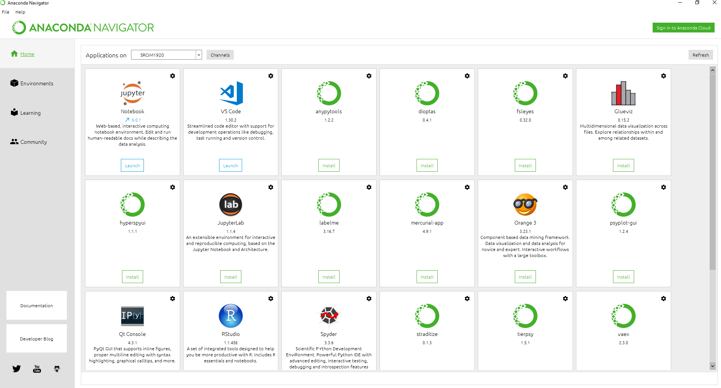
Configuring the environment
The Anaconda Navigator provides a base environment with almost everything needed for the project out of the box

Slide 3
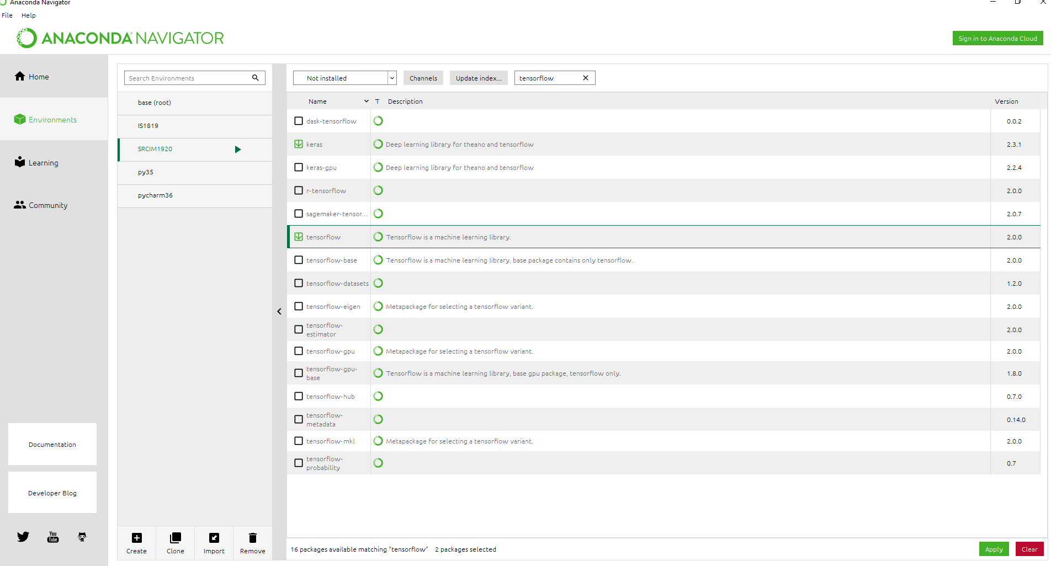
Configuring the environment
In the Environments tab you’ll find the list of existing environments. You can either use the base env which comes with several packages pre-installed, or create your own
To install additional packages, pick “Not installed” from the dropdown menu, search for the desired package, tick the checkbox and press Apply.

Slide 4
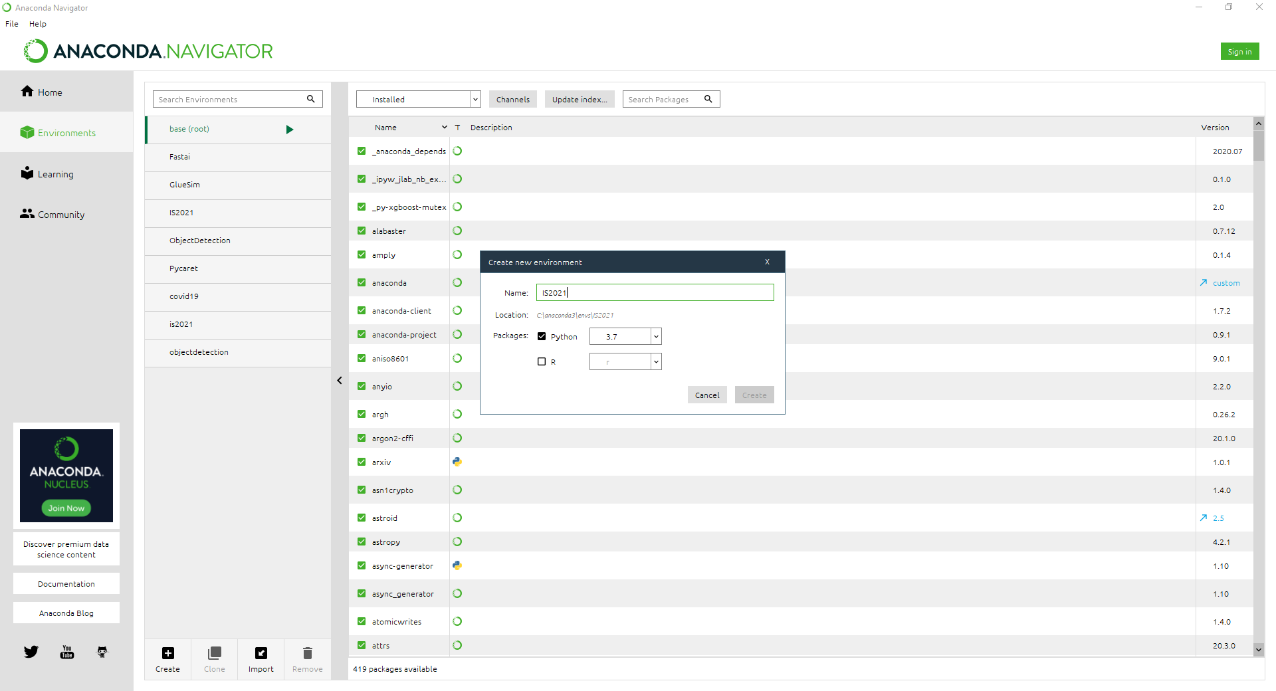
Configuring the environment
To create your own env, press Create to create a new environment for the ISCF course

Slide 5
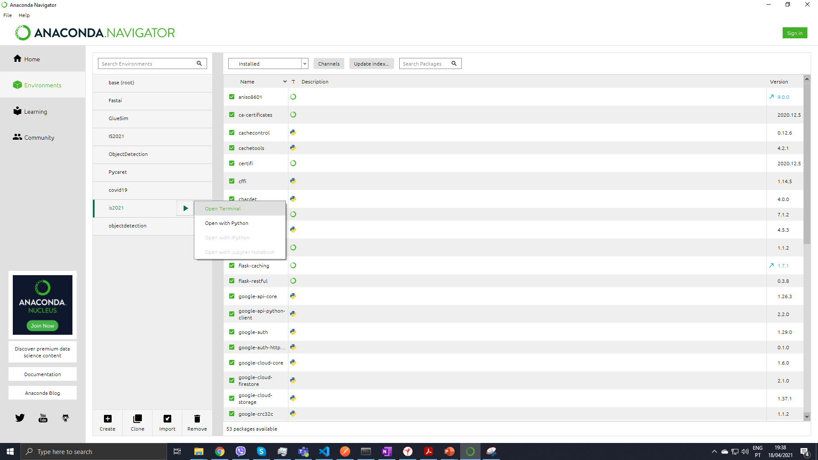
Configuring the environment
To open the Terminal for the new environment, select it , press the arrow as shown in the figure and select Open Terminal.

Slide 6
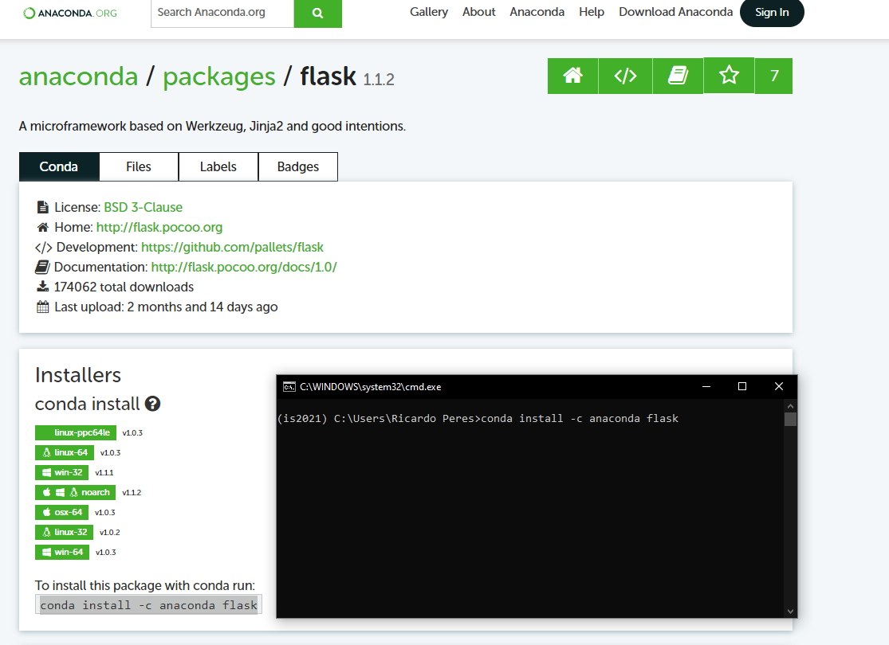
Configuring the environment
The required packages can be install by following the links in the Lab 1 assignment description and copying and running the install command in the anaconda prompt as shown:

Slide 7
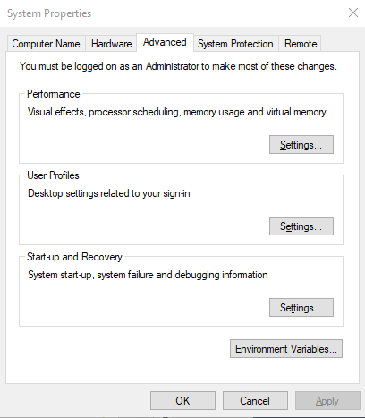
Configuring environment variables
If later on during development you experience any issues with Open SSL, also add:
..\Anaconda3
..\Anaconda3\scripts
..\Anaconda3\Library\bin
Add C:\anaconda3\condabin to your PATH:

Slide 8
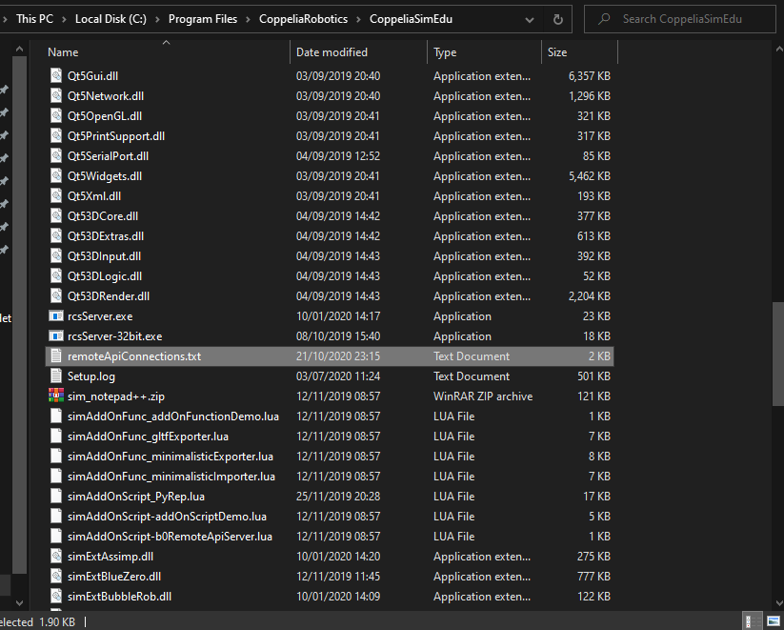
Configuring the remote API for CoppeliaSim
Replace the remoteApiConnections.txt file in the CoppeliaSim install directory with the one provided with the lab 1 project.

