Slide 1
DATA 601 –Ethics Survey Design
Felix Gonzalez, P.E. (fgonzale@umbc.edu)
Adjunct Instructor
Division of Professional Studies
Computer Science and Electrical Engineering
University of Maryland Baltimore County

Slide 2
Survey Design: 7-Step Process
Step 1: Literature Review
Step 2: Interview Experts & Create Focus Groups from Target Population
Step 3: Synthesize
Step 4: Develop Items
Step 5: Expert Validation
Step 6: Cognitive Interviewing
Step 7: Pilot Test

Slide 3
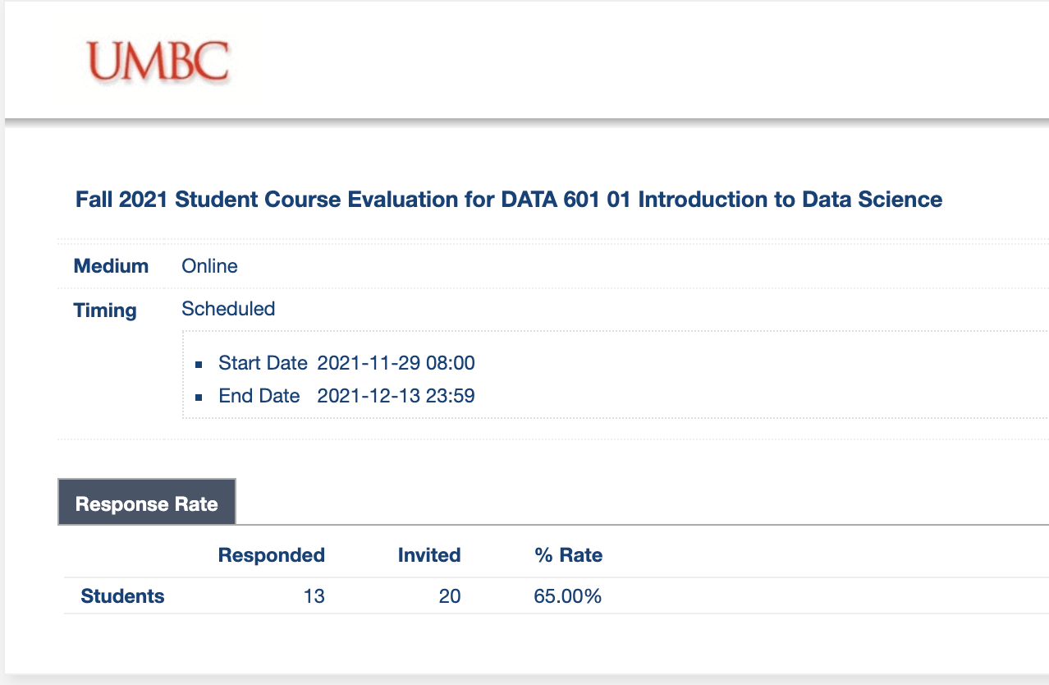
Survey Design is Almost an Art
Population matters
  Females more likely to respond than males
  Younger generation less likely to join
Questions matter ➔ Next Slides

Slide 4
Survey Design: Questions Matter
A seemingly straight forward question can lead to inaccurate data
The global economy is the most important issue in the world today.
strongly disagree | disagree | neither agree nor disagree | agree | strongly agree
Now look at the revised version
How important is the issue of the global economy in the world today?
not at all Important | slightly important | moderately important | quite important | extremely important

Slide 5
Survey Design: Questions Matter
Providing a reason…
Q8) As some of you may know, the university is debating whether to move some parts of the university to a new section of campus in Rockville. Do you think the university should move to Rockville?
Q8) As some of you may know, the university is debating whether to move some parts of the university to a new section of campus in Rockville. Do you think the university should move to Rockville so that the school can have more space?
Yes = 12.5%
Yes = 55.6%
Giving a reason will improve the extent to which people agree with you, and impact the accuracy of your survey

Slide 6
Questions?

