Slide 1
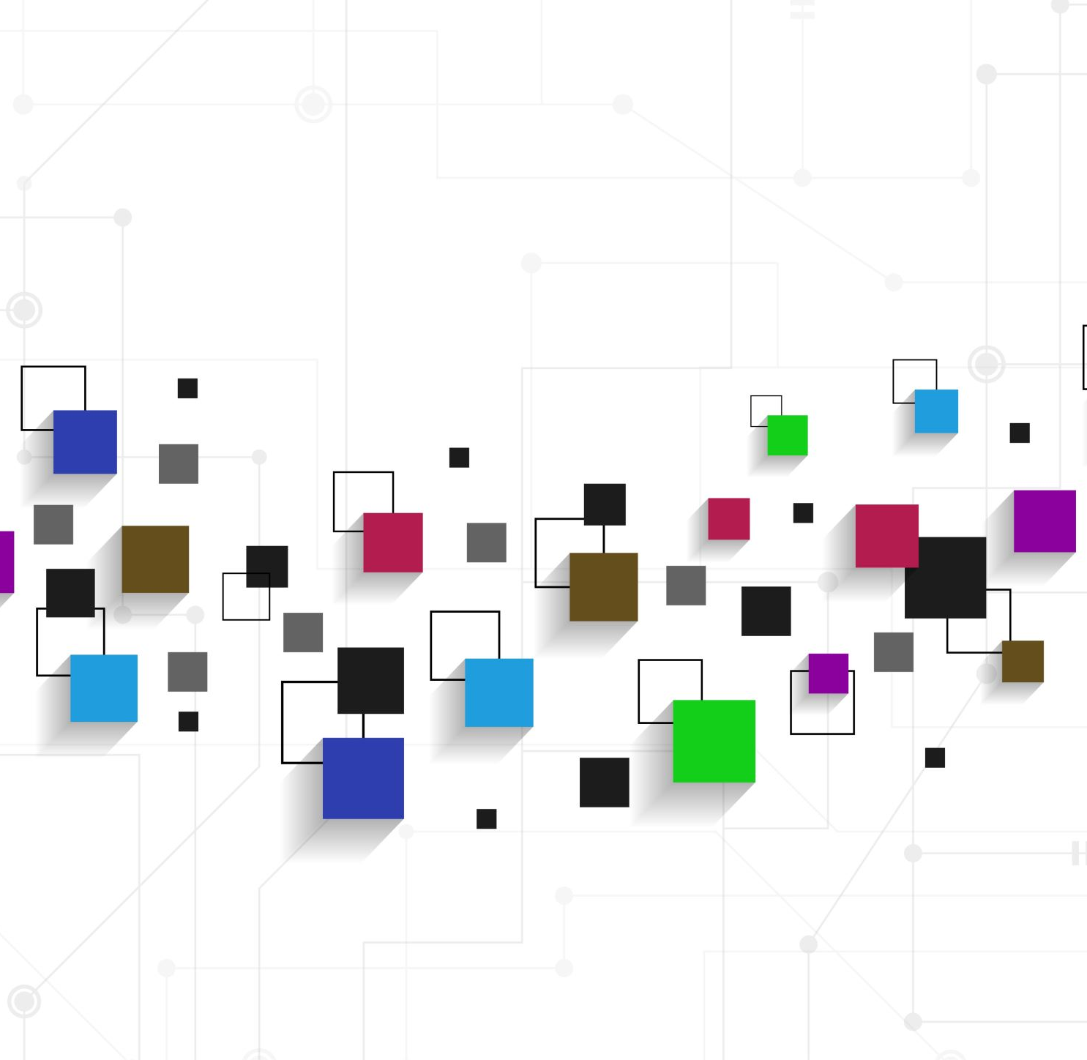
Project Symmetry
- Suraj Patil

Slide 2
What is Symmetry?
“Project Symmetry is an application using AI to accelerate Wikipedia's translation efforts in less-represented languages (less than 1 million articles) by building a semantic understanding of similar articles in various Wikipedia languages and providing relevant translations for missing information” - Notion

Slide 3
What is Goal (Objective)?
Improve the translation of content like Wikipedia in under-represented languages

Slide 4

What is the Scope?
International Organizations
Government Bodies
Medical Institutions
NGOs

Slide 5
What are the Benefits?
Over 7000 languages spoken worldwide
Will provide digital education content translation in people’s own native language without any important content being cut out
Model Available – BERT, XLNET, Sequence-Sequence, RNN, etc.
Metric used to compare – BLEU (Bilingual Evaluation Understudy)
Data Analytics on semantic comparison

Slide 6
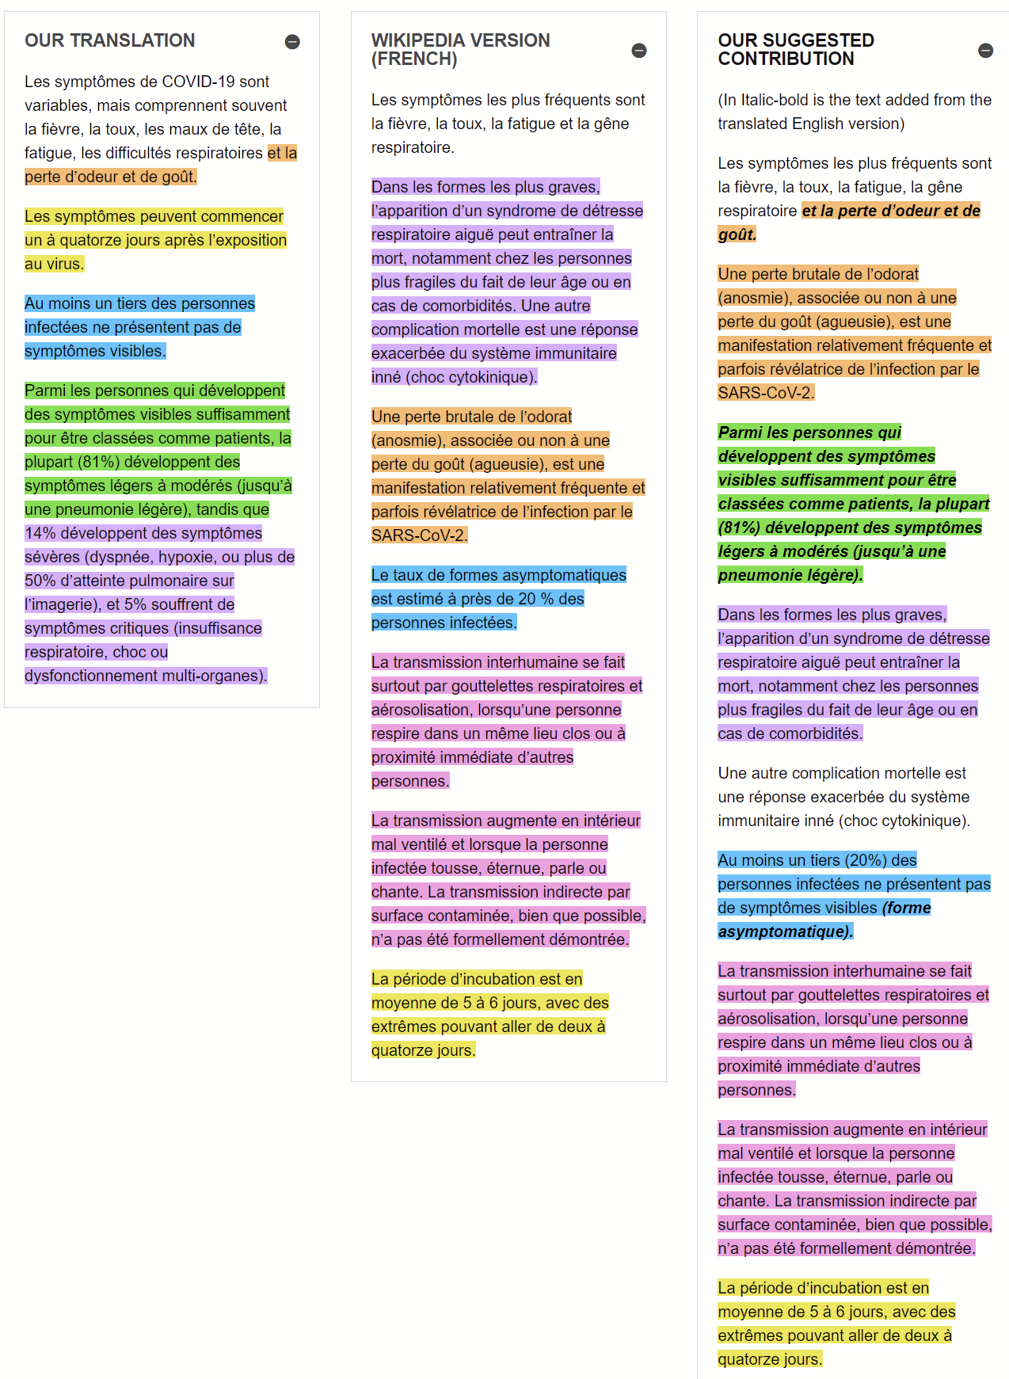
Proposed Solution

Slide 7
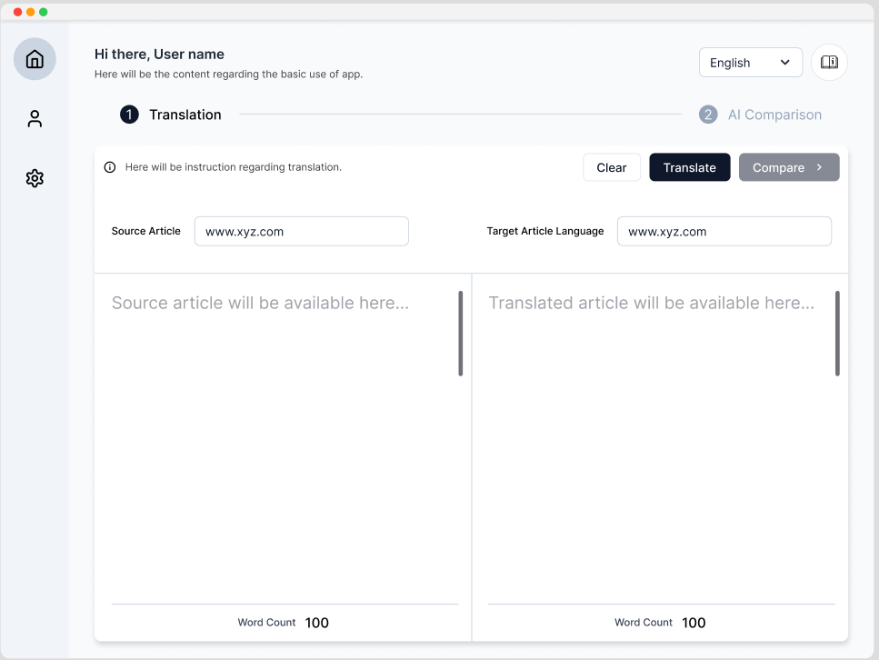
Symmetry Desktop Application

Slide 8
Progress till now!
Work Completed:
The application currently has three features active.
1. Rendering the source article using Title or URL
2. Providing translation languages available as dropdown
Work Pending:
The following work is pending and needs attention.
1. Rendering translated article
2. Getting the LLM API for semantic comparison active and running
3. Providing color coded sentences which are missed in translation (in red) and have got added during translation (in green)
4. Data Analytics on the translated content
5. Providing translation to under-represented languages using AI

Slide 9
Let’s understand the code!
The repository can be found in this [https://github.com/grey-box/Project-Symmetry-AI].
The older repository can be found in this [https://github.com/grey-box/Project-Symmetry-Semantic-comparison-Alpha].
Frontend: Electron Framework, TypeScript
Backend: FastAPI, Python

Slide 10
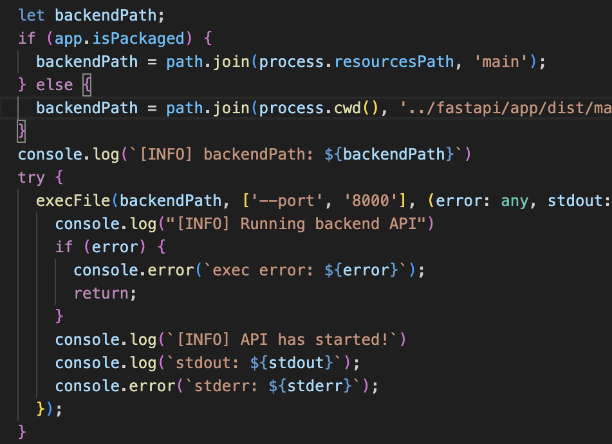
Frontend
npm run start
GreyBox/Project-Symmetry-AI/ui/src/main.ts
Runs API as background process using ‘execFile’

Slide 11
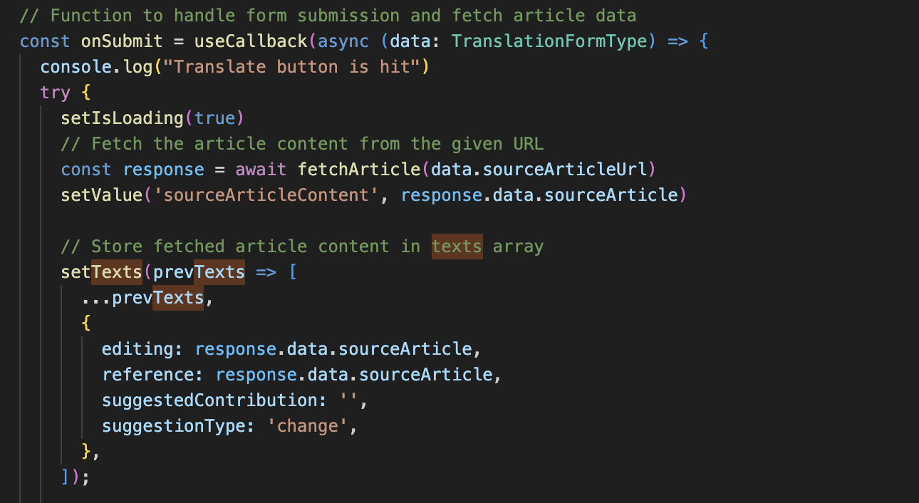
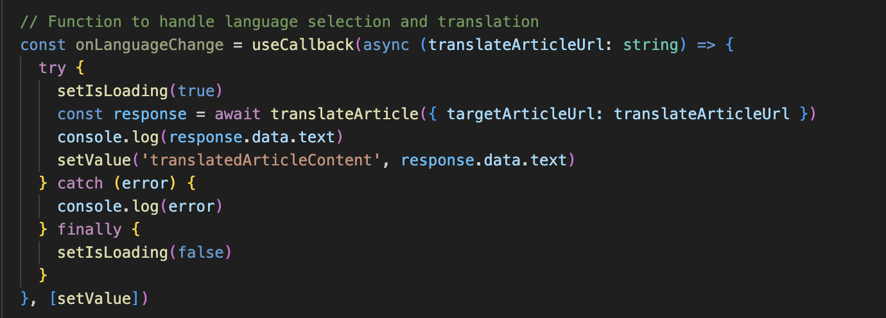
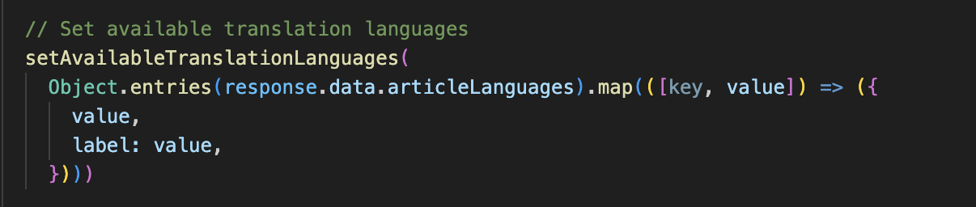
TranslationSection.tsx (GreyBox/Project-Symmetry-AI/ui/src/components/)
Fetch Source Article
Handles the UI design
Contains logic for
Rendering source article
Getting available languages
Getting translated article
Here, it calls backend API
Fetch Translate Article
Get Available languages

Slide 12
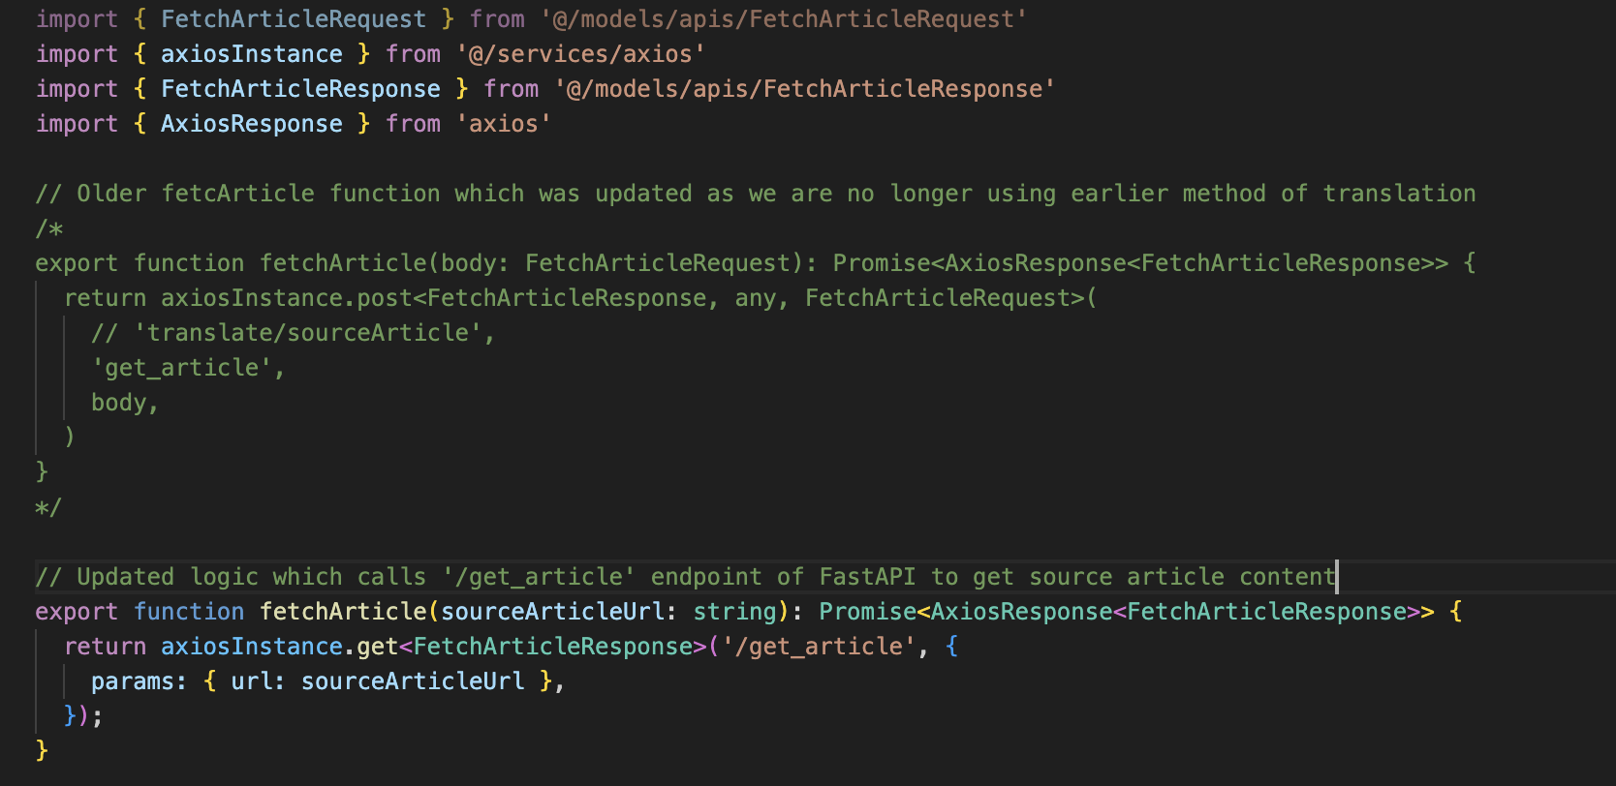
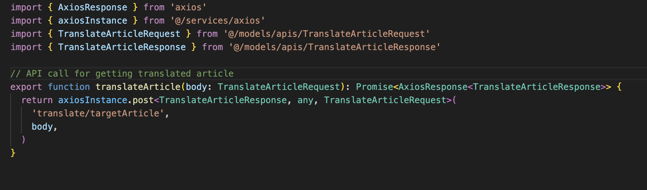
API Structure Call from Frontend
fetchArticle.ts (GreyBox/Project-Symmetry-AI/ui/src/services/
Uses ‘Axios’ for API call
Has structure pre-define for API call (request and response)
Two calls - fetchArticle and translateArticle
‘translateArticle.ts’ (GreyBox/Project-Symmetry-AI/ui/src/services/)

Slide 13
IMP files of Frontend
main.ts file (GreyBox/Project-Symmetry-AI/ui/src/main.ts)
TranslationSection.ts (GreyBox/Project-Symmetry-AI/ui/src/components/)
fetchArticle.ts (GreyBox/Project-Symmetry-AI/ui/src/services/)
translateArticle.ts (GreyBox/Project-Symmetry-AI/ui/src/services/)
AppConstants.ts (GreyBox/Project-Symmetry-AI/ui/src/constants/)
‘@/models/apis/FetchArticleRequest’ and ‘@/models/apis/FetchArticleResponse’
‘@/models/apis/translateArticleRequest’ and ‘@/models/apis/translateArticleResponse’

Slide 14
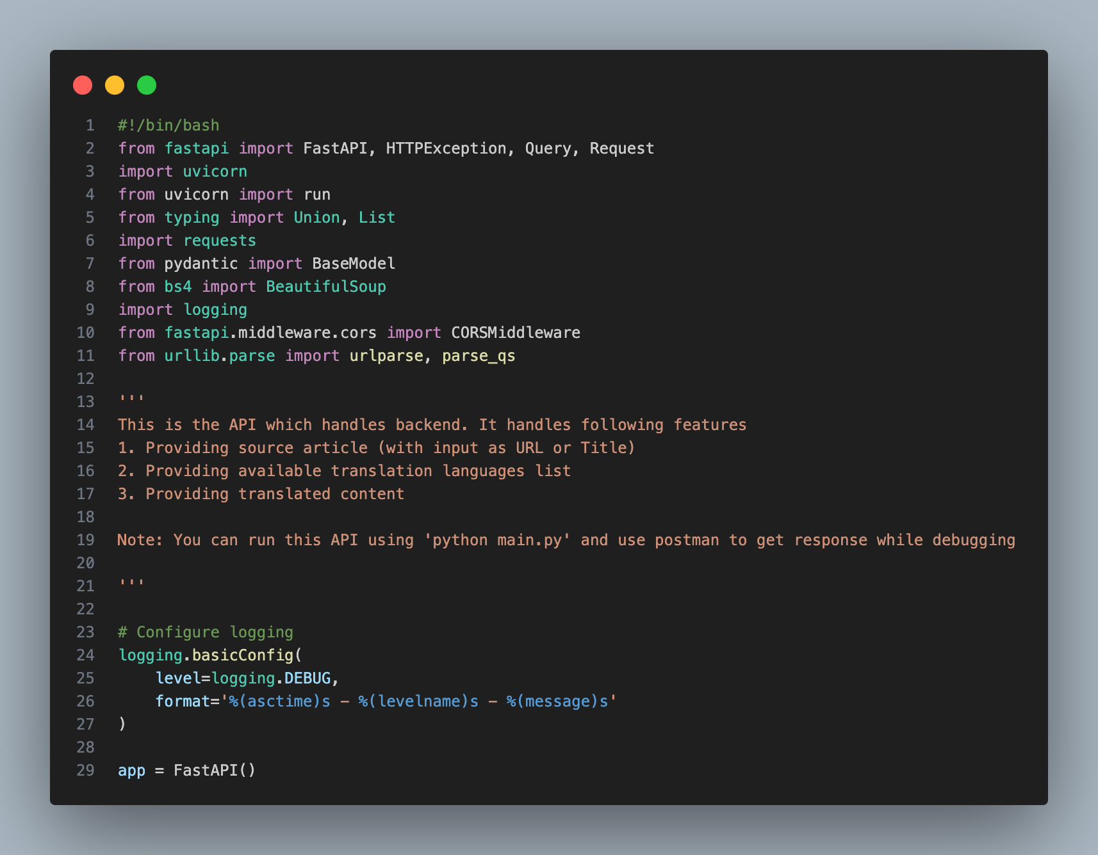
Backend

Slide 15
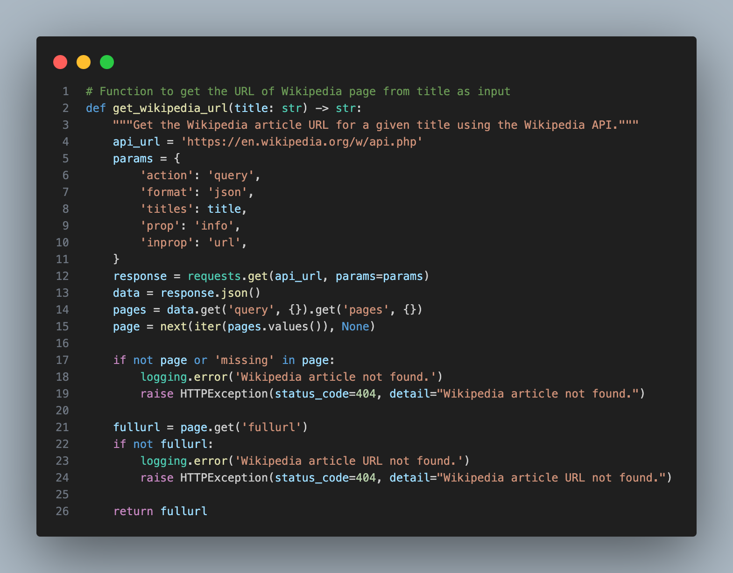
Backend

Slide 16
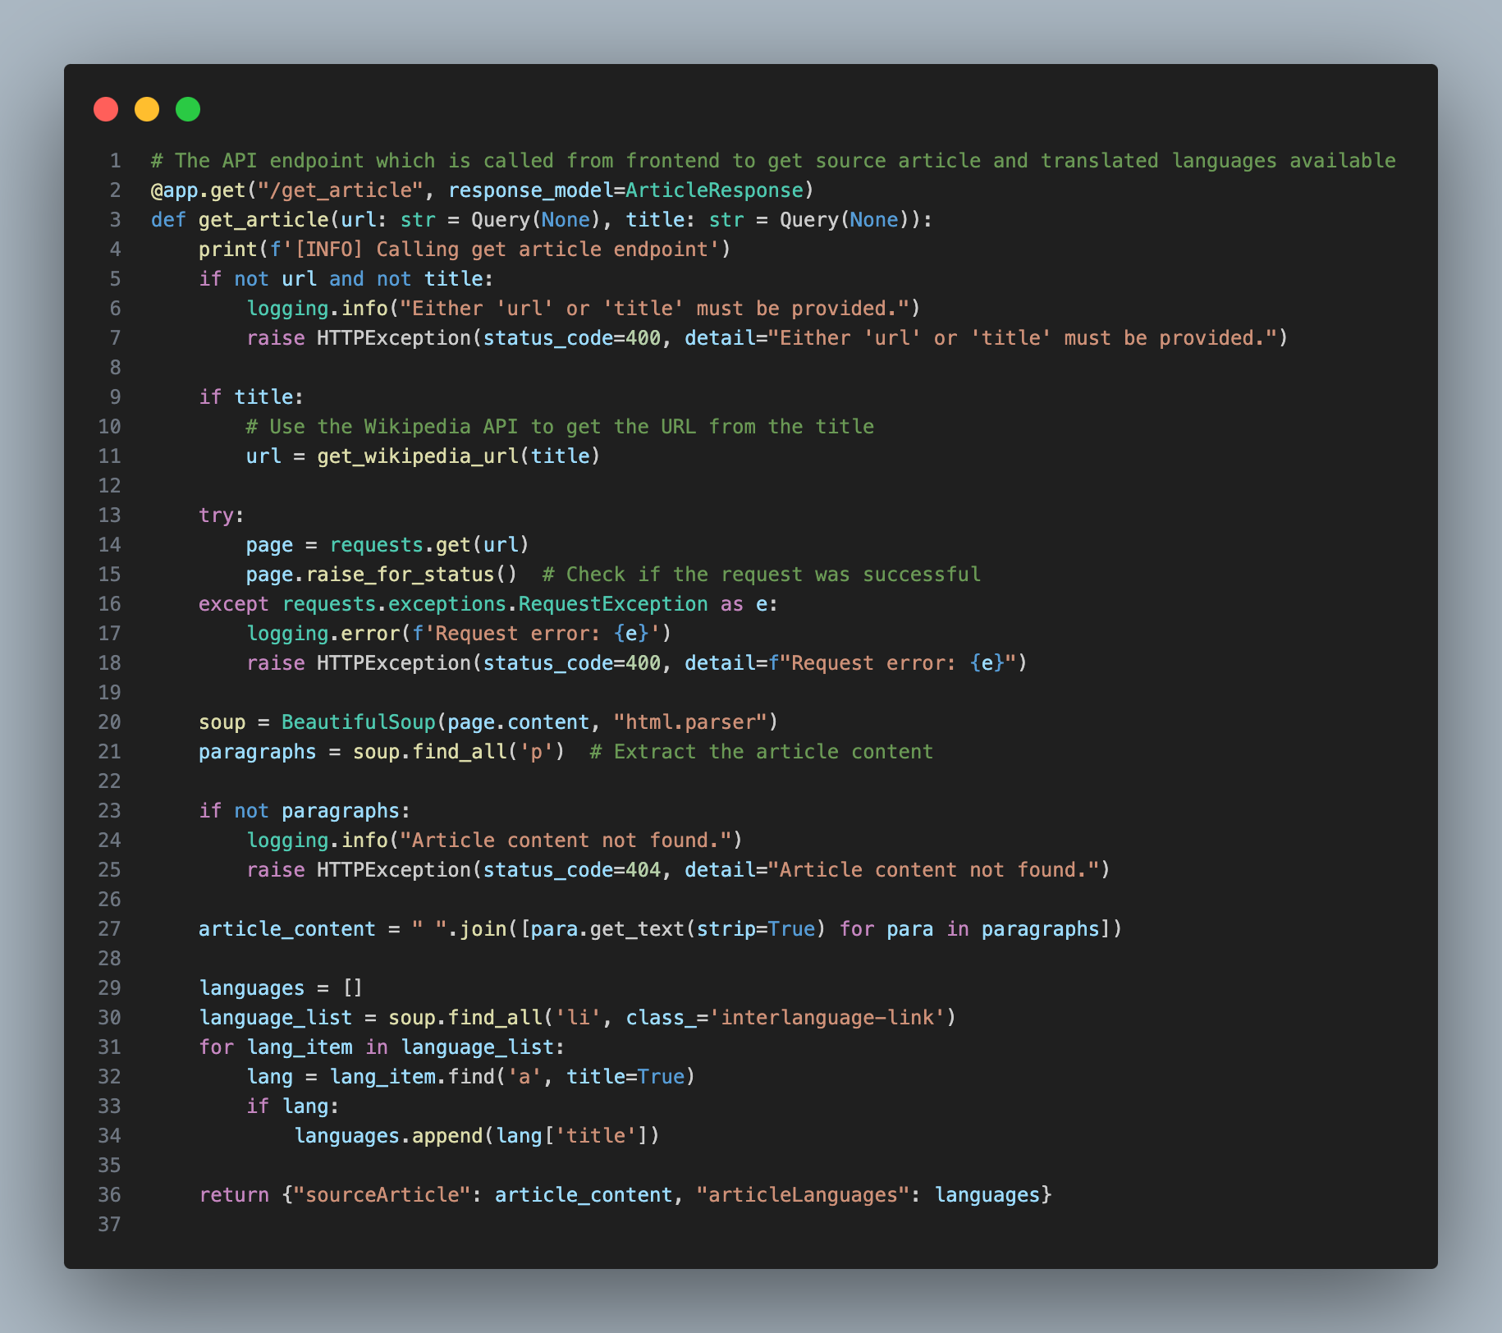
Backend

Slide 17
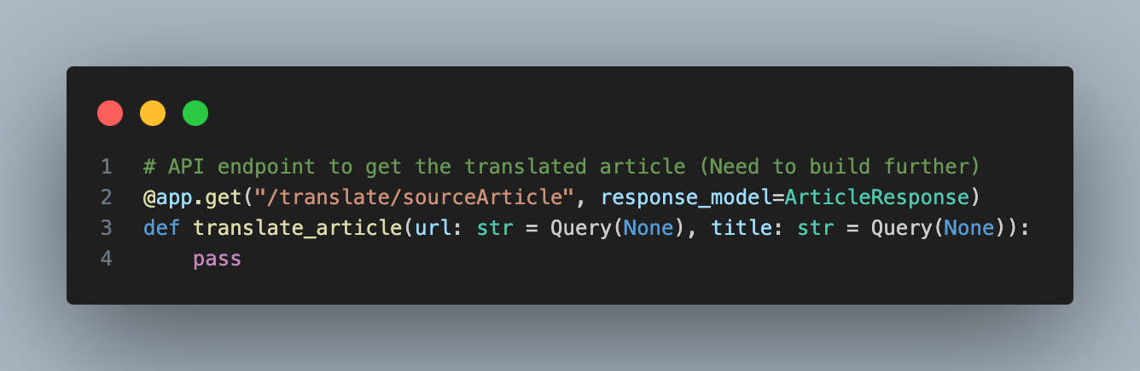
Backend

Slide 18
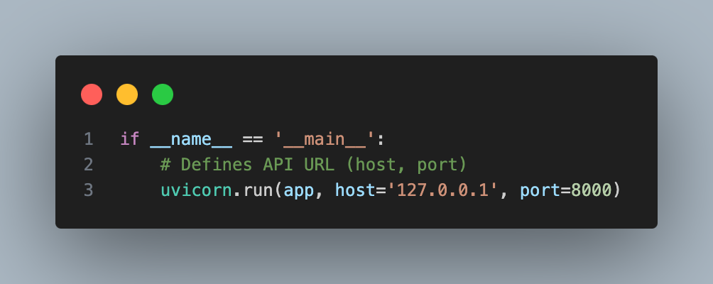
Backend

Slide 19
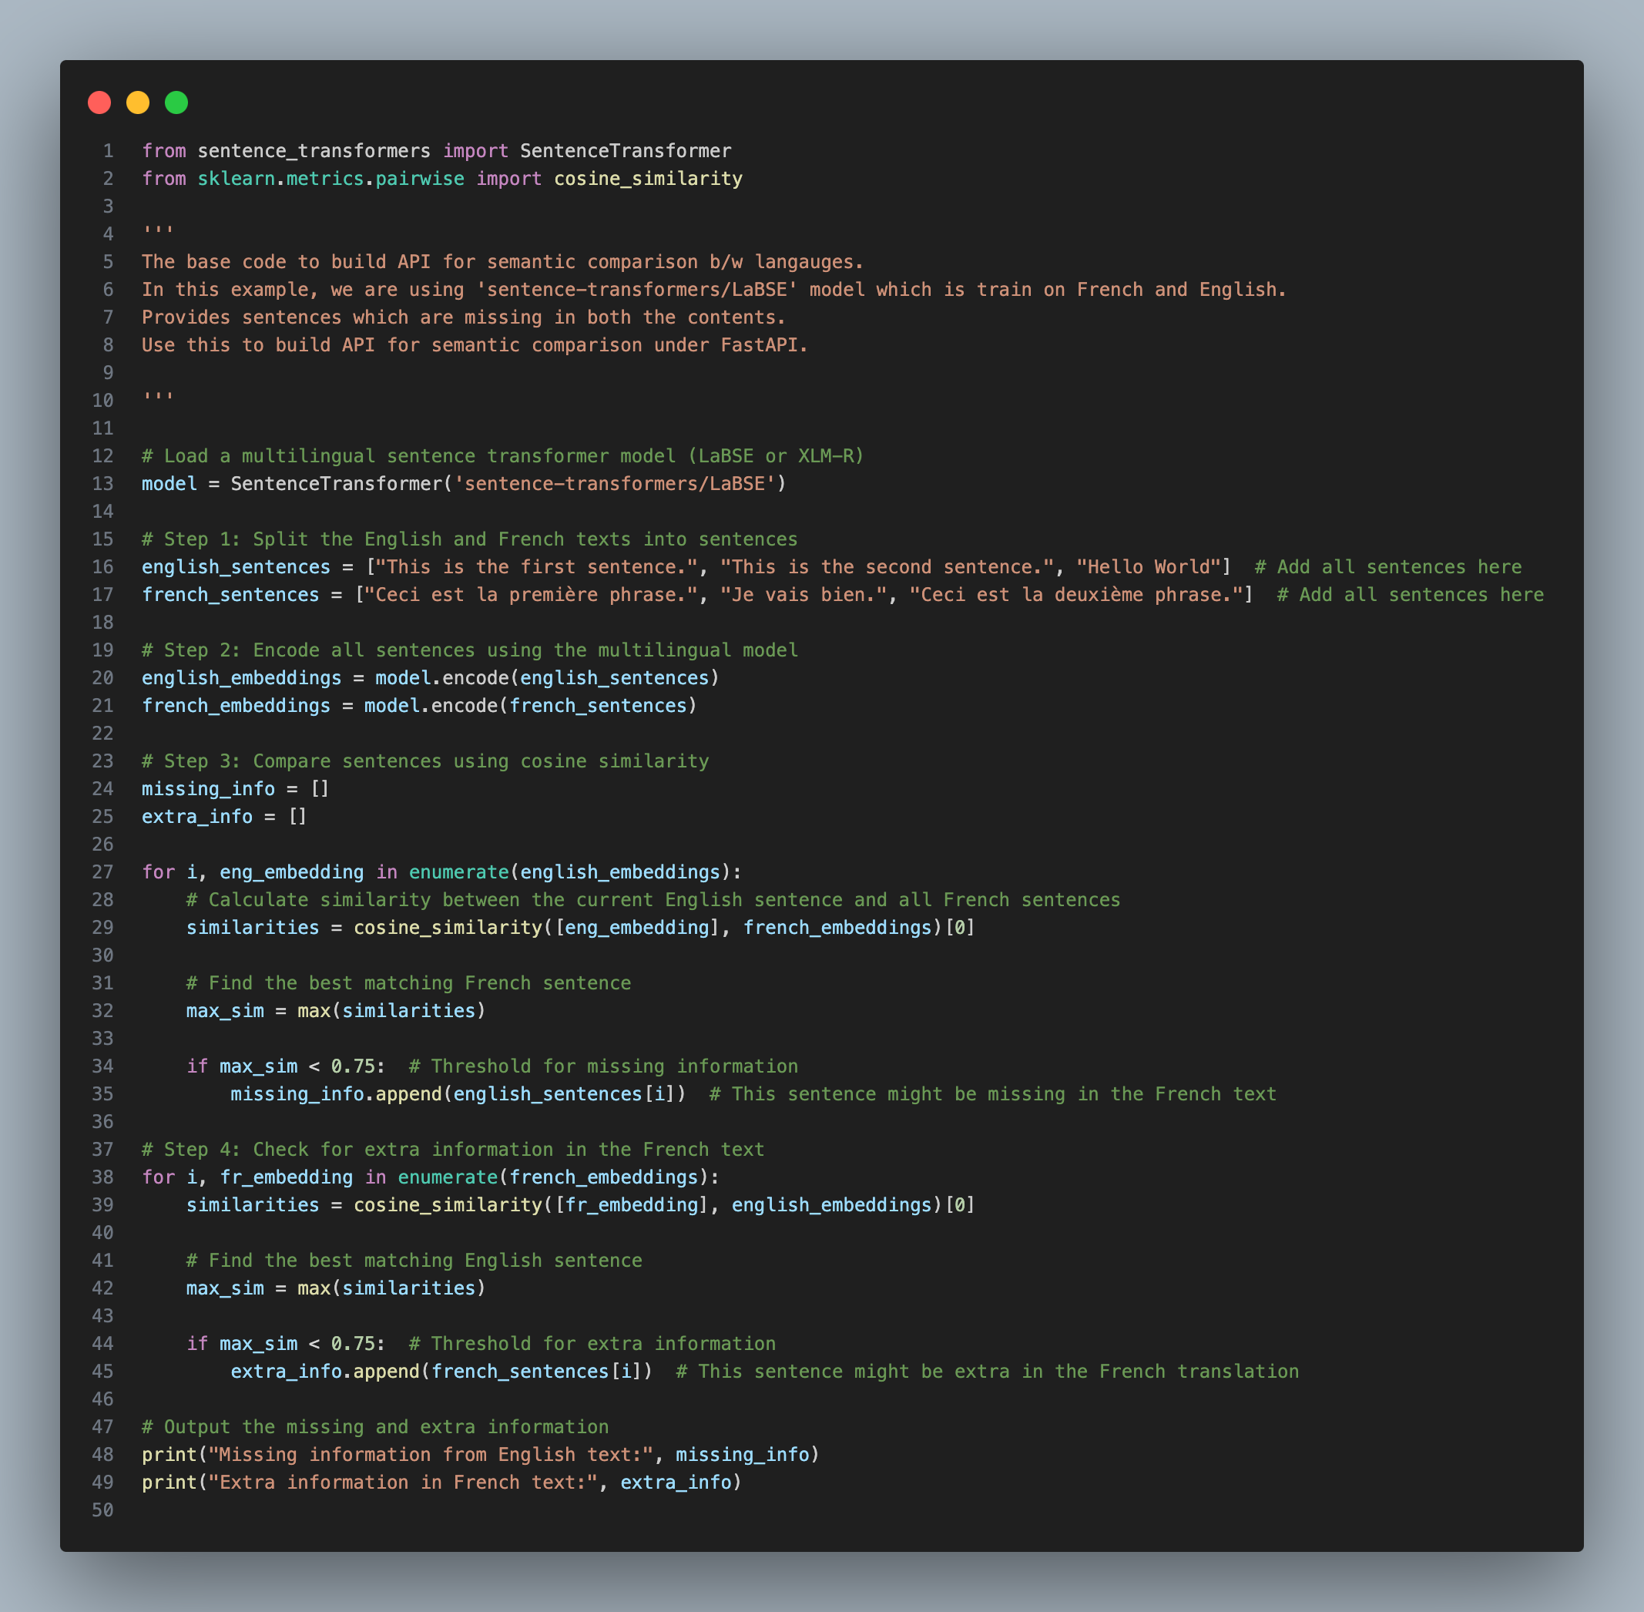
LLM Design
GreyBox/Project-Symmetry-AI/LLM

Slide 20
Thank you!
Any Questions?

