Slide 1

THE WHISTLER
Nightmare at the Cabin
A 2D Top-Down Psychological Survival Horror Game
Powered by Gale Framework (Python & Pygame)
DEVELOPED BY:
Francisco Grimaldo & Isaac Gómez
Course: Video Game Programming (2026)
Instructor: Prof. Alejandro Mujica

Slide 2
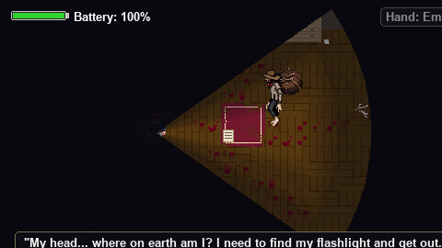
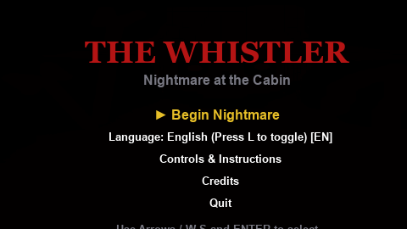
Premise & Inspiration
NARRATIVE PREMISE
• Stranded in the Fog: Andreas's car breaks down at night deep in the Venezuelan llanos. Knocked unconscious by a supernatural force, he awakens locked inside a dark, decrepit two-story cabin.
• The Cursed Stalker: The cabin is hunted by El Silbón (The Whistler)—a 6-meter-tall vengeful folklore specter carrying a sack of his victim's bones.
• The Escape Objective: The front door is secured by multiple mechanical and electrical locks. Andreas must explore, scavenge keys, solve puzzles, and escape before dawn.
INSPIRATIONS & GENRE INFLUENCES
• Venezuelan Folklore Paradox: Authentic acoustic mechanics: near whistling means the monster is distant, while faint, soft whistling means he is breathing right next to you.
• Granny & Resident Evil: Single-slot inventory management with floor swapping, recursive cabin shortcuts, and interlinked multi-step puzzle dependencies.
• Alien: Isolation: Unscripted Director AI patrolling between rooms, responsive acoustic stalking, violent door-knocking alerts, and tense wardrobe hiding.

Slide 3
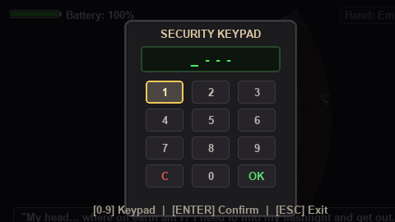
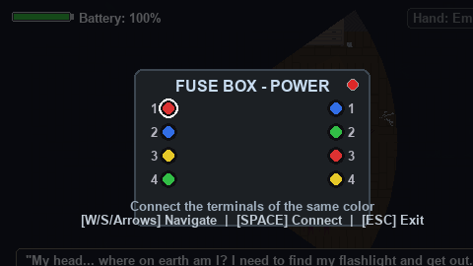
Mechanics, Controls & Gameplay
CORE GAMEPLAY MECHANICS
• Acoustic Inversion & Stealth: Sound defines survival. Soft whistling indicates extreme proximity. Andreas can throw stones to create acoustic decoys and lure the creature away.
• Volumetric Lighting & Battery Economy: Raycasted dynamic light cone with smooth directional tweening. Darkness triggers panic, while flashlight drains battery and attracts El Silbón.
• Director AI FSM: Dynamic state hierarchy (Patrol -> Investigate -> Stalking/Knocking -> Chase -> Berserk) dynamically adapting to player noise and minigame errors.
• 5 Tactile Real-Time Minigames: Fuse Box wiring, Lockpick sweet-spot, Combination Safe dial, Electronic Keypad code, and Crowbar barricade removal (world does NOT pause!).
CONTROLS & INPUT SYSTEM
• Movement: W, A, S, D / Arrow Keys
• Interact / Inspect / Hide: E
• Flashlight Toggle: F
• Throw Distraction Stone: SPACE
• Drop Held Item: G (Single-slot Granny inventory)
• Pause / Close Minigame: ESC
• Language Toggle & Fullscreen: L (EN/ES) | F11 / Alt+Enter (Fullscreen)

