Slide 1

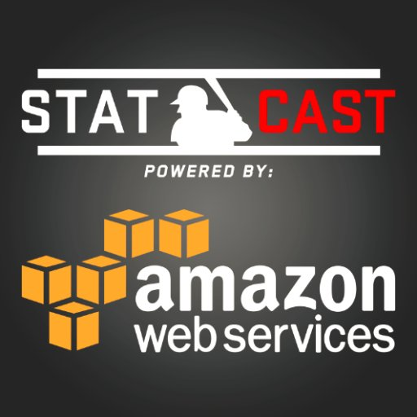
Hot Bat Fallacy
Federico Scivittaro, Francesco Scivittaro, Nick McDonnell

Slide 2
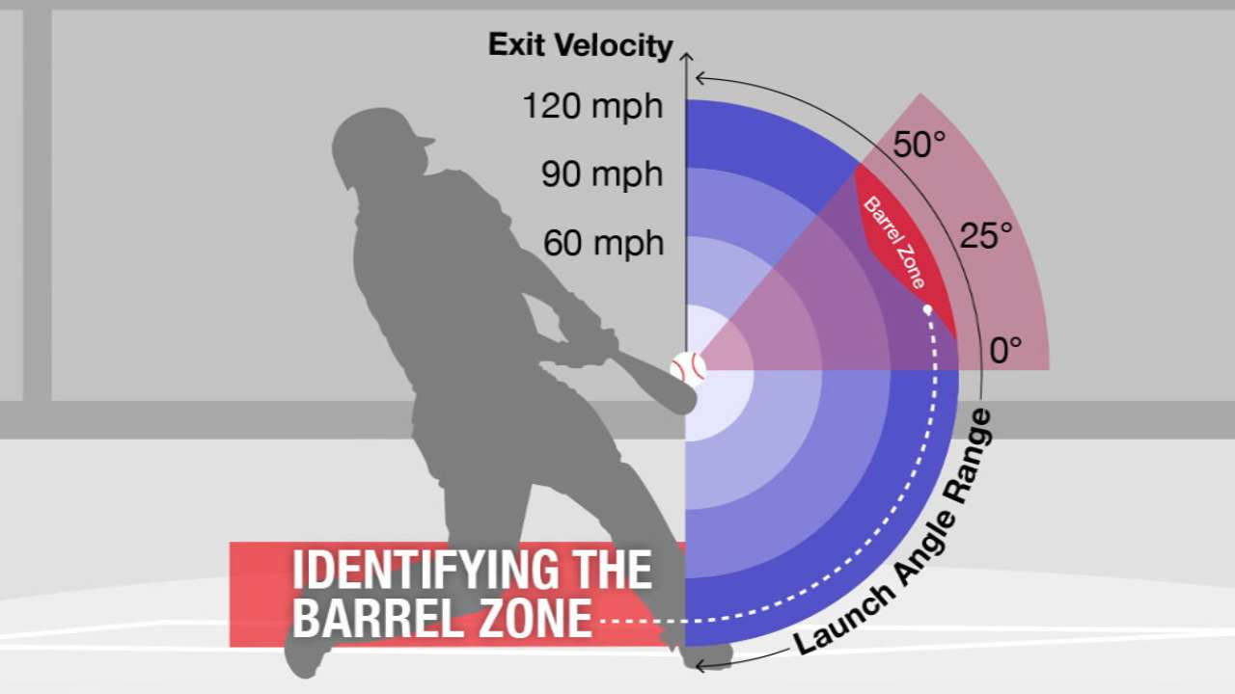
Our Goal
To use process-oriented data (barrels, exit velocity, LD%) to project MLB players’ future performance more accurately than traditional results-oriented methods (Marcels, PECOTA, ZiPS, etc)
Achieve this precision using simple methods, avoiding arbitrarily complex calculations

Slide 3
Marcel Projections
The Marcels forecasting system “is the most basic forecasting system you can have, that uses as little intelligence as possible…It uses 3 years of MLB data, with the most recent data weighted heavier. It regresses towards the mean. And it has an age factor.” - Tom Tango
Uses past statistics to evaluate future statistics (i.e. uses HRs from 2014, 2015, and 2016 to predict 2017 HRs)
Extremely simple, yet it is famously pretty effective

Slide 4
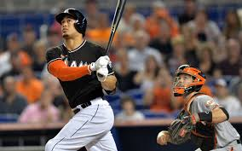
Our Model
Barrels per batted ball event
walk rate
strikeout rate
line-drive rate
average exit velocity
average distance

Slide 5
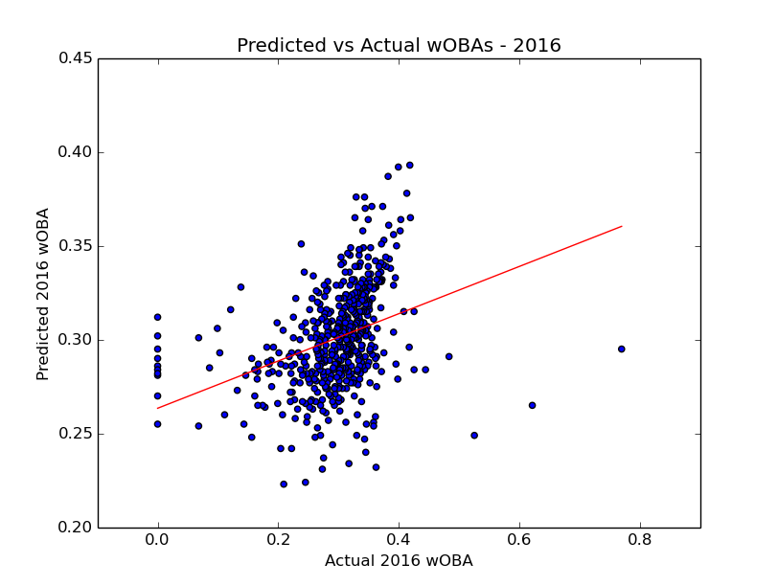
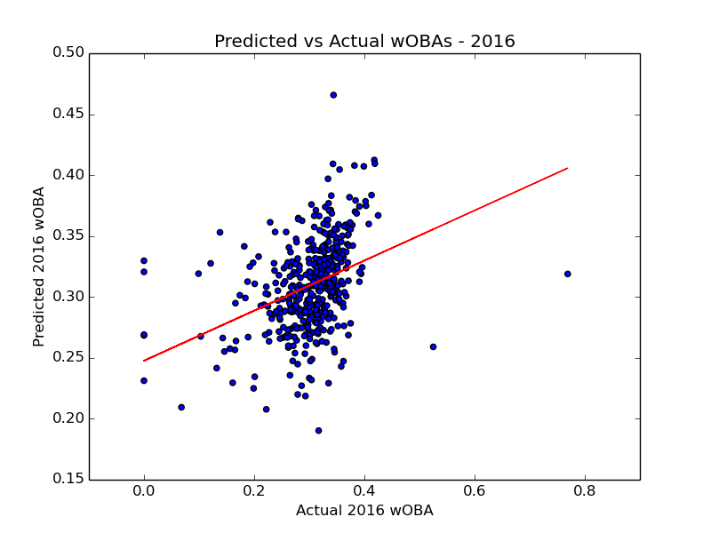
The Results We Obtained
Marcel
Statcast Model

Slide 6
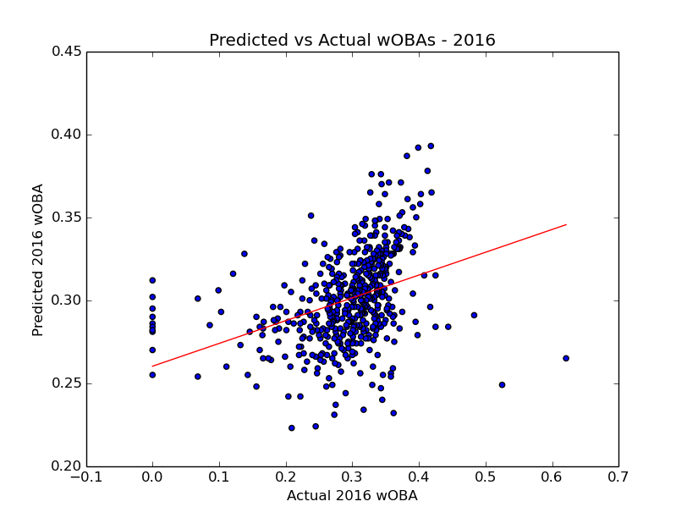
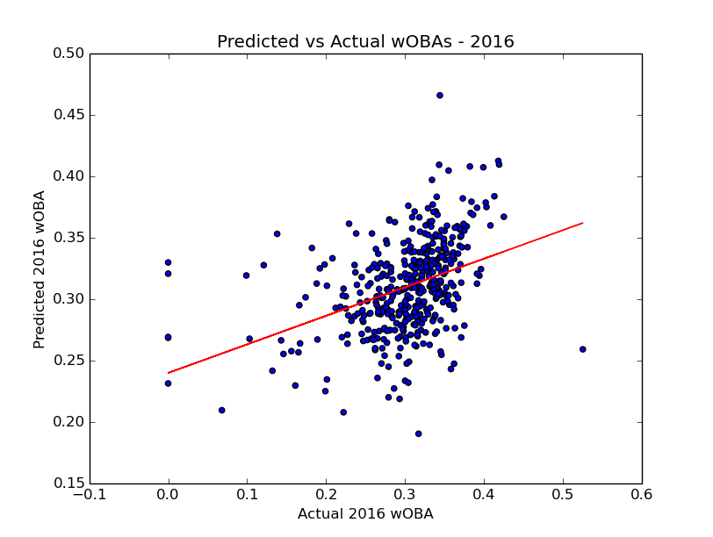
Removing Outliers
Marcel
Statcast

Slide 7
Final Results
Projection Method | Correlation Coefficient | Adjusted R-squared
Marcel | .350 | .121
Statcast Projection | .378 | .141
Marcel - Outlier Removed | .367 | .133
Statcast - Outlier Removed | .397 | .156

Slide 8
How We Organized Our Website
Name
Season
Team
Minimum Plate Appearances
After entering in the wanted data points, the website will output a table with the searchable data points as well as the Marcel Projection and our own projection.
We source our information from 3 main tables within the database:
Regular Data Table
Marcel Projections Table
Regressions Table

Slide 9
What We Learned
Parsimony matters - especially when it’s not intuitive
Balancing correlated independent variables with explanatory power
Limitations of our model
Even though it may be easy to get the data, outputting it in a visually appealing way proved to be difficult among multiple databases

Slide 10
Extensions/Improvements
Potentially include an aging factor
All other projection systems have this
Use multiple years of data to forecast results
Statcast has only existed since 2015, so this is currently limited
Forecast statistics other than wOBA
Would have to see which variables have highest explanatory value for each statistic
Forecast pitchers
The methodology would be the same, but it would require an analysis of totally different variables
Forecast players with no major league experience
Use minor league statistics? Statcast does not exist in minor league ballparks

