Slide 1
Reproducible NGS Data Analysis on Personal Laptops

Slide 2
DAY 03
ChIP-seq: from FASTQ
to peaks, differential occupancy
and de novo motifs
trimmed ChIP-seq FASTQ → BAM → QC → MACS3 peaks → IDR → peak matrix → DESeq2 → genomation → STREME

Slide 3
RECAP: DAY1 – DAY2 – DAY3
────────────────
DAY 2
────────────────
reference indexing
↓
read alignment
↓
sorted / filtered BAM
↓
library strandedness
↓
gene assignment
↓
RAW COUNT MATRIX
↓
DESeq2
↓
differential expression
────────────────
DAY 3/4
────────────────
read alignment
↓
sorted / filtered BAM
↓
ChIP-seq QCs
↓
Peak calling MACS3
↓
Additional QCs (IDR,etc..)
↓
RAW COUNT MATRIX
↓
DESeq2
↓
DeNovo motifs discovery
Concept carried forward:
Same reference genome and coordinate system
Same from FASTQ to BAM logic
Same reproducibility logic i.e. scripts, parameters, container Git repo.
ChIP-seq objective:
Protein-DNA interaction enrichment
Fragment coverage
Peak reproducibility
Motifs model from peak DNA
────────────────
DAY 1
────────────────
reference genome
+
gene annotation
+
Trimmed
paired-end FASTQ
│
▼
……

Slide 4
DAY3/4 Workflow:
FASTQ
Bowtie2
BAM
ChIP QC
phantom peak
bigWig
tracks
MACS3
peaks
Post-peak quality control
common
peak set
count matrix
scatter
correlation
PCA
DESeq2
differential
peaks
genomation
profiles
STREME
motifs
In ChIP-seq we cannot rely on pre-made annotations like in Reference based RNAseq.
ChIP-seq experiments, according to their design, can answer multiple things:
Where my DNA binding protein is the the coordinate system of my reference genome
Which sites are stronger/weaker than others
How the treatment/perturbation/genotype affects the binding of my protein

Slide 5
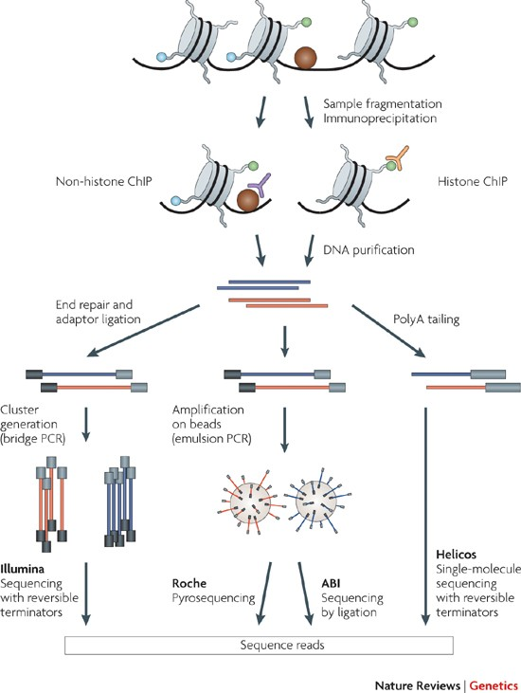
Wet-lab protocol > Bioinformatic analysis
ChIP-seq capture genome-wide Protein-DNA interations through 6 sequential steps:
Cross-link
Lyse
Shear
IP
Rev-crosslink
Library Prep & sequencing
Key Concepts:
The FASTQ reads are sampled from enriched DNA fragments.
A peak is inferred from many fragments accumulating at the same locus.
Controls matter because antibody/IP background is not the same as input DNA background.
Taken from Peter J. Park 2009

Slide 6
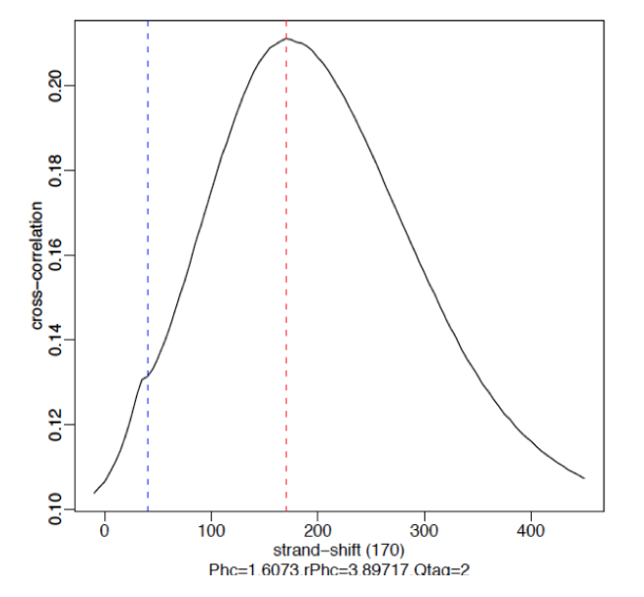
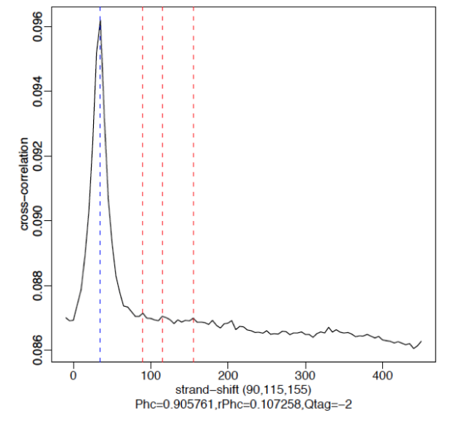
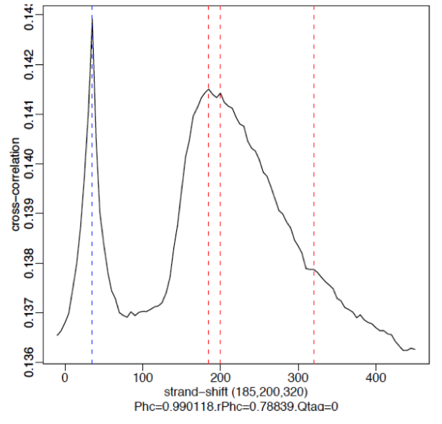
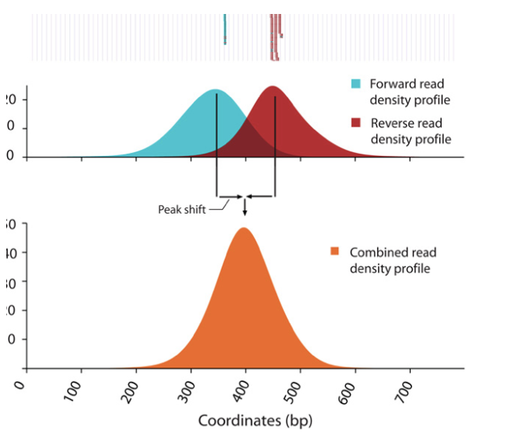
ChIP-seq specific QCs: PhantomPeak check:
Weak Signal: Strongest peak is the blue line (read length)
Strong Signal: predominant peak at the true peak shift.
No signal: Predominant peak is the blue line (read length)
FASTQ
Bowtie2
BAM
ChIP QC
phantom peak
In PE mode we can directly extrapolate this from the BAMPE insert size: so the span between read mates

Slide 7
MACS3: from aligned fragments to ChIP enrichment
FASTQ
Bowtie2
BAM
ChIP QC
phantom peak
bigWig
tracks
MACS3
peaks
Build the observed ChIP signal:
  Fragment are reconstructed either directly from the BAMPE or using the shift of FW and RW like the Phantompeak trick.
  Overlapping fragments generate the observed pileup k(x) across the genome.
Define the expected background:
  For each genomic region, MACS3 asks: how much signal would we expect in the absence of specific enrichment?
  BG is constructed from control samples (like input) or internally from the actual sample.
  MACS3 considers background at different spatial scales: genome-wide background, fragment-scale background, local background, broader local background -> It uses the largest of these! i.e MACS says my expected intesities are potentially : global average signal, or different local level signals
Convert significant enrichment into peaks:
  MACS3 compares observed pileup and expected (BG) using a Poisson model. Meaning Observed ~ Poisson(Expected) so we get how likely it is to see that observed signal given the expected signal and its theoretical distribution of the error.
  It then select those significant – join nearby portions – apply some rule for gapping – compute p and then q values - generate the peakfile!

Slide 8
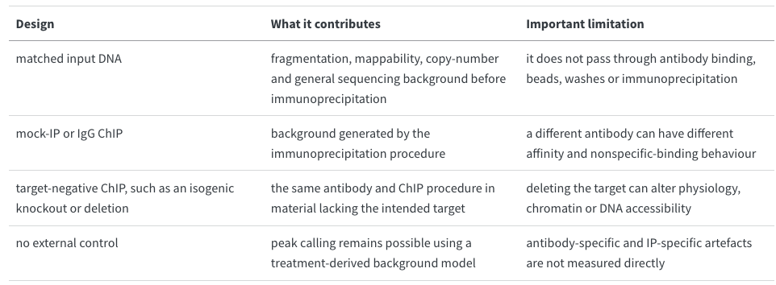
Control condition and Control-free peak calling:

Slide 9
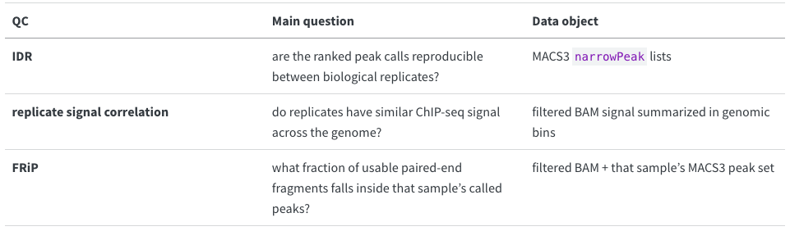
Post-peak quality control
FASTQ
Bowtie2
BAM
ChIP QC
phantom peak
bigWig
tracks
MACS3
peaks
Post-peak quality control

Slide 10
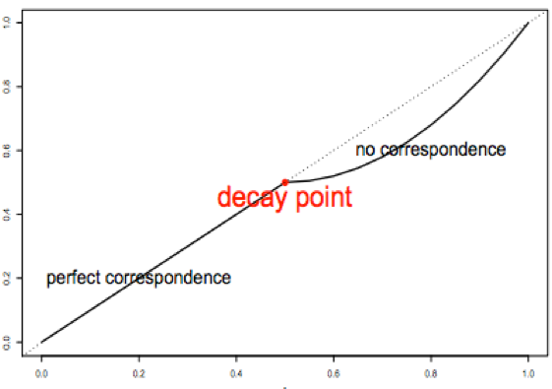
IDR: reproducibility of ranked peak calls
Do biological replicates recover a consistent ranked set of enriched regions?
Instead of simply asking if replicated leads to the same set of peaks IDR asks:
After matching peaks between replicates, are strong peaks strong in both replicates, and where does that rank agreement begin to break down?
Conceptually, IDR does four things:
matches overlapping peaks between the two replicate lists;
ranks the matched peaks using a chosen peak score;
fits a two-component model containing a reproducible and an irreproducible component;
assigns local and global measures of irreproducibility.
local IDR ~ probability that one matched peak pair belongs to the irreproducible component

Slide 11
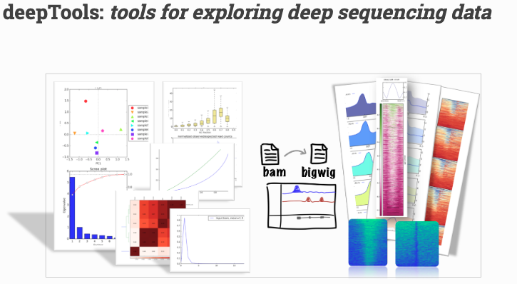
Replicate signal correlation with deepTools
IDR compares peak lists. We also want a peak-independent view of whether biological replicates have similar ChIP-seq signal across the genome. A standard approach is to summarize each BAM over the same genomic bins and correlate the resulting vectors.
multiBamSummary computes the read coverages for genomic regions for typically two or more BAM files. The analysis can be performed for the entire genome by running the program in ‘bins’ mode.
plotCorrelation Tool for the analysis and visualization of sample correlations based on the output of multiBamSummary or multiBigwigSummary. Pearson or Spearman methods are available to compute correlation coefficients.

Slide 12
FRiP: fraction of usable fragments in called peaks
The fraction of reads in peaks (FRiP) is a simple ChIP-seq signal-to-noise metric:
plotEnrichment Tool for calculating and plotting the signal enrichment in either regions in BED format or feature types (column 3) in GTF format. The underlying datapoints can also be output. Metrics are plotted as a fraction of total reads. Regions in a BED file are assigned to the ‘peak’ feature.

Slide 14
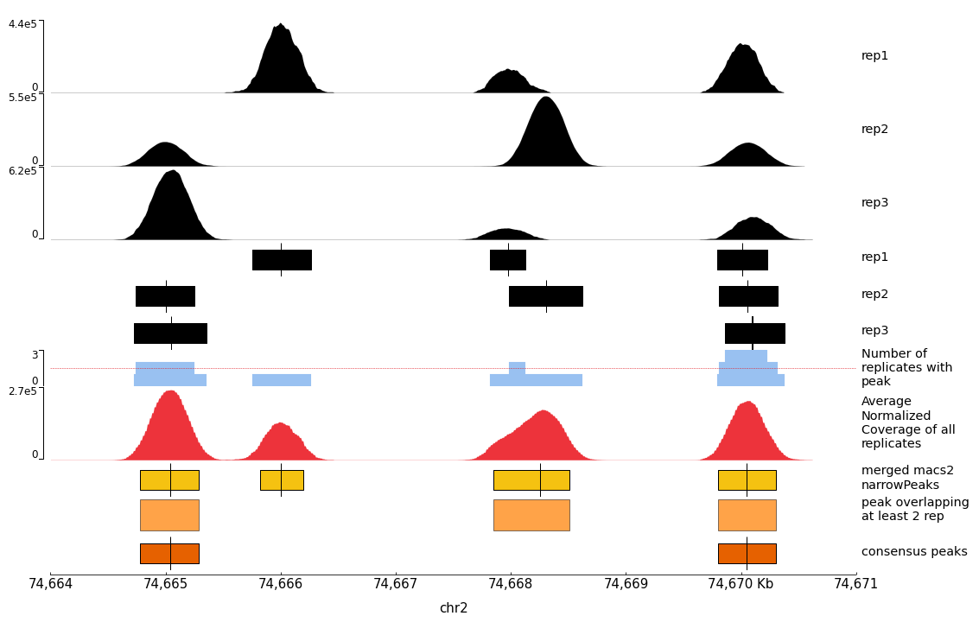

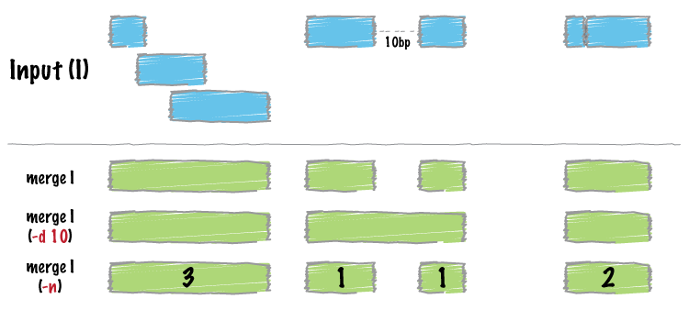
Build one common peak set and count matrix
FASTQ
Bowtie2
BAM
ChIP QC
phantom peak
bigWig
tracks
MACS3
peaks
Post-peak quality control
common
peak set
Merge called peaks
Count reads from BAM matching the consensus Peak

Slide 15
Differential peak analysis: DESEQ2
This deliberately mirrors Day 2 RNA-seq. The rows are now genomic peak intervals instead of genes, but the question is the same:
count matrix
scatter
correlation
PCA
DESeq2
differential
peaks
Conceptually is the same and the QC of the fitted dispersion follow the same rule

Slide 16

De novo motif discovery with STREME
ChIP-seq tells us where a protein-associated enrichment occurs in the genome. Motif analysis asks a different question:
Do those enriched regions share a short DNA sequence pattern more often than expected by chance?
De novo means that we do not give STREME a known HP1021 binding motif and ask whether it is present.
STREME starts from the peak sequences themselves and searches for recurring patterns that are enriched compared with a background set.
the DNA-binding preference is unknown;
we want to recover the expected motif without forcing the answer;
we want to detect additional motifs that could reflect cofactors or other sequence features associated with the peaks.
As a QC given the known motif for the targeted protein

Slide 17
De novo motif discovery with STREME
STREME proceeds from candidate sequence words toward a more flexible motif representation:
Find promising seed words. Short words enriched in the primary sequences relative to the controls provide starting points.
Refine the motif. Similar sequence occurrences are collected and used to improve the model.
Represent the motif as a position-weight matrix (PWM). Each position stores the preference for A, C, G and T rather than requiring one exact sequence.
Search both DNA strands. A DNA-binding site may occur in either orientation, so the reverse complement is considered automatically for DNA.
Evaluate enrichment. STREME asks whether sequences containing good matches to the motif are more frequent in the primary set than in the control set.
Continue searching. After a motif is found, its strongest sites are masked/erased and STREME can search for additional motifs in the remaining sequence information.

