Slide 1
Reproducible NGS Data Analysis on Personal Laptops

Slide 2
QC first
Biological interpretation second Filtering only when justified

Slide 3
RNA-seq alignment QC
After alignment, a high mapping rate does not guarantee a good RNA-seq library.
Three additional properties are particularly informative:
Duplication
Are many sequenced fragments represented repeatedly?
Is duplication explained by genuinely high transcript abundance or by low library complexity/PCR amplification?
Multi-mapping
Can reads be assigned confidently to one genomic position?
Or do several positions provide plausible alignments?
Residual rRNA
How much sequencing capacity was spent on ribosomal RNA rather than the RNA population of interest?
Key principle
QC describes properties of the library.
A QC signal does not automatically imply that the corresponding reads should be removed.

Slide 4
1) Duplication: RNA-seq is not genomic DNA sequencing
Two reads with identical genomic coordinates are coordinate duplicates.
Possible explanations include:
PCR amplification of the same original molecule;
very abundant transcripts;
non-random fragmentation/start positions;
limited library complexity.
In RNA-seq, highly expressed genes naturally produce many reads from a limited genomic interval. Therefore:
Coordinate duplication ≠ PCR duplication.
Without UMIs, we usually cannot determine whether two reads at identical coordinates originated from the same original RNA molecule.

Slide 5
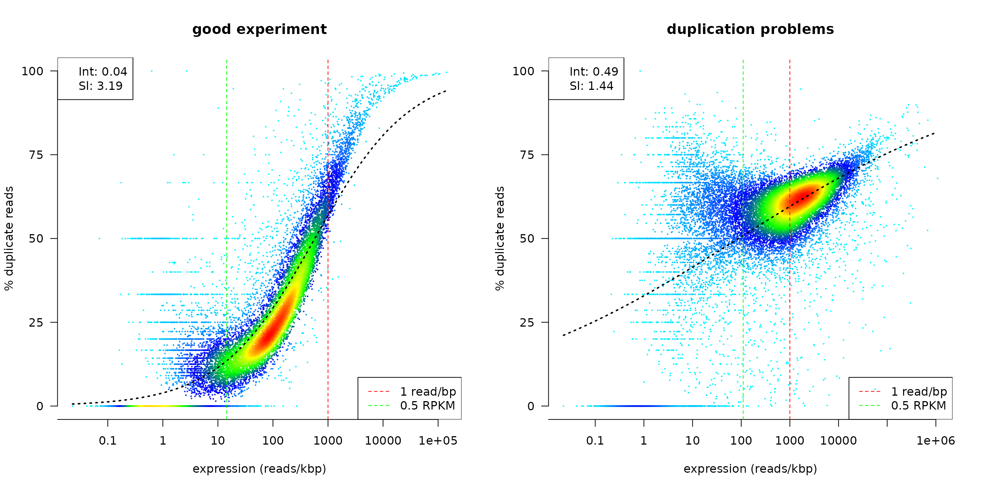
1) Duplication: RNA-seq is not genomic DNA sequencing
A global duplicate percentage is useful, but it lacks biological context.
dupRadar asks a better RNA-seq-specific question:
Does duplication increase with gene expression?
Expected:
higher duplication among highly expressed genes.
More concerning:
high duplication extending across low-expression genes; replicates behaving differently from the others.
Good practice
Measure and report duplication, compare replicates and inspect its relationship with expression.
Do not routinely deduplicate standard RNA-seq BAMs.
Removing coordinate duplicates can systematically remove legitimate reads from highly expressed genes.

Slide 6
2) Multi-mapping: ambiguity is not binary
Reads could map to:
one position
↓
high confidence
several positions, but one clearly better
↓
intermediate/high confidence
several equally plausible positions
↓
low confidence
How confident is the aligner in the reported genomic placement?
Good practice for ordinary gene-level RNA-seq
Use:
primary alignments;
appropriate FLAG filtering;
an aligner-appropriate MAPQ threshold.
Do not treat one MAPQ cutoff as universal across aligners.
Bowtie2, STAR and HISAT2 encode multimapping differently.
STAR and HISAT2 can provide NH, whereas Bowtie2 relies strongly on alignment scores, alternative alignments and MAPQ.
Aligners combine alignment scores, alternative placements and other information into MAPQ.
For Bowtie2:
AS = score of the reported alignment;
XS = score of the best alternative alignment found;
similar AS and XS → greater ambiguity;
MAPQ summarizes confidence in the selected placement.
Important:
SAM FLAG 0x100 means secondary alignment record.
It does not mean “this is a multimapping read.”
Removing secondary records therefore does not automatically remove all ambiguous reads.

Slide 7
2) Multi-mapping: ambiguity is not binary
Should we remove multimappers?
NOT ALWAYS
For standard gene-level differential expression, ambiguous reads can make assignment to individual genes uncertain.
Confidence filtering is therefore usually sensible.
But multimappers can be the signal of interest when studying:
transposable elements;
repetitive transcripts;
paralogous genes;
duplicated gene families;
multicopy sequences.
Simply deleting multimappers in these analyses preferentially deletes biologically relevant information.
The appropriate strategy may instead involve a quantification method capable of assigning or probabilistically modelling ambiguous reads.

Slide 8
3) Residual rRNA
Ribosomal RNA constitutes a very large fraction of cellular RNA.
RNA-seq protocols therefore commonly use:
rRNA depletion;
poly(A) selection in appropriate organisms/applications;
other targeted enrichment/depletion strategies.
Residual rRNA represents sequencing capacity that may contribute little to the intended gene-expression analysis.
What fraction of the library is rRNA?
Is it similar across replicates?
Is one sample an outlier?
Could differences reflect library preparation rather than biology?
Good practice
Use residual rRNA primarily as a library QC metric.
If contamination is substantial, the preferable solution is usually read-level classification/depletion:

Slide 9
QC signals can be connected
rRNA contamination, multi-mapping and apparent duplication can reinforce each other.
a) rRNA genes are often present in multiple highly similar copies in bacterial and higher Eukaryote genomes = multi-mapping.
b) Because rRNA transcripts are highly abundant and relatively short/constrained genomic regions are sampled repeatedly, many fragments can have identical or similar coordinates
= coordinate duplication.
Do these QC measurements tell a coherent story about the library?
For example, high rRNA + high multimapping + high duplication strongly suggests inspecting the rRNA-derived reads before concluding that the entire RNA-seq library has poor complexity.

