Slide 1
Reproducible NGS Data Analysis on Personal Laptops

Slide 2
Workshop agenda:
Day | Main objective | Main outputs | DATE
Day 0 | Set up the computational environment | VS Code, Git, Docker, IGV, … | -
Day 1 | Build a reproducible project, retrieve inputs data, get ready! | Metadata, reference genome, annotation, processed FASTQ | 18 Sep 2026
Day 2 | RNA-seq analysis | BAM files, gene counts, differential expression | 25 Sep 2026
Day 3 | ChIP-seq analysis | BAM files, bigWig tracks, peaks, motifs | 09 Oct 2026
Day 4 | Basic Integration: RNA-seq and ChIP-seq | Candidate regulatory relationships and genomic interpretation | 16 Oct 2026
@: Francesco.Gualdrini@gmail.com

Slide 3
DAY 01
Reproducible and portable
settings

Slide 4
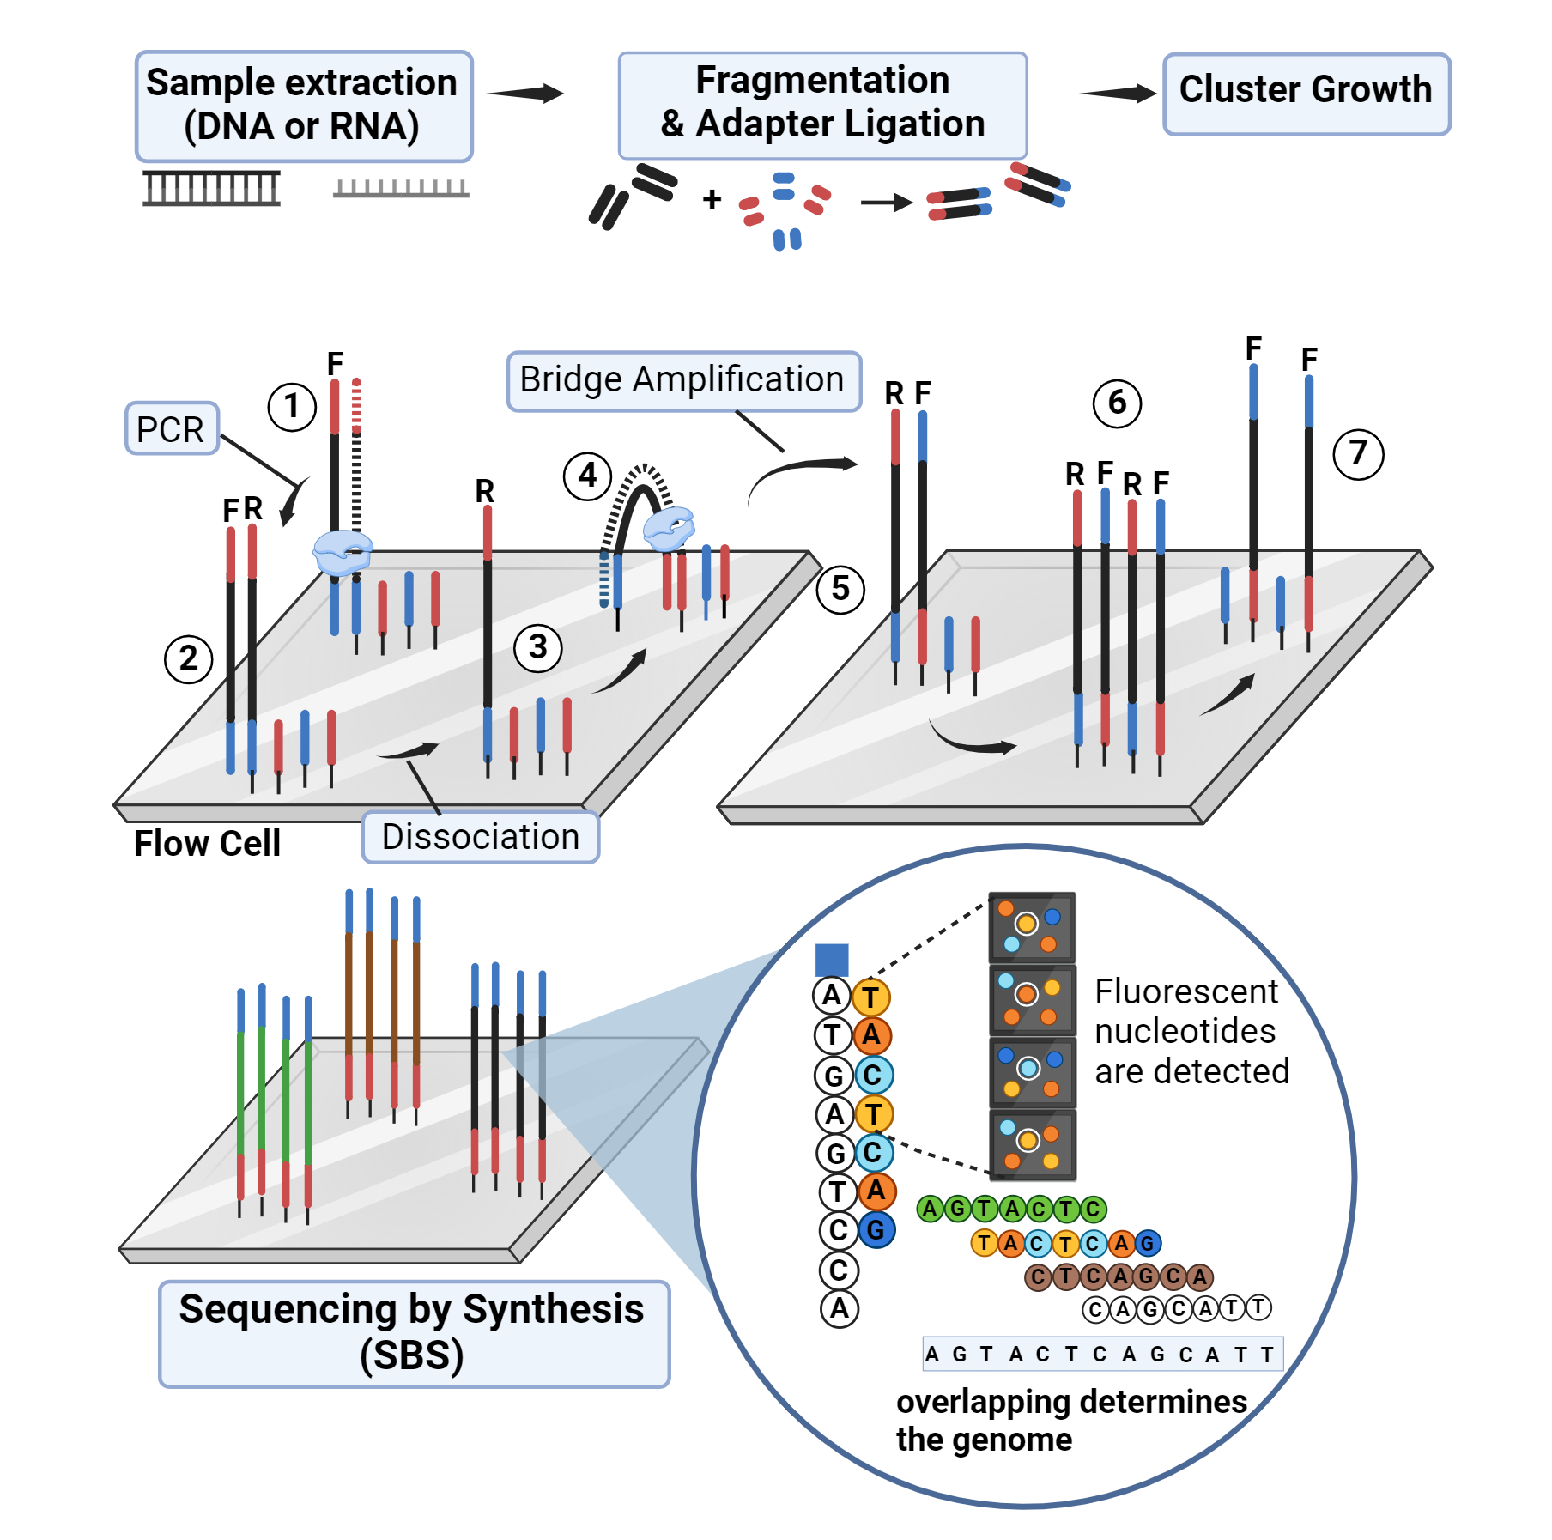
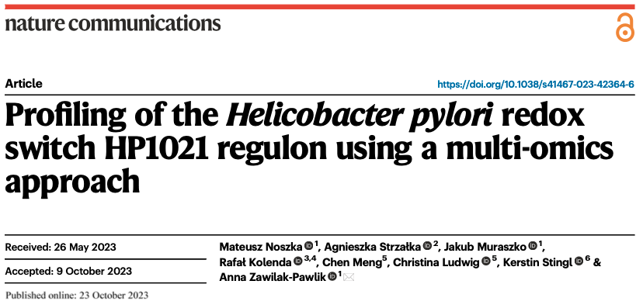
Next-generation sequencing
Next-generation sequencing (NGS) is a high-throughput technology that turns nucleic acid samples into digital nucleotide sequence text files
https://firegene.com/blogs/news/ngs-workflow-steps-next-generation-sequencing
Reference based NGS analysis is a bioinformatics method where newly sequenced DNA or RNA seuquences (reads) are aligned and compared to an existing reference genome ( or transcriptome ).
The study we will play with comes from:
HP1021: atypical orphan response regulator and redox switch protein that controls responses to oxidative stress and cellular metabolism
https://www.nature.com/articles/s41467-023-42364-6

Slide 5
Workshop objective:
Howan NGS analysis is constructed as a sequence of data transformations, and how to make those transformations transparent and reproducible.
What each analytical step does and why it is needed.
Reference-based RNA-seq and ChIP-seq workflows starting from FASTQ files.
Intermediate files and QC metrics instead of treating the workflow as a black box.
Record the data, reference, code, parameters and software environment used to generate a result.
Bioinformatics provides the computational methods used to process and analyse biological data.
Computational biology uses those data and methods to model and understand biological systems.
AI can assist code development and troubleshooting, but generated code still needs to be understood, tested and validated.

Slide 6



Reproducibility in bioinformatics
Results depends on more than the code alone!
Reproducible result = data provenance + reference + code and parameters + software environment​
A bioinformatics result can change because we changed:
the samples or files;
the genome assembly or annotation;
the command or its parameters;
the software version or dependencies.
Reproducibility means that these choices
can be reconstructed later by us or by somebody else.

Slide 7

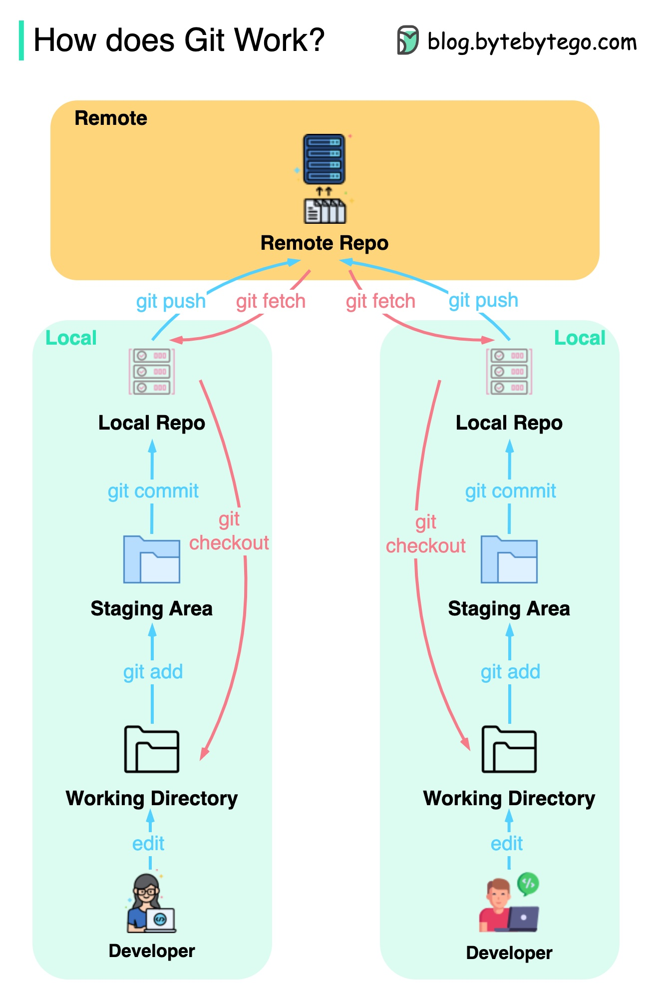
Git and GitHub
GitHub stores a remote copy and enables sharing, collaboration and troubleshooting.
Git is a version-control system that records the history of the analysis.
Git Cheat Sheet: https://git-scm.com/cheat-sheet
Getting started
Start a new repository: git init
Clone an existing repository: git clone <url>
Check the current state of the repository: git status
Prepare and make a commit
Add one file or its changes: git add <file>
Add all current changes: git add .
Unstage a file but keep the changes: git restore --staged <file>
Create a commit with a message: git commit -m "message"
Inspect changes and history
Show changes not yet staged: git diff
Show changes already staged: git diff --staged
Show the commit history: git log --oneline
Undo changes
Discard unstaged changes in a file: git restore <file>
Undo a previous commit by creating a new commit: git revert <commit>
Branches
List branches: git branch
Create a new branch and switch to it: git switch -c <name>
Switch to another branch: git switch <name>
Delete a merged branch: git branch -d <name>
Remote repository / GitHub
Download remote changes without modifying the current branch: git fetch
Download and integrate remote changes: git pull
Upload local commits to the remote repository: git push
switch branches or restore files git checkout
git push
Upload local commits to the remote repository
git fetch retrieves changes;
git pull retrieves and integrates them.
git commit
A labelled snapshot of the project at a particular point in its history.
git add
Add all or selected changes
git init / git clone
Initialize the working directory as a git repo or clone an existing one from GitHub
git checkout Replace my current copy of this file with the version stored in Git.
Git/GitHub preserve the analytical recipe.
Taken from :https://bytebytego.com/guides/git-workflow/

Slide 8
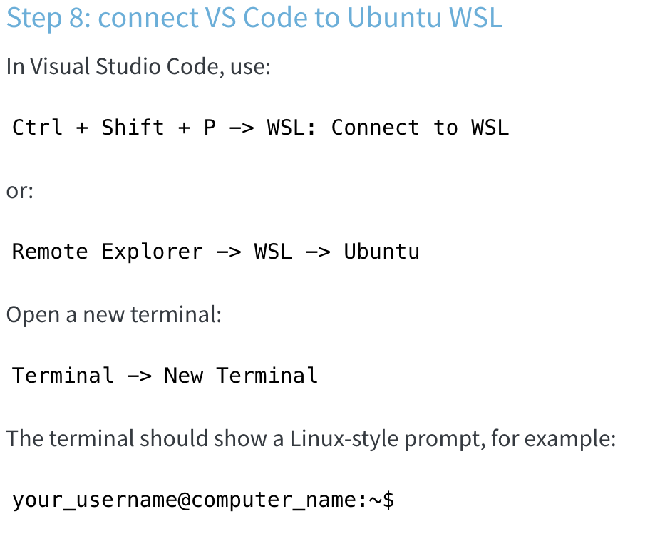
Open VSCode …
Windows users should open Visual Studio Code connected to Ubuntu WSL, open a WSL terminal, and run the commands there.
macOS and Linux users should open the workshop_ngs folder in Visual Studio Code and use the VS Code terminal.
Before running workshop commands, move to the repository root:
mkdir -p ~/workshop_ngs
cd ~/workshop_ngs
pwd
#Initialize Git locally:
git init
git status
#Set your Git identity if it has not already been configured on this computer:
git config --global user.name "Your Name"
git config --global user.email "your.email@example.com"
git config --global init.defaultBranch main
We now have to link the local git folder with our Github to generate an online repository:
Go to GitHub: https://github.com/
Log in.
Click New repository.
Use this repository name: workshop_ngs # good practice to use same name as the local folder
Choose Public or Private, depending on the course instructions.
Do not add a README file.
Do not add a .gitignore file.
Do not add a license.
Click Create repository -> you should see: https://github.com/YOUR_USERNAME/workshop_ngs
Now connect your local folder to the empty GitHub repository. Replace YOUR_USERNAME with your GitHub username:
git remote add origin https://github.com/YOUR_USERNAME/workshop_ngs.git
git remote -v

Slide 9
The first commit will be made after we create the project folders, the .gitignore, and a README file.
This way Git starts by recording the intended repository structure rather than an empty folder.
The .gitignore file is a hidden text file that tells Git which files should not be tracked or uploaded to GitHub. In this workshop, GitHub stores the reproducible record of the analysis: scripts, metadata, notes, small tables, figures, logs, and documentation. It is not used as storage for large sequencing or alignment files.
Create .gitignore and README in VS Code, or open it from the terminal:
nano .gitignore
nano README.md
# OS / R
.DS_Store
.Rhistory
.RData
# Raw sequencing data
*.fastq
*.fq
*.fastq.gz
*.fq.gz
*.sra
# Alignment files
*.sam
*.bam
*.bai
# Genome tracks
*.bw
*.bigWig
# Archives
*.zip
*.tar
*.tar.gz
# Reference genome and indexes
reference_genome/*
!reference_genome/REFERENCE.md
!reference_genome/.gitkeep
# Temporary SRA files
sra_tmp/
# Reproducible NGS workshop
Now we are ready for the first commit:
git status
git add .gitignore README.md
git commit -m "Initialize workshop repository"
git branch -M main
git push -u origin main

Slide 11

Docker and Docker Hub
Docker: is a tool to record software environment in an image.
Docker image: A packaged computational environment containing software and its dependencies.
Container: A running instance of an image.
DockerHub: is a registry for distributing container images. Images are identified by repository and tag (image:tag); tags can be updated, while digests identify immutable image content.
Docker/Docker Hub preserve the computational environment used to execute that recipe.

Slide 12
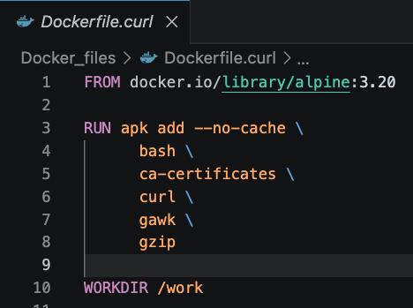
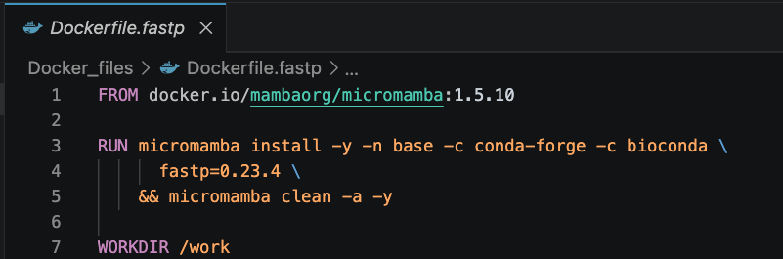
Image recipies: Dockerfile
To create a reproducible software environment, Docker needs a recipe describing how the image should be built.
A Dockerfile specifies:
the starting image;
the software to install;
the working directory;
optional default commands or entrypoints.
FROM Starting image
RUN Commands executed while building the image
WORKDIR Default directory inside the container
Why Micromamba?
Conda/Mamba environments are widely used to install bioinformatics software and dependencies.
Micromamba is a lightweight implementation of Mamba, particularly convenient inside containers.
conda-forge → general scientific/software packages
bioconda → bioinformatics packages

Slide 13
Image recipies: Dockerfile → Multi-architecture image
Open VSCode
Create a folder named Dockerfile_ recipes
mkdir -p Dockerfile_recipes
Save the 2 examples:
nano Dockerfile_recipes/Dockerfile.curl
(or open new in VSCode write and save..)
.. Type
nano Dockerfile_recipes/Dockerfile.fastp
(or open new in VSCode write and save..)
.. Type
One-time setup for multi-platform builds:
docker buildx create \
--name multiarch \
--driver docker-container \
--use
docker buildx inspect --bootstrap
--builder selects the Buildx builder
--platform defines the target CPU architectures
docker buildx build --builder multiarch \
--platform linux/amd64,linux/arm64 \
-f Dockerfile_recipes/Dockerfile.curl \
-t <dockerhub-user>/ngs-curl:1.0 \
--push .
docker buildx build --builder multiarch \
--platform linux/amd64,linux/arm64 \
-f Dockerfile_recipes/Dockerfile.fastp \
-t <dockerhub-user>/ngs-fastp:0.23.4 \
--push .
Test them:
docker run --rm <dockerhub-user>/ngs-curl:1.0 curl –version
docker run --rm <dockerhub-user>/ngs-fastp:0.23.4 fastp --version

Slide 14
How to create an image and save it to personal DockerHub
Docker Cheat Sheet: https://docs.docker.com/get-started/docker_cheatsheet.pdf
Basics:
Check Docker: docker --version
List local images: docker images
Pull an image: docker pull <image>:<tag>
Build images
Build an image: docker build -t <image>:<tag> .
Build a cross-platform image: docker buildx build --platform linux/amd64,linux/arm64 -t <username>/<image>:<tag> --push .
Run containers
Run a command using an image: docker run --rm <image>:<tag> <command>
Run code from the current folder: docker run --rm -v "$PWD":/work -w /work <image>:<tag> bash script.sh
Open an image interactively: docker run --rm -it <image>:<tag> bash
Containers
List running containers: docker ps
List all containers: docker ps -a
Docker Hub
Login: docker login
Push an image: docker push <username>/<image>:<tag>
Useful options
Remove container when finished: --rm
Interactive terminal: -it
Mount local folder: -v "$PWD":/work
Set working directory: -w /work
Force platform: --platform linux/amd64

Slide 16
Two complementary layers of reproducibility
REPRODUCIBILITY
Git
Docker
What and how did we do?
With what software and version?
GitHub
Docker Hub
scripts • metadata • history
images • tools • dependencies
But neither replaces: data provenance + reference genome + annotation (That will be to be correctly reported and coded in the WF)

Slide 17
Reference-based NGS analysis
RNA-seq and ChIP-seq share a common computational backbone
RNA / library
→ FASTQ → QC / trimming → alignment (BAM)
→ reference-based count matrix → normalization + DEG
protein–DNA interactions / ChIP library
→ FASTQ → QC / trimming → alignment (BAM)
→ peak calling → consensus peaks definition
→ reference-based count matrix → differential enrichment
→ motif enrichment/discovery
Both workflows begin with the same fundamental object: sequencing reads stored in FASTQ files.

Slide 18
Reference-based analysis requires... a reference!
Sequence tells us where we are
The reference genome FASTA defines the coordinate system.
References are in the form of FASTA or compressed FASTA files:
>chr1
ATGCGTACGTTAGCTAGCTAGCTAACGATCGATCGATCG...
CGATCGATTTAGCTAGCATCGATCGATCGTACGATCGTA...
>chr2
TTGACGATCGATCGATCGTAGCTAGCTAGCTAACGATCA...
Annotation tells us what is there
The annotation GFF3/GTF defines gene and feature coordinates.
Are plain text files tab-separated tables. Each row describes one genomic feature on the FASTA coordinate system
Format | Information | Coordinates | Typical use
GFF3 | Hierarchical features + attributes | 1-base, closed | Genome annotation
GTF | Gene/transcript feature annotation | 1-base, closed | RNA-seq quantification
BED6 | Genomic intervals + strand | 0-base, half-open | Interval operations
BED12 | Intervals + strand + block structure | 0-base, half-open | Gene/transcript models; RSeQC
narrowPeak | Enriched genomic intervals + peak statistics | 0-base, half-open | ChIP-seq, later in Day 3
Same genomic interval:
GFF/GTF
1001 ├────────────────────────┤ 1100
both coordinates included
BED
1000 ├────────────────────────┤ 1100
start included end excluded

Slide 19
Download reference genome and annotation:
Browse to:
https://www.ncbi.nlm.nih.gov/datasets/genome/
Open VSCode:
We will write first code which download reference genome, annotations and conversion into useful format
In the repo:
Create script/day1 folder
Assemble first scripts : 01_reference_genome_annotation.sh

Slide 20
#!/usr/bin/env bash
set -euo pipefail
out_dir="reference_genome"
assembly="GCF_025998455.1_ASM2599845v1"
base_url="https://ftp.ncbi.nlm.nih.gov/genomes/all/GCF/025/998/455/${assembly}"
mkdir -p "${out_dir}"
echo "Downloading genome FASTA"
curl -fL "${base_url}/${assembly}_genomic.fna.gz" -o "${out_dir}/genome.fa.gz"
gzip -df "${out_dir}/genome.fa.gz"
echo "Downloading GFF3 annotation"
curl -fL "${base_url}/${assembly}_genomic.gff.gz" -o "${out_dir}/annotation.gff3.gz"
gzip -df "${out_dir}/annotation.gff3.gz"
echo "Downloading GTF annotation"
curl -fL "${base_url}/${assembly}_genomic.gtf.gz" -o "${out_dir}/annotation.gtf.gz"
gzip -df "${out_dir}/annotation.gtf.gz"
awk -F '\t' '
BEGIN { OFS = "\t" }
$3 == "gene" {
split($9, attributes, ";")
sub(/^ID=/, "", attributes[1])
bed_start = $4 - 1
print $1, bed_start, $5, attributes[1], 0, $7, bed_start, $5, 0, 1, $5 - bed_start, 0
}
' "${out_dir}/annotation.gff3" > "${out_dir}/genes.bed"
docker run --rm -it \
-v "$PWD:/work" \
-w /work \
docker.io/fgualdr/ngs-curl
docker run --rm \
-v "$PWD:/work" \
-w /work \
docker.io/fgualdr/ngs-curl:1.0 \
bash scripts/day1/01_reference_genome_annotation.sh
In Terminal

Slide 22
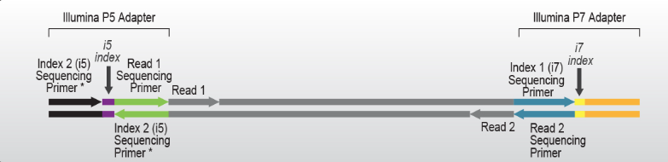
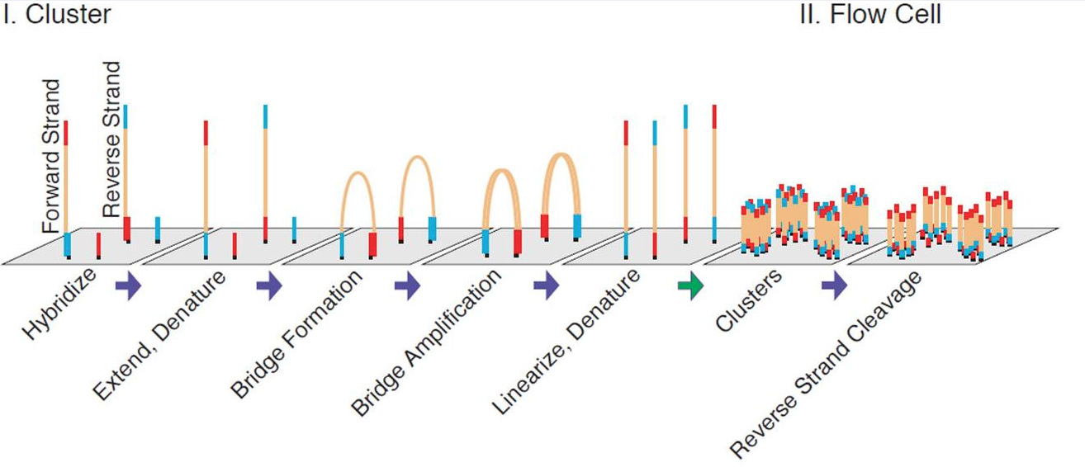
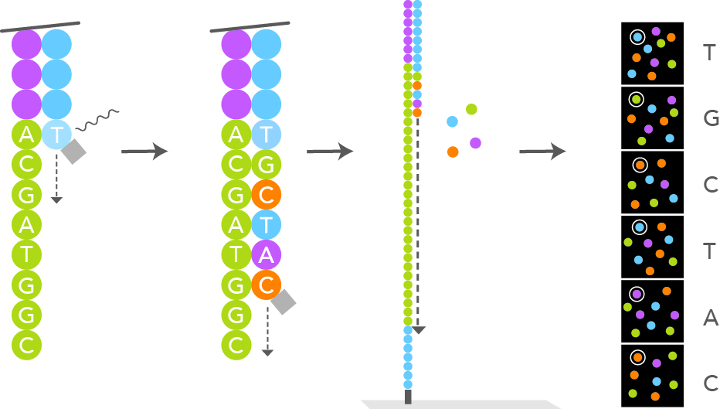
From biological molecules to sequencing reads
Illumina sequencing by synthesis
Library prep:
Library preparation converts DNA, or cDNA in RNA-seq, into adapter-flanked molecules compatible with sequencing termed P5 and P7, at their 5’ and 3’ end.
Cluster Generation &
Sequencing by Synthesis:
Libraries bind complementary oligos on the flow cell. Bridge amplification clonally amplifies each molecule into a cluster, generating enough signal for detection.
Fluorescent reversible-terminator nucleotides are incorporated one base per cycle, imaged, deblocked and extended again. Repeated cycles generate the read; fluorescence signals are converted into sequence by base calling.
Read 1 is sequenced first, followed by index read(s), then the opposite strand is sequenced as Read 2 (for PE library)

Slide 23
Sequencing layout: single-end, paired-end and indexes
Paired-end sequencing
R1 and R2 originate from opposite ends of the same library fragment.
Their records remain synchronized throughout preprocessing and alignment.
Indexes
i7/i5 sequences identify libraries multiplexed in the same sequencing run.
Demultiplexing uses these indexes to generate sample-specific FASTQ files.
https://knowledge.illumina.com
At the end of the run, the instrument stores the sequencing output as BCL files, organized by cycle and containing the base calls and quality information for each cluster.
Tools such as bcl2fastq (or the newer BCL Convert) use the sample sheet and index sequences to demultiplex the run and convert BCL data into sample-specific FASTQ files.

Slide 24
FASTQ structure: sequence + uncertainty
@SEQ_ID
GATTTGGGGTTCAAAGCAGTATCGATCAAATAGTAAATCCATTTGTTCAACTCACAGTTT
+
!''*((((***+))%%%++)(%%%%).1***-+*''))**55CCF>>>>>>CCCCCCC65
FASTQ line | Meaning
1 | Read identifier: instrument/run/lane/tile/coordinate and sometimes read/index information
2 | Called DNA sequence
3 | Separator, often just +
4 | Per-base quality string encoded as Phred quality scores
Tile
physical section
instrument name
flowcell ID
the member of a pair, 1 or 2
sample index or barcode
@A00488:92:H2JWNDSX3:2:1101:1234:5678 1:N:0:ATTACTCG+GTCGATTA
run number
lane
x/y coordinates
Additional filtering flags

Slide 25
FASTQ structure: sequence + uncertainty
The quality string encodes Phred quality scores:
Why characters?
FASTQ normally uses Phred+33 ASCII encoding:
Q=-10 * log₁₀(Perr) i.e. the probability that the base call is wrong at that position
Q = ASCII(character) − 33:
5 → Q20 = 0.01
? → Q30 = 0.001
I → Q40 = 0.0001
One sequence character </> one quality character.
Base quality estimates uncertainty in the base call, not uncertainty in genomic alignment.

Slide 26
Library preparation determines what the FASTQ represents
The same FASTQ format can represent fundamentally different libraries.
Library property | Consequence for analysis
poly(A)-selected RNA-seq | Enrichment for polyadenylated transcripts
rRNA-depleted total RNA-seq | Broader RNA representation; appropriate for bacterial transcriptomics
Unstranded RNA-seq | Read orientation does not retain transcript-of-origin information
Stranded RNA-seq | Read orientation carries transcript-strand information
Single-end / paired-end | Changes available fragment information and mapping strategy
Library strategy, strandedness, assay, biological condition and replicate identity therefore belong to the metadata, not to the FASTQ format itself.
On Day 2 we will infer/validate RNA-seq strandedness before gene counting.

Slide 27
Public sequencing archives: metadata + reads
There are several routes from a paper or accession to FASTQ files. We will look at these together in the browser:
NCBI GEO metadata and processed data, linked to raw high-throughput sequencing reads in SRA: https://www.ncbi.nlm.nih.gov/geo/
ENA Browser: https://www.ebi.ac.uk/ena/browser/home
ArrayExpress collection in BioStudies:
RNA-seq study E-MTAB-13025 and ChIP-seq study E-MTAB-13026

Slide 28
ArrayExpress collection in BioStudies + ENA route
GEO/SRA route
SRA and ENA are the major archival resources for raw sequencing data.
Depending on the repository, FASTQ files may be downloaded directly or reconstructed from run accessions.
curl -fL "$url" -o sample_R1.fastq
gzip sample_R1.fastq
fasterq-dump SRR11192680 --split-files --threads 2
gzip SRR11192680*.fastq
Coding time… open VSCode
scripts/day1/01_download_fastq.sh

Slide 29
#!/usr/bin/env bash
set -euo pipefail
srr="ERR11479311"
sample="WT_2"
outdir="raw_data/fastq/rnaseq"
tmpdir="sra_tmp"
mkdir -p "${outdir}" "${tmpdir}"
fasterq-dump "${srr}" \
--split-files \
--threads 2 \
--progress \
--details \
--outdir "${outdir}" \
--temp "${tmpdir}"
mv "${outdir}/${srr}_1.fastq" "${outdir}/${sample}_R1.fastq"
mv "${outdir}/${srr}_2.fastq" "${outdir}/${sample}_R2.fastq"
gzip "${outdir}/${sample}_R1.fastq" "${outdir}/${sample}_R2.fastq"
docker run --rm \
-v "$PWD:/work" \
-w /work \
docker.io/fgualdr/ngs-sra-tools:latest \
bash scripts/day1/01_download_fastq.sh
In Terminal

Slide 30
Unable to find image 'fgualdr/ngs-sra-tools:latest' locally
latest: Pulling from fgualdr/ngs-sra-tools
a51c11bda596: Pull complete
db035acc8c2c: Pull complete
44136fa355b3: Already exists
23acc7d0f59a: Download complete
Digest: sha256:4f5c87b31c35d6ef2878c474592fa200a4ae290a415ad5e647c746c12bea6a45
Status: Downloaded newer image for fgualdr/ngs-sra-tools:latest
cursor-cache : 5,242,880 bytes
buf-size : 1,048,576 bytes
mem-limit : 52,428,800 bytes
threads : 2
scratch-path : '/work/sra_tmp/fasterq.tmp.bf03403e5f9d.20/'
total ram : 8,319,504,384 bytes
output-format: FASTQ split file
check-mode : on
output-file : '/work/raw_data/fastq/rnaseq_test/ERR11479311.fastq'
output-dir : 'raw_data/fastq/rnaseq_test'
output : '/work/raw_data/fastq/rnaseq_test/ERR11479311.fastq'
append-mode : 'NO'
stdout-mode : 'NO'
seq-defline : '@$ac.$si $sn length=$rl'
qual-defline : '+$ac.$si $sn length=$rl'
only-unaligned : 'NO'
only-aligned : 'NO'
accession : 'ERR11479311'
accession-path: 'ERR11479311'
est. output : 9,441,782,544 bytes
disk-limit (OS) : 560,381,894,656 bytes
disk-limit-tmp (OS) : 560,381,894,656 bytes
out/tmp on same fs : 'YES'
ERR11479311 is remote
... has a size of 1,077,348,139 bytes
... is SRA-db
... SEQ has NAME column = YES
... SEQ has SPOT_GROUP column = YES
... SEQ has READ_TYPE column = YES
... SEQ has QUALITY column = YES
... SEQ has READ column = YES
... uses 'SEQUENCE' as sequence-table
SEQ.first_row = 1
SEQ.row_count = 10,632,638
SEQ.spot_count = 10,632,638
SEQ.total_base_count = 3,189,791,400
SEQ.bio_base_count = 3,189,791,400
SEQ.avg_name_len = 37
SEQ.avg_spot_group_len = 17
SEQ.avg_bio_reads_per_spot = 2
SEQ.avg_tech_reads_per_spot = 0
ALIGN.first_row = 0
ALIGN.row_count = 0
ALIGN.spot_count = 0
ALIGN.total_base_count = 0
ALIGN.bio_base_count = 0
disk-limit(s) not exeeded!
join :|----- 10.71%
The above run should produce something like this:
Which is structured in various parts:
Docker download the image if not already present
fasterq-dump check path to temporary folder and provenence of the data to be downloaded.
Then the download proceed.

Slide 32
FASTQ preprocessing and quality assessment
Quality control interrogates sequencing quality and library composition:
Signal | Potential concern | Interpretation
Per-cycle quality | Severe or sample-specific 3′ deterioration | Increased base-call uncertainty
Adapter content | Insert shorter than read length | Adapter read-through
N content | High uncertain-base fraction | Poor base calling
Read-length distribution | Excess short reads | Library/preprocessing problem
GC / base composition | Strong replicate-specific deviation | Bias, contamination or genuine library biology
Overrepresented sequences | Adapter, rRNA, contaminant, abundant biological sequence | Identify sequence before interpreting
Duplication | Low library complexity / PCR amplification | Also expected for abundant RNA or genuine ChIP enrichment
R1 vs R2 | Strong mate-specific discrepancy | Sequencing/library asymmetry
QC metrics are diagnostics, not universal pass/fail criteria.
Interpretation depends on assay, library preparation and comparison with biological replicates.

Slide 33
Trimming: what are we trying to remove?
Read trimming: remove technical signal, preserve biological information
RAW READ
5' 3'
|------------------------------------------------------|
| informative sequence | adapter |
|██████████████████████████████████████████|///////////|
high quality ────────────────────────────> Lower quality
Quality decline over read length is an intrinsic feature of sequencing, particularly toward the 3′ end, as signal quality progressively deteriorates across cycles.
Remove sequence that is technical or unreliable while retaining as much informative sequence as possible.
For standard short-read RNA-seq and ChIP-seq, preprocessing may remove:
adapter read-through when the sequenced insert is shorter than the read;
low-quality terminal sequence, typically towards the 3′ end;
reads with excessive ambiguous bases (N);
reads that become too short or uninformative after processing.
!Trimming is protocol-dependent
For conventional RNA-seq and ChIP-seq, conservative adapter/end trimming is usually compatible with downstream alignment.
However, some library designs encode information at defined positions within the read!
Over-trimming can:
reduce read length;
reduce unique mappability;
alter read-length distributions;
discard usable biological information.

Slide 34
fastp: QC and preprocessing in one step
fastp combines FASTQ quality assessment and preprocessing
Traditional modular approach:
Fast/Computational efficient 2 in 1 (FASTP):
RAW FASTQs
↓
FastQC / Falco
↓
Cutadapt / Trimmomatic
↓
TRIMMED FASTQ
↓
FastQC / Falco
RAW FASTQs
↓
fastp
  QC before processing
  paired-end adapter detection
  quality-tail trimming
  Filtering
  QC after processing
= TRIMMED R1 + R2 + HTML + JSON + log
Coding time… open VSCode
scripts/day1/03_trim_fastq.sh
parameters used
--detect_adapter_for_pe
--cut_tail
--cut_tail_window_size 4
--cut_tail_mean_quality 20
--thread 2
We detect paired-end adapter read-through inspect the 3′ tail using a 4-base sliding window.
Bases are trimmed when the mean window quality falls below Q20.

Slide 35
#!/usr/bin/env bash
set -euo pipefail
sample="WT_2"
raw_dir="raw_data/fastq/rnaseq"
out_dir="results/day1_qc/trimmed_fastq/rnaseq"
report_dir="results/logs/day1/fastp"
mkdir -p "${out_dir}" "${report_dir}"
read1="${raw_dir}/${sample}_R1.fastq.gz"
read2="${raw_dir}/${sample}_R2.fastq.gz"
fastp \
-i "${read1}" \
-I "${read2}" \
-o "${out_dir}/${sample}_R1.trimmed.fastq.gz" \
-O "${out_dir}/${sample}_R2.trimmed.fastq.gz" \
--detect_adapter_for_pe \
--cut_tail \
--cut_tail_window_size 4 \
--cut_tail_mean_quality 20 \
--thread 2 \
--html "${report_dir}/${sample}.fastp.html" \
--json "${report_dir}/${sample}.fastp.json" \
> "${report_dir}/${sample}.fastp.log" 2>&1
echo "Finished fastp for ${sample}"
docker run --rm \
-v "$PWD:/work" \
-w /work \
docker.io/fgualdr/ngs-fastp \
bash scripts/day1/03_trim_fastq.sh
In Terminal

Slide 36
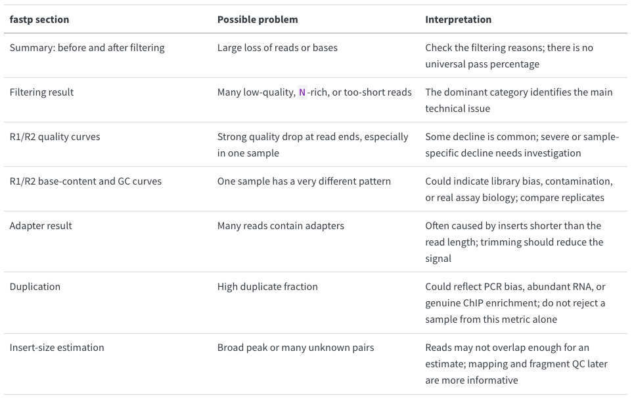
How to read the fastp report
In the VS Code Explorer, open results/logs/day1/fastp/. Right-click a *.fastp.html file, reveal it in Finder or File Explorer, and double-click it to open it in your web browser.

Slide 38
Close Day 1: commit the reproducible record
What did we produce?
README.md
.gitignore
raw_data/metadata/…
reference_genome/…
scripts/day1/…
results/day1_qc/trimmed_fastq/
results/logs/day1/metadata_fastq_download.log
results/logs/day1/fastp/
…

Slide 39
Close Day 1: commit the reproducible record
We can edit the README for Github: ie.e
nano README.md
“## Day 1: created the reproducible project structure, bla bla bla….”
git status
git add .
-> if you want could also use:
git add . BUT!!: Be carefull .gitignore must be properly specified
git commit -m "Complete Day 1 FASTQ retrieval and fastp QC"
git push

