Slide 1
Reproducible NGS Data Analysis on Personal Laptops

Slide 2
DAY 02
RNA-seq: from FASTQ to differential expression
trimmed FASTQ → alignment → BAM → gene counts → DESeq2 → biological interpretation

Slide 3
Turn sequencing reads into quantitative gene-expression measurements
────────────────
DAY 2
────────────────
reference indexing
↓
read alignment
↓
sorted / filtered BAM
↓
library strandedness
↓
gene assignment
↓
RAW COUNT MATRIX
↓
DESeq2
↓
differential expression
Today we will connect three distinct levels:
Sequence level → Where does each read pair map?
Feature level → Which annotated gene generated each fragment?
Statistical level → Is the observed difference between conditions larger than expected from biological variability?
────────────────
DAY 1
────────────────
reference genome
+
gene annotation
+
Trimmed
paired-end FASTQ
│
▼
……

Slide 4
Day 2 starts exactly where Day 1 finished
Open VSCode …
Windows users should open Visual Studio Code connected to Ubuntu WSL, open a WSL terminal, and run the commands there.
macOS and Linux users should open the workshop_ngs folder in Visual Studio Code and use the VS Code terminal.
Before running workshop commands, move to the repository root:
cd ~/workshop_ngs
pwd
Check that the RNA-seq trimmed FASTQ files are present:
Prepare the Day 2 folders:
ls -lh results/day1_qc/trimmed_fastq/rnaseq/*.trimmed.fastq.gz
mkdir -p scripts/day2_rnaseq
mkdir -p results/logs/day2
Check that the reference genome and annotation are present:
ls -lh reference_genome/genome.fa
ls -lh reference_genome/annotation.gff3
ls -lh reference_genome/genes.bed
grep '^>' reference_genome/genome.fa | grep 'NZ_AP026446.1'
grep -v '^#' reference_genome/annotation.gff3 | head -1
head -1 reference_genome/genes.bed

Slide 6
Reference-based RNA-seq FASTQ mapping
RNA-seq mapping asks where each sequenced read, or read pair, fits on a reference sequence. The input is FASTQ. The output is an alignment file that records the genomic position and alignment details for each read.
Ingredients for read mapping:
trimmed FASTQ files from Day 1
a reference genome FASTA
an aligner index built from that FASTA
must search for possible locations for millions of reads. Searching the FASTA sequence from beginning to end for every read would be inefficient, so indexes are compact files that allows aligner to search positions efficiently.
An alignment is an inference, not simply a string match.

Slide 7
Several aligner serve different purposes:
The alignment strategy depends on both the biological structure of the target and the analytical aim!
Full aligners try to place each read or read pair at one or more genomic or transcriptomic coordinates.
We have:
Method: Seed-and-extend:
split or sample short exact pieces of the read called seeds;
use the index to find seeds’s candidate reference positions
extend them across the full read;
score each alignment using matches, mismatches, gaps, clipping, base qualities, paired-end consistency;
report the best alignment or alignments
Genome aligner tools
-
Pseudoalignment or quasi-alignment tools
They infer which transcript or set of transcripts is compatible with each read or fragment. This is very fast and useful for transcript quantification.

Slide 8
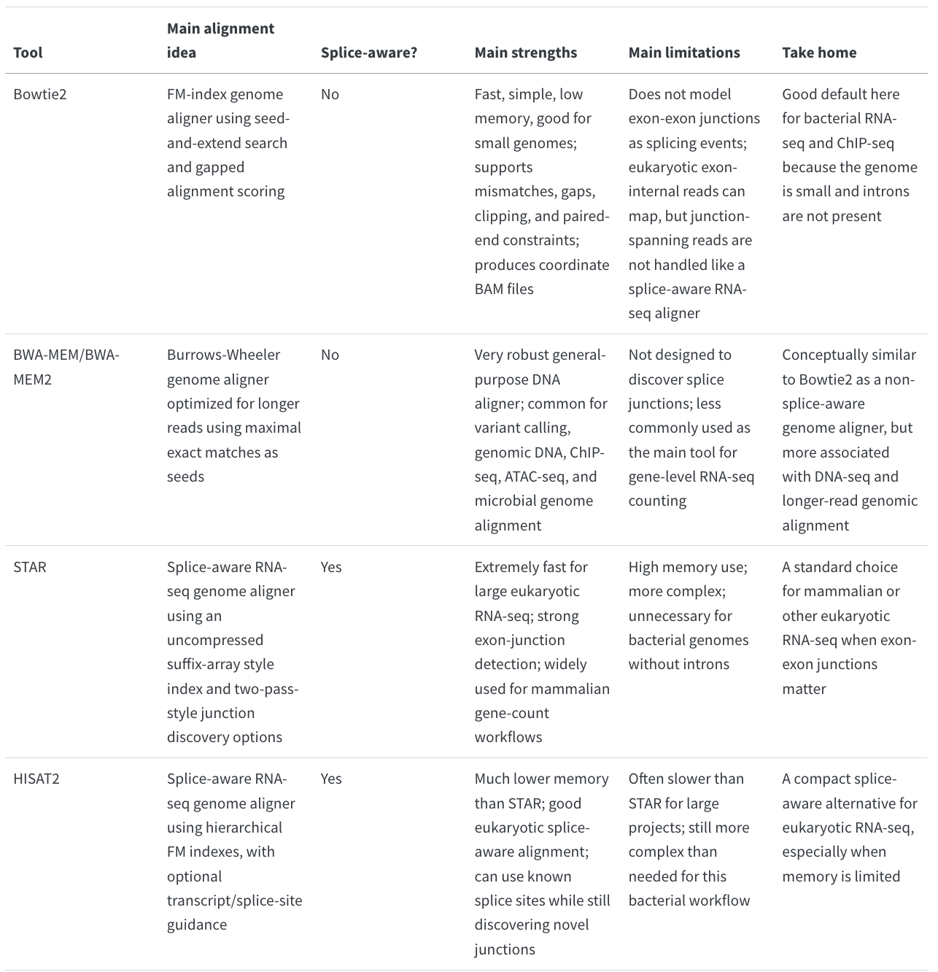
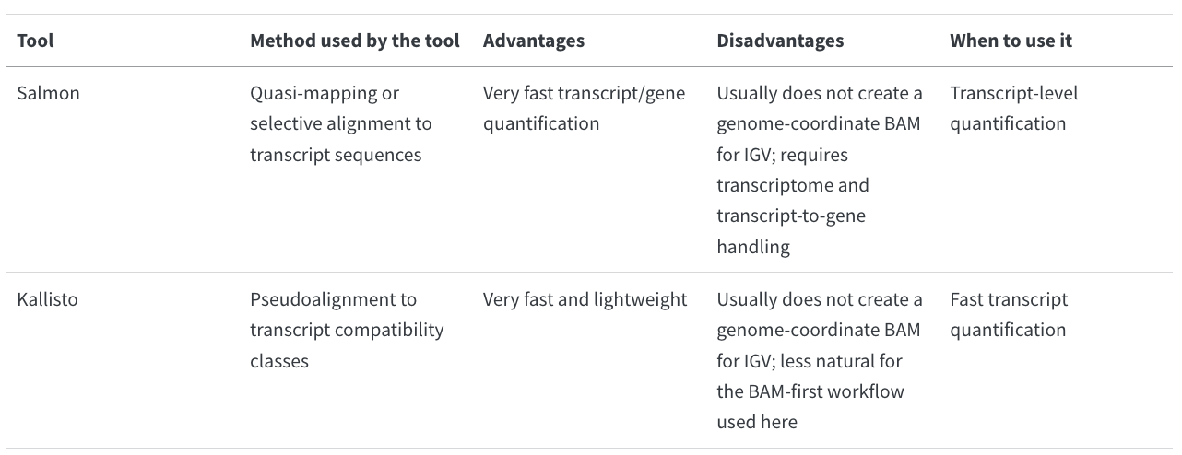
Aligners..
Pseudoaligners
Eukaryotic RNA-seq requires explicit handling of exon–exon junctions. Splice-aware aligners such as STAR and HISAT2 are specifically designed to identify and align reads spanning these junctions.

Slide 9
Indexing
Genome-wide aligner require genome indexing
Each aligner has its own indexing design as is aimed for fast search of seeds (chunks of reads) in the genome.
We will generate this index once and
we will be able to reuse it. So in VSCode:
Create:
scripts/day2_rnaseq/01_build_bowtie2_index.sh
#!/usr/bin/env bash
set -euo pipefail
genome="reference_genome/genome.fa"
index_prefix="reference_genome/bowtie2_index/genome"
mkdir -p reference_genome/bowtie2_index
bowtie2-build \
--threads 2 \
"${genome}" \
"${index_prefix}"
In the Terminal:
docker run --rm \
--user "$(id -u):$(id -g)" \
-v "$PWD:/work" \
-w /work \
docker.io/fgualdr/ngs-bowtie2-samtools \
bash scripts/day2_rnaseq/01_build_bowtie2_index.sh

Slide 10
Mapping sorting indexing filtering!
Perform the mapping:
We now have:
The genome
The index of the genome
The trimmed fastq
RNA-seq mapping asks where each sequenced read, or read pair, fits on a reference sequence.
From a FASTQ as input we want an alignment file that records the genomic position and alignment details for each read.
FASTQ:
@ERR11479310.7235242
ATTGAAAAAGAAATCTTGGCGCTAGTCAAACAAAATCCTAAAGTTAGCCTCATAGAATATGAAAATTACTTTAGCCAACTCAAATACAACCCTAACG…
+
FFFFFFF:FFF:FFFFFFFFFFFFFF:FF:FFF,FF:FFFFFFF:FFF:FFFFFFF:FFFF:FFFF:F,FFFFFFF:FFFFF:FFFFFF:F,FFFF,…
Alignment file SAM – its binary format is termed BAM
ERR11479310.7235242 99 NZ_AP026446.1 119 23 34M6I110M = 195 226 ATTGAAAAAGAAATCTTGGCGCTAGTCAAACAAAATCCTAAAGTTAGCCTCATAGAATATGAAAATTACTTTAGCCAACTCAAATACAACCCTAACG FFFFFFF:FFF:FFFFFFFFFFFFFF:FF:FFF,FF:FFFFFFF:FFF:FFFFFFF:FFFF:FFFF:F,FFFFFFF:FFFFF:FFFFFF:F,FFFF, AS:i:-64 XN:i:0 XM:i:9 XO:i:1 XG:i:6 NM:i:15 MD:Z:24A8G16G10G3G5G35C11C10T13 YS:i:-25 YT:Z:CP

Slide 11
#!/usr/bin/env bash
set -euo pipefail
fastq_dir="results/day1_qc/trimmed_fastq/rnaseq"
index_prefix="reference_genome/bowtie2_index/genome"
bam_dir="results/day2_rnaseq/bam"
log_dir="results/logs/day2"
mkdir -p "${bam_dir}" "${log_dir}"
for read1 in "${fastq_dir}"/*_R1.trimmed.fastq.gz
do
read2="${read1/_R1.trimmed.fastq.gz/_R2.trimmed.fastq.gz}"
sample_id="$(basename "${read1}" _R1.trimmed.fastq.gz)"
sam_file="${bam_dir}/${sample_id}.sam"
bam_file="${bam_dir}/${sample_id}.sorted.bam"
filtered_bam="${bam_dir}/${sample_id}.filtered.bam"
bowtie2 \
-x "${index_prefix}" \
-1 "${read1}" -2 "${read2}" -p 2 -S "${sam_file}" 2> "${log_dir}/${sample_id}.bowtie2.log"
samtools sort -@ 2 -o "${bam_file}" "${sam_file}"
samtools index "${bam_file}"
samtools flagstat "${bam_file}" > "${log_dir}/${sample_id}.flagstat.txt"
samtools view -@ 2 -b -q 10 -f 2 -F 2828 -o "${filtered_bam}" "${bam_file}"
samtools index "${filtered_bam}”
samtools flagstat "${filtered_bam}" > "${log_dir}/${sample_id}.filtered.flagstat.txt"
rm -f "${sam_file}"
done
Create scripts/day2_rnaseq/02_map_bowtie2_sort_index.sh
In the Terminal:
docker run --rm \
--user "$(id -u):$(id -g)" \
-v "$PWD:/work" \
-w /work \
docker.io/fgualdr/ngs-bowtie2-samtools \
bash scripts/day2_rnaseq/02_map_bowtie2_sort_index.sh

Slide 12
SAM/BAM format
ERR11479310.7235242 99 NZ_AP026446.1 119 23 34M6I110M = 195 226 ATTGAAAAAGAAATCTTGGCGCTAGTCAAACAAAATCCTAAAGTTAGCCTCATAGAATATGAAAATTACTTTAGCCAACTCAAATACAACCCTAACG FFFFFFF:FFF:FFFFFFFFFFFFFF:FF:FFF,FF:FFFFFFF:FFF:FFFFFFF:FFFF:FFFF:F,FFFFFFF:FFFFF:FFFFFF:F,FFFF, AS:i:-64 XN:i:0 XM:i:9 XO:i:1 XG:i:6 NM:i:15 MD:Z:24A8G16G10G3G5G35C11C10T13 YS:i:-25 YT:Z:CP
SAM contains 11 mandatory fields followed by optional/aligner specific fields:
Field Value Description
QNAME ERR11479310.7235242 Original read identifier
FLAG 99 Bit-coded information about pairing, strand and alignment status
RNAME NZ_AP026446.1 Reference sequence/chromosome
POS 119 1-based leftmost aligned position
MAPQ 23 Confidence in the reported genomic placement
CIGAR 34M6I110M Structure of the alignment
RNEXT = Mate maps to the same reference sequence
PNEXT 195 Leftmost mapping position of the mate
TLEN 226 Inferred outer template/fragment length
SEQ ATTGAAAA... Read sequence
QUAL FFFFFF... Original per-base Phred qualities
Bit Meaning Present?
1 Read belongs to a paired-end fragment ✓
2 Pair aligned properly/concordantly ✓
4 This read is unmapped ✗
8 Mate is unmapped ✗
16 This read maps to reverse strand ✗
32 Mate maps to reverse strand ✓
64 This is R1 / first mate ✓
128 This is R2 / second mate ✗
FLAG are boolean properties encoded in one integer: so 99 means:
99=1+2+32+64 Binary representation garantees that for a given integer there is only one Bit sum combination

Slide 13
SAM/BAM format
ERR11479310.7235242 99 NZ_AP026446.1 119 23 34M6I110M = 195 226 ATTGAAAAAGAAATCTTGGCGCTAGTCAAACAAAATCCTAAAGTTAGCCTCATAGAATATGAAAATTACTTTAGCCAACTCAAATACAACCCTAACG FFFFFFF:FFF:FFFFFFFFFFFFFF:FF:FFF,FF:FFFFFFF:FFF:FFFFFFF:FFFF:FFFF:F,FFFFFFF:FFFFF:FFFFFF:F,FFFF, AS:i:-64 XN:i:0 XM:i:9 XO:i:1 XG:i:6 NM:i:15 MD:Z:24A8G16G10G3G5G35C11C10T13 YS:i:-25 YT:Z:CP
SAM contains 11 mandatory fields followed by optional/aligner specific fields:
Field Value Description
QNAME ERR11479310.7235242 Original read identifier
FLAG 99 Bit-coded information about pairing, strand and alignment status
RNAME NZ_AP026446.1 Reference sequence/chromosome
POS 119 1-based leftmost aligned position
MAPQ 23 Confidence in the reported genomic placement
CIGAR 34M6I110M Structure of the alignment
RNEXT = Mate maps to the same reference sequence
PNEXT 195 Leftmost mapping position of the mate
TLEN 226 Inferred outer template/fragment length
SEQ ATTGAAAA... Read sequence
QUAL FFFFFF... Original per-base Phred qualities
Mapping error probability – aligner defined given the metric used!
MAPQ ​∼−10log10​P(mapping is wrong) I.e 23 = 10^{-23/10}
CIGAR represent alignment geometry:

Slide 14
SAM/BAM format
ERR11479310.7235242 99 NZ_AP026446.1 119 23 34M6I110M = 195 226 ATTGAAAAAGAAATCTTGGCGCTAGTCAAACAAAATCCTAAAGTTAGCCTCATAGAATATGAAAATTACTTTAGCCAACTCAAATACAACCCTAACG FFFFFFF:FFF:FFFFFFFFFFFFFF:FF:FFF,FF:FFFFFFF:FFF:FFFFFFF:FFFF:FFFF:F,FFFFFFF:FFFFF:FFFFFF:F,FFFF, AS:i:-64 XN:i:0 XM:i:9 XO:i:1 XG:i:6 NM:i:15 MD:Z:24A8G16G10G3G5G35C11C10T13 YS:i:-25 YT:Z:CP
SAM contains 11 mandatory fields followed by optional/aligner specific fields:
Field Value Description
QNAME ERR11479310.7235242 Original read identifier
FLAG 99 Bit-coded information about pairing, strand and alignment status
RNAME NZ_AP026446.1 Reference sequence/chromosome
POS 119 1-based leftmost aligned position
MAPQ 23 Confidence in the reported genomic placement
CIGAR 34M6I110M Structure of the alignment
RNEXT = Mate maps to the same reference sequence
PNEXT 195 Leftmost mapping position of the mate
TLEN 226 Inferred outer template/fragment length
SEQ ATTGAAAA... Read sequence
QUAL FFFFFF... Original per-base Phred qualities
READ ─────────────────────────────────────────────────────────────
|<--34-->|IIIIII|<-------------------110------------------->|
REFERENCE ───────── ─────────────────────────────────────────────
^^^^^^
6-bp insertion
relative to reference
CIGAR represent alignment geometry: As bowtie allows gap-alignment by default! So its scoring model allows mismatches and insertions/deletions when they give the best-scoring alignment.
For Bacterial this is quite convenient!
sequenced strain often differs from the chosen reference by SNPs and small indels

Slide 15
SAM/BAM format
ERR11479310.7235242 99 NZ_AP026446.1 119 23 34M6I110M = 195 226 ATTGAAAAAGAAATCTTGGCGCTAGTCAAACAAAATCCTAAAGTTAGCCTCATAGAATATGAAAATTACTTTAGCCAACTCAAATACAACCCTAACG FFFFFFF:FFF:FFFFFFFFFFFFFF:FF:FFF,FF:FFFFFFF:FFF:FFFFFFF:FFFF:FFFF:F,FFFFFFF:FFFFF:FFFFFF:F,FFFF, AS:i:-64 XN:i:0 XM:i:9 XO:i:1 XG:i:6 NM:i:15 MD:Z:24A8G16G10G3G5G35C11C10T13 YS:i:-25 YT:Z:CP
SAM contains 11 mandatory fields followed by optional/aligner specific fields:
Field Value Description
QNAME ERR11479310.7235242 Original read identifier
FLAG 99 Bit-coded information about pairing, strand and alignment status
RNAME NZ_AP026446.1 Reference sequence/chromosome
POS 119 1-based leftmost aligned position
MAPQ 23 Confidence in the reported genomic placement
CIGAR 34M6I110M Structure of the alignment
RNEXT = Mate maps to the same reference sequence
PNEXT 195 Leftmost mapping position of the mate
TLEN 226 Inferred outer template/fragment length
SEQ ATTGAAAA... Read sequence
QUAL FFFFFF... Original per-base Phred qualities
RNEXT, PNEXT,TLEN: in PE mode these describe the mate position relative to the read of interest.
RNEXT – chromosome info for the mate
PNEXT – start position for the mate
TLEN – total inferred length of the PE fragment

Slide 16
SAM/BAM format
ERR11479310.7235242 99 NZ_AP026446.1 119 23 34M6I110M = 195 226 ATTGAAAAAGAAATCTTGGCGCTAGTCAAACAAAATCCTAAAGTTAGCCTCATAGAATATGAAAATTACTTTAGCCAACTCAAATACAACCCTAACG FFFFFFF:FFF:FFFFFFFFFFFFFF:FF:FFF,FF:FFFFFFF:FFF:FFFFFFF:FFFF:FFFF:F,FFFFFFF:FFFFF:FFFFFF:F,FFFF, AS:i:-64 XN:i:0 XM:i:9 XO:i:1 XG:i:6 NM:i:15 MD:Z:24A8G16G10G3G5G35C11C10T13 YS:i:-25 YT:Z:CP
Bowtie2 optional SAM tags: Additional columns in the SAM are optional and aligner specific:
Tag Value Meaning
AS:i -64 Alignment score for this read
XM:i 9 Number of mismatches
XO:i 1 Number of gap openings
XG:i 6 Number of gap extensions
NM:i 15 Edit distance from reference
XN:i 0 Ambiguous reference bases overlapped
MD:Z 24A8… Reference mismatches/deletions encoded explicitly
YS:i -25 Alignment score of the mate
YT:Z CP Concordantly aligned pair

Slide 17
Before counting..
Strandedness should come from library provenance—and can be checked empirically
From the M&M of the paper:
“The prokaryotic directional mRNA library preparation was performed at the Novogene Bioinformatics Technology Co. Ltd. (Cambridge, UK). The ribosomal RNA was removed from the total RNA, followed by ethanol precipitation. After fragmentation, the first strand of cDNA was synthesised using random hexamer primers. During the second strand cDNA synthesis, dUTPs were replaced with dTTPs in the reaction buffer. The directional library was ready after end repair, A-tailing, adapter ligation, size selection, USER enzyme digestion, amplification, and purification. The library was checked with Qubit, RT-qPCR for quantification and a bioanalyser for size distribution detection.”
We expect read 1 to be in the same orientation as the RNA! So we can count reads per gene in a strand specific manner.

Slide 18
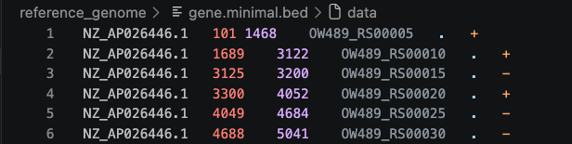
Metadata first, empirical validation when necessary
RSeQC
Run infer_experiment.py on one representative BAM and reconcile the output with the library metadata.
For pair-end RNA-seq, there are two different ways to strand reads (such as Illumina ScriptSeq protocol):
1++,1–,2+-,2-+
read1 mapped to ‘+’ strand indicates parental gene on ‘+’ strand
read1 mapped to ‘-’ strand indicates parental gene on ‘-’ strand
read2 mapped to ‘+’ strand indicates parental gene on ‘-’ strand
read2 mapped to ‘-’ strand indicates parental gene on ‘+’ strand
1+-,1-+,2++,2–
read1 mapped to ‘+’ strand indicates parental gene on ‘-’ strand
read1 mapped to ‘-’ strand indicates parental gene on ‘+’ strand
read2 mapped to ‘+’ strand indicates parental gene on ‘+’ strand
read2 mapped to ‘-’ strand indicates parental gene on ‘-’ strand
docker run --rm \
--user "$(id -u):$(id -g)" \
-v "$PWD:/work" \
-w /work \
docker.io/getwilds/rseqc \
infer_experiment.py \
-i results/day2_rnaseq/bam/WT_1.filtered.bam \
-r reference_genome/genes.bed
BED format minimal we need tab separated file with:
chrom, start, end, name, score, strand

Slide 19
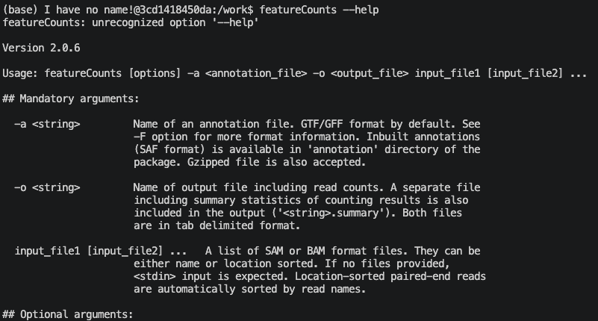
Count reads per gene with featureCounts
Having defined the library strategy, we can now count the number of reads mapped to the H. pylori genome and crossing each annotated gene.
This can be done in number of ways here we use featureCouns. We can inspect the function with:
docker run --rm \
--user "$(id -u):$(id -g)" \
-v "$PWD:/work" \
-w /work -it \
docker.io/fgualdr/ngs-featurecounts \
bash

Slide 20
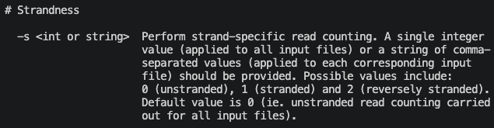


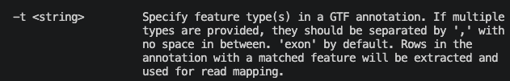
Count reads per gene with featureCounts

Slide 21
#!/usr/bin/env bash
set -euo pipefail
annotation="reference_genome/annotation.gff3"
bam_dir="results/day2_rnaseq/bam"
counts_dir="results/day2_rnaseq/counts"
log_dir="results/logs/day2"
featurecounts_out="${counts_dir}/featureCounts_all_samples.txt"
mkdir -p "${counts_dir}" "${log_dir}"
bam_files=("${bam_dir}"/*.filtered.bam)
featureCounts \
-T 2 \
-p \
--countReadPairs \
-B \
-C \
-s 1 \
-t gene \
-g ID \
-a "${annotation}" \
-o "${featurecounts_out}" \
"${bam_files[@]}" \
2>&1 | tee "${log_dir}/featureCounts_all_samples.log"
echo "Wrote ${featurecounts_out}"
In the Terminal
docker run --rm \
--user "$(id -u):$(id -g)" \
-v "$PWD:/work" \
-w /work \
docker.io/fgualdr/ngs-featurecounts \
bash scripts/day2_rnaseq/03_featurecounts_all_samples.sh

Slide 22
Differential expression analysis in R
Aim: Differential expression: effect size relative to biological variability

