Slide 1
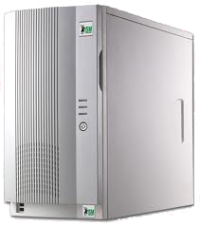



HTTP
FQL
SQL
USER INTERFACE
PRESENTATION SERVER
APPLICATION BASE
DATABASE

