Slide 1
INPUT
OUTPUT
PROGRAM

Slide 2
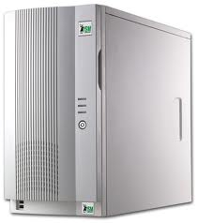




Slide 3
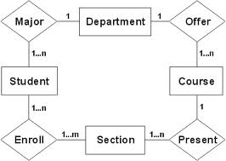
SYSTEM

Slide 5
Single Reference (non-unique)
Single Reference (unique)
CORPORATE INFORMATION
ACCOUNTS
CUSTOMERS
CUSTOMERS

Slide 6
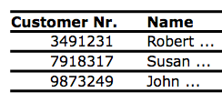
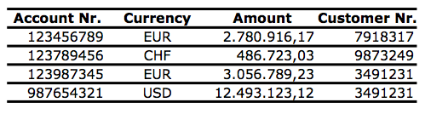
Single Reference (non-unique)
CUSTOMERS
ACCOUNTS
SINGLE REFERENCES Each Account belongs to one (and only one) Customer.
NON-UNIQUE REFERENCE The same Customer can have more than one Account (Customer Nr. can be repeated)

