Slide 1
Global coral and fish diversity blahhhhh
François Guilhaumon

Slide 2
Introduction
In this paper we study the distribution of coral genera and fish species across the world coral reefs.

Slide 3
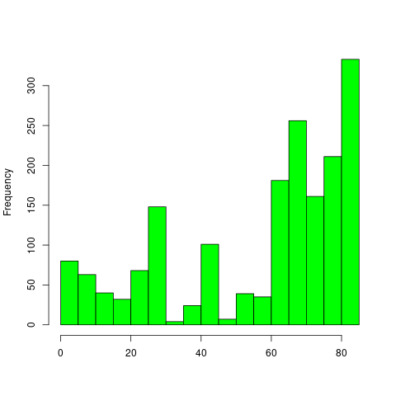
Results
In the data table we have 1783 observations (coral reefs cells).

