Slide 1
Miles2Run
http://www.miles2run.org/

Slide 2
Miles2Run
Track your daily runs
Allows you to log your daily running/walking activities
Shows a dashboard(with beautiful graphs) to track your progress.
Allow user to create their goals and work towards them.
A platform to organize community runs
Organizers can create community run events
Runners join the community run and log their activities
Shows a public page for a community run with useful stats and world map.
Social network for runners
Follow other runners
View their activities on your home page
Its free

Slide 3
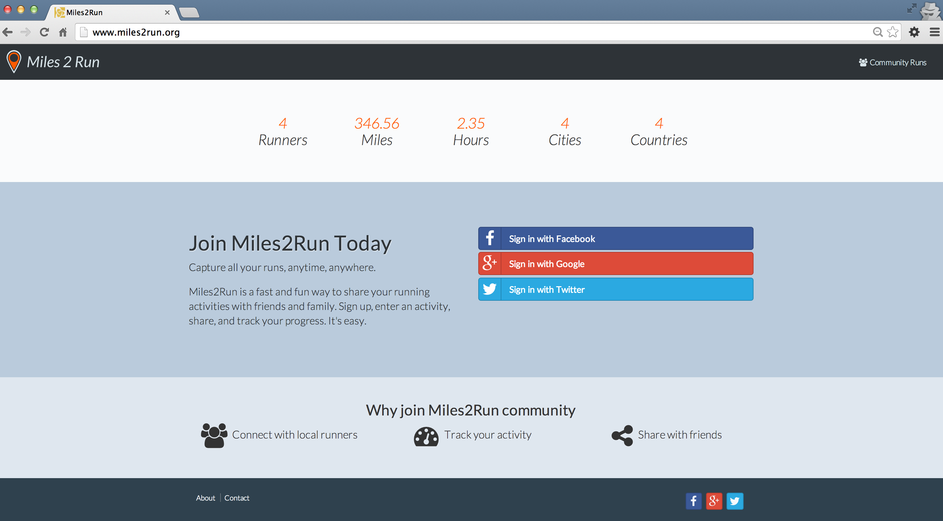
Miles2Run

Slide 4
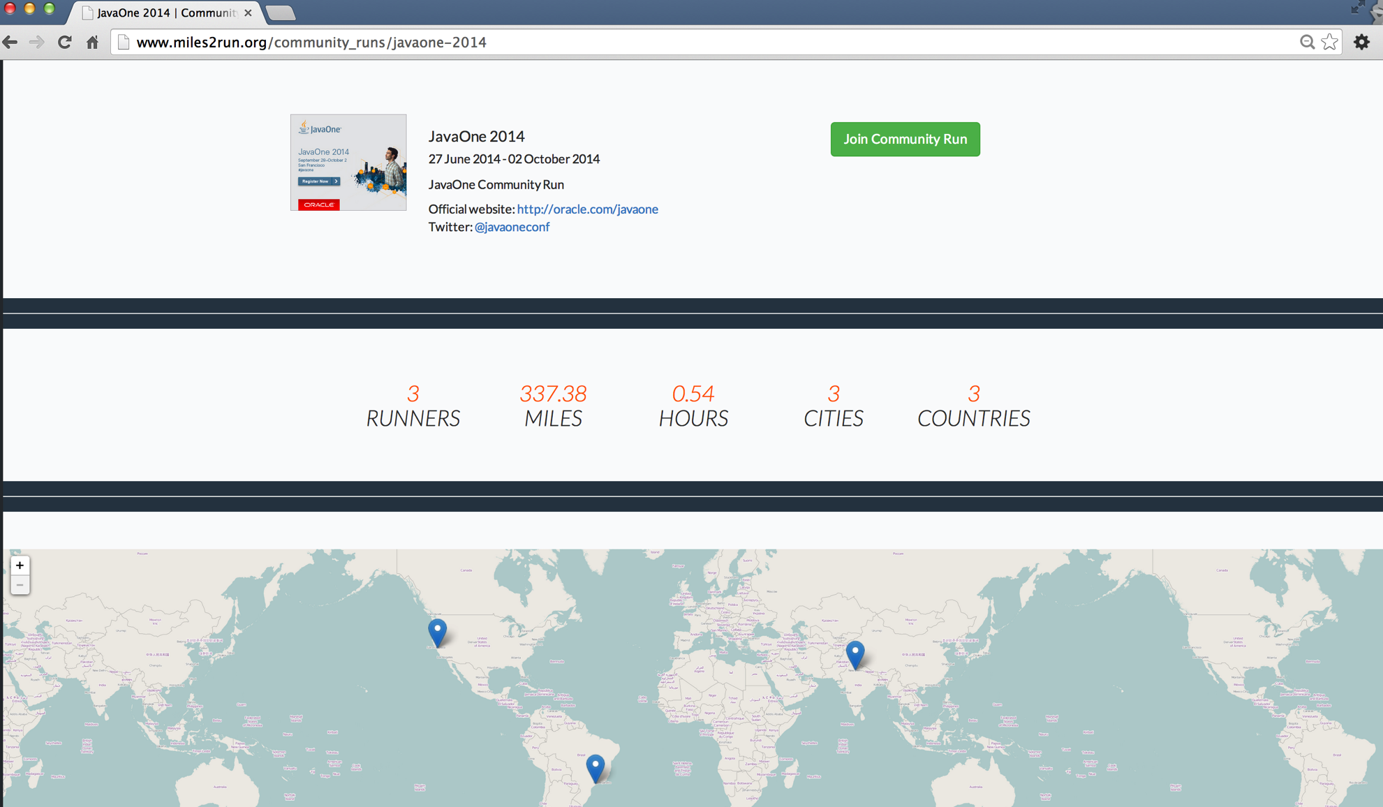
Miles2Run Community Run Page

Slide 5
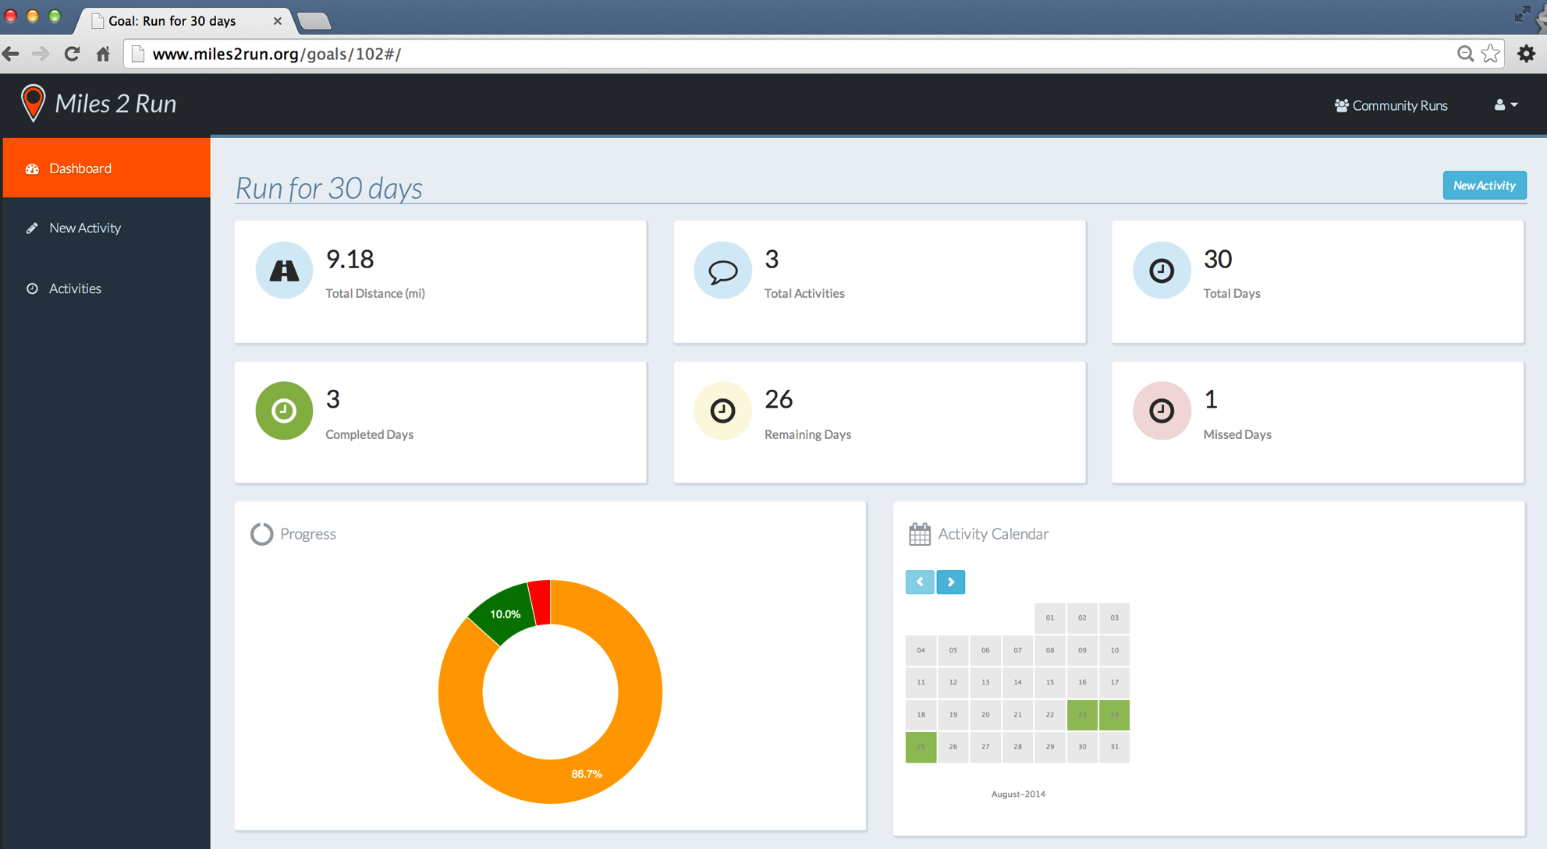
Miles2run Goal Dashboard

Slide 6
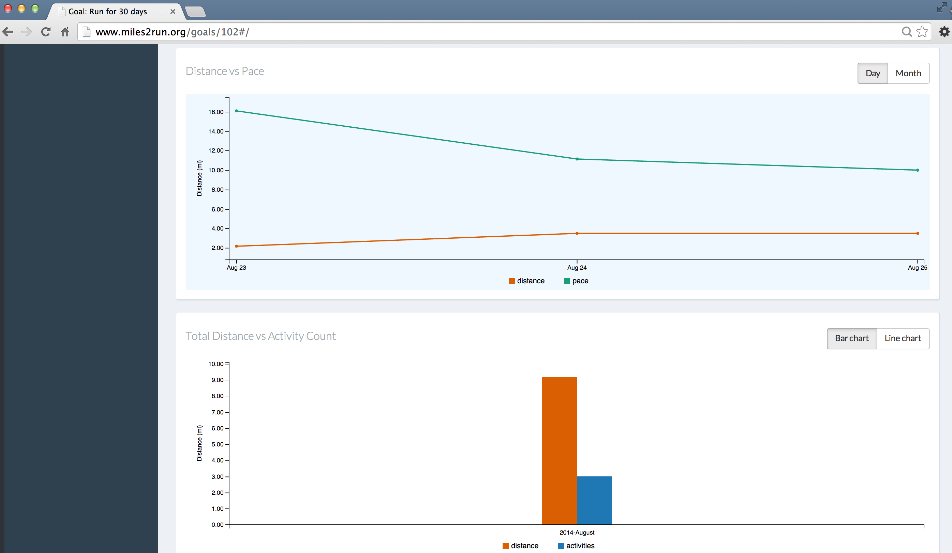
Miles2Run Goal Dashboard

Slide 7
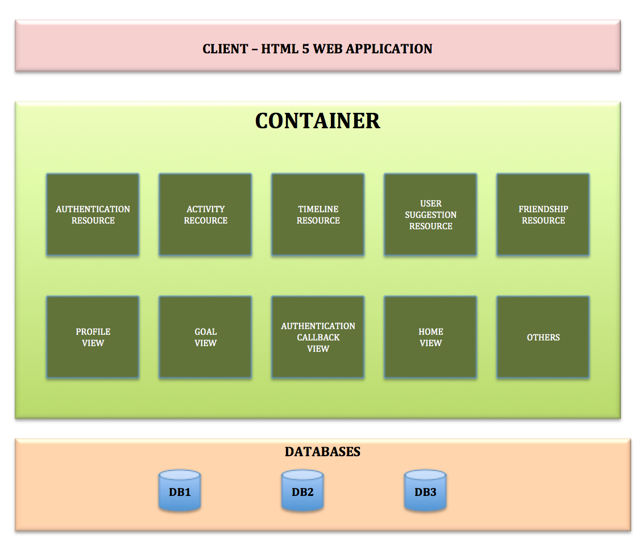
Software Architecture

Slide 8
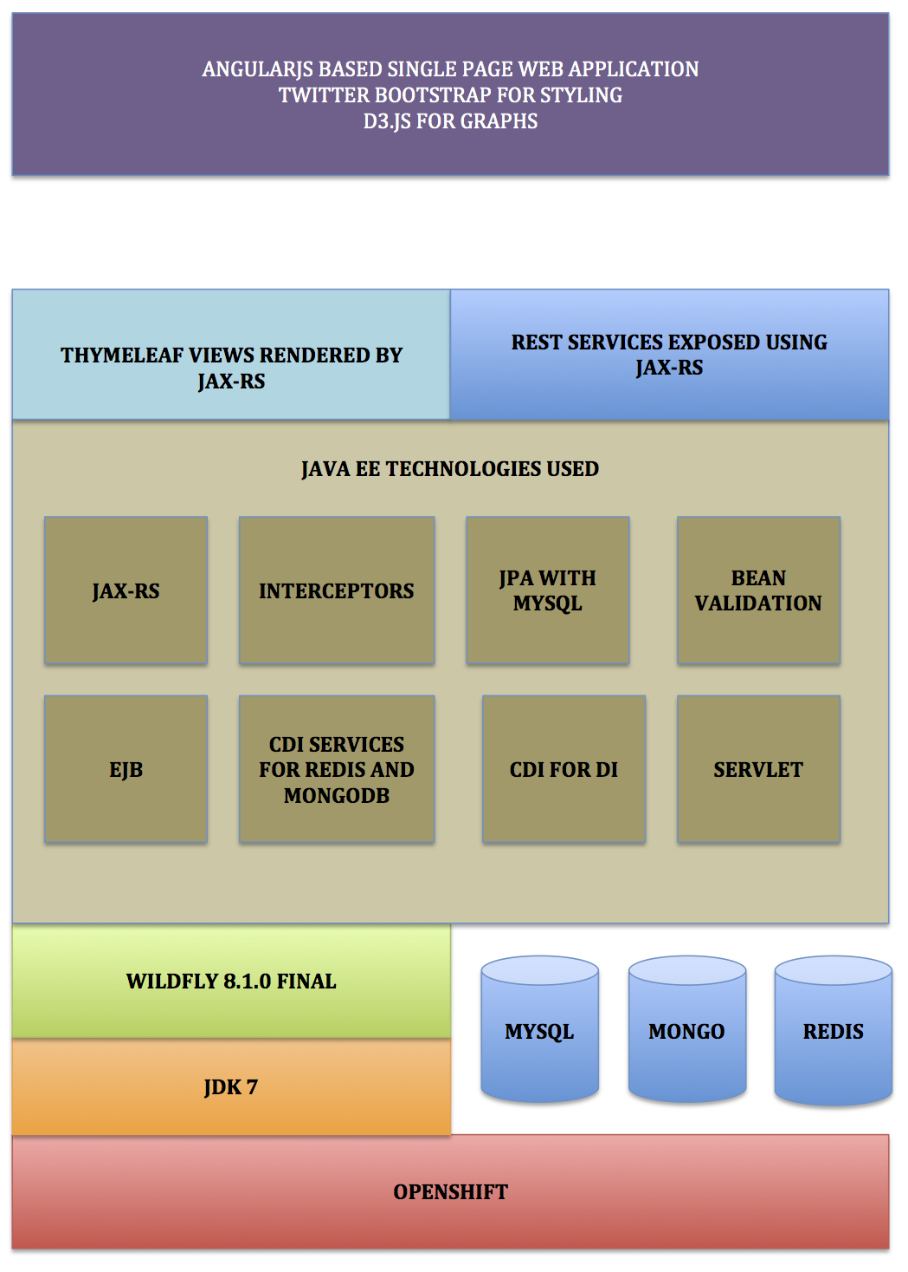
Technology Diagram

Slide 9
Technologies Used
User Interface
Twitter Bootstrap Theme
AngularJS based multiple SPA
D3.js for pretty Graphs
HTML 5 Views
Thymeleaf HTML 5 rendered by JAX-RS
REST Interface
AngularJS based front end consumes REST/JSON web services written using JAX-RS
Authentication using JAX-RS filters

Slide 10
Technologies Used
Middleware
EJB JPA services to work with MySQL
CDI services to work with NoSQL databases.
Joda-Time API for working with Date
Authenticating with various OAuth providers like Twitter using their respective client API.
SLF4J with logback for logging

Slide 11
Additional Libraries
OAuth providers client libraries
Joda-Time for working with date and time
jadira.usertype for storing date as UTC in database
Database client APIs for Redis and MongoDB
Thymeleaf template engine for server side HTML 5 views.
JUnit with Mockito for Unit testing
Arquillian for integration testing

Slide 12
Runtime
JDK 8
WildFly 8.1.0 Final running on OpenShift
MySQL, Redis, and MongoDB

Slide 13
Why MySQL?
Contains all the application data. All write operations write to MySQL.
Transactional datastore for storing all business entities like Activity, Goal, User profiles, etc.

Slide 14
Why Redis?
To generate timeline data
Redis sorted sets are very useful to implement timeline like functionalities.
To store and render counters
Counters to store data like number of runners, cites, countries, etc.
To store user notifications
Notification like when someone follow a user, notification data is stored in Redis.

Slide 15
Why MongoDB?
Used MongoDB for location based user recommendations.
Follower and following data for a user are stored in MongoDB.
MongoDB inbuilt support for array types make it very easy to store follower and following data in one single document.

Slide 16
Tools
IntelliJ Idea
Jenkins – not now but planned to use it for CI and deployment
Git as version control

Slide 17
Wishlist for Java EE 8
Support for NoSQL databases
Support for OAuth so that it becomes easy to add OAuth support to application and use existing OAuth providers.
Modern MVC framework with support for pluggable template engines.

