Slide 1
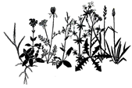

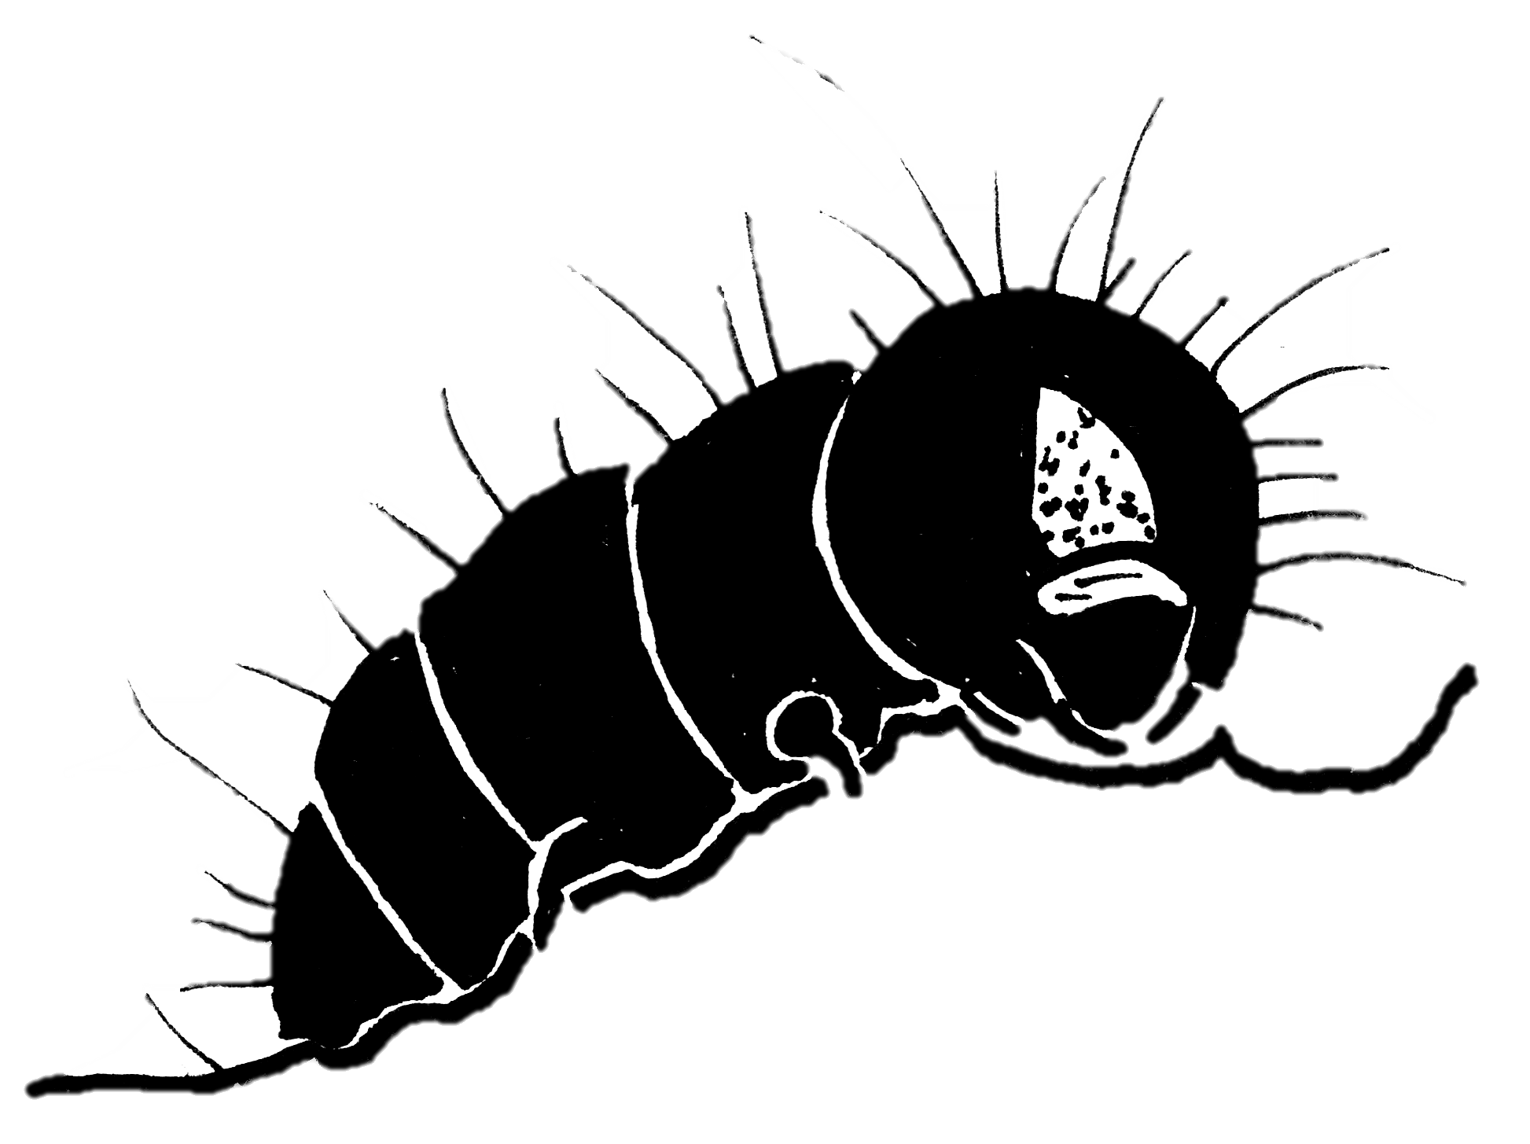
a)
Thermal tolerance
Temperature
Ecological filtering
Plant community diversity
Plant-herbivore interaction
Herbivory
Direct
Indirect: mediation
Indirect: moderation
Thermal mismatch;
Plant quality;
Relative growth rates
b)
Temperature
warm
cold
Thermal mismatch;
Plant quality;
Relative growth rates
Herbivory
Thermal tolerance
Ecological filtering
Plant community diversity
Notes:
In my work, I often try to summarize these kinds of complicated and often non-linear relationships using path diagrams – and this is the path diagram that I’ve drawn to summarize the effect of temperature on herbivory. Here, increasing Temperature modifies herbivory directly ---
But also by changing the structure of plant communities – which itself might have multiple dimensions.
Today, I’ll present an attempt to apply this framework to understand the response of community-level herbivory to changing temperature along a 1100m elevation gradient.
But the story is even more complicated than this, because know that biodiversity has many components, including taxonomic, functional, and phylogenetic components, these different dimensions of biodiversity cab differ in their response to environmental change,
AND how each of these responds to changing environmental temperatures might depend on the role that those temperatures play on structuring plant communities.
So, this strongly suggests that if we REALLY want to understand how climate impacts invertebrate herbivory, then we need to take into account not just the abiotic drivers of herbivory, but also the biotic drivers, and more importantly, how these factors combine and interact with one another..

Slide 2
Termal tolerance Ecological filtering Thermal mismatch etc
Herbivory
+ +
Herbivory
Herbivory
Temperature
Plant community structure
Plant community structure
Temperature
warm
cold
Herbivory
Plant community structure

