Slide 1
Internship: High Level Synthesis
By Wouter Van Gansbeke
Supervisors: Wim Meeus & Bertrand Dujardin
Notes:
Wouter
TODO in een PPT offline versie:
- slidenummers
- grafieken invoegen

Slide 2
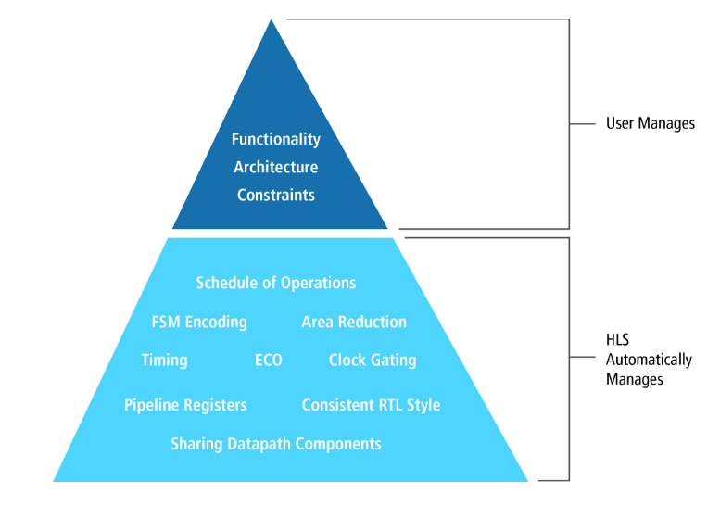
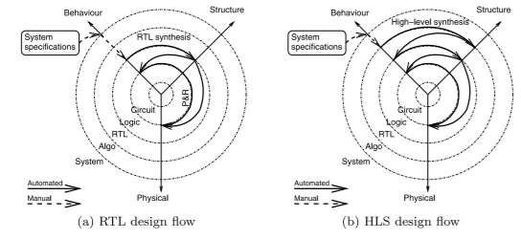
High Level Synthesis: Introduction
Notes:
Wouter

Slide 3
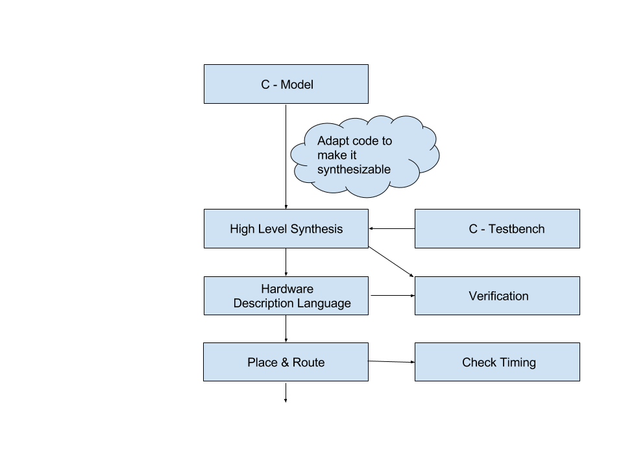
High Level Synthesis: Workflow
Main steps:
Write C / C++ code and test bench
Verify functional behavior of the C / C++ code
Specify top level function, platform, clock, constraints and directives
Synthesize C / C++ to RTL
Verify RTL using the C test bench
Notes:
Stijn

Slide 4
High Level Synthesis: Benefits
Benefits:
Accelerate design time
Reduce verification / simulation effort and time
Easy adaptation to other design requirements (reuse)
Closer to algorithm, less code and by extend less errors
Detect errors early in the design process
Locate bottlenecks fast
=> Productivity increase and time to market decrease!
Notes:
Stijn

Slide 5
High Level Synthesis: Pitfalls
Pitfalls:
No clock accurate designs possible
Some software difficult / impossible to convert to hardware
It is not possible to use existing RTL code as an input for HLS software
Hard to read generated RTL code
Cause of errors not always clear
Maturity of the tool
Notes:
Stijn

Slide 6
From C model to synthesizable C (I)
Code changes:
Top level function cannot be a class member function
C constructs must be of bounded size
'unsupported memory access on variable'
Pointer to pointer in top level not possible:
Matrices
Pointer from within a class to other object
Pointer casting
No recursive functions (tail recursion)
Arbitrary Precision data types to optimize word length
No dynamic memory allocation
No memset, memcopy
Notes:
Wouter

Slide 7
From C model to synthesizable C (II)
Encoutered cosimulation problems:
'Stuck at TB testing' or 'Segmentation Fault Error' caused by:
Large chunks of data
Calling top level functions too much
Not using volatile pointers when reused
Amount of rereads/rewrites need to be specified using INTERFACE directive
Solution:
Array sizing
Call top-level function a small number of times
Use Limit diskspace configuration
Notes:
Wouter

Slide 8
Mapping on FPGA
Pointers:
Can conceal relations
Limit optimizations
Monolithic vs Distributed memory on FPGA
Dynamic memory allocation: stack, heap
Variables in registers
Arrays in block ram
No shared memory but hardware constructs exist
Memory based => stream based on FPGA
Notes:
Wouter

Slide 9
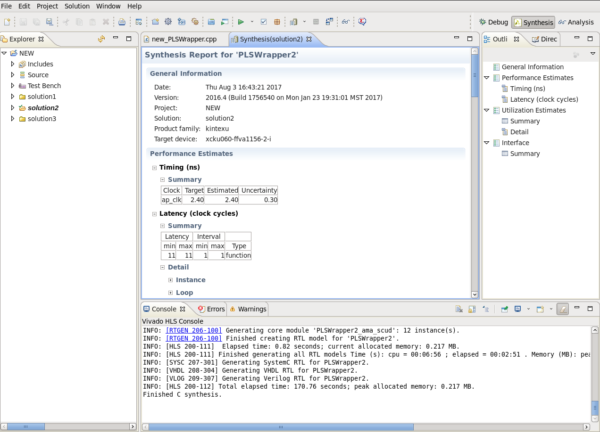
HLS Software: Xilinx Vivado HLS
Positive
Easy & nice Eclipse based GUI
Good tutorial and manual
Online forum
Negative
Bad estimates
File name length limited by default
User responsible for correct cosimulation result
Notes:
Stijn
File name limited to 30 characters ==> weird naming of output files and functions, change in solution settings, config_compile, name_max_length

Slide 10
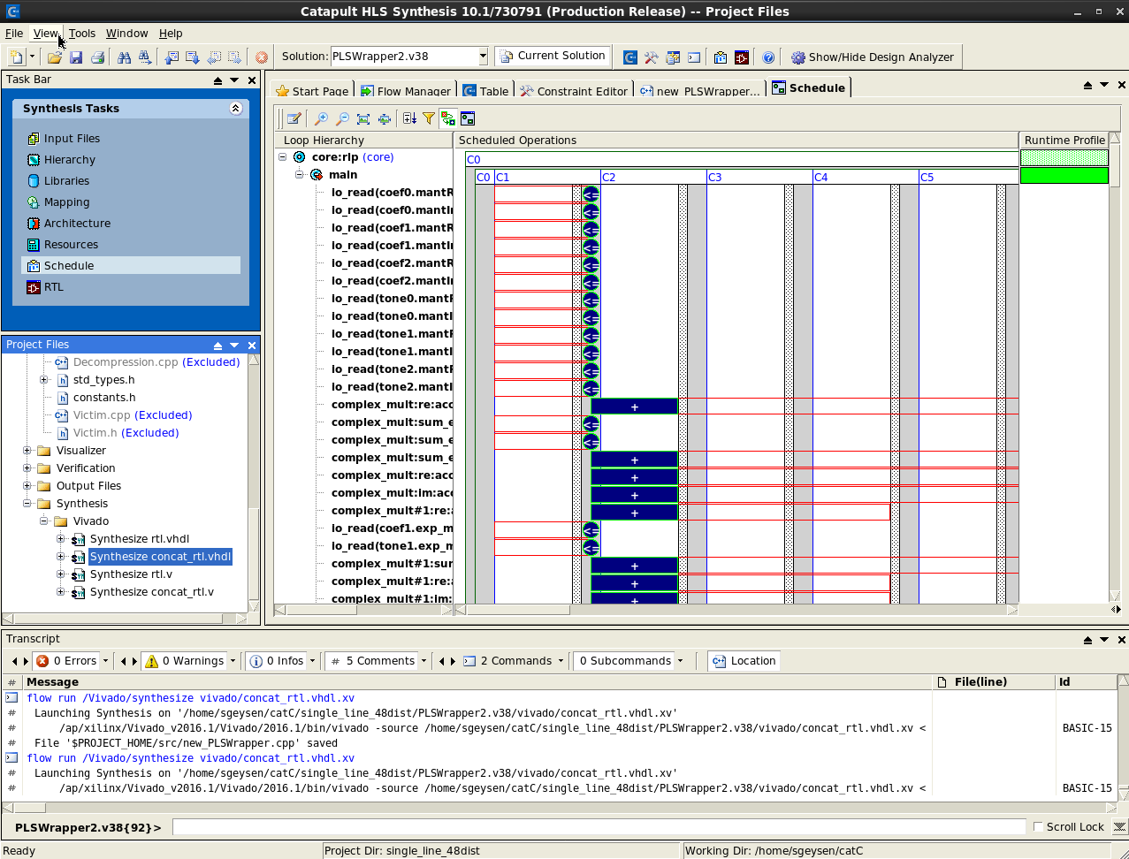
HLS Software: Mentor Graphics Catapult
Positive
Not limited to Xilinx FPGA's
Good overview of the synthesis steps
Good manuals
Cosimulation: Compares top level I/O of C and RTL code
Negative
Limited amount of shortcuts
Not easy to tweak the result
Too optimistic about critical path
Limited amount of online information
Notes:
Stijn

Slide 11

Arbitrary precision data types
Avoid unnecessary resource utilization
Each vendor different version:
Vivado HLS : AP (AutoPilot)
Catapult HLS: AC (Algorithmic C)
Similarly but different:
Bit padding:
Notes:
Stijn

Slide 12
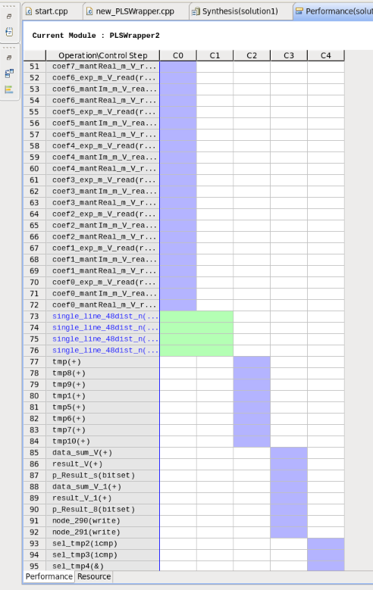
Optimizations workflow (I)
Directives/ pragma's & config used
Strategy
Throughput: decrease initiation interval
Latency
Area
Notes:
Wouter

Slide 13
Optimizations workflow (II)
1. Initial changes using:
Interface
ap_none, ap_memory, ap_vld, ap_ovld
Datapack
Loop trip count
Re-reading
2. Increase concurrency
Dependencies:
Dataflow = Read/write
Anti-dependence = write/read
Output dependence = write
Pipeline by decreasing interval (loops)
Caution: memory accesses when using arrays
Block RAM has limited ports (2)
Array partition /array reshape pragma
Flush pipeline
Dataflow (functions)
Notes:
Wouter

Slide 14
Optimizations workflow (III)
3. Latency
Inline recursively: reduce function call overhead
Latency directive: watch critical path
For loop incrementation
Question mark in latency report
4. Area
Inline
Adapted datatypes
Resource directive
Array mapping
Notes:
Wouter

Slide 15
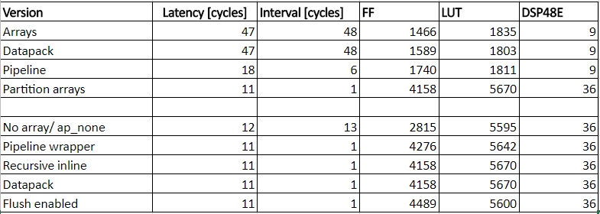
Report
Notes:
Wouter

Slide 16
Comparison: Design verification time
Original RTL design:
Compilation: 52 sec
Running test: 14 min 58 sec
Total: 15 min 50 sec
Vivado HLS:
C simulation: 17 sec
C synthesis: 1 min 44 sec
C / RTL cosimulation: 2 min 56 sec
Total: 4 min 57 sec
Catapult C*:
C simulation: 47 sec
C synthesis: 3 min 20 sec
ModelSim simulation: 7 min 20 sec
Total: 11 min 27 sec
* Catapult running on “beantsu0212” server instead of “devasic”
Notes:
Stijn

Slide 17
Comparison: Code length
Original RTL design:
1198 lines in 10 files
+ common files
Vivado HLS generated VHDL:
3708 lines total in 4 files
Catapult HLS generated VHDL:
7303 lines in 1 file
C code:
314 lines main logic
+ common files
Notes:
Stijn

Slide 18
Implementation results
Notes:
Stijn

Slide 19
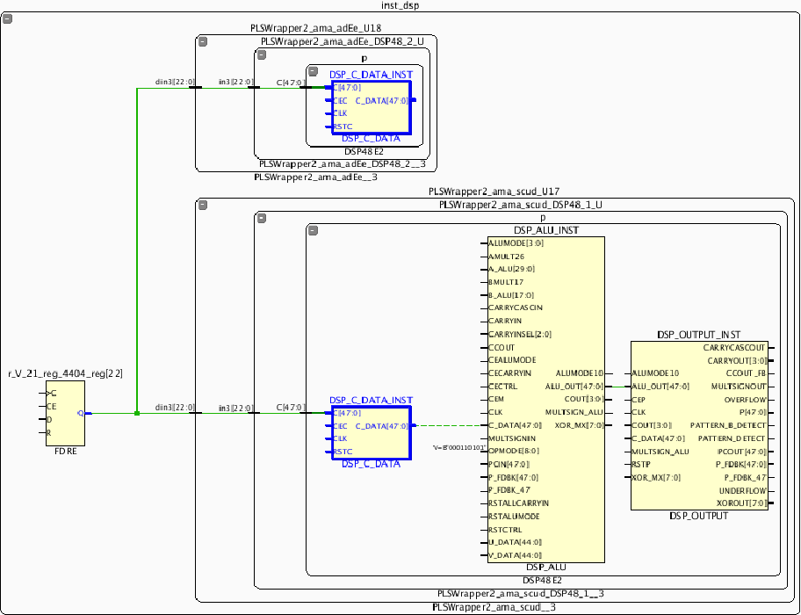
Problems
No timing closure
Location:
Prevent crossing IO gap
multiple times
Fanout:
Signbit drives 52 ports
= 2*(48-22)
Paths
Stages in mapping on FPGA
Synthesize
Place
Phys opt
Route
Post phys opt
Notes:
Wouter

Slide 20
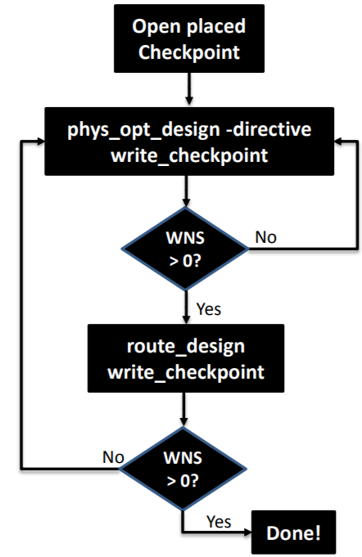
Solutions: Optimize routing methodology
Solve fanout with register replication
Load is halved, aggressiveFanout directive
Solve location
Pblock creation
Ignore DSP in column next to IO block
DSP48E2_X8Y, DSP48E2_X17Y
Shorten critical path with
Latency directive
Resource directive
Max_fanout directive (only in Catapult)
Notes:
Wouter

Slide 21
Timing Results for complete Bini
WNS : -0.084 ns
TNS : -0.354 ns
12 Failing endpoints
WHS : 0.016 ns
Critical path in bini Ethernet subsystem (single_1g).
No failing endpoints in or connected to the HLS design
Notes:
Stijn

Slide 22
Conclusions
HLS can accelerate RTL design of arithmetic parts a lot
3x faster verification
Reuse of C testbench
4x smaller code to maintain
Easy design changes (i.e. less area, different clock, pipelining ...)
Easy to compare different solutions
Critical path estimates of HLS tools not reliable
Timing critical parts and connecting HLS blocks still needs to be done in RTL
Tools will become better:
More accurate simulation libraries
More C code possibilities
Notes:
Stijn

Slide 23
Where to start
Getting started:
This presentation
Vivado HLS tutorial: chapter 1 & 2
Mentor HLS Bluebook: chapter 4 – Fundamentals of HLS
Basic reference:
Vivado HLS reference guide ug902: chapter 3
Catapult user and reference manual: chapter 8
Notes:
Stijn

Slide 24
Questions?

