Slide 1
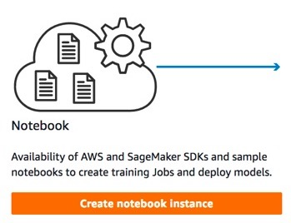
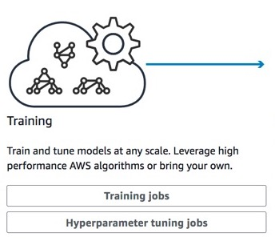





AMAZON SAGEMAKER
Build
Train
Pre-built notebook instances
Highly-optimized machine learning algorithms

