Slide 1
Visualizing Civic Engagement - City of Bloomington
Team: Abhigna Devarasetty, Krishna Teja Jillelamudi, Fhariya Aseem Fathima
Course: Data Visualization (INFO – I 590) – Fall 2023
INDIANA UNIVERSITY

Slide 2
Content
Understanding Civic Engagement
Aims of the Analysis
Data Description
Navigating through Data
Visualization of data and Insights
Data Improvization Suggestions
Future Scope
Q & A
Notes:
Yoyo!

Slide 3
Understanding Civic Engagement
Context: In this project, we delve into the heart of Bloomington to uncover the patterns and intensity of civic engagement.
Significance: Civic engagement is a vital indicator of community health and responsiveness. By analyzing service requests from the Open311 system, we gain insights into how residents interact with local government and city services
Scope: Our analysis spans a significant time frame from 2014 to 2023, providing a comprehensive look at the evolution of civic needs and responses in Bloomington.
Goal: The goal is to translate raw data into meaningful narratives that can inform city planners, policymakers, and the public, fostering a more responsive and engaged community.

Slide 4
Aims of the analysis
Our primary objective is to visualize and analyze civic engagement in Bloomington through service requests recorded in the Open311 system.
Identify key trends in service request types, frequency, and response times over the years.
Uncover geographical patterns by mapping service requests across different ZIP codes in the city.
Evaluate the performance and collaboration of different city agencies in addressing civic issues.
Assess the level and nature of community engagement by analyzing the types and frequency of service requests.
Provide actionable insights to city officials and stakeholders for data-driven urban planning and community development decision-making.

Slide 5
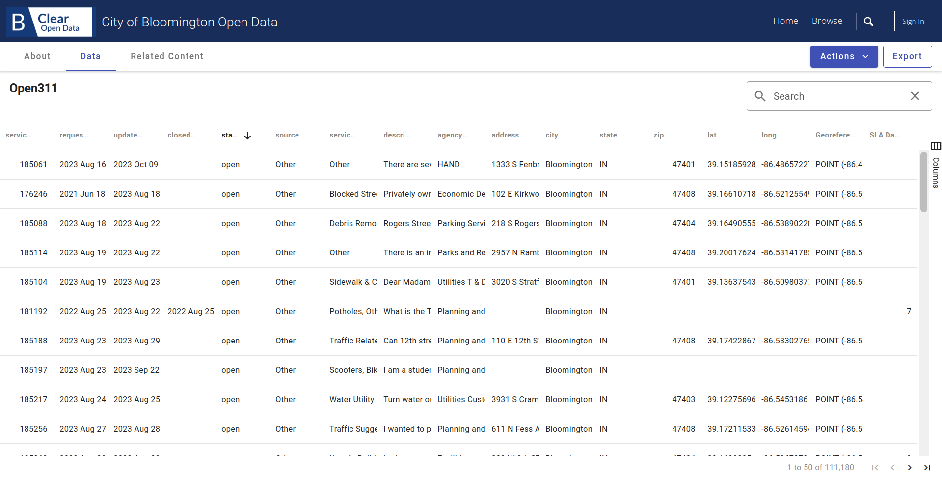
Data Description
Dataset details:
Number of rows: 35,657
Number of columns: 17
Last Updated: December 6, 2023
Data Provided by:
City of Bloomington, Indiana

Slide 6
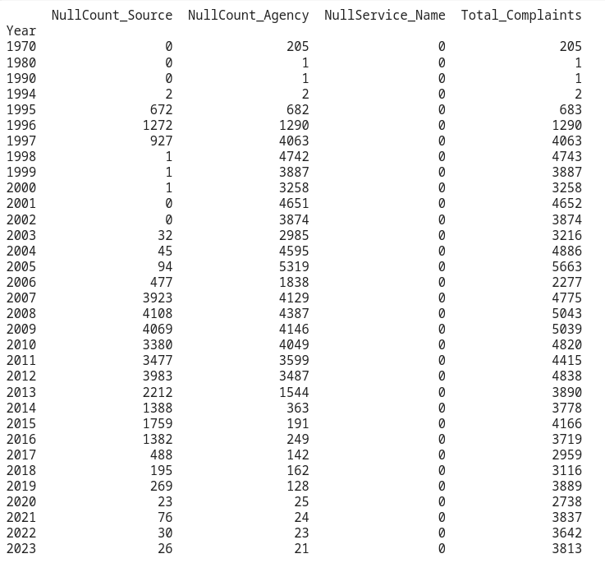
Navigating through Data
Handling Null Values in 'Agency' Column:
Challenge: Approximately 60% of data in the 'agency_responsible' column were null, a critical aspect of our analysis.
Solution: Grouped data by 'service_name' and replaced null values in 'agency_responsible' with the mode (most frequent value) of each respective 'service_name' group. This maintained data integrity and provided meaningful insights into agency responsibilities.

Slide 7
Navigating through Data
Transforming ZIP Code Data:
Challenge: ZIP codes were initially in float format, which was not ideal for categorical analysis.
Solution: Converted ZIP codes to a string format, ensuring accurate representation and analysis of geographical data.
Focusing on Recent Data (2014-2023):
Observation: Data from 1996 to 2013 contained a large number of null values and inconsistencies.
Decision: Chose to focus the analysis on data from 2014 onwards, where the quality and completeness of data significantly improved. This decision ensured a more reliable and relevant analysis of recent trends in civic engagement.

Slide 8
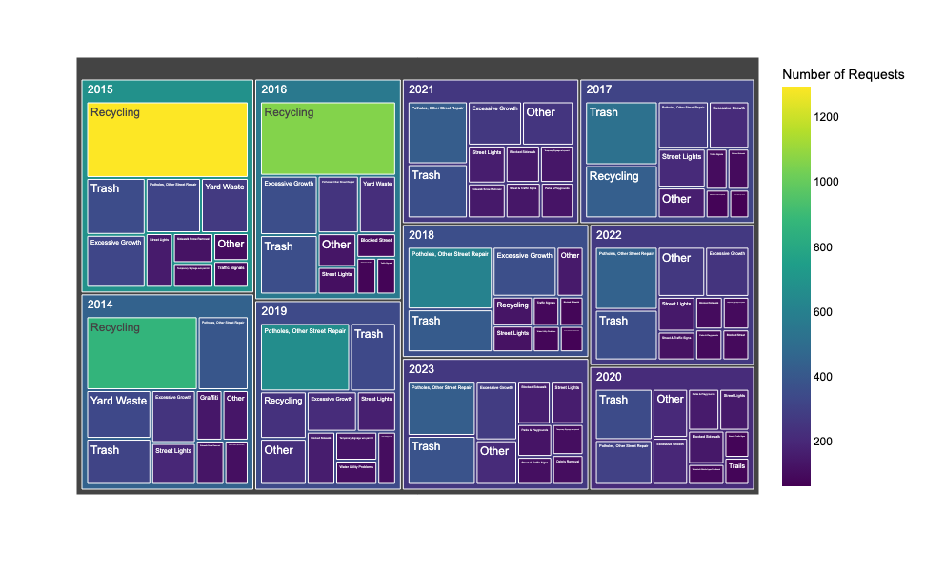
Top 10 Most Requested Services Each Year
Tree map
We employed a 'viridis' color scale on a well-structured treemap to clearly delineate annual service request trends for an intuitive and accessible visualization.
Insights from the graph:
"Recycling" and "Trash" are prominent services across multiple years, suggesting they are common and consistent concerns for residents.
"Yard Waste" is another frequently requested service, particularly in the earlier years (2014 - 2016).
The presence of "Excessive Growth" and "Street Lights" in multiple years indicates ongoing issues in these areas.

Slide 9
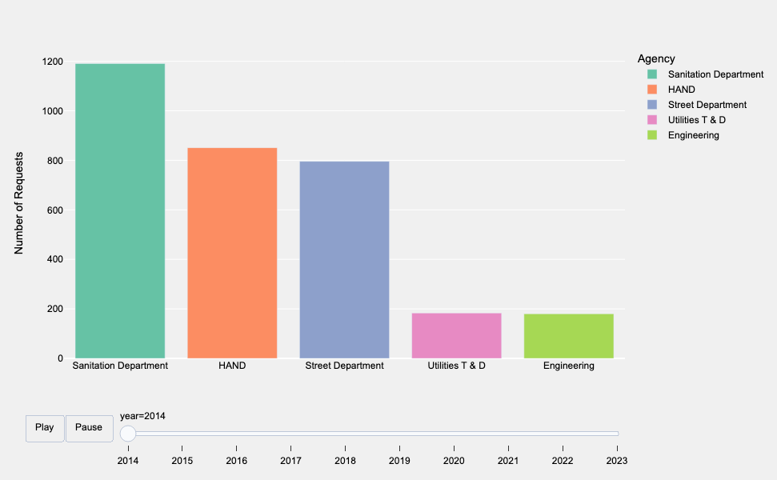
Top 5 Most Active Agencies Each Year
Timeline plot
We have used 'Set2' color palette for clear differentiation of agencies and incorporates an interactive slider, providing a dynamic view of the service request distribution among the top agencies across different years.
Insights from the graph:
It appears that the Sanitation Department and HAND are frequently among the top agencies over the years, indicating they handle a significant portion of the service requests.
The Utilities T & D and Engineering departments also feature prominently, suggesting their critical roles in municipal services.

Slide 10
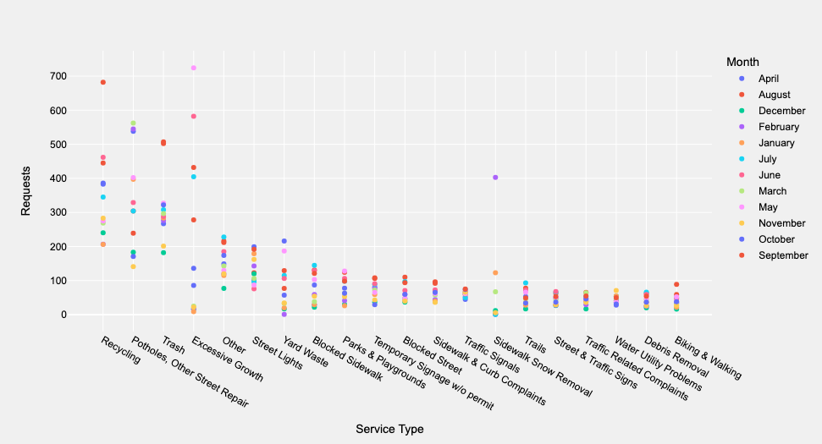
Distribution of Requests for Top 20 Most Reported Service Types Over Months
We utilized a color-coded scatter plot to represent the monthly distribution of service requests across various service types which gave clear visualization of seasonal trends and peak service demands.
Insights from the graph:
Seasonal Patterns: Services such as "Yard Waste" and "Snow Removal", show clear seasonal patterns, with peaks that likely correspond to specific seasons, fall for yard waste and winter for snow removal.
High-Demand Services: "Potholes" and "Trash" appear to be consistently in demand throughout the year, with "Potholes" is in peak during specific months, which could be associated with post-winter damage.

Slide 11
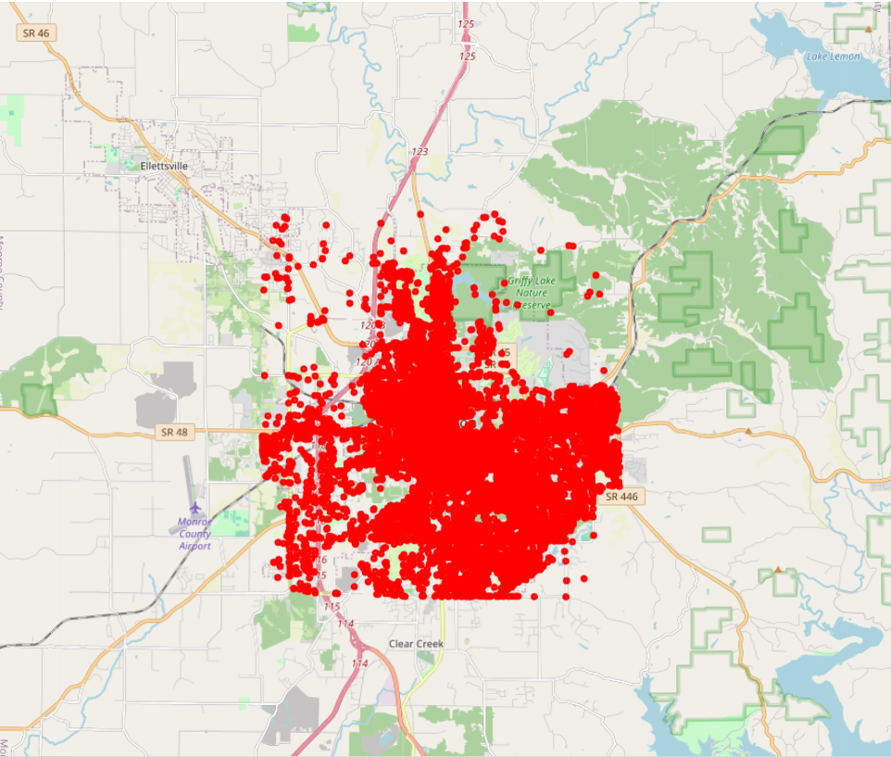
Locations of the requests made
Maps
Utilizing the OpenCage Geocoding API and the Python package Folium, latitude and longitude columns from Open 311 data are transformed into interactive maps.
Insights from the graph:
Plotting the locations gave us an understanding on how important is it to use other methods of aggregation, but upon close inspections it was evident for us to notice few patterns on how a specific service is more occurring in a specific type of locations.

Slide 12
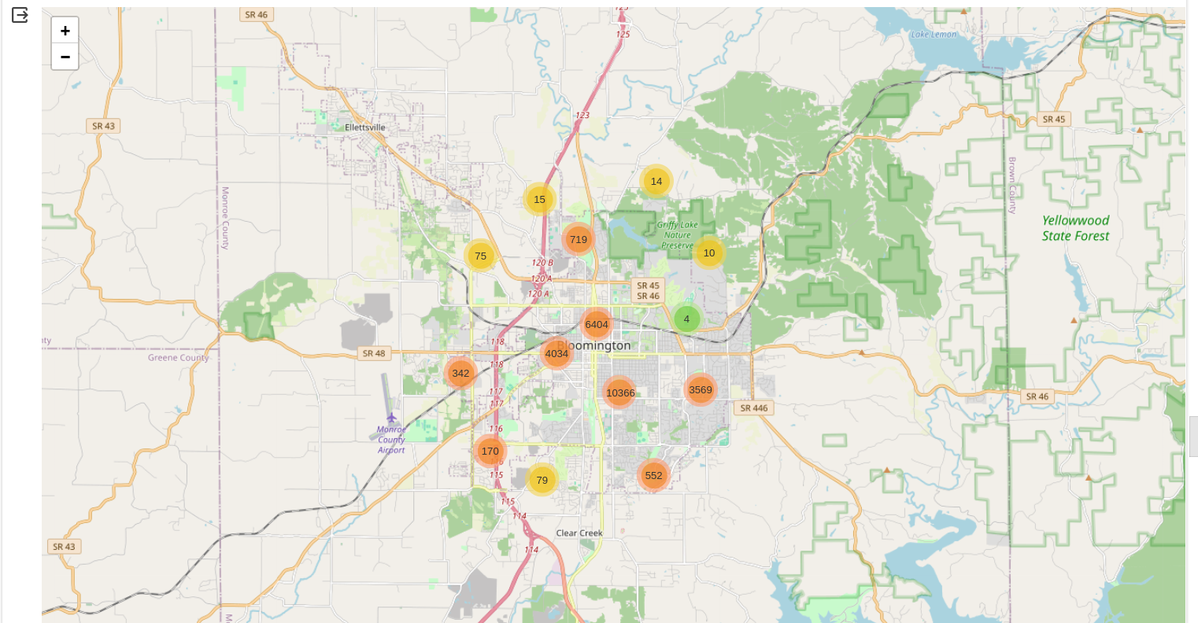
Cluster wise density of the requests
Maps
In Folium, the MarkerCluster() object is utilized to efficiently manage and display markers on a map. This is particularly useful when working with latitude and longitude columns from Open 311 data, allowing the creation of visually clean and interactive maps with clustered markers based on geographic coordinates.
Insights from the graph:
Clustering was able to give us a sense of where most issues are situated at, zooming in and out provided us with an understanding on what areas in general contribute to most requests.

Slide 13
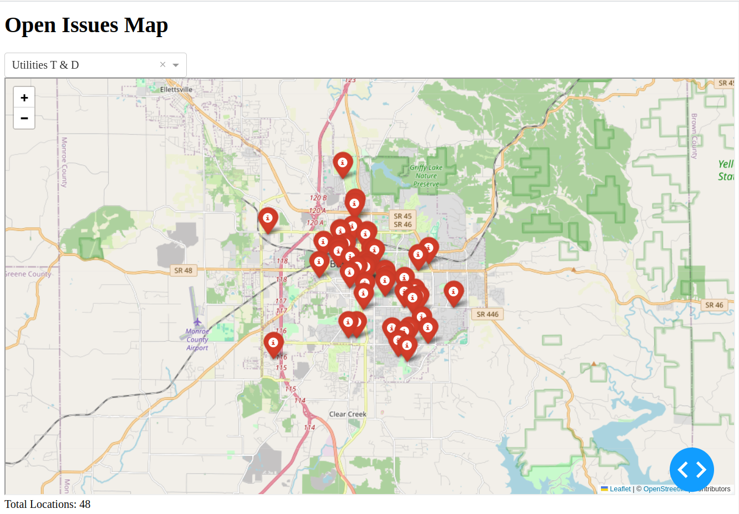
Open Issues dashboard
Maps
Dash, a Python package, is employed to create dynamic and interactive web-based visualizations using data from Open 311. The focus is on the "lat," "long," and "agency_responsible" columns, specifically filtering data where the "status_description" is set to 'open'.
Insights from the graph:
Visualization of open issues of individual agencies along with their count gave us further understanding that was lacking in the location mapping plot. This dashboard can allows citizens to know the nearby requests and is a good foundation to further developments.

Slide 14
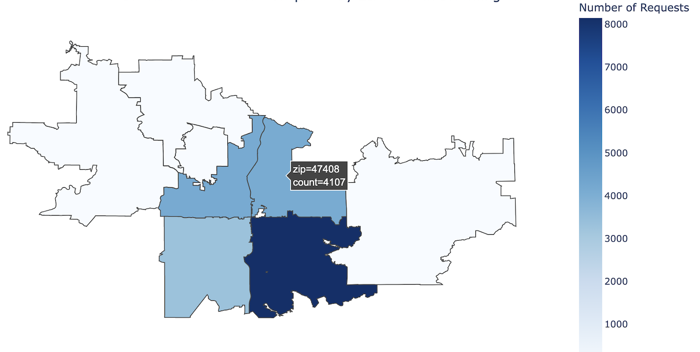
Distribution of Requests by ZIP Code
Maps
The Plotly Choropleth Python package is utilized to visualize geographic data, focusing on Open311 data's "zip" columns.
Insights from the graph:
Distributing the requests by zipcode with the help of choropleth showed us how majority of the issues are from certain zones which explains given the population density of those areas.

Slide 15
Data improvization suggestions
Mapping of Agencies to Service Names:
Challenge: Faced difficulties in accurately mapping agencies to service names due to incomplete or missing data.
Approach: Employed statistical methods, like mode replacement, but acknowledged the potential for minor inaccuracies in agency-service correlations.
Inconsistencies in Location Data:
Challenge: Encountered inconsistencies and inaccuracies in the geographical data, impacting the precision of spatial analyses.
Mitigation: Utilized data cleaning and transformation techniques, though some geographical insights may still have limitations.
Data Quality and Completeness:
Limitation: Varied quality and completeness of historical data, especially for earlier years.
Decision: Chose to focus on more recent data (from 2014) for a more reliable analysis, accepting the trade-off of excluding older data.

Slide 16
Future Scope
Real-Time Visualizations: Implement live data feeds for immediate insights into civic issues, enabling prompt responses from city officials and the community.
Integration with External Datasets: Enrich the analysis by merging Open311 data with external sources like demographic and traffic data to understand civic dynamics comprehensively.
Customizable Dashboards: Develop interactive dashboards that allow stakeholders to personalize data exploration, enhancing user engagement and accessibility.
Integration with news articles and social media posts: We can use the content from news articles and posts on social media understand more about the complaints and take into account the issues are overlooked.

Slide 17
Questions?

