Slide 1
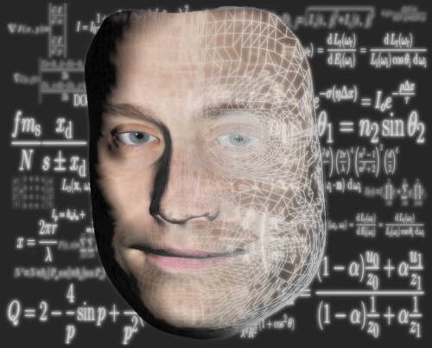

Music and AI (Title)
Author name , Douglas W. Cunningham,
Department of Graphical Systems, Univ. BTU Cottbus-Senftenberg, Cottbus, Germany
1. INTRODUCTION
Introduction ,,,,,,
2. RESEARCH QUESTION
3. METHODOLOGY
References :
[1] ,,,
Contact :
Iemail.email@b-tu.de

