Slide 1

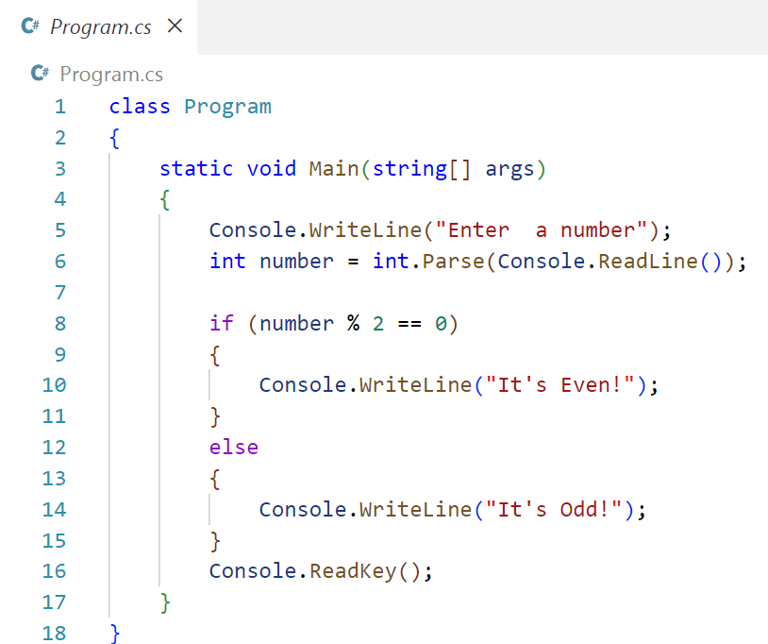
C# Challenge #1

