Slide 1
AKS Workshop
Faik Hakan Bilgen,
Sr. CSA, Microsoft

Slide 2
Observability

Slide 3
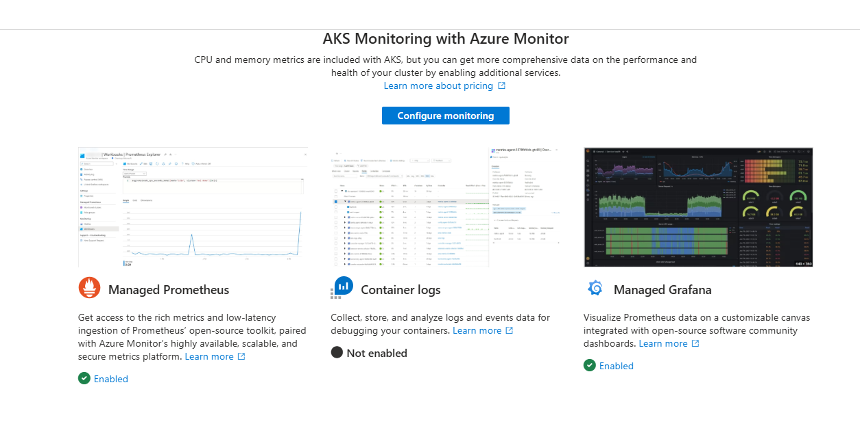
AKS Monitoring

Slide 4
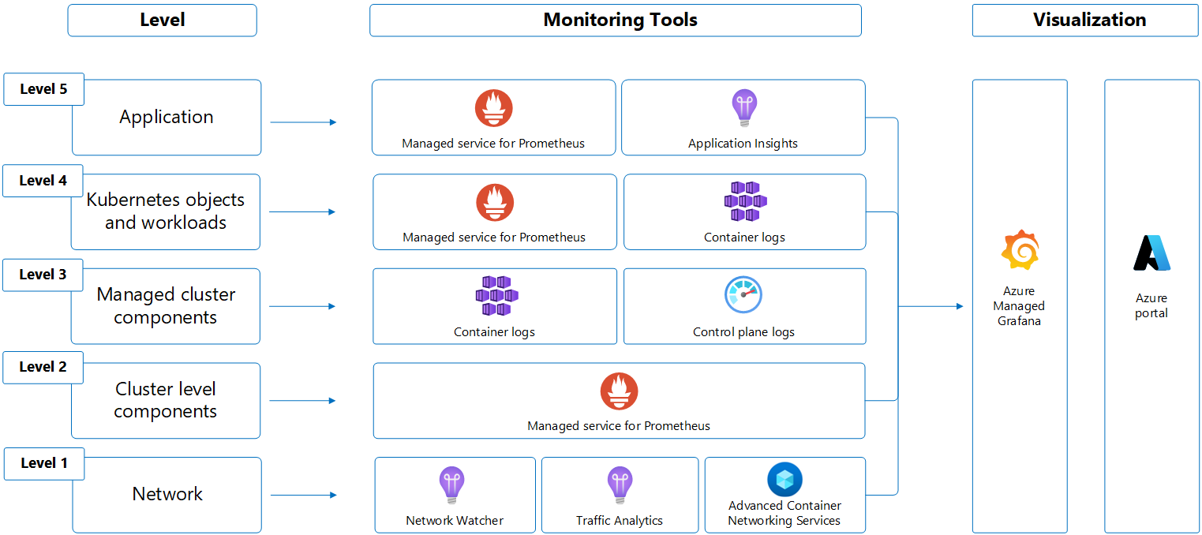
AKS Layers

Slide 5

AKS Monitoring
Monitor
Resource Visualizer
Monitoring
  Insights
  Alerts
  Metrics
  Advisor Recommendations
  Logs

Slide 6
DEMO
Advanced Observability Concepts
Notes:
https://azure-samples.github.io/aks-labs/docs/operations/observability-and-monitoring

Slide 7
The agentic CLI for AKS
Notes:
https://blog.aks.azure.com/2025/08/15/cli-agent-for-aks
https://github.com/Azure/agentic-cli-for-aks
https://learn.microsoft.com/en-us/azure/aks/cli-agent-for-aks-overview

Slide 8
Questions ?

Slide 9
📊 Checking AKS agent status...
✅ Helm Release: deployed
📦 Deployments:
• aks-agent: 1/1 ready
• aks-mcp: 1/1 ready
🐳 Pods:
• aks-agent-74f6ccff98-4qc9h: Running ✓
• aks-mcp-58d89c588c-smf6x: Running ✓
📋 LLM Configurations:
• azure/gpt-5.2-chat
API Base: https://coe-appinv-resource.openai.azure.com/
API Version: 2024-12-01-preview
✅ AKS agent is ready and running!

Slide 10
Thank you

