Slide 1
AKS Deep Dive Workshop
SECURITY
Faik Hakan Bilgen,
Sr. CSA, Microsoft

Slide 2
AKS Security

Slide 3
Security Concepts
Build Security
Registry Security
Cluster security
Node security
Network security
Application Security
Notes:
Explain the concepts in https://learn.microsoft.com/en-us/azure/aks/concepts-security

Slide 4
Security Vulnerability Management
Vulnerability management involves detecting, assessing, mitigating, and reporting on any security vulnerabilities that exist in an organization's systems and software.
Vulnerability management is a shared responsibility between you and Microsoft.

Slide 5
Finding and Fixing Vulnerabilities
Microsoft identifies and patches vulnerabilities and missing security updates for the following components:
AKS Container Images
Windows Server worker nodes
Ubuntu operating system
Azure Linux OS
Nodes

Slide 6
AKS Container Images
Microsoft takes responsibility for building the open-source packages that is deployed on AKS
Microsoft is active in the broader Kubernetes ecosystem
Microsoft scans container images
Microsoft discovers and updates vulnerabilities unknown to scanners
Notes:
Check the same title in https://learn.microsoft.com/en-us/azure/aks/concepts-vulnerability-management for the details

Slide 7
Security Vulnerability Management
Worker Nodes
Linux Nodes
Windows Server Nodes
Notes:
Check https://learn.microsoft.com/en-us/azure/aks/concepts-vulnerability-management#worker-nodes for the details

Slide 8
Vulnerability Classification
Severity | Description
Critical | A vulnerability easily exploitable in all clusters by an unauthenticated remote attacker that leads to full system compromise.
High | A vulnerability easily exploitable for many clusters that leads to loss of confidentiality, integrity, or availability.
Medium | A vulnerability exploitable for some clusters where loss of confidentiality, integrity, or availability is limited by common configurations, difficulty of the exploit itself, required access, or user interaction.
Low | All other vulnerabilities. Exploitation is unlikely or consequences of exploitation are limited.
Kubernetes vulnerability scoring system
Notes:
Check https://learn.microsoft.com/en-us/azure/aks/concepts-vulnerability-management#how-vulnerabilities-are-classified for the details

Slide 9
Security Baseline
lorem
Notes:
Introduction - Kubernetes CSI Developer Documentation

Slide 10
Confidential Containers Security Policy
As described by the Confidential Computing Consortium (CCC),
"Confidential Computing is the protection of data in use by performing computation in a hardware-based, attested Trusted Execution Environment (TEE)."
AKS Confidential Containers are designed to protect Kubernetes pods data in use from unauthorized access from outside of these pods. Each pod is executed in a Utility VM (UVM) protected by the AMD SEV-SNP TEE by encrypting data in use and prevent access to the data by the Host Operating System (OS).
Microsoft engineers collaborated with the Confidential Containers (CoCo) and Kata Containers open-source communities on the design and implementation of the Confidential Containers.
Notes:
Introduction - Kubernetes CSI Developer Documentation

Slide 11
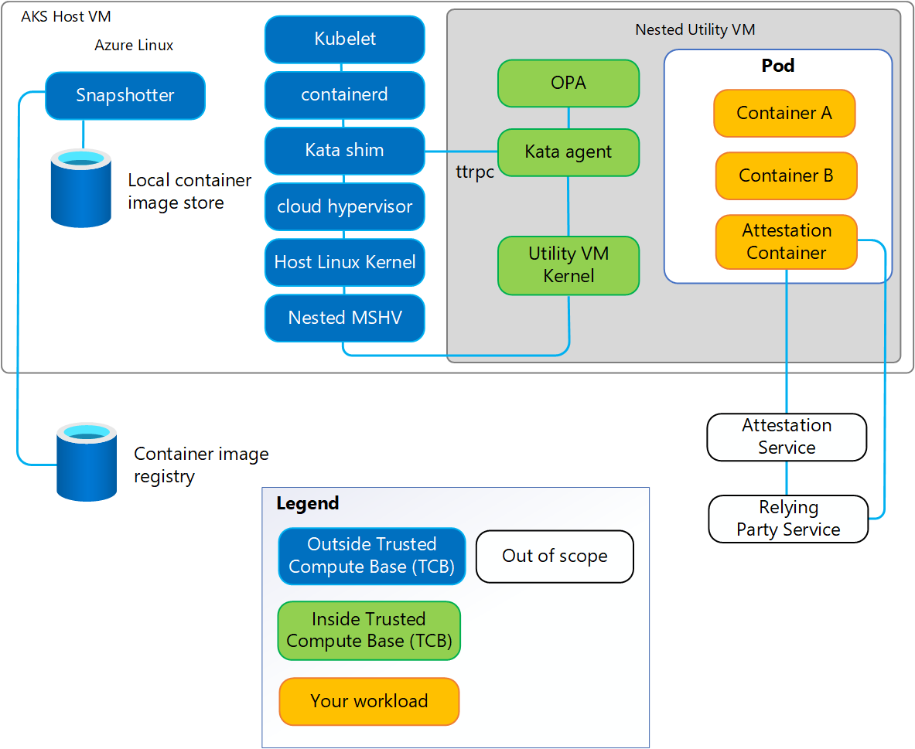
Confidential Containers Security Policy
Notes:
https://learn.microsoft.com/en-us/azure/confidential-computing/confidential-containers-aks-security-policy?toc=%2Fazure%2Faks%2Ftoc.json&bc=%2Fazure%2Faks%2Fbreadcrumb%2Ftoc.json#security-policy-overview
One of the main components of the Kata Containers system architecture is the Kata agent.
When using Kata Containers to implement Confidential Containers, the agent is executed inside the hardware-based TEE and therefore is part of the pod's Trusted Computing Base (TCB). As shown in the diagram, the Kata agent provides a set of ttrpc APIs allowing the system components outside of the TEE to create and manage Confidential-based Kubernetes pods. These other components (for example, the Kata Shim) aren't part of the pod's TCB. Therefore, the agent must protect itself from potentially buggy or malicious API calls.
In AKS Confidential Containers, the Kata agent API self-protection is implemented using a security policy (also known as the Kata Agent Policy), specified by the owners of the confidential pods. The policy document contains rules and data corresponding to each pod, using the industry standard Rego policy language. The enforcement of the policy inside the Utility VM (UVM) is implemented using the Open Policy Agent (OPA) – a graduated project of the Cloud Native Computing Foundation (CNCF).

Slide 12
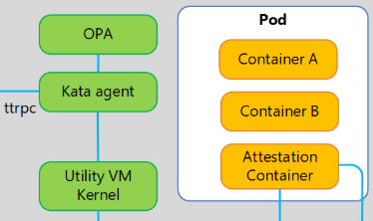
Policy
Contents
The security policy describes all the calls to agent’s ttrpc APIs (and the parameters of these API calls) that are expected for creating and managing the Confidential pod.
The policy document of each pod is a text file, using the Rego language.
Data
Rules
Default values
Notes:
https://learn.microsoft.com/en-us/azure/confidential-computing/confidential-containers-aks-security-policy?toc=%2Fazure%2Faks%2Ftoc.json&bc=%2Fazure%2Faks%2Fbreadcrumb%2Ftoc.json#policy-contents

Slide 13
DEMO
Rego Policy Language

Slide 14
Security Controls by Azure Policy
lorem
Notes:
Introduction - Kubernetes CSI Developer Documentation

Slide 15
Container Security

Slide 16
Defender for Containers Overview
Microsoft Defender for Containers is a cloud-native solution that enhances, monitors, and maintains the security of your containerized assets.
These assets include Kubernetes clusters, nodes, workloads, registries, images, and more. It protects applications across multicloud and on-premises environments.

Slide 17
5 Core Domains of Container Security
Security posture management
Vulnerability assessment
Run-time threat protection
Containers software supply chain protection
Deployment & monitoring
Notes:
Explain the content in https://learn.microsoft.com/en-us/azure/defender-for-cloud/defender-for-containers-introduction

Slide 18
Enable Defender for Containers
Notes:
Introduction - Kubernetes CSI Developer Documentation

Slide 19
DEMO
Deploy Defender for Containers Deployment Overview
Notes:
Manually setup Defender for AKS via Azure Portal
AKSDeepDive\src\DDSecurity\ContainerSecurity\checkDefenderSetup.sh
AKSDeepDive\src\DDSecurity\KubernetesAlertSimulator\simulate.sh

Slide 20
Confidential Containers overview
lorem
Notes:
Introduction - Kubernetes CSI Developer Documentation

Slide 21
DEMO
Deploy Confidential Containers with default policy

Slide 22
Image Security

Slide 23
Container Image Management Best Practices
lorem
Notes:
Introduction - Kubernetes CSI Developer Documentation

Slide 24
Validate Signed Images with Image Integrity
lorem
Notes:
Introduction - Kubernetes CSI Developer Documentation

Slide 25
DEMO
Validate Signed Images with Image Integrity

Slide 26
Remove Vulnerable Images with ImageCleaner
lorem
Notes:
Introduction - Kubernetes CSI Developer Documentation

Slide 27
DEMO
Remove Vulnerable Images with ImageCleaner

Slide 28
Scan Images in your CI/CD Workflow
lorem
Notes:
Introduction - Kubernetes CSI Developer Documentation

Slide 29
Scan images in ACR Registries
lorem
Notes:
Introduction - Kubernetes CSI Developer Documentation

Slide 30
Cluster Security

Slide 31
Cluster Security Best Practices
lorem
Notes:
Introduction - Kubernetes CSI Developer Documentation

Slide 32
Azure kubelogin
lorem
Notes:
Introduction - Kubernetes CSI Developer Documentation

Slide 33
DEMO
Azure kubelogin

Slide 34
Managed Identities - Overview
lorem
Notes:
Introduction - Kubernetes CSI Developer Documentation

Slide 35
Enable a Managed Identity on your Cluster
lorem
Notes:
Introduction - Kubernetes CSI Developer Documentation

Slide 36
DEMO
Enable a Managed Identity on your Cluster

Slide 37
Create a Service Principal
lorem
Notes:
Introduction - Kubernetes CSI Developer Documentation

Slide 38
DEMO
Create a Service Principal

Slide 39
Enable access to AKS clusters using Trusted Access
lorem
Notes:
Introduction - Kubernetes CSI Developer Documentation

Slide 40
DEMO
Enable access to AKS clusters using Trusted Access

Slide 41
Limit access to cluster configuration file
lorem
Notes:
Introduction - Kubernetes CSI Developer Documentation

Slide 42
DEMO
Limit access to cluster configuration file

Slide 43
Define API server authorized IP ranges
lorem
Notes:
Introduction - Kubernetes CSI Developer Documentation

Slide 44
DEMO
Define API server authorized IP ranges

Slide 45
Use service tags for API server authorized IP ranges in AKS
lorem
Notes:
Introduction - Kubernetes CSI Developer Documentation

Slide 46
DEMO
Use service tags for API server authorized IP ranges in AKS

Slide 47
Manage Cluster Certificates and Rotation
lorem
Notes:
Introduction - Kubernetes CSI Developer Documentation

Slide 48
DEMO
Manage Cluster Certificates and Rotation

Slide 49
Use Custom Certificate Authorities
lorem
Notes:
Introduction - Kubernetes CSI Developer Documentation

Slide 50
DEMO
Use custom certificate authorities

Slide 51
Use Azure Policy
lorem
Notes:
Introduction - Kubernetes CSI Developer Documentation

Slide 52
DEMO
Use Azure Policy

Slide 53
Control Deployments with Azure Policy
lorem
Notes:
Introduction - Kubernetes CSI Developer Documentation

Slide 54
DEMO
Control Deployments with Azure Policy

Slide 55
Enforce Best Practices with Deployment Safeguards
lorem
Notes:
Introduction - Kubernetes CSI Developer Documentation

Slide 56
DEMO
Enforce Best Practices with Deployment Safeguards

Slide 57
Create an OIDC Issuer for your Cluster
lorem
Notes:
Introduction - Kubernetes CSI Developer Documentation

Slide 58
DEMO
Create an OIDC Issuer for your Cluster

Slide 59
Create an OIDC Issuer for your Cluster
lorem
Notes:
Introduction - Kubernetes CSI Developer Documentation

Slide 60
DEMO
Create an OIDC Issuer for your Cluster

Slide 61
Enable KMS Data Encryption in AKS
lorem
Notes:
Introduction - Kubernetes CSI Developer Documentation

Slide 62
DEMO
Enable KMS Data Encryption in AKS

Slide 63
Use KMS etcd Encryption (legacy)
lorem
Notes:
Introduction - Kubernetes CSI Developer Documentation

Slide 64
DEMO
Use KMS etcd Encryption (legacy)

Slide 65
Update Key Vault Mode
lorem
Notes:
Introduction - Kubernetes CSI Developer Documentation

Slide 66
DEMO
Update Key Vault Mode

Slide 67
Migrate to KMS v2
lorem
Notes:
Introduction - Kubernetes CSI Developer Documentation

Slide 68
DEMO
Migrate to KMS v2

Slide 69
Observability for KMS etcd Encryption
lorem
Notes:
Introduction - Kubernetes CSI Developer Documentation

Slide 70
DEMO
Observability for KMS etcd Encryption

Slide 71
Migrate to KMS with platform-managed or customer-managed keys
lorem
Notes:
Introduction - Kubernetes CSI Developer Documentation

Slide 72
DEMO
Migrate to KMS with platform-managed or customer-managed keys

Slide 73
Secure Container Access to Resources
lorem
Notes:
Introduction - Kubernetes CSI Developer Documentation

Slide 74
DEMO
Secure Container Access to Resources

Slide 75
Node Security

Slide 76
BYOK for Azure Managed Disks
lorem
Notes:
Introduction - Kubernetes CSI Developer Documentation

Slide 77
DEMO
BYOK for Azure Managed Disks

Slide 78
Enable Host-Based Encryption
lorem
Notes:
Introduction - Kubernetes CSI Developer Documentation

Slide 79
DEMO
Enable Host-Based Encryption

Slide 80
Enable FIPS
lorem
Notes:
Introduction - Kubernetes CSI Developer Documentation

Slide 81
DEMO
Enable FIPS

Slide 82
Use Confidential Virtual Machines
lorem
Notes:
Introduction - Kubernetes CSI Developer Documentation

Slide 83
DEMO
Use Confidential Virtual Machines

Slide 84
Use Dedicated Hosts with AKS
lorem
Notes:
Introduction - Kubernetes CSI Developer Documentation

Slide 85
DEMO
Use Dedicated Hosts with AKS

Slide 86
Restrict access to IMDS
lorem
Notes:
Introduction - Kubernetes CSI Developer Documentation

Slide 87
DEMO
Restrict access to IMDS

Slide 88
Authentication and Authorization

Slide 89
Access and Identity Concepts
lorem
Notes:
Introduction - Kubernetes CSI Developer Documentation

Slide 90
Authentication and authorization best practices
lorem
Notes:
Introduction - Kubernetes CSI Developer Documentation

Slide 91
Use Managed Identities
lorem
Notes:
Introduction - Kubernetes CSI Developer Documentation

Slide 92
DEMO
Use Managed Identities

Slide 93
Create Service Principal
lorem
Notes:
Introduction - Kubernetes CSI Developer Documentation

Slide 94
DEMO
Create Service Principal

Slide 95
Enable AKS-Managed Microsoft Entra Integration
lorem
Notes:
Introduction - Kubernetes CSI Developer Documentation

Slide 96
DEMO
Enable AKS-Managed Microsoft Entra Integration

Slide 97
Manage Local Accounts
lorem
Notes:
Introduction - Kubernetes CSI Developer Documentation

Slide 98
DEMO
Manage Local Accounts

Slide 99
Cluster and Node Access Control with Conditional Access
lorem
Notes:
Introduction - Kubernetes CSI Developer Documentation

Slide 100
DEMO
Cluster and Node Access Control with Conditional Access

Slide 101
Cluster and node access control with Privileged Identity Management
lorem
Notes:
Introduction - Kubernetes CSI Developer Documentation

Slide 102
DEMO
Cluster and Node Access Control with Privileged Identity Management

Slide 103
Microsoft Entra Integration (Legacy)
lorem
Notes:
Introduction - Kubernetes CSI Developer Documentation

Slide 104
DEMO
Microsoft Entra Integration (Legacy)

Slide 105
Enable GMSA Integration
lorem
Notes:
Introduction - Kubernetes CSI Developer Documentation

Slide 106
DEMO
Enable GMSA Integration

Slide 107
Use Azure RBAC for Kubernetes Authorization
lorem
Notes:
Introduction - Kubernetes CSI Developer Documentation

Slide 108
DEMO
Use Azure RBAC for Kubernetes Authorization

Slide 109
Use Kubernetes RBAC with Microsoft Entra Integration
lorem
Notes:
Introduction - Kubernetes CSI Developer Documentation

Slide 110
DEMO
Use Kubernetes RBAC with Microsoft Entra Integration

Slide 111
Use Kubernetes RBAC with Microsoft Entra Integration
lorem
Notes:
Introduction - Kubernetes CSI Developer Documentation

Slide 112
DEMO
Use Kubernetes RBAC with Microsoft Entra Integration

Slide 113
Update Cluster Credentials
lorem
Notes:
Introduction - Kubernetes CSI Developer Documentation

Slide 114
DEMO
Update Cluster Credentials

Slide 115
Limit Access to Cluster Configuration File
lorem
Notes:
Introduction - Kubernetes CSI Developer Documentation

Slide 116
DEMO
Limit Access to Cluster Configuration File

Slide 117
External Identity Provider Authentication Overview
lorem
Notes:
Introduction - Kubernetes CSI Developer Documentation

Slide 118
DEMO
External Identity Provider Authentication Overview

Slide 119
Configure External Identity Providers
lorem
Notes:
Introduction - Kubernetes CSI Developer Documentation

Slide 120
DEMO
Configure External Identity Providers

Slide 121
Control Deployments with Azure Policy
lorem
Notes:
Introduction - Kubernetes CSI Developer Documentation

Slide 122
DEMO
Control Deployments with Azure Policy

Slide 123
Application Security

Slide 124
Create an OIDC Issuer for your Cluster
lorem
Notes:
Introduction - Kubernetes CSI Developer Documentation

Slide 125
DEMO
Create an OIDC Issuer for your Cluster

Slide 126
Workload Identity Overview
lorem
Notes:
Introduction - Kubernetes CSI Developer Documentation

Slide 127
DEMO
Workload Identity Overview

Slide 128
Deploy and Configure Workload Identity
lorem
Notes:
Introduction - Kubernetes CSI Developer Documentation

Slide 129
DEMO
Deploy and Configure Workload Identity for a Cluster

Slide 130
Configure Cross-Tenant Workload Identity
lorem
Notes:
Introduction - Kubernetes CSI Developer Documentation

Slide 131
DEMO
Configure Cross-Tenant Workload Identity

Slide 132
Migrate your App from Pod identity to Workload Identity
lorem
Notes:
Introduction - Kubernetes CSI Developer Documentation

Slide 133
DEMO
Migrate your App from Pod identity to Workload Identity

Slide 134
Identity Bindings Overview
lorem
Notes:
Introduction - Kubernetes CSI Developer Documentation

Slide 135
Set up identity bindings
lorem
Notes:
Introduction - Kubernetes CSI Developer Documentation

Slide 136
DEMO
Set up identity bindings

Slide 137
Microsoft Entra Pod Identity
lorem
Notes:
Introduction - Kubernetes CSI Developer Documentation

Slide 138
DEMO
Microsoft Entra Pod Identity

Slide 139
Pod Sandboxing Overview
lorem
Notes:
Introduction - Kubernetes CSI Developer Documentation

Slide 140
Pod Sandboxing Considerations
lorem
Notes:
Introduction - Kubernetes CSI Developer Documentation

Slide 141
Deploy Pod Sandboxing
lorem
Notes:
Introduction - Kubernetes CSI Developer Documentation

Slide 142
DEMO
Deploy Pod Sandboxing

Slide 143
Secure Pod Traffic with Network Policies
lorem
Notes:
Introduction - Kubernetes CSI Developer Documentation

Slide 144
DEMO
Secure Pod Traffic with Network Policies

Slide 145
Network Policy Best Practices
lorem
Notes:
Introduction - Kubernetes CSI Developer Documentation

Slide 146
DEMO
Network Policy Best Practices

Slide 147
Use Network Policies in the Azure Portal
lorem
Notes:
Introduction - Kubernetes CSI Developer Documentation

Slide 148
DEMO
Use Network Policies in the Azure Portal

Slide 149
Pod Security Policies
lorem
Notes:
Introduction - Kubernetes CSI Developer Documentation

Slide 150
DEMO
Pod Security Policies

Slide 151
Pod Security Best Practices
lorem
Notes:
Introduction - Kubernetes CSI Developer Documentation

Slide 152
Resource Management Best Practices
lorem
Notes:
Introduction - Kubernetes CSI Developer Documentation

Slide 153
Configure TLS for NGINX Ingress Controller
lorem
Notes:
Introduction - Kubernetes CSI Developer Documentation

Slide 154
1 - Configure Secrets Store CSI Driver
lorem
Notes:
Introduction - Kubernetes CSI Developer Documentation

Slide 155
DEMO
1 - Configure Secrets Store CSI Driver

Slide 156
2 - Provider Azure Key Vault Access
lorem
Notes:
Introduction - Kubernetes CSI Developer Documentation

Slide 157
DEMO
2 - Provider Azure Key Vault Access

Slide 158
3 - Apply Extra Configurations or Perform
Troubleshooting
lorem
Notes:
Introduction - Kubernetes CSI Developer Documentation

Slide 159
DEMO
3 - Apply Extra Configurations or Perform
Troubleshooting

Slide 160
Open ID Connect (OIDC) on AKS
OpenID Connect (OIDC) extends the OAuth 2.0 authorization protocol for use as another authentication protocol issued by Microsoft Entra ID.
You can use OIDC to enable single sign-on (SSO) between OAuth-enabled applications on your Azure Kubernetes Service (AKS) cluster using a security token called an ID token.
You can enable the OIDC issuer on your AKS clusters, which allows Microsoft Entra ID (or another cloud provider's identity and access management platform) to discover the API server's public signing keys.

Slide 161
Open ID Connect (OIDC) on AKS
You can't disable OIDC issuer once enabled
Enabling OIDC issuer on existing clusters requires API server restart (brief downtime)
Maximum token lifetime is 24 hours (one day)
Projected service account tokens required for Kubernetes 1.30+ clusters

Slide 162
Open ID Connect (OIDC) on AKS
Create an AKS cluster with the OIDC issuer
Enable the OIDC issuer on an existing AKS cluster
# Set environment variables
RESOURCE_GROUP=<your-resource-group-name>
CLUSTER_NAME=<your-aks-cluster-name>
# Create the AKS cluster with OIDC issuer enabled (OIDC issuer enabled by default for Kubernetes 1.34+)
az aks create
--resource-group $RESOURCE_GROUP
--name $CLUSTER_NAME
--node-count 1
--enable-oidc-issuer
--generate-ssh-keys
# Set environment variables
RESOURCE_GROUP=<your-resource-group-name>
CLUSTER_NAME=<your-aks-cluster-name>
# Enable the OIDC issuer on the existing AKS cluster
az aks update
--resource-group $RESOURCE_GROUP
--name $CLUSTER_NAME
--enable-oidc-issuer

Slide 163
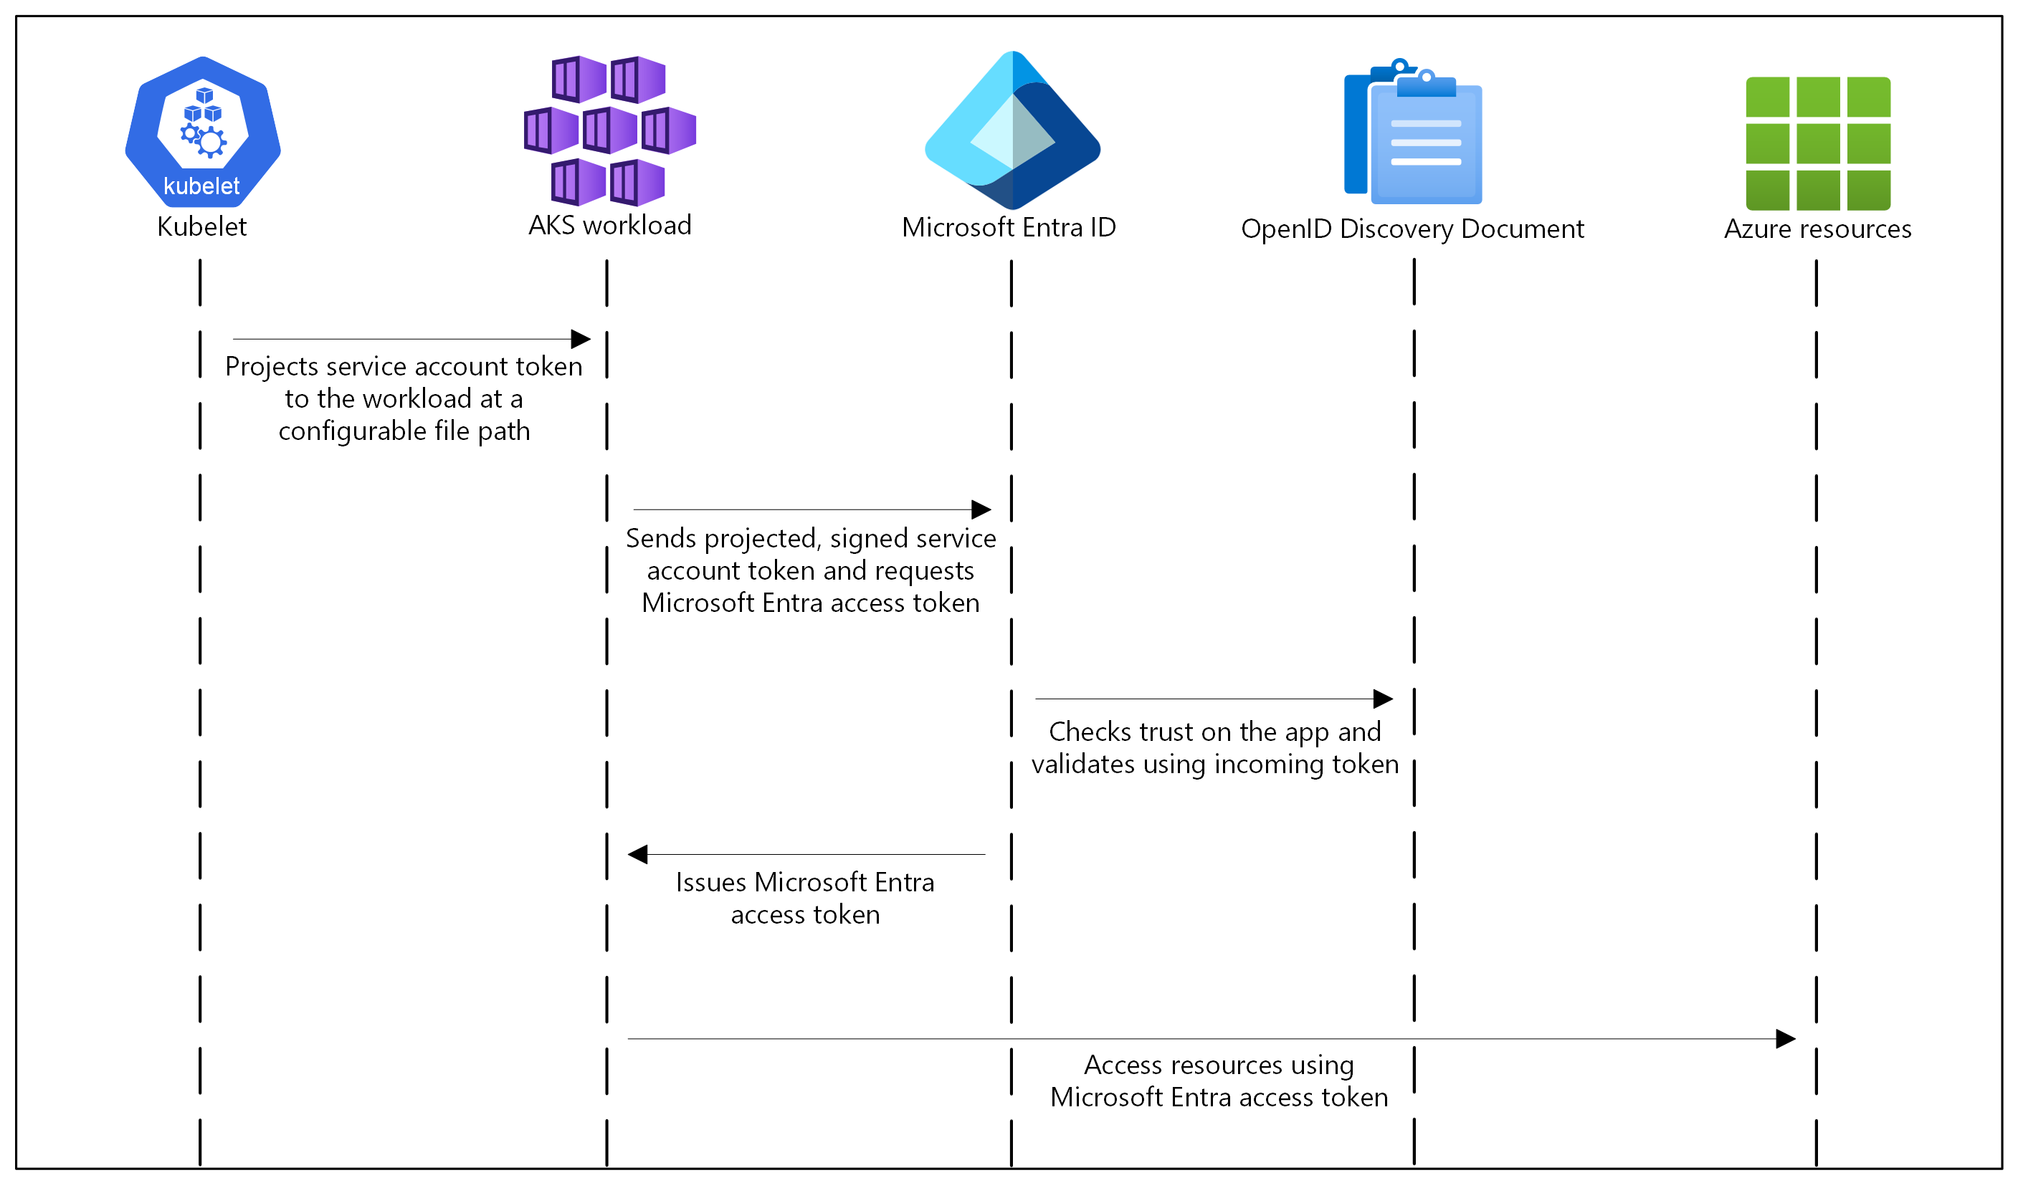
OIDC on AKS How it works
In this security model, the AKS cluster acts
as the token issuer.
Microsoft Entra ID uses OIDC to discover
public signing keys and verify the authenticity
of the service account token before exchanging it for a Microsoft Entra token.
Your workload can exchange a service account
token projected to its volume for a
Microsoft Entra token using the Azure Identity
client library or the MSAL.

Slide 164
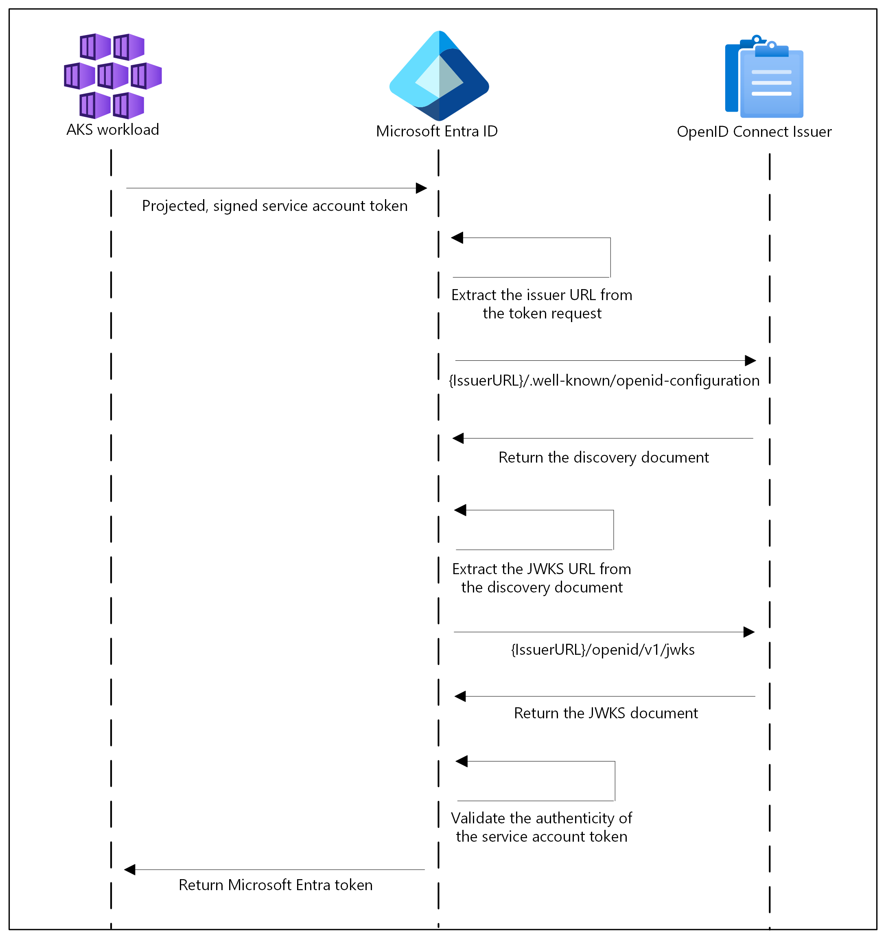
Authentication Sequence of OIDC

Slide 165
Open ID Connect (OIDC) on AKS
Endpoint | Description
{IssuerURL}/.well-known/openid-configuration | Also known as the OIDC discovery document. This contains the metadata about the issuer's configurations.
{IssuerURL}/openid/v1/jwks | This contains the public signing key(s) that Microsoft Entra ID uses to verify the authenticity of the service account token.
Get the OIDC Issuer URL
# Set environment variables
RESOURCE_GROUP=<your-resource-group-name>
CLUSTER_NAME=<your-aks-cluster-name>
# Get the OIDC issuer URL
az aks show
--name $CLUSTER_NAME
--resource-group $RESOURCE_GROUP
--query "oidcIssuerProfile.issuerUrl" -o tsv

Slide 166
Service Account Labels and Annotations
Microsoft Entra Workload ID supports the following mappings related to a service account:
One-to-one, where a service account references a Microsoft Entra object.
Many-to-one, where multiple service accounts reference the same Microsoft Entra object.
One-to-many, where a service account references multiple Microsoft Entra objects by changing the client ID annotation.
Note: If you update the service account annotations, you must restart the pod for the changes to take effect.

Slide 167
Service Account Annotations
Annotation | Description | Default
azure.workload.identity/client-id | Represents the Microsoft Entra application client ID to be used with the pod.
azure.workload.identity/tenant-id | Represents the Azure tenant ID where the Microsoft Entra application is registered. | AZURE_TENANT_ID environment variable extracted from azure-wi-webhook-config ConfigMap.
azure.workload.identity/service-account-token-expiration | Represents the expirationSeconds field for the projected service account token. It's an optional field that you configure to prevent any downtime caused by errors during service account token refresh. Kubernetes service account token expiry isn't correlated with Microsoft Entra tokens. Microsoft Entra tokens expire in 24 hours after they're issued. | 3600 Supported range is 3600-86400.

Slide 168
Pod Labels
Label | Description | Recommended value | Required
azure.workload.identity/use | This label is required in the pod template spec. Only pods with this label are mutated by the azure-workload-identity mutating admission webhook to inject the Azure specific environment variables and the projected service account token volume. | true | Yes

Slide 169
Pod Annotations
Annotation | Description | Default
azure.workload.identity/service-account-token-expiration | Pod annotations take precedence over service account annotations. | 3600 Supported range is 3600-86400.
azure.workload.identity/skip-containers | Represents a semi-colon-separated list of containers to skip adding projected service account token volume. For example, container1;container2. | By default, the projected service account token volume is added to all containers if the pod is labeled with azure.workload.identity/use: true.
azure.workload.identity/inject-proxy-sidecar | Injects a proxy init container and proxy sidecar into the pod. The proxy sidecar is used to intercept token requests to IMDS and acquire a Microsoft Entra token on behalf of the user with federated identity credential. | false
azure.workload.identity/proxy-sidecar-port | Represents the port of the proxy sidecar. | 8000

Slide 170
DEMO
Deploy and configure Microsoft Entra Workload ID on an Azure Kubernetes Service (AKS) cluster

Slide 171
Deploy and configure Microsoft Entra Workload ID on an Azure Kubernetes Service (AKS) cluster
Create a new or update an existing AKS cluster using the Azure CLI with OpenID Connect (OIDC) issuer and Microsoft Entra Workload ID enabled.
Create a workload identity and Kubernetes service account.
Configure the managed identity for token federation.
Deploy the workload and verify authentication with the workload identity.
Optionally grant a pod in the cluster access to secrets in an Azure key vault.

Slide 172
Secrets Store CSI Driver

Slide 173
CSI Driver
The Container Storage Interface (CSI) is a standard for exposing arbitrary block and file storage systems to containerized workloads on Container Orchestration Systems (COS) like Kubernetes.
Using CSI third-party storage providers can write and deploy plugins exposing new storage systems in Kubernetes without ever having to touch the core Kubernetes code.
Notes:
Introduction - Kubernetes CSI Developer Documentation

Slide 174
Secret Store CSI Driver
Secrets Store CSI Driver for Kubernetes secrets - Integrates secrets stores with Kubernetes via a Container Storage Interface (CSI) volume.
The Secrets Store CSI Driver secrets-store.csi.k8s.io allows Kubernetes to mount multiple secrets, keys, and certs stored in enterprise-grade external secrets stores into their pods as a volume. Once the Volume is attached, the data in it is mounted into the container's file system.
Notes:
kubernetes-sigs/secrets-store-csi-driver: Secrets Store CSI driver for Kubernetes secrets - Integrates secrets stores with Kubernetes via a CSI volume.

Slide 175
Azure Key Vault provider for Secret Store CSI Driver in an AKS cluster
The Azure Key Vault provider for Secrets Store CSI Driver allows for the integration of an Azure Key Vault as a secret store with an Azure Kubernetes Service (AKS) cluster via a CSI volume.
Notes:
kubernetes-sigs/secrets-store-csi-driver: Secrets Store CSI driver for Kubernetes secrets - Integrates secrets stores with Kubernetes via a CSI volume.

Slide 176
Features
Mounts secrets, keys, and certificates to a pod using a CSI volume.
Supports CSI inline volumes.
Supports mounting multiple secrets store objects as a single volume.
Supports pod portability with the SecretProviderClass CRD.
Supports Windows containers.
Syncs with Kubernetes secrets.
Supports autorotation of mounted contents and synced Kubernetes secrets.

Slide 177
Limitations
A container using a ConfigMap or Secret as a subPath volume mount does not receive automated updates when the secret is rotated. This is a Kubernetes limitation. To have the changes take effect, the application needs to reload the changed file by either watching for changes in the file system or by restarting the pod.
The add-on creates a managed identity named azurekeyvaultsecretsprovider-xxx in the node resource group and assigns it to the Virtual Machine Scale Sets (VMSS) automatically. You can use this managed identity or your own managed identity to access the key vault. It's not supported to prevent creation of the identity.

Slide 178
DEMO
Azure Key Vault Provider for Secret Store CSI Driver in AKS

Slide 179
Pod Security Admission (PSA)

Slide 180
Pod Security Standards
The Pod Security Standards define three different policies to broadly cover the security spectrum.
These policies are cumulative and range from highly-permissive to highly-restrictive.
Profile | Description
Privileged | Unrestricted policy, providing the widest possible level of permissions. This policy allows for known privilege escalations.
Baseline | Minimally restrictive policy which prevents known privilege escalations. Allows the default (minimally specified) Pod configuration.
Restricted | Heavily restricted policy, following current Pod hardening best practices.
Notes:
Pod Security Standards | Kubernetes

Slide 181
The Privileged Policy
The Privileged policy is purposely-open, and entirely unrestricted. This type of policy is typically aimed at system- and infrastructure-level workloads managed by privileged, trusted users.
The Privileged policy is defined by an absence of restrictions. If you define a Pod where the Privileged security policy applies, the Pod you define is able to bypass typical container isolation mechanisms. For example, you can define a Pod that has access to the node's host network.
Notes:
Pod Security Standards | Kubernetes

Slide 182
The Baseline Policy
The Baseline policy is aimed at ease of adoption for common containerized workloads while preventing known privilege escalations.
This policy is targeted at application operators and developers of non-critical applications.
Notes:
Pod Security Standards | Kubernetes

Slide 183
The Restricted Policy
The Restricted policy is aimed at enforcing current Pod hardening best practices, at the expense of some compatibility.
It is targeted at operators and developers of security-critical applications, as well as lower-trust users.
Notes:
Pod Security Standards | Kubernetes

Slide 184
Pod Security Admission in AKS
Pod Security Admission (PSA) uses labels to enforce Pod Security Standards policies on pods running in a namespace.
In AKS, Pod Security Admission is enabled by default.
Notes:
Pod Security Standards | Kubernetes

Slide 185
DEMO
Pod Security Admission

Slide 186
Demo Companion
The following security context elements are missing
Element | Pod Level | Container Level | Purpose
runAsNonRoot | ✓ | ✓ | Prevent running as root
runAsUser | ✓ | ✓ | Specify user ID
runAsGroup | ✓ | ✓ | Specify group ID
fsGroup | ✓ |  | File system group for volumes
readOnlyRootFilesystem |  | ✓ | Make root filesystem read-only
allowPrivilegeEscalation |  | ✓ | Prevent privilege escalation
capabilities |  | ✓ | Drop/add Linux capabilities
seccompProfile | ✓ | ✓ | Apply seccomp filtering
Warning: would violate PodSecurity "restricted:latest": allowPrivilegeEscalation != false (container "azure-vote-back" must set securityContext.allowPrivilegeEscalation=false), unrestricted capabilities (container "azure-vote-back" must set securityContext.capabilities.drop=["ALL"]), runAsNonRoot != true (pod or container "azure-vote-back" must set securityContext.runAsNonRoot=true), seccompProfile (pod or container "azure-vote-back" must set securityContext.seccompProfile.type to "RuntimeDefault" or "Localhost")
deployment.apps/azure-vote-back created
service/azure-vote-back created
Warning: would violate PodSecurity "restricted:latest": allowPrivilegeEscalation != false (container "azure-vote-front" must set securityContext.allowPrivilegeEscalation=false), unrestricted capabilities (container "azure-vote-front" must set securityContext.capabilities.drop=["ALL"]), runAsNonRoot != true (pod or container "azure-vote-front" must set securityContext.runAsNonRoot=true), seccompProfile (pod or container "azure-vote-front" must set securityContext.seccompProfile.type to "RuntimeDefault" or "Localhost")
deployment.apps/azure-vote-front created
service/azure-vote-front created

Slide 187
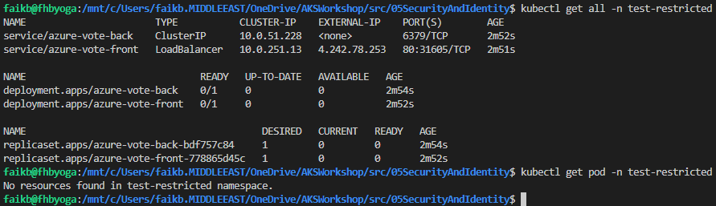
Demo Companion

Slide 188
Questions ?

Slide 189
Thank you

