Slide 1
AKS Deep Dive Workshop
SECURITY
Faik Hakan Bilgen,
Sr. CSA, Microsoft

Slide 2
Security Concepts
Build Security
Registry Security
Cluster Security
Node Security
Network Security
Application Security
Notes:
Explain the concepts in https://learn.microsoft.com/en-us/azure/aks/concepts-security

Slide 3
Module 1
Identity and Access

Slide 4
Identity and access
Access and identity overview
Manage access to the AKS resource
Cluster authentication
Cluster authorization
Cluster identity (managed identities and service principals)
Workload identity (pod to Azure)

Slide 5
Access and Identity Overview
Scenario | Question it answers
A. Kubernetes control-plane authentication | Who is the caller hitting the Kubernetes API?
B. Kubernetes control-plane authorization | What is the caller allowed to do once authenticated to the Kubernetes API?
C. AKS resource authorization (Azure Resource Manager) | Who can perform Azure-level operations on the AKS resource, such as pulling kubeconfig?
D. Cluster identity (cluster → Azure) | How does the AKS cluster act on Azure to manage resources on your behalf?
E. Workload identity (pod → Azure) | How do pods authenticate to Azure services such as Key Vault or Storage?

Slide 6
A. Kubernetes control-plane authentication
Microsoft Entra ID (recommended)
Use Entra ID identities and groups to sign in to the cluster. Microsoft Entra integration provisions and rotates the integration on your behalf. To enable, see Use Microsoft Entra integration.
Local accounts
A built-in cluster admin certificate that bypasses Entra ID. We recommend disabling local accounts in production.
External identity providers
Use an OIDC-compliant identity provider other than Microsoft Entra ID. See External identity provider authentication.

Slide 7
B. Kubernetes control-plane authorization
Kubernetes RBAC
The native Kubernetes Role / ClusterRole / RoleBinding model evaluated by the API server. Permissions live in the cluster as Kubernetes objects.
Microsoft Entra ID authorization
An AKS authorization webhook delegates authorization decisions to Microsoft Entra ID using Azure role assignments. Azure RBAC role assignments with dataActions are supported for all standard Kubernetes API resources, and role assignments with Azure ABAC conditions are supported for custom resources. Permissions are managed centrally in Microsoft Entra ID and can govern many clusters from a single role assignment at subscription, management group, or resource group scope.

Slide 8
C. AKS resource authorization (Azure Resource Manager)
In addition to authorizing calls to the Kubernetes API, you also need to authorize
Azure-level operations on the AKS resource itself. The most common example is controlling who can pull a cluster's kubeconfig, which is a standalone Azure Resource Manager operation that you can govern granularly with Azure RBAC.
This is standard Azure RBAC against the Microsoft.ContainerService resource provider, separate from authorizing the Kubernetes API.

Slide 9
D. Cluster identity (cluster → Azure)
Control-plane identity
Used by the cluster control plane to manage Azure resources for the cluster.
Kubelet identity
Used by the kubelet on each node to authenticate to services such as Azure Container Registry.
Add-ons/extensions identity. Some AKS add-ons and extensions use their own managed identities.

Slide 10
E. Workload identity (pod → Azure)
Workload identity lets pods running in your AKS cluster authenticate to Microsoft Entra–protected Azure services (such as Key Vault, Storage, or Cosmos DB) without storing secrets in the cluster.
AKS uses Microsoft Entra Workload ID, which projects a Kubernetes service account token federated to a Microsoft Entra application or user-assigned managed identity.

Slide 11
Manage access to the AKS resource

Slide 12
AKS service permissions reference
Identity creating and operating the cluster permissions
AKS cluster identity permissions
Additional AKS cluster identity permissions
AKS node mapped identity
  Registries configured with "RBAC Registry Permissions"
  Registries configured with "RBAC Registry + ABAC Repository Permissions"
https://learn.microsoft.com/en-us/azure/aks/aks-service-permissions
Notes:
When creating a cluster, AKS generates or modifies resources it needs (like VMs and NICs) to create and run the cluster on behalf of the user.
This identity is distinct from the cluster's identity permission, which is created during cluster creation.

Slide 13
Control access to kubeconfig
Available permissions for cluster roles
  Azure Kubernetes Service Cluster Admin Role
  Azure Kubernetes Service Cluster User Role

Slide 14
Control access to kubeconfig
Assign role permissions to a user or group
az role assignment create --assignee $ACCOUNT_ID --scope $AKS_CLUSTER --role "Azure Kubernetes Service Cluster Admin Role"
az role assignment create --assignee $ACCOUNT_ID --scope $AKS_CLUSTER --role "Azure Kubernetes Service Cluster User Role"
Get and verify the configuration information
az role assignment list --assignee $ACCOUNT_ID --scope $AKS_CLUSTER
Remove role permissions
az role assignment delete --assignee $ACCOUNT_ID --scope $AKS_CLUSTER

Slide 15
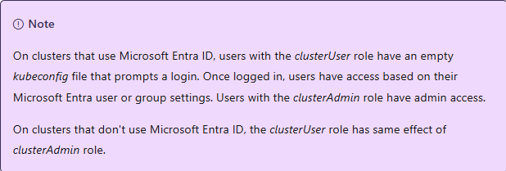
Control access to kubeconfig

Slide 16
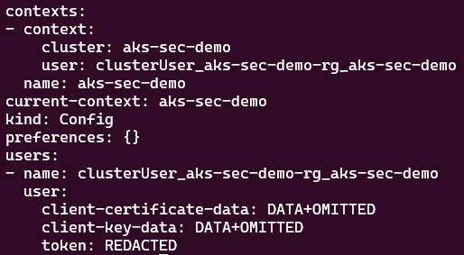
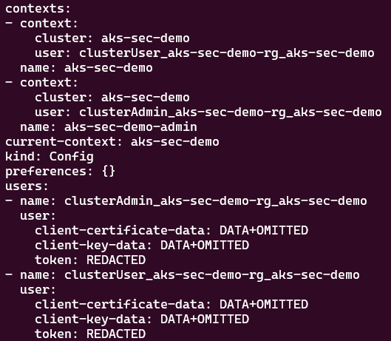
Control access to kubeconfig

Slide 17
DEMO
Manage Access
Notes:
src/DDSecurity/1IdentityAndAccess/manageAccess.sh

Slide 18
Cluster Authentication

Slide 19
Cluster Authentication Concepts
Microsoft Entra ID authentication to cluster control plane
External identity provider authentication to cluster (overview)
Disable local accounts
Authenticate to cluster nodes

Slide 20
Microsoft Entra ID authentication to cluster control plane
Kubernetes itself doesn't provide an identity directory. Without an external identity provider, you'd need to manage local credentials per cluster, which doesn't scale and creates audit gaps.
We recommend deploying AKS clusters with Microsoft Entra ID authentication for the control plane. With this integration, the cluster validates incoming Kubernetes API requests against Microsoft Entra ID and uses the caller's Entra identity for authorization decisions.
Notes:
Enable Microsoft Entra ID authentication for the AKS control plane - Azure Kubernetes Service | Microsoft Learn

Slide 21
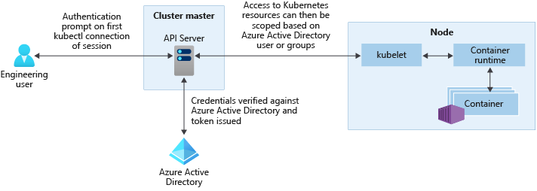
Microsoft Entra ID authentication to cluster control plane

Slide 22

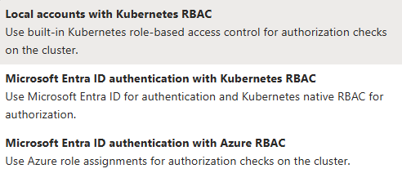
Microsoft Entra ID authentication to cluster control plane

Slide 23
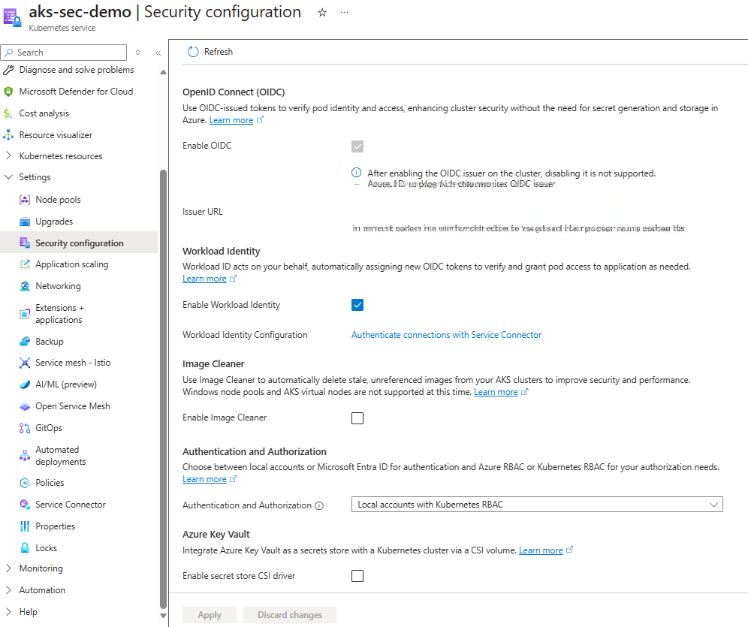
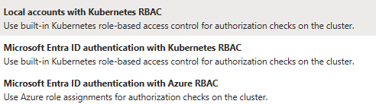
Microsoft Entra ID authentication to cluster control plane

Slide 24
Microsoft Entra ID authentication to cluster control plane

Slide 25
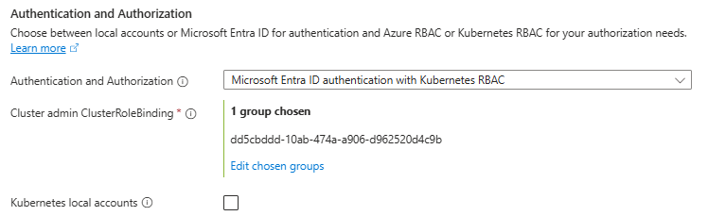
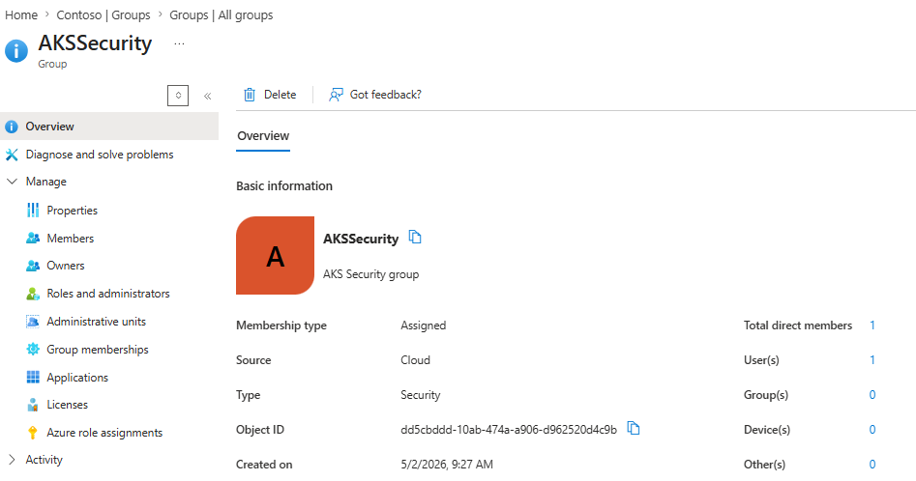
Microsoft Entra ID authentication to cluster control plane

Slide 26
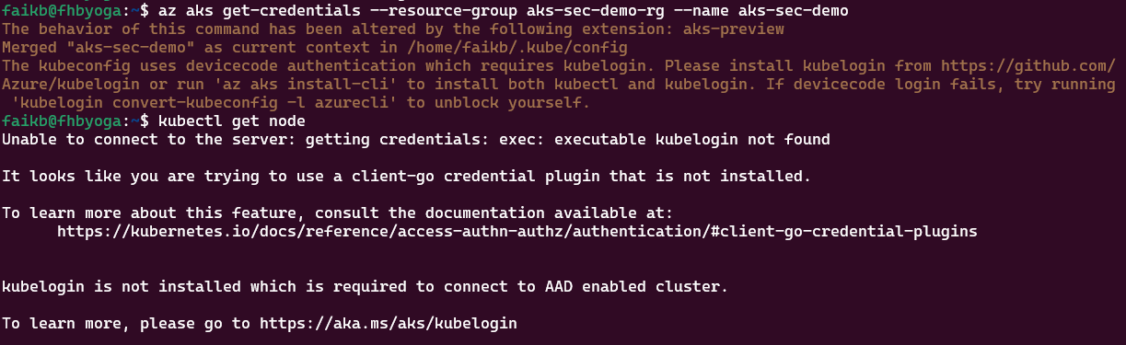
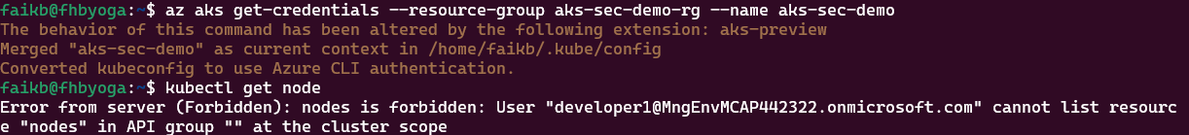
Control access to kubeconfig

Slide 27
DEMO
Enable Entra ID Authentication
Notes:
src/DDSecurity/1IdentityAndAccess/EnableEntraIDIntegration.sh
Reference: https://learn.microsoft.com/en-us/azure/aks/entra-id-control-plane-authentication

Slide 28
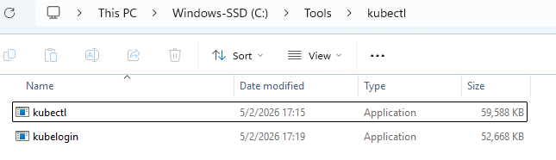
Authenticate with kubelogin
The kubelogin plugin in Azure is a client-go credential plugin that implements Microsoft Entra authentication. The kubelogin plugin offers features that aren't available in the kubectl command-line tool.
Download kubectl and kubelogin and keep them at the same location
  https://github.com/Azure/kubelogin/releases
  https://kubernetes.io/releases/download/#binaries
Add the path of these binaries to the environment variable "Path" !!!
Notes:
References:
https://learn.microsoft.com/en-us/azure/aks/kubelogin-authentication?tabs=environment-variables&pivots=device-code
https://azure.github.io/kubelogin/concepts/login-modes/azurecli.html

Slide 29
Disable local cluster admin accounts
Local accounts use a built-in cluster admin certificate that bypasses Microsoft Entra ID. Any caller who can list this credential gets full cluster admin access without going through Entra ID, which breaks centralized audit, Conditional Access, and Privileged Identity Management. In production, disable local accounts so that all access flows through Microsoft Entra ID.
To enforce this at scale across many clusters, assign the built-in Azure Policy Azure Kubernetes Service Clusters should have local authentication methods disabled at a subscription or management group scope. The policy audits or denies clusters that are created or updated with local accounts enabled.

Slide 30
DEMO
Disable local cluster admin accounts
Notes:
src/DDSecurity/1IdentityAndAccess/DisableLocalAccounts.sh
Reference:
https://learn.microsoft.com/en-us/azure/aks/local-accounts

Slide 31
Manage SSH access to nodes
Beyond authenticating to the Kubernetes API, you might also need to authenticate directly to a node over SSH for troubleshooting. AKS supports three SSH access modes that you set per cluster or node pool:
Disabled SSH (preview): Block SSH access to nodes entirely. Recommended for production where node-level access is governed only through kubectl debug or other Kubernetes-native paths.
Local user SSH: Traditional SSH key–based access. Use this only when Entra ID based SSH isn't an option, and rotate keys regularly.
Microsoft Entra ID based SSH (preview): Sign in to nodes using Microsoft Entra identities, with no SSH keys to manage. This mode is consistent with the rest of cluster authentication: it inherits Conditional Access and multifactor authentication from Entra ID, supports just-in-time elevation through Azure RBAC and Privileged Identity Management, and centralizes audit through Entra ID sign-in logs.

Slide 32
DEMO
Manage SSH access to nodes
Notes:
src/DDSecurity/1IdentityAndAccess/NodeAccesswithSSH.sh
Reference:
https://learn.microsoft.com/en-us/azure/aks/manage-ssh-node-access?pivots=entraid-ssh

Slide 33
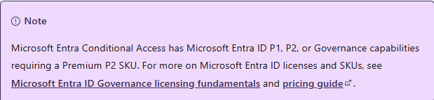
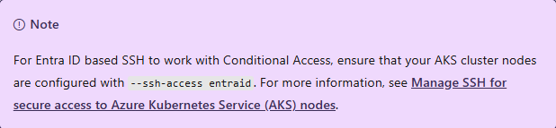
Conditional Access for cluster and node access
When you integrate Microsoft Entra ID with your AKS cluster, you can use Conditional Access to control access to your cluster control plane and cluster nodes.
When you enable Entra ID based SSH access on your AKS cluster nodes, you can apply Conditional Access policies to control SSH access to the nodes. This provides additional security by enforcing device compliance, multifactor authentication, or other conditions before users can SSH into cluster nodes.

Slide 34
DEMO
Conditional Access for cluster and node access
Notes:
src/DDSecurity/1IdentityAndAccess/NodeAccesswithSSH.sh
Reference:
https://learn.microsoft.com/en-us/azure/aks/access-control-managed-azure-ad

Slide 35
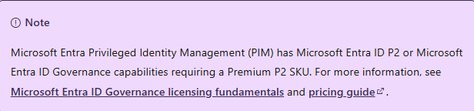
Privileged Identity Management for cluster and node access
When setting up permissions for different teams, you might want to set default permissions for specified teams, then grant privileged access to specific users when needed. Using Azure Kubernetes Service (AKS) with Microsoft Entra ID allows you to set up Privileged Identity Management (PIM) for just-in-time (JIT) requests for both cluster control plane access and SSH access to nodes.

Slide 36
DEMO
Privileged Identity Management for cluster and node access
Notes:
src/DDSecurity/1IdentityAndAccess/PIMforAKS.sh
Reference:
https://learn.microsoft.com/en-us/azure/aks/privileged-identity-management

Slide 37
External identity provider authentication to cluster
Some organizations need to authenticate cluster users with an OIDC-compliant identity provider other than Microsoft Entra ID — for example, GitHub, Google Workspace, Okta, or a self-hosted IdP. AKS supports this through structured authentication, which configures the Kubernetes API server's JWT authenticators to validate tokens issued by your external provider.
Use this option only when you have a hard requirement to keep cluster identity outside Microsoft Entra ID. Otherwise, prefer the Microsoft Entra ID path for richer integration with Conditional Access, multifactor authentication, and Privileged Identity Management.

Slide 38
External identity provider authentication to cluster
Azure Kubernetes Service (AKS) supports structured authentication, which allows you to configure external identity providers for authenticating users to the Kubernetes API server.
This feature is based on the upstream Kubernetes structured authentication configuration. AKS implements this functionality through JSON Web Token (JWT) authenticators that validate tokens from external identity providers according to your configuration.
With structured authentication, organizations can integrate AKS with their existing identity infrastructure beyond Microsoft Entra ID.

Slide 39
External identity provider authentication to cluster
Structured authentication extends AKS beyond traditional Microsoft Entra ID integration by supporting industry-standard OpenID Connect (OIDC) identity providers. This feature allows you to:
Authenticate users with external identity providers like Google, GitHub, or any OIDC-compliant provider.
Maintain centralized identity management across your organization.
Implement custom claim validation and user mapping rules.
Support multiple identity providers simultaneously on a single cluster.

Slide 40
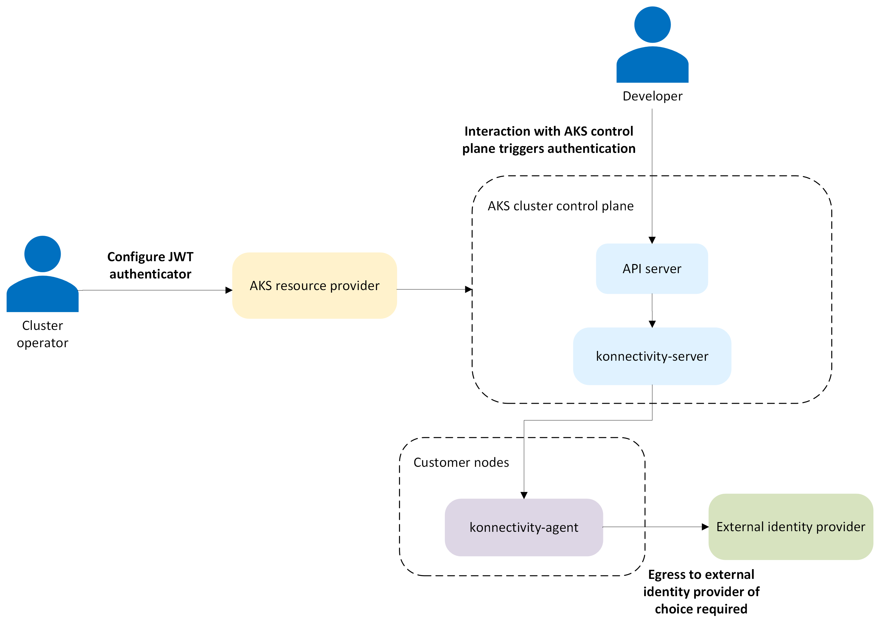
External identity provider authentication flow
Notes:
When a user attempts to access the Kubernetes API server using structured authentication with an external identity provider, the authentication and authorization flow is as follows:
Authentication: The following steps validate the user's identity:
Token presentation: The user presents a JWT token from their configured identity provider.
Token validation: The API server validates the token's signature, issuer, audience, and expiration.
Claim processing: Custom claim validation rules are applied to ensure the token meets your requirements.
User mapping: Claims are mapped to Kubernetes user identity (username, groups, and extra attributes).
Authorization: Standard Kubernetes Role-Based Access Control (RBAC) determines what actions the authenticated user can perform.

Slide 41
External identity provider authentication to cluster
Supported identity providers
GitHub: Authenticate using GitHub identities or GitHub Actions.
Google OAuth 2.0: Use Google accounts for authentication.
Generic OIDC providers: Any provider implementing OIDC standards.
Custom identity solutions: Organization-specific OIDC implementations.
Requirements for external identity providers
Support OIDC standards.
Provide publicly accessible OIDC discovery endpoints.
Issue JWT tokens with appropriate claims.
Be accessible from AKS cluster nodes for token validation.

Slide 42
JWT authenticators for AKS structured authentication
A JWT authenticator is a configuration object that defines how AKS validates and processes tokens from an external identity provider. For example, AKS expects an ID token (JWT) whose aud (audience) claim matches the audience value you configure for the authenticator, such as "my-api", or an OAuth client ID. Each JWT authenticator includes the following components:
Issuer configuration: Specifies the OIDC issuer URL and the expected audience values for tokens.
Claim validation rules: Uses CEL (Common Expression Language) expressions to enforce custom validation logic on token claims.
Claim mappings: Defines how JWT claims are mapped to Kubernetes user attributes such as username, groups, and extra fields.
User validation rules: Applies extra validation logic after claim mapping to further restrict or allow access.

Slide 43
CEL expressions for claim validation and mapping
Structured authentication uses CEL expressions (Common Expression Language) for flexible claim validation and mapping. CEL provides a secure sandbox environment for evaluating custom logic against JWT claims.
// Validate that the 'sub' claim exists
has(claims.sub)
// Map username with AKS prefix
'aks:jwt:' + claims.sub
// Map groups from comma-separated string
claims.groups.split(',').map(g, 'aks:jwt:' + g)
// Conditional mapping based on claim verification
'aks:jwt:' + (claims.email_verified ? claims.email : claims.sub)

Slide 44
Security best practices
Use strong claim validation: Implement comprehensive validation rules to ensure only authorized tokens are accepted.
Limit token scope: Configure your identity provider to issue tokens with minimal necessary claims.
Regular rotation: Rotate client secrets and certificates regularly.
Monitor access: Enable resource logs and turn on kube-apiserver logs to inspect any potential issues with the configured JWT authenticators and track authentication events.
Test configurations: Validate your JWT authenticator configuration in a nonproduction environment first.

Slide 45
Security considerations
Prefix requirements: All usernames and groups mapped through structured authentication must be prefixed with aks:jwt: to prevent conflicts with other authentication methods and system accounts.
Network access: Identity provider endpoints must be accessible from:
  AKS cluster nodes for token validation.
  Client systems for token acquisition.
  Any network paths involved in the authentication flow.
Validation layers: Structured authentication provides multiple validation layers:
  Token signature validation ensures token authenticity.
  Standard claim validation verifies issuer, audience, and expiration.
  Custom claim validation applies your organization's specific requirements.
  User validation final checks after claim mapping.

Slide 46
External identity provider authentication to cluster
lorem

Slide 47
Cluster Authorization

Slide 48
Cluster authorization concepts
lorem

Slide 49
Use Microsoft Entra ID authorization for the Kubernetes API
lorem

Slide 50
Use Kubernetes RBAC with Microsoft Entra Integration
lorem

Slide 51
Cluster Identity

Slide 52
Managed identities overview
lorem

Slide 53
Use a system-assigned managed identity
lorem

Slide 54
Use a user-assigned managed identity
lorem

Slide 55
Use a pre-created kubelet managed identity
lorem

Slide 56
Service principal as cluster identity
lorem

Slide 57
Rotate cluster credentials
lorem

Slide 58
Workload Identity (Pod to Azure)

Slide 59
Workload identity overview
lorem

Slide 60
Create an OIDC issuer for your cluster
lorem

Slide 61
Deploy and configure workload identity for a cluster
lorem

Slide 62
Configure cross-tenant workload identity
lorem

Slide 63
Identity Bindings for scalable workload identity (overview)
lorem

Slide 64
Set up identity bindings for scalable workload identity
lorem

Slide 65
Migrate from pod identity to workload identity
lorem

Slide 66
Microsoft Entra pod identity (legacy)
lorem

Slide 67
Module 2
Cluster Hardening

Slide 68
Cluster Hardening
Cluster security best practices
Control plane access
Certificates
Encryption at rest (KMS etcd)
Node hardening
Policy and governance

Slide 69
Cluster security best practices

Slide 70
Control plane access

Slide 71
Define API server authorized IP ranges
lorem

Slide 72
Use service tags for API server authorized IP ranges
lorem

Slide 73
Trusted Access for Azure services
lorem

Slide 74
Certificates

Slide 75
Manage cluster certificates and rotation
lorem

Slide 76
Custom certificate authorities on nodes
lorem

Slide 77
Encryption at rest (KMS etcd)

Slide 78
KMS encryption at rest of K8s API resources (overview)
lorem

Slide 79
Configure KMS encryption at rest of K8s API resources
lorem

Slide 80
Update key vault mode for legacy KMS
lorem

Slide 81
Migrate to KMS v2 (legacy)
lorem

Slide 82
Migrate to KMS with platform-managed or customer-managed keys
lorem

Slide 83
KMS observability (legacy)
lorem

Slide 84
Use KMS etcd encryption (legacy)
lorem

Slide 85
Node hardening

Slide 86
Encrypt Azure managed disks using customer-managed keys
lorem

Slide 87
Host-based encryption
lorem

Slide 88
FIPS-compliant node pools
lorem

Slide 89
Azure dedicated Hosts for AKS nodes
lorem

Slide 90
Restrict access to IMDS
lorem

Slide 91
Policy and governance

Slide 92
Enforce compliance with Azure Policy
lorem

Slide 93
Azure Policy for Kubernetes (concepts)
lorem

Slide 94
Enforce best practices with deployment safeguards
lorem

Slide 95
Security controls by Azure Policy
lorem

Slide 96
Module 3
Workload Hardening

Slide 97
Workload Hardening
Pod Security
Pod Sandboxing
Network Policies
Secrets Management

Slide 98
Pod Security

Slide 99
Pod Security Best Practices
lorem

Slide 100
Pod Security Admission
lorem

Slide 101
Pod security policies (legacy)
lorem

Slide 102
Container privilege hardening (Linux)
lorem

Slide 103
Pod Sandboxing

Slide 104
Pod Sandboxing overview
lorem

Slide 105
Pod Sandboxing considerations
lorem

Slide 106
Deploy Pod Sandboxing
lorem

Slide 107
Network Policies

Slide 108
Secure pod traffic with network policies
lorem

Slide 109
Network policy best practices
lorem

Slide 110
Use network policies in the Azure portal
lorem

Slide 111
Secrets Management

Slide 112
Serve NGINX TLS certs from Key Vault
lorem

Slide 113
Configure the Azure Key Vault provider for Secrets Store CSI Driver
lorem

Slide 114
Provide access to Azure Key Vault from Secrets Store CSI Driver
lorem

Slide 115
Configure and troubleshoot the Azure Key Vault provider for Secrets Store CSI Driver
lorem

Slide 116
Module 4
Confidential Workloads

Slide 117
Confidential Wworkloads
Confidential VM nodes
Confidential containers

Slide 118
Confidential VM nodes

Slide 119
Confidential containers

Slide 120
Confidential Containers (preview)
lorem

Slide 121
Deploy with default policy
lorem

Slide 122
Confidential Containers security policy
lorem

Slide 123
Module 5
Vulnerability Management

Slide 124
Vulnerability Management
Vulnerability management

Slide 125
Vulnerability management

Slide 126
Vulnerability management overview
lorem

Slide 127
Subscribe to AKS security bulletins
lorem

Slide 128
Container image management best practices
lorem

Slide 129
Remove vulnerable images with Image Cleaner
lorem

Slide 130
Build and registry time scanning
lorem

Slide 131
Scan images in your CI/CD workflow
lorem

Slide 132
Scan container images for vulnerabilities
lorem

Slide 133
Cluster-side scanning and enforcement
lorem

Slide 134
Scan AKS nodes for vulnerabilities
lorem

Slide 135
Gate workload deployment on vulnerability metadata
lorem

Slide 136
Module 6
Supply Chain Security

Slide 137
Supply Chain Security
Verify signed container images at deploy time

Slide 138
Module 7
Threat Detection and Response

Slide 139
Threat Detection and Response
Container threat protection overview
Runtime alerts for Kubernetes clusters
Detect binary drift in running containers

Slide 140
Module 8
Compliance and Benchmarks

Slide 141
Compliance and Benchmarks
Center for Internet Security (CIS) benchmarks
Payment Card Industry Data Security Standard (PCI DSS)

Slide 142
AKS Security

Slide 143
Security Vulnerability Management
Vulnerability management involves detecting, assessing, mitigating, and reporting on any security vulnerabilities that exist in an organization's systems and software.
Vulnerability management is a shared responsibility between you and Microsoft.

Slide 144
Finding and Fixing Vulnerabilities
Microsoft identifies and patches vulnerabilities and missing security updates for the following components:
AKS Container Images
Windows Server worker nodes
Ubuntu operating system
Azure Linux OS
Nodes

Slide 145
AKS Container Images
Microsoft takes responsibility for building the open-source packages that is deployed on AKS
Microsoft is active in the broader Kubernetes ecosystem
Microsoft scans container images
Microsoft discovers and updates vulnerabilities unknown to scanners
Notes:
Check the same title in https://learn.microsoft.com/en-us/azure/aks/concepts-vulnerability-management for the details

Slide 146
Security Vulnerability Management
Worker Nodes
Linux Nodes
Windows Server Nodes
Notes:
Check https://learn.microsoft.com/en-us/azure/aks/concepts-vulnerability-management#worker-nodes for the details

Slide 147
Vulnerability Classification
Severity | Description
Critical | A vulnerability easily exploitable in all clusters by an unauthenticated remote attacker that leads to full system compromise.
High | A vulnerability easily exploitable for many clusters that leads to loss of confidentiality, integrity, or availability.
Medium | A vulnerability exploitable for some clusters where loss of confidentiality, integrity, or availability is limited by common configurations, difficulty of the exploit itself, required access, or user interaction.
Low | All other vulnerabilities. Exploitation is unlikely or consequences of exploitation are limited.
Kubernetes vulnerability scoring system
Notes:
Check https://learn.microsoft.com/en-us/azure/aks/concepts-vulnerability-management#how-vulnerabilities-are-classified for the details

Slide 148
Security Baseline
lorem
Notes:
Introduction - Kubernetes CSI Developer Documentation

Slide 149
Confidential Containers Security Policy
As described by the Confidential Computing Consortium (CCC),
"Confidential Computing is the protection of data in use by performing computation in a hardware-based, attested Trusted Execution Environment (TEE)."
AKS Confidential Containers are designed to protect Kubernetes pods data in use from unauthorized access from outside of these pods. Each pod is executed in a Utility VM (UVM) protected by the AMD SEV-SNP TEE by encrypting data in use and prevent access to the data by the Host Operating System (OS).
Microsoft engineers collaborated with the Confidential Containers (CoCo) and Kata Containers open-source communities on the design and implementation of the Confidential Containers.
Notes:
Introduction - Kubernetes CSI Developer Documentation

Slide 150
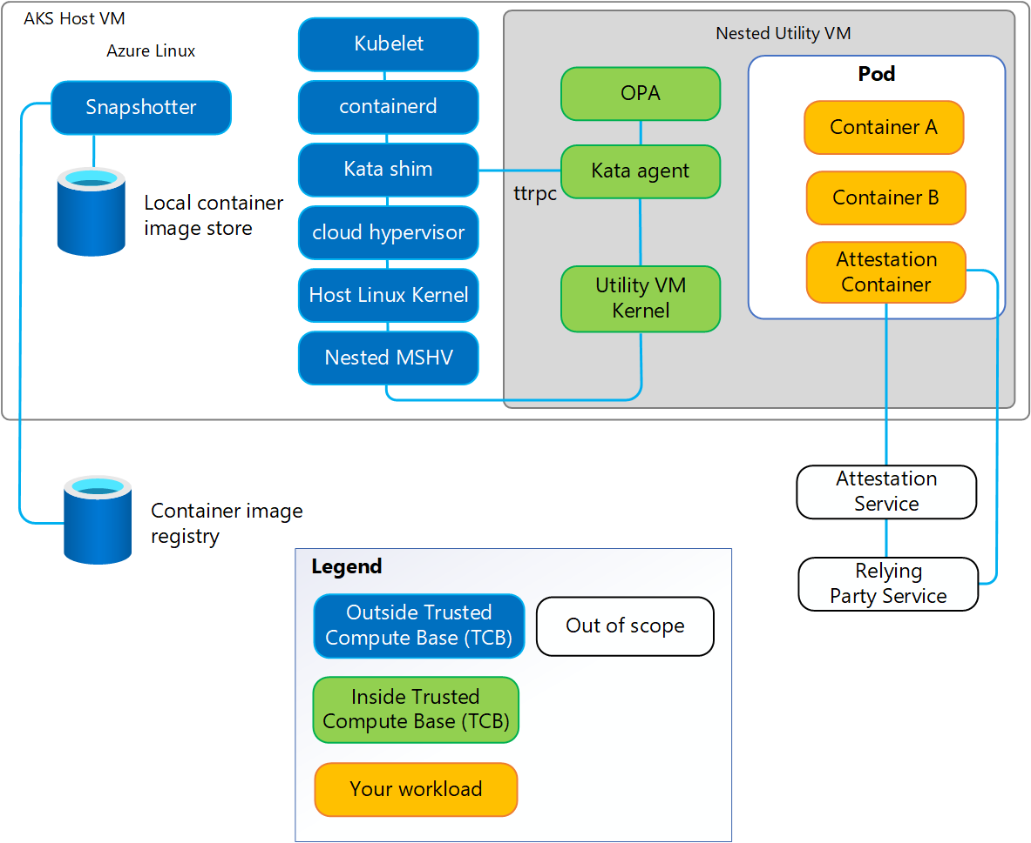
Confidential Containers Security Policy
Notes:
https://learn.microsoft.com/en-us/azure/confidential-computing/confidential-containers-aks-security-policy?toc=%2Fazure%2Faks%2Ftoc.json&bc=%2Fazure%2Faks%2Fbreadcrumb%2Ftoc.json#security-policy-overview
One of the main components of the Kata Containers system architecture is the Kata agent.
When using Kata Containers to implement Confidential Containers, the agent is executed inside the hardware-based TEE and therefore is part of the pod's Trusted Computing Base (TCB). As shown in the diagram, the Kata agent provides a set of ttrpc APIs allowing the system components outside of the TEE to create and manage Confidential-based Kubernetes pods. These other components (for example, the Kata Shim) aren't part of the pod's TCB. Therefore, the agent must protect itself from potentially buggy or malicious API calls.
In AKS Confidential Containers, the Kata agent API self-protection is implemented using a security policy (also known as the Kata Agent Policy), specified by the owners of the confidential pods. The policy document contains rules and data corresponding to each pod, using the industry standard Rego policy language. The enforcement of the policy inside the Utility VM (UVM) is implemented using the Open Policy Agent (OPA) – a graduated project of the Cloud Native Computing Foundation (CNCF).

Slide 151
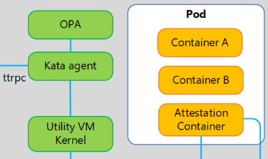
Policy
Contents
The security policy describes all the calls to agent’s ttrpc APIs (and the parameters of these API calls) that are expected for creating and managing the Confidential pod.
The policy document of each pod is a text file, using the Rego language.
Data
Rules
Default values
Notes:
https://learn.microsoft.com/en-us/azure/confidential-computing/confidential-containers-aks-security-policy?toc=%2Fazure%2Faks%2Ftoc.json&bc=%2Fazure%2Faks%2Fbreadcrumb%2Ftoc.json#policy-contents

Slide 152
DEMO
Rego Policy Language

Slide 153
Security Controls by Azure Policy
lorem
Notes:
Introduction - Kubernetes CSI Developer Documentation

Slide 154
Container Security

Slide 155
Defender for Containers Overview
Microsoft Defender for Containers is a cloud-native solution that enhances, monitors, and maintains the security of your containerized assets.
These assets include Kubernetes clusters, nodes, workloads, registries, images, and more. It protects applications across multicloud and on-premises environments.

Slide 156
5 Core Domains of Container Security
Security posture management
Vulnerability assessment
Run-time threat protection
Containers software supply chain protection
Deployment & monitoring
Notes:
Explain the content in https://learn.microsoft.com/en-us/azure/defender-for-cloud/defender-for-containers-introduction
https://learn.microsoft.com/en-us/azure/defender-for-cloud/defender-for-containers-introduction?toc=%2Fazure%2Faks%2Ftoc.json&bc=%2Fazure%2Faks%2Fbreadcrumb%2Ftoc.json

Slide 157
DEMO
Deploy Defender for Containers Deployment Overview
Notes:
Manually setup Defender for AKS via Azure Portal
AKSDeepDive\src\DDSecurity\ContainerSecurity\checkDefenderSetup.sh
AKSDeepDive\src\DDSecurity\KubernetesAlertSimulator\simulate.sh
https://learn.microsoft.com/en-us/azure/defender-for-cloud/alerts-containers#install-the-simulation-tool

Slide 158
Confidential Containers Overview
The Confidential Containers preview is set to sunset in March 2026. After this date, customers with existing Confidential Container node pools should expect to see reduced functionality, and you won't be able to spin up any new nodes with the KataCcIsolation runtime. Customers currently using Confidential Container node pools can continue using them as normal. If you want to move off Confidential Containers, consider the following alternatives:
Confidential VMs on AKS: Offers a similar hardware-based TEE that leverages AMD SEV-SNP security features, without the addition of per-VM isolation for workloads seen in Confidential Containers.
Application enclave support: Provides users with Intel SGX confidential computing VM nodes that support hardware-based, process-level container isolation through the Intel SGX trusted execution environment.
Notes:
https://learn.microsoft.com/en-us/azure/confidential-computing/confidential-node-pool-aks
https://techcommunity.microsoft.com/blog/azureconfidentialcomputingblog/amd-sev-snp-confidential-vm-nodes-are-now-generally-available-in-aks/3649065
https://github.com/Azure/confidential-computing-cvm-guest-attestation/blob/main/aks-linux-sample/README.md
https://youtu.be/mkCSGGNtwmc
In the context of a Trusted Execution Environment (TEE), attest means:
To cryptographically prove that a piece of code is running inside a genuine, untampered secure environment.
It is essentially a verifiable proof of trust.
🔐 What Is a Trusted Execution Environment (TEE)?
A TEE is a secure area of a processor that:
Isolated from the normal OS
Protects code and data from the host system
Prevents tampering—even by admins or hypervisors
Examples:
Intel SGX
AMD SEV-SNP
ARM TrustZone
Azure Confidential Computing
🧠 What “Attestation” Actually Means
Attestation answers this question:
"How do I know this code is really running inside a secure enclave and hasn't been modified?"
It works using:
Measurement (hash of code + configuration)
Signing by hardware root of trust
Verification by a remote party
🔎 Two Types of Attestation
1️⃣ Local Attestation
One enclave verifies another enclave on the same machine
2️⃣ Remote Attestation (Most Important in Cloud)
A remote service verifies the TEE
Used heavily in cloud confidential computing
🔄 Simplified Remote Attestation Flow
Workload starts inside TEE
Hardware calculates cryptographic measurement
Hardware signs it
Proof (attestation report) is sent to verifier
Verifier checks signature + measurement
If valid → secrets are released
No valid attestation → no secrets.
🏗 Why This Matters (Especially in Cloud / AKS Context)
Since you're working with Azure, AKS, and secure workloads:
Attestation is critical for:
Confidential Containers
Protecting AI models
Secure key release
Zero-trust compute
Preventing host compromise attacks
For example:
Microsoft Azure Attestation verifies TEE claims.
Confidential Containers use attestation before injecting secrets.
🔐 Real-World Example
Imagine:
You deploy a sensitive AI model to a confidential VM.
Before sending the model encryption key:
You require attestation proof
You verify the measurement
Only then release the key
This ensures:
Cloud provider admins cannot inspect it
Hypervisor compromise cannot access it
Root access on host cannot dump memory
🧩 In One Sentence
Attestation is the cryptographic proof that code is running in a genuine, untampered Trusted Execution Environment.

Slide 159
Confidential Containers Overview
Confidential Containers on Azure Container Instances: Allows for lift-and-shift deployments on containers backed by AMD SEV-SNP. Functionality includes performing full guest attestation, access to toolings to generate policies, and utilizing sidecar containers for secure key releases. ACI nodes can be run on AKS via virtual nodes.
Azure RedHat OpenShift Confidential Containers: Offers a similar AMD SEV-SNP backed TEE and utilizes the Kata runtime for per-container level isolation.
Open source Confidential Containers: Gives a similar AMD SEV-SNP backed TEE that comes with per-container isolation through Kata.
Notes:
https://learn.microsoft.com/en-us/azure/confidential-computing/confidential-node-pool-aks
https://techcommunity.microsoft.com/blog/azureconfidentialcomputingblog/amd-sev-snp-confidential-vm-nodes-are-now-generally-available-in-aks/3649065
https://github.com/Azure/confidential-computing-cvm-guest-attestation/blob/main/aks-linux-sample/README.md
https://youtu.be/mkCSGGNtwmc
In the context of a Trusted Execution Environment (TEE), attest means:
To cryptographically prove that a piece of code is running inside a genuine, untampered secure environment.
It is essentially a verifiable proof of trust.
🔐 What Is a Trusted Execution Environment (TEE)?
A TEE is a secure area of a processor that:
Isolated from the normal OS
Protects code and data from the host system
Prevents tampering—even by admins or hypervisors
Examples:
Intel SGX
AMD SEV-SNP
ARM TrustZone
Azure Confidential Computing
🧠 What “Attestation” Actually Means
Attestation answers this question:
"How do I know this code is really running inside a secure enclave and hasn't been modified?"
It works using:
Measurement (hash of code + configuration)
Signing by hardware root of trust
Verification by a remote party
🔎 Two Types of Attestation
1️⃣ Local Attestation
One enclave verifies another enclave on the same machine
2️⃣ Remote Attestation (Most Important in Cloud)
A remote service verifies the TEE
Used heavily in cloud confidential computing
🔄 Simplified Remote Attestation Flow
Workload starts inside TEE
Hardware calculates cryptographic measurement
Hardware signs it
Proof (attestation report) is sent to verifier
Verifier checks signature + measurement
If valid → secrets are released
No valid attestation → no secrets.
🏗 Why This Matters (Especially in Cloud / AKS Context)
Since you're working with Azure, AKS, and secure workloads:
Attestation is critical for:
Confidential Containers
Protecting AI models
Secure key release
Zero-trust compute
Preventing host compromise attacks
For example:
Microsoft Azure Attestation verifies TEE claims.
Confidential Containers use attestation before injecting secrets.
🔐 Real-World Example
Imagine:
You deploy a sensitive AI model to a confidential VM.
Before sending the model encryption key:
You require attestation proof
You verify the measurement
Only then release the key
This ensures:
Cloud provider admins cannot inspect it
Hypervisor compromise cannot access it
Root access on host cannot dump memory
🧩 In One Sentence
Attestation is the cryptographic proof that code is running in a genuine, untampered Trusted Execution Environment.

Slide 160
Confidential Computing
Quickstart: Deploy an AKS cluster with confidential computing Intel SGX agent nodes by using the Azure CLI
https://learn.microsoft.com/en-us/azure/confidential-computing/confidential-enclave-nodes-aks-get-started
Enclave Aware Containers with Intel SGX
https://learn.microsoft.com/en-us/azure/confidential-computing/enclave-aware-containers
Confidential computing plugin for Confidential VMs
https://learn.microsoft.com/en-us/azure/confidential-computing/confidential-nodes-aks-addon
AMD SEV-SNP confidential VM nodes are now generally available in AKS
https://techcommunity.microsoft.com/blog/azureconfidentialcomputingblog/amd-sev-snp-confidential-vm-nodes-are-now-generally-available-in-aks/3649065
Application enclaves
https://learn.microsoft.com/en-us/azure/confidential-computing/application-development

Slide 161
Confidential VM node pool support on AKS with AMD SEV-SNP confidential VMs
AKS now supports confidential VM node pools with Azure confidential VMs. These confidential VMs are the generally available DCasv5 and ECasv5 confidential VM-series utilizing 3rd Gen AMD EPYCTM processors with Secure Encrypted Virtualization-Secure Nested Paging (SEV-SNP) security features.
Notes:
https://learn.microsoft.com/en-us/azure/confidential-computing/confidential-node-pool-aks
https://techcommunity.microsoft.com/blog/azureconfidentialcomputingblog/amd-sev-snp-confidential-vm-nodes-are-now-generally-available-in-aks/3649065
https://github.com/Azure/confidential-computing-cvm-guest-attestation/blob/main/aks-linux-sample/README.md
https://youtu.be/mkCSGGNtwmc
In the context of a Trusted Execution Environment (TEE), attest means:
To cryptographically prove that a piece of code is running inside a genuine, untampered secure environment.
It is essentially a verifiable proof of trust.
🔐 What Is a Trusted Execution Environment (TEE)?
A TEE is a secure area of a processor that:
Isolated from the normal OS
Protects code and data from the host system
Prevents tampering—even by admins or hypervisors
Examples:
Intel SGX
AMD SEV-SNP
ARM TrustZone
Azure Confidential Computing
🧠 What “Attestation” Actually Means
Attestation answers this question:
"How do I know this code is really running inside a secure enclave and hasn't been modified?"
It works using:
Measurement (hash of code + configuration)
Signing by hardware root of trust
Verification by a remote party
🔎 Two Types of Attestation
1️⃣ Local Attestation
One enclave verifies another enclave on the same machine
2️⃣ Remote Attestation (Most Important in Cloud)
A remote service verifies the TEE
Used heavily in cloud confidential computing
🔄 Simplified Remote Attestation Flow
Workload starts inside TEE
Hardware calculates cryptographic measurement
Hardware signs it
Proof (attestation report) is sent to verifier
Verifier checks signature + measurement
If valid → secrets are released
No valid attestation → no secrets.
🏗 Why This Matters (Especially in Cloud / AKS Context)
Since you're working with Azure, AKS, and secure workloads:
Attestation is critical for:
Confidential Containers
Protecting AI models
Secure key release
Zero-trust compute
Preventing host compromise attacks
For example:
Microsoft Azure Attestation verifies TEE claims.
Confidential Containers use attestation before injecting secrets.
🔐 Real-World Example
Imagine:
You deploy a sensitive AI model to a confidential VM.
Before sending the model encryption key:
You require attestation proof
You verify the measurement
Only then release the key
This ensures:
Cloud provider admins cannot inspect it
Hypervisor compromise cannot access it
Root access on host cannot dump memory
🧩 In One Sentence
Attestation is the cryptographic proof that code is running in a genuine, untampered Trusted Execution Environment.

Slide 162
Application enclave support with Intel SGX based confidential computing nodes on AKS
Azure Kubernetes Service (AKS) supports adding Intel SGX confidential computing VM nodes as agent pools in a cluster.
These nodes allow you to run sensitive workloads within a hardware-based TEE. TEEs allow user-level code from containers to allocate private regions of memory to execute the code with CPU directly.
These private memory regions that execute directly with CPU are called enclaves. Enclaves help protect the data confidentiality, data integrity and code integrity from other processes running on the same nodes, as well as Azure operator.
Notes:
https://www.youtube.com/watch?v=FYZxtHI_Or0
https://learn.microsoft.com/en-us/azure/confidential-computing/confidential-nodes-aks-overview

Slide 163
Application enclave support with Intel SGX based confidential computing nodes on AKS
The Intel SGX execution model also removes the intermediate layers of Guest OS, Host OS and Hypervisor thus reducing the attack surface area.
The hardware based per container isolated execution model in a node allows applications to directly execute with the CPU, while keeping the special block of memory encrypted per container.
Confidential computing nodes with confidential containers are a great addition to your zero-trust, security planning and defense-in-depth container strategy.
Notes:
https://www.youtube.com/watch?v=FYZxtHI_Or0
https://learn.microsoft.com/en-us/azure/confidential-computing/confidential-nodes-aks-overview

Slide 164
DEMO
Intel SGX Demo

Slide 165
DEMO
AMD SVE-SNP Demo

Slide 166
Image Security

Slide 167
Container Image Management Best Practices
Container and container image security is a major priority when developing and running applications in Azure Kubernetes Service (AKS).
Containers with outdated base images or unpatched application runtimes introduce security risks and possible attack vectors.
You can minimize these risks by integrating and running scan and remediation tools in your containers at build and runtime.
The earlier you catch the vulnerability or outdated base image, the more secure your application is.
Notes:
https://learn.microsoft.com/en-us/azure/aks/operator-best-practices-container-image-management

Slide 168
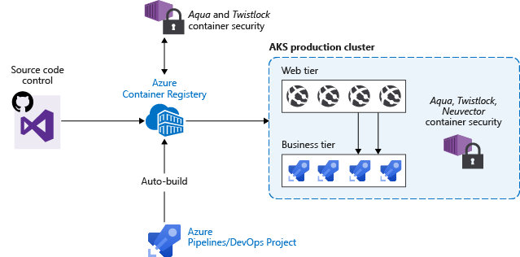
Secure the Images and Runtime
Best Practice
Scan your container images for vulnerabilities.
Only deploy validated images.
Regularly update the base images and application runtime.
Redeploy workloads in the AKS cluster.
Notes:
https://learn.microsoft.com/en-us/azure/aks/operator-best-practices-container-image-management

Slide 169
Secure the Images and Runtime
Best Practice
Scan your container images for vulnerabilities.
Only deploy validated images.
Regularly update the base images and application runtime.
Redeploy workloads in the AKS cluster.
Notes:
https://learn.microsoft.com/en-us/azure/aks/operator-best-practices-container-image-management

Slide 170
Automatically build new images on base image update
Best Practice
As you use base images for application images, use automation to build new images when the base image is updated.
Since updated base images typically include security fixes, update any downstream application container images.
Integrate this build process into validation and deployment pipelines such as Azure Pipelines or Jenkins.
These pipelines ensure your applications continue to run on the updated based images.
Once your application container images are validated, you can then update AKS deployments to run the latest secure images.
Azure Container Registry Tasks can also automatically update container images when the base image is updated.
With this feature, you build a few base images and keep them updated with bug and security fixes.
Notes:
Introduction - Kubernetes CSI Developer Documentation

Slide 171
Validate Signed Images with Image Integrity
Using signed container images helps verify that your deployments are built from a trusted entity and that images haven't been tampered with since their creation.
Image Integrity is a service that allows you to add an Azure Policy built-in definition to verify that only signed images are deployed to your AKS clusters.
Image Integrity is a feature based on Ratify. On an AKS cluster, the feature name and property name is ImageIntegrity, while the relevant Image Integrity pods' names contain Ratify.
Notes:
https://learn.microsoft.com/en-us/azure/aks/image-integrity?tabs=azure-cli

Slide 172
Validate Signed Images with Image Integrity
Using signed container images helps verify that your deployments are built from a trusted entity and that images haven't been tampered with since their creation.
Image Integrity is a service that allows you to add an Azure Policy built-in definition to verify that only signed images are deployed to your AKS clusters.
Image Integrity is a feature based on Ratify. On an AKS cluster, the feature name and property name is ImageIntegrity, while the relevant Image Integrity pods' names contain Ratify.
Notes:
https://learn.microsoft.com/en-us/azure/aks/image-integrity?tabs=azure-cli
In Kubernetes, Gatekeeper is a policy enforcement engine that ensures your cluster follows defined security and compliance rules.
More precisely:
Gatekeeper is an admission controller that enforces policies using Open Policy Agent (OPA).
🧠 What Problem Does Gatekeeper Solve?
Kubernetes by default allows almost anything unless restricted.
For example, without policy enforcement, someone could:
Deploy a privileged container
Run as root
Use latest image tags
Expose a LoadBalancer publicly
Mount host paths
Gatekeeper prevents this by validating resources before they are created.
🏗 How It Works
Gatekeeper runs as a validating admission webhook.
When you run:
kubectl apply -f deployment.yaml
Flow:
API Server receives request
Gatekeeper intercepts it
Policy is evaluated
If policy passes → resource created
If policy fails → request rejected
🔧 Technology Behind It
Gatekeeper uses:
Open Policy Agent (OPA)
Rego policy language
Kubernetes admission controller mechanism
📦 Gatekeeper Components
ConstraintTemplate
Defines reusable policy logic (written in Rego)
Constraint
Applies that template to specific resources
📌 Example Use Cases
🚫 Block Privileged Containers
Policy:
violation {
input.review.object.spec.containers[_].securityContext.privileged == true
}
Result:
If someone tries to deploy a privileged pod → rejected.
🏷 Require Labels
Enforce:
All resources must have owner
Must have environment
Must follow naming conventions
🔐 Enforce Security Standards
Prevent hostPath mounts
Disallow latest tag
Require resource limits
Enforce Pod Security Standards
🏢 In Enterprise / AKS Context
Since you work heavily with AKS and governance:
Gatekeeper is commonly used for:
Azure policy integration
Enterprise governance
Multi-team cluster control
Regulated environments (finance, healthcare)
In AKS specifically, Azure Policy for Kubernetes integrates with Gatekeeper under the hood.
🔄 Gatekeeper vs Alternatives
ToolPurposeGatekeeperOPA-based policy enforcementKyvernoNative Kubernetes policy engine (no Rego)Pod Security AdmissionBuilt-in basic pod security
🧩 In One Sentence
Gatekeeper is a Kubernetes admission controller that enforces custom policies using Open Policy Agent before resources are admitted into the cluster.
If you’d like, I can also:
Show a minimal AKS + Gatekeeper setup
Compare Gatekeeper vs Kyverno deeply
Or show how Azure Policy uses Gatekeeper internally

Slide 173
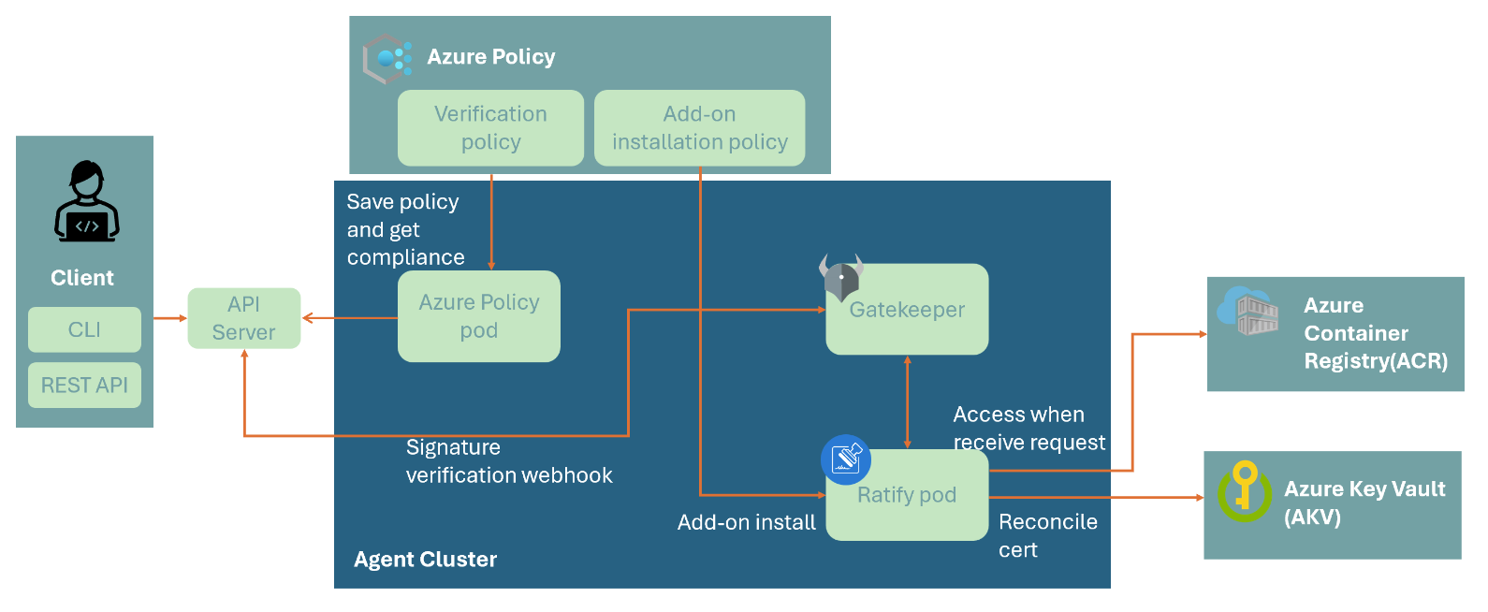
How Image Integrity works?
Notes:
https://learn.microsoft.com/en-us/azure/aks/image-integrity?tabs=azure-cli
Image Integrity uses Ratify, Azure Policy, and Gatekeeper to validate signed images before deploying them to your AKS clusters. Enabling Image Integrity on your cluster deploys a Ratify pod.
This Ratify pod performs the following tasks:
1. Reconciles certificates from Azure Key Vault per the configuration you set up through Ratify CRDs.
2. Accesses images stored in ACR when validation requests come from Azure Policy. To enable this experience, Azure Policy extends Gatekeeper, an admission controller webhook for Open Policy Agent (OPA).
3. Determines whether the target image is signed with a trusted cert and therefore considered as trusted.
4. AzurePolicy and Gatekeeper consume the validation results as the compliance state to decide whether to allow the deployment request.
If you mean AKS’s built-in “ImageIntegrity” add-on (the thing that deploys a Ratify pod and wires into Azure Policy/Gatekeeper), then no — you should not use that specific feature for production ACR registries or production workloads right now, because Microsoft documents it as Preview and explicitly says you shouldn’t use it for production ACR registries or workloads. (Microsoft Learn)
What is safe for production?
✅ Production-safe pattern: Ratify (as a normal Kubernetes component) + policy enforcement
Microsoft has guidance for validating container image signatures with Ratify + Azure Policy, where you install Ratify (e.g., Helm) and then use Azure Policy with either Audit or Deny effects. That approach is described as a “secure supply chain” scenario and supports a real enforcement mode (Deny) for blocking unsigned/untrusted images. (Microsoft Learn)
So the practical answer is:
Don’t use the AKS “ImageIntegrity” add-on (Preview) for production. (Microsoft Learn)
Do use image signing + signature verification in production, but implement it using the supported supply-chain approach (Ratify + Notation + Azure Policy / Gatekeeper), starting in Audit and graduating to Deny once you’re confident. (Microsoft Learn)
Why Microsoft says “don’t use ImageIntegrity preview” in prod
The AKS ImageIntegrity doc lists concrete limitations, including:
It’s Preview
Audit is the only supported verification policy effect (in that add-on experience)
Other limits like max signature count and verifier constraints (Microsoft Learn)
That combination is usually why it’s positioned as non-production today.
Recommended rollout approach (what teams actually do)
Sign images (Notation + Key Vault / Trusted Signing) as part of CI/CD. (Microsoft Learn)
Deploy Ratify + Gatekeeper to the cluster (or your platform baseline). (ratify.dev)
Start with Audit for a while (observe what would break). (Microsoft Learn)
Move to Deny for key namespaces/workloads once clean. (Microsoft Learn)
If you tell me whether your enforcement target is AKS (admission-time) or ACR (registry governance) and whether you’re using Notation/Notary v2, I can outline the exact production architecture (including identity, AKV/Trusted Signing, and policy scoping) in a few concrete steps.

Slide 174
Image Integrity: Considerations and Limitations
Your AKS clusters must run Kubernetes version 1.26 or above.
You shouldn't use this feature for production Azure Container Registry (ACR) registries or workloads.
Image Integrity supports a maximum of 200 unique signatures concurrently cluster-wide.
Notation is the only supported verifier.
Audit is the only supported verification policy effect.
Notes:
https://learn.microsoft.com/en-us/azure/aks/image-integrity?tabs=azure-cli
If you mean AKS’s built-in “ImageIntegrity” add-on (the thing that deploys a Ratify pod and wires into Azure Policy/Gatekeeper), then no — you should not use that specific feature for production ACR registries or production workloads right now, because Microsoft documents it as Preview and explicitly says you shouldn’t use it for production ACR registries or workloads. (Microsoft Learn)
What is safe for production?
✅ Production-safe pattern: Ratify (as a normal Kubernetes component) + policy enforcement
Microsoft has guidance for validating container image signatures with Ratify + Azure Policy, where you install Ratify (e.g., Helm) and then use Azure Policy with either Audit or Deny effects. That approach is described as a “secure supply chain” scenario and supports a real enforcement mode (Deny) for blocking unsigned/untrusted images. (Microsoft Learn)
So the practical answer is:
Don’t use the AKS “ImageIntegrity” add-on (Preview) for production. (Microsoft Learn)
Do use image signing + signature verification in production, but implement it using the supported supply-chain approach (Ratify + Notation + Azure Policy / Gatekeeper), starting in Audit and graduating to Deny once you’re confident. (Microsoft Learn)
Why Microsoft says “don’t use ImageIntegrity preview” in prod
The AKS ImageIntegrity doc lists concrete limitations, including:
It’s Preview
Audit is the only supported verification policy effect (in that add-on experience)
Other limits like max signature count and verifier constraints (Microsoft Learn)
That combination is usually why it’s positioned as non-production today.
Recommended rollout approach (what teams actually do)
Sign images (Notation + Key Vault / Trusted Signing) as part of CI/CD. (Microsoft Learn)
Deploy Ratify + Gatekeeper to the cluster (or your platform baseline). (ratify.dev)
Start with Audit for a while (observe what would break). (Microsoft Learn)
Move to Deny for key namespaces/workloads once clean. (Microsoft Learn)
If you tell me whether your enforcement target is AKS (admission-time) or ACR (registry governance) and whether you’re using Notation/Notary v2, I can outline the exact production architecture (including identity, AKV/Trusted Signing, and policy scoping) in a few concrete steps.

Slide 175
DEMO
Validate Signed Images with Image Integrity

Slide 176
Remove Vulnerable Images with ImageCleaner
lorem
Notes:
Introduction - Kubernetes CSI Developer Documentation

Slide 177
DEMO
Remove Vulnerable Images with ImageCleaner

Slide 178
Scan Images in your CI/CD Workflow
lorem
Notes:
Introduction - Kubernetes CSI Developer Documentation

Slide 179
Scan images in ACR Registries
lorem
Notes:
Introduction - Kubernetes CSI Developer Documentation

Slide 180
Cluster Security

Slide 181
Cluster Security Best Practices
lorem
Notes:
Introduction - Kubernetes CSI Developer Documentation

Slide 182
Azure kubelogin
lorem
Notes:
Introduction - Kubernetes CSI Developer Documentation

Slide 183
DEMO
Azure kubelogin

Slide 184
Managed Identities - Overview
lorem
Notes:
Introduction - Kubernetes CSI Developer Documentation

Slide 185
Enable a Managed Identity on your Cluster
lorem
Notes:
Introduction - Kubernetes CSI Developer Documentation

Slide 186
DEMO
Enable a Managed Identity on your Cluster

Slide 187
Create a Service Principal
lorem
Notes:
Introduction - Kubernetes CSI Developer Documentation

Slide 188
DEMO
Create a Service Principal

Slide 189
Enable access to AKS clusters using Trusted Access
lorem
Notes:
Introduction - Kubernetes CSI Developer Documentation

Slide 190
DEMO
Enable access to AKS clusters using Trusted Access

Slide 191
Limit access to cluster configuration file
lorem
Notes:
Introduction - Kubernetes CSI Developer Documentation

Slide 192
DEMO
Limit access to cluster configuration file

Slide 193
Define API server authorized IP ranges
lorem
Notes:
Introduction - Kubernetes CSI Developer Documentation

Slide 194
DEMO
Define API server authorized IP ranges

Slide 195
Use service tags for API server authorized IP ranges in AKS
lorem
Notes:
Introduction - Kubernetes CSI Developer Documentation

Slide 196
DEMO
Use service tags for API server authorized IP ranges in AKS

Slide 197
Manage Cluster Certificates and Rotation
lorem
Notes:
Introduction - Kubernetes CSI Developer Documentation

Slide 198
DEMO
Manage Cluster Certificates and Rotation

Slide 199
Use Custom Certificate Authorities
lorem
Notes:
Introduction - Kubernetes CSI Developer Documentation

Slide 200
DEMO
Use custom certificate authorities

Slide 201
Use Azure Policy
lorem
Notes:
Introduction - Kubernetes CSI Developer Documentation

Slide 202
DEMO
Use Azure Policy

Slide 203
Control Deployments with Azure Policy
lorem
Notes:
Introduction - Kubernetes CSI Developer Documentation

Slide 204
DEMO
Control Deployments with Azure Policy

Slide 205
Enforce Best Practices with Deployment Safeguards
lorem
Notes:
Introduction - Kubernetes CSI Developer Documentation

Slide 206
DEMO
Enforce Best Practices with Deployment Safeguards

Slide 207
Create an OIDC Issuer for your Cluster
lorem
Notes:
Introduction - Kubernetes CSI Developer Documentation

Slide 208
DEMO
Create an OIDC Issuer for your Cluster

Slide 209
Create an OIDC Issuer for your Cluster
lorem
Notes:
Introduction - Kubernetes CSI Developer Documentation

Slide 210
DEMO
Create an OIDC Issuer for your Cluster

Slide 211
Enable KMS Data Encryption in AKS
lorem
Notes:
Introduction - Kubernetes CSI Developer Documentation

Slide 212
DEMO
Enable KMS Data Encryption in AKS

Slide 213
Use KMS etcd Encryption (legacy)
lorem
Notes:
Introduction - Kubernetes CSI Developer Documentation

Slide 214
DEMO
Use KMS etcd Encryption (legacy)

Slide 215
Update Key Vault Mode
lorem
Notes:
Introduction - Kubernetes CSI Developer Documentation

Slide 216
DEMO
Update Key Vault Mode

Slide 217
Migrate to KMS v2
lorem
Notes:
Introduction - Kubernetes CSI Developer Documentation

Slide 218
DEMO
Migrate to KMS v2

Slide 219
Observability for KMS etcd Encryption
lorem
Notes:
Introduction - Kubernetes CSI Developer Documentation

Slide 220
DEMO
Observability for KMS etcd Encryption

Slide 221
Migrate to KMS with platform-managed or customer-managed keys
lorem
Notes:
Introduction - Kubernetes CSI Developer Documentation

Slide 222
DEMO
Migrate to KMS with platform-managed or customer-managed keys

Slide 223
Secure Container Access to Resources
lorem
Notes:
Introduction - Kubernetes CSI Developer Documentation

Slide 224
DEMO
Secure Container Access to Resources

Slide 225
Node Security

Slide 226
BYOK for Azure Managed Disks
lorem
Notes:
Introduction - Kubernetes CSI Developer Documentation

Slide 227
DEMO
BYOK for Azure Managed Disks

Slide 228
Enable Host-Based Encryption
lorem
Notes:
Introduction - Kubernetes CSI Developer Documentation

Slide 229
DEMO
Enable Host-Based Encryption

Slide 230
Enable FIPS
lorem
Notes:
Introduction - Kubernetes CSI Developer Documentation

Slide 231
DEMO
Enable FIPS

Slide 232
Use Confidential Virtual Machines
lorem
Notes:
Introduction - Kubernetes CSI Developer Documentation

Slide 233
DEMO
Use Confidential Virtual Machines

Slide 234
Use Dedicated Hosts with AKS
lorem
Notes:
Introduction - Kubernetes CSI Developer Documentation

Slide 235
DEMO
Use Dedicated Hosts with AKS

Slide 236
Restrict access to IMDS
lorem
Notes:
Introduction - Kubernetes CSI Developer Documentation

Slide 237
DEMO
Restrict access to IMDS

Slide 238
Authentication and Authorization

Slide 239
Authentication and authorization best practices
lorem
Notes:
Introduction - Kubernetes CSI Developer Documentation

Slide 240
Use Managed Identities
lorem
Notes:
Introduction - Kubernetes CSI Developer Documentation

Slide 241
DEMO
Use Managed Identities

Slide 242
Create Service Principal
lorem
Notes:
Introduction - Kubernetes CSI Developer Documentation

Slide 243
DEMO
Create Service Principal

Slide 244
Enable AKS-Managed Microsoft Entra Integration
lorem
Notes:
Introduction - Kubernetes CSI Developer Documentation

Slide 245
DEMO
Enable AKS-Managed Microsoft Entra Integration

Slide 246
Manage Local Accounts
lorem
Notes:
Introduction - Kubernetes CSI Developer Documentation

Slide 247
DEMO
Manage Local Accounts

Slide 248
Cluster and Node Access Control with Conditional Access
lorem
Notes:
Introduction - Kubernetes CSI Developer Documentation

Slide 249
DEMO
Cluster and Node Access Control with Conditional Access

Slide 250
Cluster and node access control with Privileged Identity Management
lorem
Notes:
Introduction - Kubernetes CSI Developer Documentation

Slide 251
DEMO
Cluster and Node Access Control with Privileged Identity Management

Slide 252
Microsoft Entra Integration (Legacy)
lorem
Notes:
Introduction - Kubernetes CSI Developer Documentation

Slide 253
DEMO
Microsoft Entra Integration (Legacy)

Slide 254
Enable GMSA Integration
lorem
Notes:
Introduction - Kubernetes CSI Developer Documentation

Slide 255
DEMO
Enable GMSA Integration

Slide 256
Use Azure RBAC for Kubernetes Authorization
lorem
Notes:
Introduction - Kubernetes CSI Developer Documentation

Slide 257
DEMO
Use Azure RBAC for Kubernetes Authorization

Slide 258
Use Kubernetes RBAC with Microsoft Entra Integration
lorem
Notes:
Introduction - Kubernetes CSI Developer Documentation

Slide 259
DEMO
Use Kubernetes RBAC with Microsoft Entra Integration

Slide 260
Use Kubernetes RBAC with Microsoft Entra Integration
lorem
Notes:
Introduction - Kubernetes CSI Developer Documentation

Slide 261
DEMO
Use Kubernetes RBAC with Microsoft Entra Integration

Slide 262
Update Cluster Credentials
lorem
Notes:
Introduction - Kubernetes CSI Developer Documentation

Slide 263
DEMO
Update Cluster Credentials

Slide 264
Limit Access to Cluster Configuration File
lorem
Notes:
Introduction - Kubernetes CSI Developer Documentation

Slide 265
DEMO
Limit Access to Cluster Configuration File

Slide 266
External Identity Provider Authentication Overview
lorem
Notes:
Introduction - Kubernetes CSI Developer Documentation

Slide 267
DEMO
External Identity Provider Authentication Overview

Slide 268
Configure External Identity Providers
lorem
Notes:
Introduction - Kubernetes CSI Developer Documentation

Slide 269
DEMO
Configure External Identity Providers

Slide 270
Control Deployments with Azure Policy
lorem
Notes:
Introduction - Kubernetes CSI Developer Documentation

Slide 271
DEMO
Control Deployments with Azure Policy

Slide 272
Application Security

Slide 273
Create an OIDC Issuer for your Cluster
lorem
Notes:
Introduction - Kubernetes CSI Developer Documentation

Slide 274
DEMO
Create an OIDC Issuer for your Cluster

Slide 275
Workload Identity Overview
lorem
Notes:
Introduction - Kubernetes CSI Developer Documentation

Slide 276
DEMO
Workload Identity Overview

Slide 277
Deploy and Configure Workload Identity
lorem
Notes:
Introduction - Kubernetes CSI Developer Documentation

Slide 278
DEMO
Deploy and Configure Workload Identity for a Cluster

Slide 279
Configure Cross-Tenant Workload Identity
lorem
Notes:
Introduction - Kubernetes CSI Developer Documentation

Slide 280
DEMO
Configure Cross-Tenant Workload Identity

Slide 281
Migrate your App from Pod identity to Workload Identity
lorem
Notes:
Introduction - Kubernetes CSI Developer Documentation

Slide 282
DEMO
Migrate your App from Pod identity to Workload Identity

Slide 283
Identity Bindings Overview
lorem
Notes:
Introduction - Kubernetes CSI Developer Documentation

Slide 284
Set up identity bindings
lorem
Notes:
Introduction - Kubernetes CSI Developer Documentation

Slide 285
DEMO
Set up identity bindings

Slide 286
Microsoft Entra Pod Identity
lorem
Notes:
Introduction - Kubernetes CSI Developer Documentation

Slide 287
DEMO
Microsoft Entra Pod Identity

Slide 288
Pod Sandboxing Overview
lorem
Notes:
Introduction - Kubernetes CSI Developer Documentation

Slide 289
Pod Sandboxing Considerations
lorem
Notes:
Introduction - Kubernetes CSI Developer Documentation

Slide 290
Deploy Pod Sandboxing
lorem
Notes:
Introduction - Kubernetes CSI Developer Documentation

Slide 291
DEMO
Deploy Pod Sandboxing

Slide 292
Secure Pod Traffic with Network Policies
lorem
Notes:
Introduction - Kubernetes CSI Developer Documentation

Slide 293
DEMO
Secure Pod Traffic with Network Policies

Slide 294
Network Policy Best Practices
lorem
Notes:
Introduction - Kubernetes CSI Developer Documentation

Slide 295
DEMO
Network Policy Best Practices

Slide 296
Use Network Policies in the Azure Portal
lorem
Notes:
Introduction - Kubernetes CSI Developer Documentation

Slide 297
DEMO
Use Network Policies in the Azure Portal

Slide 298
Pod Security Policies
lorem
Notes:
Introduction - Kubernetes CSI Developer Documentation

Slide 299
DEMO
Pod Security Policies

Slide 300
Pod Security Best Practices
lorem
Notes:
Introduction - Kubernetes CSI Developer Documentation

Slide 301
Resource Management Best Practices
lorem
Notes:
Introduction - Kubernetes CSI Developer Documentation

Slide 302
Configure TLS for NGINX Ingress Controller
lorem
Notes:
Introduction - Kubernetes CSI Developer Documentation

Slide 303
1 - Configure Secrets Store CSI Driver
lorem
Notes:
Introduction - Kubernetes CSI Developer Documentation

Slide 304
DEMO
1 - Configure Secrets Store CSI Driver

Slide 305
2 - Provider Azure Key Vault Access
lorem
Notes:
Introduction - Kubernetes CSI Developer Documentation

Slide 306
DEMO
2 - Provider Azure Key Vault Access

Slide 307
3 - Apply Extra Configurations or Perform
Troubleshooting
lorem
Notes:
Introduction - Kubernetes CSI Developer Documentation

Slide 308
DEMO
3 - Apply Extra Configurations or Perform
Troubleshooting

Slide 309
Open ID Connect (OIDC) on AKS
OpenID Connect (OIDC) extends the OAuth 2.0 authorization protocol for use as another authentication protocol issued by Microsoft Entra ID.
You can use OIDC to enable single sign-on (SSO) between OAuth-enabled applications on your Azure Kubernetes Service (AKS) cluster using a security token called an ID token.
You can enable the OIDC issuer on your AKS clusters, which allows Microsoft Entra ID (or another cloud provider's identity and access management platform) to discover the API server's public signing keys.

Slide 310
Open ID Connect (OIDC) on AKS
You can't disable OIDC issuer once enabled
Enabling OIDC issuer on existing clusters requires API server restart (brief downtime)
Maximum token lifetime is 24 hours (one day)
Projected service account tokens required for Kubernetes 1.30+ clusters

Slide 311
Open ID Connect (OIDC) on AKS
Create an AKS cluster with the OIDC issuer
Enable the OIDC issuer on an existing AKS cluster
# Set environment variables
RESOURCE_GROUP=<your-resource-group-name>
CLUSTER_NAME=<your-aks-cluster-name>
# Create the AKS cluster with OIDC issuer enabled (OIDC issuer enabled by default for Kubernetes 1.34+)
az aks create
--resource-group $RESOURCE_GROUP
--name $CLUSTER_NAME
--node-count 1
--enable-oidc-issuer
--generate-ssh-keys
# Set environment variables
RESOURCE_GROUP=<your-resource-group-name>
CLUSTER_NAME=<your-aks-cluster-name>
# Enable the OIDC issuer on the existing AKS cluster
az aks update
--resource-group $RESOURCE_GROUP
--name $CLUSTER_NAME
--enable-oidc-issuer

Slide 312
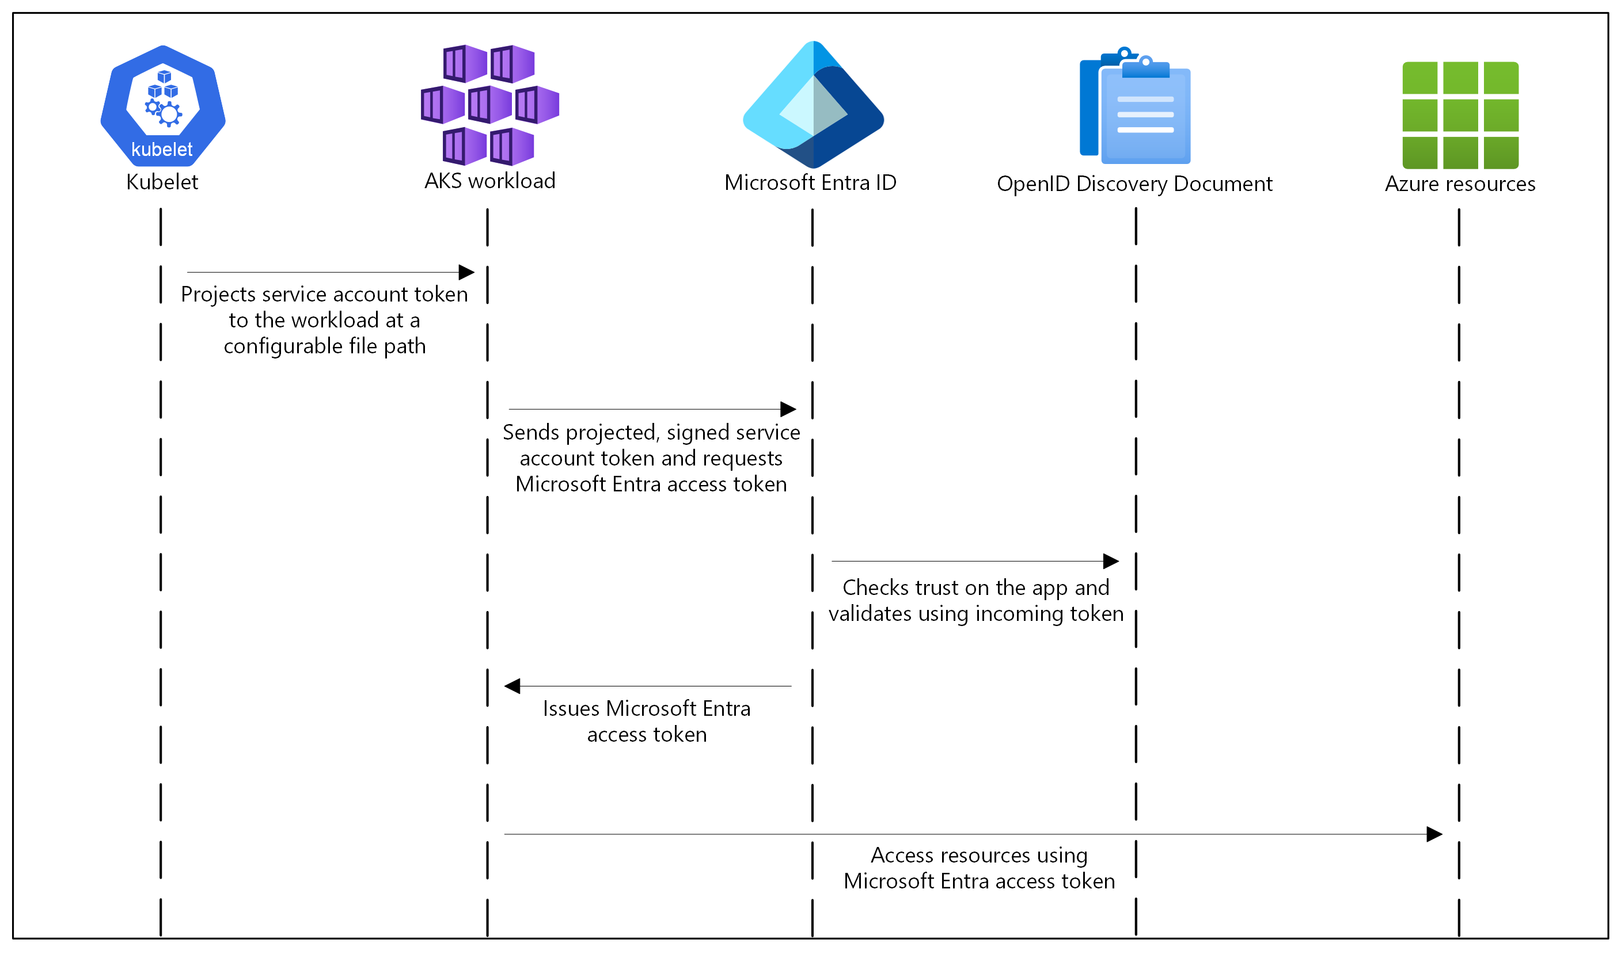
OIDC on AKS How it works
In this security model, the AKS cluster acts
as the token issuer.
Microsoft Entra ID uses OIDC to discover
public signing keys and verify the authenticity
of the service account token before exchanging it for a Microsoft Entra token.
Your workload can exchange a service account
token projected to its volume for a
Microsoft Entra token using the Azure Identity
client library or the MSAL.

Slide 313
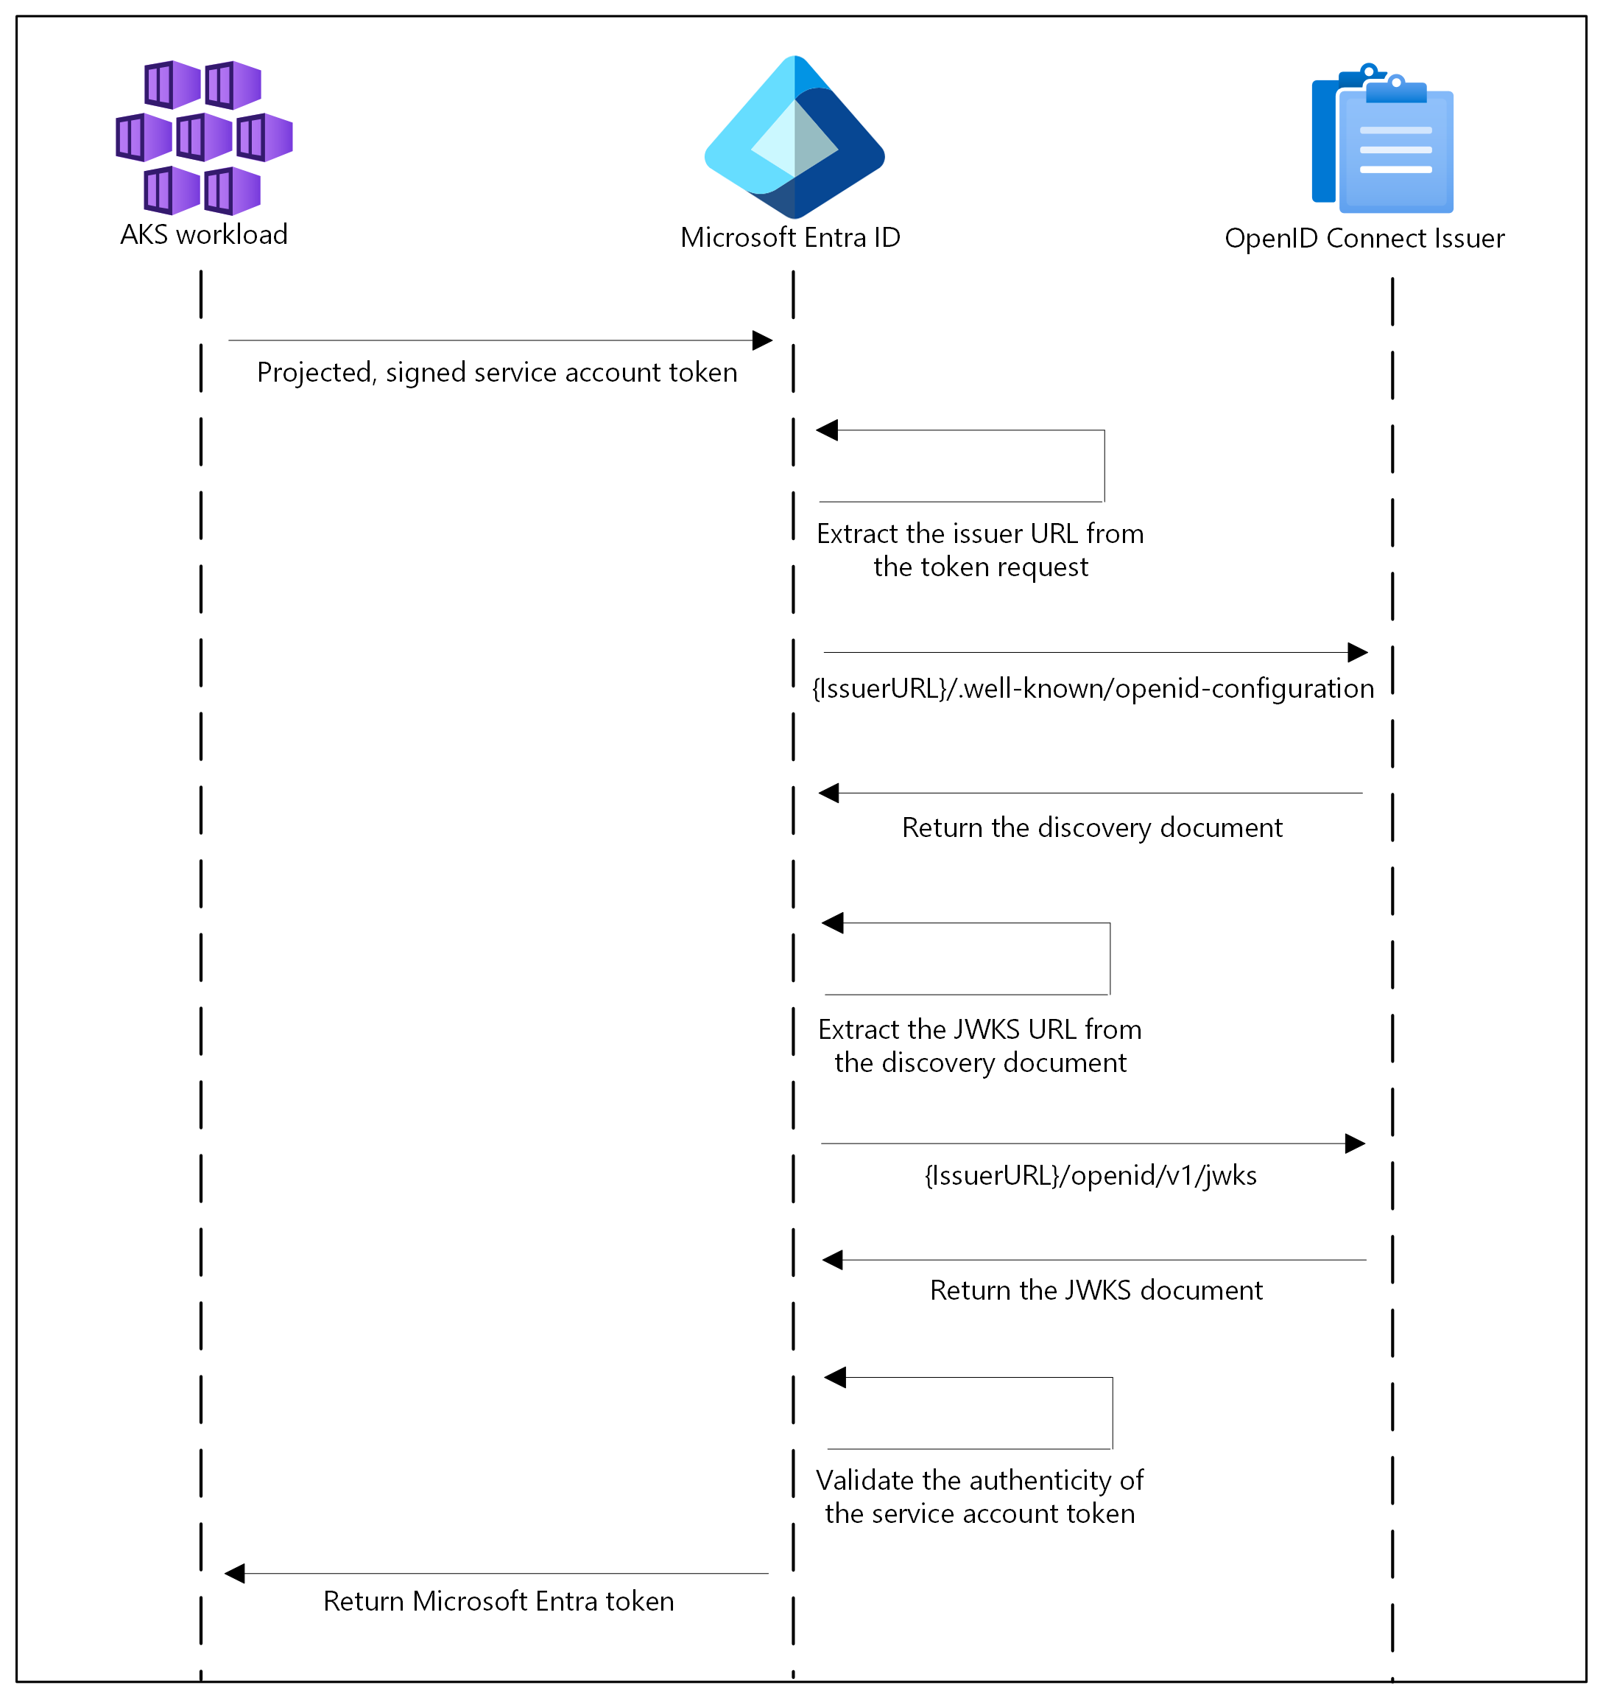
Authentication Sequence of OIDC

Slide 314
Open ID Connect (OIDC) on AKS
Endpoint | Description
{IssuerURL}/.well-known/openid-configuration | Also known as the OIDC discovery document. This contains the metadata about the issuer's configurations.
{IssuerURL}/openid/v1/jwks | This contains the public signing key(s) that Microsoft Entra ID uses to verify the authenticity of the service account token.
Get the OIDC Issuer URL
# Set environment variables
RESOURCE_GROUP=<your-resource-group-name>
CLUSTER_NAME=<your-aks-cluster-name>
# Get the OIDC issuer URL
az aks show
--name $CLUSTER_NAME
--resource-group $RESOURCE_GROUP
--query "oidcIssuerProfile.issuerUrl" -o tsv

Slide 315
Service Account Labels and Annotations
Microsoft Entra Workload ID supports the following mappings related to a service account:
One-to-one, where a service account references a Microsoft Entra object.
Many-to-one, where multiple service accounts reference the same Microsoft Entra object.
One-to-many, where a service account references multiple Microsoft Entra objects by changing the client ID annotation.
Note: If you update the service account annotations, you must restart the pod for the changes to take effect.

Slide 316
Service Account Annotations
Annotation | Description | Default
azure.workload.identity/client-id | Represents the Microsoft Entra application client ID to be used with the pod.
azure.workload.identity/tenant-id | Represents the Azure tenant ID where the Microsoft Entra application is registered. | AZURE_TENANT_ID environment variable extracted from azure-wi-webhook-config ConfigMap.
azure.workload.identity/service-account-token-expiration | Represents the expirationSeconds field for the projected service account token. It's an optional field that you configure to prevent any downtime caused by errors during service account token refresh. Kubernetes service account token expiry isn't correlated with Microsoft Entra tokens. Microsoft Entra tokens expire in 24 hours after they're issued. | 3600 Supported range is 3600-86400.

Slide 317
Pod Labels
Label | Description | Recommended value | Required
azure.workload.identity/use | This label is required in the pod template spec. Only pods with this label are mutated by the azure-workload-identity mutating admission webhook to inject the Azure specific environment variables and the projected service account token volume. | true | Yes

Slide 318
Pod Annotations
Annotation | Description | Default
azure.workload.identity/service-account-token-expiration | Pod annotations take precedence over service account annotations. | 3600 Supported range is 3600-86400.
azure.workload.identity/skip-containers | Represents a semi-colon-separated list of containers to skip adding projected service account token volume. For example, container1;container2. | By default, the projected service account token volume is added to all containers if the pod is labeled with azure.workload.identity/use: true.
azure.workload.identity/inject-proxy-sidecar | Injects a proxy init container and proxy sidecar into the pod. The proxy sidecar is used to intercept token requests to IMDS and acquire a Microsoft Entra token on behalf of the user with federated identity credential. | false
azure.workload.identity/proxy-sidecar-port | Represents the port of the proxy sidecar. | 8000

Slide 319
DEMO
Deploy and configure Microsoft Entra Workload ID on an Azure Kubernetes Service (AKS) cluster

Slide 320
Deploy and configure Microsoft Entra Workload ID on an Azure Kubernetes Service (AKS) cluster
Create a new or update an existing AKS cluster using the Azure CLI with OpenID Connect (OIDC) issuer and Microsoft Entra Workload ID enabled.
Create a workload identity and Kubernetes service account.
Configure the managed identity for token federation.
Deploy the workload and verify authentication with the workload identity.
Optionally grant a pod in the cluster access to secrets in an Azure key vault.

Slide 321
Secrets Store CSI Driver

Slide 322
CSI Driver
The Container Storage Interface (CSI) is a standard for exposing arbitrary block and file storage systems to containerized workloads on Container Orchestration Systems (COS) like Kubernetes.
Using CSI third-party storage providers can write and deploy plugins exposing new storage systems in Kubernetes without ever having to touch the core Kubernetes code.
Notes:
Introduction - Kubernetes CSI Developer Documentation

Slide 323
Secret Store CSI Driver
Secrets Store CSI Driver for Kubernetes secrets - Integrates secrets stores with Kubernetes via a Container Storage Interface (CSI) volume.
The Secrets Store CSI Driver secrets-store.csi.k8s.io allows Kubernetes to mount multiple secrets, keys, and certs stored in enterprise-grade external secrets stores into their pods as a volume. Once the Volume is attached, the data in it is mounted into the container's file system.
Notes:
kubernetes-sigs/secrets-store-csi-driver: Secrets Store CSI driver for Kubernetes secrets - Integrates secrets stores with Kubernetes via a CSI volume.

Slide 324
Azure Key Vault provider for Secret Store CSI Driver in an AKS cluster
The Azure Key Vault provider for Secrets Store CSI Driver allows for the integration of an Azure Key Vault as a secret store with an Azure Kubernetes Service (AKS) cluster via a CSI volume.
Notes:
kubernetes-sigs/secrets-store-csi-driver: Secrets Store CSI driver for Kubernetes secrets - Integrates secrets stores with Kubernetes via a CSI volume.

Slide 325
Features
Mounts secrets, keys, and certificates to a pod using a CSI volume.
Supports CSI inline volumes.
Supports mounting multiple secrets store objects as a single volume.
Supports pod portability with the SecretProviderClass CRD.
Supports Windows containers.
Syncs with Kubernetes secrets.
Supports autorotation of mounted contents and synced Kubernetes secrets.

Slide 326
Limitations
A container using a ConfigMap or Secret as a subPath volume mount does not receive automated updates when the secret is rotated. This is a Kubernetes limitation. To have the changes take effect, the application needs to reload the changed file by either watching for changes in the file system or by restarting the pod.
The add-on creates a managed identity named azurekeyvaultsecretsprovider-xxx in the node resource group and assigns it to the Virtual Machine Scale Sets (VMSS) automatically. You can use this managed identity or your own managed identity to access the key vault. It's not supported to prevent creation of the identity.

Slide 327
DEMO
Azure Key Vault Provider for Secret Store CSI Driver in AKS

Slide 328
Pod Security Admission (PSA)

Slide 329
Pod Security Standards
The Pod Security Standards define three different policies to broadly cover the security spectrum.
These policies are cumulative and range from highly-permissive to highly-restrictive.
Profile | Description
Privileged | Unrestricted policy, providing the widest possible level of permissions. This policy allows for known privilege escalations.
Baseline | Minimally restrictive policy which prevents known privilege escalations. Allows the default (minimally specified) Pod configuration.
Restricted | Heavily restricted policy, following current Pod hardening best practices.
Notes:
Pod Security Standards | Kubernetes

Slide 330
The Privileged Policy
The Privileged policy is purposely-open, and entirely unrestricted. This type of policy is typically aimed at system- and infrastructure-level workloads managed by privileged, trusted users.
The Privileged policy is defined by an absence of restrictions. If you define a Pod where the Privileged security policy applies, the Pod you define is able to bypass typical container isolation mechanisms. For example, you can define a Pod that has access to the node's host network.
Notes:
Pod Security Standards | Kubernetes

Slide 331
The Baseline Policy
The Baseline policy is aimed at ease of adoption for common containerized workloads while preventing known privilege escalations.
This policy is targeted at application operators and developers of non-critical applications.
Notes:
Pod Security Standards | Kubernetes

Slide 332
The Restricted Policy
The Restricted policy is aimed at enforcing current Pod hardening best practices, at the expense of some compatibility.
It is targeted at operators and developers of security-critical applications, as well as lower-trust users.
Notes:
Pod Security Standards | Kubernetes

Slide 333
Pod Security Admission in AKS
Pod Security Admission (PSA) uses labels to enforce Pod Security Standards policies on pods running in a namespace.
In AKS, Pod Security Admission is enabled by default.
Notes:
Pod Security Standards | Kubernetes

Slide 334
DEMO
Pod Security Admission

Slide 335
Demo Companion
The following security context elements are missing
Element | Pod Level | Container Level | Purpose
runAsNonRoot | ✓ | ✓ | Prevent running as root
runAsUser | ✓ | ✓ | Specify user ID
runAsGroup | ✓ | ✓ | Specify group ID
fsGroup | ✓ |  | File system group for volumes
readOnlyRootFilesystem |  | ✓ | Make root filesystem read-only
allowPrivilegeEscalation |  | ✓ | Prevent privilege escalation
capabilities |  | ✓ | Drop/add Linux capabilities
seccompProfile | ✓ | ✓ | Apply seccomp filtering
Warning: would violate PodSecurity "restricted:latest": allowPrivilegeEscalation != false (container "azure-vote-back" must set securityContext.allowPrivilegeEscalation=false), unrestricted capabilities (container "azure-vote-back" must set securityContext.capabilities.drop=["ALL"]), runAsNonRoot != true (pod or container "azure-vote-back" must set securityContext.runAsNonRoot=true), seccompProfile (pod or container "azure-vote-back" must set securityContext.seccompProfile.type to "RuntimeDefault" or "Localhost")
deployment.apps/azure-vote-back created
service/azure-vote-back created
Warning: would violate PodSecurity "restricted:latest": allowPrivilegeEscalation != false (container "azure-vote-front" must set securityContext.allowPrivilegeEscalation=false), unrestricted capabilities (container "azure-vote-front" must set securityContext.capabilities.drop=["ALL"]), runAsNonRoot != true (pod or container "azure-vote-front" must set securityContext.runAsNonRoot=true), seccompProfile (pod or container "azure-vote-front" must set securityContext.seccompProfile.type to "RuntimeDefault" or "Localhost")
deployment.apps/azure-vote-front created
service/azure-vote-front created

Slide 336
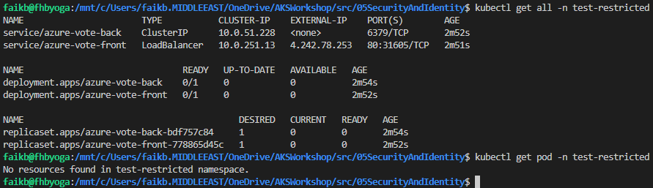
Demo Companion

Slide 337
Questions ?

Slide 338
Thank you

