Slide 1
AKS
Faik Hakan Bilgen,
Sr. CSA, Microsoft

Slide 2
Introduction to AKS

Slide 3
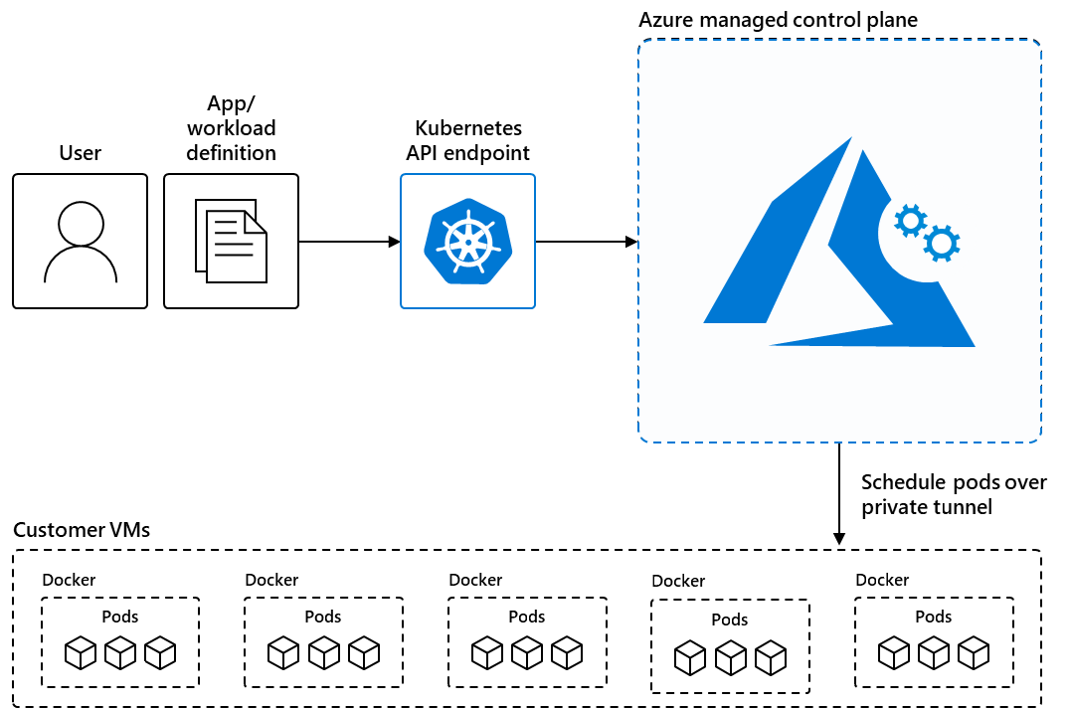
Azure Kubernetes Service (AKS)
AKS reduces the complexity and operational overhead of managing
Kubernetes by offloading much of that responsibility to Azure.
Azure Kubernetes Service (AKS) is a managed Kubernetes service
that you can use to deploy and manage containerized applications
that require high availability, scalability, and portability, and
for deploying applications to multiple regions,
using open-source tools and integrating with existing DevOps tools.

Slide 4
Container Solutions in Azure
Container solution | Resource type
Azure Kubernetes Service | Managed Kubernetes
Azure Red Hat OpenShift | Managed Kubernetes
Azure Arc-enabled Kubernetes | Unmanaged Kubernetes
Azure Container Instances | Managed Docker container instance
Azure Container Apps | Managed Kubernetes

Slide 5
Use Cases for AKS
Lift and shift to containers with AKS
Migrate existing applications to containers and run them in a fully managed Kubernetes environment.
Microservices with AKS
Simplify the deployment and management of microservices-based applications with streamlined horizontal scaling,
self-healing, load balancing, and secret management.
Secure DevOps for AKS
Efficiently balance speed and security by implementing secure DevOps with Kubernetes.
Bursting from AKS with ACI
Use virtual nodes to provision pods inside ACI that start in seconds and scale to meet demand.
Machine learning model training with AKS
Train models using large datasets with familiar tools, such as TensorFlow and Kubeflow.
Data streaming with AKS
Ingest and process real-time data streams with millions of data points collected via sensors, and
perform fast analyses and computations to develop insights into complex scenarios.
Using Windows containers on AKS
Run Windows Server containers on AKS to modernize your Windows applications and infrastructure.

Slide 6
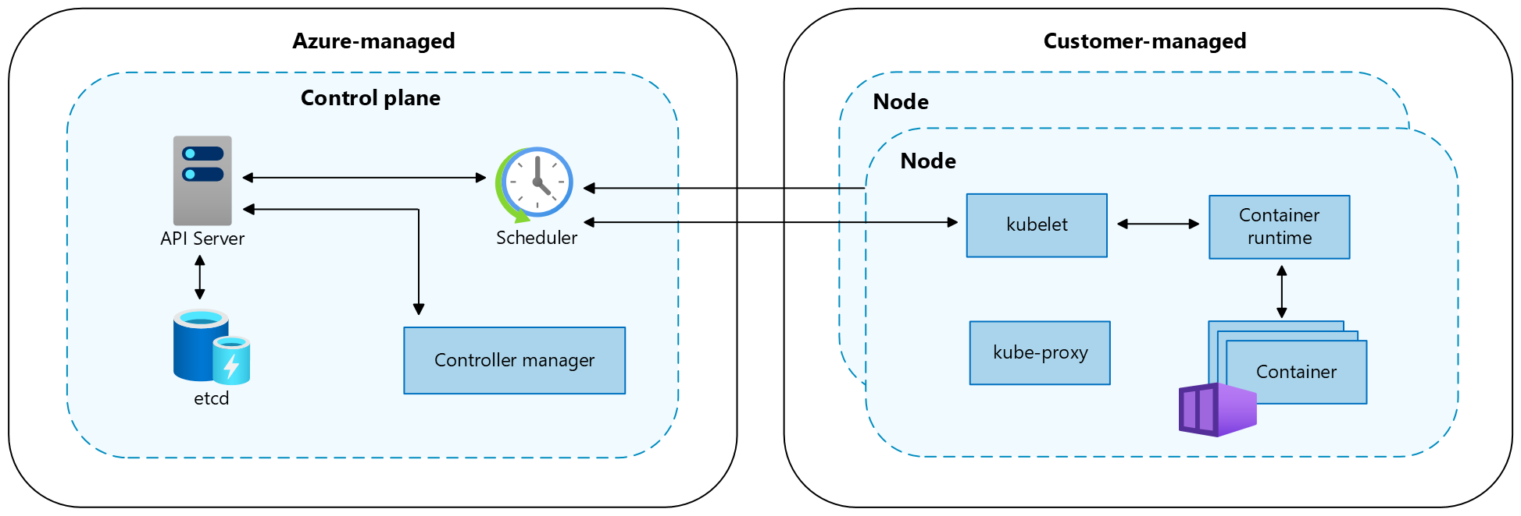
Core AKS Concepts
Component | Description
kubelet | The kubelet ensures that containers are running in a pod.
kube-proxy | The kube-proxy is a network proxy that maintains network rules on nodes.
container runtime | The container runtime manages the execution and lifecycle of containers.
Component | Description
kube-apiserver | The API server (kube-apiserver) exposes the Kubernetes API to enable requests to the cluster from inside and outside of the cluster.
etcd | The highly available key-value store etcd helps to maintain the state of your Kubernetes cluster and configuration.
kube-scheduler | The scheduler (kube-scheduler) helps to make scheduling decisions. It watches for new pods with no assigned node and selects a node for them to run on.
kube-controller-manager | The controller manager (kube-controller-manager) runs controller processes, such as noticing and responding when nodes go down.
cloud-controller-manager | The cloud controller manager (cloud-controller-manager) embeds cloud-specific control logic to run controllers specific to the cloud provider.

Slide 7
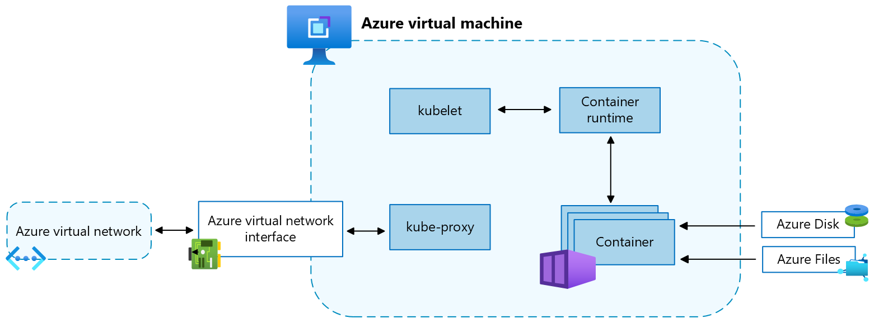
Core AKS Concepts
VM size and image
OS disks
Resource reservations
OS
Container runtime
Pods
Node pools
Node resource group

Slide 8
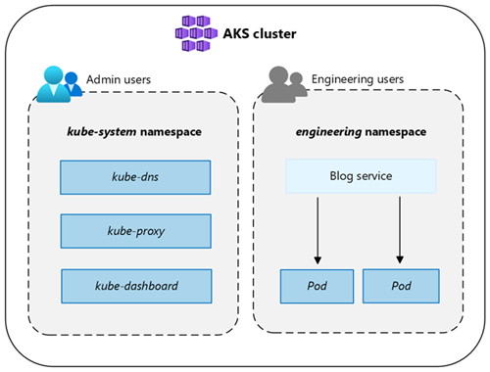
Core AKS Concepts
Namespace | Description
default | The default namespace allows you to start using cluster resources without creating a new namespace.
kube-node-lease | The kube-node-lease namespace enables nodes to communicate their availability to the control plane.
kube-public | The kube-public namespace isn't typically used, but you can use it so that resources are visible across the whole cluster by any user.
kube-system | The kube-system namespace is used by Kubernetes to manage cluster resources, such as coredns, konnectivity-agent, and metrics-server. It is not recommended to deploy your own applications to this namespace.

Slide 9
Setting up an AKS Cluster

Slide 10
Setup an AKS Cluster
Method of set up | Setup Guidance
Via Azure Portal
Using Azure CLI
Using Bicep
Using Terraform

