Slide 1
AKS Workshop
Faik Hakan Bilgen,
Sr. CSA, Microsoft

Slide 2
Security and Identity

Slide 3
Open ID Connect (OIDC) on AKS
OpenID Connect (OIDC) extends the OAuth 2.0 authorization protocol for use as another authentication protocol issued by Microsoft Entra ID.
You can use OIDC to enable single sign-on (SSO) between OAuth-enabled applications on your Azure Kubernetes Service (AKS) cluster using a security token called an ID token.
You can enable the OIDC issuer on your AKS clusters, which allows Microsoft Entra ID (or another cloud provider's identity and access management platform) to discover the API server's public signing keys.

Slide 4
Open ID Connect (OIDC) on AKS
You can't disable OIDC issuer once enabled
Enabling OIDC issuer on existing clusters requires API server restart (brief downtime)
Maximum token lifetime is 24 hours (one day)
Projected service account tokens required for Kubernetes 1.30+ clusters

Slide 5
Open ID Connect (OIDC) on AKS
Create an AKS cluster with the OIDC issuer
Enable the OIDC issuer on an existing AKS cluster
# Set environment variables
RESOURCE_GROUP=<your-resource-group-name>
CLUSTER_NAME=<your-aks-cluster-name>
# Create the AKS cluster with OIDC issuer enabled (OIDC issuer enabled by default for Kubernetes 1.34+)
az aks create
--resource-group $RESOURCE_GROUP
--name $CLUSTER_NAME
--node-count 1
--enable-oidc-issuer
--generate-ssh-keys
# Set environment variables
RESOURCE_GROUP=<your-resource-group-name>
CLUSTER_NAME=<your-aks-cluster-name>
# Enable the OIDC issuer on the existing AKS cluster
az aks update
--resource-group $RESOURCE_GROUP
--name $CLUSTER_NAME
--enable-oidc-issuer

Slide 6
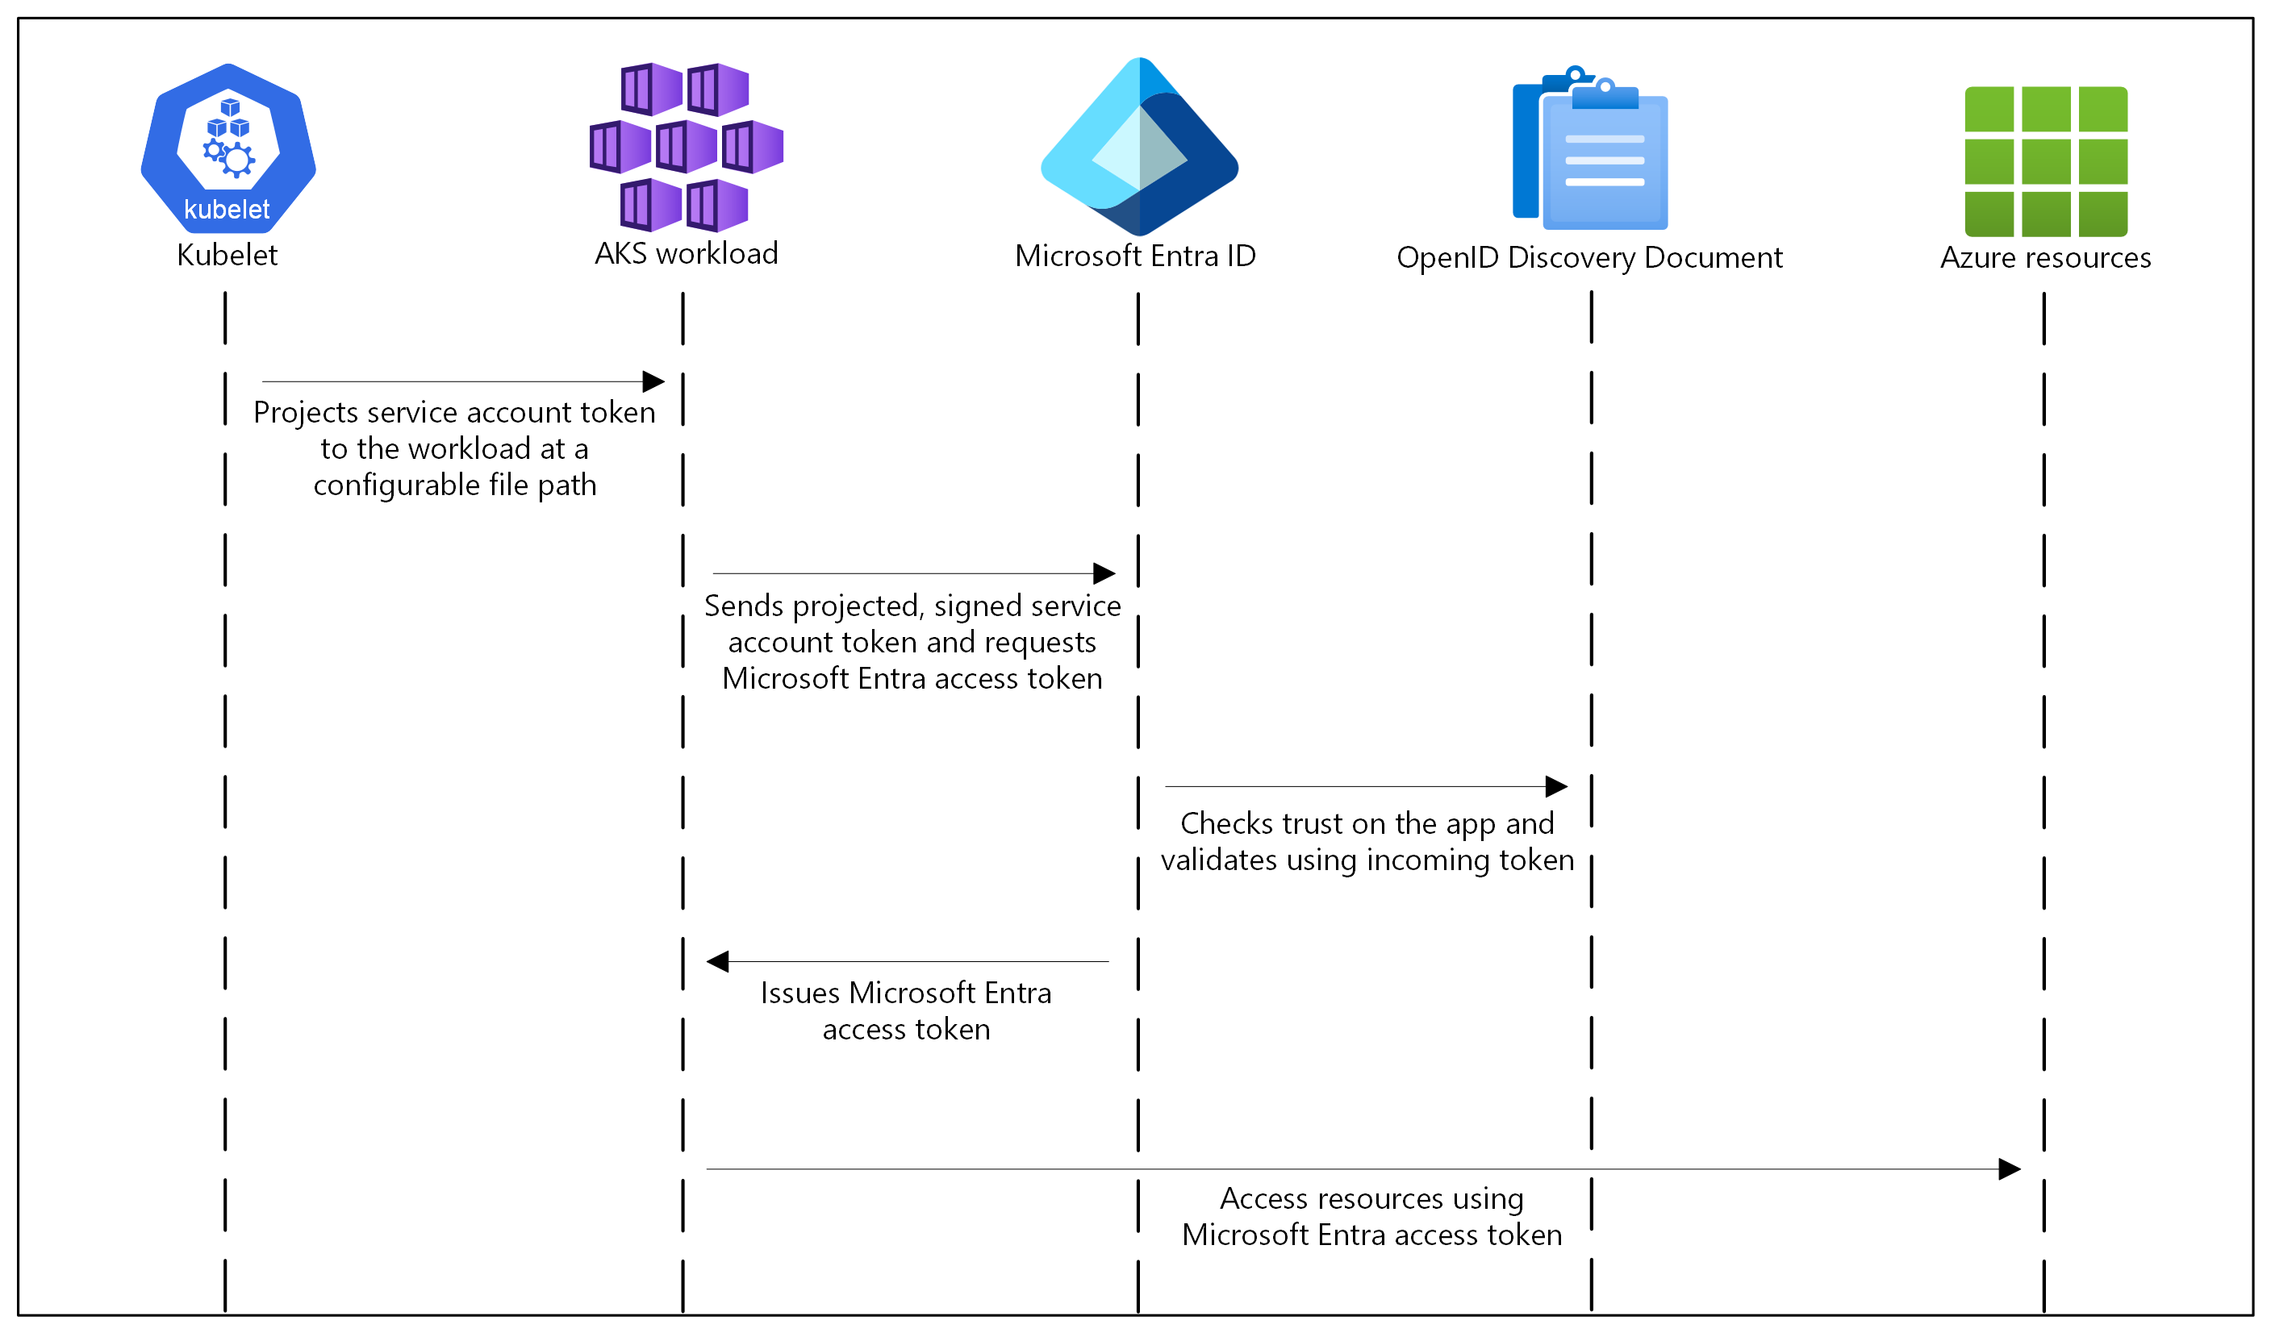
OIDC on AKS How it works
In this security model, the AKS cluster acts
as the token issuer.
Microsoft Entra ID uses OIDC to discover
public signing keys and verify the authenticity
of the service account token before exchanging it for a Microsoft Entra token.
Your workload can exchange a service account
token projected to its volume for a
Microsoft Entra token using the Azure Identity
client library or the MSAL.

Slide 7
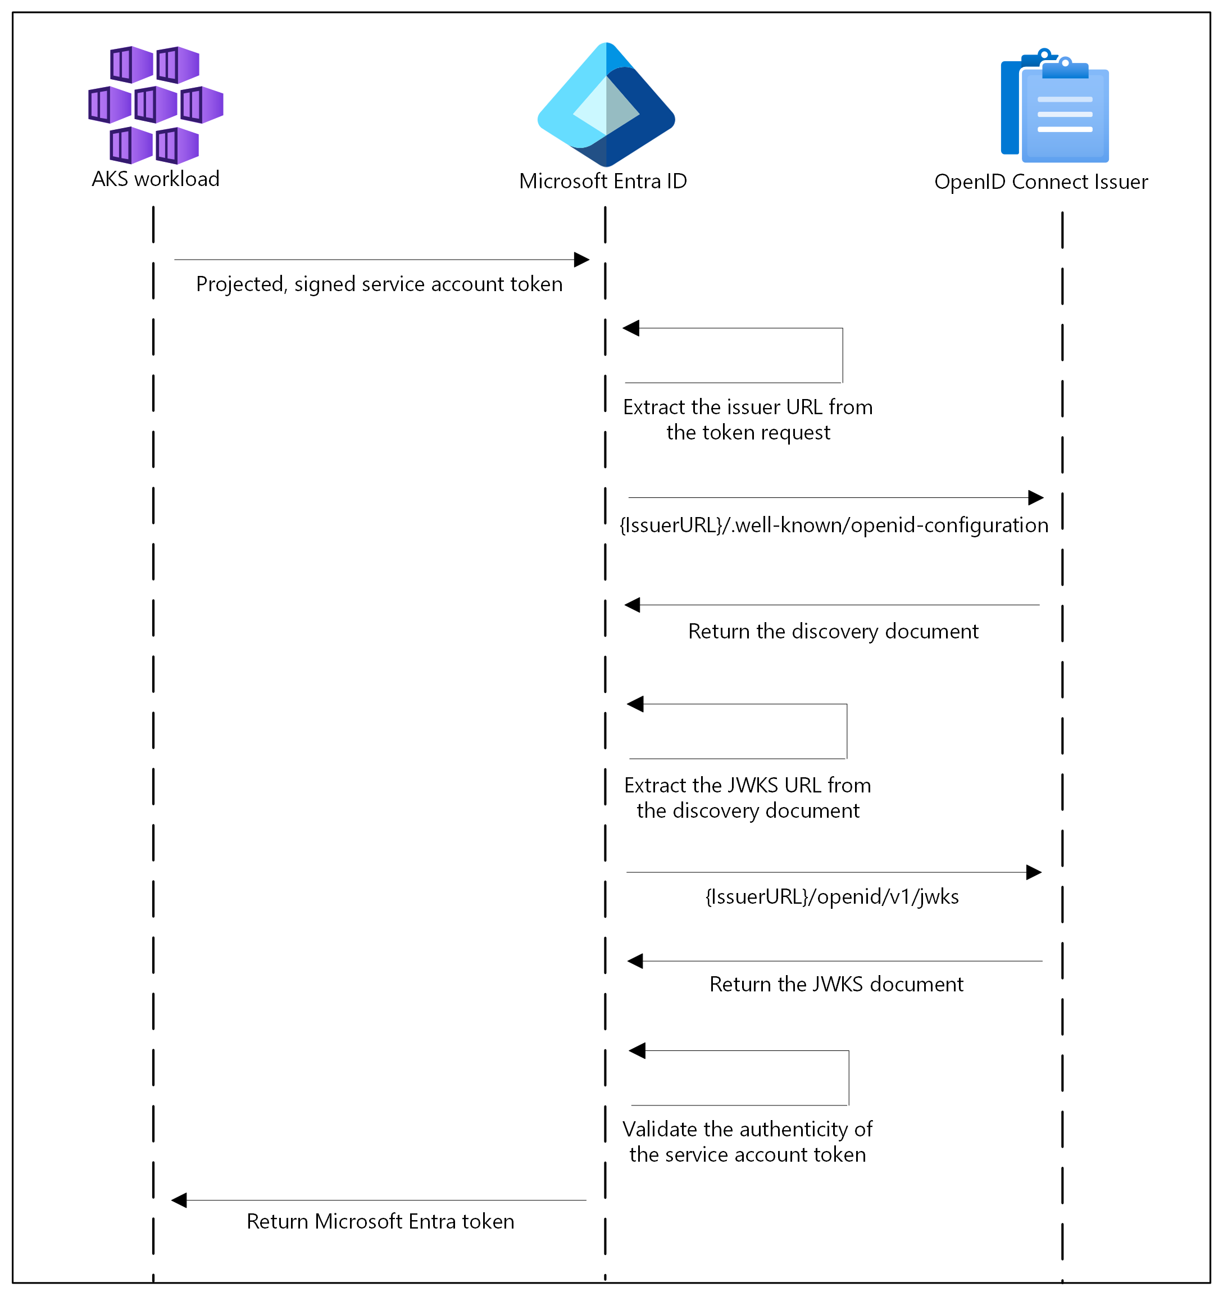
Authentication Sequence of OIDC

Slide 8
Open ID Connect (OIDC) on AKS
Endpoint | Description
{IssuerURL}/.well-known/openid-configuration | Also known as the OIDC discovery document. This contains the metadata about the issuer's configurations.
{IssuerURL}/openid/v1/jwks | This contains the public signing key(s) that Microsoft Entra ID uses to verify the authenticity of the service account token.
Get the OIDC Issuer URL
# Set environment variables
RESOURCE_GROUP=<your-resource-group-name>
CLUSTER_NAME=<your-aks-cluster-name>
# Get the OIDC issuer URL
az aks show
--name $CLUSTER_NAME
--resource-group $RESOURCE_GROUP
--query "oidcIssuerProfile.issuerUrl" -o tsv

Slide 9
Service Account Labels and Annotations
Microsoft Entra Workload ID supports the following mappings related to a service account:
One-to-one, where a service account references a Microsoft Entra object.
Many-to-one, where multiple service accounts reference the same Microsoft Entra object.
One-to-many, where a service account references multiple Microsoft Entra objects by changing the client ID annotation.
Note: If you update the service account annotations, you must restart the pod for the changes to take effect.

Slide 10
Service Account Annotations
Annotation | Description | Default
azure.workload.identity/client-id | Represents the Microsoft Entra application client ID to be used with the pod.
azure.workload.identity/tenant-id | Represents the Azure tenant ID where the Microsoft Entra application is registered. | AZURE_TENANT_ID environment variable extracted from azure-wi-webhook-config ConfigMap.
azure.workload.identity/service-account-token-expiration | Represents the expirationSeconds field for the projected service account token. It's an optional field that you configure to prevent any downtime caused by errors during service account token refresh. Kubernetes service account token expiry isn't correlated with Microsoft Entra tokens. Microsoft Entra tokens expire in 24 hours after they're issued. | 3600 Supported range is 3600-86400.

Slide 11
Pod Labels
Label | Description | Recommended value | Required
azure.workload.identity/use | This label is required in the pod template spec. Only pods with this label are mutated by the azure-workload-identity mutating admission webhook to inject the Azure specific environment variables and the projected service account token volume. | true | Yes

Slide 12
Pod Annotations
Annotation | Description | Default
azure.workload.identity/service-account-token-expiration | Pod annotations take precedence over service account annotations. | 3600 Supported range is 3600-86400.
azure.workload.identity/skip-containers | Represents a semi-colon-separated list of containers to skip adding projected service account token volume. For example, container1;container2. | By default, the projected service account token volume is added to all containers if the pod is labeled with azure.workload.identity/use: true.
azure.workload.identity/inject-proxy-sidecar | Injects a proxy init container and proxy sidecar into the pod. The proxy sidecar is used to intercept token requests to IMDS and acquire a Microsoft Entra token on behalf of the user with federated identity credential. | false
azure.workload.identity/proxy-sidecar-port | Represents the port of the proxy sidecar. | 8000

Slide 13
DEMO
Deploy and configure Microsoft Entra Workload ID on an Azure Kubernetes Service (AKS) cluster

Slide 14
Deploy and configure Microsoft Entra Workload ID on an Azure Kubernetes Service (AKS) cluster
Create a new or update an existing AKS cluster using the Azure CLI with OpenID Connect (OIDC) issuer and Microsoft Entra Workload ID enabled.
Create a workload identity and Kubernetes service account.
Configure the managed identity for token federation.
Deploy the workload and verify authentication with the workload identity.
Optionally grant a pod in the cluster access to secrets in an Azure key vault.

Slide 15
Secrets Store CSI Driver

Slide 16
CSI Driver
The Container Storage Interface (CSI) is a standard for exposing arbitrary block and file storage systems to containerized workloads on Container Orchestration Systems (COs) like Kubernetes.
Using CSI third-party storage providers can write and deploy plugins exposing new storage systems in Kubernetes without ever having to touch the core Kubernetes code.
Notes:
Introduction - Kubernetes CSI Developer Documentation

Slide 17
Secret Store CSI Driver
Secrets Store CSI Driver for Kubernetes secrets - Integrates secrets stores with Kubernetes via a Container Storage Interface (CSI) volume.
The Secrets Store CSI Driver secrets-store.csi.k8s.io allows Kubernetes to mount multiple secrets, keys, and certs stored in enterprise-grade external secrets stores into their pods as a volume. Once the Volume is attached, the data in it is mounted into the container's file system.
Notes:
kubernetes-sigs/secrets-store-csi-driver: Secrets Store CSI driver for Kubernetes secrets - Integrates secrets stores with Kubernetes via a CSI volume.

Slide 18
Azure Key Vault provider for Secret Store CSI Driver in an AKS cluster
The Azure Key Vault provider for Secrets Store CSI Driver allows for the integration of an Azure Key Vault as a secret store with an Azure Kubernetes Service (AKS) cluster via a CSI volume.
Notes:
kubernetes-sigs/secrets-store-csi-driver: Secrets Store CSI driver for Kubernetes secrets - Integrates secrets stores with Kubernetes via a CSI volume.

Slide 19
Features
Mounts secrets, keys, and certificates to a pod using a CSI volume.
Supports CSI inline volumes.
Supports mounting multiple secrets store objects as a single volume.
Supports pod portability with the SecretProviderClass CRD.
Supports Windows containers.
Syncs with Kubernetes secrets.
Supports autorotation of mounted contents and synced Kubernetes secrets.

Slide 20
Limitations
A container using a ConfigMap or Secret as a subPath volume mount does not receive automated updates when the secret is rotated. This is a Kubernetes limitation. To have the changes take effect, the application needs to reload the changed file by either watching for changes in the file system or by restarting the pod.
The add-on creates a managed identity named azurekeyvaultsecretsprovider-xxx in the node resource group and assigns it to the Virtual Machine Scale Sets (VMSS) automatically. You can use this managed identity or your own managed identity to access the key vault. It's not supported to prevent creation of the identity.

Slide 21
DEMO
Azure Key Vault Provider for Secret Store CSI Driver in AKS

Slide 22
Pod Security Admission (PSA)

Slide 23
Pod Security Standards
The Pod Security Standards define three different policies to broadly cover the security spectrum.
These policies are cumulative and range from highly-permissive to highly-restrictive.
Profile | Description
Privileged | Unrestricted policy, providing the widest possible level of permissions. This policy allows for known privilege escalations.
Baseline | Minimally restrictive policy which prevents known privilege escalations. Allows the default (minimally specified) Pod configuration.
Restricted | Heavily restricted policy, following current Pod hardening best practices.
Notes:
Pod Security Standards | Kubernetes

Slide 24
The Privileged Policy
The Privileged policy is purposely-open, and entirely unrestricted. This type of policy is typically aimed at system- and infrastructure-level workloads managed by privileged, trusted users.
The Privileged policy is defined by an absence of restrictions. If you define a Pod where the Privileged security policy applies, the Pod you define is able to bypass typical container isolation mechanisms. For example, you can define a Pod that has access to the node's host network.
Notes:
Pod Security Standards | Kubernetes

Slide 25
The Baseline Policy
The Baseline policy is aimed at ease of adoption for common containerized workloads while preventing known privilege escalations.
This policy is targeted at application operators and developers of non-critical applications.
Notes:
Pod Security Standards | Kubernetes

Slide 26
The Restricted Policy
The Restricted policy is aimed at enforcing current Pod hardening best practices, at the expense of some compatibility.
It is targeted at operators and developers of security-critical applications, as well as lower-trust users.
Notes:
Pod Security Standards | Kubernetes

Slide 27
Pod Security Admission in AKS
Pod Security Admission (PSA) uses labels to enforce Pod Security Standards policies on pods running in a namespace.
In AKS, Pod Security Admission is enabled by default.
Notes:
Pod Security Standards | Kubernetes

Slide 28
DEMO
Pod Security Admission

Slide 29
Demo Companion
The following security context elements are missing
Element | Pod Level | Container Level | Purpose
runAsNonRoot | ✓ | ✓ | Prevent running as root
runAsUser | ✓ | ✓ | Specify user ID
runAsGroup | ✓ | ✓ | Specify group ID
fsGroup | ✓ |  | File system group for volumes
readOnlyRootFilesystem |  | ✓ | Make root filesystem read-only
allowPrivilegeEscalation |  | ✓ | Prevent privilege escalation
capabilities |  | ✓ | Drop/add Linux capabilities
seccompProfile | ✓ | ✓ | Apply seccomp filtering
Warning: would violate PodSecurity "restricted:latest": allowPrivilegeEscalation != false (container "azure-vote-back" must set securityContext.allowPrivilegeEscalation=false), unrestricted capabilities (container "azure-vote-back" must set securityContext.capabilities.drop=["ALL"]), runAsNonRoot != true (pod or container "azure-vote-back" must set securityContext.runAsNonRoot=true), seccompProfile (pod or container "azure-vote-back" must set securityContext.seccompProfile.type to "RuntimeDefault" or "Localhost")
deployment.apps/azure-vote-back created
service/azure-vote-back created
Warning: would violate PodSecurity "restricted:latest": allowPrivilegeEscalation != false (container "azure-vote-front" must set securityContext.allowPrivilegeEscalation=false), unrestricted capabilities (container "azure-vote-front" must set securityContext.capabilities.drop=["ALL"]), runAsNonRoot != true (pod or container "azure-vote-front" must set securityContext.runAsNonRoot=true), seccompProfile (pod or container "azure-vote-front" must set securityContext.seccompProfile.type to "RuntimeDefault" or "Localhost")
deployment.apps/azure-vote-front created
service/azure-vote-front created

Slide 30
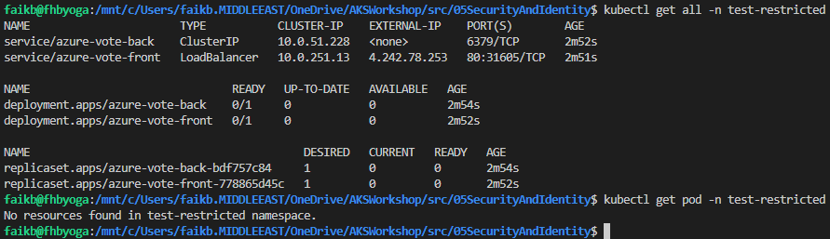
Demo Companion

Slide 31
Questions ?

Slide 32
Thank you

