Slide 1
AKS Workshop
Faik Hakan Bilgen,
Sr. CSA, Microsoft

Slide 2
Versions and Upgrades

Slide 3
AKS Versioning
[major].[minor].[patch]
Examples:
1.29.2, 1.29.1
Each number in the version reflects compatibility with previous versions:
Major versions: Introduce incompatible API changes or break backward compatibility.
Minor versions: Add new features while maintaining backward compatibility.
Patch versions: Include backward-compatible bug fixes.

Slide 4
AKS Versioning
Always use the latest patch release for your current minor version.
For example, if your production cluster is on 1.29.1 and 1.29.2 is the latest available patch version available for the 1.29 minor version, you should upgrade to 1.29.2 as soon as possible to ensure your cluster is fully patched and supported.
K8s version | Upstream release | AKS preview | AKS GA | End of life | Platform support
1.29 | Dec-23 | Feb-24 | Mar-24 | Mar-25 | Until 1.33 GA
1.3 | Apr-24 | Jun-24 | Jul-24 | 22-Aug-25 | Until 1.34 GA
1.31 | Aug-24 | Oct-24 | Nov-24 | 1-Nov-25 | Until 1.35 GA
1.32 | Dec-24 | Feb-25 | Apr-25 | Mar-26 | Until 1.36 GA
1.33 | Apr-25 | May-25 | Jun-25 | Jun-26 | Until 1.37 GA
1.34 | Aug-25 | Oct-25 | Nov-25 | Nov-26 | Until 1.38 GA
1.35 | Dec-25 | Feb-26 | Mar-26 | Mar-27 | Until 1.39 GA

Slide 5
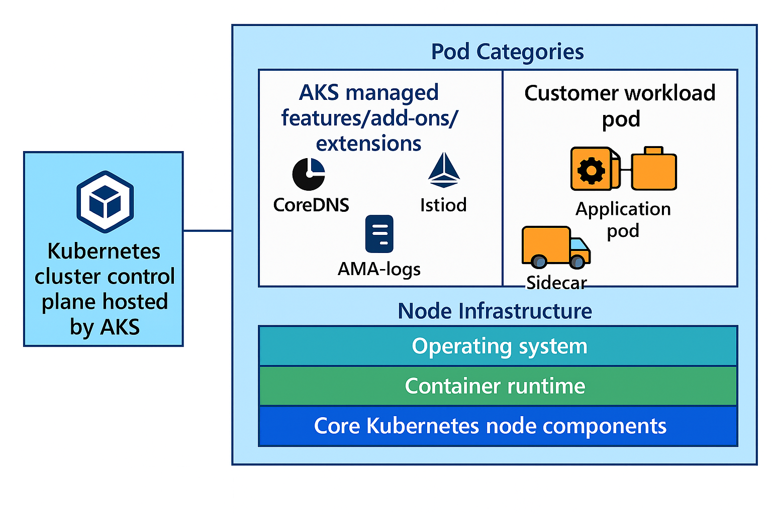
AKS Component Versioning

Slide 6
Versioning and Updates for AKS Components
 | Control plane | Node images | Standalone add-on/features/extension pods | AKS components inside customer workload pods
What is versioned? | Kubernetes API server, etcd, controllers | Operating system, container runtime, and core Kubernetes node components | AKS feature/add-ons/extensions that are running standalone pods (for example - istiod) | Sidecars or supporting containers injected by add-ons/extensions
Versioning model | Follows upstream Kubernetes semantic versioning (MAJOR.MINOR.PATCH). AKS offers community and Long Term Support (LTS) models. More information can be found in AKS version support policy documentation | Node image versions along with VHD notes published with AKS releases. | Add-on/feature/extension minor version tied 1-1 to AKS minor version | Sidecar version must be compatible with add-on control plane
Update method | Customer has control over which MAJOR.MINOR.PATCH version to upgrade to. Manual (az aks upgrade) or automatic using autoupgrade channels | Customer can upgrade to latest supported node image version. Manual (az aks nodepool upgrade) or automatic using autoupgrade channels | - Minor version upgraded when control plane minor version is upgraded (except Istio; see Istio upgrade documentation) - Patch version upgraded by AKS releases automatically | Customer needs to manually update (restart workloads having sidecars) to compatible sidecar versions as documented by the add-on/feature/extension.

Slide 7
Upgrade Node Pools
As a best practice, you should upgrade all node pools in an AKS cluster to the same Kubernetes version.
The default behavior of [az aks upgrade][az-aks-upgrade] is to upgrade all node pools together with the control plane to achieve this alignment.
The ability to upgrade individual node pools lets you perform a rolling upgrade and schedule pods between node pools to maintain application uptime.

Slide 8
Upgrade Node Pools
An AKS cluster has two cluster resource objects with Kubernetes versions associated to them:
The cluster control plane Kubernetes version
And a node pool with a Kubernetes version

Slide 9
Upgrade Node Pools
Kubernetes uses the standard Semantic Versioning versioning scheme.
The version number is expressed as x.y.z, where x is the major version, y is the minor version, and z is the patch version. For example, in version 1.12.6, 1 is the major version, 12 is the minor version, and 6 is the patch version.
The Kubernetes version of the control plane and the initial node pool are set during cluster creation.
Other node pools have their Kubernetes version set when they are added to the cluster. The Kubernetes versions may differ between node pools and between a node pool and the control plane.

Slide 10
Upgrade Node Pools
Rules for valid versions to upgrade node pools:
The node pool version must have the same major version as the control plane.
The node pool minor version must be within two minor versions of the control plane version.
The node pool version can't be greater than the control major.minor.patch version.

Slide 11
Upgrade Node Pools
Rules for submitting an upgrade operation:
You can't downgrade the control plane or a node pool Kubernetes version.
If a node pool Kubernetes version isn't specified, the behavior depends on the client. In Azure Resource Manager (ARM) templates, declaration falls back to the existing version defined for the node pool. If nothing is set, it falls back to the control plane version.
You can't simultaneously submit multiple operations on a single control plane or node pool resource. You can either upgrade or scale a control plane or a node pool at a given time.

Slide 12
Upgrade AKS & Node Pools
Upgrade behavior for the control plane and node pools:
az aks upgrade upgrades the control plane and all node pools in the cluster to the same Kubernetes version.
az aks upgrade with the --control-plane-only flag upgrades only the cluster control plane and leaves all node pools unchanged.
az aks nodepool upgrade upgrades only the target node pool with the specified Kubernetes version.

Slide 13
Upgrade Node Pools
az aks upgrade --name
--resource-group
[--control-plane-only]
[--disable-force-upgrade]
[--enable-force-upgrade]
[--if-match]
[--if-none-match]
[--k8s-support-plan {AKSLongTermSupport, KubernetesOfficial}]
[--kubernetes-version]
[--no-wait]
[--node-image-only]
[--tier {free, premium, standard}]
[--upgrade-override-until]
[--yes]

Slide 14
Upgrade AKS OS Only
az aks upgrade --name
--resource-group
[--control-plane-only]
[--disable-force-upgrade]
[--enable-force-upgrade]
[--if-match]
[--if-none-match]
[--k8s-support-plan {AKSLongTermSupport, KubernetesOfficial}]
[--kubernetes-version]
[--no-wait]
[--node-image-only]
[--tier {free, premium, standard}]
[--upgrade-override-until]
[--yes]

Slide 15
Update Node Pool OS Image Only
az aks nodepool update
--resource-group <RESOURCE-GROUP>
--cluster-name <CLUSTER-NAME>
--os-sku <OS-SKU>
--name <NODE-POOL-NAME>

Slide 16
Upgrade an AKS Cluster
Cordoning
When you cordon a node the Kubernetes scheduler will no longer place new pods on that node, but any pods already running there will continue to operate normally.
kubectl cordon <node-name>
Draining
Draining a node is the process of safely evicting all running pods from a node so it can be taken offline for maintenance, upgrades, or decommissioning.
kubectl drain <node-name>

Slide 17
Upgrade an AKS Cluster
AKS nodes are carefully cordoned and drained to minimize any potential disruptions to running applications. During this process, AKS performs the following steps:
Adds a new buffer node (or as many nodes as configured in max surge) to the cluster that runs the specified Kubernetes version.
Cordons and drains one of the old nodes to minimize disruption to running applications. If you're using max surge, it cordons and drains as many nodes at the same time as the number of buffer nodes specified.
When the old node is fully drained, it's reimaged to receive the new version and becomes the buffer node for the following node to be upgraded.
This process repeats until all nodes in the cluster have been upgraded.
At the end of the process, the last buffer node is deleted, maintaining the existing agent node count and zone balance.

Slide 18
Rolling Upgrade

Slide 19
Step 1: Initial setup
Pod A
Pod C
Pod B
Pod D
Node 1
(v1.30)
Node 2
(v1.30)
Surge Node
(v1.31)
Node 1 | Pod A, Pod B
Node 2 | Pod C, Pod D
Surge Node | Empty (except for DaemonSets and new pods)

Slide 20
Step 2: Cordon and drain first node
Pod C
Pod D
Pod B
Pod A
Node 1
(v1.30)
Node 2
(v1.30)
Surge Node
(v1.31)
Pod A | Evicted and replaced on Serge Node
Pod B | Evicted and replaced on Node 2
Node 1 | AKS cordons Node 1 to prevent new pod scheduling, then drains existing pods

Slide 21
Step 3: Upgrade first node
Pod C
Pod D
Pod B
Pod A
Node 1
(v1.31)
Node 2
(v1.30)
Surge Node
(v1.31)
Node 1 | Upgraded to v1.31
Node 2 | Pod B, Pod C and Pod D
Surge Node | Pod A

Slide 22
Step 4: Cordon and drain second node
Pod C
Pod D
Pod B
Pod A
Node 1
(v1.31)
Node 2
(v1.31)
Surge Node
(v1.31)
Pod B, Pod C | Evicted and replaced on Node 1
Pod D | Evicted and replaced on Surge Node
Node 2 | Cordoned and reimaged to v1.31

Slide 23
Step 5: Remove surge node
Pod C
Pod D
Pod B
Pod A
Node 1
(v1.31)
Node 2
(v1.31)
Surge Node
(v1.31)
Pod A | Evicted and replaced on Node 1
Pod D | Evicted and replaced on Node 2
Surge Node | Deleted

Slide 24
Final State
Pod C
Pod D
Pod B
Pod A
Node 1
(v1.31)
Node 2
(v1.31)

Slide 25
Enforcing Rolling Upgrade
az aks nodepool update \
--resource-group <resource-group-name> \
--cluster-name <cluster-name> \
--name <nodepool-name> \
--max-surge <max-surge-value>
The default behavior is Rolling Update

Slide 26
DEMO
Upgrade AKS Node Pool with Rolling-Upgrade

Slide 27
Upgrade with Pod Disruption

Slide 28
Step 1: Initial setup
Pod A
(PDB)
Pod C
Pod B
Pod D
Node 1
(v1.30)
Node 2
(v1.30)
Surge Node 1
(v1.31)
Surge Node 2
(v1.31)
Node 1 | Pod A (PDB), Pod B
Node 2 | Pod C, Pod D
Surge Nodes | Newly created 2 nodes
PDB | Prevents Pod A eviction

Slide 29
Step 2: Attempt to drain first node (blocked)
Pod A
(PDB)
Pod C
Pod D
Pod B
Node 1 –Quarantined-
(v1.30)
Node 2
(v1.30)
Surge Node 1
(v1.31)
Surge Node 2
(v1.31)
Node 1 | Cordoned and marked as quarantined (Pod A stuck)
Pod B | Evicted and replaced on Surge Node 1, while Surge Node 2 temporarily used
Status | Node 1 upgrade blocked

Slide 30
Step 3: Proceed to second node
Pod A
(PDB)
Pod C
Pod D
Pod B
Node 1 –Quarantined-
(v1.30)
Node 2
(v1.30)
Surge Node 1
(v1.31)
Surge Node 2
(v1.31)
Node 1 | Remains quarantined (v1.30)
Node 2 | Cordoned and drained successfully
Pod C, D | Evicted and replaced on Surge Node 2

Slide 31
Step 4: Proceed to second node
Pod A
(PDB)
Pod C
Pod D
Pod B
Node 1 –Quarantined-
(v1.30)
Node 2
(v1.31)
Surge Node 1
(v1.31)
Surge Node 2
(v1.31)
Node 1 | Still quarantined (v1.30) with Pod A
Node 2 | Upgraded to v1.31
Surge Node 1 | Pod B
Surge Node 2 | Pod C, Pod D

Slide 32
Step 5: One Surge node becomes permanent replacement as another gets removed
Pod A
(PDB)
Pod C
Pod D
Pod B
Node 1 –Quarantined-
(v1.30)
Node 2
(v1.31)
Surge Node 1
(v1.31)
Surge Node 2
(v1.31)
Node 1 | Quarantined (v1.30) – requires manual intervention
Pod C, Pod D | Evicted from Surge Node 2 and replaced on Node 2
Surge Node 1 (v1.31) | Pod B (now permanent)
Surge Node 2 | Deleted

Slide 33
Final State
Pod A
(PDB)
Pod C
Pod D
Pod B
Node 1 –Quarantined-
(v1.30)
Node 2
(v1.31)
Former Surge Node
(v1.31)
Node 1 | Quarantined (v1.30) – requires manual intervention (*)
Node 2 (v1.31) | Running normally
Former Surge Node (v1.31) | Now permanent replacement

Slide 34
(*): Resolve undrainable nodes 1/2
Remove the responsible PDB
kubectl delete pdb <pdb-name>
Remove the Quarantined label
kubectl label nodes <node-name> <label-name>
[Optionally] delete the blocked node
az aks nodepool delete-machines --cluster-name <cluster-name> --machine-names <machine-name> --name <node-pool-name> --resource-group <resource-group-name>

Slide 35
(*): Resolve undrainable nodes 2/2
Reconcile the cluster status
# Update the cluster to restore the provisioning status
az aks update --resource-group <resource-group-name> --name <cluster-name>
# Scale the node pool to restore the original size
az aks nodepool scale --resource-group <resource-group-name> --cluster-name <cluster-name> --name <node-pool-name> --node-count 2

Slide 36
Manuel Blue-Green Upgrade

Slide 37
Step 1: Create green node pool
Pod A
Pod B
Node 1 (v1.30)
Node 3 (v1.31)
Blue node pool (v1.30): Pod A, B, C, D (existing)
az aks nodepool add
Green node pool (v1.31): Empty, manually created by you
Pod C
Pod D
Node 2 (v1.30)
Node 4 (v1.31)

Slide 38
Step 2: Manually cordon blue nodes
Pod A
Pod B
Node 1 (v1.30)
Node 3 (v1.31)
kubectl cordon on each blue node
Blue nodes: Cordoned, no new pods scheduled
Green nodes: Ready to receive workloads
Pod C
Pod D
Node 2 (v1.30)
Node 4 (v1.31)

Slide 39
Step 3 A: Manually drain blue nodes
Pod A
Node 1 (v1.30)
Node 3 (v1.31)
Pod B
kubectl drain on selected blue nodes
Pod migration: Pods automatically reschedule to green nodes
You verify workloads on green nodes before proceeding
Pod C
Pod D
Node 2 (v1.30)
Node 4 (v1.31)

Slide 40
Step 3 B: Manually drain blue nodes
Pod A
Pod C
Node 1 (v1.30)
Node 3 (v1.31)
Pod B
kubectl drain on selected blue nodes
Pod migration: Pods automatically reschedule to green nodes
You verify workloads on green nodes before proceeding
Pod D
Node 2 (v1.30)
Node 4 (v1.31)

Slide 41
Step 4: Validate and decide
Pod A
Pod C
Node 1 (v1.30)
Node 3 (v1.31)
Pod B
Check application metrics and logs
Run validation tests on green node pool
Commit to green or rollback to blue
Pod D
Node 2 (v1.30)
Node 4 (v1.31)

Slide 42
Step 5 A: Commit (success)
Pod A
Pod C
Node 3 (v1.31)
Pod B
Delete blue node pool using az aks nodepool delete
Green node pool becomes primary
Pod D
Node 4 (v1.31)

Slide 43
Step 5 B: Rollback (Issues detected)
Pod A
Pod C
Node 1 (v1.30)
Pod B
Uncordon blue nodes using kubectl uncordon
Drain green nodes using kubectl drain
Delete green node pool using az aks nodepool delete
Pod D
Node 2 (v1.30)

Slide 44
DEMO
Upgrade AKS Node Pool Blue-Green Upgrade

Slide 45
Automate Upgrades

Slide 46
Cluster Autoupgrade Channels
Channel | Action | Example
none | disables autoupgrades and keeps the cluster at its current version of Kubernetes. | Default setting if left unchanged.
patch | automatically upgrades the cluster to the latest supported patch version when it becomes available while keeping the minor version the same. | For example, if a cluster runs version 1.17.7, and versions 1.17.9, 1.18.4, 1.18.6, and 1.19.1 are available, the cluster upgrades to 1.17.9.
stable | automatically upgrades the cluster to the latest supported patch release on minor version N-1, where N is the latest supported minor version. | For example, if a cluster runs version 1.17.7 and versions 1.17.9, 1.18.4, 1.18.6, and 1.19.1 are available, the cluster upgrades to 1.18.6.
rapid | automatically upgrades the cluster to the latest supported patch release on the latest supported minor version. | In cases where the cluster's Kubernetes version is an N-2 minor version, where N is the latest supported minor version, the cluster first upgrades to the latest supported patch version on N-1 minor version. For example, if a cluster runs version 1.17.7 and versions 1.17.9, 1.18.4, 1.18.6, and 1.19.1 are available, the cluster first upgrades to 1.18.6, then upgrades to 1.19.1.
node-image(legacy) | automatically upgrades the node image to the latest version available. | Microsoft provides patches and new images for image nodes frequently (weekly), but your running nodes don't get the new images unless you do a node image upgrade. Turning on the node-image channel automatically updates your node images whenever a new version is available. If you use this channel, Linux [unattended upgrades] are disabled by default. Node image upgrades work on patch versions that are deprecated, so long as the minor Kubernetes version is still supported. This channel is no longer recommended and is planned for deprecation in future. For an option that can automatically upgrade node images, see the NodeImage channel in node image autoupgrade.

Slide 47
Node OS Upgrade Channels
Channel | Description | OS-specific behavior
None | Your nodes don't have security updates applied automatically. This means you're solely responsible for your security updates. | N/A
Unmanaged | The OS built-in patching infrastructure automatically applies OS updates. Newly allocated machines are initially unpatched. The OS's infrastructure patches them at some point. | Ubuntu and Azure Linux (CPU node pools) apply security patches through unattended upgrade/dnf-automatic roughly once per day around 06:00 UTC. Windows doesn't automatically apply security patches, so this option behaves equivalently to None. You need to manage the reboot process using a tool like kured. Azure Linux with OS Guard on AKS doesn't support Unmanaged.
SecurityPatch | OS security patches, which are AKS-tested, fully managed, and applied with safe deployment practices. AKS regularly updates the node's virtual hard disk (VHD) with patches from the image maintainer labeled "security only." There might be disruptions when the security patches are applied to the nodes. However, AKS is limiting disruptions by only reimaging your nodes only, when necessary, such as for certain kernel security packages. When the patches are applied, the VHD is updated and existing machines are upgraded to that VHD, honoring maintenance windows and surge settings. If AKS decides that reimaging nodes isn't necessary, it patches nodes live without draining pods and performs no VHD update. This option incurs the extra cost of hosting the VHDs in your node resource group. If you use this channel, Linux unattended upgrades are disabled by default. | Azure Linux doesn't support this channel on GPU-enabled VMs. SecurityPatch works on kubernetes patch versions that are deprecated, so long as the minor Kubernetes version is still supported. Flatcar Container Linux for AKS and Azure Linux with OS Guard on AKS do not support SecurityPatch.
NodeImage | AKS updates the nodes with a newly patched VHD containing security fixes and bug fixes on a weekly cadence. The update to the new VHD is disruptive, following maintenance windows and surge settings. No extra VHD cost is incurred when choosing this option. If you use this channel, Linux unattended upgrades are disabled by default. Node image upgrades are supported as long as cluster Kubernetes minor version is still in support. Node images are AKS-tested, fully managed, and applied with safe deployment practices.

Slide 48
Node OS Upgrade Channels
Property | NodeImage Channel | SecurityPatch Channel | Recommended Channel
Speed of shipping | The typical build, test, release, and rollout timelines for a new VHD can take approximately two weeks following safe deployment practices. Although in the event of CVEs, accelerated rollouts can occur on a case by case basis. The exact timing when a new VHD hits a region can be monitored via release-tracker. | SecurityPatch releases are relatively faster than NodeImage, even with safe deployment practices. SecurityPatch has the advantage of 'Live-patching' in Linux environments, where patching leads to selective 'reimaging' and doesn't reimage every time a patch gets applied. Re-image if it happens is controlled by maintenance windows. | SecurityPatch
Bugfixes | Carries bug fixes in addition to security fixes. | Strictly carries only security fixes. | NodeImage
Channel | Updates Ownership | Default cadence
Unmanaged | OS driven security updates. AKS has no control over these updates. | Nightly around 6AM UTC for Ubuntu and Azure Linux. Monthly for Windows.
SecurityPatch | AKS-tested, fully managed, and applied with safe deployment practices. For more information, see Increased security and resiliency of Canonical workloads on Azure. | Typically faster than weekly, AKS determined cadence.
NodeImage | AKS-tested, fully managed, and applied with safe deployment practices. For more real time information on releases, look up AKS Node Images in Release tracker | Weekly.

Slide 49
Node OS Upgrade Channels
Property | NodeImage Channel | SecurityPatch Channel | Recommended Channel
Speed of shipping | The typical build, test, release, and rollout timelines for a new VHD can take approximately two weeks following safe deployment practices. Although in the event of CVEs, accelerated rollouts can occur on a case by case basis. The exact timing when a new VHD hits a region can be monitored via release-tracker. | SecurityPatch releases are relatively faster than NodeImage, even with safe deployment practices. SecurityPatch has the advantage of 'Live-patching' in Linux environments, where patching leads to selective 'reimaging' and doesn't reimage every time a patch gets applied. Re-image if it happens is controlled by maintenance windows. | SecurityPatch
Bugfixes | Carries bug fixes in addition to security fixes. | Strictly carries only security fixes. | NodeImage
Channel | Updates Ownership | Default cadence
Unmanaged | OS driven security updates. AKS has no control over these updates. | Nightly around 6AM UTC for Ubuntu and Azure Linux. Monthly for Windows.
SecurityPatch | AKS-tested, fully managed, and applied with safe deployment practices. For more information, see Increased security and resiliency of Canonical workloads on Azure. | Typically faster than weekly, AKS determined cadence.
NodeImage | AKS-tested, fully managed, and applied with safe deployment practices. For more real time information on releases, look up AKS Node Images in Release tracker | Weekly.

Slide 50
Node OS Upgrade Channels
az aks update --resource-group <Resource-Group> --name <Cluster-Name> --auto-upgrade-channel stable
az aks update --resource-group <Resource-Group> --name <Cluster-Name> --node-os-upgrade-channel SecurityPatch
az aks maintenanceconfiguration add --resource-group <Resource-Group> --cluster-name <Cluster-Name>
--name aksManagedAutoUpgradeSchedule --schedule-type Weekly --day-of-week Saturday --interval-weeks 3
--duration 8 --utc-offset +03:00 --start-time 15:00
az aks maintenanceconfiguration add --resource-group <Resource-Group> --cluster-name <Cluster-Name>
--name aksManagedNodeOSUpgradeSchedule --schedule-type Weekly --day-of-week Saturday --interval-weeks 3
--duration 8 --utc-offset +03:00 --start-time 17:00

Slide 51
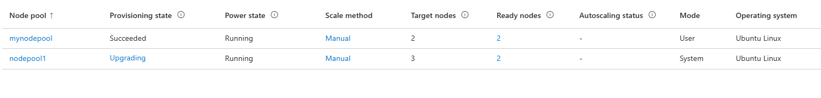
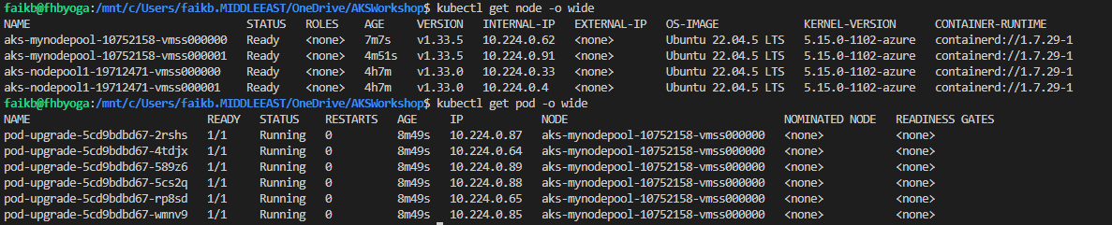
Node OS Upgrade Channels

Slide 52
Upgrade Events (kubectl get events --field-selector source=upgrader)
LAST SEEN TYPE REASON OBJECT MESSAGE
19m Normal Cordon node/aks-mynodepool-10752158-vmss000000 Cordoning node aks-mynodepool-10752158-vmss000000
19m Normal Cordon node/aks-mynodepool-10752158-vmss000000 Cordoned node aks-mynodepool-10752158-vmss000000
19m Normal Drain node/aks-mynodepool-10752158-vmss000000 Draining node: aks-mynodepool-10752158-vmss000000
18m Normal Upgrade node/aks-mynodepool-10752158-vmss000000 Deleting node aks-mynodepool-10752158-vmss000000 from API server
16m Normal Cordon node/aks-mynodepool-10752158-vmss000001 Cordoning node aks-mynodepool-10752158-vmss000001
16m Normal Cordon node/aks-mynodepool-10752158-vmss000001 Cordoned node aks-mynodepool-10752158-vmss000001
16m Normal Drain node/aks-mynodepool-10752158-vmss000001 Draining node: aks-mynodepool-10752158-vmss000001
16m Normal Upgrade node/aks-mynodepool-10752158-vmss000001 Deleting node aks-mynodepool-10752158-vmss000001 from API server
14m Normal Surge node/aks-mynodepool-10752158-vmss000002 Removing surge node: aks-mynodepool-10752158-vmss000002
14m Normal Cordon node/aks-mynodepool-10752158-vmss000002 Cordoning node aks-mynodepool-10752158-vmss000002
14m Normal Cordon node/aks-mynodepool-10752158-vmss000002 Cordoned node aks-mynodepool-10752158-vmss000002
14m Normal Drain node/aks-mynodepool-10752158-vmss000002 Draining node: aks-mynodepool-10752158-vmss000002
8m51s Normal Cordon node/aks-nodepool1-19712471-vmss000000 Cordoning node aks-nodepool1-19712471-vmss000000
8m50s Normal Cordon node/aks-nodepool1-19712471-vmss000000 Cordoned node aks-nodepool1-19712471-vmss000000
8m50s Normal Drain node/aks-nodepool1-19712471-vmss000000 Draining node: aks-nodepool1-19712471-vmss000000
8m19s Normal Upgrade node/aks-nodepool1-19712471-vmss000000 Deleting node aks-nodepool1-19712471-vmss000000 from API server
6m28s Normal Cordon node/aks-nodepool1-19712471-vmss000001 Cordoning node aks-nodepool1-19712471-vmss000001
6m28s Normal Cordon node/aks-nodepool1-19712471-vmss000001 Cordoned node aks-nodepool1-19712471-vmss000001
6m28s Normal Drain node/aks-nodepool1-19712471-vmss000001 Draining node: aks-nodepool1-19712471-vmss000001
6m17s Warning Drain node/aks-nodepool1-19712471-vmss000001 Eviction blocked by Too Many Requests (usually a pdb): konnectivity-agent-7b94d95b97-dkk67
5m27s Warning Drain node/aks-nodepool1-19712471-vmss000001 Eviction blocked by Too Many Requests (usually a pdb): metrics-server-7577897796-h9h7k
6m17s Warning Drain node/aks-nodepool1-19712471-vmss000001 Eviction blocked by Too Many Requests (usually a pdb): coredns-5b5b89b58c-7w8tv
4m46s Normal Upgrade node/aks-nodepool1-19712471-vmss000001 Deleting node aks-nodepool1-19712471-vmss000001 from API server
3m7s Normal Surge node/aks-nodepool1-19712471-vmss000002 Removing surge node: aks-nodepool1-19712471-vmss000002
3m7s Normal Cordon node/aks-nodepool1-19712471-vmss000002 Cordoning node aks-nodepool1-19712471-vmss000002
3m7s Normal Cordon node/aks-nodepool1-19712471-vmss000002 Cordoned node aks-nodepool1-19712471-vmss000002
3m7s Normal Drain node/aks-nodepool1-19712471-vmss000002 Draining node: aks-nodepool1-19712471-vmss000002
Cluster Nodes (kubectl get node -o wide)
NAME STATUS ROLES AGE VERSION INTERNAL-IP EXTERNAL-IP OS-IMAGE KERNEL-VERSION CONTAINER-RUNTIME
aks-mynodepool-10752158-vmss000000 Ready <none> 16m v1.33.5 10.224.0.62 <none> Ubuntu 22.04.5 LTS 5.15.0-1102-azure containerd://1.7.29-1
aks-mynodepool-10752158-vmss000001 Ready <none> 14m v1.33.5 10.224.0.91 <none> Ubuntu 22.04.5 LTS 5.15.0-1102-azure containerd://1.7.29-1
aks-nodepool1-19712471-vmss000000 Ready <none> 6m15s v1.33.5 10.224.0.33 <none> Ubuntu 22.04.5 LTS 5.15.0-1102-azure containerd://1.7.29-1
aks-nodepool1-19712471-vmss000001 Ready <none> 2m47s v1.33.5 10.224.0.4 <none> Ubuntu 22.04.5 LTS 5.15.0-1102-azure containerd://1.7.29-1

Slide 53
DEMO
Automatic Upgrade with Maintenance Window

Slide 54
Questions ?

Slide 55
Thank you

