Slide 1
AKS Workshop
Faik Hakan Bilgen,
Sr. CSA, Microsoft

Slide 2
Networking

Slide 3
Networking for applications in AKS
You can connect to and expose applications internally or externally.
You can build highly available applications by load balancing your applications.
You can restrict the flow of network traffic into or between pods and nodes to improve security.
You can configure Ingress traffic for SSL/TLS termination or routing of multiple components for your more complex applications.
Notes:
https://learn.microsoft.com/en-us/azure/aks/concepts-network

Slide 4
Kubernetes Networking Basics
Kubernetes nodes and virtual network: Kubernetes nodes are connected to a virtual network. This setup enables pods to have both inbound and outbound connectivity.
Kube-proxy component: kube-proxy runs on each node and is responsible for providing the necessary network features.
Notes:
https://learn.microsoft.com/en-us/azure/aks/concepts-network

Slide 5
Kubernetes Networking Basics
Load balancer: You can use a load balancer to distribute network traffic evenly across various resources.
Ingress controllers: These facilitate Layer 7 routing, which is essential for directing application traffic.
Egress traffic control: Kubernetes allows you to manage and control outbound traffic from cluster nodes.
Network policies: These policies enable security measures and filtering for network traffic in pods.
Notes:
https://learn.microsoft.com/en-us/azure/aks/concepts-network

Slide 6
Kubernetes Networking Basics
Azure streamlines virtual networking for AKS clusters.
Creating a Kubernetes load balancer on Azure simultaneously sets up the corresponding Azure load balancer resource.
As you open network ports to pods, Azure automatically configures the necessary network security group rules.
Azure can also manage external DNS configurations for HTTP application routing as new Ingress routes are established.
Notes:
https://learn.microsoft.com/en-us/azure/aks/concepts-network

Slide 7
Networking Basics
Outbound configuration options
By default, AKS clusters have unrestricted outbound (egress) Internet access, which allows the nodes and services you run to access external resources as needed. If desired, you can restrict outbound traffic.
Network security groups
Custom virtual network requirement
Network policies
By default, all pods in an AKS cluster can send and receive traffic without limitations. For improved security, define rules that control the flow of traffic, like:
Back-end applications are only exposed to required frontend services.
Database components are only accessible to the application tiers that connect to them.
Notes:
https://learn.microsoft.com/en-us/azure/aks/concepts-network

Slide 8
DEMO
Creating Node Pools

Slide 9
AKS Container Network Interface (CNI) Networking

Slide 10
CNI Overview
Kubernetes uses Container Networking Interface (CNI) plugins to manage networking in Kubernetes clusters.
CNI plug-ins are responsible for:
  assigning IP addresses to pods
  network routing between pods,
  Kubernetes service routing,
  and more…
Azure Kubernetes Service (AKS) provides multiple CNI plugins that you can use in your clusters, depending on your networking requirements.
Notes:
https://learn.microsoft.com/en-us/azure/aks/configure-kubenet

Slide 11
Networking Models in AKS
Overlay network model: Overlay networking is the most common networking model used in Kubernetes. Pods are given an IP address from a private, logically separate CIDR from the Azure virtual network subnet where AKS nodes are deployed. This model enables simpler, improved scalability when compared to the flat network model.
Flat network model: A flat network model in AKS assigns IP addresses to pods from a subnet from the same Azure virtual network as the AKS nodes. Any traffic leaving your clusters isn't SNAT'd, and the pod IP address is directly exposed to the destination. This model can be useful for scenarios like exposing pod IP addresses to external services.
Notes:
https://learn.microsoft.com/en-us/azure/aks/concepts-network

Slide 12
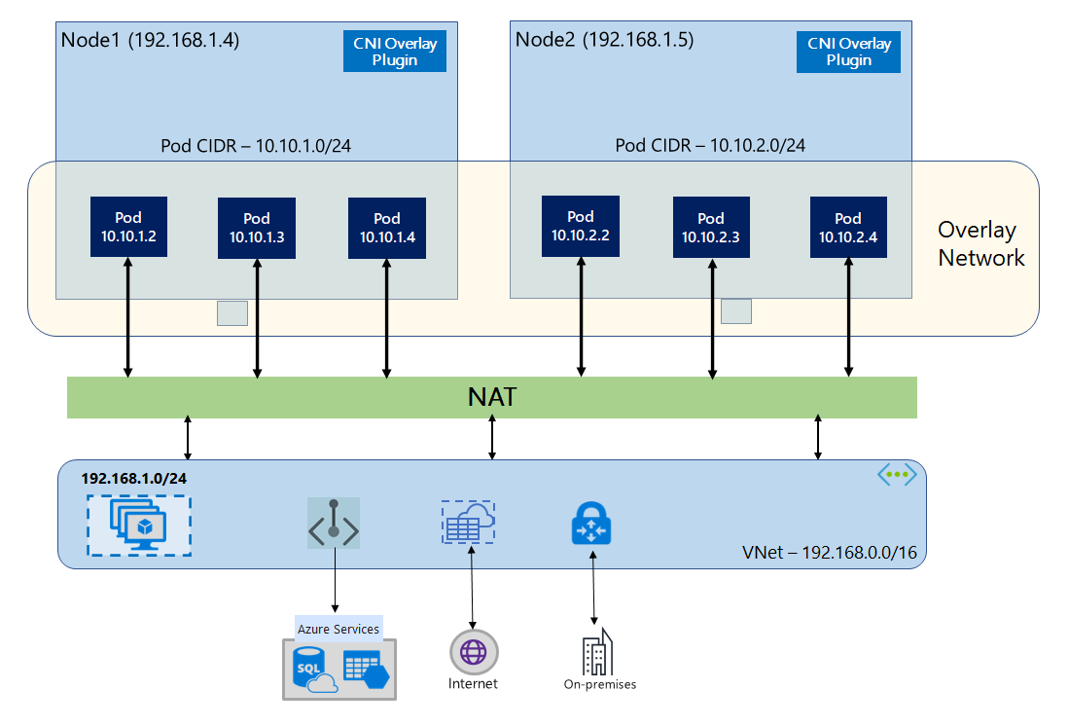
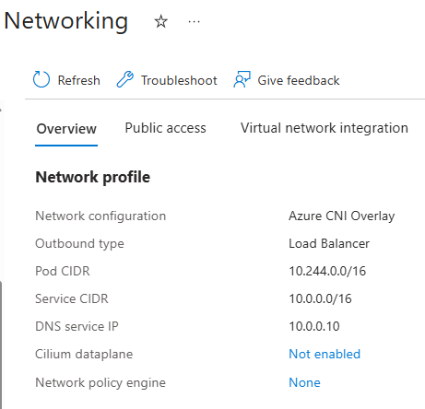
Overlay Network Model -default
Notes:
Concepts - CNI Networking in AKS - Azure Kubernetes Service | Microsoft Learn

Slide 13
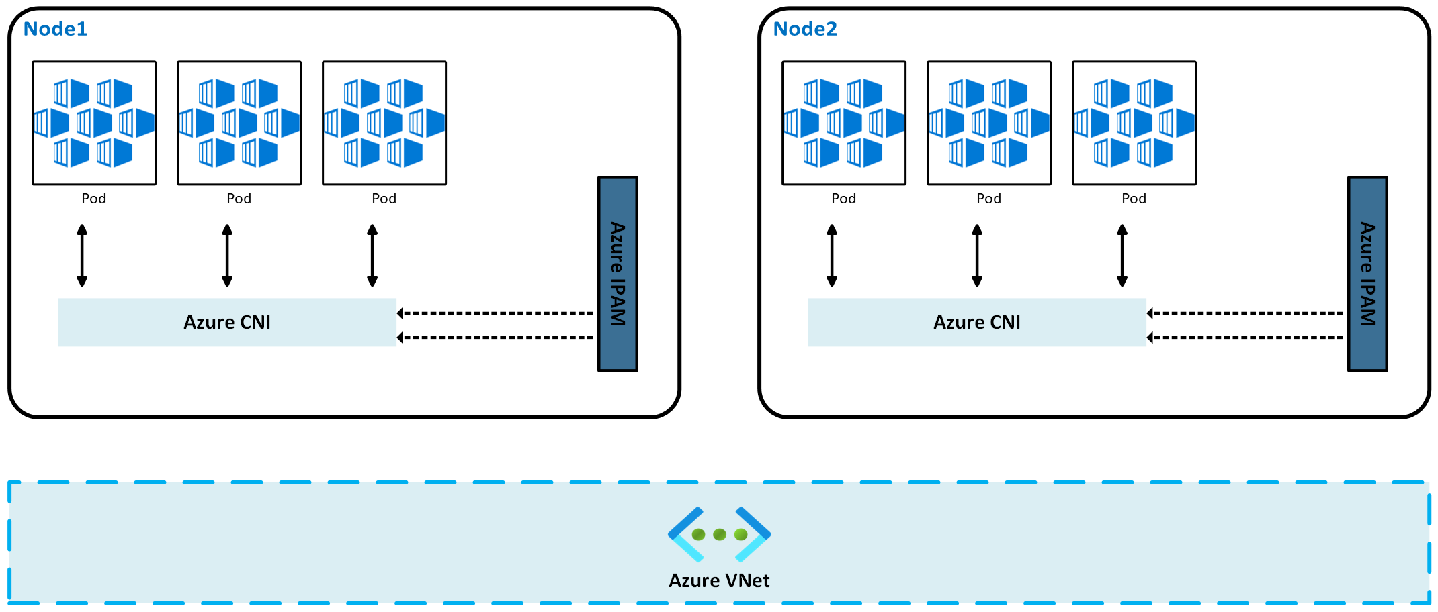
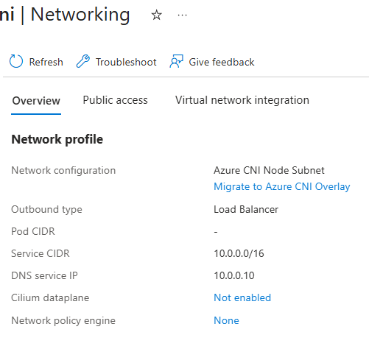
Flat Networks
Notes:
Concepts - CNI Networking in AKS - Azure Kubernetes Service | Microsoft Learn

Slide 14
CNI Pod Subnet

Slide 15
CNI Pod Subnet
Azure CNI Pod Subnet assigns IP addresses to pods from a separate subnet from your cluster Nodes.
This feature is available in two modes:
Dynamic IP Allocation
Static Block Allocation
Notes:
https://learn.microsoft.com/en-us/azure/aks/concepts-network-azure-cni-pod-subnet

Slide 16
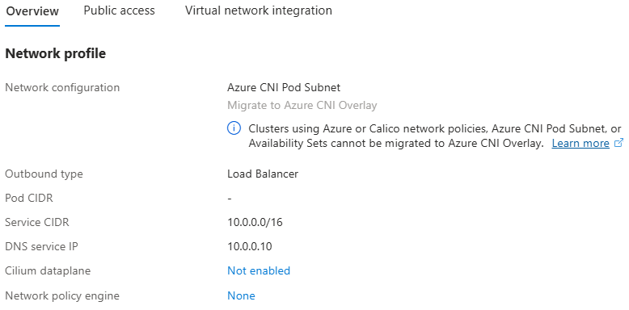
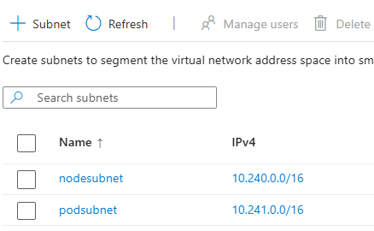
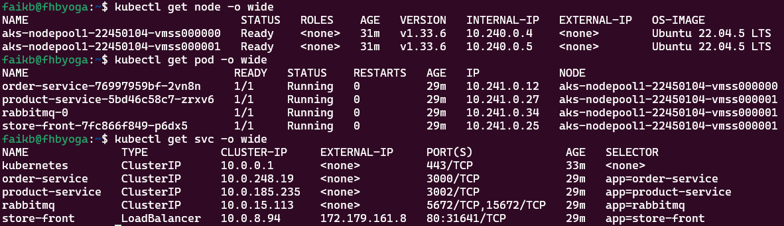
CNI
Networking
(Pod Subnet)

Slide 17
CNI Node Subnet
(Legacy)

Slide 18
CNI Node Subnet (Legacy)
In Azure Kubernetes Service (AKS), while Azure CNI Overlay and Azure CNI Pod Subnet are recommended for most scenarios, legacy networking models such as Azure CNI Node Subnet and kubenet are still available and supported.
Notes:
https://learn.microsoft.com/en-us/azure/aks/concepts-network-azure-cni-pod-subnet

Slide 19
CNI Node Subnet (Legacy)
With Azure Container Networking Interface (CNI), every pod gets an IP address from the subnet and can be accessed directly.
Systems in the same virtual network as the AKS cluster see the pod IP as the source address for any traffic from the pod.
Systems outside the AKS cluster virtual network see the node IP as the source address for any traffic from the pod.
These IP addresses must be unique across your network space and must be planned in advance.
Each node has a configuration parameter for the maximum number of pods that it supports.
The equivalent number of IP addresses per node are then reserved up front for that node.
This approach requires more planning, and often leads to IP address exhaustion or the need to rebuild clusters in a larger subnet as your application demands grow.
Notes:
https://learn.microsoft.com/en-us/azure/aks/concepts-network-azure-cni-pod-subnet

Slide 20
CNI Node Subnet (Legacy)
With Azure CNI Node Subnet, each pod receives an IP address in the IP subnet and can communicate directly with other pods and services.
Your clusters can be as large as the IP address range you specify.
However, you must plan the IP address range in advance, and all the IP addresses are consumed by the AKS nodes based on the maximum number of pods they can support.
Advanced network features and scenarios such as virtual nodes or Network Policies (either Azure or Calico) are supported with Azure CNI.
Notes:
https://learn.microsoft.com/en-us/azure/aks/concepts-network-azure-cni-pod-subnet

Slide 21
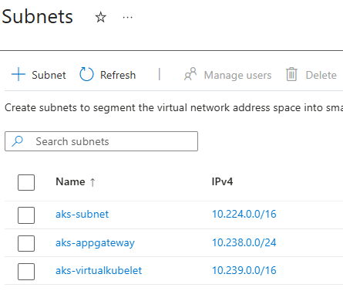
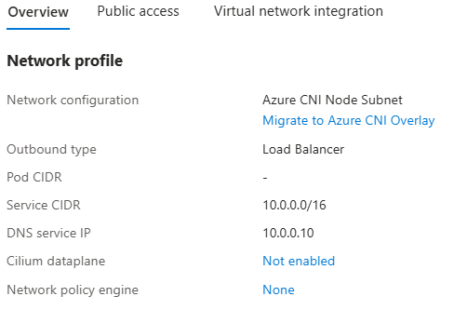
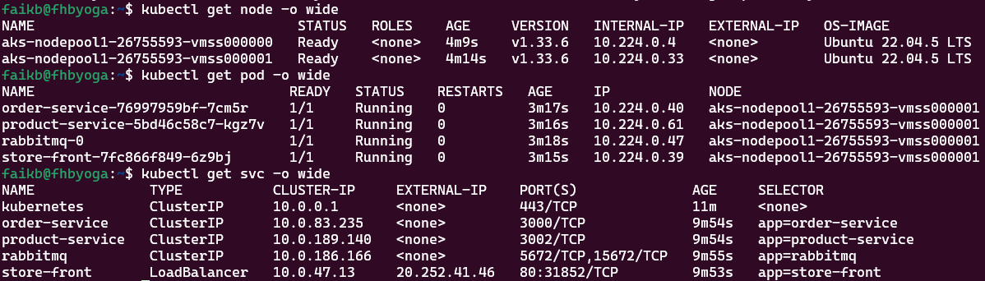
CNI
Networking
(Legacy)

Slide 22
kubenet

Slide 23
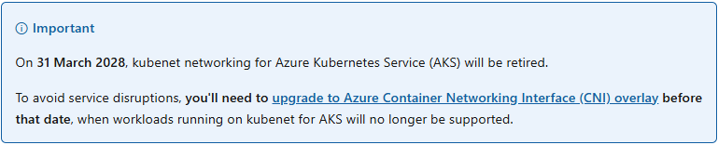
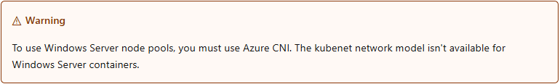
kubenet Networking
https://learn.microsoft.com/en-us/azure/aks/configure-kubenet
Notes:
https://learn.microsoft.com/en-us/azure/aks/configure-kubenet

Slide 24
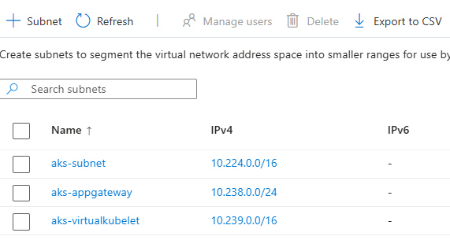
kubenet Networking
AKS clusters use kubenet and create an Azure virtual network and subnet for you by default.
With kubenet, nodes get an IP address from the Azure virtual network subnet.
Notes:
https://learn.microsoft.com/en-us/azure/aks/configure-kubenet

Slide 25
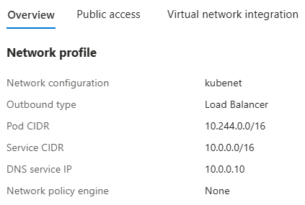
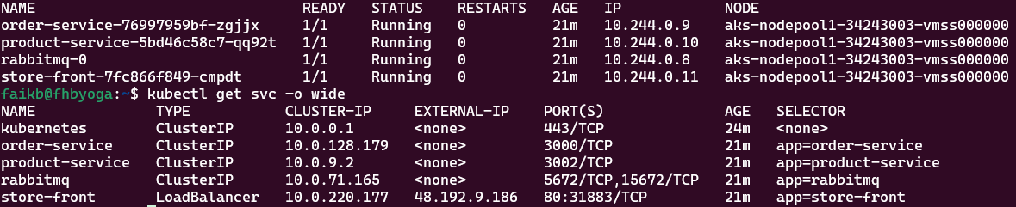
kubenet Networking
Pods receive an IP address from a logically different address space to the Azure virtual network subnet of the nodes.
Network address translation (NAT) is then configured so the pods can reach resources on the Azure virtual network.
The source IP address of the traffic is NAT'd to the node's primary IP address. This approach greatly reduces the number of IP addresses you need to reserve in your network space for pods to use.
Notes:
https://learn.microsoft.com/en-us/azure/aks/configure-kubenet

Slide 26
kubenet Networking
With kubenet, only the nodes receive an IP address in the virtual network subnet.
Pods can't communicate directly with each other.
Instead, User Defined Routing (UDR) and IP forwarding handle connectivity between pods across nodes.
UDRs and IP forwarding configuration is created and maintained by the AKS service by default,
but you can bring your own route table for custom route management if you want.
You can also deploy pods behind a service that receives an assigned IP address and load balances traffic for the application.
Notes:
https://learn.microsoft.com/en-us/azure/aks/configure-kubenet

Slide 27
kubenet Networking Limitations
An additional hop is required in the design of kubenet, which adds minor latency to pod communication.
Route tables and user-defined routes are required for using kubenet, which adds complexity to operations.
Direct pod addressing isn't supported for kubenet due to kubenet design.
Unlike Azure CNI clusters, multiple kubenet clusters can't share a subnet.
Notes:
https://learn.microsoft.com/en-us/azure/aks/configure-kubenet

Slide 28
kubenet Networking Limitations
AKS doesn't apply Network Security Groups (NSGs) to its subnet and doesn't modify any of the NSGs associated with that subnet. If you provide your own subnet and add NSGs associated with that subnet, you must ensure the security rules in the NSGs allow traffic between the node and pod CIDR.
Features not supported on kubenet include:
Azure network policies
Windows node pools
Virtual nodes add-on
Notes:
https://learn.microsoft.com/en-us/azure/aks/configure-kubenet

Slide 29
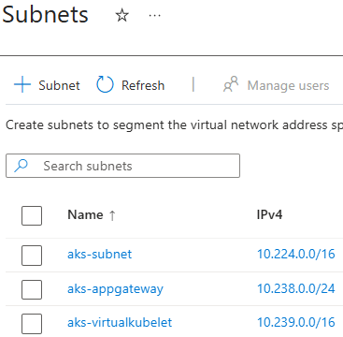
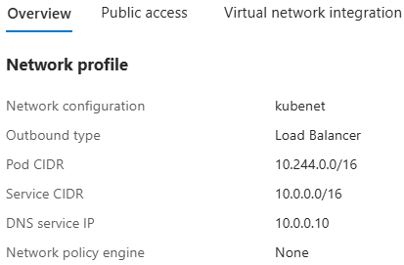
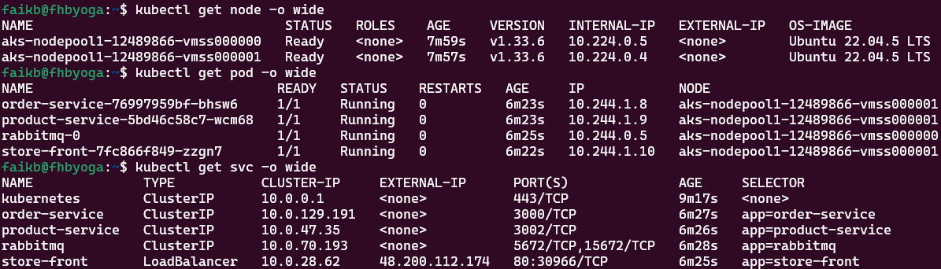
kubenet
Networking

Slide 30
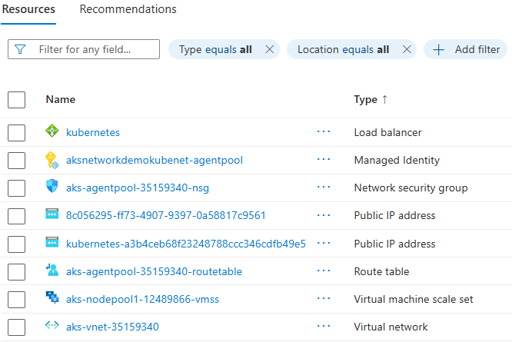
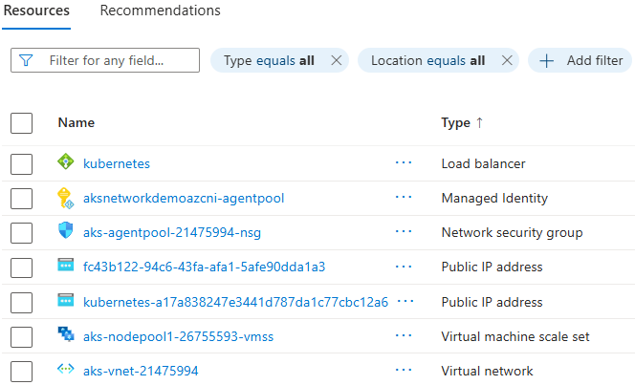
kubenet Networking
CNI Networking

Slide 31
Azure CNI Overlay

Slide 32
CNI Overlay Networking
Azure CNI Overlay is a networking model for Azure Kubernetes Service (AKS) that provides efficient IP address management and high-performance pod communication.
Notes:
https://learn.microsoft.com/en-us/azure/aks/configure-kubenet

Slide 33
CNI Overlay Networking
Azure CNI Overlay is a networking model for Azure Kubernetes Service (AKS) that provides efficient IP address management and high-performance pod communication.
In overlay networking, only the Kubernetes cluster nodes are assigned IPs from subnets.
Pods receive IPs from a private Classless Inter-Domain Routing (CIDR) range provided at the time of cluster creation.
Each node is assigned a /24 address space carved out from the same CIDR.
Extra nodes created when you scale out a cluster automatically receive /24 address spaces from the same CIDR.
Azure CNI assigns IPs to pods from this /24 space.
Notes:
https://learn.microsoft.com/en-us/azure/aks/configure-kubenet

Slide 34
CNI Overlay Networking
A separate routing domain is created in the Azure networking stack for the pod's private CIDR space.
This domain creates an overlay network for direct communication between pods.
There's no need to provision custom routes on the cluster subnet or use an encapsulation method to tunnel traffic between pods, which provides connectivity performance between pods on par with virtual machines (VMs) in a virtual network.
Workloads running within the pods aren't even aware that network address manipulation is happening.
Notes:
https://learn.microsoft.com/en-us/azure/aks/configure-kubenet

Slide 35
CNI Overlay Networking
Notes:
https://learn.microsoft.com/en-us/azure/aks/configure-kubenet

Slide 36
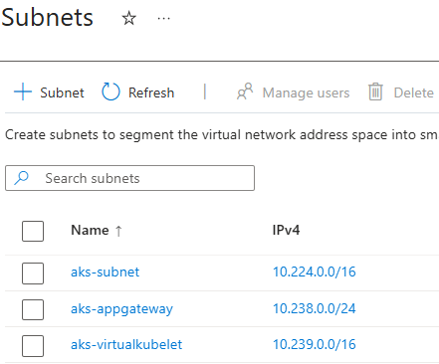
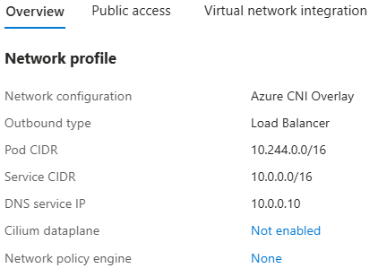
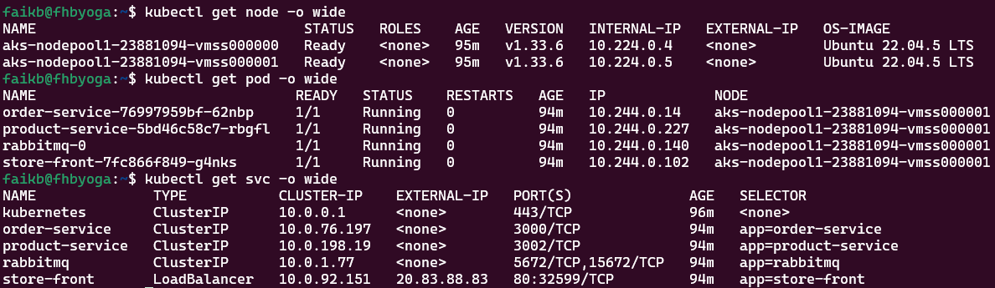
CNI Overlay
Networking

Slide 37
CNI Overlay Networking
Communication with endpoints outside the cluster, such as on-premises and peered virtual networks, uses the node IP through network address translation (NAT).
Azure CNI translates the source IP (overlay IP of the pod) of the traffic to the primary IP address of the VM. This translation enables the Azure networking stack to route the traffic to the destination.
Endpoints outside the cluster can't connect to a pod directly. You have to publish the pod's application as a Kubernetes Load Balancer service to make it reachable on the virtual network.
Notes:
https://learn.microsoft.com/en-us/azure/aks/configure-kubenet

Slide 38
CNI Overlay Networking
You can provide outbound (egress) connectivity to the internet for overlay pods by using a standard load balancer or managed NAT gateway.
You can also control egress traffic by directing it to a firewall via user-defined routes on the cluster subnet.
You can configure ingress connectivity to the cluster by using an ingress controller, such as Application Gateway for Containers, NGINX, or the application routing add-on.
Notes:
https://learn.microsoft.com/en-us/azure/aks/configure-kubenet

Slide 39
CNI Overlay & kubenet specifications
Area | Azure CNI Overlay | kubenet
Cluster scale | 5,000 nodes and 250 pods per node | 400 nodes and 250 pods per node
Network configuration | Simple - no extra configurations required for pod networking | Complex - requires route tables and user-defined routes on the cluster subnet for pod networking
Pod connectivity performance | Performance on par with VMs in a virtual network | Extra hop adds latency
Kubernetes network policies | Azure network policies, Calico, Cilium | Calico
OS platforms supported | Linux, Windows Server 2022, Windows Server 2019 | Linux only
Notes:
https://learn.microsoft.com/en-us/azure/aks/configure-kubenet

Slide 40
IP Address Availability
kubenet: A simple /24 IP address range can support up to 251 nodes in the cluster. Each Azure virtual network subnet reserves the first three IP addresses for management operations. This node count can support up to 27,610 pods, with a default maximum of 110 pods per node.
Azure CNI: That same basic /24 subnet range can only support a maximum of eight nodes in the cluster. This node count can only support up to 240 pods, with a default maximum of 30 pods per node.
Notes:
https://learn.microsoft.com/en-us/azure/aks/configure-kubenet

Slide 41
Choose a network model to use
Use kubenet when:
You have limited IP address space.
Most of the pod communication is within the cluster.
You don't need advanced AKS features, such as virtual nodes or Azure Network Policy.
Use Azure CNI when:
You have available IP address space.
Most of the pod communication is to resources outside of the cluster.
You don't want to manage user defined routes for pod connectivity.
You need AKS advanced features, such as virtual nodes or Azure Network Policy.
Notes:
https://learn.microsoft.com/en-us/azure/aks/configure-kubenet

Slide 42
Choosing a CNI plugin
Use kubenet when:
You have limited IP address space.
Most of the pod communication is within the cluster.
You don't need advanced AKS features, such as virtual nodes or Azure Network Policy.
Use Azure CNI when:
You have available IP address space.
Most of the pod communication is to resources outside of the cluster.
You don't want to manage user defined routes for pod connectivity.
You need AKS advanced features, such as virtual nodes or Azure Network Policy.
Notes:
https://learn.microsoft.com/en-us/azure/aks/configure-kubenet

Slide 43
Network Policies

Slide 44
Overview of Network Policy
By default, all pods in an AKS cluster can send and receive traffic without limitations. To improve security, you can define rules that control the flow of traffic.
Network policy is a Kubernetes specification that defines access policies for communication between pods. When you use network policies, you define an ordered set of rules to send and receive traffic. You apply the rules to a collection of pods that match one or more label selectors.
You define the network policy rules as YAML manifests, and you can include them in wider manifests that also create a deployment or service.
Notes:
https://learn.microsoft.com/en-us/azure/aks/use-network-policies

Slide 45
Network policy options in AKS
Azure provides three network policy engines for enforcing network policies:
Cilium (for AKS clusters using Azure CNI Powered by Cilium)
Azure Network Policy Manager (NPM)
Calico (an open-source network and network security solution founded by Tigera)
We recommend using Cilium. Cilium enforces network policy on the traffic using Linux Berkeley Packet Filter (BPF), which is more efficient than IPTables.
To enforce the specified policies, Azure NPM uses IPTables for Linux and Host Network Service (HNS) ACLPolicies for Windows. Policies are translated into sets of allowed and disallowed IP pairs. These pairs are then programmed as IPTable or HNS ACLPolicy filter rules.
Notes:
https://learn.microsoft.com/en-us/azure/aks/use-network-policies

Slide 46
Network policy options in AKS
Network policy engine | Supported platforms | Supported networking options | Kubernetes specification compliance | Other features | Support
Cilium | Linux | Azure CNI | Supports all policy types | FQDN, L3/4, L7 | Azure support and engineering team
Azure NPM | Linux, Windows Server 2022 | Azure CNI | Supports all policy types | N/A | Azure support and engineering team
Calico | Linux, Windows Server 2019, Windows Server 2022 | Azure CNI (Linux, Windows Server 2019, Windows Server 2022) and kubenet (Linux) | Supports all policy types | While Calico has many features that AKS doesn't block, AKS doesn't test or support them. For more information, see Calico Network Policy issue. | Azure support and engineering team
Notes:
https://learn.microsoft.com/en-us/azure/aks/use-network-policies

Slide 47
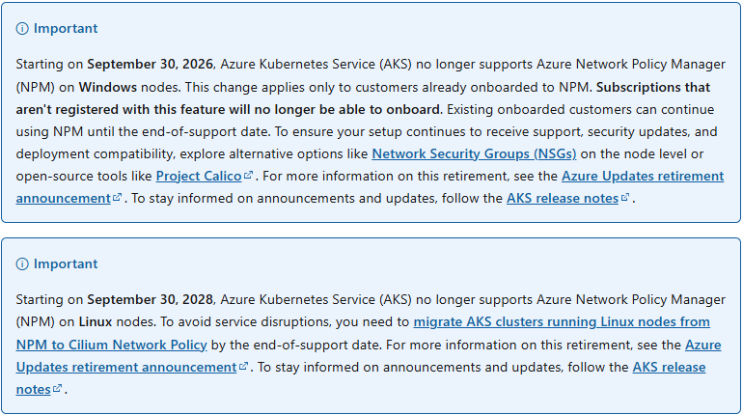
Network policy options in AKS
Notes:
https://learn.microsoft.com/en-us/azure/aks/use-network-policies

Slide 48
Network policy options in AKS
Notes:
https://learn.microsoft.com/en-us/azure/aks/use-network-policies

Slide 49
Questions ?

Slide 50
Thank you

