Slide 1
AKS Workshop
Faik Hakan Bilgen,
Sr. CSA, Microsoft

Slide 2
Observability

Slide 3
DEMO
Advanced Observability Concepts
Notes:
https://azure-samples.github.io/aks-labs/docs/operations/observability-and-monitoring

Slide 4
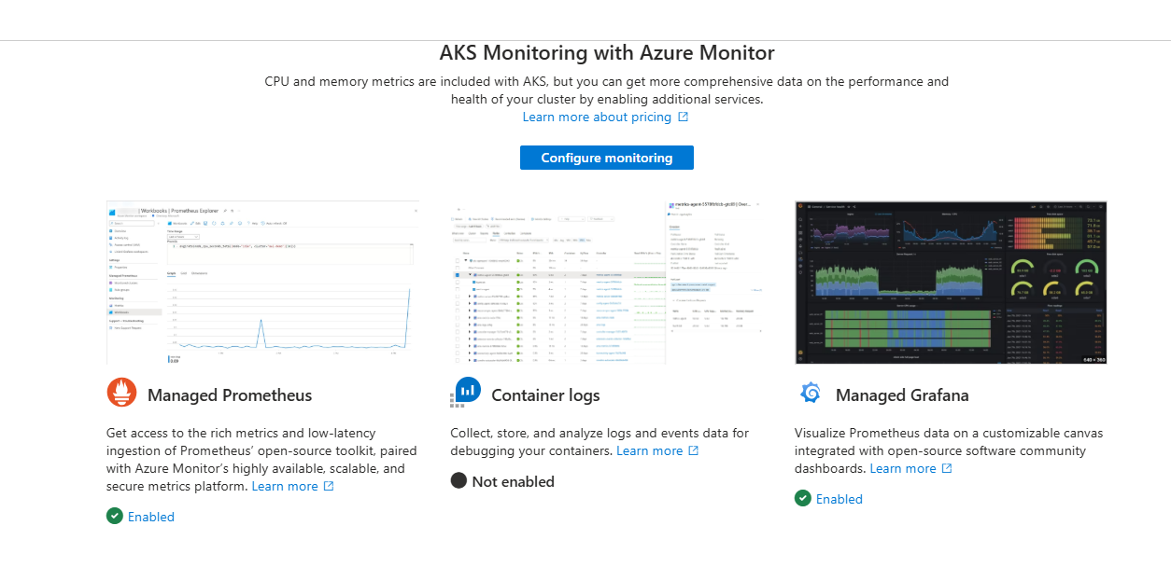
AKS Monitoring

Slide 5
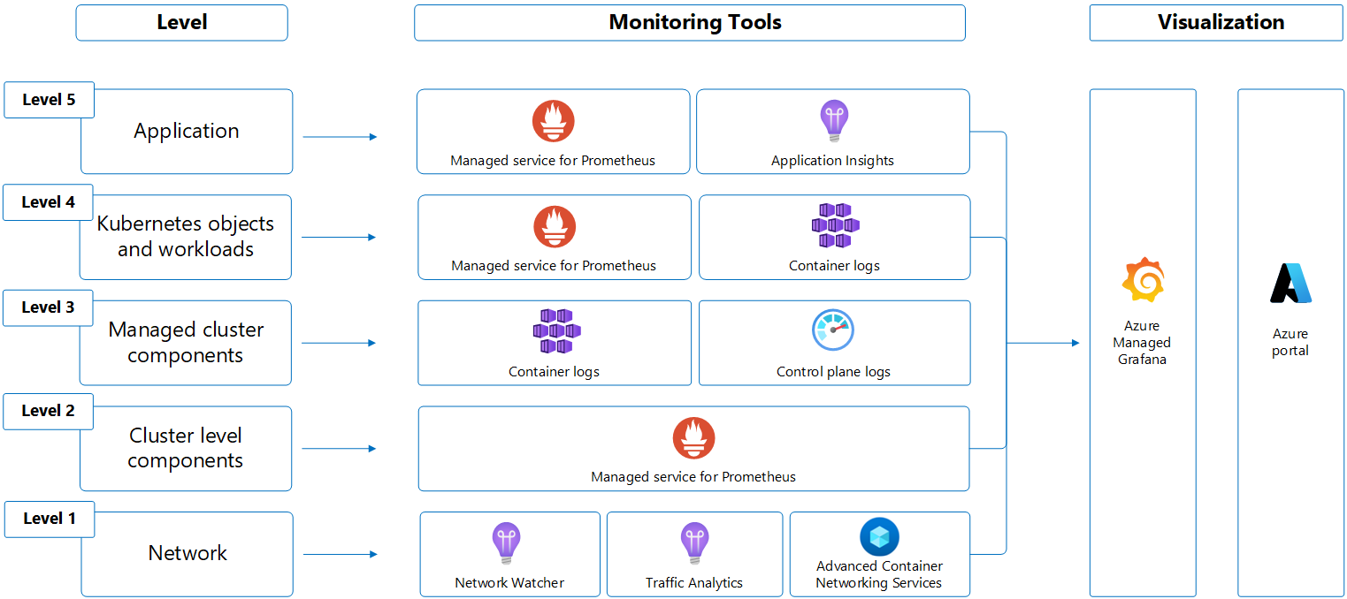
AKS Layers

Slide 6

AKS Monitoring
Monitor
Resource Visualizer
Monitoring
  Insights
  Alerts
  Metrics
  Advisor Recommendations
  Logs

Slide 7
About the agentic CLI for AKS

Slide 8
Questions ?

Slide 9
Thank you

