Slide 1

Performance in the age of intelligent cloud
Building fast, frugal and sustainable software on Azure
Azure
AI
Observability
For Microsoft Turkey summer interns
Faik Hakan Bilgen, Snr. CSA faikb@microsoft.com
Materials at
https://github.com/fhbilgen/PublicPresentations/tree/main/MSTRSummer2026
https://github.com/fhbilgen/demo-summer-2026
Notes:
Speaker notes: Talk track: Open with a simple framing: every CPU cycle, byte of RAM, storage operation and network call has an engineering cost and an environmental cost. Performance is not only speed, it is resource discipline. Visual on this slide was generated with Microsoft Copilot. Source: Brand Central Azure page notes Azure provides brand guidelines, templates and creative assets: https://brandcentral.microsoft.com/content/brandcentral/us/en/microsoft-brand/products/azure.html [Sources] Visual on this slide was generated with Microsoft Copilot. Source: Brand Central Azure page notes Azure provides brand guidelines, templates and creative assets: https://brandcentral.microsoft.com/content/brandcentral/us/en/microsoft-brand/products/azure.html

Slide 2

Why performance is a sustainability topic
A performant workload does useful work with fewer resources.
The core idea
Mental model
Azure Well-Architected connection
• Cloud software consumes physical resources.
• Waste appears as idle compute, memory pressure, storage growth and network chatter.
• Frugal software improves user experience, cost and sustainability together.
• Fast is good.
• Efficient is better.
• Efficient + observable + continuously optimized is cloud engineering maturity.
• Sustainability guidance emphasizes design and operational choices that influence resource consumption.
• Performance efficiency recommendations focus on application efficiency, compute, network and storage footprint.
https://learn.microsoft.com/en-us/azure/well-architected/
Notes:
Speaker notes: Talk track: Connect the audience’s likely interest in AI and coding to the practical engineering discipline of performance. The sustainable workload is not a separate concept from good architecture. It is usually the visible result of efficiency. Visual on this slide was generated with Microsoft Copilot. Source: Azure Well-Architected Framework sustainability overview says design choices shape resource consumption and sustainability overlaps with cost optimization: https://learn.microsoft.com/en-us/azure/well-architected/sustainability/overview Source: Azure Well-Architected Framework sustainability workload documentation lists performance efficiency areas including application efficiency, compute, network and storage footprint: https://learn.microsoft.com/en-us/azure/well-architected/sustainability/ [Sources] Visual on this slide was generated with Microsoft Copilot. Source: Azure Well-Architected Framework sustainability overview says design choices shape resource consumption and sustainability overlaps with cost optimization: https://learn.microsoft.com/en-us/azure/well-architected/sustainability/overview Source: Azure Well-Architected Framework sustainability workload documentation lists performance efficiency areas including application efficiency, compute, network and storage footprint: https://learn.microsoft.com/en-us/azure/well-architected/sustainability/

Slide 3
The four resources your code spends
The cloud bill and the carbon footprint both start with resource consumption.
CPU cycles
RAM
• Algorithm complexity, hot loops, serialization, encryption, compression
• Object allocation, caching, buffering, leaks, GC behavior
Persistent storage
Network bandwidth
• Indexes, logs, blobs, backups, retention, data duplication
• Chatty APIs, payload size, retries, cross-region traffic
Less waste = more headroom for innovation
Notes:
Speaker notes: Talk track: Ask students to think of code as spending a budget. Every loop, allocation, query and request spends from a cloud resource budget. Performance engineering is the craft of spending deliberately. Source: Azure Well-Architected sustainability guidance links sustainability and performance to resource consumption across compute, memory, storage, network and time: https://github.com/MicrosoftDocs/well-architected/blob/main/well-architected/sustainability/sustainability-performance-efficiency-recommendations.md [Sources] Source: Azure Well-Architected sustainability guidance links sustainability and performance to resource consumption across compute, memory, storage, network and time: https://github.com/MicrosoftDocs/well-architected/blob/main/well-architected/sustainability/sustainability-performance-efficiency-recommendations.md

Slide 4
From “run faster” to “run smarter”
Performance is a loop, not a one-time benchmark.
1. Define
2. Measure
3. Analyze
4. Optimize
5. Validate
SLOs, latency, throughput, resource targets
Metrics, logs, traces, profiles, dumps
Bottlenecks, regressions, dependency behavior
Code, data, scale, architecture
Load tests, canaries, guardrails
Key message: optimization without measurement is guesswork.
Notes:
Speaker notes: Talk track: Introduce a repeatable engineering loop. The students should leave with a mindset: do not optimize random code. Define targets, measure, analyze and validate. Source: Azure Monitor documentation says Azure Monitor helps collect and analyze telemetry to maximize performance and availability: https://learn.microsoft.com/en-us/azure/azure-monitor/ [Sources] Source: Azure Monitor documentation says Azure Monitor helps collect and analyze telemetry to maximize performance and availability: https://learn.microsoft.com/en-us/azure/azure-monitor/

Slide 5

Observability: the data foundation for optimization
Metrics tell you what changed. Logs tell you what happened. Traces tell you where time went.
Metrics
Logs
Traces
• Time-series signals.
• Great for resource usage, latency, throughput and error rate.
• Best for dashboards and alerts.
• Detailed event records.
• Great for exceptions, diagnostics and audit trails.
• Best for investigation and context.
• End-to-end request path.
• Great for distributed systems and dependency latency.
• Best for finding bottlenecks.
Ask better questions
Why is this slow?
Where is waste?
What changed?
Notes:
Speaker notes: Talk track: Explain that AI does not magically know what is happening in a cloud system. It needs high-quality telemetry. Poor observability leads to poor recommendations. Visual on this slide was generated with Microsoft Copilot. Source: Azure Monitor documentation describes monitoring Azure and on-premises services and aggregating/analyzing metrics, logs and traces: https://learn.microsoft.com/en-us/azure/azure-monitor/ Source: Application Insights overview describes Application Insights as an APM feature of Azure Monitor and says OpenTelemetry can instrument applications and collect telemetry: https://learn.microsoft.com/en-us/azure/azure-monitor/app/app-insights-overview [Sources] Visual on this slide was generated with Microsoft Copilot. Source: Azure Monitor documentation describes monitoring Azure and on-premises services and aggregating/analyzing metrics, logs and traces: https://learn.microsoft.com/en-us/azure/azure-monitor/ Source: Application Insights overview describes Application Insights as an APM feature of Azure Monitor and says OpenTelemetry can instrument applications and collect telemetry: https://learn.microsoft.com/en-us/azure/azure-monitor/app/app-insights-overview

Slide 6
Azure Monitor + Application Insights: the optimization toolbox
A practical map for students: from signal to action.
Application dashboard
Application map
Live metrics
Performance view
Health and performance at a glance
Architecture and component interactions
Near-real-time activity and performance
Request duration and bottlenecks
Failures view
Logs / KQL
Alerts
Profiler
Exceptions and failure hotspots
Deep exploration across telemetry
Proactive detection and notification
CPU and memory triggered traces
Use the right tool for the signal you need.
Notes:
Speaker notes: Talk track: Keep this practical. Show students the mental map of where to look in the Azure portal if a workload is slow or wasteful. Source: Application Insights overview lists capabilities including dashboard, application map, live metrics, search, availability, failures, performance, alerts, metrics, logs, workbooks and Grafana dashboards: https://learn.microsoft.com/en-us/azure/azure-monitor/app/app-insights-overview Source: Application Insights Profiler settings page describes CPU and memory triggers and on-demand profiling sessions: https://learn.microsoft.com/en-us/azure/azure-monitor/profiler/profiler-settings [Sources] Source: Application Insights overview lists capabilities including dashboard, application map, live metrics, search, availability, failures, performance, alerts, metrics, logs, workbooks and Grafana dashboards: https://learn.microsoft.com/en-us/azure/azure-monitor/app/app-insights-overview Source: Application Insights Profiler settings page describes CPU and memory triggers and on-demand profiling sessions: https://learn.microsoft.com/en-us/azure/azure-monitor/profiler/profiler-settings

Slide 7
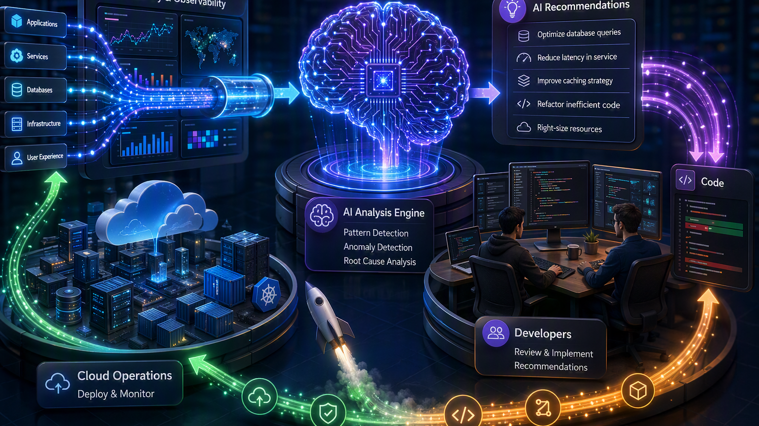
Where AI enters the performance loop
AI can help analyze telemetry and turn data into engineering hypotheses.
Input to AI
AI analysis
Human-in-the-loop result
• Telemetry: metrics, logs and traces.
• Profiles and diagnostic snapshots.
• Architecture context and code context.
• Pattern detection.
• Anomaly explanation.
• Bottleneck prioritization.
• Suggested experiments.
• Treat recommendations as hypotheses.
• Review code and architecture tradeoffs.
• Validate with load tests and production telemetry.
Notes:
Speaker notes: Talk track: Make an important distinction: AI should accelerate analysis, not replace engineering judgment. Ask students to validate every optimization with data. Visual on this slide was generated with Microsoft Copilot. Source: Azure Monitor Code Optimizations page describes an AI-based service in Application Insights that works with Application Insights Profiler for .NET to detect CPU and memory performance issues at code level and provide recommendations: https://learn.microsoft.com/en-us/azure/azure-monitor/optimization-insights/code-optimizations-profiler-overview [Sources] Visual on this slide was generated with Microsoft Copilot. Source: Azure Monitor Code Optimizations page describes an AI-based service in Application Insights that works with Application Insights Profiler for .NET to detect CPU and memory performance issues at code level and provide recommendations: https://learn.microsoft.com/en-us/azure/azure-monitor/optimization-insights/code-optimizations-profiler-overview

Slide 8
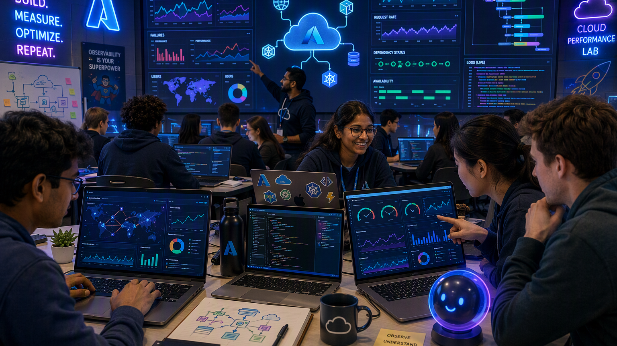
Code-level optimization: from hot path to pull request
GitHub Copilot can help developers reason about code changes when given enough context.
1. Identify the hot path
2. Bring context to Copilot
3. Validate the change
• Profiler points to methods, functions and call stacks.
• Code Optimizations narrows down bottlenecks and provides code-level recommendations.
• Explain the method, workload, SLO and profiling evidence.
• Ask for alternatives with complexity, allocation and reliability tradeoffs.
• Run tests and benchmark before/after.
• Deploy safely and monitor the same signals again.
Notes:
Speaker notes: Talk track: Describe Copilot as a reasoning partner. The better the evidence you give it, the better the output. Never accept performance recommendations without tests. Visual on this slide was generated with Microsoft Copilot. Source: GitHub Copilot documentation says Copilot can enhance productivity and assist as you work on code: https://docs.github.com/en/copilot Source: Azure Monitor Code Optimizations page says Code Optimizations connects data with methods/functions, finds bottlenecks and provides code-level performance fixes based on insights; it also mentions copying insight context to GitHub Copilot: https://learn.microsoft.com/en-us/azure/azure-monitor/optimization-insights/code-optimizations-profiler-overview [Sources] Visual on this slide was generated with Microsoft Copilot. Source: GitHub Copilot documentation says Copilot can enhance productivity and assist as you work on code: https://docs.github.com/en/copilot Source: Azure Monitor Code Optimizations page says Code Optimizations connects data with methods/functions, finds bottlenecks and provides code-level performance fixes based on insights; it also mentions copying insight context to GitHub Copilot: https://learn.microsoft.com/en-us/azure/azure-monitor/optimization-insights/code-optimizations-profiler-overview

Slide 9
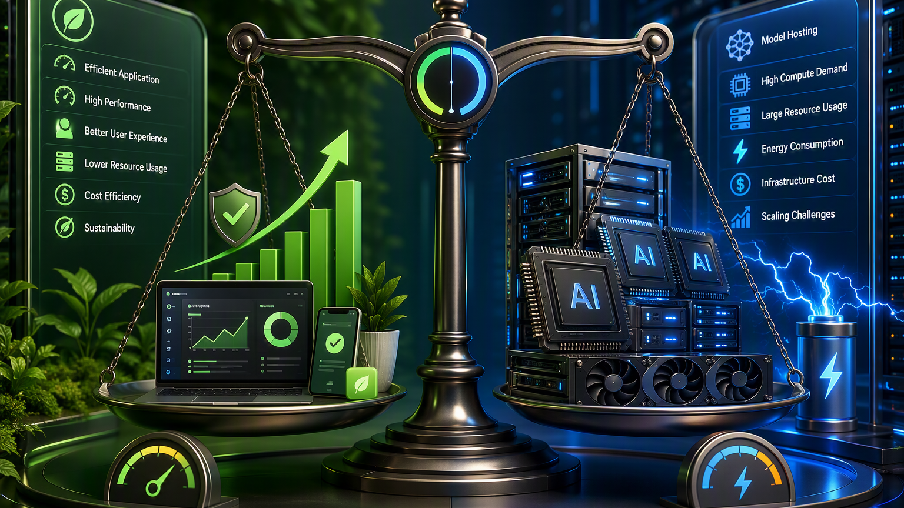
When metrics are not enough: profiles and memory dumps
Deep diagnostics reveal what is consuming CPU or keeping memory alive.
CPU profiling
Memory analysis
AI-assisted diagnostics
• Find expensive methods and call chains.
• Compare before/after or date-to-date regressions.
• Use samples to guide code inspection.
• Look for allocation spikes and retained objects.
• Understand roots that keep graphs alive.
• Reduce large object graphs or avoid materialization.
• AI can summarize patterns in profiler/dump evidence.
• Useful for explaining hypotheses to humans.
• Protect customer data and handle dumps with care.
Notes:
Speaker notes: Talk track: A memory dump is like a frozen snapshot of a process. It can be powerful, but it can contain sensitive data and must be handled carefully. For interns, keep demos synthetic. Visual on this slide was generated with Microsoft Copilot. Source: Application Insights Profiler settings page explains CPU and memory triggers for profiling sessions: https://learn.microsoft.com/en-us/azure/azure-monitor/profiler/profiler-settings Source: Application Insights smart detection documentation says memory leak detection can automatically analyze memory consumption of each process and warn about potential leaks or increased memory consumption: https://learn.microsoft.com/en-us/azure/azure-monitor/alerts/proactive-potential-memory-leak [Sources] Visual on this slide was generated with Microsoft Copilot. Source: Application Insights Profiler settings page explains CPU and memory triggers for profiling sessions: https://learn.microsoft.com/en-us/azure/azure-monitor/profiler/profiler-settings Source: Application Insights smart detection documentation says memory leak detection can automatically analyze memory consumption of each process and warn about potential leaks or increased memory consumption: https://learn.microsoft.com/en-us/azure/azure-monitor/alerts/proactive-potential-memory-leak

Slide 10
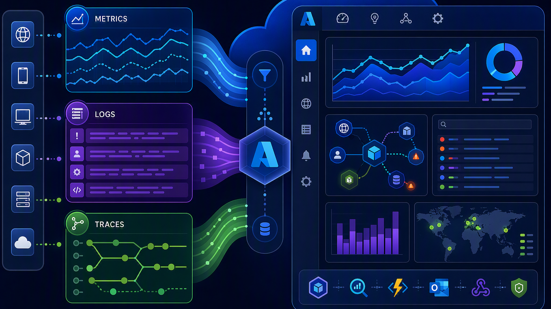
The AI tradeoff: optimization also consumes resources
AI is powerful, but model hosting and inference have their own compute and cost footprint.
Use AI where it amplifies value
Avoid “AI for everything”
Balance equation
• Complex bottleneck analysis.
• Large-codebase reasoning.
• Incident triage and hypothesis generation.
• Code review for repeated patterns.
• Do not send every log line to a model.
• Use sampling, aggregation and cheaper analysis first.
• Keep humans in control of expensive decisions.
• Performance gain > AI analysis cost.
• Risk reduction > operational complexity.
• Repeatable workflow > one-off magic.
Notes:
Speaker notes: Talk track: This is the nuance slide. AI should be used deliberately: the goal is not maximum model usage, the goal is better software using the right amount of intelligence. Visual on this slide was generated with Microsoft Copilot. Source: Azure Monitor Code Optimizations page states the Profiler typically adds 5% to 15% CPU and memory overhead while actively collecting traces, and that some code-level fix suggestions require GitHub Copilot or Copilot for Azure: https://learn.microsoft.com/en-us/azure/azure-monitor/optimization-insights/code-optimizations-profiler-overview [Sources] Visual on this slide was generated with Microsoft Copilot. Source: Azure Monitor Code Optimizations page states the Profiler typically adds 5% to 15% CPU and memory overhead while actively collecting traces, and that some code-level fix suggestions require GitHub Copilot or Copilot for Azure: https://learn.microsoft.com/en-us/azure/azure-monitor/optimization-insights/code-optimizations-profiler-overview

Slide 11
Frugal software patterns students can apply immediately
Small design choices compound at cloud scale.
Measure first
Right-size data
Reduce allocations
Cache intentionally
Set SLOs and define what “better” means.
Avoid over-fetching, over-retention and unnecessary duplication.
Stream large data and avoid building huge object graphs.
Cache hot data with eviction, size limits and freshness rules.
Batch wisely
Scale elastically
Place data close
Automate regression checks
Reduce chatty calls, but watch latency and failure blast radius.
Autoscale based on meaningful workload signals.
Minimize cross-region traffic and unnecessary hops.
Benchmark critical paths in CI/CD.
Important: every pattern has tradeoffs. Validate with your workload.
Notes:
Speaker notes: Talk track: This is the practical “what can I do Monday morning?” slide. Encourage interns to see performance as ordinary engineering hygiene, not only heroic incident response. Source: Azure Well-Architected sustainability guidance includes reducing structural waste, idle platform waste, storage growth, delivery-path amplification, and performance efficiency work across application, compute, network and storage: https://learn.microsoft.com/en-us/azure/well-architected/sustainability/ [Sources] Source: Azure Well-Architected sustainability guidance includes reducing structural waste, idle platform waste, storage growth, delivery-path amplification, and performance efficiency work across application, compute, network and storage: https://learn.microsoft.com/en-us/azure/well-architected/sustainability/

Slide 12
Reference architecture for AI-assisted optimization
A simple flow you can explain on a whiteboard.
App on Azure
Telemetry
Azure Monitor + App Insights
AI analysis
Code / config change
Deploy + validate
Feedback loop: optimize only after you can observe the effect.
Notes:
Speaker notes: Talk track: Use this as a bridge into demos. This flow gives students a mental architecture: app emits telemetry, Monitor stores and analyzes it, AI helps reason about improvement, developers implement and validate. Source: Azure Monitor documentation describes collection, analysis, alerts and automation for telemetry: https://learn.microsoft.com/en-us/azure/azure-monitor/ Source: Application Insights overview describes application performance monitoring and OpenTelemetry support: https://learn.microsoft.com/en-us/azure/azure-monitor/app/app-insights-overview Source: GitHub Copilot for Azure documentation lists Learn, Design and develop, Deploy, and Troubleshoot scenarios, including diagnosing slow Azure resources: https://learn.microsoft.com/en-us/azure/developer/github-copilot-azure/introduction [Sources] Source: Azure Monitor documentation describes collection, analysis, alerts and automation for telemetry: https://learn.microsoft.com/en-us/azure/azure-monitor/ Source: Application Insights overview describes application performance monitoring and OpenTelemetry support: https://learn.microsoft.com/en-us/azure/azure-monitor/app/app-insights-overview Source: GitHub Copilot for Azure documentation lists Learn, Design and develop, Deploy, and Troubleshoot scenarios, including diagnosing slow Azure resources: https://learn.microsoft.com/en-us/azure/developer/github-copilot-azure/introduction

Slide 13
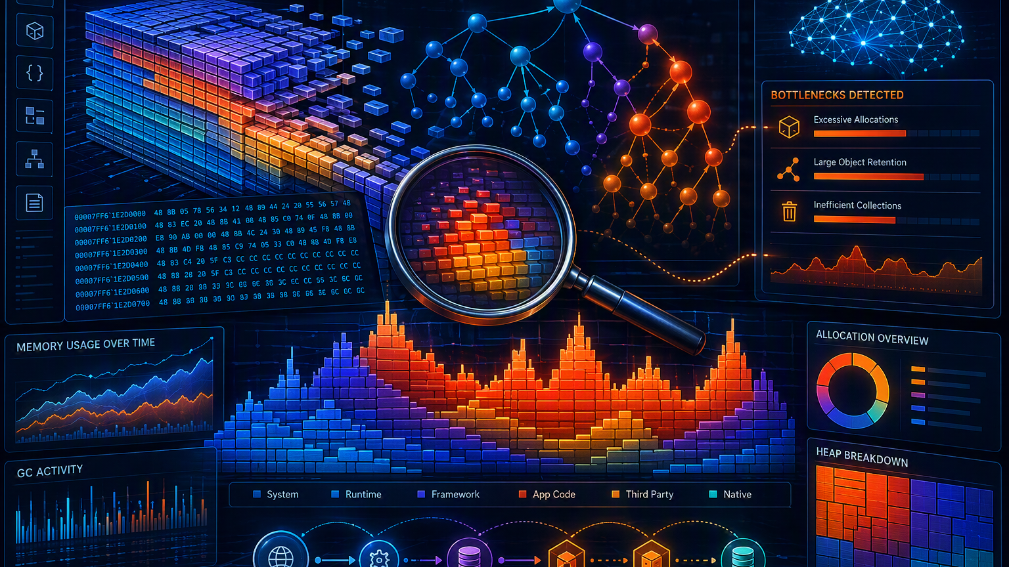
Demo ideas for the session
Pick 2 or 3 depending on available environment and time.
Demo A: observe a slow API
Demo B: Copilot refactor
Demo C: memory pressure story
• Run a simple API with an intentionally slow endpoint.
• Show request duration in Application Insights.
• Use logs/traces to find the slow dependency.
• Open inefficient code in VS Code.
• Ask GitHub Copilot to explain complexity and suggest alternatives.
• Run a micro-benchmark before/after.
• Use a synthetic JSON parser that materializes a huge DOM.
• Show memory growth and object allocation evidence.
• Refactor to streaming or typed models.
Notes:
Speaker notes: Talk track: Keep demos safe, synthetic and repeatable. Avoid customer data and real production dumps. Tell students the goal is the method, not a fancy tool trick. Visual on this slide was generated with Microsoft Copilot. Source: Application Insights overview includes performance, failures, search, live metrics and logs experiences used in Demo A: https://learn.microsoft.com/en-us/azure/azure-monitor/app/app-insights-overview Source: GitHub Copilot documentation supports developer assistance while working on code, used in Demo B: https://docs.github.com/en/copilot Source: Application Insights Profiler and memory leak smart detection documentation support the diagnostics concepts in Demo C: https://learn.microsoft.com/en-us/azure/azure-monitor/profiler/profiler-settings and https://learn.microsoft.com/en-us/azure/azure-monitor/alerts/proactive-potential-memory-leak [Sources] Visual on this slide was generated with Microsoft Copilot. Source: Application Insights overview includes performance, failures, search, live metrics and logs experiences used in Demo A: https://learn.microsoft.com/en-us/azure/azure-monitor/app/app-insights-overview Source: GitHub Copilot documentation supports developer assistance while working on code, used in Demo B: https://docs.github.com/en/copilot Source: Application Insights Profiler and memory leak smart detection documentation support the diagnostics concepts in Demo C: https://learn.microsoft.com/en-us/azure/azure-monitor/profiler/profiler-settings and https://learn.microsoft.com/en-us/azure/azure-monitor/alerts/proactive-potential-memory-leak

Slide 14
Build. Measure. Optimize. Repeat.
The intelligent cloud rewards software that is observable, efficient and continuously improved.
1
CPU cycles saved
2
Bytes not allocated
3
Requests not wasted
4
Ideas validated
Call to action for interns: whenever you build something, ask “how will I know it is efficient?”
Thank you
Notes:
Speaker notes: Talk track: Close with the engineering habit. Observability makes performance visible. AI can accelerate insight. Human judgment validates the tradeoffs. Visual on this slide was generated with Microsoft Copilot. Source: Azure Monitor documentation says Azure Monitor provides tools for collecting and analyzing telemetry to maximize performance and availability: https://learn.microsoft.com/en-us/azure/azure-monitor/ Source: Azure Well-Architected sustainability overview connects efficiency, cost optimization and resource waste reduction: https://learn.microsoft.com/en-us/azure/well-architected/sustainability/overview [Sources] Visual on this slide was generated with Microsoft Copilot. Source: Azure Monitor documentation says Azure Monitor provides tools for collecting and analyzing telemetry to maximize performance and availability: https://learn.microsoft.com/en-us/azure/azure-monitor/ Source: Azure Well-Architected sustainability overview connects efficiency, cost optimization and resource waste reduction: https://learn.microsoft.com/en-us/azure/well-architected/sustainability/overview

