Slide 1
What is AI?
Notes:
In this video, we will examine what Artificial Intelligence is, and what artificial intelligence is not. We will spend time developing a more careful definition of Artificial Intelligence that is realistic and captures what it is capable of.

Slide 2

Terms of Use
Notes:
Please feel free to use these resources as long as you credit us.

Slide 3

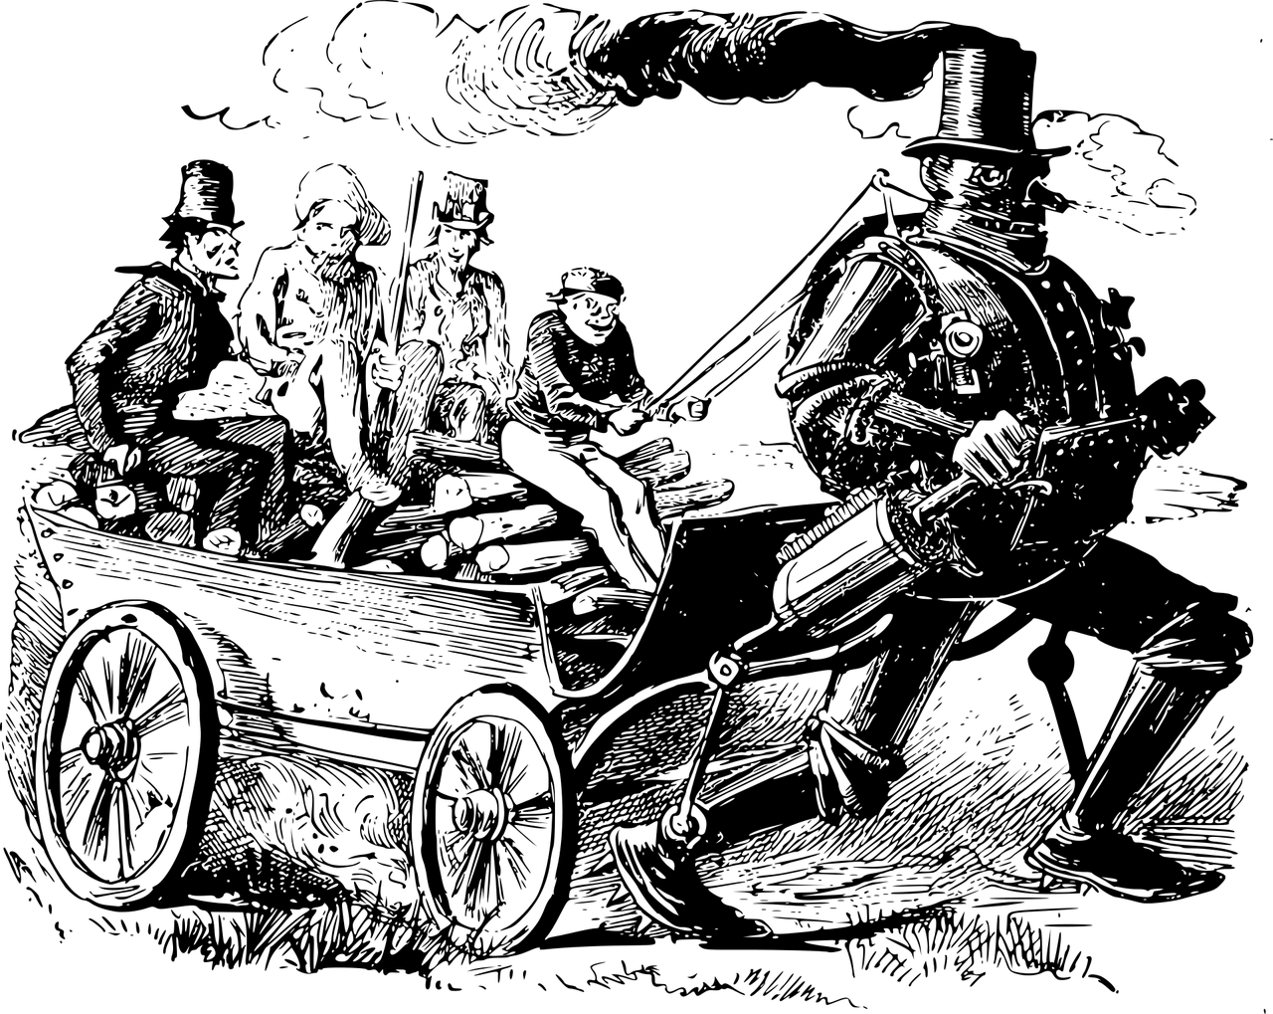
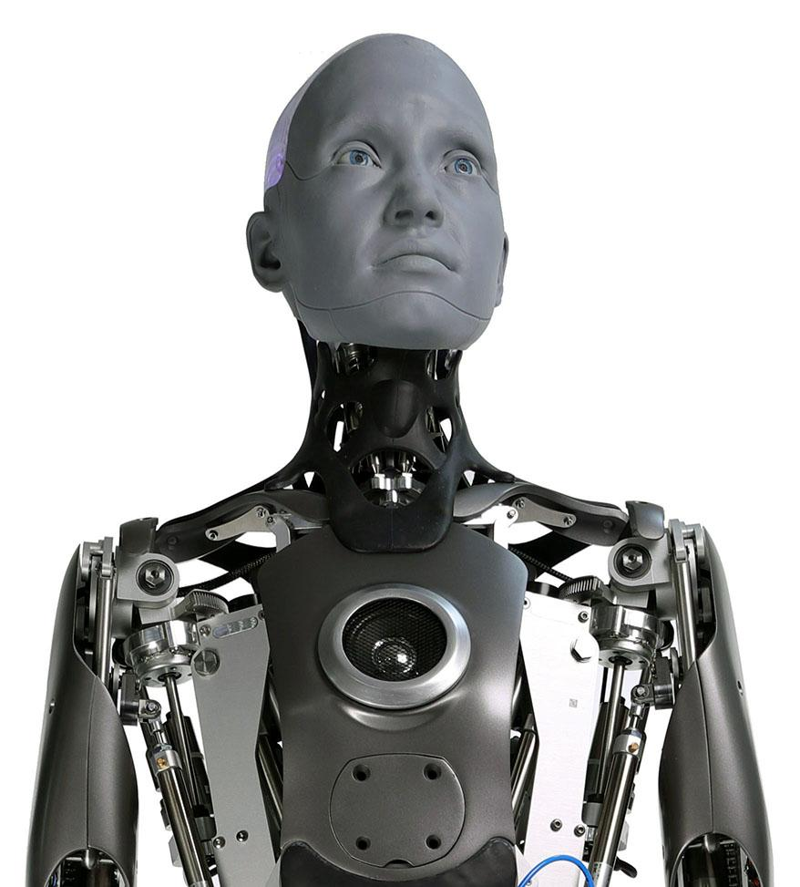
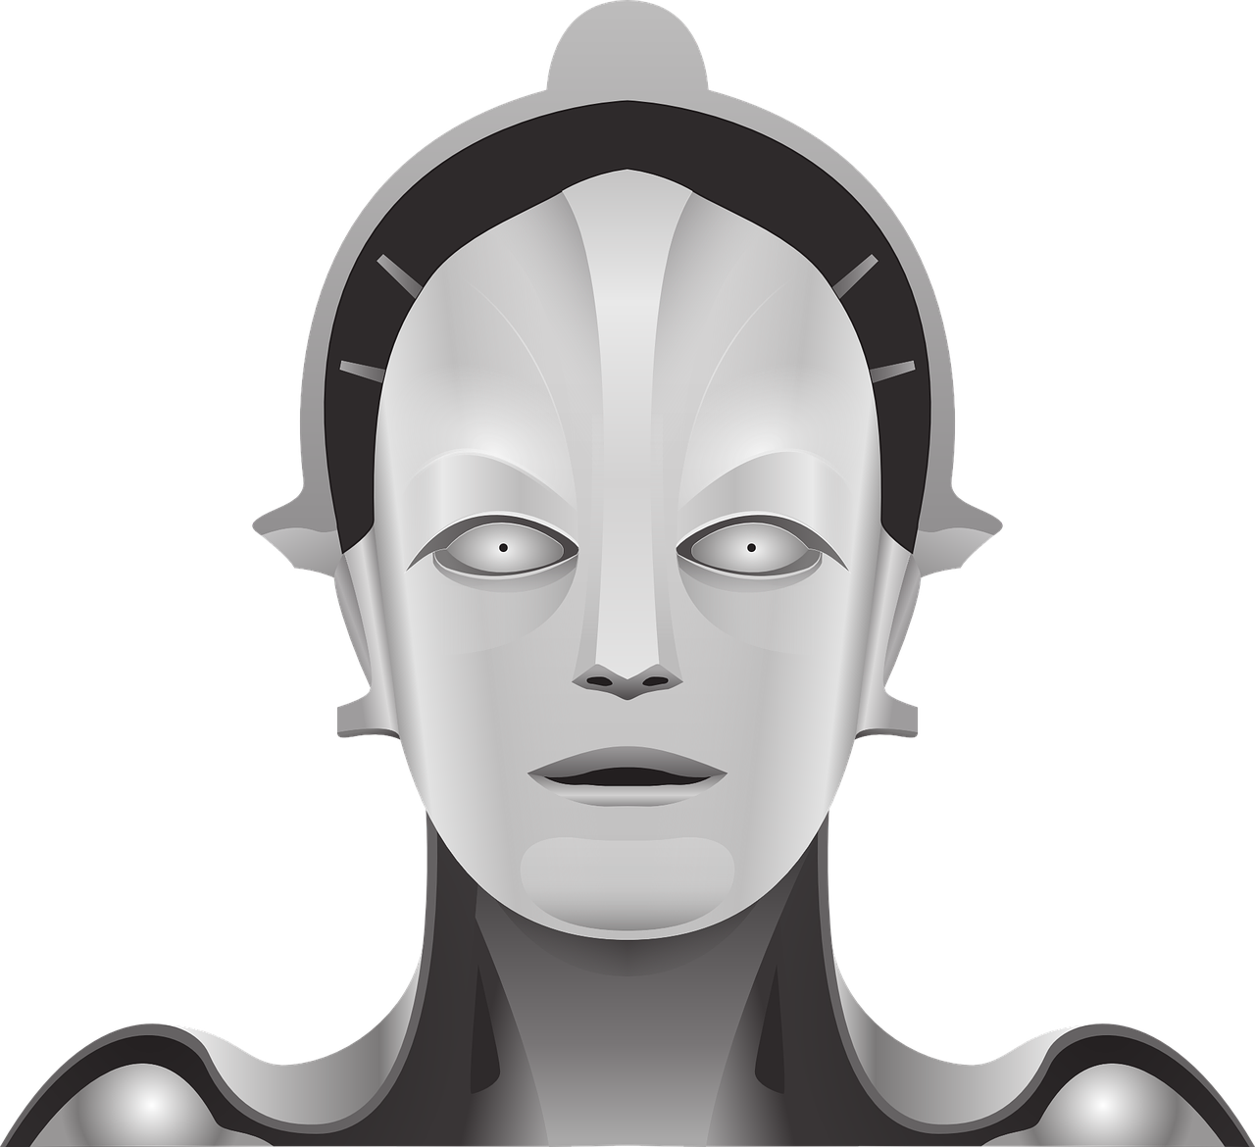
We worry about AI…
Image credits: Tom Cowap and Willy Jackson, CC BY-SA 4.0, via Wikimedia Commons; https://pixabay.com/
Notes:
When people think about artificial intelligence, they often imagine robots acting just like humans. We worry about robots being smarter than us, or passing tests that make them seem just like people. In the film Two Thousand and One A Space Odyssey, a story warns us about a ship computer going rogue for its own interests.

Slide 4
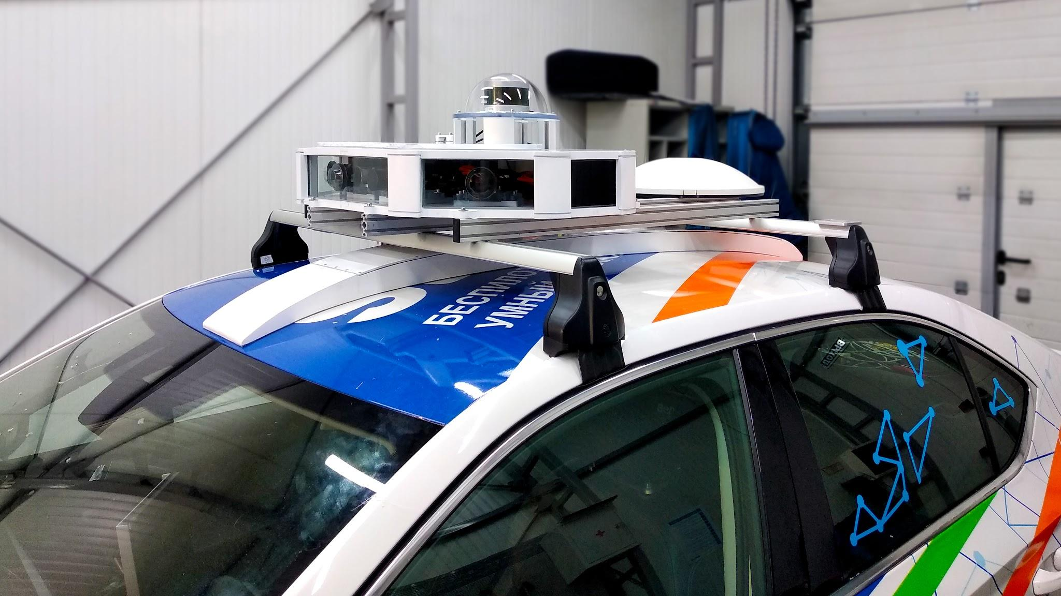
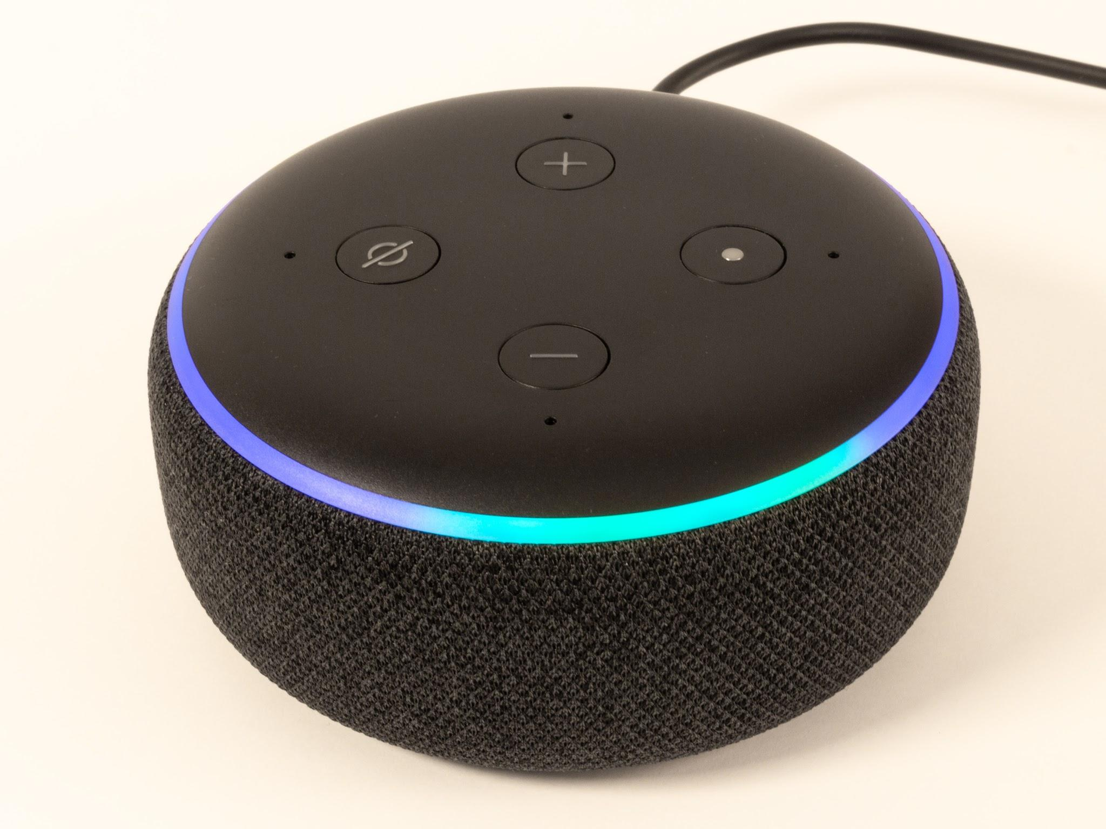
Current AI systems are limited to specific tasks
Image credits: Alena Nesterova, CC BY-SA 4.0, via Wikimedia Commons; Samuel Wiki, CC0, via Wikimedia Commons
Notes:
Computers with human-like thinking are called artificial general intelligence, but we haven’t achieved that yet. Right now, our EHY EYE works well for specific jobs, like recognizing voices or driving cars. But, it's not good at doing lots of different things at once. For example, an EHY EYE that recognizes and responds to voice commands can't understand self driving car sensor data, and vice versa.

Slide 5
Artificial Intelligence: recognizing, learning, solving a task?
“As soon as it works, no one calls it artificial intelligence anymore…”
John McCarthy
Notes:
In the world of artificial intelligence, we often think about machines mimicking tasks like recognizing, learning, or solving. However, what's tricky is that once a task works well, it no longer feels like EHY EYE. As John McCarthy, a pioneer in EHY EYE, put it: "As soon as it works, no one calls it artificial intelligence anymore." So, our idea of what's considered EHY EYE keeps changing as we make technology better.

Slide 6
Defining Intelligence: Shifting Benchmarks
Movie recommendations
Chess
1980 1990 2000 2010 2020
Optical character recognition in newspapers
Email spam checker
Facial recognition
Self-driving cars
Voice control
Image adapted from https://simplystatistics.org/posts/2017-01-19-what-is-artificial-intelligence/
Notes:
For instance, 20 years ago, the idea of an email spam checker was new. People were surprised that a computer could identify junk email accurately, and people called it “artificial intelligence”. Now that these kind of tools are commonplace, we no longer see them as EHY EYE. It's not considered intelligent as it's not learning something new and surprising.

Slide 7
Artificial Intelligence, in 3 parts:
Notes:
It is clear that we need a definition or EHY EYE that is concrete, specific, and doesn’t change with societal expectations. We believe that a sound Artificial Intelligence system is made out of three parts.

Slide 8
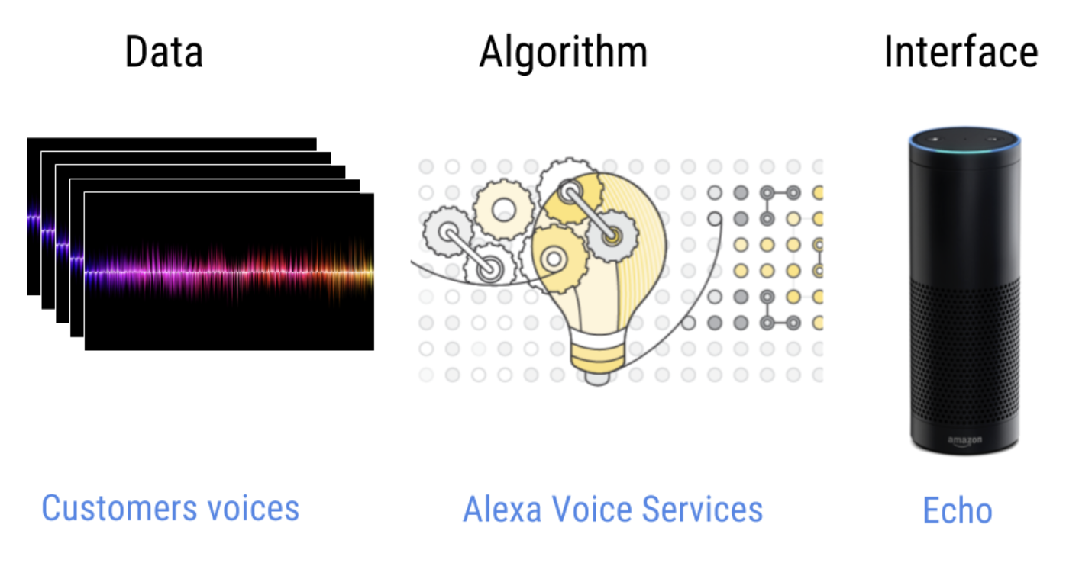
Artificial Intelligence, in 3 parts:
Data
Image credit: https://simplystatistics.org/posts/2017-01-19-what-is-artificial-intelligence/
Notes:
The first part is the data set. We need data examples that can be used to train a statistical or machine learning model to make predictions.

Slide 9
Artificial Intelligence, in 3 parts:
Data
Algorithm
Image credit: https://simplystatistics.org/posts/2017-01-19-what-is-artificial-intelligence/
Notes:
The second part is the algorithm. We need an algorithm that can be trained based on the data examples to take a new example and execute a human-like task. For instance, the algorithm learns which images has a cat from pre-labeled images. When given a new image from the user, it decides whether the image has a cat in it.

Slide 10
Artificial Intelligence, in 3 parts:
Data
Algorithm
Interface
Image credit: https://simplystatistics.org/posts/2017-01-19-what-is-artificial-intelligence/
Notes:
Lastly, we have the interface. We need a physical interface or software for the trained algorithm to receive a data input and execute the human-like task in the real world.

Slide 11
Example: Amazon Echo
Data
Algorithm
Interface
Customer voices
Alexa Voice Services
Amazon Echo
Image credit: https://simplystatistics.org/posts/2017-01-19-what-is-artificial-intelligence/
Notes:
As an example, consider Amazon Echo’s voice control device.

Slide 12
Example: Amazon Echo
Data
Algorithm
Interface
Customer voices
Alexa Voice Services
Amazon Echo
Image credit: https://simplystatistics.org/posts/2017-01-19-what-is-artificial-intelligence/
Notes:
The data set consists of customer voices talking to Amazon Echo or other devices.

Slide 13
Example: Amazon Echo
Data
Algorithm
Interface
Customer voices
Alexa Voice Services
Amazon Echo
Image credit: https://simplystatistics.org/posts/2017-01-19-what-is-artificial-intelligence/
Notes:
The algorithm is a machine learning algorithm that predicts what a new customer voice is asking it to do. Given human voice’s request, it may set a kitchen timer.

Slide 14
Example: Amazon Echo
Data
Algorithm
Interface
Customer voices
Alexa Voice Services
Amazon Echo
Image credit: https://simplystatistics.org/posts/2017-01-19-what-is-artificial-intelligence/
Notes:
Lastly, the interface, is a physical device with a microphone, speaker, and computer software running the algorithm and accessing the data. It is the part that will interact with humans.

Slide 15
Example: Amazon Echo
Data
Algorithm
Interface
Customer voices
Alexa Voice Services
Amazon Echo
Image credit: https://simplystatistics.org/posts/2017-01-19-what-is-artificial-intelligence/
Notes:
When the data, algorithm, and interface are put together and work well, we have an artificial intelligence system. This definition encompass artificial intelligence systems from email spam checkers to self-driving cars independently of societal expectations, and is specific enough that it captures realistic products we are inventing.

Slide 16
Summary What is AI?
Three part framework of data, algorithms, and interfaces
Do specific technologies meet the criteria for being classified as AI using this framework?
Keep adaptability and training with new data in mind as we move further!
Notes:
The definition of artificial intelligence has shifted over time. We use the three part framework of data, algorithms, and interfaces to describe EHY EYE applications. You will need to consider specific technologies and whether they meet the criteria for being classified as EHY EYE using this framework. Adaptability and training with new data are key factors to keep in mind as we move further in the course.

