Slide 1

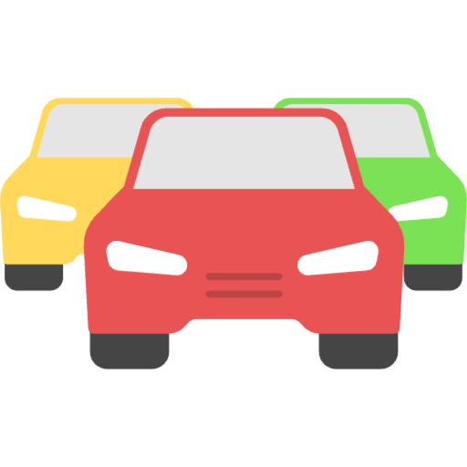
Pattern Recognition
You might notice a pattern between amount of traffic and time of day.
3am
4pm
Images from https://www.iconpacks.net/

Slide 2

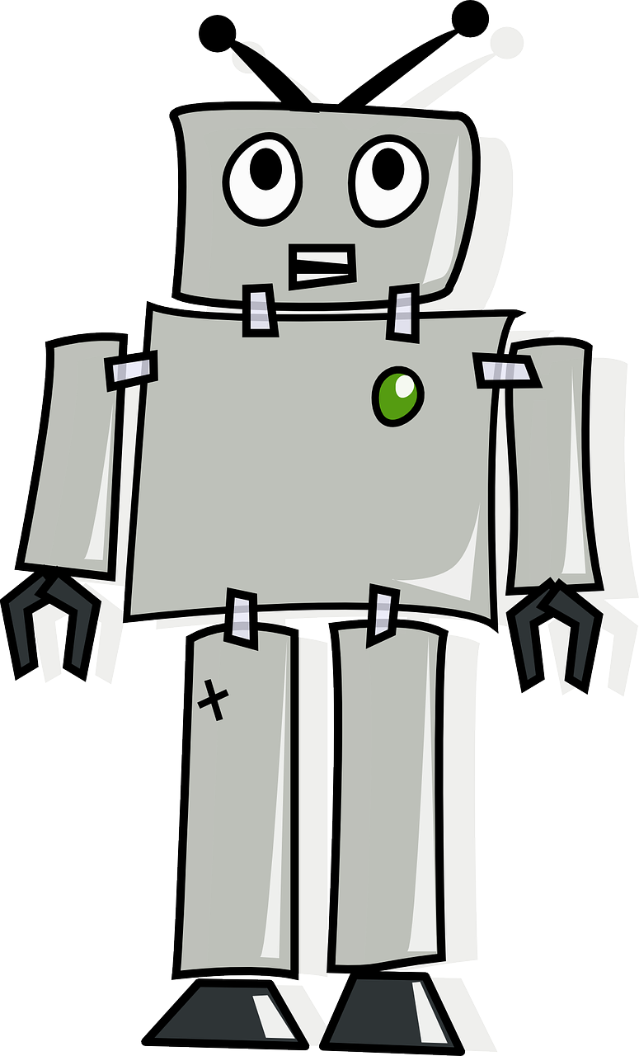

Machine Learning
3am
Good to know my score for next time! It helps me improve my accuracy.
4pm
4pm
holiday
4pm
Sunday
Images from https://pixabay.com/ and https://www.iconpacks.net/

Slide 3
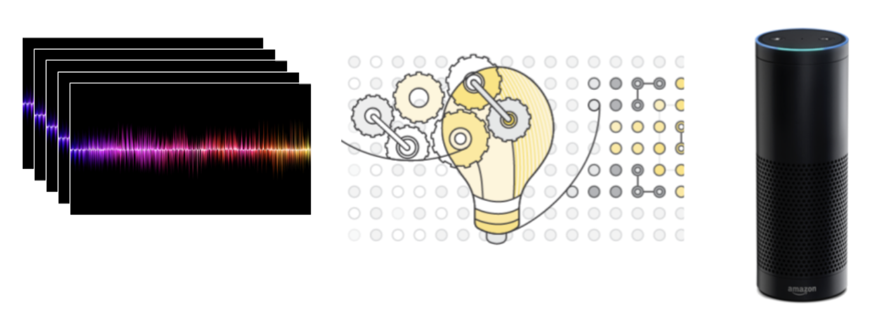
Data Algorithm Interface
Customer voices Alexa Voice Services Amazon Echo
Image credit: https://simplystatistics.org/posts/2017-01-19-what-is-artificial-intelligence/

Slide 4
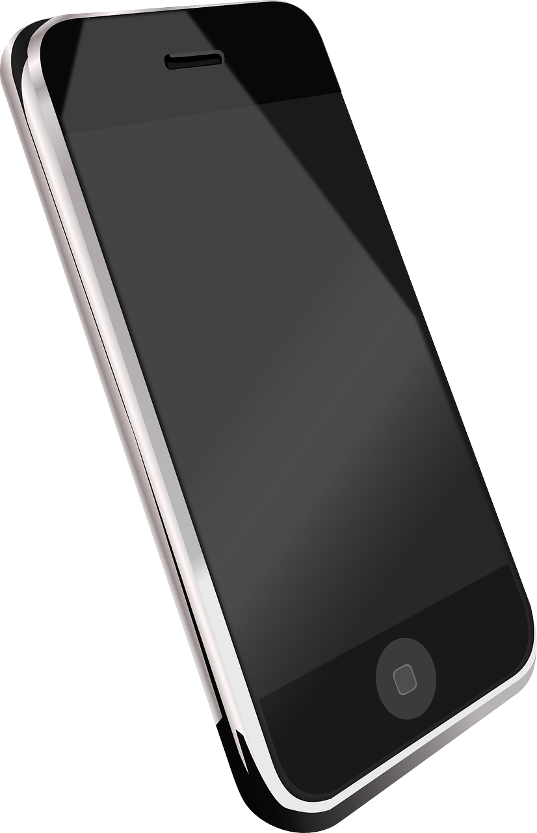
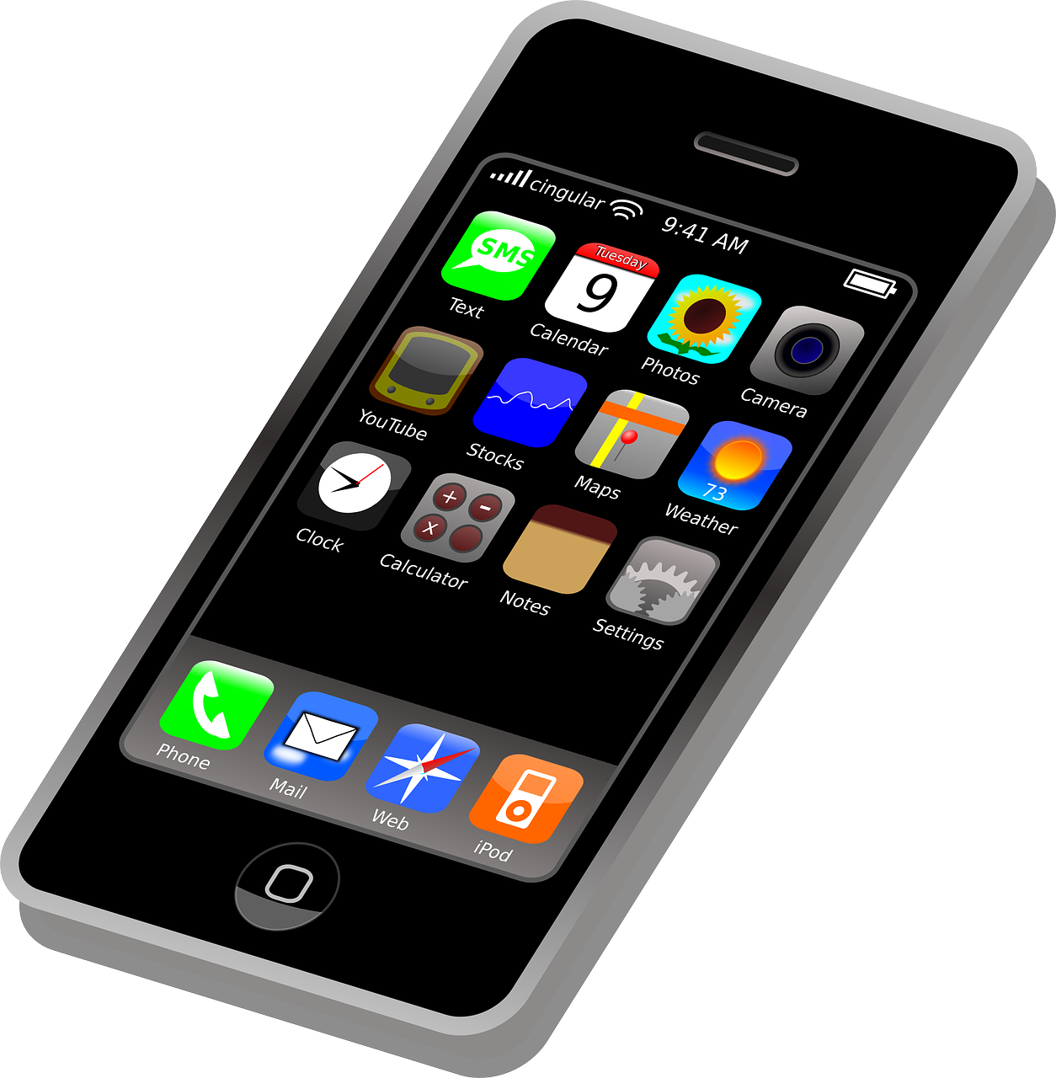
Smartphones
=
AI ?
Images from https://pixabay.com/

Slide 5
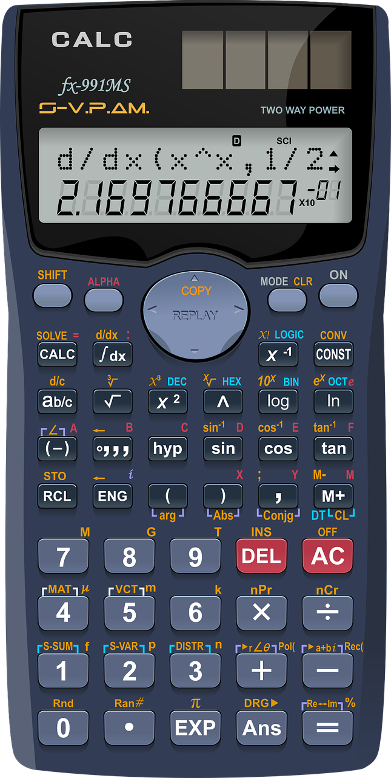
Calculators
=
AI ?
Image from https://pixabay.com/

Slide 6

Computer Programs
=
AI ?
Image from https://pixabay.com/

Slide 7
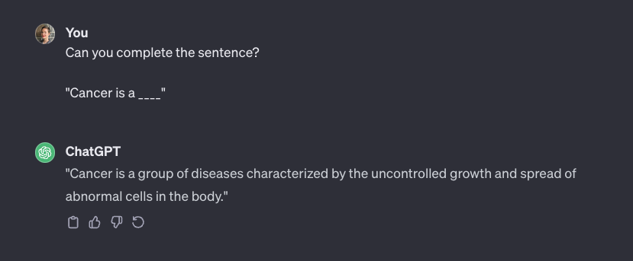

Patterns in Text Data
Images from https://www.iconpacks.net/ and https://chat.openai.com/

