Slide 1
Training and Testing data
Notes:
In the last chapter, we started to think about the ethics of using relevant and unbiased data for building our Aigh eye model. In this video we will see that even if our data represents our population of interest, issues can still happen if the data is mishandled during the AIGH eye model building process. Let's take a look at how that can happen.

Slide 2
Population and sample
Sample: 1,000 dog photos
Population: all the dog photos!
Notes:
The data we collect to train our model is typically a limited representation of what we want to study, and as we explored in the previous chapter, bias can arise through our choice of selection. Let us define two terms commonly used in artificial intelligence and statistics research: the population is the entire group of entities we want to study. If we were building an artificial intelligence system to classify dog photographs based on their breeds, then the population is every dog photograph in the world. That’s prohibitively expensive and not easy data to acquire, so we use a sample, which is a subset of the population, to represent our desired population.
When our sample is a random subset of our population, we say that our data is unbiased and represent our population of interest. However, even if we are sure that the sample is representative of the population, a different type of bias and harm from the data can arise. It has to do with how we use the sample data for training and evaluating the model.

Slide 3
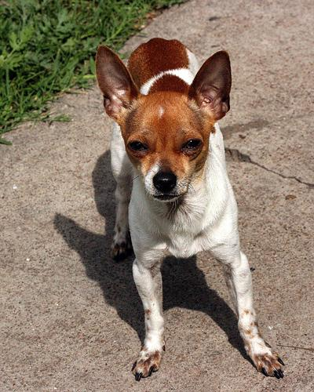
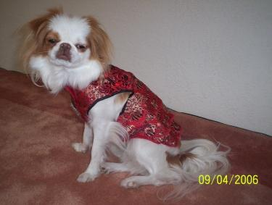
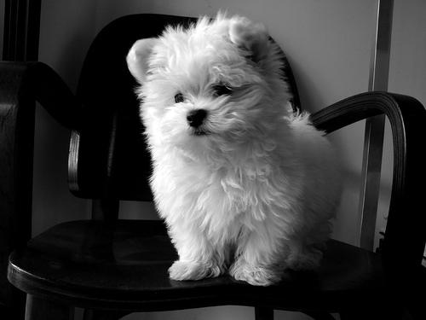
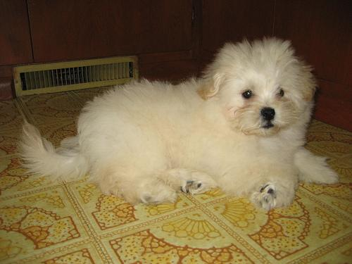
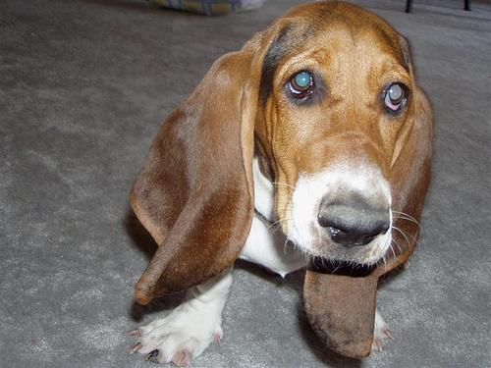
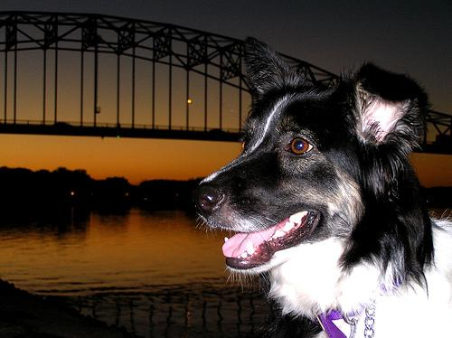
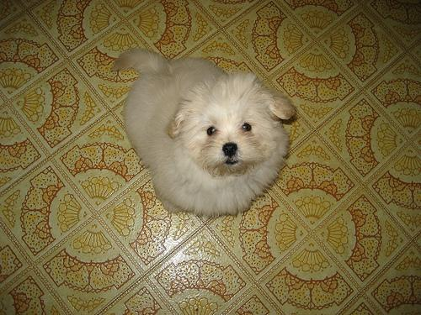
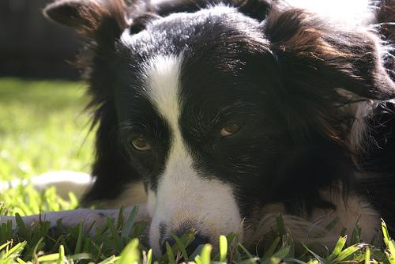
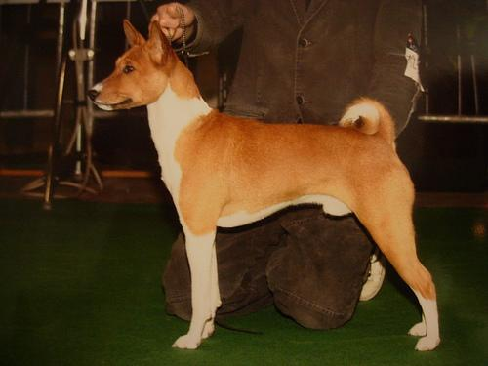
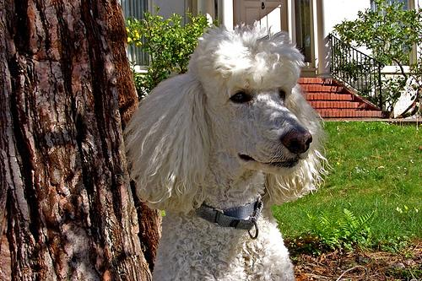
Training data
Chihuahua
Japanese Spaniel
Maltese
Pekinese
Bassett
Border collie
Pekinese
Border collie
Basenji
Poodle
Aditya Khosla, Nityananda Jayadevaprakash, Bangpeng Yao and Li Fei-Fei. Novel dataset for Fine-Grained Image Categorization. First Workshop on Fine-Grained Visual Categorization (FGVC), IEEE Conference on Computer Vision and Pattern Recognition (CVPR), 2011.
Notes:
This image depicts some of our samples for building an artificial intelligence model to classify dog photographs based on their breeds. Each dog photograph has a corresponding label that gives the correct dog breed, and the goal of the model training process is to have the artificial intelligence model learn the association between photograph and dog breed label. For now, we will use all of our samples for training the model. The data we use for model training is called the training data. Then, once the model is trained and has learned the association between photograph and dog breed, model will be able make new predictions: given a new dog image without its breed label, the model will make a prediction what its breed label is.

Slide 4
Testing data
Aditya Khosla, Nityananda Jayadevaprakash, Bangpeng Yao and Li Fei-Fei. Novel dataset for Fine-Grained Image Categorization. First Workshop on Fine-Grained Visual Categorization (FGVC), IEEE Conference on Computer Vision and Pattern Recognition (CVPR), 2011.
Notes:
To evaluate how well this model is good as predicting dog breeds from dog images, we need to use some of our samples to evaluate our model. The samples being used for model evaluation is called the testing data. For instance, suppose we used these four images to score our model. We give it to our trained model without the true breed label, and then the model makes a prediction on the breed. Then we compare the predicted breed label with the true label to compute the model accuracy.

Slide 5
Evaluation
Chihuahua
Japanese Spaniel
Accuracy: 3/4 = 75%
Border collie
Poodle
Aditya Khosla, Nityananda Jayadevaprakash, Bangpeng Yao and Li Fei-Fei. Novel dataset for Fine-Grained Image Categorization. First Workshop on Fine-Grained Visual Categorization (FGVC), IEEE Conference on Computer Vision and Pattern Recognition (CVPR), 2011.
Notes:
Suppose we get 3 out of 4 breed predictions correct. That would be an accuracy of 75 percent.

Slide 6
Wrong: Samples for training and testing
Testing + Training
Training only
Chihuahua
Japanese Spaniel
Maltese
Pekinese
Bassett
Border collie
Pekinese
Border collie
Basenji
Poodle
Aditya Khosla, Nityananda Jayadevaprakash, Bangpeng Yao and Li Fei-Fei. Novel dataset for Fine-Grained Image Categorization. First Workshop on Fine-Grained Visual Categorization (FGVC), IEEE Conference on Computer Vision and Pattern Recognition (CVPR), 2011.
Notes:
However, we have inflated our model evaluation accuracy. The samples we used for model evaluation were also used for model training! Our training and testing data are not independent of each other.
Why is this a problem? When we train a model, the model will naturally perform well on the training data, because the model has seen it before. This is called Overfitting.
In real life, when the dog breed image labeling system is deployed, the model would not be seeing any dog images it has seen in the training data. Our model evaluation accuracy is likely too high because it is evaluated on data it was trained on.

Slide 7
Correct: Samples for training and testing
Testing only
Training only
Maltese
Pekinese
Bassett
Border collie
Basenji
Poodle
Aditya Khosla, Nityananda Jayadevaprakash, Bangpeng Yao and Li Fei-Fei. Novel dataset for Fine-Grained Image Categorization. First Workshop on Fine-Grained Visual Categorization (FGVC), IEEE Conference on Computer Vision and Pattern Recognition (CVPR), 2011.
Notes:
Let’s fix this. Given a sample, we split it into two independent groups for training and testing. We use the training data for training the model, and we use the testing data for evaluating the model. They don’t overlap.

Slide 8
Evaluation is reflective of the model in the wild!
Poodle
Japanese Spaniel
Accuracy: 2/4 = 50%
Border collie
Greyhound
Aditya Khosla, Nityananda Jayadevaprakash, Bangpeng Yao and Li Fei-Fei. Novel dataset for Fine-Grained Image Categorization. First Workshop on Fine-Grained Visual Categorization (FGVC), IEEE Conference on Computer Vision and Pattern Recognition (CVPR), 2011.
Notes:
This seemingly small tweak in how data is partitioned during model training and evaluation can have a large impact on how artificial intelligence systems are evaluated. We always should have independence between training and testing data so that our model accuracy is not inflated.
If we don't have this independence of trianinga and testing data, many real-life promotions of artificial intelligence may be overhyped. Imagine that someone claimed that their cancer diagnostic model from a blood draw is 90%. But their testing data is a subset of their training data. That would over-inflate their model accuracy, and it will less accurate than advertised when used on new patient data. Doctors would make clinical decisions on inaccurate information and potentially create harm.

Slide 9

Terms of Use
Notes:
This content is free to adapt and share with attribution.

