Slide 1
AI Possibilities
Notes:
Welcome to Artificial Intelligence Possibilities. We’ll discuss some real examples of using EHY EYE to help you work.

Slide 2

Terms of Use
Notes:
Please feel free to use these resources as long as you credit us.

Slide 3

AI is opening many new doors of possibility!
Photo by TopSphere Media on Unsplash
Notes:
EHY EYE is opening many new doors of possibility in many different fields. Let’s explore several of the general ways in which EHY EYE can be used today.

Slide 4

Advances in Text Mining
Find Patterns
Find Topics
Generative AI
Icons from https://www.iconpacks.net/
Notes:
Text mining is when a computer identifies patterns, or is tasked with finding text related to specific topics within large bodies of text, such as across many different files, or with in a large policy document. Historically, mine ing for relevant text had to follow rule-based or statistical methods that required a lot of human oversight. Generative Aigh eye has led to many advancements in text mining.

Slide 5
Advances in Text Mining
Find Patterns
Find Topics
Generative AI
Contextual Understanding
Icons from https://www.iconpacks.net/
Notes:
These advancements include Contextual Understanding. Transformer models, especially, have enhanced contextual understanding in text mining. Models can consider relationships between words in a sentence, regardless of their order. This results in more accurate extraction of context-dependent information.

Slide 6
Advances in Text Mining
Find Patterns
Find Topics
Generative AI
Contextual Understanding
Text Completion and Generation
Icons from https://www.iconpacks.net/
Notes:
Generative artificial intelligence also allows for the completion of pieces of text that have gaps. In text mining, this capability is useful for handling incomplete or noisy data, and can improve the overall quality of mined information.

Slide 7
Advances in Text Mining
Find Patterns
Find Topics
Generative AI
Contextual Understanding
Text Completion and Generation
Domain-Specific Language
Icons from https://www.iconpacks.net/
Notes:
Another advantage of generative artificial intelligence is domain-specific language generation. This is particularly beneficial in industries where specialized terminology, jargon, or nuance is prevalent. By training generative models on domain-specific data, text mining models can behave more accurately for the discipline in question.

Slide 8



Advances in Text Mining
Find Patterns
Find Topics
Generative AI
Contextual Understanding
Text Completion and Generation
Domain-Specific Language
Icons from https://www.iconpacks.net/
Notes:
More specific examples of this include mining clinical patient notes to identify patients with similar symptoms, or mining extensive technical or financial documents to identify relevant sections more easily.

Slide 9
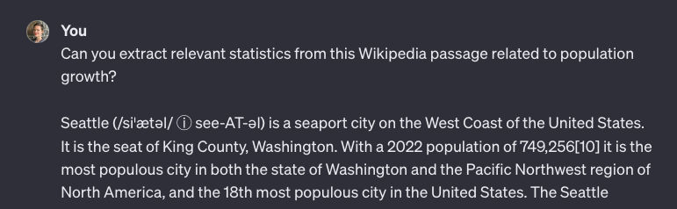

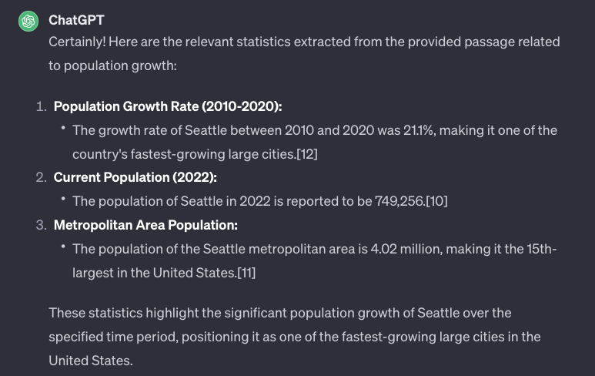
Example: Advances in Text Mining
Icons from https://www.iconpacks.net/ ; screenshots from https://chat.openai.com/
Notes:
A simplified example of text mining can be seen here. If we provide some information from the Wikipedia article for the city of Seattle, we can then ask the large language model to extract only relevant statistics related to population growth.

Slide 10


Modify / Generate Text
Change Tone
Summarize
Translate
Icons from https://www.iconpacks.net/
Notes:
Artificial intelligence can be used to modify or generate text. This could mean changing the tone of a piece of writing, creating summaries based on text input, or making writing more understandable to different audiences.

Slide 11

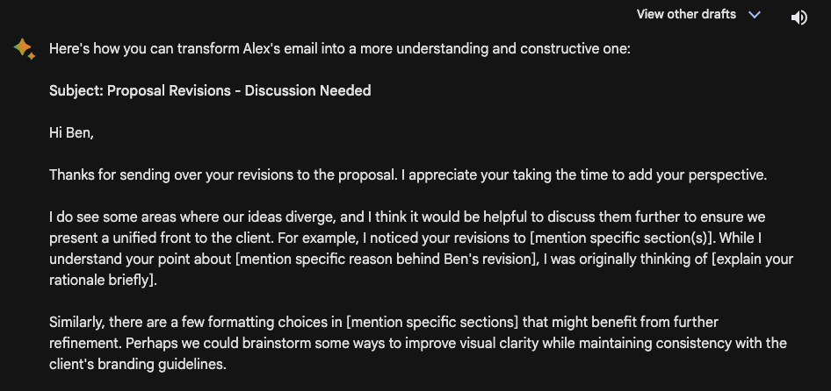
Example: Change Tone
Icons from https://www.iconpacks.net/ ; screenshots from https://bard.google.com/
Notes:
One example of modifying text is altering an email to be more empathetic, constructive, and understanding. We all have our moments of frustration, but Aigh EYE can help us be better colleagues. By asking Bard to transform this email, we can prevent an uncomfortable and hurtful work situation.

Slide 12



Automate Tedious Processes
Icons from https://www.iconpacks.net/
Notes:
Generative artificial intelligence can help tackle repetitive or tedious processes. It can be especially useful for automating work that requires conversion of content from one form to another, for example text-to-speech, image-to-text, and so on.

Slide 13

Example: Automate Processes
Transcription
Summary
Image from Chris Montgomery via Unsplash. Icons from https://www.iconpacks.net/
Notes:
Many generative artificial intelligence note takers have entered our world recently. The online meeting platform, Zoom, has an "EHY EYE assistant" that can summarize meetings. Companies, like Fireflies and Otter, also offer similar functionality, recording meeting notes, offering summaries, capturing action items, and more.

Slide 14

Idea Generation
Icons from https://www.iconpacks.net/
Notes:
Generative artificial intelligence can provide templates or scaffolds. In other words, EHY EYE can get the creative juices flowing and make it easier to start new content. Aigh EYE can also help synthesize data to suggest possible new relationships.

Slide 15

Example: Idea Generation
Marino et al. 2023 Bioinformatics Advances; Icons from https://www.iconpacks.net/; Image from stevepb via Pixabay
Notes:
The Diabetes Data and Hypothesis Hub, for example, makes it easier for biomedical researchers to access and use data related to diabetes. The Hub has a GEE PEE TEE type Aigh EYE, which allows it to generate hypotheses. It randomly selects gene sets and compares them with gene sets found in published articles. The Aigh I then provides ideas about possible explanations for the similarities between these gene sets.

Slide 16
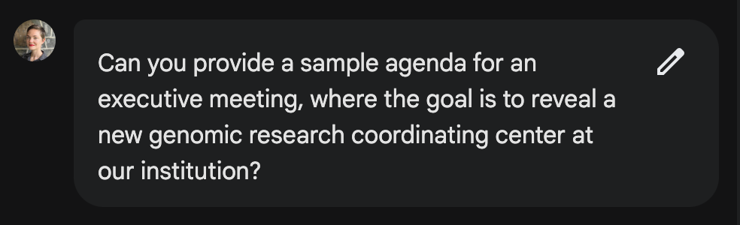
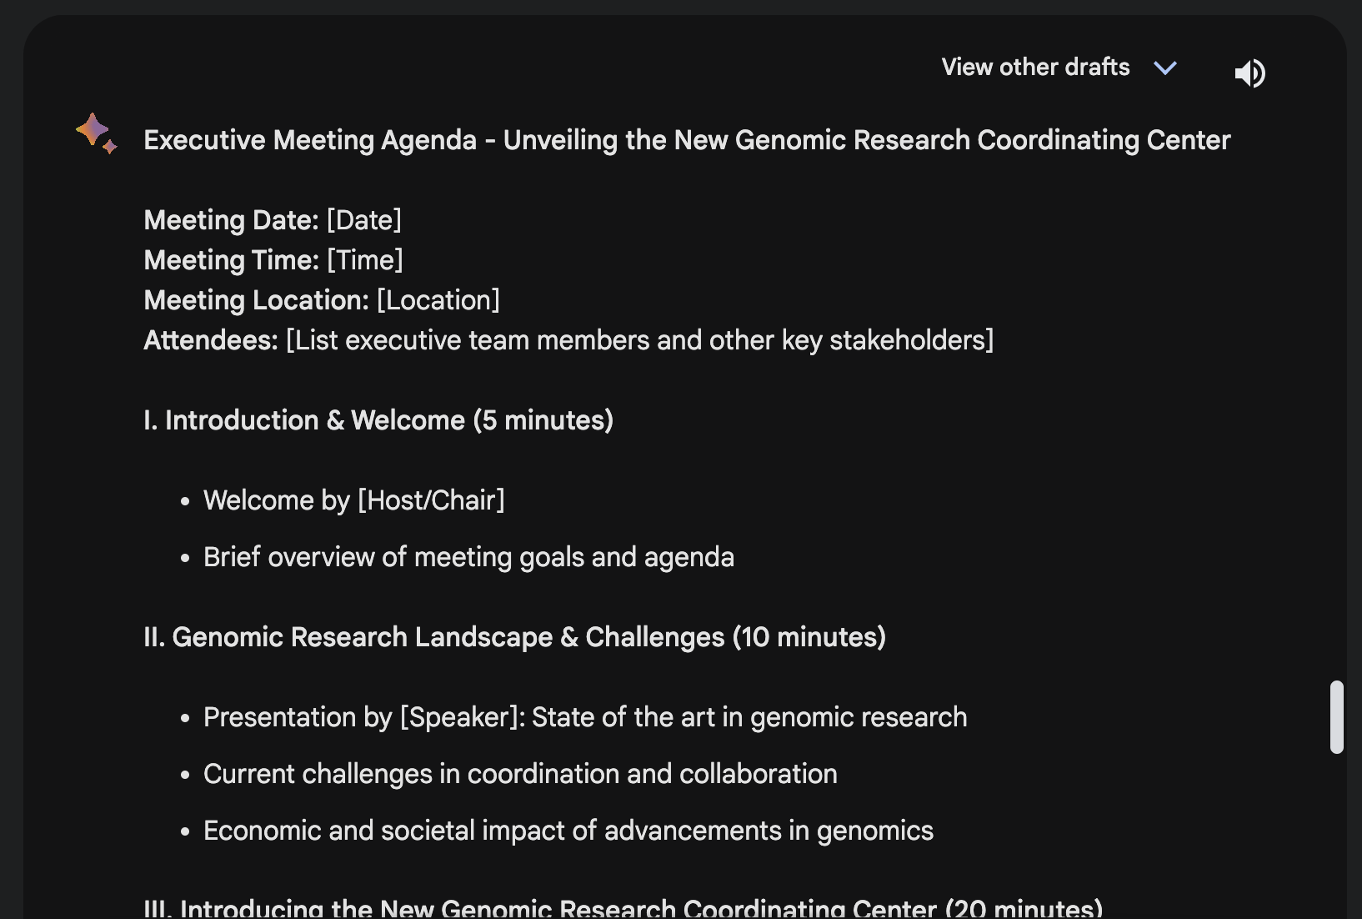
Example: Planning and Organizing
Icons from https://www.iconpacks.net/ ; screenshots from https://chat.openai.com/
Notes:
You can use generative artificial intelligence to suggest and break down ways to accomplish a task, based on prior task planning. In other words, it can generate a template for events or projects. For example, it can plan the agenda for a conference or meeting, or plan and assign roles for a new project task list. In the screenshots above, we can see that Aigh EYE can give us a good starting point, for an executive meeting agenda.

Slide 17


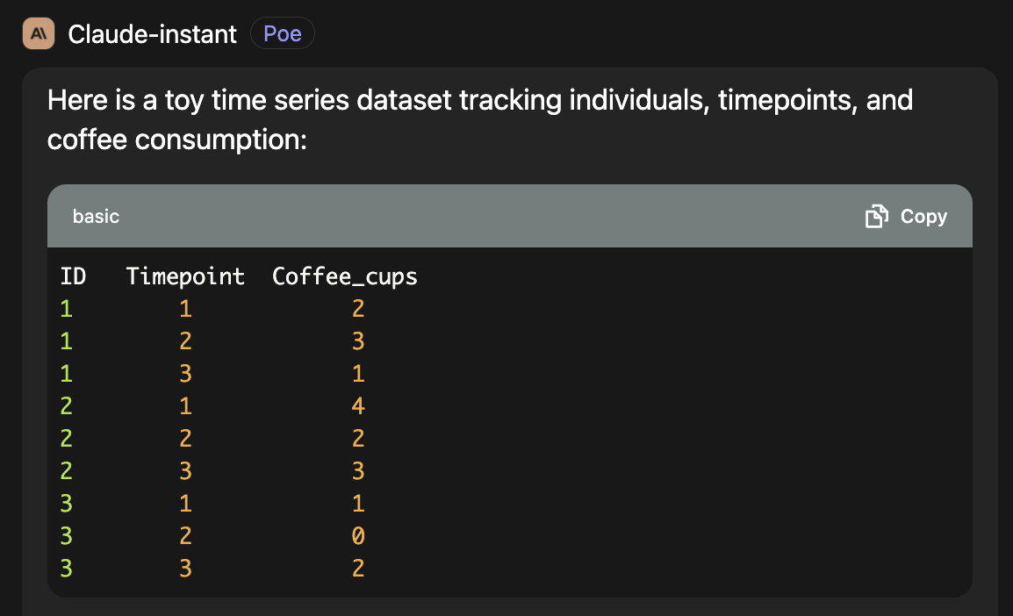
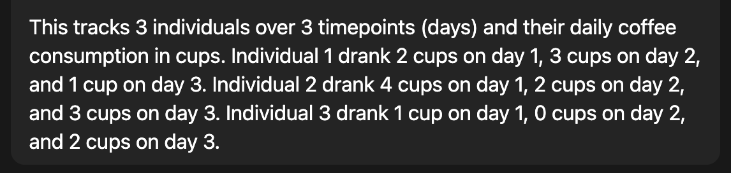
Example: Synthetic Data
Image via Pixabay; Screenshots from https://poe.com/Claude-instant
Notes:
You can use generative EHY EYE to create synthetic or toy data examples. It can also fill in sparse data, based on data it has seen before. Here, we are generating a very silly dataset to experiment with some analysis approaches.

Slide 18
Text-to-Speech-to-Text
Icons from https://www.iconpacks.net/
Notes:
Generative EHY EYE is great at converting text to realistic sounding speech. It can also listen to you dictate and convert that speech into text. Many of the EHY EYE tools that do this are commercial and cost money.

