Slide 1
Why do I need an AI policy?
Notes:
aigh eye tools are already changing how we work, and they will continue to do so for years. Creating an aigh eye policy for your organization can help your employees confidently navigate this new work landscape.

Slide 2

Terms of Use
Notes:
Except where otherwise indicated, the contents of this video are available for use under C C B Y 4 point 0

Slide 3
Disclaimer: The thoughts and ideas presented in this course are not to be substituted for legal or ethical advice and are only meant to give you a starting point for gathering information about AI policy and regulations to consider.
Notes:
The thoughts and ideas presented in this course are not to be substituted for legal or ethical advice. They are only meant to give you a starting point for gathering information about aigh eye policy and regulations to consider.

Slide 4
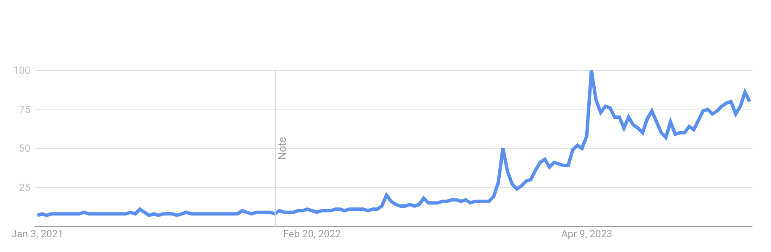
AI systems are in a period of explosive growth
Google searches for “AI”
Notes:
Big technological shifts always trigger a period of explosive growth where the technology and what’s possible changes incredibly quickly. We’re in that stage right now with aigh eye systems. Everyone is curious, scared, and interested in aigh eye

Slide 5
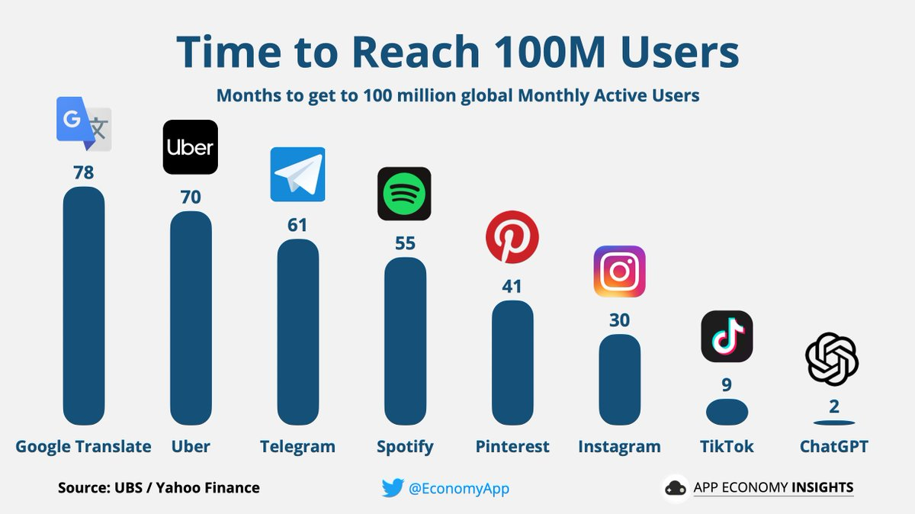
https://twitter.com/EconomyApp/status/1622029832099082241?ref=assemblyai.com
Notes:
Chat G P T accumulated 100 million users in 2 months, which is faster than many other major apps.

Slide 6
The future workforce is using AI and bans are not effective:
Over 40% of university students use ChatGPT for coursework.
39% of prospective students say they wouldn’t consider going to a college that banned ChatGPT and other AI
https://study.com/resources/chatgpt-in-the-classroom
Notes:
The future workforce is using aigh eye and bans will not be effective. Over 40% of university students use Chat G P T for coursework.
39% of prospective students say they wouldn’t consider going to a college that banned Chat G P T and other El eI ems.

Slide 7
Everyone is using it – but no one knows how to use it properly.
In this rapidly changing environment how can we know what is appropriate for AI usage?
Notes:
Each month regularly brings new opportunities and surprises, many of which we can’t anticipate and require organizations to adapt quickly. Everyone is using aigh eye but not everyone knows how to use it properly. The rapid changes are making new capabilities feasible while also bringing to light new and unique concerns. How can we keep up with what is appropriate for aigh eye use?

Slide 8

Adopting AI systems at the right time can benefit your organization
Image from StableDiffusionXL on Poe.com
Notes:
Adopting this new technology at the right time and in a way that minimizes mistakes and bad outcomes can make great things happen for your organization.
It’s a bit like catching the tail of a rocket ship that just being launched, but catching it in a way that doesn’t burn you to a crisp.

Slide 9
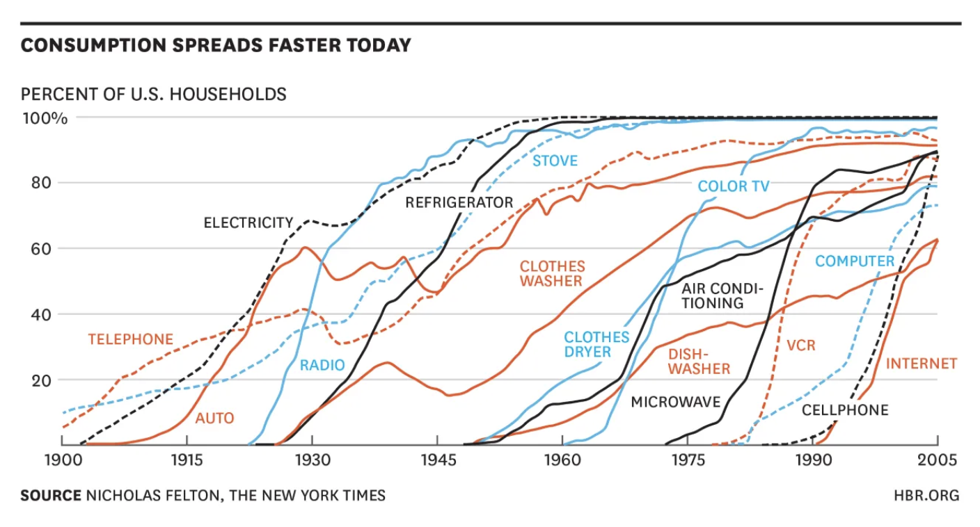
New technology adoption is scary
Caution is advisable; all out bans are not practical
https://medium.com/pronouncedkyle/new-technology-is-always-scary-8bf977a13773
Notes:
New technology adoption is scary, and while caution is advisable, all-out bans are not practical. Thirty or so years ago, we had a similar technological shift with the advent of the Internet. At the time, using the Internet for common, everyday tasks was a big deal, and there was fear about how it would change how we work. Now, we have accepted the Internet as a way of life and it’s a normal experience to look things up on Google or shop on the internet. In 30 years, aigh eye systems will be the same.

Slide 10
Employees will use AI – and this can make them more effective!
But, AI policies can balance their use with safety and security measures
Notes:
Employees will use aigh eye and this will make them more effective. Thoughtful aigh eye policies can balance your employees’ use with safety and security measures.

