Slide 1
AI Case Study: Financial Services
Notes:
In this case study, we will look at how artificial intelligence has been utilized in governmental financial services. National banks, such as the Federal Reserve of United States and the European Central bank of the European Union have started to explore how Artificial Intelligence can be used for data mining and economic forecast prediction. Let’s see where they are coming from.

Slide 2

Terms of Use

Slide 3
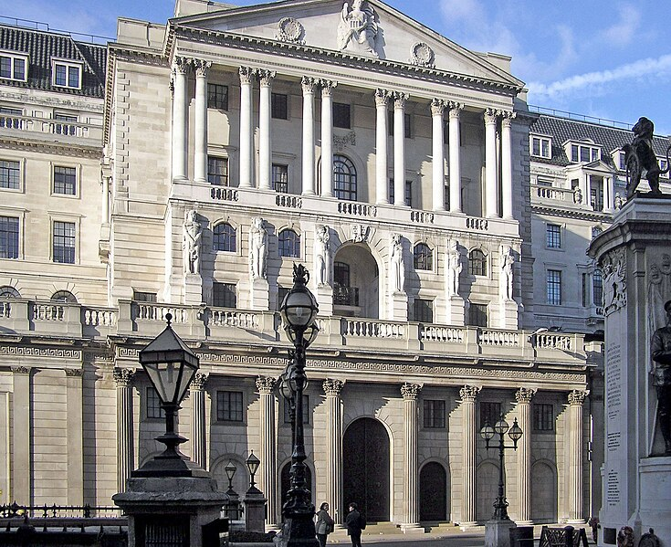
Uses of artificial intelligence for improving financial institutions
Most financial institutions weigh the benefits and risks of AI carefully before implementation.
High risk: predicting inflation, and acting on it.
Low risk: automating financial sector predicting
Arpingstone, Public domain, via Wikimedia Commons
Notes:
There are many uses of artificial intelligence for improving financial institutions, each with potential benefits and risks. Most financial institutions weigh the benefits and risks carefully before implementation.
For instance, if a financial institution takes a high-risk prediction seriously, such as predicting a financial crisis or a large recession, then it would have huge impact on a bank’s policy and allows the bank to act early. However, many financial institutions are hesitant to take action based on artificial intelligence predictions because the prediction is high-risk. If the prediction is not accurate then there can be severe consequences. Additionally, data on rare events such as financial crises are not abundant, so researchers worry that there is not enough data to train accurate models.
Many banks prefer to pilot artificial intelligence for low-risk, repeated predictions, in which the events are common and there is a lot of data to train the model on.
Let’s look at a few examples that illustrate the potential benefits and risks of artificial intelligence for improving financial institutions.

Slide 4

Web scraping and classification
{
“Non-profit”,
“small business”,
“government”,
“international corporation”
……
Tom Ventura from Denver, CO, USA, CC BY 2.0 <https://creativecommons.org/licenses/by/2.0>, via Wikimedia Commons
Notes:
An important task in analysis of economic data is to classify business by institutional sector.
For instance, given 10 million legal entities in the European Union, they need to be classified by financial sector to conduct downstream analysis. In the past, classifying legal entities was curated by expert knowledge.
Text-based analysis and machine learning classifiers, which are all considered AI models, help reduce this manual curation time. An AI model would extract important keywords and classify into an appropriate financial sector, such as “non-profits”, “small business”, or “government”.
This would be a low-risk use of AI, as one could easily validate the result to the true financial sector.

Slide 5

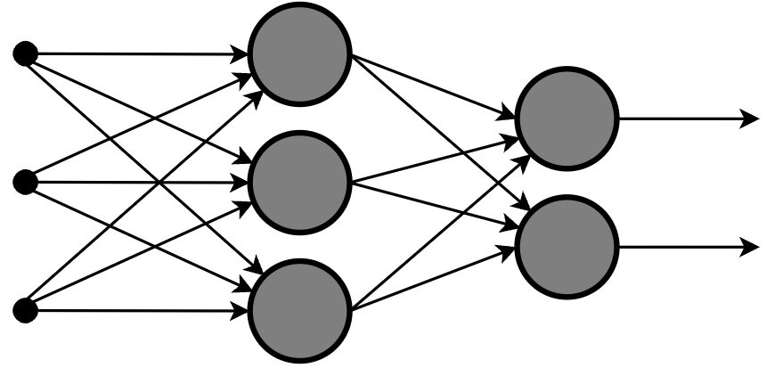
Incorporating new predictors for forecasting
Artificial Intelligence model to forecast gross domestic product
Social media as an indicator of public sentiment
Jason Howie, CC BY 2.0 <https://creativecommons.org/licenses/by/2.0>, via Wikimedia Commons
Offnfopt, CC BY-SA 3.0 <https://creativecommons.org/licenses/by-sa/3.0>, via Wikimedia Commons
Notes:
Banks are considering expanding upon existing traditional economic models to bring in a wider data sources, such as pulling in social media feeds as an indicator of public sentiment. The National bank of France has started to use social media information to estimate the public perception of inflation. The Malaysian national bank has started to incorporate new articles into its financial model of gross domestic product estimation.
This may raise questions about government oversight of social media information.

Slide 6
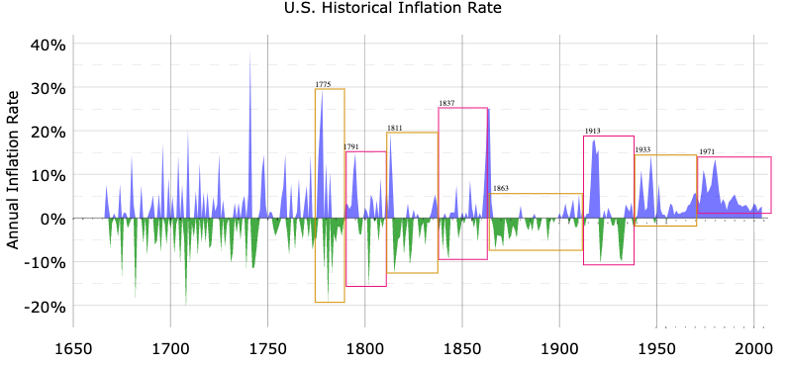
Using Large Language Models to predict inflation
Lalala666, Public domain, via Wikimedia Commons
Notes:
The US Federal Reserve has researched the idea of using pre-trained large language models from Google to make inflation prediction. Usually, inflation is predicted from the Survey of Professional Forecasters, which pools forecasts from a range of financial forecasts and experts. When compared to the true inflation rate, the researchers found that the large language models performed slightly better than the Survey of Professional Forecasters.
A concern of using pre-trained large language models is that the data sources used for model training are not known, so the financial institution may be using data that is not in line with its policy. Also, a potential risk of using large language models that perform similarly is the convergence of predictions. If large language models make very similar predictions, banks would act similarly and make similar policies, which may lead to financial instability.

Slide 7
Uses of artificial intelligence for improving financial institutions
Benefits
Reduce workload of redundant tasks
Consider wider sources information to represent public sentiment
Create better predictive time series models
Risks
Need to carefully benchmark models for high-risk predictions
Need to consider the ethics and privacy of any new data for a model
New models should encourage financial institutions to act creatively, not converge in groupthink.
Notes:
In this case study, you got to see the uses of artificial intelligence for improving financial institutions.
Some exciting benefits include reducing workload of redundant tasks, incorporating creative data sources to represent public sentiment, and building better time series models for inflation.
However, these benefits come with considerable risks that require careful implementation. For instance, one needs to carefully benchmark models before acting on them especially in high-risk situations. Adding new data sources always require ethics and privacy evaluation. Finally, if central banks develop models that rely on similar assumptions and datasets and act similarly, then it could lead to the same financial risks.

