Slide 1
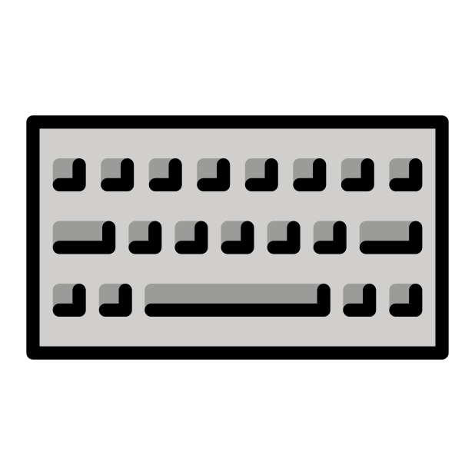
Customized Interfaces for AI
Notes:
Customized Interfaces for eh I In this chapter we will discuss examples of using customized interfaces for eh I.

Slide 2

Terms of Use
Notes:
This page describes the terms of use for this content.

Slide 3
Sometimes you need the power of AI underneath the hood of your own website/app
Notes:
Sometimes you need the power of AI underneath the hood of your own website/app. There are multiple strategies you can employ to achieve this. In this scenario, you need to have your website or app that has its own interface.

Slide 4


The two most common user interfaces:
GUI (Graphics user interface)
Point and click
Command line:
Type in a command
Notes:
Interfaces are how people will use your app. There's two main interface types that are most common: GUIs and Command line
- `GUI` - stands for "Graphics user interface" -- it's the most widely used. Here users point and click buttons to tell a computer and its software what they'd like to do.
- `Command line` - generally for software that is for individuals with more technical expertise and comfort with programming. In this interface, users type commands in order to perform tasks

Slide 5




What’s your use case?
Customized Interface
Input
I need users to access an AI model but from our own website/app
What is this?
Algorithms
Output
It’s an apple.
Training Data
Notes:
In this scenario we could maintain all of the same machinery but merely have a different platform where our users arrive.

Slide 6
Embed a premade AI
tools in your app
Use an API underneath
the hood of your app
Deploy existing model in
Your own app
AI solutions for customized interface
Least amount of expertise but other customizing may not be possible
Lowest
Investment
Will likely require a subscription but won’t require as much maintenance as creating your own custom model
Requires the most technical expertise but allows for most customizations
Highest
Investment
Sources: https://hbr.org/2023/07/how-to-train-generative-ai-using-your-companys-data
Notes:
There are multiple strategies for empowering your website or app with an eh I model or tool. These are arranged in order from lowest to highest investment. Embed premade eh I tools in your app - There are prepackaged solutions for standard eh I tools that you might want for your website. These are subscription services but require minimal expertise to employ. Use an A P I (Application programming interface) underneath the hood of your app -- an increasing number of L L Ms and other eh I tools have A P Is available. A P Is allow one to access a website or tool programmatically. This means that you can build your tool in such a way that underneath the hood it is powered by an eh I tool. Deploy existing model in your own app - this is the most technically intensive solution but would be necessary if you require other types of customizations for your eh I tool.

Slide 7
Usability experts are going to be really helpful for carrying out this kind of need
Interfaces can make or break a tool’s usability and hence popularity!
Notes:
Usability experts are going to be really helpful for carrying out this kind of need. Interface designs can make or break a tool’s usability and hence popularity!

Slide 8
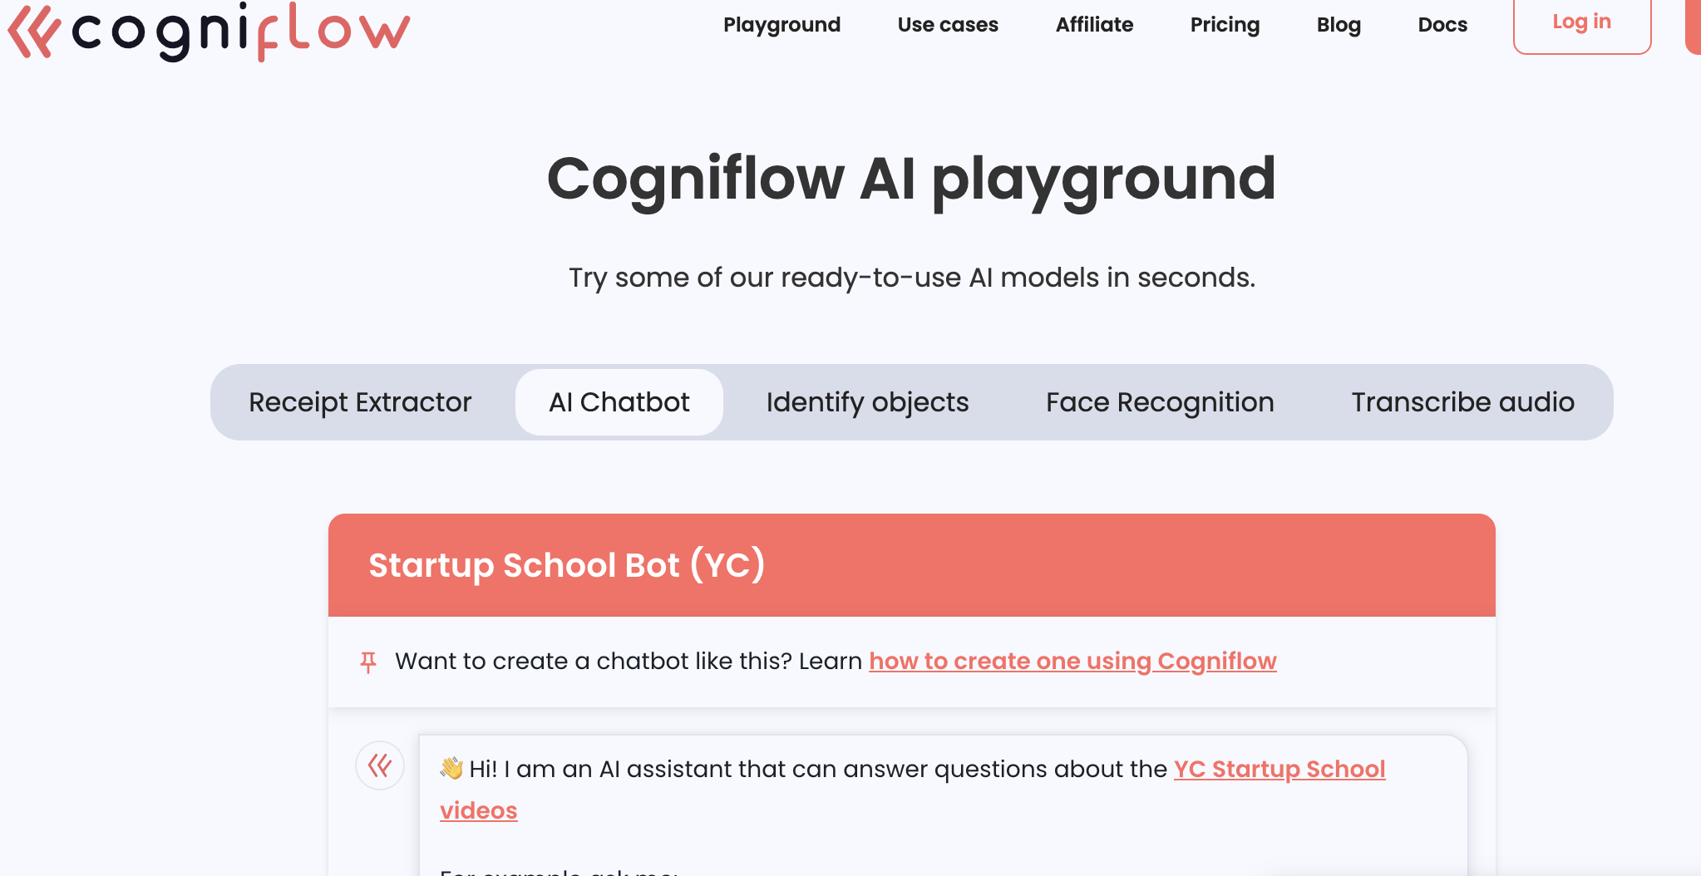
Premade AI tools
no need to reinvent the wheel
https://www.cogniflow.ai/ai-playground
Notes:
Some services like Cogniflow offer prepackaged eh I services like chatbots that you can embed in your website or tool. This has the advantage of being minimal maintenance or software development knowledge needed. But as always, you generally don't have the ability to highly customize or finely tune these types of options. Cogniflow is a subscription service.

Slide 9
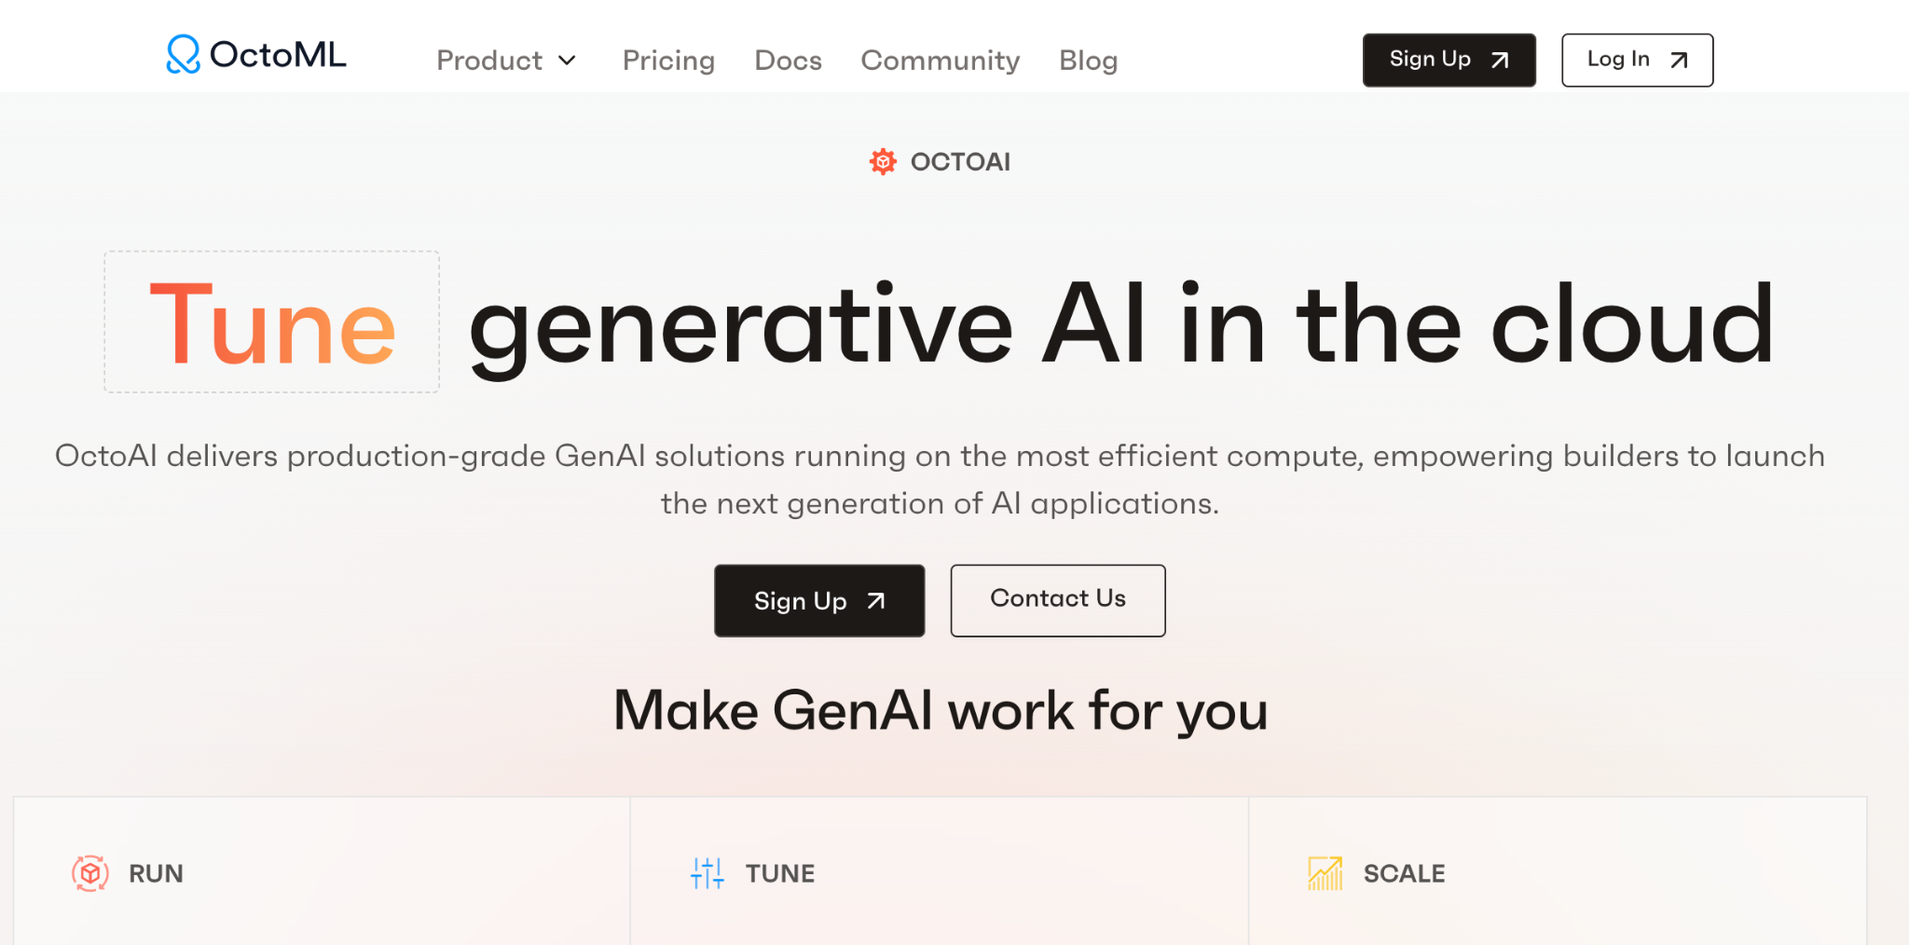
OctoML is premade
but allows for fine tuning as well
Notes:
Octo M L also has premade eh I services but allows for more customizations and fine tuning of models than Cogniflow does. It is a pay as you go type service since you use their computing resources.

Slide 10
Pre-package tools may only have certain options…
APIs are very powerful and allow you to incorporate all the power of an AI tool into your website/app
Notes:
Pre-package tools may only have certain options…
In contrast, A P Is can be very powerful and allow you to incorporate all the power of an eh I tool into your website/app. They also free you team from having to do as much back end development. Although not all eh I tools have A P I access, an increasing number of them are developing this as an option.

Slide 11
Examples of AI platforms with APIs
 | Status | Allows for tuning/customizations | Links
ChatGPT’s API | Works well. Allows customizations. | Yes and other customizations | https://openai.com/pricing
Bard | Beta version released – not yet available to everyone | TBD | How to Use Google Bard API
Google Cloud’s Speech to Text API |  | Specialized models are available | Speech-to-Text: Automatic Speech Recognition
Source: https://getstream.io/blog/artificial-intelligence-api/
Notes:
Currently Chat G P T's A P I is the most well developed for L L M (it appears at the time of writing this) but of course it requires a higher cost subscription plan. Bard may have a beta version of their A P I being further developed and released. Other types of eh I models (not L L Ms) often have A P I access as well like Google Cloud's speech to text A P I.

Slide 12
If you need more than a custom interface but also custom knowledge, security you, or handling you will likely need to build custom AI solutions
– again this requires more staff expertise
Notes:
If you need more than a custom interface but also custom knowledge, security you will likely need to build custom eh I solutions – again this requires more staff expertise
In the next chapter we will discuss custom eh I builds.

