Slide 1
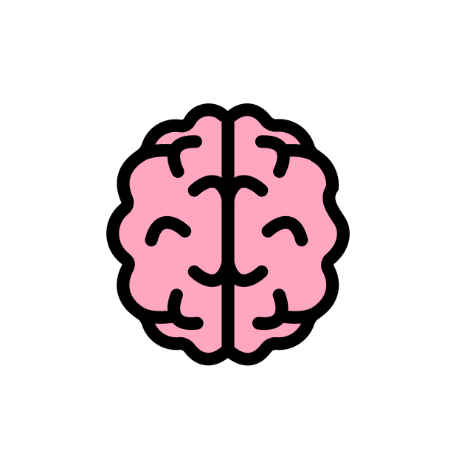
Customized Knowledge for AI
Notes:
How can you meet customized knowledge needs for eh I tools? In this chapter we will discuss the basics of what it means to customize eh I tools for domain specific knowledge needs.

Slide 2

Terms of Use
Notes:
These are the terms of use for this content

Slide 3


Don’t ask your primary care physician about how to fix your motorbike
Neither should you depend on an AI model for something it isn’t trained for
?
Notes:
Customized knowledge needs are perhaps the most common eh I tool need. And intuitively many can understand this. Just as you wouldn't ask your primary physician to fix your motorbike, neither should you depend on an eh I model for something it isn’t trained for.

Slide 4
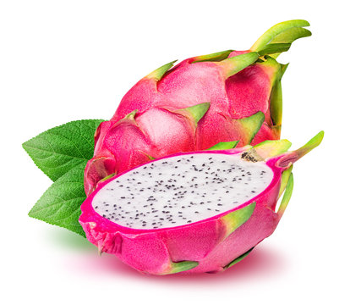

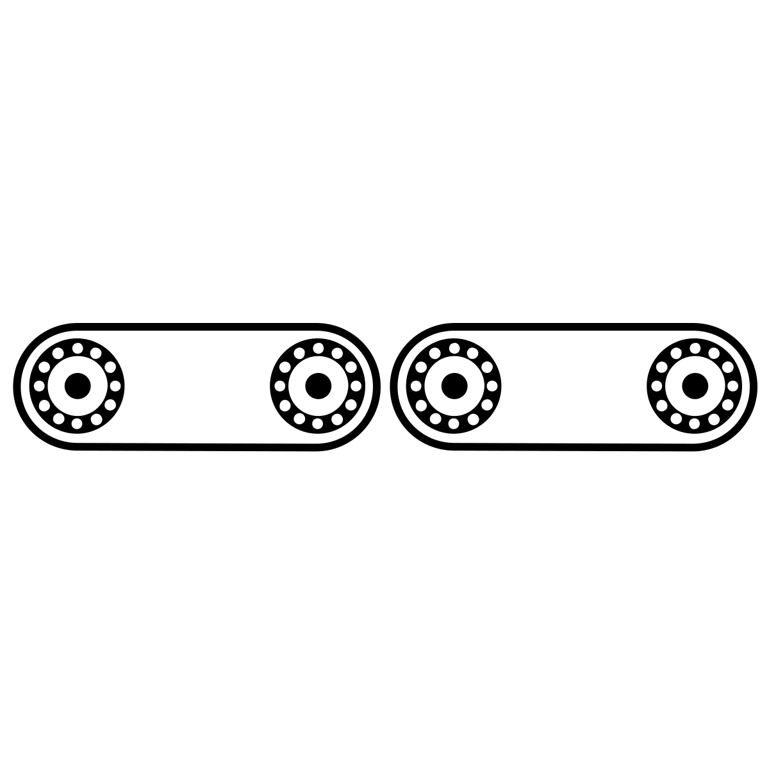

What’s your use case?
Customized Knowledge
Input
What is this?
My input questions are domain specific.
Algorithms
Output
It’s an apple.
Training Data
Notes:
When we are discussing customized knowledge needs, we are describing that existing AI models are not accurately addressing the needs we have. The output from the eh I models is incorrect or not useful.

Slide 5
Prompt engineering
Prompt-tuning
Fine-tuning a model
Training from Scratch
Getting a better output from a AI model
Lowest
Investment
The user of the model asks better questions
Make the model better - but efficiently
Make the model better - but with a bit more investment
Make a whole new ChatGPT; this is prohibitively expensive
Highest
Investment
Sources: https://hbr.org/2023/07/how-to-train-generative-ai-using-your-companys-data
Notes:
In summary, we will cover 4 different strategies for obtaining better output from an AI model.
If the goal of customized knowledge is to get better output from an eh I model, there are multiple strategies we can employ to achieve this goal. We will discuss them in order to lowest to highest investment. It's generally best to see if the low investment strategies can meet your needs before turning to the higher investment strategies. **prompt engineering** is when the user asks a better question as opposed to retraining the model. **prompt tuning** is when we use an iterative prompt and feedback strategy to make the model work better. It is lower investment attempt than fine tuning. **fine tuning** is when we give additional training to the model to have it perform better. So in our opening example, fine tuning is like sending the primary care fellowship to learn an additional skill set. **training from scratch** is when we quite literally build a whole new model from the beginning. For most use cases this is not necessary and it is prohibitively expensive.

Slide 6


Sometimes it's not the model who needs training
It's the user
Prompt Engineering
Sources: Screenshot from chatGPT
Notes:
Sometimes it’s not the model who needs training, it’s the user.
Eh I models, just like humans, are not mind readers, and just as we all learned how to google, we also need to learn how to engineer prompts. Prompt engineering does not require technical expertise in the traditional sense. Instead it just involves a lot of being more specific and retrying an eh I model with a different prompt.

Slide 7
1. Know the model’s strengths and weaknesses
2. Be as specific as possible
3. Utilize contextual prompts
4. Provide AI models with examples
5. Experiment with prompts and personas
6. Try chain-of-thought prompting
Best practices for prompt engineering
Source: https://cloud.google.com/blog/products/application-development/five-best-practices-for-prompt-engineering
Notes:
It’s also a good idea to keep in mind best practices for prompt engineering. These are tips according to Google.
1. Know the model’s strengths and weaknesses
2. Be as specific as possible
3. Utilize contextual prompts
4. Provide AI models with examples
5. Experiment with prompts and personas
6. Try chain-of-thought prompting

Slide 8
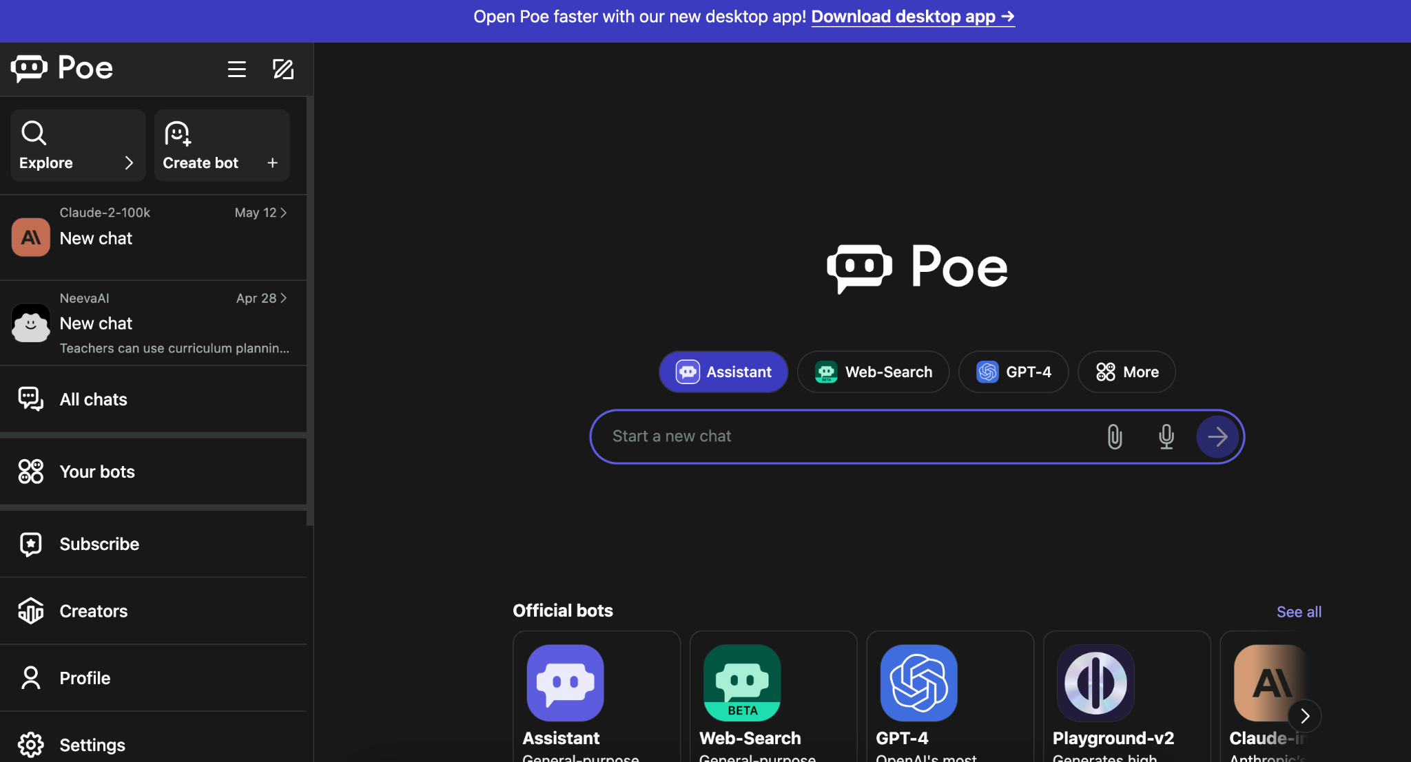
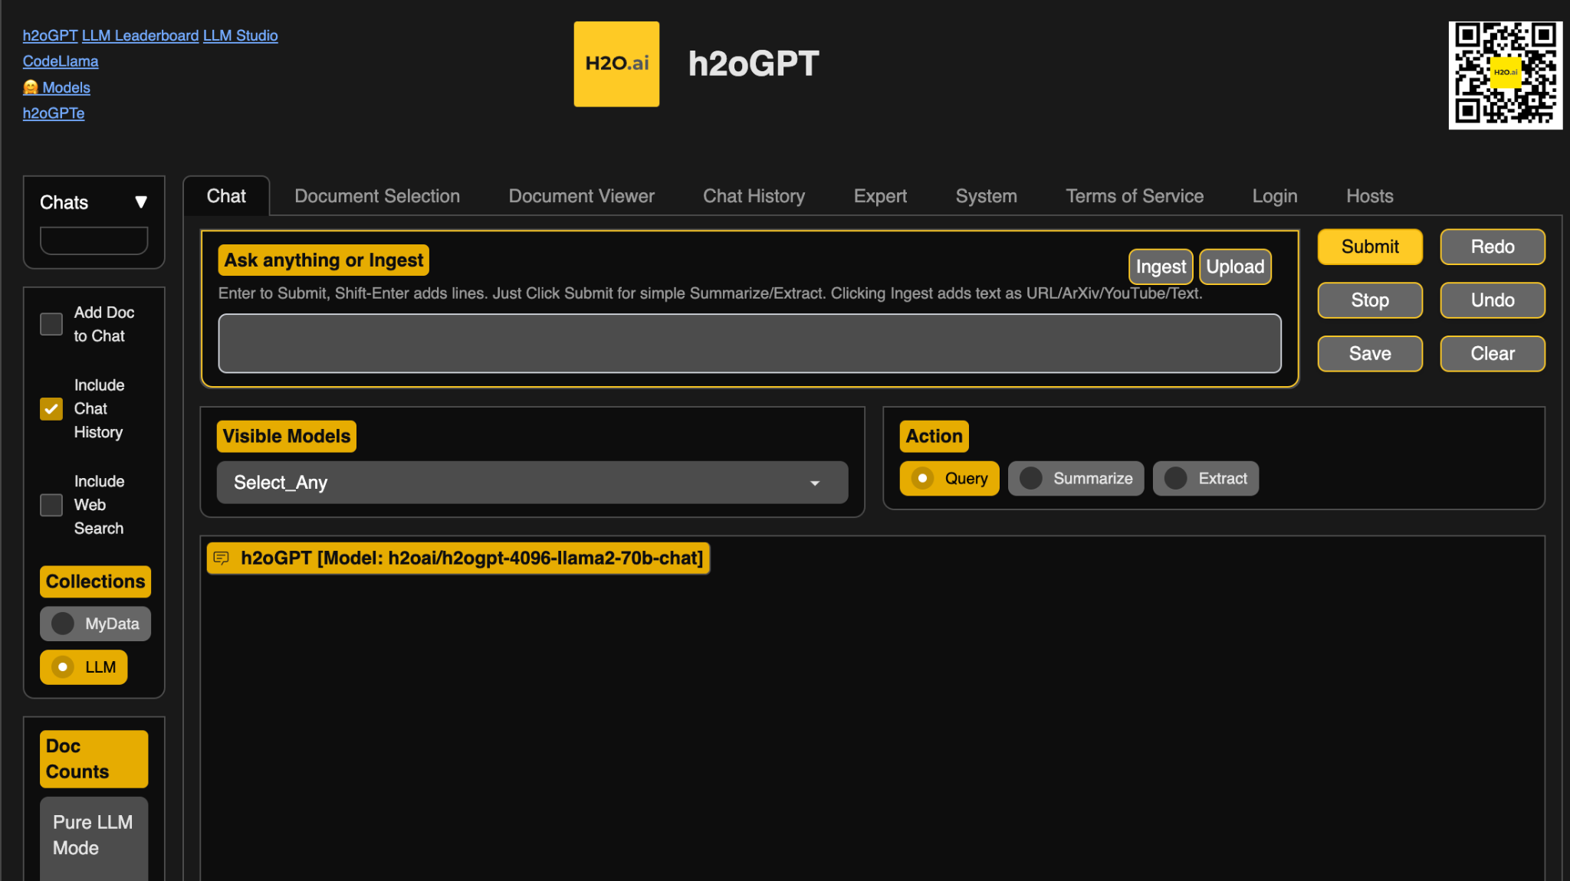
https://poe.com/ and https://gpt.h2o.ai/
Their differing training and algorithms will lead to differing results
Test out prompts on multiple AI platforms
these websites have multiple competitors in one place
Notes:
In addition to prompt engineering it's also vital to note that different eh I models are trained on different things. So if one is not giving you the output you need, try another! For LLMs, you can use poe dot com or gpt dot h 2 o dot eh i to test out prompts on multiple eh I platforms side by side.

Slide 9
Using prompts to help training LLMs
More efficient than fine tuning
But may or may not address your customization needs
Like giving a crossword puzzle clue to the LLM
Prompt tuning or “P-tuning”
Source: https://research.ibm.com/blog/what-is-ai-prompt-tuning
Notes:
Because prompt tuning sounds a lot like prompt engineering it would be easy to think these strategies are the same, but they are not.
Prompt tuning is a lower stakes type of tuning where you use your prompts to help train an LLM. It's more efficient than fine tuning. But it may or may not address your customization needs.
Basically you can think of prompt tuning like giving the LLM more context and instructions around what you are trying to receive back from it. A good analogy from this IBM article is that prompt tuning is like crossword puzzle clues for the LLM. It guides the model toward the right answer.

Slide 10
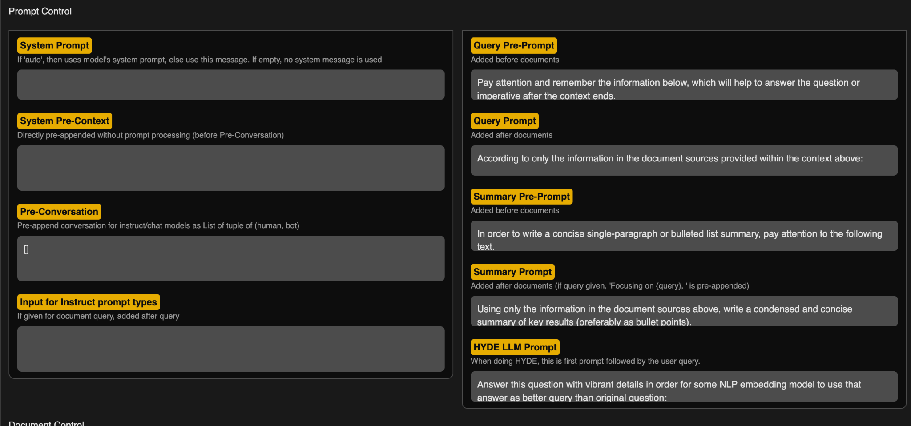
A type or prompt tuning offered by https://gpt.h2o.ai/ – go to the Expert tab
Test out prompt tuning
Notes:
You can test out prompt tuning without doing software engineering by trying out the g p t dot h 2 o platform

Slide 11


Training from scratch vs. fine tuning
Training a baby for a specialized education job would be costly and inefficient
<
https://docs.google.com/presentation/d/1rdVYJyS7xLYDsoZwC99VyQSnnaKelUnsVG4j2rHWjFA/edit#slide=id.g1965a5f7f0a_0_44
Instead, you find a person who has a lot of the training you need and then fine-tune their skills.
Pictures from OpenMoji.org
Notes:
First some context around fine tuning.
Let's make a hiring analog. If you needed someone to fulfill a specialized education job, you wouldn't train a baby who has almost no knowledge as a starting point. This would be unnecessarily time costly and inefficient. Instead, you find a person who has a lot of the training you need and then fine-tune their skills.

Slide 12
Training from scratch
ChatGPT cost ~$100 million to create
Training models from scratch requires an insane amount of data and computing costs
It’s almost never where you will want to start.
Pictures from OpenMoji.org
Source: https://www.wired.com/story/openai-ceo-sam-altman-the-age-of-giant-ai-models-is-already-over/
Notes:
ChatGPT cost ~$100 million to create
Training models from scratch requires an insane amount of data and computing costs
It’s almost never where you will want to start.

Slide 13
Before exploring fine tuning:
Are you sure no other model works?
(If you’ve only tried chatGPT go try other AI platforms)
https://www.nature.com/articles/d41586-023-03023-4
Notes:
But fine tuning also might cost money, so before we jump to this strategy we need to check one more time whether we've surveyed the available models for their fitness of our project's needs. Are you sure no other model works? if you've only tried ChatGPT go try other AI platforms. If an LLM is what you are looking for you can read our paper for a summary.

Slide 14
Fine tuning
train an existing model to do the job better
Finding a base open source base model to train for your purposes:
What AI model is trained on data most closely related to your application?
Which based model performs best based on your prior testing? Test LLM models on side by side here
Choose the smallest one that you can get away with
Bigger doesn’t mean better performance
https://huggingface.co/blog/large-language-models
Notes:
For us to fine tune a model, we'll first need to identify the base model that gets closest to what we are looking for.
When looking for a base model we want to consider at least these items congruently:
1. Which is trained on data most similar to your application?
2. Which models have performed the best based on your prior testing?

Slide 15
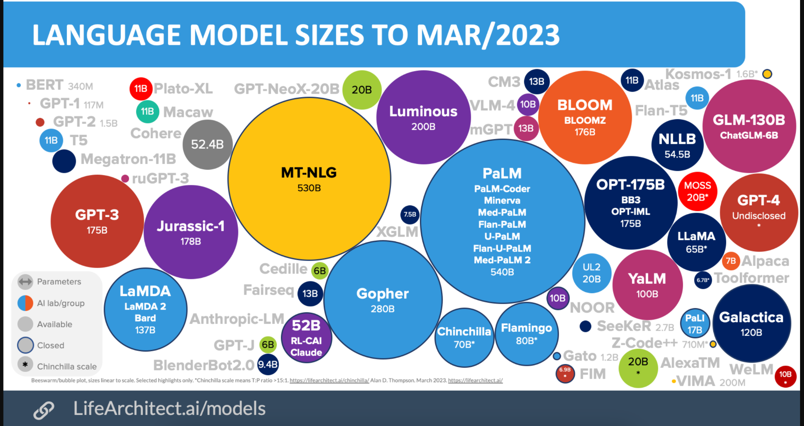
https://s10251.pcdn.co/wp-content/uploads/2023/03/2023-Alan-D-Thompson-AI-Bubbles-Rev-7b.png
Notes:
No need to unnecessarily increase our computing costs, try to find the smallest one that performs the best. Note that bigger doesn't mean it performs better -- think jack of all trades master of none. You want a model that isn't too general. Speaking of the size of models, here is a visual demonstrating the sizes of a lot of the LLM's in existence as of March 2023

Slide 16
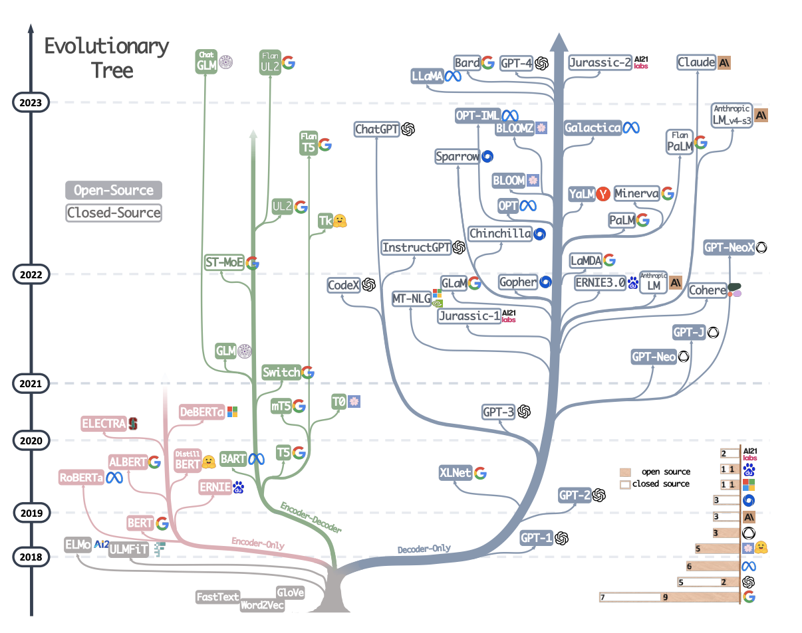
https://arxiv.org/pdf/2304.13712.pdf
Notes:
It also might be worth considering how these models are related. Perhaps an earlier, smaller version would be easier for you to train than using the latest, biggest large language model that doesn’t contain better information for your purposes.

Slide 17
Fine tuning
train an existing model to do the job better
How will you evaluate an AI models performance?*
Where do the existing models fall short?
What information does it need to perform better?
Do you have this data?
How much cleaning will it need?
Is it unprotected?*
*More on these items in future chapters
Notes:
- What information do you think would help close the knowledge gap of the existing models to meet your needs?
- Do you have the data you might be able to fine tune a model to help it perform better?
- How much cleaning will this data need?
- Is this data unprotected and freely able to be shared or submitted to an open source repository?

Slide 18
Example starting points for Fine or P-tuning
 | What is needed | P-tuning Docs | Fine Tuning Docs | For use with protected data?
Monster API | No code needed Subscription fees Data cleaning likely needed |  | Introducing no-code LLM FineTuning with Monster API Launch a Fine-Tuning Job - Monster API Docs | No
h2oGPT | Can be used from GUI or command line Data cleaning likely needed | Experiment settings | H2O LLM Studio | Effortless Fine-Tuning of Large Language Models with Open-Source H2O LLM Studio | Not from the GUI but the command line could if built right
HuggingFace | Python needed Data cleaning likely needed | P-tuning for sequence classification Prompt tuning for causal language modeling | Fine-tune a pretrained model Introduction - Hugging Face NLP Course | If you build it right*
*More on this in the next chapter
Notes:
Just because you may have identified you require fine tuning for an AI project doesn't necessarily mean you will need a lot of technical expertise. There are some solutions like MonsterAPI and H2o that allow for fine tuning without code. These might be good platforms to explore either as a way to meet needs or to experiment to determine a larger strategy. As described in the previous chapter, Hugging Face also has many tutorials on how to fine tune. This strategy would involve more code, frameworks, and software development.

Slide 19
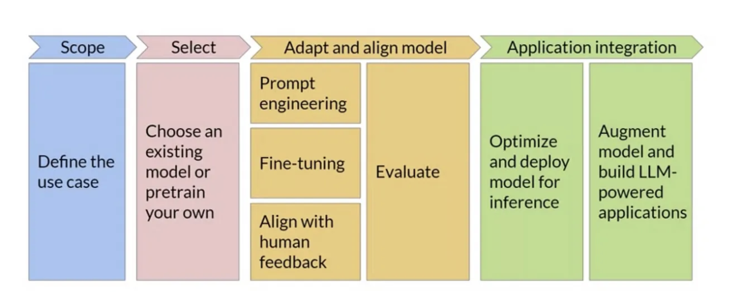
You are here
Ongoing monitoring throughout the project
https://medium.com/@kanikaadik07/generative-ai-project-life-cycle-55ce9092e24a
Notes:
If you do decide to build using open source models from Hugging Face or elsewhere you should consider these stages for your project timelines. In this course we have already discuss defining the use case and selecting an existing model and adapting that model. But in the upcoming chapters we will discuss deployment and evaluation of models.

