Slide 1
Mapping

Slide 2
Making maps in R
Maps can be tricky in R! There are many packages to choose from.
usmap is compatible with ggplot
maps is “Base R”
Some require API keys (e.g., ggmap, tidycensus)
Some are interactive (e.g., leaflet)
Some provide utilities (e.g., tigris)
Some deal with raster data (e.g., terra)

Slide 3
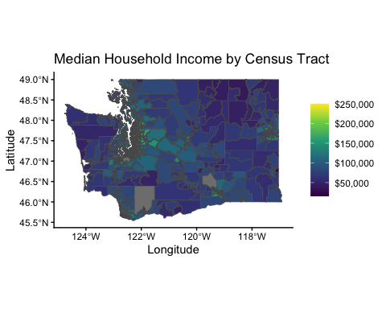
What does a map in R look like?

Slide 4
Data formats - boundary data
library(tidyverse) head(map_data("county"))
long lat group order region subregion 1 -86.50517 32.34920 1 1 alabama autauga 2 -86.53382 32.35493 1 2 alabama autauga 3 -86.54527 32.36639 1 3 alabama autauga 4 -86.55673 32.37785 1 4 alabama autauga 5 -86.57966 32.38357 1 5 alabama autauga 6 -86.59111 32.37785 1 6 alabama autauga

Slide 5
Data formats - boundary data
long: Longitude (x-coordinate)
lat: Latitude (y-coordinate)
group: Identifies unique polygons (each county may have multiple polygons if it contains islands or complex borders).
order: Sequence in which points should be connected to form the boundary (polygons).
region: State name (e.g., “alabama”).
subregion: County name within the state (e.g., “autauga”).

Slide 6
Data formats - sf data
library(usmapdata) head(us_map("county"))
Simple feature collection with 6 features and 4 fields Geometry type: MULTIPOLYGON Dimension: XY Bounding box: xmin: -2584074 ymin: -2602555 xmax: -1295469 ymax: -2030775 Projected CRS: NAD27 / US National Atlas Equal Area fips abbr full county geom 1 02013 AK Alaska Aleutians East Borough MULTIPOLYGON (((-1757988 -2... 2 02016 AK Alaska Aleutians West Census Area MULTIPOLYGON (((-2390688 -2... 3 02020 AK Alaska Anchorage Municipality MULTIPOLYGON (((-1513326 -2... 4 02050 AK Alaska Bethel Census Area MULTIPOLYGON (((-1899724 -2... 5 02060 AK Alaska Bristol Bay Borough MULTIPOLYGON (((-1681144 -2... 6 02063 AK Alaska Chugach Census Area MULTIPOLYGON (((-1472549 -2...

Slide 7
Data formats - sf data
This data is “Simple Feature” (sf) data used for spatial analysis.
These objects store geometric shapes (like points, lines, or polygons) along with associated attributes (metadata).
the geom column is a MULTIPOLYGON — a geometry type representing complex shapes, which may consist of multiple polygons (e.g., islands or non-contiguous regions).
Federal Information Processing System (FIPS) Codes for States and Counties are numbers which uniquely identify geographic areas. See this data key.

Slide 8
ggplot has spatial functions
geom_polygon() works with boundary data
Let’s plot county outlines and major cities.
library(tidyverse) # `map_data()` from ggplot2 library(maps) # `us.cities` data wa_county <- map_data("county") |> filter(region == "washington") wa_cities <- us.cities |> filter(country.etc == "WA") plot_1 <- ggplot() + geom_polygon(data = wa_county, aes(x = long, y = lat, group = group), color = "black", fill = NA) + geom_point(data = wa_cities, aes(x = long, y = lat)) + labs(title = "Washington State Cities", x = "longitude", y = "latitude") + coord_fixed(1.3)

Slide 9
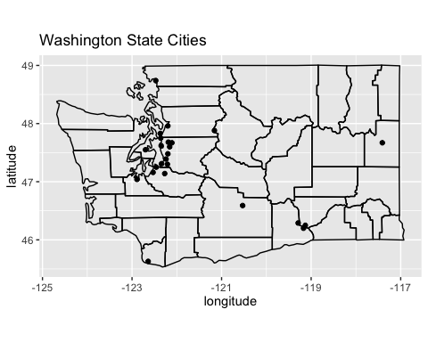
ggplot has spatial functions

Slide 10
maps package is more similar to Base R
library(maps) # `map` and `map.cities` functions and `us.cities` data map('county', region = 'washington', col = "#5E610B") map.cities(us.cities, country="WA", col = "#642EFE", cex = 2) title(main = "Washington State Cities")

Slide 11
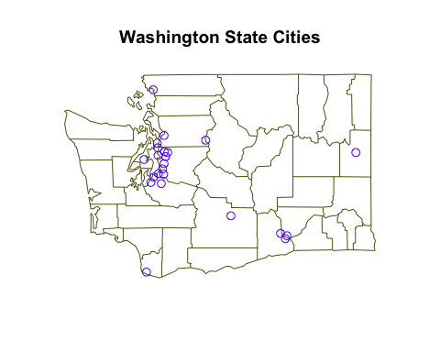
maps package is more similar to Base R

Slide 12
usmap is compatible with ggplot
Let’s fill each county based on its population.
library(tidyverse) library(usmap) # `countypop` data and the `plot_usmap()` function wa_dat <- countypop |> filter(abbr == "WA") plot_3 <- plot_usmap(data = wa_dat, values = "pop_2022", include = c("WA")) + scale_fill_continuous() + theme(legend.position = "right")

Slide 13
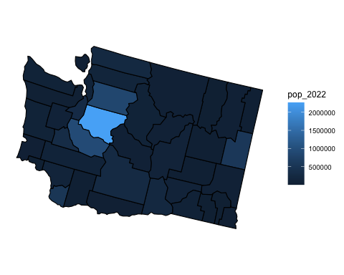
usmap is compatible with ggplot

Slide 14
It can get complicated! ggplot fill by county
Sometimes a lot of cleanup is needed to join boundary data with attributes of interest!
library(tidyverse) library(usmap) # `countypop` data library(maps) # `us.cities` data # Get county boundaries wa_county <- map_data("county") |> filter(region == "washington") # Get county-level ("subregion") population wa_dat <- countypop |> filter(abbr == "WA") |> mutate(subregion = tolower(str_remove(county, " County"))) |> group_by(subregion) |> summarize(pop_2022 = sum(pop_2022)) # Combine the data wa_complete <- wa_county |> inner_join(wa_dat) # Get WA cities and their coordinates wa_cities <- us.cities |> filter(country.etc == "WA")

Slide 15
It can get complicated! ggplot fill by county
Sometimes a lot of cleanup is needed to join boundary data with attributes of interest!
# Step 2: create the plot plot_4 <- ggplot() + geom_polygon(data = wa_complete, aes(x = long, y = lat, group = group, fill = pop_2022)) + geom_point(data = wa_cities, aes(x = long, y = lat), color = "red") + labs( title = "Washington State Population and Cities, 2022", x = "longitude", y = "latitude") + coord_fixed(1.3)

Slide 16
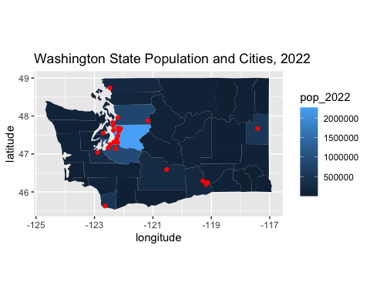
It can get complicated! ggplot fill by county

Slide 17
tidycensus is helpful for tract level
Use geom_sf() function with SF data.
Let’s fill each census tract by median household income.
library(tidyverse) # `geom_sf()` from ggplot2 library(tidycensus) # `get_acs()` function for American Community Survey data wa_income <- get_acs( geography = "tract", variables = "B19013_001", # Median income code state = "WA", year = 2022, geometry = TRUE )

Slide 18
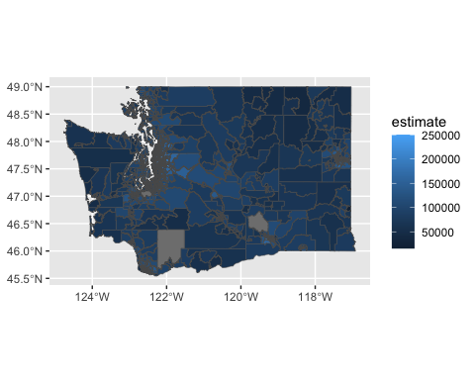
tidycensus is helpful for tract level
ggplot(data = wa_income, aes(fill = estimate)) + geom_sf()

Slide 19
Getting fancier..
ggplot(data = wa_income, aes(fill = estimate)) + geom_sf() + labs(title = "Median Household Income by Census Tract", x = "Longitude", y = "Latitude") + theme_classic() + scale_fill_viridis_c(labels = scales::label_dollar()) + theme(legend.title = element_blank())

Slide 20
Tips for Mapping in R
Know the functions: make sure your data going into plotting functions is similar to
Data Structure: Ensure column names match between datasets for join() operations
e.g., subregion needs to align in both wa_county and wa_dat to make wa_complete.
Make sure all datasets (like counties and cities) use the same geographic system, such as longitude-latitude pairs.
Clean Data to make life easier
Use functions like tolower() and str_remove() to standardize text (e.g., removing “County”).
Group and summarize data when plotting aggregates, like population by county.

Slide 21
More resources
https://rspatial.org/index.html (whole course using terra!)
https://rfortherestofus.com/2024/06/us-maps
https://ggplot2-book.org/maps
https://walker-data.com/tidycensus/articles/spatial-data.html
https://walker-data.com/census-r/mapping-census-data-with-r.html
https://jtr13.github.io/cc19/different-ways-of-plotting-u-s-map-in-r.html

Slide 22
tigris has many utility functions
tigris gets boundary shapefiles from the US Census Bureau (as sf data).
zctas(): ZIP code tabulation areas
voting_districts(): voting districts
school_districts(): school districts
library(tigris) zip_wa <- zctas(state = "WA", year = 2010)

Slide 23
Storing API keys safely
Never EVER put API keys on GitHUB!
http://api.census.gov/data/key_signup.html
library(tidycensus) census_api_key("111111abc", install = TRUE) # First time, reload your environment so you can use the key without restarting R. readRenviron("~/.Renviron") # You can check it with: Sys.getenv("CENSUS_API_KEY")
Source: https://walker-data.com/tidycensus/reference/census_api_key.html

