Slide 1
Reproducibility - Intro to R
Candace Savonen

Slide 2

Photo by Simone Secci on Unsplash
Patil, Peng, Leek (2016) https://www.biorxiv.org/content/10.1101/066803v1
Notes:
Reproducibility means a different analyst re­-performing the same analysis with the same code and data obtains the same result.

Slide 3



My data analysis is showing a pattern that is very
informative for the ongoing research in my field.
Variable B
Variable A
Ruby the Researcher
Image created by Candace Savonen using Avataars.
Notes:
Ruby the researcher has found something very interesting through data analysis. Ruby has a scatterplot on her computer that shows blue and pink data points and a trendline. The scatterplot has Variable A on the x axis and Variable B on the y axis. Ruby says my data analysis is showing a pattern that is very informative for ongoing research in my field.

Slide 4




Repeatable: keeping everything the same but repeating the analysis - do we get the same results?
Ruby the Researcher
Code
Data
Results
Variable B
Variable A
Image created by Candace Savonen using Avataars.
Notes:
Repeatable means that if you keep everything the same but repeat the analysis - do you get the same results? Ruby the researcher has her same code and data but a repeat sign around them. If she re-runs the analysis, will she get the same scatterplot of results we’ve seen previously?

Slide 5

Reproducible: using the same data and analysis but in the hands of another researcher - do we get the same results?
Ruby the Researcher
Avi the Associate
Data
Code
Results
Code
Data
Variable B
Variable A
Image created by Candace Savonen using Avataars.
Notes:
Reproducible: using the same data and analysis but in the hands of another researcher - do we get the same results?
Ruby the researcher sends her code and data to Avi the Associate who then tries to re-run the same analysis on his own computer. Will Avi get the same scatterplot and results?

Slide 6
Replicable: with new data do we obtain the same inferences?
Ruby the Researcher
Avi the Associate
Code
Same Code
New Data
Variable A and B are positively correlated
Image created by Candace Savonen using Avataars.
Notes:
Replicable: with new data do we obtain the same inferences? Ruby the researcher sends her code to Avi the Associate who then tries to re-run the same analysis on his own computer but now with new data (represented by a different color flashdrive). Will Avi come to the same inference that Ruby’s analysis did?

Slide 7
Replicability
new researcher, new data
Effort
Time
Reproducibility
new researcher, same data
Repeatability
same researcher, same data
Based off of a figure from Essawy et al, 2020 https://doi.org/10.1016/j.envsoft.2020.104753
Notes:
A triangular graph shows a hierarchy of research. Repeatability is a the bottom ‘same researcher, same machine’, Reproducibility is above that, ‘new researcher, same data’ and on the very top is Replicability ‘new researcher, new data’.

Slide 8

Ruby’s findings are super relevant to my work and I’m interested in using her methods!
Variable B
Variable A
Ruby the Researcher
Avi the Associate
Image created by Candace Savonen using Avataars.
Notes:
Ruby the researcher has found something very interesting through data analysis. Ruby has a scatterplot on her computer that shows blue data points and an trendline that shows a positive correlation. The scatterplot has Variable A on the x axis and Variable B on the y axis. Avi the associate sees Ruby the researcher’s results and is also excited about the findings. Avi says ‘Ruby’s findings are super relevant to my work and I’m interested in using her methods!’

Slide 9


Here, Avi, this code runs well on my computer, let me email it to you!
R = 0.893
So exciting!
Variable B
Variable A
Ruby’s computer
Avi’s computer
Ruby the Researcher
Avi the Associate
Image created by Candace Savonen using Avataars.
Notes:
Ruby the researcher has her computer with a plot and a significant and exciting research result. Ruby says ‘Here, Avi, this code runs well on my computer, let me email it to you!’ Avi the associate says ‘so exciting’

Slide 10
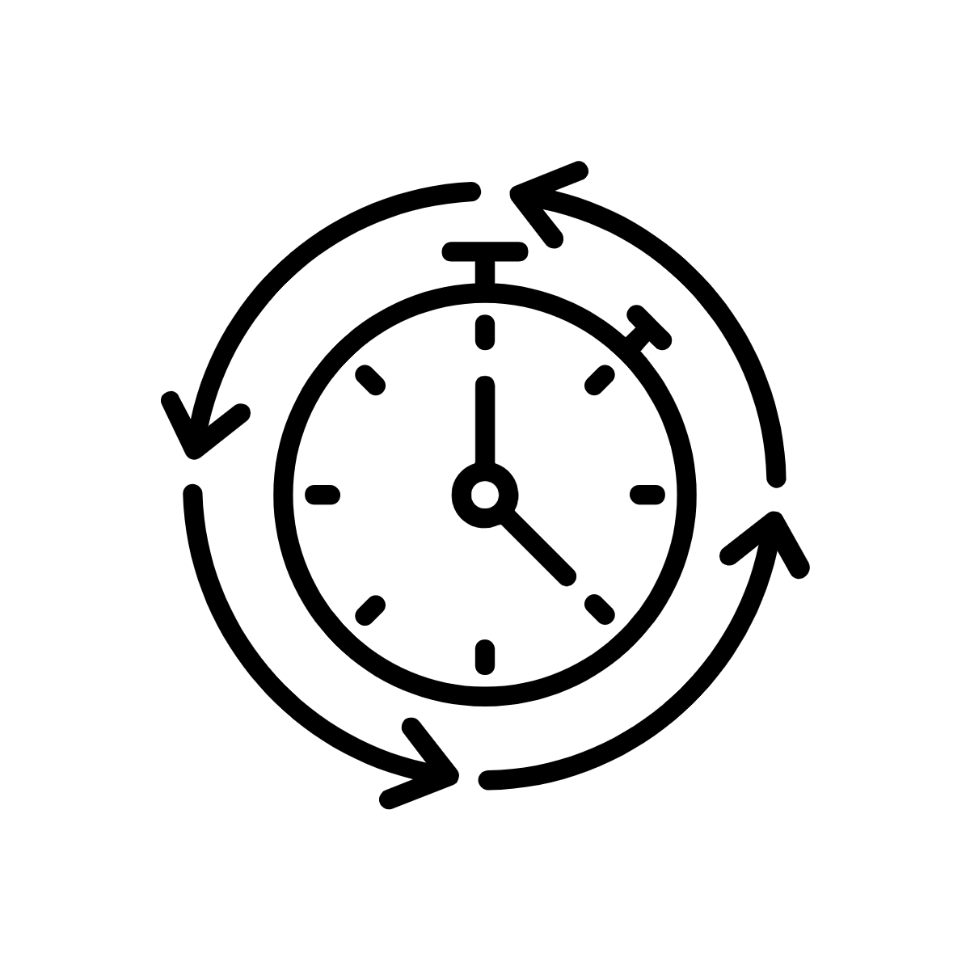



Ruby’s code and data
ERROR ERROR ERROR ERROR ERROR ERROR ERROR ERROR
ERROR ERROR
Avi the Associate
Avi’s computer
Image created by Candace Savonen using Avataars.
Notes:
Avi the associate is confused and sweating. His computer has the word ‘error’ written all over it and its on fire trying to use Ruby’s code on Ruby’s data. This is using a substantial amount of time and effort on Avi’s part.

Slide 11


Re:Re:Re: Data
Hi Ruby, I don’t understand what this code is supposed to be doing...
Error: file path “Ruby’s computer/Ruby’s file/final_version10.R” not found
Ruby the Researcher
Avi the Associate
Avi’s computer
Re:Re:Re: Data
Hi Avi, It works for me?
Image created by Candace Savonen using Avataars.
Notes:
Ruby the researcher and Avi are emailing back and forth. Avi is very confused about Ruby’s code and data. Avi’s computer says ‘Error: file path “Ruby’s computer/Ruby’s file/final_version10.R” not found’. Avi email says ‘Re:Re:Re: Data Hi Ruby, I don’t understand what this code is supposed to be doing…’ Ruby is also confused and emails back to Avi ‘Re:Re:Re: Data Hi Avi, It works for me?’

Slide 12

R = 0.893
R = 0.891
Ruby’s code and data
Variable B
Variable B
Variable A
Variable A
Ruby’s
computer
Ruby the Researcher
Avi the Associate
Avi’s computer
Image created by Candace Savonen using Avataars.
Notes:
Ruby the researcher and Avi the associate are both very confused and slightly horrified that they both ran the same code and data but received different results.

Slide 13
Just because something is reproducible doesn’t mean it is correct.
But it is a necessary step to help check for correctness and get to replicability.

Slide 14

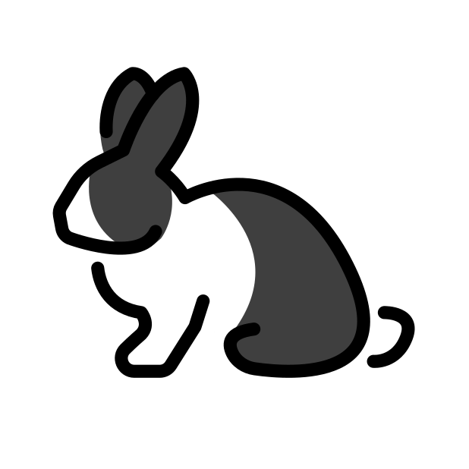
Reproducibility is a tortoise’s game - it’s an incremental and slow process but it has high payoffs!
Notes:
Reproducibility is a tortoise’s game - it’s an incremental and slow process but it has high payoffs!

Slide 15
Reproducible analyses save everyone time and effort!
Notes:
Reproducible analyses save everyone time and effort!

Slide 16

Now Ruby
Future Ruby
Ruby’s code
Ruby’s code
ERROR
Image created by Candace Savonen using Avataars.
Notes:
Ruby the researcher’s code works now as represented on her computer by a check mark. But Future Ruby, who has gray hair has an error running the same code!

Slide 17






Ruby’s code - not as reproducible
ERROR
ERROR
ERROR
ERROR
ERROR
ERROR
ERROR
Image created by Candace Savonen using Avataars.
Notes:
If Ruby’s code is less reproducible, every researcher who attempts to use Ruby’s code will encounter the same errors and each person will have to fix it. This adds up to a lot of spent researcher time and effort.

Slide 18






Ruby’s code - made reproducibly
ERROR
Image created by Candace Savonen using Avataars.
Notes:
If Ruby’s code is built in a sturdier manner, it will save others’ time who might also need to perform a similar analysis. Ruby’s code is made reproducibly in this example and only one of her seven colleagues that are using her code needed to troubleshoot an error.

Slide 19
If your results are not repeatable they will NOT be reproducible.
In other words, if you can’t get the same answer twice, other researchers won’t be able to get your answer reliably either.
Patil, Peng, Leek (2016) https://www.biorxiv.org/content/10.1101/066803v1
Notes:
If your results are not repeatable they will NOT be reproducible. In other words, if you can’t get the same answer twice, other researchers won’t be able to get your answer either.

Slide 20
Step 1) Get your code to work once
Step 2) Get your code to work reliably for you
Step 3) Get your code to work for someone else
Notes:
Step 1) Get your code to work once
Step 2) Get your code to work reliably for you
Step 3) Get your code to work for someone else

Slide 21
Re-runs sometimes
Re-runs reliably in most contexts
Re-runs in every situation and gets the same result every time
Ran once
Not repeatable
Every analysis starts here
Perfectly reproducible
No analysis reaches here
Image created by Candace Savonen.
Notes:
Reproducibility is on a continuum. This graph shows a two sided arrow with a gradient. On the very left is a ‘not repeatable analysis’ it was ran once. To the right of that is an analysis that ‘re-runs sometimes’. To the right of this, is an analysis that ‘Re-runs reliably in most contexts’. And all the way to the right is a ‘perfectly reproducible analysis’ that ‘Re-runs in every situation and gets the same result every time’. In red lettering we note that every analysis is started by being run once but no analysis is ‘perfectly reproducible’.

Slide 22
R Markdown notebooks are a handy tool for reproducibility!

Slide 23
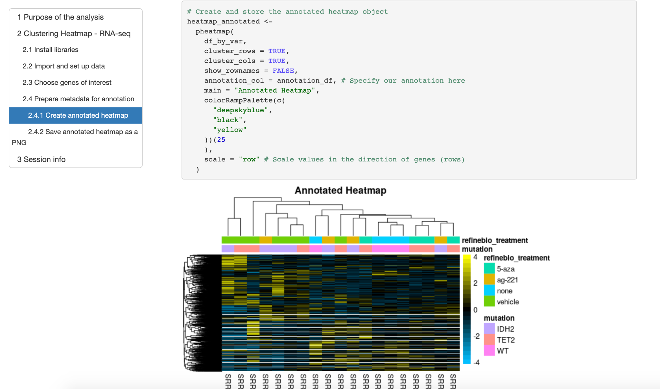
Working from this notebook allows me to interactively develop on my data analysis and write down my thoughts about the process all in one place!
RMarkdown is conducive to interactive development!
Ruby the Researcher
Image created by Candace Savonen using Avataars.
Notes:
Ruby is looking at her computer that has a lovely notebook with a heatmap! Ruby says ‘Working from this notebook allows me to interactively develop on my data analysis and write down my thoughts about the process all in one place!’

Slide 24
Avi, here’s some output from this scientific notebook I’ve been developing from!
This is so easy to follow and read, even though I didn’t write the code. Thanks for sharing your exciting results!
R = 0.893
Ruby the Researcher
Avi the Associate
RMarkdown creates easily shareable output!
Image created by Candace Savonen using Avataars.
Notes:
Ruby the researcher has her computer showing her notebook. Ruby says ‘Avi, here’s some output from this scientific notebook I’ve been developing from!’ Avi the associate says ‘This is so easy to follow and read, even though I didn’t write the code. Thanks for sharing your exciting results!’

Slide 25
Yay! I just got the data for 5 more samples. Because of my handy notebook set up, I can easily call one command and re-run the analysis so it is updated with the new samples included!
Ruby the Researcher
RMarkdown is handy for creating updateable reports!
Image created by Candace Savonen using Avataars.
Notes:
Ruby is looking at her computer that has a lovely notebook with a heatmap! Ruby says ‘Yay! I just got the data for 5 more samples. Because of my handy notebook set up, I can easily call one command and re-run the analysis so it is updated with the new samples included!’

Slide 26
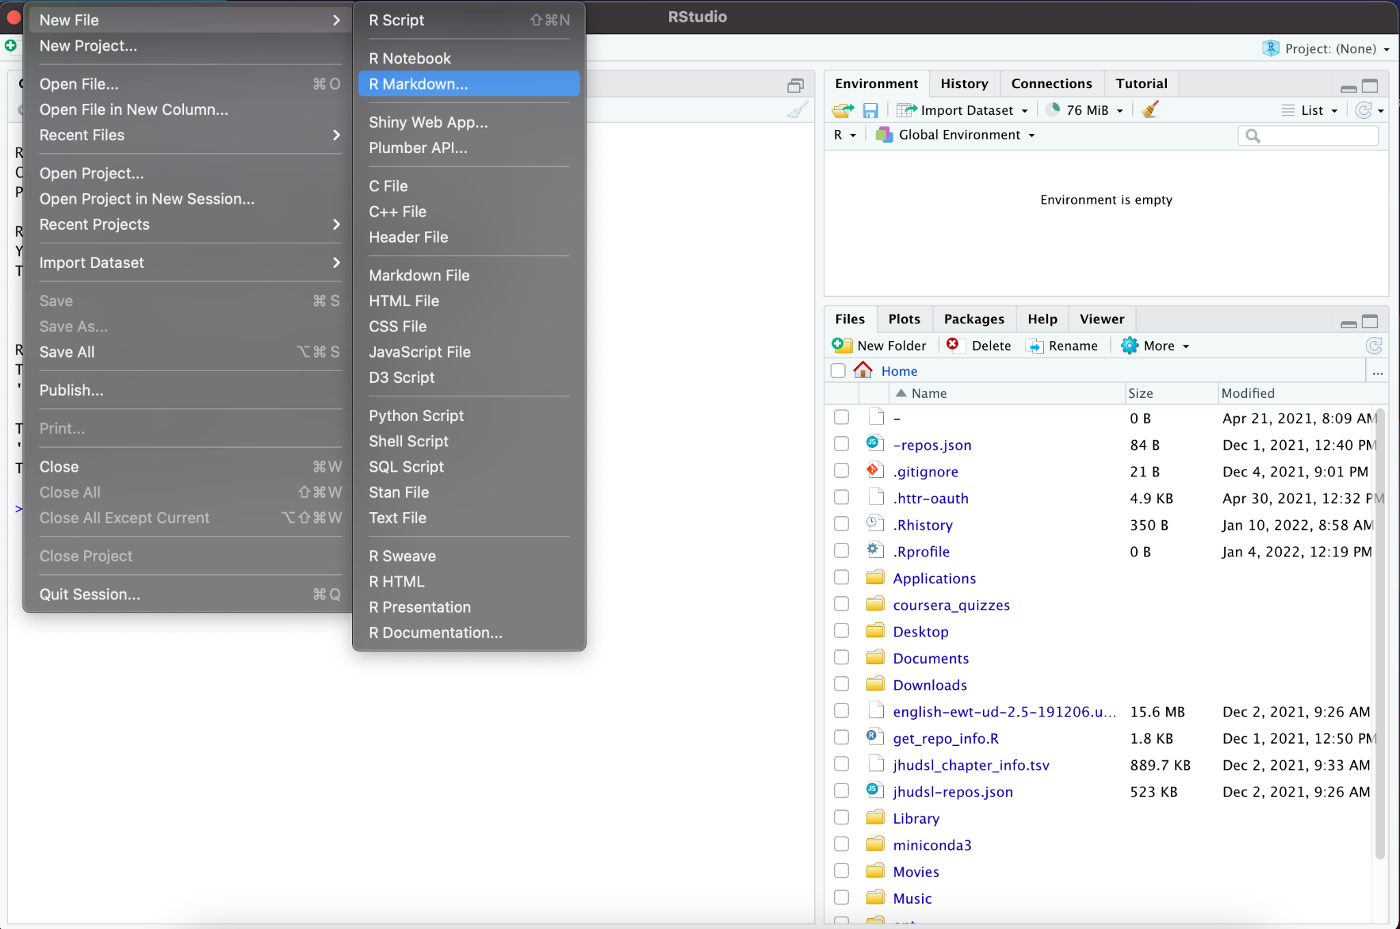
Screenshot by Candace Savonen
Notes:
In RStudio, you can create a new notebook by going to File > New Files > R Markdown. Then open up this chapter’s example code folder and open the make_heatmap.R file.

Slide 27
Package versions affect reproducibility!

Slide 28


Ruby’s local computing environment
Avi’s local computing environment
2.1.0
2.0.1
4.2.1
3.0.1
2.1.0
5.1.0
3.1.0
1.0.1
4.1.1
3.9.0
R = 0.893
R = 0.891
Created by Candace Savonen
Notes:
Ruby has a particular computing environment she has developed her code from. This computing environment is represented as a bubble above her computer with various hexagons with version numbers as well as Rstudio and R installed on her computer. Her code ran just fine on her particular computing environment. Avi attempted to run Ruby’s code on his very different local computing environment and got an error. His computer runs the same code but came up with a different result!

Slide 29
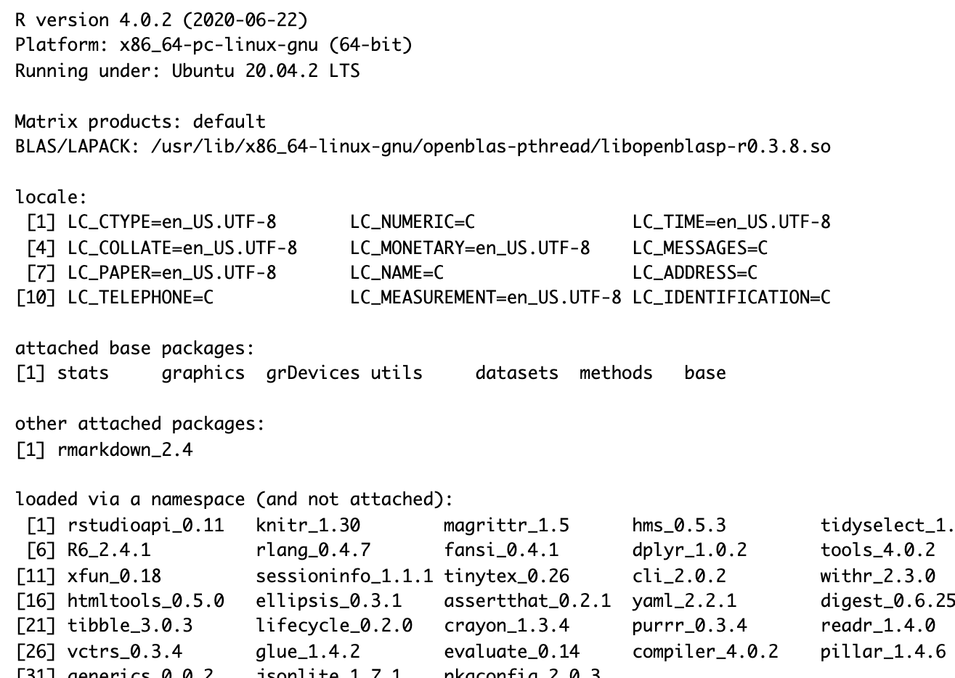
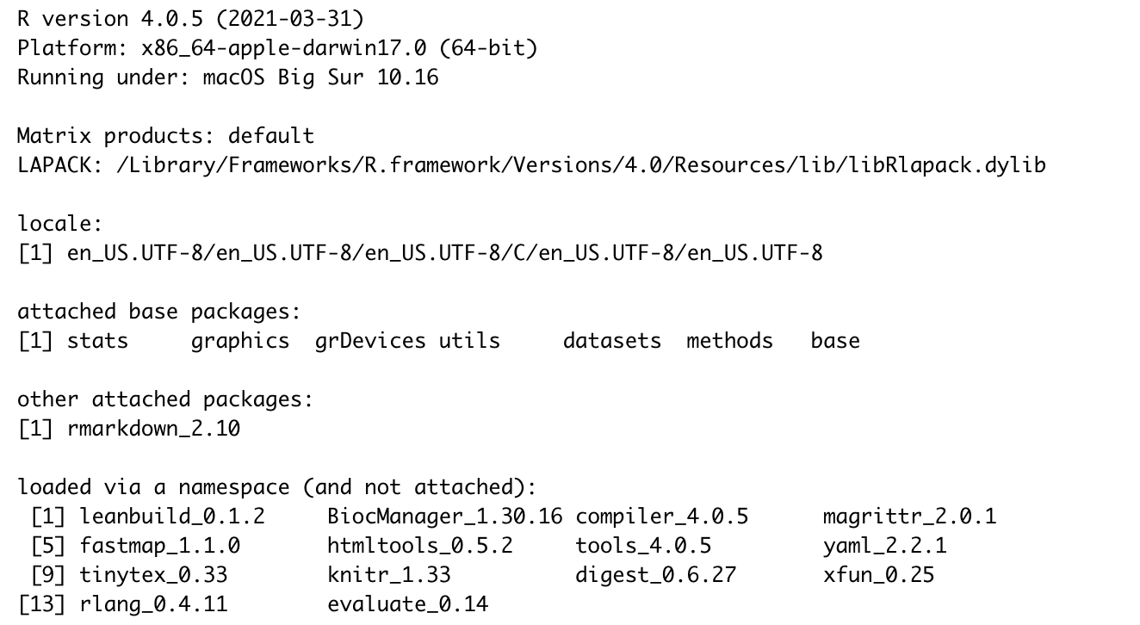
Ruby’s session info print out
Avi’s session info print out
R version 4.0.2 vs 4.0.5
Different operating systems!
rmarkdown 2.4 vs 2.10
If Avi and Ruby have discrepancies in their results, the session info print out gives a record which may have clues to why that might be!
Image by Candace Savonen
Notes:
Two session info print outs are show side by side. One is labeled as ‘Ruby’s session info print out’ and the other as ‘Avi’s session info print out’. Highlighted we can see that they have different R versions: 4.0.2 vs 4.0.5. They also have different operating systems. The packages they have attached is rmarkdown but they also have different rmarkdown package versions! If Avi and Ruby have discrepancies in their results, the session info print out gives a record which may have clues to why that might be! This can give them items to look into for determining why the results didn’t reproduce as expected.

Slide 30
DRY code: Don’t repeat yourself!

Slide 31
DRY code is easier on readers because they don't have to review the same thing twice, but also because they don't have to review the same thing twice.

Slide 32
DRY code is easier on readers because they don't have to review the same thing twice, but also because they don't have to review the same thing twice.

Slide 33
After you get your code working, next step is to make it:
Readable - can others understand what you are doing?
Efficient - Is this the best way to do this?

Slide 34
For more on these topics:
The RMarkdown book
Writing in Markdown
Jenny Bryan’s organizational strategies.
Write efficient R code for science.
Reproducibility in Cancer Informatics course

Slide 35

Introduction to Reproducibility in Cancer Informatics
Notes:
Introduction to Reproducibility in Cancer Informatics. Written by: Candace Savonen. Contributed and Edited by Sarah Wheelan and Jeff Leek

