Slide 1
Basic R

Slide 2
Working in R
For now, we will be working in the Console (Pane 1 )

Slide 3
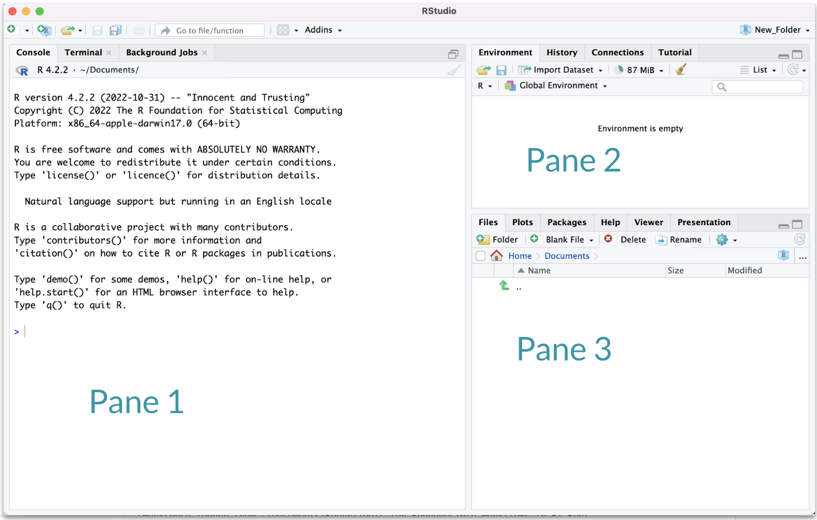

Slide 4
FYI: Changing R versions
Check your R version.
You might change it later today if you aren’t up to date with us.
Go to Tools > Global Options > General. Next to “R version”, click Change, choose the newest version from the list, click Apply, and restart RStudio. (1, 2, 3, 4)

Slide 5
R as a calculator
The R console is a full calculator
Try to play around with it:
+, -, /, * are add, subtract, divide and multiply
^ or ** is power
parentheses – ( and ) – work with order of operations
%% finds the remainder

Slide 6
R as a calculator
Try evaluating the following. Type these in the Console and press return to evaluate:
2 + 2
2 * 3 / 4
2^4 - 1

Slide 7
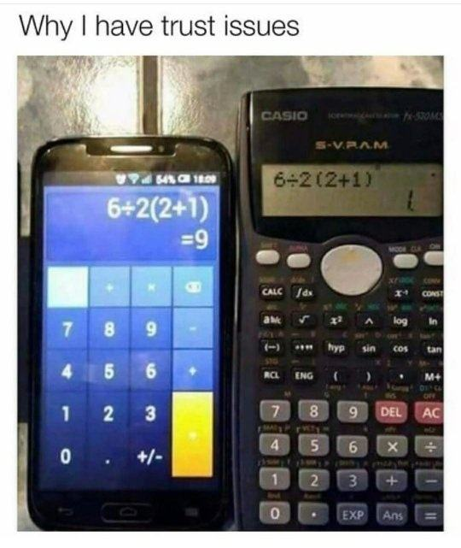

Slide 8
Basic terms: “object”
Object - an object is something that can be worked with or on in R - can be lots of different things!
You can think of objects as nouns in R.
a variable
a dataset
a plot
… many more

Slide 9
Assigning values to objects
You can create objects within the R environment and from files on your computer
R uses <- to create objects (you might also see = used, but this is not best practice)
x <- 2 x
[1] 2
x * 4
[1] 8
x + 2
[1] 4

Slide 10
GUT CHECK: What is an “object”?
A. Something I can touch
B. Something that can be worked with in R
C. A software version

Slide 11
Objects with text
Create objects with text using quotation marks:
y <- "hello world!" y
[1] "hello world!"

Slide 12
numeric vs. character classes?
We will talk in-depth about classes. For now:
numeric
Numbers
No quotation marks
2
character
Text with quotation marks
Green lettering (default)
"hello!"

Slide 13
Common issues

Slide 14
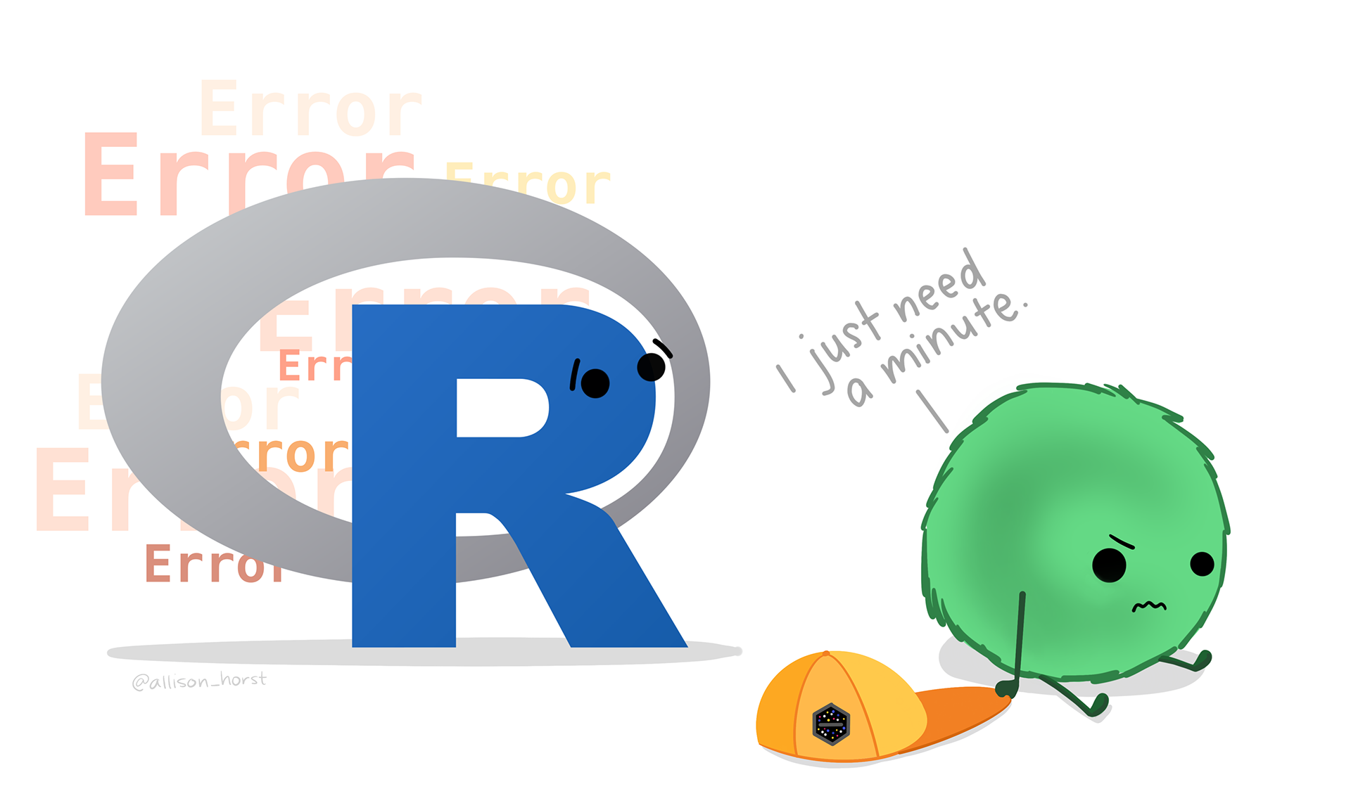

Slide 15
TROUBLESHOOTING: R is case sensitive
Object names are case-sensitive, i.e., X and x are different
x
[1] 2
X
Error: object 'X' not found

Slide 16
TROUBLESHOOTING: No commas in big numbers
Commas separate objects in R, so they shouldn’t be used when entering big numbers.
z <- 3,000
Error in parse(text = input): <text>:1:7: unexpected ',' 1: z <- 3, ^

Slide 17
TROUBLESHOOTING: Complete the statement
10 /
Error in parse(text = input): <text>:2:0: unexpected end of input 1: 10 / ^
+ indicates an incomplete statement. Hit “esc” to clear and bring back the >.

Slide 18
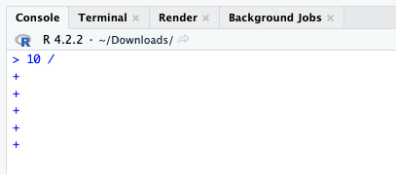

Slide 19
TROUBLESHOOTING: Zoom Quotation Marks
y <- “hello world!”
Error in parse(text = input): <text>:1:6: unexpected input 1: y <- “ ^
Retype the quotation marks!
y <- "hello world!"

Slide 20
Simple object practice
Try assigning your full name to an R object called name

Slide 21
Simple object practice
Try assigning your full name to an R object called name
name <- "Ava Hoffman" name
[1] "Ava Hoffman"

Slide 22
Combining objects with c()
Use c() to collect/combine single R objects into a vector of R objects. It is mostly used for creating vectors of numbers and character strings.
x <- c(1, 4, 6, 8) x
[1] 1 4 6 8

Slide 23
Combining objects with c()
Try assigning your first and last name as 2 separate character strings into a vector called name2

Slide 24
Combining objects with c()
Try assigning your first and last name as 2 separate character strings into a vector called name2
name2 <- c("Ava", "Hoffman") name2
[1] "Ava" "Hoffman"

Slide 25
Basic terms: “function”
Function - a function is a piece of code that allows you to do something in R. You can write your own, use functions that come directly from installing R, or use functions from additional packages.
You can think of a function as verb in R.
A function might help you add numbers together, create a plot, or organize your data.

Slide 26
Using functions on our vector
class() tells us what kind of values the object contains (numeric, character, etc)
length() tells us how many elements.
name
[1] "Ava Hoffman"
class(name)
[1] "character"
x
[1] 1 4 6 8
length(x)
[1] 4

Slide 27
GUT CHECK: What is a “function”?
A. a number or text
B. a button inside RStudio
C. code that does something

Slide 28
Combining vectors
It’s fine to combine vectors, but all values will end up with the same class!
vect <- c(name, x) vect
[1] "Ava Hoffman" "1" "4" "6" "8"
class(vect)
[1] "character"

Slide 29
Practicing functions
What do you expect for the length of the name2 object?
What is the class?

Slide 30
Practicing functions
What do you expect for the length of the name2 object?
What is the class?
length(name2)
[1] 2
class(name2)
[1] "character"

Slide 31
Commenting in code
# creates a comment in R code
# 1 + 2 <- this does not get run 1 + 2 # <- this does
[1] 3

Slide 32
Lab Part 1
Assign values to objects with <- (new name on left side)
Use the c() function to combine text/numbers/etc. into a vector
class() tells you the class (kind) of object
Use the length() function to determine number of elements
# for comments or to deactivate a line of code
Just open up the file to see the questions for lab. More about the file type soon!
💻 Lab

Slide 33
Math + vector objects
You can perform math with vectors.
x + 2
[1] 3 6 8 10
x * 3
[1] 3 12 18 24
x + c(1, 2, 3, 4)
[1] 2 6 9 12

Slide 34
Math + vector objects
But math can only be performed on numbers.
name2 + 4
Error in name2 + 4: non-numeric argument to binary operator

Slide 35
Reassigning to a new object
Save these modified vectors as a new vector called y.
y <- x + c(1, 2, 3, 4) y
[1] 2 6 9 12
Note that the R object y is no longer “hello world!” - It has been overwritten by assigning new data to the same name.

Slide 36
Reassigning to a new object
Reassigning allows you to make changes “in place”
# results not stored: x + c(1, 2, 3, 4) # x remains unchanged, results stored in `y`: y <- x + c(1, 2, 3, 4) # replace `x` in place x <- x + c(1, 2, 3, 4)

Slide 37
R objects
You can get more attributes than just class. The function str() gives you the structure of the object.
str(x)
num [1:4] 1 4 6 8
str(y)
num [1:4] 2 6 9 12
This tells you that x is a numeric vector and tells you the length.

Slide 38
Basic terms: “argument”
Argument - what you pass to a function
can be data like the number 1 or 20234
can be options about how you want the function to work
separated by commas
Like an adverb.

Slide 39
Create vectors with seq()
For numeric: seq()
The from argument says what number to start on.
The to argument says what number to not go above.
The by argument says how much to increment by.
The length.out argument says how long the vector should be overall.
seq(from = 0, to = 1, by = 0.2)
[1] 0.0 0.2 0.4 0.6 0.8 1.0
seq(from = 0, to = 10, by = 1)
[1] 0 1 2 3 4 5 6 7 8 9 10
seq(from = -5, to = 5, length.out = 10)
[1] -5.0000000 -3.8888889 -2.7777778 -1.6666667 -0.5555556 0.5555556 [7] 1.6666667 2.7777778 3.8888889 5.0000000

Slide 40
Useful functions to create vectors rep()
For character: rep() can create very long vectors. Works for creating character and numeric vectors.
The each argument specifies how many of each item you want repeated. The times argument specifies how many times you want the vector repeated.
rep(WHAT_TO_REPEAT, arguments)
rep(c("black", "white"), each = 3)
[1] "black" "black" "black" "white" "white" "white"
rep(c("black", "white"), times = 3)
[1] "black" "white" "black" "white" "black" "white"
rep(c("black", "white"), each = 2, times = 2)
[1] "black" "black" "white" "white" "black" "black" "white" "white"

Slide 41
Creating numeric vectors sample()
You can use the sample() function to make a random sequence. The x argument specifies what you are sampling from. The size argument specifies how many values there should be. The replace argument specifies if values should be replaced or not.
seq_hun <- seq(from = 0, to = 100, by = 1) seq_hun
[1] 0 1 2 3 4 5 6 7 8 9 10 11 12 13 14 15 16 17 [19] 18 19 20 21 22 23 24 25 26 27 28 29 30 31 32 33 34 35 [37] 36 37 38 39 40 41 42 43 44 45 46 47 48 49 50 51 52 53 [55] 54 55 56 57 58 59 60 61 62 63 64 65 66 67 68 69 70 71 [73] 72 73 74 75 76 77 78 79 80 81 82 83 84 85 86 87 88 89 [91] 90 91 92 93 94 95 96 97 98 99 100
y <- sample(x = seq_hun, size = 5, replace = TRUE) y
[1] 55 61 3 3 20

Slide 42
Installing packages to do more!
Some functions and data come with R right out of the box (“base R”). We will add more functionality with packages. Think of these like “expansion packs” for R.
Must be done once for each installation of R (e.g., version 4.2 >> 4.3).
An important package we will use is tidyverse. It is a mega-package great for data import, wrangling, and visualization.
install.packages("tidyverse")

Slide 43
Loading packages
After installing packages, you will need to “load” them into memory so that you can use them.
This must be done every time you start R.
We use a function called library to load packages.
library(tidyverse)

Slide 44
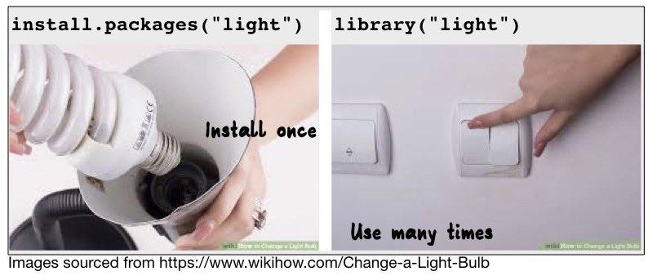
Installing + Loading packages

Slide 45
RStudio Shortcuts
 | Windows | Mac
Insert assignment operator (<-) | Alt+- | Option+-

Slide 46
More soon! See shortcuts here.

Slide 47
Summary
R functions as a calculator
Use <- to save (assign) values to objects. Reassigning allows you to make changes “in place”.
Use c() to combine into vectors
length(), class(), and str() tell you information about an object
The sequence seq() function helps you create numeric vectors (from,to, by, and length.out arguments)
The repeat rep() function helps you create vectors with the each and times arguments
sample() makes random vectors
install.packages() and library() install and load packages, respectively.

Slide 48
Summary
🏠 Class Website
💻 Basic R Lab
📃 Day 1 Cheatsheet

Slide 49


Slide 50
Image by Gerd Altmann from Pixabay

