Slide 1
Introduction to R: Homework 1

Slide 2
Download Lesson
Click the following link to download the lesson:
https://github.com/fhdsl/DaSEH/raw/main/modules/HW/Intro_to_R_Course.swc

Slide 3
Install Swirl
Open RStudio. Copy and paste the following code into the console. Press enter to run:
install.packages("swirl"); library(swirl)

Slide 4
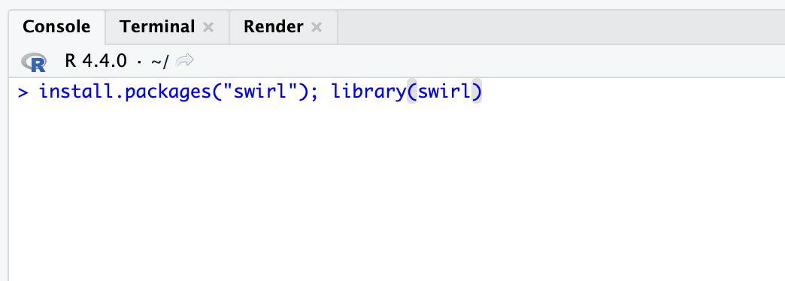

Slide 5
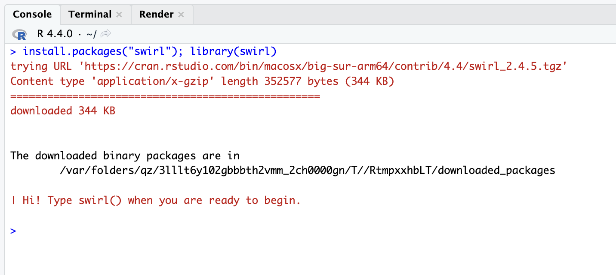

Slide 6
Install Lesson in RStudio
After the successful installation, run the following:
install_course()
You should see a popup where you can select the .swc file you downloaded earlier. Select it to continue.

Slide 7
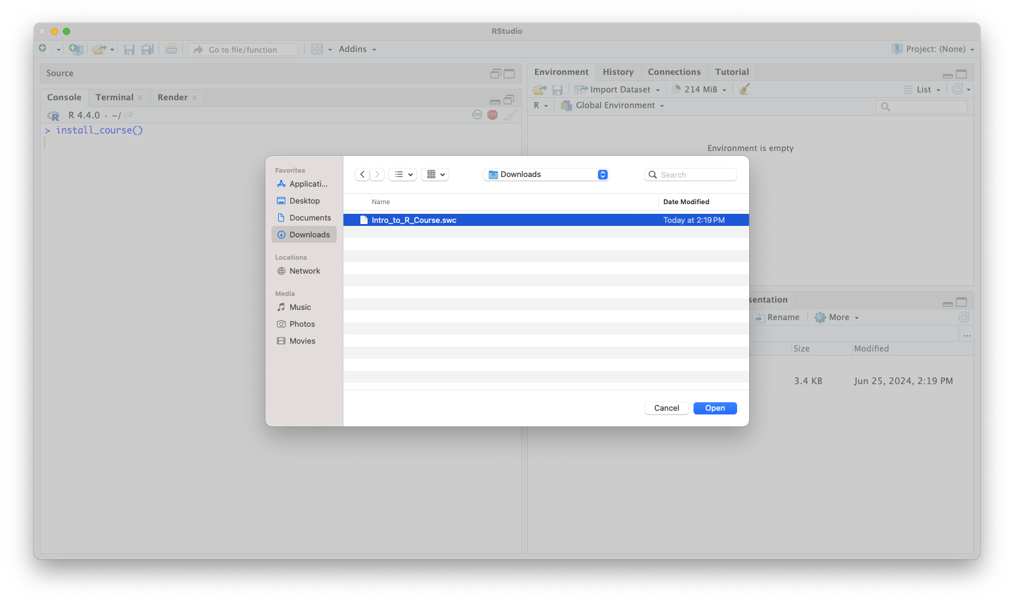

Slide 8
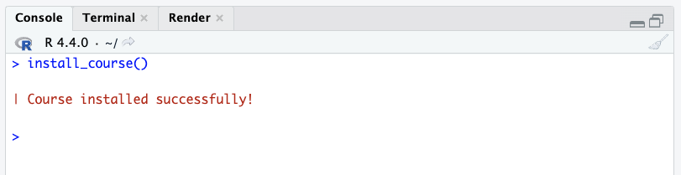

Slide 9
Launch swirl
Next, run the following:
swirl()

Slide 10
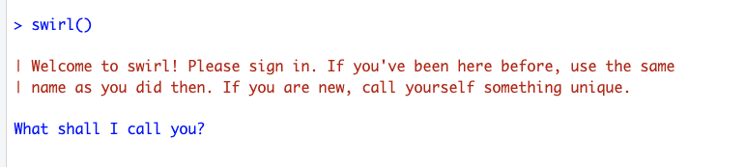

Slide 11
Complete Questions
Follow along with the questions in RStudio’s console.

