Slide 1
R and RStudio Installation

Slide 2
R is a powerful analytical language and contains a number of useful packages for analyzing data.
RStudio is a free and open-source integrated development environment (IDE) for R. RStudio provides comprehensive facilities to R programmers and is highly recommended in this class.
Please complete the following before the start of the class to hit the ground running.
Sections:
Installing R
Installing RStudio
R packages
Installing R Packages (Point and Click)
Installing R Packages (Code)
Exercise: Install an R package

Slide 3
Installing R
We recommend installing the most recent version or R (4.6.0 (called ‘Because it was There’) as of April 24, 2026). If you have had installed R already some time ago, we recommend updating/reinstalling it to the most recent version. Use a link below to launch download of R installers (if the download does not start, a fix may be to copy-paste the below link to your browser):
Download For Mac users (M1 chip)
Download For Mac users (Intel chip)
Download For Windows users
For other operating systems, or if you prefer to access the download link from the official website, visit https://cran.r-project.org/ and select Download R for Linux, Download R for macOS or Download R for Windows based on which device you have.
Once the proper installer has been selected, run the installer and follow the on-screen directions. This installation includes the R language and a basic graphical user interface (GUI). Rather using the basic GUI, we recommend installing RStudio - an integrated development environment (IDE) that lets you interact with R with some added benefits.

Slide 4
Installing RStudio
To install RStudio, visit https://posit.co/download/rstudio-desktop/. The website should look something like this:

Slide 5
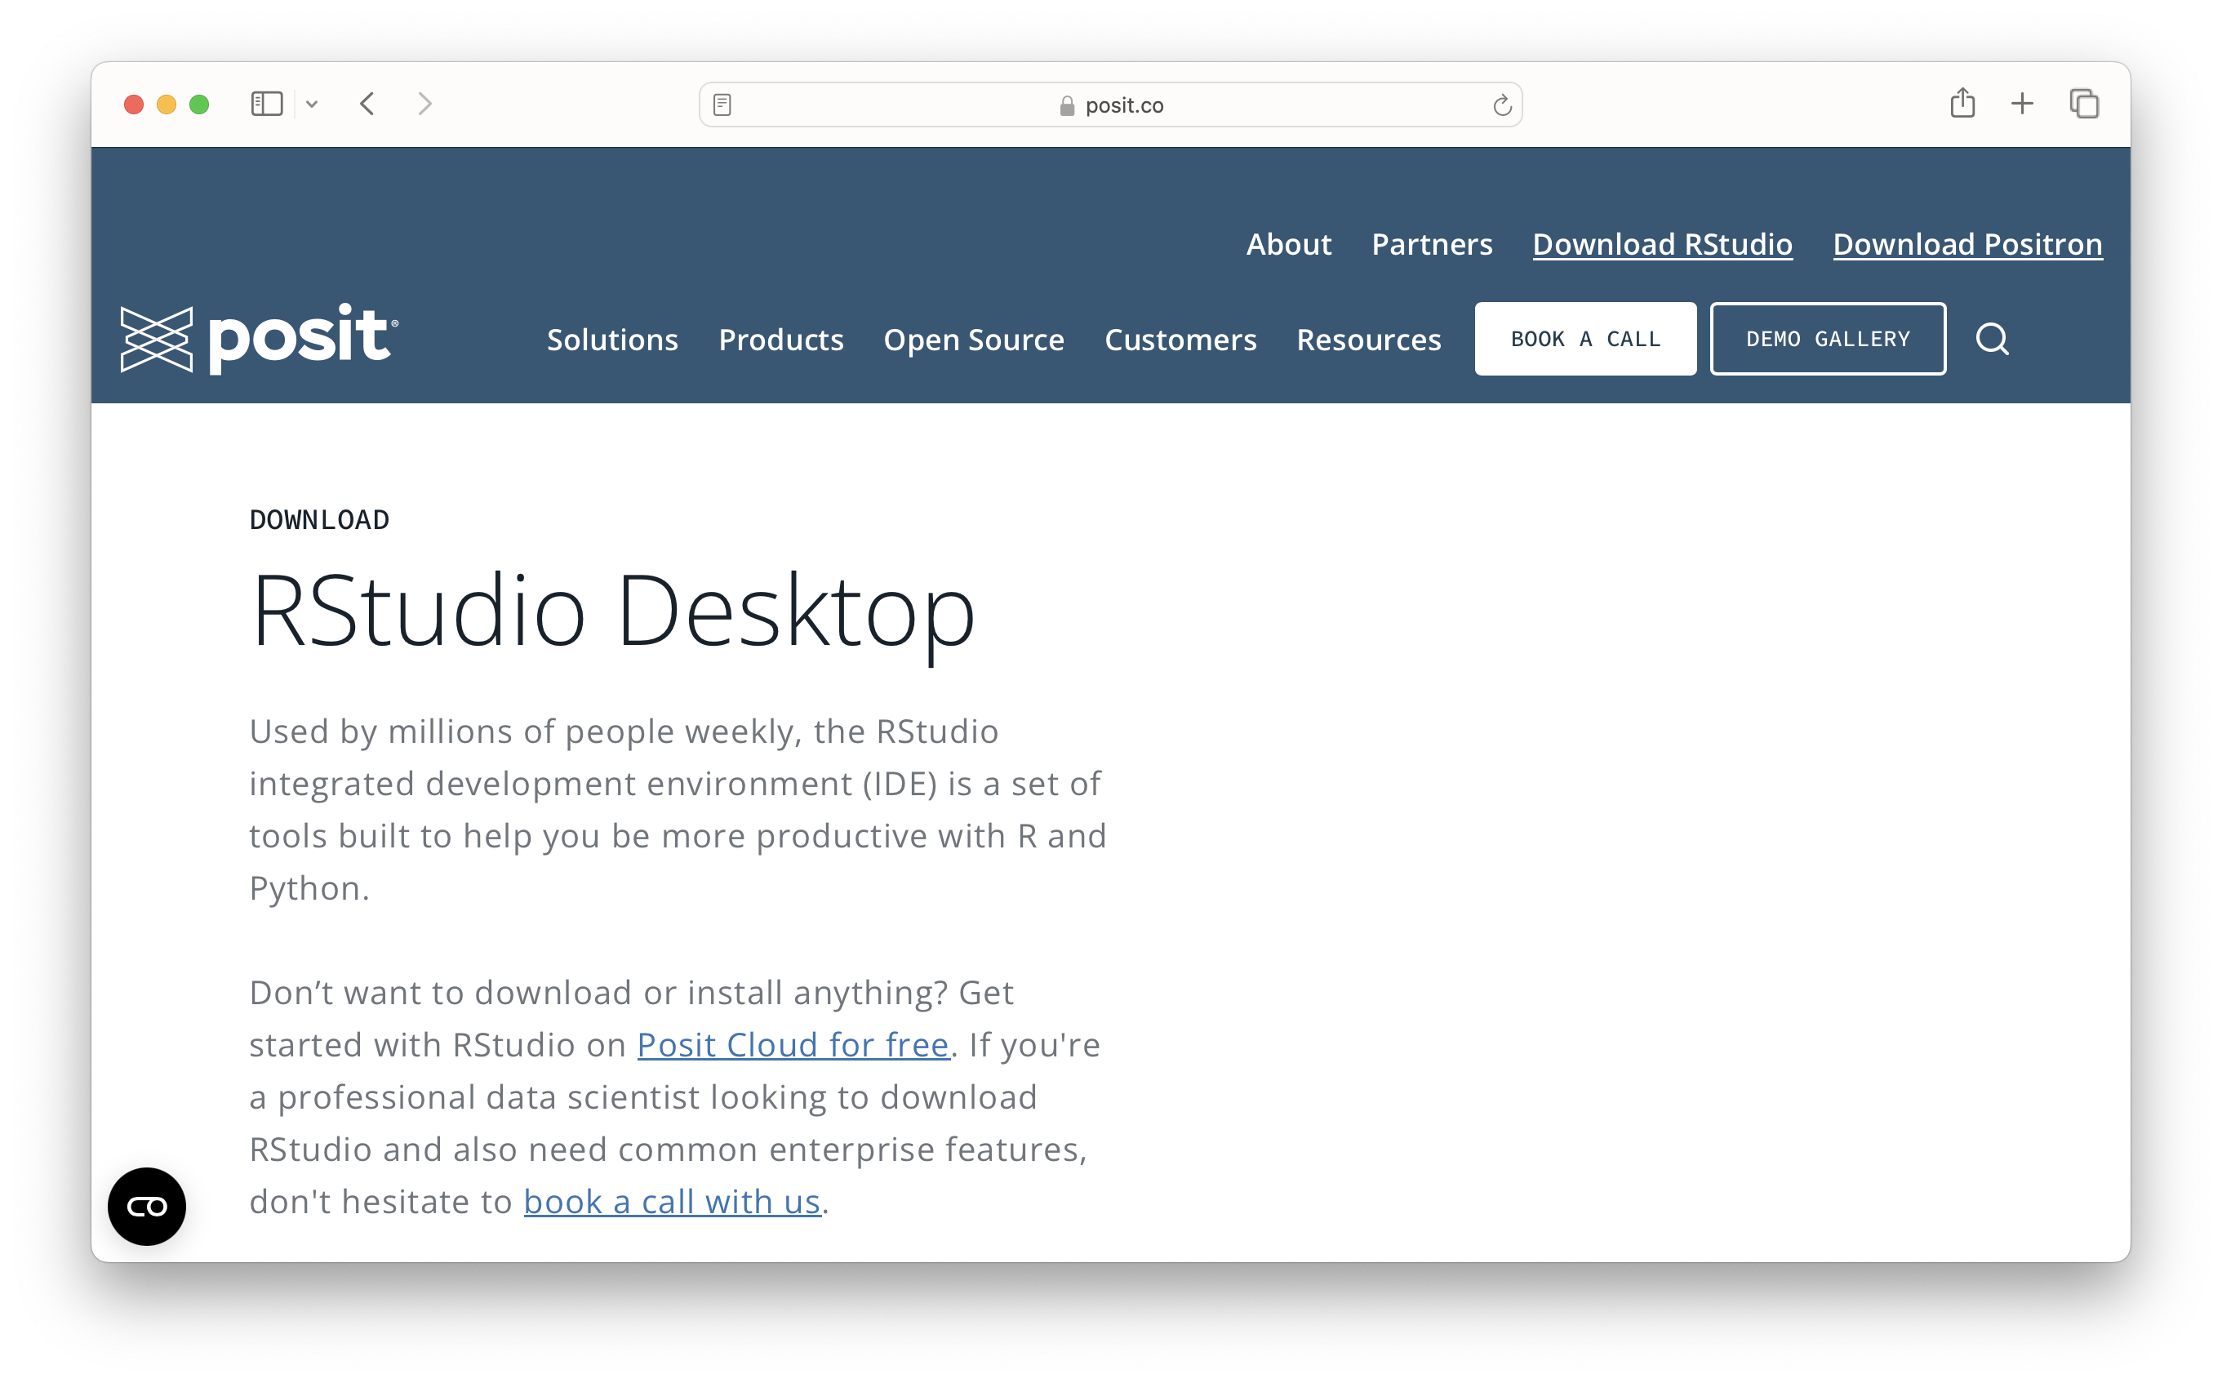

Slide 6
Once on the website, scroll down and select the proper installation file for your platform (Windows, Mac, etc.). Open up the installer and follow the directions to install RStudio.
Note that your operating system may be too old to install the current version of RStudio. If this is the case try installing progressively older versions found here until it works. You will know if it worked if you try to open RStudio and you see an interface without a message about things going poorly.

Slide 7
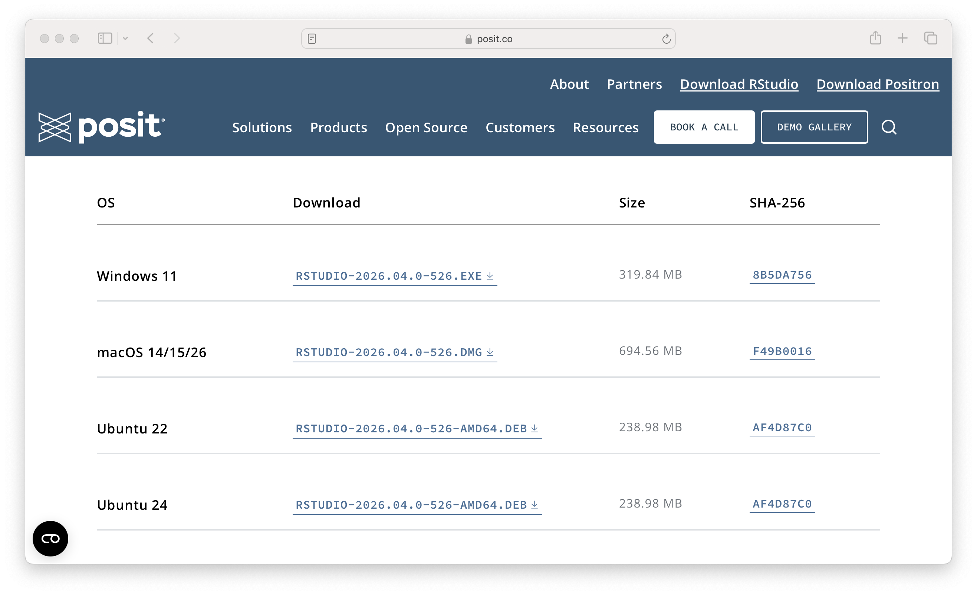

Slide 8
When you open up RStudio, it should look like this:

Slide 9
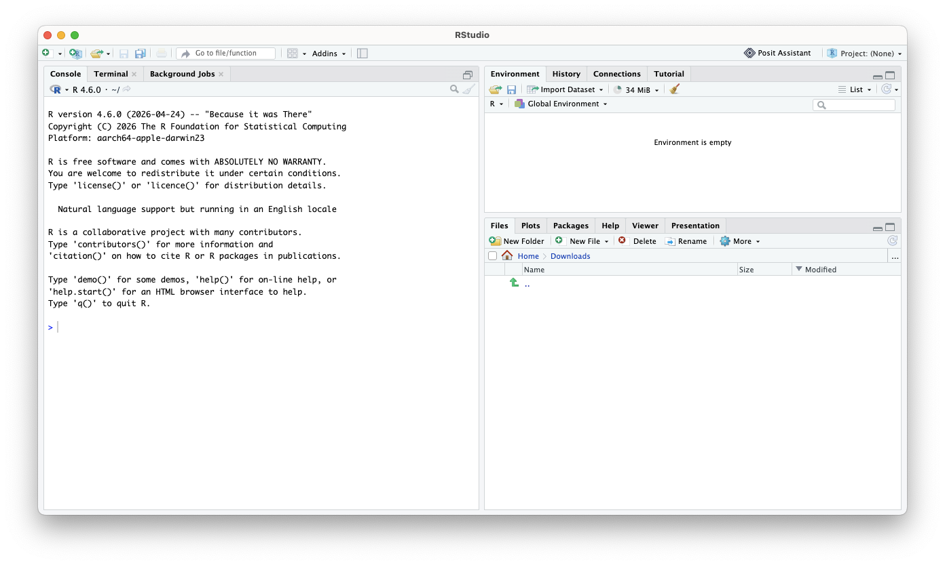

Slide 10
When you open RStudio for the first time, there are three main windows.
The Console is the left window where you can run lines of code and see the output.
The Environment is the upper-right window where you can manage your data and variables and see previous commands entered (under the “History” tab).
The Files is the bottom-right window where you can look at directories, install packages, see plots, and look at help files for various R commands.
You can customize the look of your RStudio IDE in Tools > Global Options....
Troubleshooting the Installation Process
If you run into trouble, did you install the correct version of software for your operating system?
Check that you installed the version right for your type of system, (macOS vs Windows for example).
Check if maybe you need a different version for the age of your system. First, check that your version of R was suitable.
There are multiple versions for different macOS systems. You can check the apple icon (top left corner) and “About This Mac” to learn more about the age of your operating system. If your operating system is older (and you can’t update it), try installing progressively older versions found here until it works. You will know if it worked if you try to open RStudio and you see an interface without a message about things going poorly. Here you can see an example of this. Unfortunately, the documentation is poor about what older versions work for which operating systems.
If you get an error about something called “Rtools”, You probably need some add-on software for a Windows machine. Note that this is not an additional R package to install. Here is a quick guide to installing Rtools: link.

Slide 11
R packages
Packages are the fundamental units of reproducible R code. They are collections of R code that typically share some common purpose.
Examples:
dplyr - package of functions for fast data set manipulation (subsetting, summarizing, rearranging, and joining together data sets);
ggplot2 - “R’s famous package for making beautiful graphics”; allows to build multiple-layers, highly customizable plots.
You can install a package via point-and-click methods or with code.
Installing R Package (Point and Click)
First, click on the “Packages” tab, followed by the “Install” Button.

Slide 12
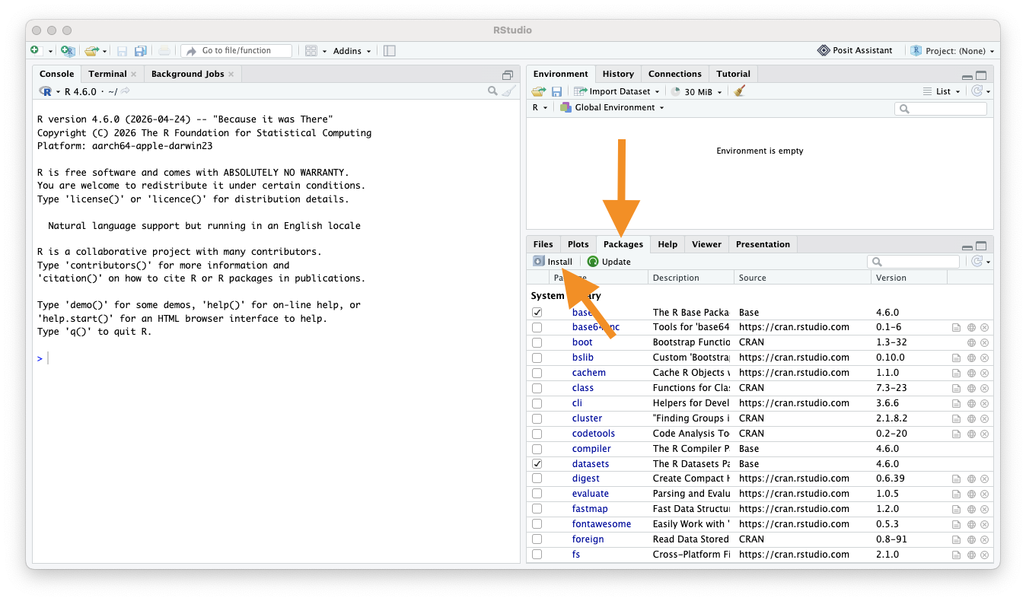

Slide 13
Select “Package Repository (CRAN)” and type in the name of the package you want to install.

Slide 14
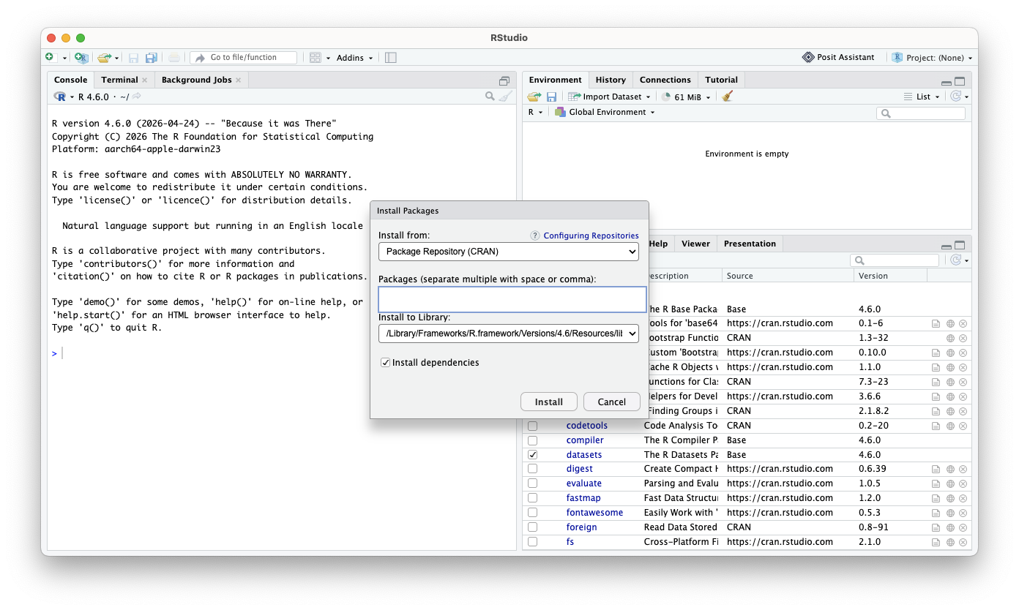

Slide 15
To load the package, check the box next to the package name.

Slide 16
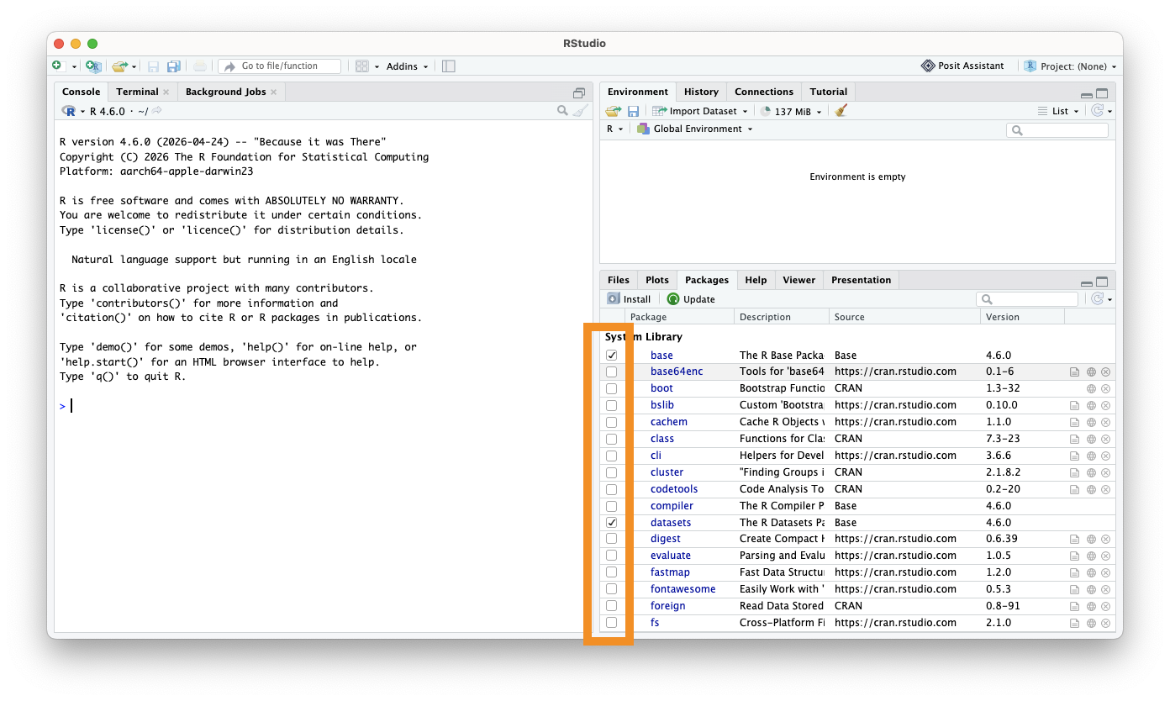

Slide 17
Installing R Package (Code)
To install an R package, type in the RStudio console
install.packages("replace_with_package_name")
Press enter to execute the command.
Once a package is installed, to use its contents in current R session, we run in the RStudio console the command
library(replace_with_package_name)
(Note the difference in presence of the quotation mark in the two above commands.)
Exercise: Install an R package
Use the above to install the tidyverse package. Execute the library(...) command above to check if the package loads successfully.

Slide 18
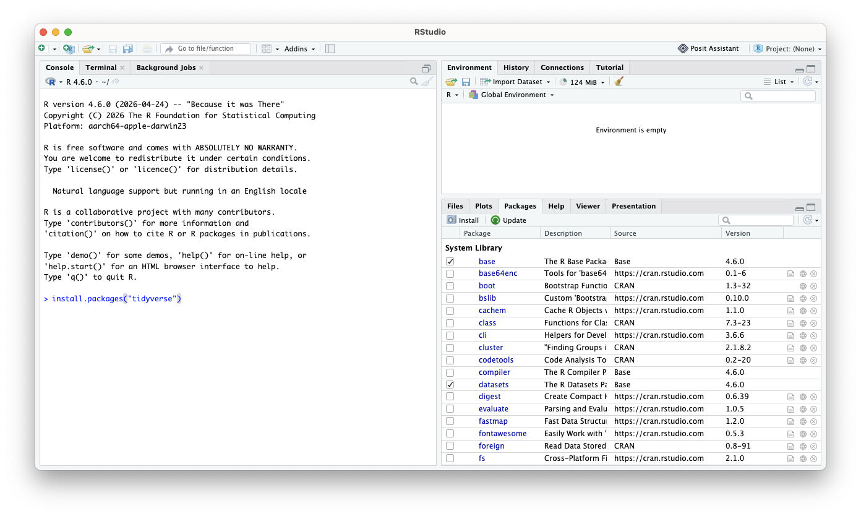

Slide 19
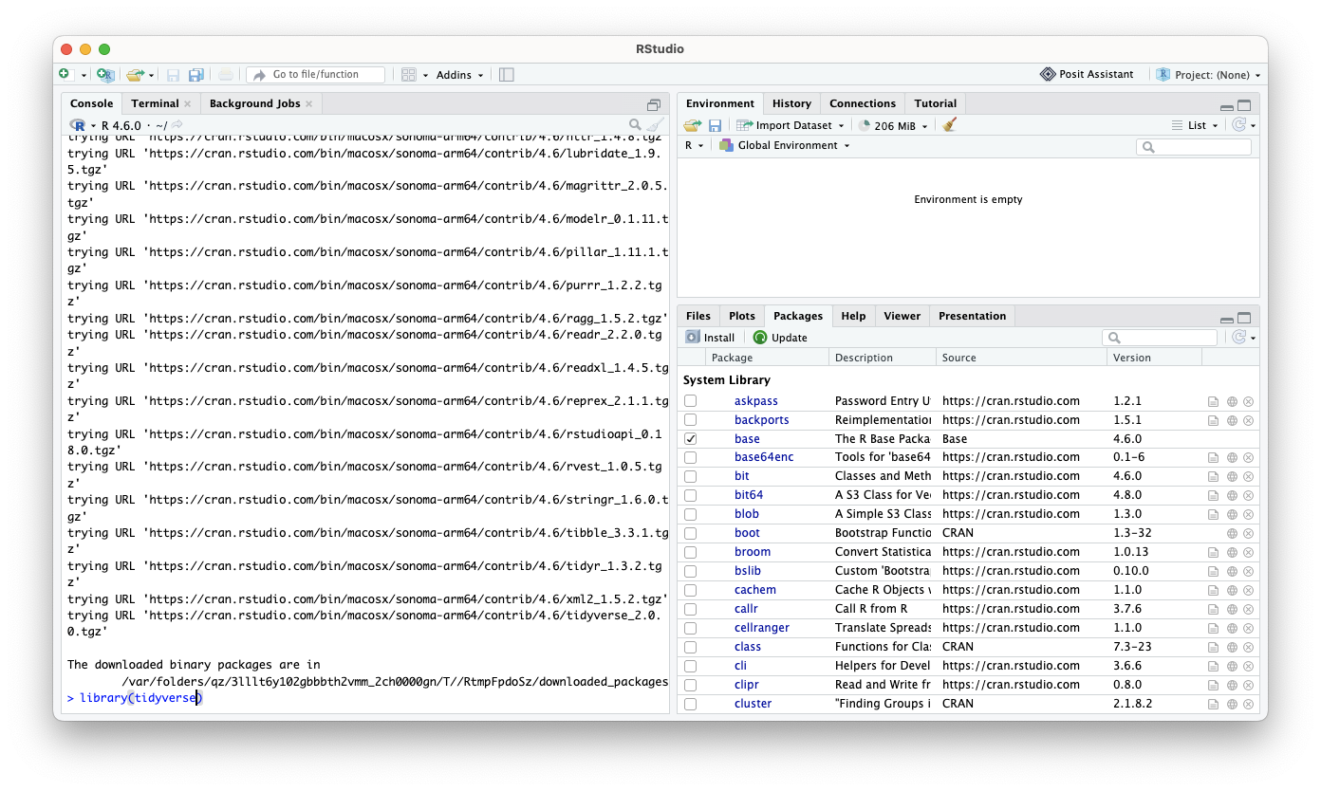

Slide 20
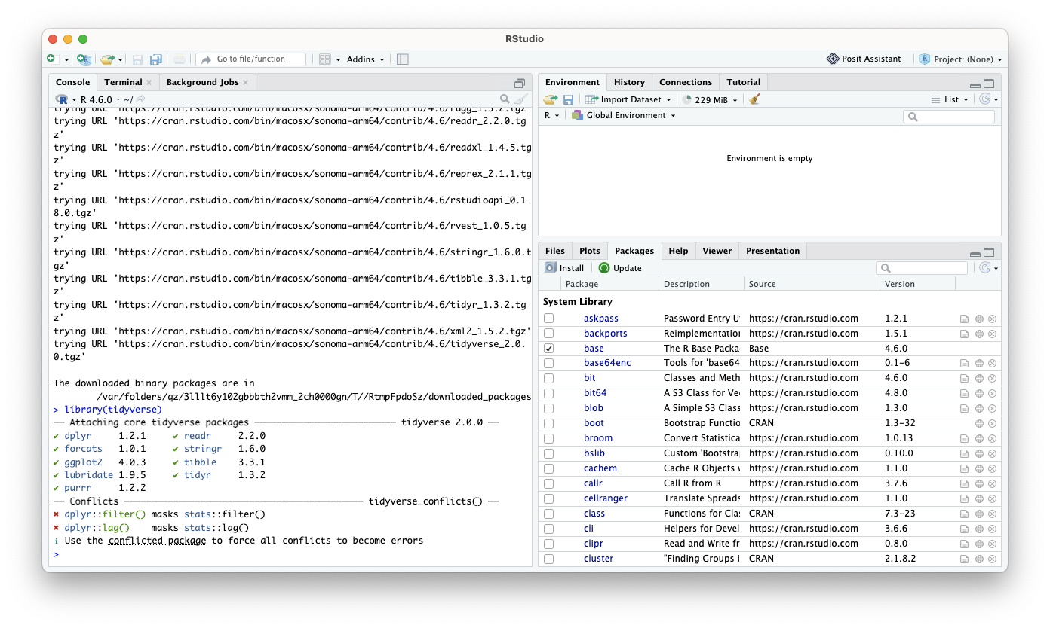

Slide 21
If you want extra practice, we will also be using the packages rmarkdown, naniar, and janitor.

